Slide 1
Small Business Works 2022:
Acquisition Professional Toolbox:
Subcontracting Resources
Day 2: July 27, 2022
U.S. General Services Administration

Slide 2
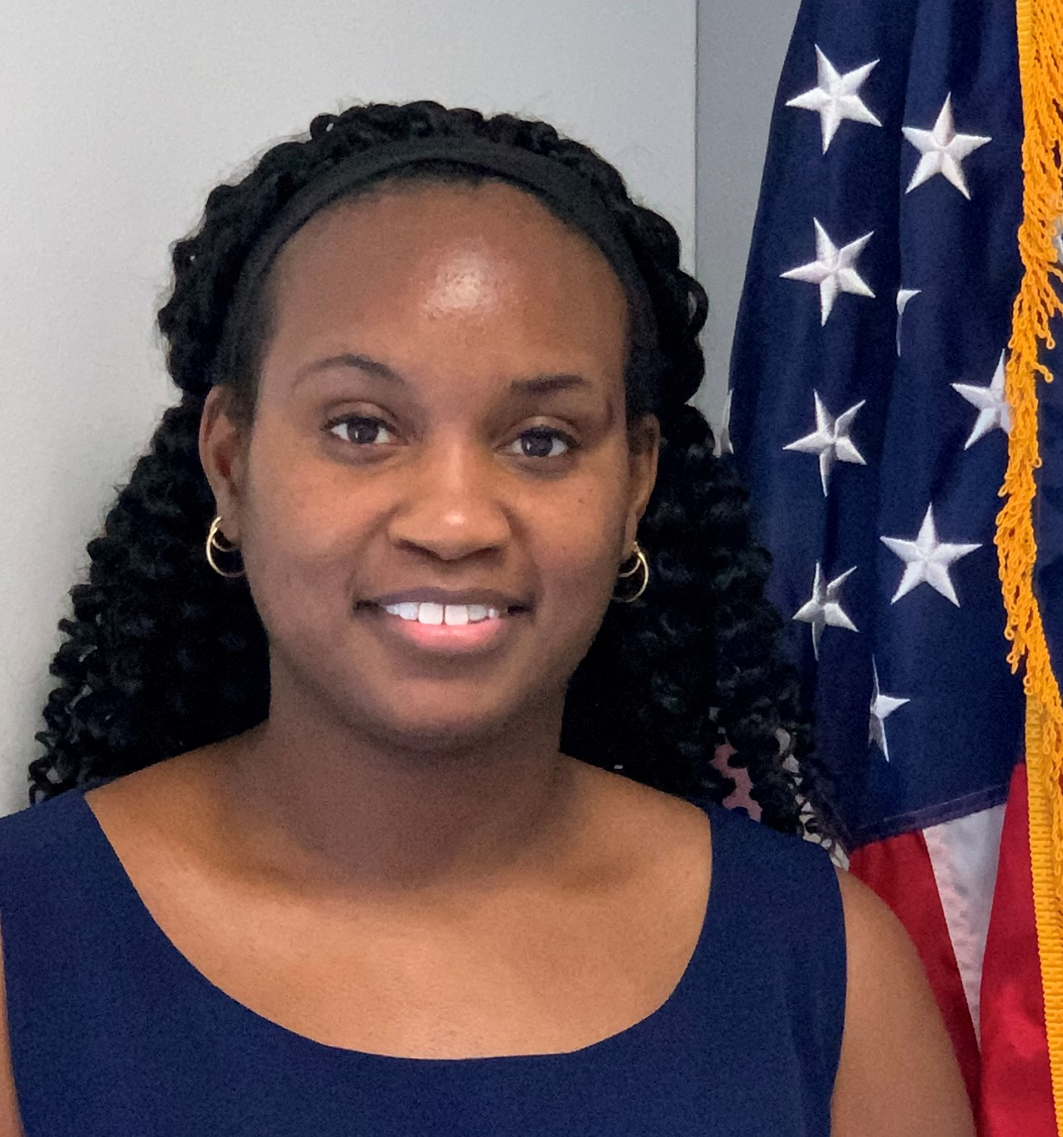
TODAY’S MODERATOR
Carena Jackson
Subcontracting Program Manager
U.S. General Services Administration

Slide 3
TODAY’S PANELIST
Arielle Douglas
Deputy Director, OSDBU
U.S. Environmental Protection Agency

Slide 4
TODAY’S PANELIST
Richard Mann
Small Business Program Manager
National Aeronautics and Space Administration

Slide 5
TODAY’S PANELIST
Christopher Sao
Commercial Market Representative (CMR)
U.S. Small Business Administration

Slide 6
Contract Award

Slide 7
Post Award Responsibilities
Individual Subcontracting (SubK) Plan – SBA Area Director where the contract will be performed
Commercial Subcontracting (SubK) Plan – SBA Area Director where the Contractor’s headquarters is located
Notes:
Post-award responsibilities of the contracting officer (FAR 19.705-6):
After a contract or contract modification containing a subcontracting plan is awarded or an existing subcontracting plan is amended, the contracting officer shall do the following:
Notify the SBA of the award by sending a copy of the award document and approved Subcontracting Plan to the Area Director, Office of Government Contracting, in the SBA area office where the contract will be performed.
Forward a copy of each commercial plan and any associated approvals to the Area Director, Office of Government Contracting, in the SBA area office where the contractor’s headquarters is located.
List of SBA Area Directors: https://www.sba.gov/federal-contracting/counseling-help/contracting-area-directors

Slide 8
Importance of SBA receiving SubK Plans
Notify
Coded Correctly
Monitor
Notes:
The importance of SBA receiving the approved Subcontracting Plans:
SBA is notified that a contract requiring a plan was awarded
Ensures each contract is coded correctly in the Contract Action Report (CAR) so that data flows accordingly to eSRS and contractor reports can be filed
Plans are used to monitor contract performance and to conduct company Performance Reviews and Compliance Reviews

Slide 9
Subcontracting Resources

Slide 10
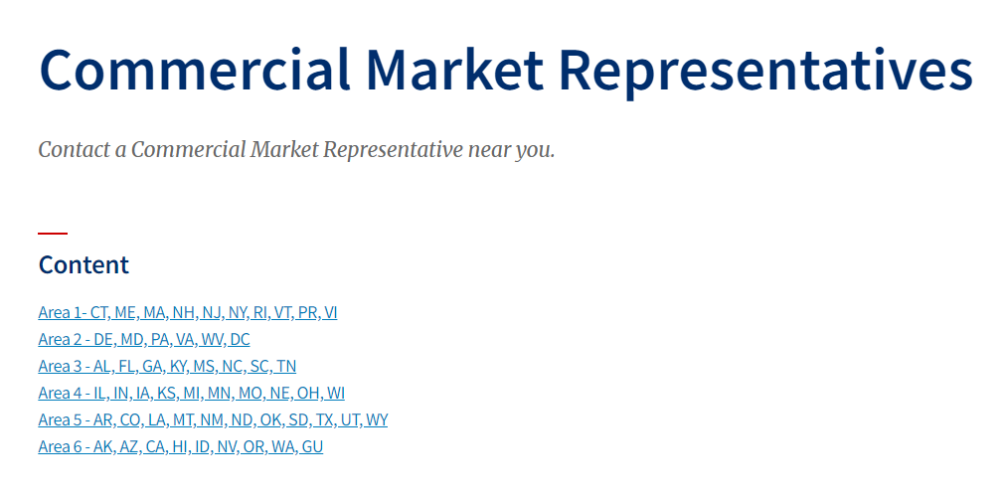
SBA Commercial Market Representative (CMR)
Subcontracting@sba.gov
Notes:
SBA Commercial Market Representatives (CMR)
Assist in questions related to SBA Subcontracting Program
General questions may be sent to email: subcontracting@sba.gov
List of SBA CMRs: https://www.sba.gov/federal-contracting/counseling-help/commercial-market-representatives

Slide 11
Outreach/Networking Events
Notes:
Outreach / Networking Events
Traditional method
FAR 19.705-7 recognizes outreach/matchmaking event participation as an indicator of good faith effort
Can be tougher to network in a virtual environment

Slide 12
Prime Contractor Insight
Notes:
Many of the large prime contractors have their own small business program office also known as the supplier diversity office. Small Business Liaison Officers often time leads this offices and are the first stop for small businesses looking to become subcontracting partners with these companies
Several large business primes use an internal small business database. These databases have a robust amount of small businesses that include information about their capabilities, past performance, primary NAICS codes, and any other relevant information.
All of the prime program managers and capture managers have access to this internal and can use it to identify partners for subcontracting opportunities
Prime contractors look for small businesses that have the three “E”s experience, expertise and engagement
Experience: Prime contractors look for small business subcontractors using the Dynamic Small Business Search and the System for Award Management – they look to determine if the small business profiles are relevant and up to date
Expertise: Does the small business have a presence within the marketplace in which they seek opportunities
Engagement: Do they attend outreach/networking/forecasting events that are hosted by Federal agencies or that are hosted by the prime contractor?
Does the small business have positive relationships with the Federal Agency OSDBU or with the program officials?
Does the small business have current or previous prime or subcontracting work with the relevant federal agency?
Most prime contractors plan for procurements 1-2 years in advance – therefore looking for small business subcontracting partners start early.
Does the small business know about potential upcoming procurements they would like to prime along with a large business partner or are they looking for strictly subcontracting work with a prime contractor

Slide 13
Subcontracting Network (SubNet)
Notes:
SubNet (https://eweb1.sba.gov/subnet/client/dsp_Landing.cfm)
Bridges the gap between businesses seeking small businesses and small business seeking contracting opportunities
Allows prime contractors to post actual subcontracting opportunities

Slide 14
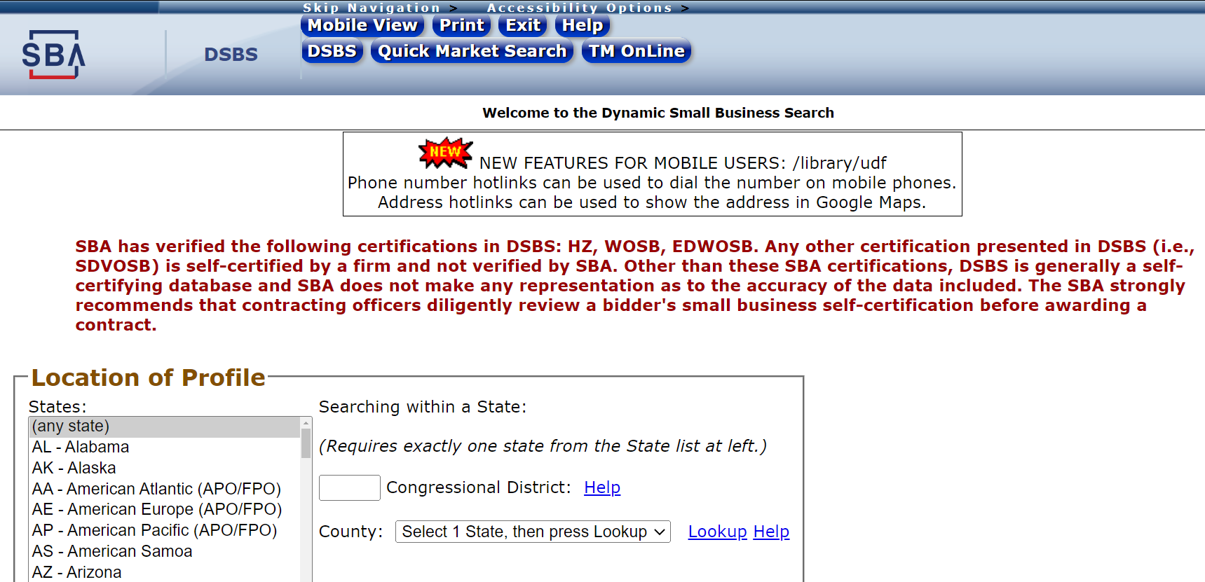
Dynamic Small Business Search (DSBS)
https://web.sba.gov/pro-net/search/dsp_dsbs.cfm
Notes:
Dynamic Small Business Search (DSBS)
Website is https://web.sba.gov/pro-net/search/dsp_dsbs.cfm – not easily found
Can search by:
Vendor Location
Socioeconomic categories
NAICS Codes
General Nature of Business
Bonding Levels
Quality Assurance Standards
Size
Combinations of the above

Slide 15
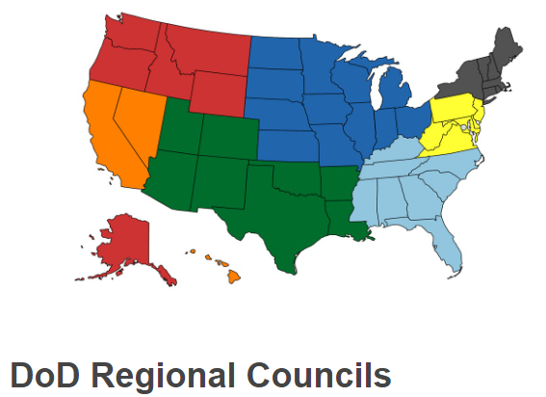
Organizations & Consortiums
Notes:
Organizations and Consortiums
DoD Regional Councils (https://business.defense.gov/Acquisition/DoD-Regional-Councils/)
7 regional councils, established for the purpose of promoting Federal Small Business Programs and SB utilization and to provide training
Members consist of DoD and all Federal civilian agencies, SBLOs, and PTACs
i.e. DoD Northeast Regional Council https://www.dodneregional.org/
TRIAD (https://www.ndia.org/divisions/small-business/triad)
Provides a forum in which members may benefit from the exchange of experience, ideas, and information
Members include Government agencies, large businesses, and small businesses
Procurement Technical Assistance Center (PTAC - https://www.aptac-us.org/)
Help local businesses compete successfully in the government marketplace
Local PTACs have a broad and dynamic portfolio of SBs actively seeking prime and subcontracting opportunities

Slide 16
Agency (EPA) Vendor Database
Notes:
EPA Vendor Database
At the beginning of FY 22 EPA re-launched its Small Business Vendor Database system.
Internally EPA program officials and contracting officials use this database to locate capable small businesses who are looking to do business with EPA
The database includes the name of the company, primary NAICS codes, core capabilities and even if the contractor has current or previous work with the Agency
Searches within the system can be done by Keywork, NAICS Code, past performance keyword, state and city
We encourage prime contractors to utilize this database to locate small business partners
Within this database we also include information about upcoming agency or OSDBU hosted vendor engagement events to include forecasting and matchmaking events.
This is our go to database for all things related to small business vendor engagement here at EPA!

Slide 17
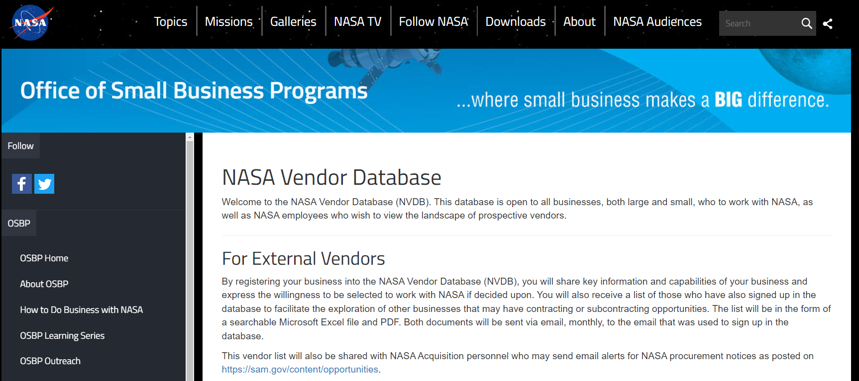
Agency (NASA) Vendor Database
Notes:
NASA Vendor Database
Website is https://www.nasa.gov/osbp/nasa-vendor-database
Pulls vendor info from sam.gov
Updated list of vendors is sent out monthly
Used for communication of upcoming procurement opportunities and outreach events

Slide 18
Links to Resources
DoD Regional Councils: https://business.defense.gov/Acquisition/DoD-Regional-Councils/
Dynamic Small Business Search: https://web.sba.gov/pro-net/search/dsp_dsbs.cfm
EPA Vendor Database: https://vpmdsweb.epa.gov/
GSA eLibrary: https://www.gsaelibrary.gsa.gov/ElibMain/home.do
NASA Vendor Database: https://www.nasa.gov/osbp/nasa-vendor-database
Procurement Technical Assistance Center (PTAC): https://www.aptac-us.org/
SBA Area Directors: https://www.sba.gov/federal-contracting/counseling-help/contracting-area-directors
SBA Commercial Market Representatives (CMR): https://www.sba.gov/federal-contracting/counseling-help/commercial-market-representatives
Subcontracting Network (SubNet): https://eweb1.sba.gov/subnet/client/dsp_Landing.cfm
TRIAD: https://www.ndia.org/divisions/small-business/triad

Slide 19
Questions?

Slide 20
Thank You!

