Slide 1
GSA PBS Client Workshop
Thursday, October 6th, 2011
“Reimbursable Work Authorizations”
Office of Client Solutions | 1800 F Street, NW Washington, DC 20405 | 202.501.0206 | www.gsa.gov

Slide 2
Small Projects & Reimbursable Services “SPRS” Division
Purpose is to provide GSA PBS customers (internal and external) with an institutionalized RWA management process from receipt of RWA to close-out
The National RWA Program had an FY2011 RWA workload of 26,000 RWAs worth over $4 Billion
Approximately $850 Million in Recovery Act RWAs
RWAs from over 350 agency bureaus
Notes:
2

Slide 3
RWA Basics - What Is an RWA?
An RWA is an agreement between GSA and a customer whereby GSA agrees to provide materials and/or services, and the customer agrees to reimburse GSA’s costs.
RWAs capture and bill the costs of altering, renovating, repairing, or providing services, in GSA-managed space, over and above the basic operations financed through rent.
The RWA identifies the specific needs of the customer and establishes financial agreement.
Provides written documentation of a formal agreement
Notes:
3

Slide 4
RWA Lifecycle
Standardized RWA process; consistent, scalable, and repeatable.
Phase 1: Requirements
Phase 2: Cost Estimate
Phase 3: Acceptance
Phase 4: Execution
Phase 5: Completion and Close-Out
Notes:
4

Slide 5
Identify Customer Need
When a space need has been identified, the customer should contact GSA to assist in developing requirements for the RWA.
GSA conducts requirement development meetings with the customer (if necessary) to create the statement of work.
A fully defined statement of work must be written so that:
A supporting cost estimate can be developed
Any remaining balance cannot be used for unrelated projects outside of the original statement of work
If GSA receives an unsolicited RWA Form 2957 at any time during this process, GSA official must send “Receipt Letter” to customer.
Notes:
5

Slide 6
Phase 2: Cost Estimate
Phase 1: Requirements
Phase 2: Cost Estimate
Phase 3: Acceptance
Phase 4: Execution
Phase 5: Completion and Close-Out
Notes:
6

Slide 7
Cost Estimating
Statement of work and estimate are basis for binding agreement, resulting in obligation of funds by customer
Estimate may come from customer, lessor, or GSA
The greater the specificity:
The lower the contingency will need to be
The more likely expectations will be met
The less chance of change orders and delays
Notes:
7

Slide 8
Common Estimate Components
Construction Costs & Contingencies
+ Architecture/Engineering (A/E) Costs
+ Construction Management (CM) Costs
+ 4% Project Management (PM) Fee
+ Personal Property Costs
+ RWA Overhead Fee (sliding scale)
= Authorized Amount of RWA
Notes:
8

Slide 9
Phase 3: Acceptance
Phase 1: Requirements
Phase 2: Cost Estimate
Phase 3: Acceptance
Phase 4: Execution
Phase 5: Completion and Close-Out
Notes:
9

Slide 10
Acknowledgement of Receipt
If the RWA form was not received earlier in the process, then a “Receipt Letter” will be sent.
Acknowledgement by GSA of physical possession of RWA Form 2957
Further clarifying discussions may be necessary
Notes:
10

Slide 11
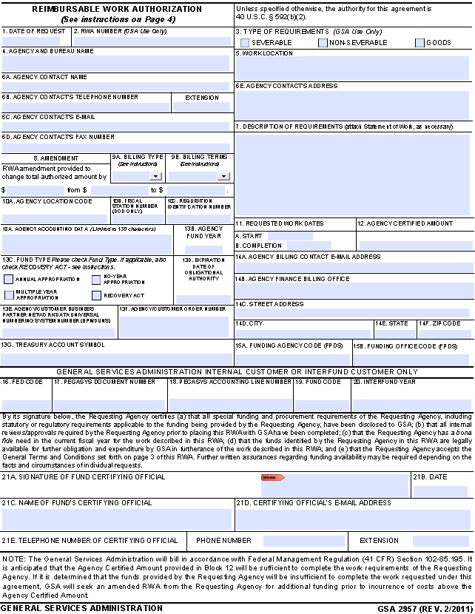
Current RWA Form 2957
Mandatory to use new form (revised 2/2011)
Blocks 15A and 15B Added (FPDS)
Use Billing Type N and Pay.gov for Credit Card Payments
Digital Signature Capability
Access Form at www.gsa.gov/rwa

Slide 12
Acceptance
Customer completes first page of the RWA Form 2957
RWAs are not automatically accepted; they must meet important criteria, such as:
Bona fide need
Fully defined statement of work
Cost estimate
Proper funding
Required customer signature
GSA agrees to provide requested services by signing the RWA Form 2957 and entering it into the RWA Entry and Tracking Application (RETA)
“Acceptance Letter” sent
Customer establishes obligation
Notes:
12

Slide 13
Phase 4: Execution
Phase 1: Requirements
Phase 2: Cost Estimate
Phase 3: Acceptance
Phase 4: Execution
Phase 5: Completion and Close-Out
Notes:
13

Slide 14
Amendments
Amendments to RWA must meet three requirements
Bona Fide need exists
Funds are legally available for new purpose(s)
The Appropriation has not lapsed
Agencies may amend RWAs to increase/decrease RWA amount for within Statement of Work changes
GSA Public Buildings Service
Notes:
14

Slide 15
Phase 5: Completion and Close-Out
Phase 1: Requirements
Phase 2: Cost Estimate
Phase 3: Acceptance
Phase 4: Execution
Phase 5: Completion and Close-Out
Notes:
15

Slide 16
Substantial Completion
Actual work is substantially complete
Beneficial occupancy (space can be utilized by customer)
Punch list items may exist
GSA sends “Completion Letter” to customer
Customer should not deobligate funds at this point
Notes:
16

Slide 17
Financial Close-Out
Most projects are closed out within 60 days after substantial completion
All costs have been billed and all invoices have been paid
GSA and customer settle final bills
GSA sends “Close-Out Letter” to customer signifying that all punch list items are complete and all costs have been billed
Signed 2957 must be sent with “Close-Out Letter”
Upon receiving “Close-Out Letter”, customer should deobligate any remaining funds
Notes:
17

Slide 18
Clarification of Obligation & Liquidation
Customer agency obligates funds to GSA in its financial system upon receiving Acceptance Letter.
GSA obligates funding to vendors as contracts are signed. GSA liquidates obligations as vendors deliver goods and/or services.
GSA bills the customer for services rendered.
Customer liquidates its obligation as payments are made to GSA.
Notes:
18

Slide 19
RWA Customer Letters Recap
Phase 1: Requirements
Phase 2: Cost Estimate
Phase 3: Acceptance
Phase 4: Execution
Phase 5: Completion and Close-Out
Acknowledgement
Of RWA
“Receipt Letter”
RWA
“Acceptance Letter”
Substantial
“Completion
Letter”
• No financial action
Financial
“Close-Out Letter”
• Customer deobligates
RWA Project “Follow-up Letter”
(if necessary)
Notes:
19

Slide 20
Recent RWA Initiatives
4 RWA Customer Letters are mandatory
Federal Customer Guide to RWAs released
Multiple Buildings “Study” for F & N Type RWAs
4% Project Management Fee Automation
Credit Card payments require pay.gov use & entry
Cost Management Ranges of Accuracy
Bundled Training & RWA Levels II and III Training
eRETA Customer Portal
Decommissioning RWA Search October – THIS MONTH!!

Slide 21
eRETA 1.0
eRETA stands for External RWA Entry and Tracking Application
A customer-facing application where real-time RWA information and documentation is available to customers
Launched in April 2011
Replaces the "RWA Search" Website - to be closed Oct. 2011
Let's take a tour:
www.gsa.gov/ereta
Notes:
eRETA UAT: http://p06r6s-trn101:90/eRETA/webforms/Login.aspx

Slide 22
eRETA 2.0 - The Future of RWA eCommerce
Electronically submit RWA Work Requests
Automatically routed to appropriate region for assignment of Project Manager, Estimator, RWA Analyst, etc
Track status of request, view estimates, and collaboratively update requirements documents online
Enter customer information (page 1 of RWA) to ensure data is not mis-keyed or omitted
Data interfaces automatically into RETA to ensure accuracy
Digitally sign RWA using eSignature
Real-time interface with RETA allows GSA to digitally sign and send Acceptance Letter within hours, even minutes

Slide 23
Web Resources: Customer Facing
SPRS Division: Find a multitude of information regarding reimbursable work authorizations including policies and guidance at http://www.gsa.gov/rwa
eRETA: Access to all RWA Information (Financial Information, Documentation, Communications) http://www.gsa.gov/ereta
Bill View: View statements and invoices generated by GSA billings at http://www.finance.gsa.gov/billview/
Notes:
23

Slide 24
Reimbursable Services Regional Core Team
October 2011

Slide 25
Thank You!
Ashlee Carlson
Ashlee.Carlson@gsa.gov
202.501.9189
Steven Sacco
Steven.Sacco@gsa.gov
202.208.6177
www.gsa.gov/rwa
AskRWA@gsa.gov
www.gsa.gov/ereta
eRETA@gsa.gov

