Slide 1
Revolutionary FAR Overhaul (RFO) Updates
…for Industry!
June 16, 2026 9:30-10:00 am EST
Notes:
Polly Intro Tee Up

Slide 2


Presenters
Polly Hall
Executive Lead,
RFO Practitioner Workstream
Polly.Hall@gsa.gov
Danielle Mouw
RFO & GSA PILOTS
Danielle.Mouw@gsa.gov
Notes:
Validation - new in federal contracting? represent a small business? DC or other locations?

Slide 3

The Revolutionary FAR Overhaul (RFO)
Restores and reemphasizes CO Discretion for simpler, faster acquisitions, greater competition, and better outcomes for mission delivery.
The Revolutionary FAR Overhaul (RFO)
  Most comprehensive overhaul of the FAR since it was 1st published in 1984
The RFO initiative:
  Returns the FAR to its statutory roots;
  Rewrites it in plain language;
  Removes non-statutory rules (unless essential for sound procurement); and
  Creates non-regulatory acquisition guides that provide strategies grounded in best practices.
The RFO is grounded in these EOs - check them out!
Executive Order 14275 — Restoring Common Sense to Federal Procurement
  OMB Memo 25-26 — Overhauling the Federal Acquisition Regulation
Executive Order 14271 — Ensuring Commercial, Cost-Effective Solutions
Executive Order 14240 — Eliminating Waste and Saving Taxpayer Dollars by Consolidating Procurement
Notes:
Polly 3-6
-Mention sunset provision - every 4 years
Mandate: The RFO was mandated by Executive Order 14275: Restoring Common Sense to Federal Procurement.
Goal of the Revision: The primary goal was to revise the FAR to restore its statutory roots (what is required by law) and include only what is essential for sound, uniform procurement practice.
Content Removed: Explain that non-statutory rules that were deemed non-essential or better suited for discretionary, sound business judgment were removed from the FAR.
Cover the following points when discussing Executive Orders:
EO 14271: Ensuring Commercial Cost-Effective Solutions: This drove the focus on cost effectiveness and commercial practices, leading to the consolidation of commercial practices under FAR Part 12 and the associated updates..
EO 14240: Focus on Existing Federal Marketplace: This drove the shift to prioritize the existing federal marketplace (FSS and GWACs) before using the open market, which were captured in RFO 8.104 and the associated updates, including further updates, to federal Category Management policy.
Updates to FAR Part 8 (specifically 8.104) implement this category management policy. Mention the emphasis on using existing governmentwide contracts and BPAs that are required use and must consider that are otherwise part of category management principles.
This is the first time the FAR has been updated this extensively through deviations. We’re going to talk more about that shortly.
The RFO really is a pivotal opportunity to align acquisition policy with today’s mission needs, technologies, and market dynamics.

Slide 4

A new modernized framework
RFO 1.101 Framework
REGULATORY
NON-REGULATORY
FAR Companion*
Category Management Buying Guide*
Streamlined FAR
Agency Supplemental Regulations
* Living resources that will be regularly updated to reflect evolving best practices and the changing way that commercial supplies and services are purchased.
Notes:
New Guidance: Introduce updates to FAR 1.101 that add new non-regulatory acquisition guides as part of the FAR framework. Inaugural guides are the FAR Companion and Category Management Buying Guide, which will be covered later, as part of the FAR framework. Danielle is going to talk a little more about the intent of these guides - ultimately to empower the AWF
Emphasize the opportunity to consolidate best practices within a central location leading to more efficient buying and changing culture.
These tools provide the necessary guidance, examples, and 'soft structure' to help the workforce confidently and defensibly exercise the new flexibilities.
—-------- Danielle points=
Acquisition Guide
Purpose and Use
FAR Companion
Intended to be read side-by-side with the FAR. Provides guidance to consider.
Nothing in the FAR Companion is mandated for use, and there is no requirement to document non-use.
Category Management Buying Guide
Provides support for finding solutions in the federal marketplace, helping streamline the determination of whether the existing marketplace can meet your need.
Each category page includes a list of existing schedules and vehicles.
Emphasize the importance of the FAR Council’s Foreword to the FAR companion and acquisition professionals using their discretion.

Slide 5
The Administration’s RFO goals
Speeding Acquisition | Focus on only necessary regulation that provides real value and eliminate the lost time and money to meet unnecessary regulations Increase our attention on non-regulatory tools, such as the FAR Companion Deliver capability at mission speed against needs
Reducing Costs | Restore the commercial first policy of the Federal Acquisition Streamlining Act. Refresh and strengthen our category management practices for leveraging existing governmentwide contract vehicles to get even better value for the taxpayer, especially when addressing needs that can be satisfied commercially Prioritize outcome-based approaches rather than unnecessarily prescriptive requirements.
Increasing Competition | Increase competition by reducing regulatory and compliance burdens Strengthen communication with all partners to ensure requirements are clearly articulated and the path to meeting mission needs is understood across the enterprise
REGULATORY
Notes:
New Guidance: Introduce updates to FAR 1.101 that add new non-regulatory acquisition guides as part of the FAR framework. Inaugural guides are the FAR Companion and Category Management Buying Guide, which will be covered later, as part of the FAR framework. Danielle is going to talk a little more about the intent of these guides - ultimately to empower the AWF
Emphasize the opportunity to consolidate best practices within a central location leading to more efficient buying and changing culture.
These tools provide the necessary guidance, examples, and 'soft structure' to help the workforce confidently and defensibly exercise the new flexibilities.
—-------- Danielle points=
Acquisition Guide
Purpose and Use
FAR Companion
Intended to be read side-by-side with the FAR. Provides guidance to consider.
Nothing in the FAR Companion is mandated for use, and there is no requirement to document non-use.
Category Management Buying Guide
Provides support for finding solutions in the federal marketplace, helping streamline the determination of whether the existing marketplace can meet your need.
Each category page includes a list of existing schedules and vehicles.
Emphasize the importance of the FAR Council’s Foreword to the FAR companion and acquisition professionals using their discretion.

Slide 6

Where are we in the RFO journey?
RFO Phase 2
Rule-making (Proposed Rules)
New
Codified FAR
Original Codified FAR
RFO Phase 1
Model deviations
RFO Phase 1
Agency issued deviations
PHASE I OVERVIEW
Remove most non-statutory content from the FAR
Convert to plain language, including shift from “shall” to “must.”
Post FAR model deviations to follow until formal
rulemaking complete.
Release non-regulatory strategic acquisition guidance (FAR Companion, Category Management Buying Guide)
Agencies post deviations within 30 days of release of “new” language.
Public comments taken on deviations to inform Phase II.
PHASE II OVERVIEW
Review public comments from Phase I and adjudicate as appropriate.
Release draft rule to Civilian Acquisition Agency Council, Defense Acquisition Regulation Council, OIRA and OFPP. Adjudicate comments.
Publish proposed rule on Federal Register.
Public comments will be taken for ~30 days.
Adjudicate public comments.
Post final rule = new regulatory FAR text..
Agency supplements go through rulemaking process to finalize revisions consistent with changes in the FAR
Notes:
New Guidance: Introduce updates to FAR 1.101 that add new non-regulatory acquisition guides as part of the FAR framework. Inaugural guides are the FAR Companion and Category Management Buying Guide, which will be covered later, as part of the FAR framework. Danielle is going to talk a little more about the intent of these guides - ultimately to empower the AWF
Emphasize the opportunity to consolidate best practices within a central location leading to more efficient buying and changing culture.
These tools provide the necessary guidance, examples, and 'soft structure' to help the workforce confidently and defensibly exercise the new flexibilities.
—-------- Danielle points=
Acquisition Guide
Purpose and Use
FAR Companion
Intended to be read side-by-side with the FAR. Provides guidance to consider.
Nothing in the FAR Companion is mandated for use, and there is no requirement to document non-use.
Category Management Buying Guide
Provides support for finding solutions in the federal marketplace, helping streamline the determination of whether the existing marketplace can meet your need.
Each category page includes a list of existing schedules and vehicles.
Emphasize the importance of the FAR Council’s Foreword to the FAR companion and acquisition professionals using their discretion.

Slide 7

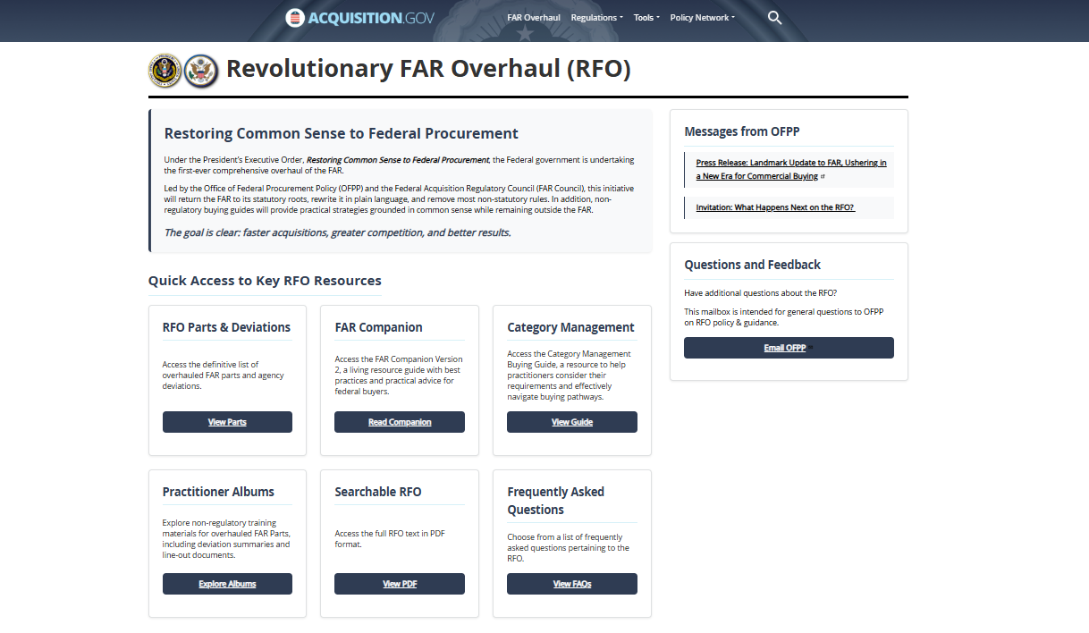
RFO Website Demo: Resources for modernized acquisition
Overhauled FAR parts and Agency deviations
FAR Companion and Category Management Buying Guide
Practitioner Albums – Change Summaries and Resources
Central location for all RFO resources: https://www.acquisition.gov/far-overhaul
Notes:
Danielle 7-9 w demo

Slide 8
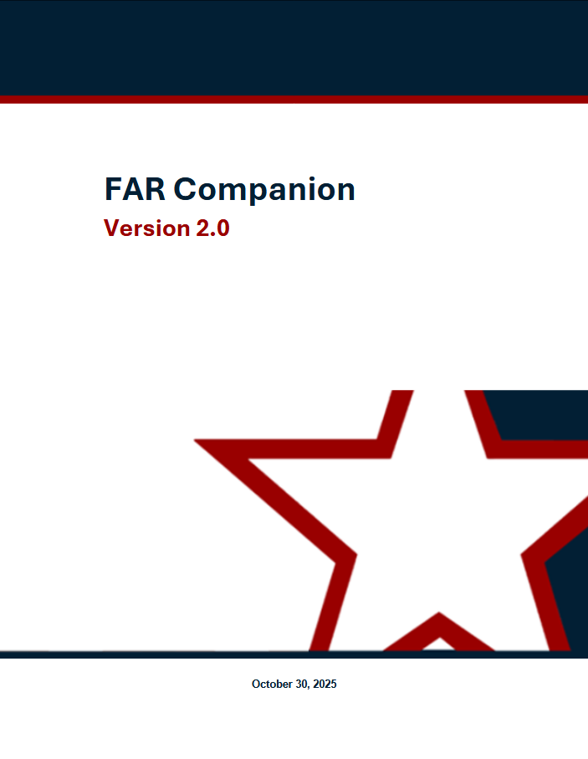
FAR Companion - Discretionary, Streamlined Practice
Applying Sound Business Judgment
The FAR Companion works in concert with the FAR and agency supplements.
The FAR Council's Foreword charges acquisition professionals to maximize use of their sound business judgment and discretion when policies are not statutorily prescribed.
Notes:
Danielle 7-9 w demo

Slide 9
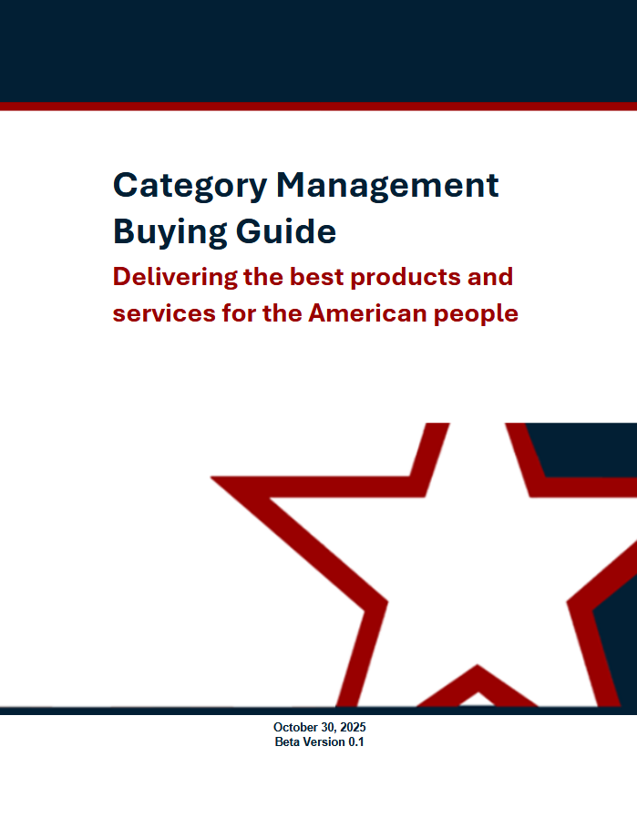
Category Management Buying Guide - Federal Marketplace
Highlights sector-specific buying tips for navigating government-wide contracts.
Helps maximize centralized ordering of common spend and recognize the efficiency and cost benefits of leveraging previously negotiated terms and conditions from precompeted vehicles.
Notes:
Danielle

Slide 10
Key Changes - Acquisition Planning
Part
Changes
Acq Planning is still required, but it has been streamlined to emphasize flexibility and move away from prescriptive checklists in favor of a dynamic planning process. Specific elements are no longer required.
Part 7: Acquisition Planning
Planning must promote use of commercial products & services where they meet the need; competition; use of existing contracts.
Part 10: Market Research
Greater flexibility in techniques: FAR no longer lists specific market research techniques that must be used but instead requires research appropriate to the circumstances (in a manner that suits the acquisition’s size and complexity).
Competition in Contracting Act (CICA) still applies and may necessitate market research
Commercial Overhaul of Parts 8, 12, and 16
Significant simplification – 46 applicable clauses removed
Centralizing commercial acquisition policy in Part 12
Greater emphasis on use of Governmentwide contracts and BPAs
Streamlined commercial ordering procedures
More flexibility on contract types
Construction is now included as a commercial service!
Notes:
Polly 10-11

Slide 11
Key Changes - Policy Refinement
Part
Changes
Focus on industry communication
Updated definitions and processes on multiple terms: discussions, clarifications, communications and deficiency
Part 15: Contracting by Negotiation
Part 16: Contract Types
A new contract type is permitted if it is in the best interest of the government. Deliberate shift from restrictive to permissive framework to empower COs.
On-and-off ramps: authorizes “on-ramping” (adding new contractors) and “off-ramping” (removing contractors) from a multiple-award contract during its ordering period to maintain current, competitive, and innovative pools of vendors on multiple-award contracts.
Broader authority to establish BPAs – under multiple-award contracts (e.g., IDIQs)
Rule of Two above the micro-purchase threshold applies to open market contract awards; Rule of Two does not apply to orders under multiple award contracts.
For the 8(a) program, when an acquisition is below the competitive threshold, contracting officers must first try conducting the acquisition as a competitive 8(a) order using SBA-approved government-wide contracts.
A requirement is automatically released from the 8(a) program if the follow-on will be set aside under the HUBZone, SDVOSB, or WOSB programst
Part 19: Small Business

Slide 12
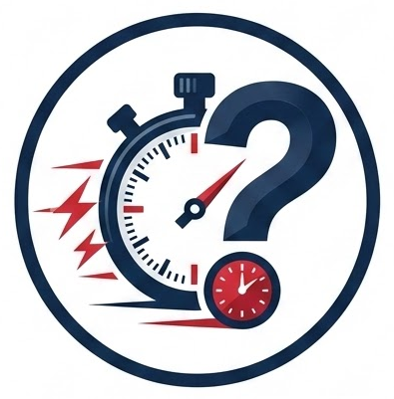
Quick Trivia - RFO Learning Cycle
True or False?
Once the new FAR is codified, implementation is complete.
Notes:
Danielle - While the updated final FAR is the final regulatory step, implementation is a fluid environment with learning, resources, application and feedback with industry all looping to support adoption-- changing words is one step - changing application is the goal.

Slide 13
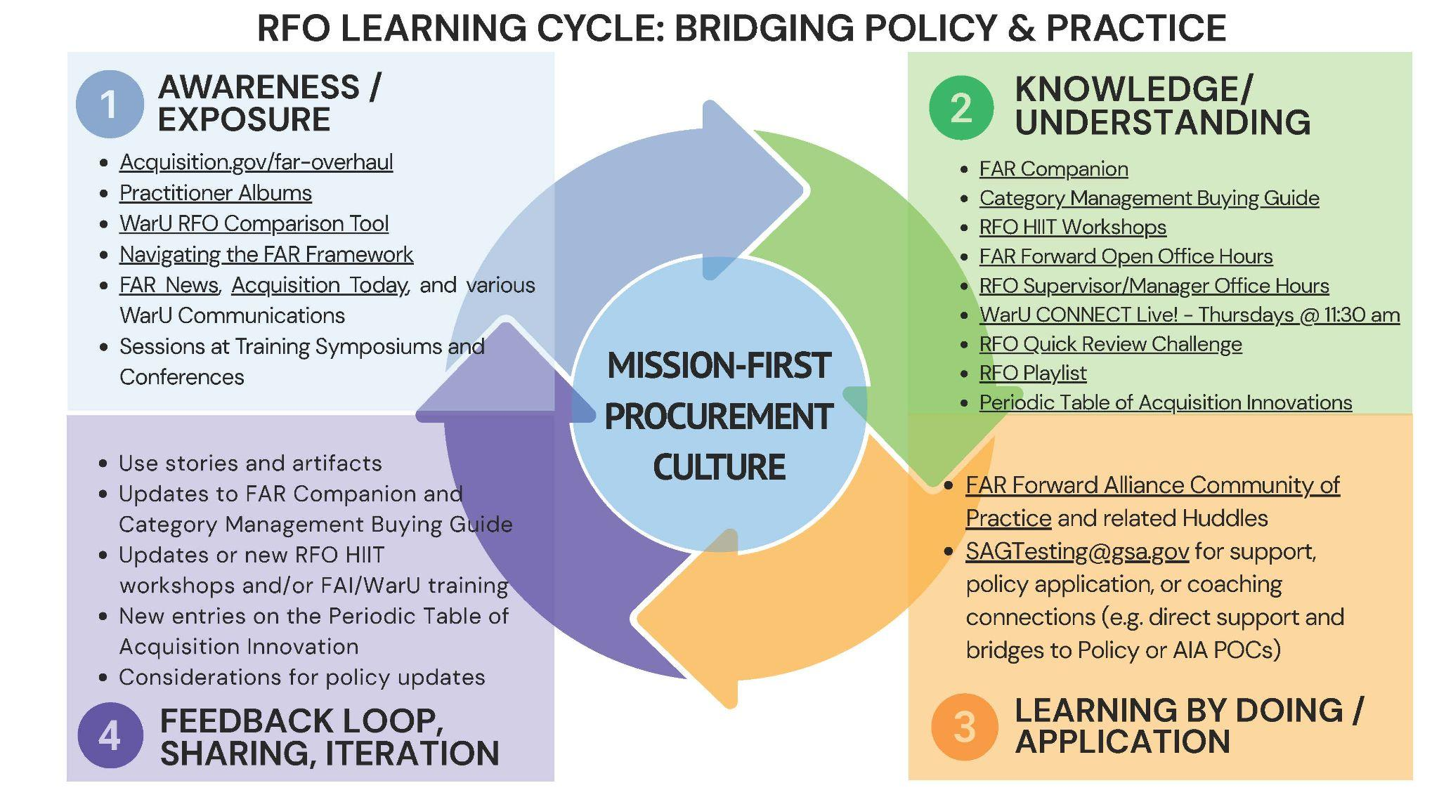
RFO Learning Cycle
Notes:
Polly - 13 as closer – While the updated final FAR is the final regulatory step, implementation is a fluid environment with learning, resources, application and feedback with industry all looping to support adoption-- changing words is one step - changing application is the goal.

Slide 14
Thank You.

Slide 15
GSA Trademark Icon

