Slide 1
SAM.gov
The Gateway to the Federal Award Lifecycle
TTS Office of Awards, Regulatory & Oversight Systems | June 2026

Slide 2


Presenters
Dahianna Salazar Foreman
Zack Sionakides
Engagement Lead
Office of Awards, Regulatory & Oversight Systems (AROS)
Technology Transformation Services
Director, Awards Division
Integrated Award Environment (IAE)
Technology Transformation Services

Slide 3



SAM.gov
System consolidation
We are unifying our federal award systems into Sam.gov. This consolidation aims to facilitate a smooth, efficient process for both industry and government
13 systems
2012
2 systems
2026
3

Slide 4
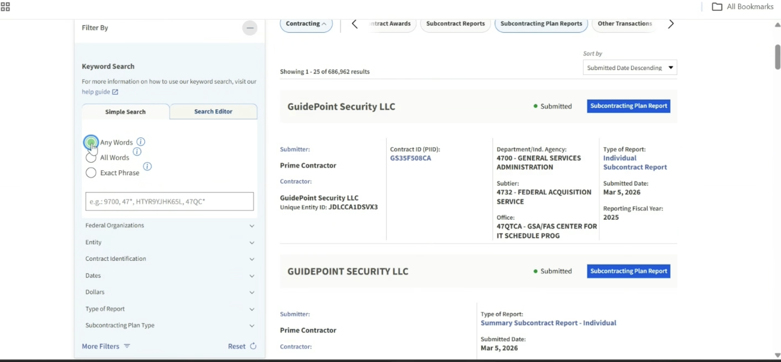
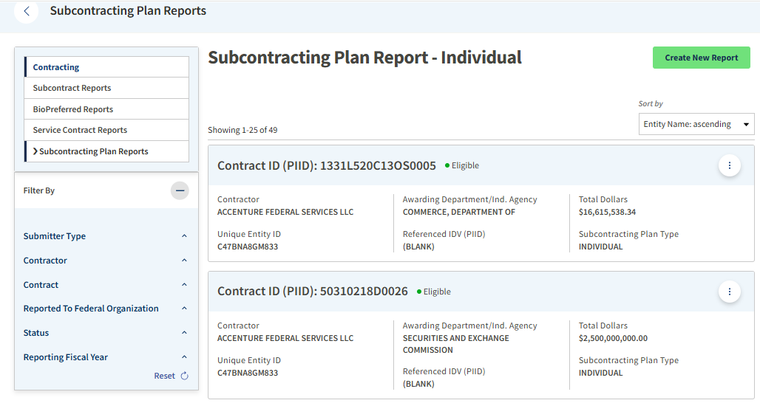
Recent updates and consolidations
eSRS transition to SAM.gov
All subcontracting plan reporting functions are now in SAM.gov and incorporate all statutory and regulatory requirements, including those from the Small Business Act and the Revolutionary FAR Overhaul.
It also streamlines the reporting process by utilizing existing entity and contract data already available in SAM.
Transition page: sam.gov/esrs
Company A
GS1CDE1FGHJ
123456789101
Company A
Company A
$16,000,000.00
ABCDE1FGHJK2
C1234567
Company A
123456789101
Company A
$2,000,000,000.00
C1234561

Slide 5
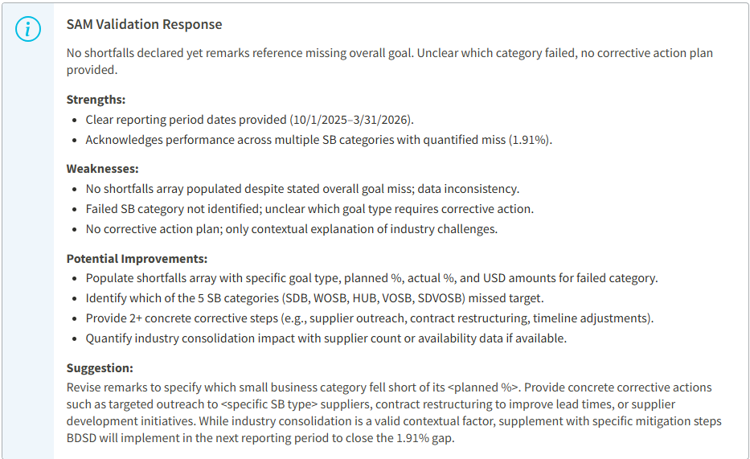

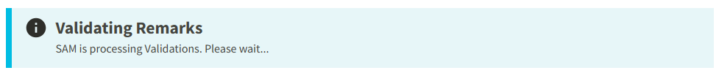
Recent updates and consolidations (Cont)
Recent updates and consolidations
eSRS transition to SAM.gov
Latest updates
AI Review of “Remarks” during the ISR/SSR data entry
The "Validate Remarks" feature on the ISR and SSR data entry forms uses an AI mechanism to review contractor-submitted Goals, Actuals, and Remarks. Subsequently, it provides feedback, including Strengths, Weaknesses, Potential Improvements, and Suggestions.

Slide 6

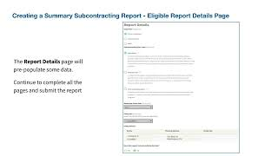
Recent updates and consolidations (Cont.)
Recent updates and consolidations
eSRS transition to SAM.gov
Subcontracting Plan Reporting on SAM.gov - Data Entry Individual (ISR)
Subcontracting Plan Reporting on SAM.gov - Data Entry Summary (SSR)

Slide 7
Recent updates and consolidations (Cont..)
Recent updates and consolidations
eSRS transition to SAM.gov
Contract Retrieval issue
SBA granted an extension to the mid-year reporting deadline to ensure contractors report among the challenges.
Thank you for your patience and collaboration while we resolve the issue.

Slide 8
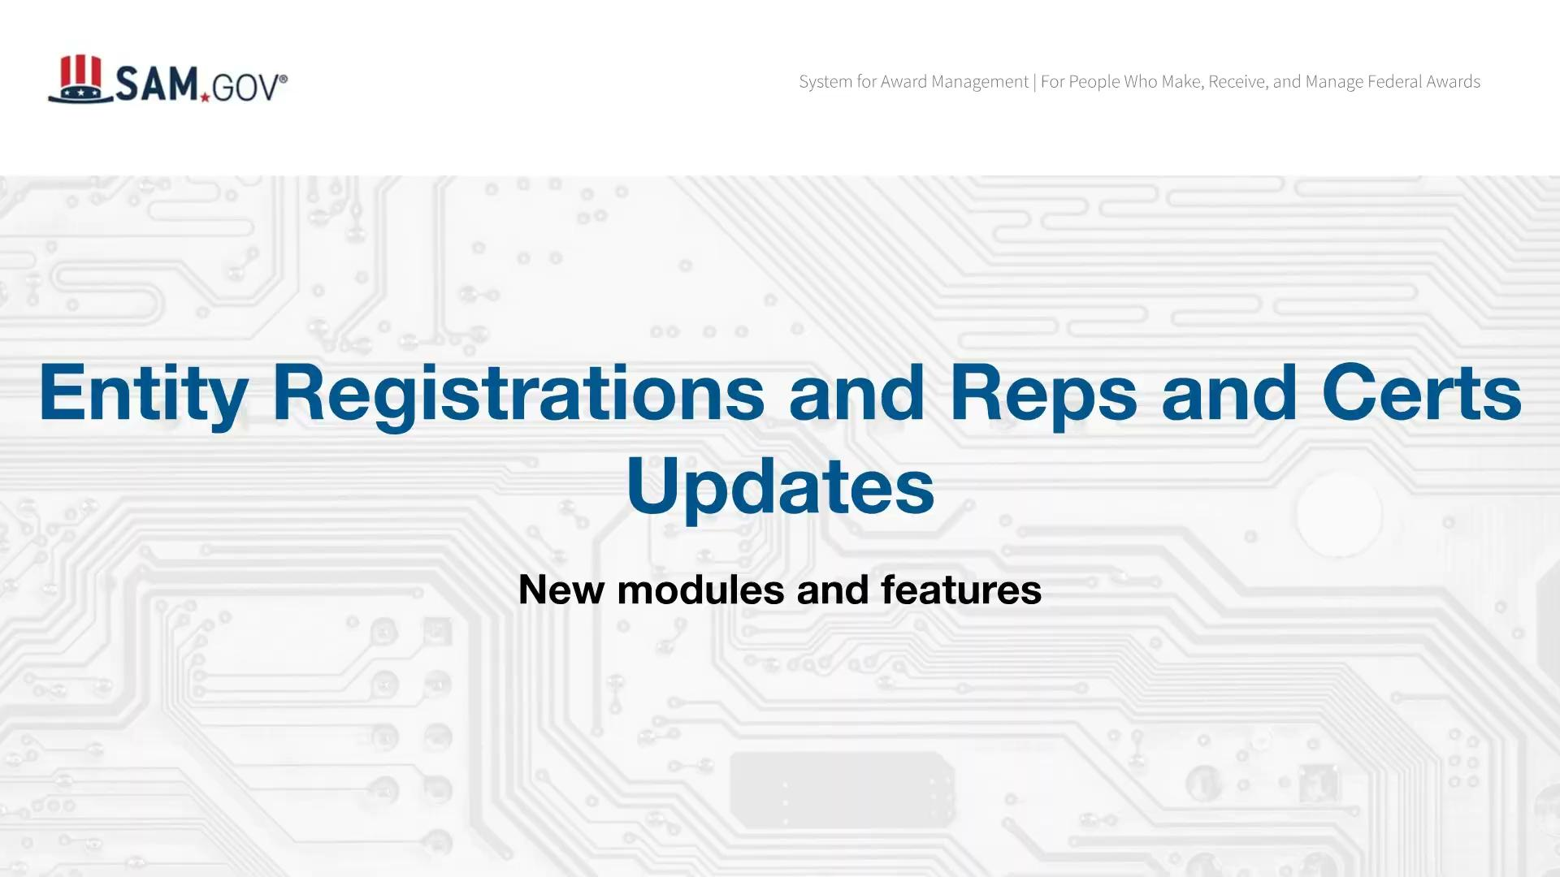
Recent updates and consolidations
Entity registration and FAR/DFAR Reps and Certs

Slide 9
Recent updates and consolidations
Entity registration and FAR/DFAR Reps and Certs
Entity-Level representation questions are included in the registration process reducing the need to fill out redundant questions
DFARS, Offer-Level, and Financial Assistance representations are their own separate modules and can be completed at their own pace
Questions are grouped more intuitively so you don’t have to context switch
Information you have provided is carried forward to other modules so you only need to fill it out once

Slide 10

What’s next for SAM.gov
IAE Roadmap
FY26 Q3-4
FY 27
Consolidate multiple award systems into SAM.gov
Consolidate award systems for a smooth and efficient process
Consolidate Integrity record data entry (fka FAPIIS) into SAM.gov
Improve Federal Assistance Listings to FY27 standards
Revolutionary FAR Overhaul updates
Consolidate award systems for a smooth and efficient process
Consolidate CPARS past performance records into SAM.gov
Improve customer service
Enhance and strengthen the Federal Service Desk (FSD)
Improve agents performance and implement system enhancements

Slide 11
Questions?

Slide 12
Thank You.

Slide 13
GSA Trademark Icon

