Slide 1
EASY ORDERING WITH GSA GLOBAL SUPPLY®
Acquisition Training for the Real World Winter 2026
Presented By: Iris Wright-Simpson
General Supplies and Services Portfolio
January 26, 2026

Slide 2
Training Agenda
GSA Overview and the National Supply System
The GSA Global Supply® Program
  Product Availability
  Supply Transformation
  Order Placement & Special Orders
  Additional Options: Part Numbers, Global Reach
  Customer Service
Notes:
In this training session, I will be providing an overview of GSA Global Supply® and how it can fulfill your supply needs for commonly available items like office products, tools and housewares. I’ll start with a bit of context on GSA and our role in the National Supply System and before I finish I’ll touch on some significant, ongoing program changes underway for the GSA Global Supply® program.

Slide 3
U.S. General Services Administration
Creation: Established by President Truman on July 1, 1949.
Original Mission: To dispose of war surplus, manage and store government records, manage emergency preparedness, and stockpile strategic supplies.
An Evolving Mission: The Public Buildings Service normally houses more than 1 million federal civilian workers, many in 480 historic buildings. The Federal Acquisition Service facilitates the purchase of goods and services.
Notes:
GSA was established by President Harry Truman on July 1, 1949, to streamline the administrative work of the federal government. GSA consolidated a variety of different functions, including the National Archives Establishment, the Federal Works Agency, the Public Buildings Administration, the Bureau of Federal Supply, the Office of Contract Settlement and the War Assets Administration into one federal agency tasked with administering supplies and providing workplaces for federal employees.
The original mission of the GSA was to dispose of war surplus goods (still an issue 4 years after World War II ended), manage and store government records, handle emergency preparedness, and stockpile strategic supplies for wartime.
However, over time GSA’s mission evolved, as it has for many Federal agencies, to the the point where most attention is focused on its two largest functions – the Public Buildings Service and the Federal Acquisition Service. GSA has provided workspace for more than 1 million federal civilian workers, oversees more than 480 historic buildings, and facilitates the purchase of goods and services from quality commercial vendors.

Slide 4
Procuring Products and Services for the Government
The Federal Acquisition Service was established to provide an economical and efficient system for the procurement, supply, and eventual disposal of property. Intent was to eliminate duplication and maximize the government’s leverage.
On July 1, 1952, the Defense Cataloging and Standardization Act was approved, establishing a single catalog system leading to the National Supply System. GSA and DoD partner to avoid unnecessary duplication.
Notes:
Within GSA, the Federal Acquisition Service (FAS) was established as a central organization to provide an economical and efficient system for the procurement, supply, and eventual disposal of property. Its intent was to eliminate duplicate functions and to establish a professional resource that would maximize the government’s leverage in obtaining supplies and services.
On July 1, 1952, Public Law 436, the Defense Cataloging and Standardization Act, was approved by the 82nd Congress. This law established a single catalog system and related supply standardization program, and was instrumental in establishing a uniform National Supply System. Section 11 of Public Law 436 reads as follows: “The Administrator of General Services and the Secretary of Defense shall coordinate the cataloging and standardization activities of the General Services Administration and the Department of Defense so as to avoid unnecessary duplication.”

Slide 5
Working In Partnership With DOD To Furnish Supplies
A 1971 GSA-DoD agreement assigned to GSA those Federal Supply Classes (FSCs), or commodities commonly used by federal agencies, which are commercially available and not predominantly of a military nature.
GSA Global Supply® is a part of the Federal Acquisition Service and is the Government to Government Supply source for commodities assigned under the 1971 Agreement. GSA Global Supply® is now a strategic partner with DoD on full-service supply solutions in CONUS and OCONUS environments.
Notes:
In 1971, GSA and DoD entered into an agreement to eliminate avoidable overlap between their respective supply systems. This agreement divided the management of consumable items between GSA and the Defense Supply Agency (DSA, now Defense Logistics Agency). It assigned to GSA those Federal Supply Classes (FSCs), or commodities commonly used by federal agencies, which are commercially available and not predominantly of a military nature. DLA was assigned those items that were more military in nature.
GSA Global Supply® is a part of the Federal Acquisition Service and is the Government to Government Supply source for commodities that GSA is assigned under the 1971 GSA / DoD Agreement. GSA Global Supply® has also evolved into a strategic partner with DoD on full-service supply solutions in CONUS and OCONUS environments. Throughout the rest of the presentation, we’ll be talking in detail about the GSA Global Supply® program – and some of its responsibilities, particularly within the DoD Supply Chain.

Slide 6
GSA as Wholesale Supply Source - FAR OVERHAUL
FAR 8.002: Priorities for use of Government supply sources.
(a) Except as required by 8.003…, agencies shall satisfy requirements for supplies and services from or through the sources and publications listed below:
  Agency inventories
  Excess from other agencies
  Federal Prison Industries, Inc. (UNICOR)
  Supplies which are on the Procurement List maintained by the Committee for Purchase from People who are Blind or Severely Disabled
  Wholesale supply sources, such as stock programs of the GSA (GSA Global Supply®), DLA or VA
FAR OVERHAUL
Notes:
GSA Global Supply® is a Government to Government Wholesale Supply Source that was previously listed in FAR 8.002, as a Priority for use of Government supply sources. GSA was referenced along with DLA that agencies should utilize for supply requirements.

Slide 7
FAR OVERHAUL Part 8 - Recommended Sources
8.104 Use of existing contracts.
(a) When supplies or services are unavailable from the mandatory sources listed agencies should procure commercial products and commercial services, including those that can be modified to fill agencies' needs, to the maximum extent possible, in accordance with the policy of Executive Order 14271, Ensuring Commercial, Cost-Effective Solutions in Federal Contracts. When a commercial product or commercial service meets an agency’s needs and is available on an existing contract or Blanket Purchase Agreement awarded for Governmentwide use (such as the Federal Supply Schedule, Governmentwide Acquisition Contract, or other Indefinite-Delivery, Indefinite-Quantity contracts), the agency -
(1) must use the existing government-wide contract or blanket purchase agreement to buy the supply or service if the contract has been designated by the Office of Federal Procurement Policy a “required use” contract, unless the head of the contracting activity provides an exception (e.g., because the contract’s terms and conditions, scope, or performance period do not meet the agency’s needs); and
Notes:
And while we are no longer included as a priority source the FAR and its companion guide tells us the we must take full ad of existing contracts which Global Supply is.
And there is a real benefit to using Global Supply….You see, when placing an order with GSA Global Supply®, you are placing an order directly with the Government. You are NOT placing an order direct with a vendor. GSA has already procured the item on your behalf. Please note that you can also satisfy UNICOR and AbilityOne (which manufactures items on the Procurement List from NIB / SourceAmerica) requirements when purchasing through GSA Global Supply®. Both UNICOR and AbilityOne items are available within the GSA Global Supply® product offering.

Slide 8
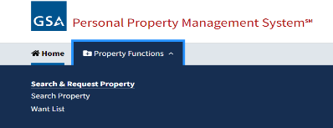
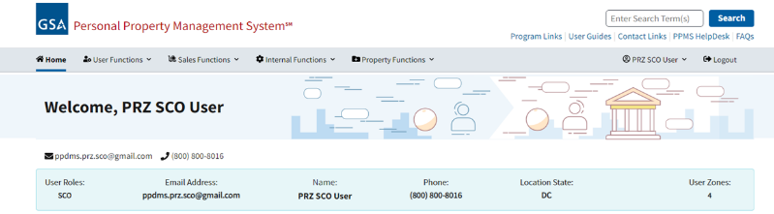
PPMS.gov
Notes:
As an aside, I’ll note that our colleagues in GSA’s Personal Property Management program oversee the PPMS disposal program. This process allows agencies with excess property to post it for possible use by other federal agencies. You and your colleagues can use the PPMS website to report, view or, claim property from another federal agency. Remember that PPM is your first source of supply, before considering any of the purchase alternatives.

Slide 9
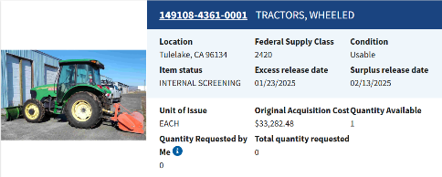
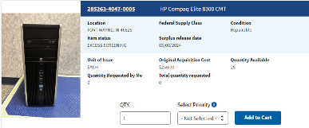
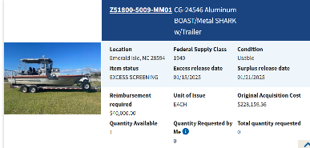
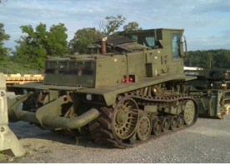

PPMS.gov
Notes:
These are examples of the vast array of items available through PPMS.
PPM’s disaster response process proved invaluable when Hurricane Helene hit land in September of 2024. In just one week, PPM facilitated the donation of almost $1M of crucial disaster response items to impacted communities. Donated items include generators; tools (shovels, tarps, stakes, lanterns, flashlights); power distribution panels; motorized vehicles (a boat, trucks, trailers, ATVs, dump trucks, loaders); tents, clothing, water, food and more.
These successful endeavors are made possible due to PPM’s partnership with agencies like DoD, who stand ready and can easily make property available. PPM distributes lists of the identified property to Federal Agencies and State Agencies for Surplus Property within the affected areas, while also expediting the transfer or donation of disaster relief items.
During wildfire season, (May-November of 24 one of our Property Specialist worked diligently with DLA in, PA to transfer an earth mover tractor, (original acquisition cost of $362,687) to USDA (DNR in the state of Washington). This special tractor was be used by local and statewide mobilization fire responses; significant because “it can be driven on asphalt to construct fire lines and protect structures in rural areas.”
Again a very worthwhile first source of supply worth noting.

Slide 10
GSA Global Supply® - Wholesale Supply Source
Your order is a simple requisition between agencies.
Requisitions satisfy all Federal Acquisition Regulation (FAR) requirements, including trade agreement policies, socio economic goals, AbilityOne mandates, and executive orders.
Place a requisition via DoD Activity Address Code (DoDAAC), Civilian Activity Address Code (AAC), and/or Government Purchase Card (GPC).
GSA is integrated with DoD (DoD) financial systems.
Notes:
So, what does it mean to be a Government to Government Wholesale Supply Source? GSA Global Supply® has already procured the most in-demand product on the Government’s behalf – meaning that your order is a simple requisition between agencies. You don’t have to go out and compete items to ensure best price, or worry about where the product is manufactured. GSA ensures that all of the applicable Federal Acquisition Regulations are met so that you can simply place the order. GSA Global Supply® has been procuring items on behalf of the government for over 70 years – and, we have the knowledge and skills to ensure mandates, executive orders, socioeconomic goals, and more are met. When it comes to placing the order, you simply place a requisition utilizing your DoD Activity Address Code (DoDAAC), Civilian Activity Address Code or Government Purchase Card.

Slide 11
Integrated into the National Supply System
GSA-managed National Stock Numbers (NSNs) are available directly through DoD, service-specific internal supply systems for requisitioning as well as FedMall (DLA’s e-commerce acquisition platform).
As requisitions are placed via internal supply systems for GSA managed items, orders route through DLA and to GSA for fulfillment.
Status updates on your requisition route back through to internal supply systems.
GSA transactions conform to performance criteria (i.e., packing, marking).
Military regs cite GSA policy & procedures as a part of DOD logistics guidance.
Notes:
DoD Customers can access the GSA Global Supply® product offering directly through their internal supply systems. You would simply utilize your supply system - for Army, it could be GCSS - to order the applicable National Stock Number. Once the order is placed through your supply system, the requisition is routed via DLA to GSA for fulfillment. If it was a DLA managed item, it would be route to DLA for fulfillment. GSA then processes the requisition utilizing the information loaded for that particular requisition. Status updates on items ordered will be routed back through to your internal supply system.

Slide 12
GSA Global Supply® - Support to DoD & More
FY 24 Business Volume: $805M
    Department of Defense (over 90%)
    Federal civilian agencies
Your Supply / Logistics Partner
    Mission support to the Warfighter & civilian agencies
    Disaster Relief / Emergency Response
GSA also manages retail stores worldwide (ServMart. NAVFAC PWDs and base stores; while they are not GSA Global Supply® stores, we work in partnership with DOD and our commercial partner to stock and manage them.
Notes:
So, let’s take a step back for a minute – and look at GSA Global Supply’s support of DoD. GSA Global Supply’s mission has been in place since the creation of GSA. As an owner with DLA of the National Supply System, GSA plays a significant role in supporting the Department of Defense. In FY2024, GSA Global Supply’s business volume was $805M – and over 90% of that support was provided to the Department of Defense. We have long sought to increase our business with civilian agencies, and with some of the changes that are being implemented by the current administration it may happen by default.
When it comes to the type of support that GSA Global Supply® provides, it comes down to one clear objective: Mission Support. That mission has included support of Operation Enduring Freedom in Afghanistan; disaster support for hurricanes, tornadoes or flooding and of course everyday support of the soldier, airman, marine or seaman located stateside. We provide supply chain solutions that meet the needs of our customer base, regardless of location or mission.
GSA Global Supply® has multiple Acquisition experts that manage the entire product offering available – well over 1.7 million items. They also provide special order support. And, lastly, GSA has a few several retail stores and forward supply points around the world where we’ve partnered with vendors to manage these locations. So even though they aren't managed by Global Supply® anymore, they too are requisition-based, and worth noting.

Slide 13

GSA Global Supply® Best-in-Class Solution
Designated by OMB after rigorous review and reconfirmed multiple times
Most BIC solutions are narrowly focused (e.g. OS4 office supplies)
GSA Global Supply® is a broad channel
Also Section 889 compliant!
Notes:
It’s also worth noting that GSA Global Supply® has been designated by OMB as a Best-in-Class solution. Use of Best in Class is also being redefined, but Global That involves a rigorous review by OMB before they select these preferred solutions for federal agencies. What’s striking about this choice is that most BIC programs are narrowly defined. OS4 for office supplies gives you office supplies. Fedrooms covers hotels while you’re on travel. GSA Global Supply®, by contrast, is a broad solution that covers many product categories, including office supplies, but also furniture, cleaning supplies, tools and much more. The safety and simplicity of requisition buying makes it a great tool.

Slide 14
PRODUCT AVAILABILITY
GSA Global Supply®

Slide 15
GSA Products to Support Your Mission
Management of Consumable items within the National Supply System are split between DLA and GSA
  GSA manages ~ 50,000 National Stock Numbers (NSNs)
  DLA manages ~ 3.9 Million NSNs
National Stock Numbers
  FSCs assigned to GSA include:
    Tools and Hardware, Housewares, Food Service & Cleaning Supplies
    Office Products, including Shipping and Packaging Supplies
    Furniture
Notes:
GSA was assigned those FSCs or commodities commonly used by federal agencies which are commercially available on the civilian economy and not predominantly of a military nature. DLA was assigned those FSCs or commodities commonly used in military operations or weapons systems support, irrespective of their use by civil agencies. GSA manages roughly 50,000 National Stock Numbers, whereas DLA manages upwards of 3.9M National Stock Numbers. Some of key FSCs assigned to GSA include Tools and Hardware, Shipping and Packaging Supplies, Office Products and Housewares. Each of these FSCs contains hundreds to thousands of National Stock Numbers.
What’s the significance of a National Stock Number?
Each item repetitively used, bought, stocked and/or distributed by the Federal Government requires an NSN.
The NSN standardizes product identification across the federal government and allows a high-level data capture of demand, consolidated sourcing and acquisition, and supply chain efficiencies.
Reduces downtime by enabling acquisition personnel to quickly identify, locate, and order parts or supplies.
Identifies items with unique characteristics/requirements (i.e. PRIME – Plastics Removal in Marine Environment).
The most significant and far-reaching benefit of the NSN is that it provides life cycle management of items of supply, from requisition to acquisition to maintenance to final disposal.
NSNs are not used for new product launches/introductions.
DO NOT READ: To learn more, visit http://www.dlis.dla.mil, and click on Cataloging. The Supply Support Request (SSR) process is contained in DOD 4140.26-M (vol. 6).

Slide 16
GSA Products to Support Your Mission: FSSI
Federal Strategic Sourcing Initiative
FSSI - Multiple BPAs and IDIQ contracts to leverage savings
  Cross-agency, strategic sourcing initiative helps the government leverage data, dollars and good business sense.
GSA Global Supply® is leveraging strategic sourcing vehicles to drive down pricing and delivery time: Office, JanSan and MRO items
Notes:
GSA is expanding the scope of its Federal Strategic Sourcing Initiative contracts. We have done so across three broad categories of products, Office Supplies, Janitorial and Sanitation products and Maintenance, Repair and Operating supplies. Our intent is to leverage the buying power of the federal government to secure better pricing, help you track spending data and still satisfy socioeconomic purchasing goals.
Contracts for these categories, under what we call the Purchasing Channel, have been operating for several years. What’s newer is our use of the “Requisition channel” contract vehicles for Global Supply requisitions. As an example, we have created IT products as part of our requisition offering.
First and foremost is the goal of saving you money. But at the same time, we aim to improve the level of service by streamlining the number of vendor partners we work with and standardizing elements like delivery time and packaging standards.
So, there are a few change that customers will see:
Faster delivery as new contract vehicles standardize requirements across large segments of the product line. AND, Depending on your location, and our partners’ locations, many of you will see faster delivery.
We are expanding our purchasing options to provide better service to you
No (or reduced) minimum order quantities (MOQ)
Lower cost as we leverage strategic sourcing and market pressure to get competitive prices
And with our IT enhancements implemented nearly a decade ago, we’ve increased the level of transparency so we can better see your order status and even tracking information on individual shipments. So there’s
Simplified data collection and enhanced transparency to better manage spending and measure savings

Slide 17
GSA Products to Support Your Mission: Part Numbers
GSA Global Supply® Part Numbers (GSPN)
  Hundreds of thousands of commercially available Office Supplies, Tools and Hardware, Cleaning Supplies, IT and other items
  GSPN’s are prefixed with 'FO4', 'FMR', 'FJS', or 'GIT'
  Expanded product offering with easy access to items on GSA Global Supply®, GSA Advantage, and FedMall
Special Order (Non-Contract) Part Numbers
  Provides the ability to requisition a product not readily available:
    Limited to commodities the GSA manages
    MILSTRIP accepted
    GSA handles acquisition, administration, logistics and payment issues
Notes:
In addition to the National Stock Number offering, GSA also has a substantial number of Part Numbers available for ordering. In 2006, GSA Global Supply® expanded its product offering to include easy access to commercially available items in several categories, including Office Supplies and Tools/Hardware. We’ve partnered with industry leaders to provide access to brand name items in a requisition-based environment. Again, GSA Global Supply® has done all of the upfront work and negotiated fair and reasonable pricing so that you simply have to place the order.
We have been working on a dramatic expansion of our product offering. It now represents roughly 1.7 million items. Instead of issuing NSNs for each item, and having to manage those in perpetuity, we are using commercial part numbers
GSA also provides access to a Special Order Program that allows customers to requisition products unavailable in the GSA Global Supply® offering (both existing Part Numbers and National Stock Numbers). GSA is limited to purchasing only those products and ancillary services that are within the Federal Supply Classes that that GSA Global Supply® manages. When utilizing the Special Order Program, you have the flexibility of using either a MILSTRIP or MIPR. GSA Global Supply® handles end-to-end support from the initial acquisition of the item, to shipment at your location and payment to the vendor.

Slide 18
GSA Global Supply® - Special Orders
Requisition a product not available on e-commerce websites (i.e. GSA Global Supply®, GSA Advantage, FedMall)
  Limited to products in commodity classes that GSA Global Supply® manages
GSA provides complete acquisition, administration, logistics and payment support
Available to global DoD customer base, via MIPR or MILSTRIP
One entry point, Email: RPC@gsa.gov
Notes:
If the item you need cannot be found in the GSA Global Supply® offering, we offer a Special Order Program (SOP) to obtain those products. Customer agencies can place requisitions with GSA Global Supply® and be assured that we will take all the necessary steps to ensure compliance with applicable procurement regulations. We are limited to supporting products and ancillary services within the commodity classes that GSA Global Supply® manages. This program is available to our global customer base – and, can be used via MILSTRIP or MIPR. The SOP option includes a wide variety of products such as tools and hardware, office products, cleaning supplies and safety equipment. We can support requirements ranging from the simple to complex, from low cost to above the Simplified Acquisition Threshold. And, for ease of use, there is one entry point for your requirements. Simply call or email the Special Order Desk.

Slide 19
GSA Global Supply® - Global Reach
In support of customers Outside of the Continental U.S. (OCONUS) who are in Europe,(EUCOM) some countries in Africa and the Middle East , those in the Indo-Pacific - Hawaii, Guam, Korea, mainland Japan and Okinawa (INDOPACOM), CENTCOM and Alaska, GSA Global Supply® sources hundreds of National Stock Numbers (NSNs) in-theaters overseas.
GSA’s vendor partners stock the NSN locally and delivers in 3-15 days (depending on the country); much faster than shipment via DLA from CONUS
Available via FEDSTRIP/MILSTRIP and GSA Advantage!® and GSA Global Supply® websites too (NSNs are visible on FedMall, but not flagged for OCONUS availability)
Notes:
Also, I’ll touch briefly on a newer initiative we have begun to better serve our far-flung customers. As you might know, traditionally orders from customers in Europe or Asia flowed to GSA and we (our vendor partners) shipped them to a DLA consolidation point. DLA grouped those items with their own products and filled containers that were put on boats and eventually reached customers overseas.
Under the new program, we have partnered with vendors who stock high-demand items in, Germany, Guam, Korea, Japan and Hawaii and delivers in just a few days to customers. Instead of waiting weeks or months, customers will have those items in a few days. Customers are thrilled with the shorter wait time. In the past year we added a facility to support Alaska customers and and two locations in Italy (Sigonella and Naples)

Slide 20
ORDER PLACEMENT
GSA Global Supply®
Notes:
Regarding Price changes while ordering: while price changes are inevitable, I think it's safe to say they are less frequent that you would see compared to MAS or open market vendors. Obviously, the longer the approval process takes, the greater is the likelihood for a change in price or availability. Nevertheless, I think the GSA Global Supply offering is less volatile than others.

Slide 21
GSA Global Supply® – Placing an Order
Web:
  http://www.GSAglobalsupply.gsa.gov
  http://www.gsaAdvantage.gov
  https://piee.eb.mil/ (FedMall)
MILSTRIP
  Internal Supply System or manually via DD 1348-6 (email form to RPC@gsa.gov)
Phone: 800-488-3111
Notes:
Now that we’ve talked about the basics of the GSA Global Supply® program and the product offering available, let’s review the different ways that you can place an order. GSA is focused on providing flexible ordering options. We want to save you time and money by streamlining the order process. First and foremost, you can place a MILSTRIP order either via your internal supply system (such as GCSS-Army, etc.) or via a DD1348-6 (manual transmission). In OCONUS locations, you have a network of stores available that allow you to access the product offering in a walk-in environment.
We would recommend (as well as the host DoD organizations) that you check stock in the stores prior to requisitioning via another method. We want to ensure that the product gets to you in the shortest time possible – and, this is assured when visiting a local store. We also provide web options for ordering product in a 24/7 environment. There are three web options, and we’ll spend time walking through the differences on each site. And, lastly, you have the ability to phone or fax in orders to our knowledgeable GSA Global Supply® call center.

Slide 22
GSA Global Supply® – Placing an Order via DoDAAC/AAC
DoDAAC/AAC options: MILSTRIP, Web, and Phone
Integration with your Agency’s financial systems
Inter-fund billing via DoDAAC/AAC/UIC/RUC
  Billing cycle 1st and 15th of each month
  Tens of thousands of DoDAAC/AAC transactions processed per month
GSA Global Supply® or GSA Advantage!® or FedMall websites
Manual entry still available: email SF 344 or DD 1348-6 to RPC@gsa.gov
Need to apply for a DoDAAC/AAC? Or want to validate your DoDAAC/AAC before you order? Email OrderMgmt@gsa.gov for help
Notes:
We know that not every person or office is suitable for a purchase card. When it comes to placing an order via a DoD Activity Address Code, or Civilian Activity Address Code, you have multiple ordering options. You can utilize MILSTRIP via your internal supply system; visit a local GSA Retail Store, or place a DoDAAC order via Web, Phone and/or Fax. When you place an order with GSA utilizing your DoDAAC, the order is integrated with your Agency’s financial systems. Twice a month, on the first business day of the month and again at mid-month, GSA bundles all of the pending AAC/DoDAAC charges and conveys them to the Treasury Department. Treasury draws the relevant funds from customer accounts and transfers those funds to GSA. In recent years, DoD has encouraged its buyers to pay particular attention to using the correct Fund Code in order to minimize errors and ensure smooth processing of orders, billing and payments. In a typical month, tens of thousands of AAC/DoDAAC transactions are processed smoothly by GSA Global Supply®.
If you need to apply for a new DoDAAC, GSA can provide the necessary contact information for your Agency to help you get started. Send an email to the address near the bottom of your screen and we’ll be glad to help.

Slide 23
GSA Global Supply® – via Purchase Card
Place orders via Government Purchase Card using the following ordering options: GSA Websites and/or Phone
Government to Government Bill
  Billing is from “GSA,” not multiple vendors
Pre authorization credit card purchasing
  Process ~ tens of thousands credit card billings monthly
Consolidated and line-item billing options
One central point in GSA for all shipping, billing questions – National Customer Service Center (NCSC)
Notes:
Of course, you can also place orders via Government Purchase Card with GSA Global Supply®. We accept the use of the Government Purchase Card for orders placed via Web, Phone and Fax. When placing an order via Government Purchase Card, you are still conducting a Government to Government purchase meaning that your credit card statement is going to indicate “GSA” as the supplier. All purchases made through GSA go through a pre-authorization prior to submittal. And, you can buy with confidence because GSA processes tens of thousands of card billings a month. Since you are placing a requisition with GSA Global Supply®, you have the ability to place orders with generous spending limits.

Slide 24
GSA Global Supply® – Ordering Methods
Website Ordering
  GSA Global Supply® Ordering site
    http://www.gsaglobalsupply.gsa.gov
    Research and order thousands of GSA Global Supply® items
    Order via DoDAAC / AAC and Government Purchase Card
    One site to access all requisition-based items
    Site does not contain acquisition-based (MAS) items
    Check requisition status, and reconcile against your GPC
Notes:
Now, we’ll turn our attention to the web-ordering options available via GSA Global Supply®. The first option – and, most highly recommended, is the GSA Global Supply® ordering site. This is where you are going to find easy access to only those items available for requisitioning via GSA Global Supply®. Many thousands of items are available on this site, to include both GSA Global Supply® National Stock Numbers and part-numbered items. You don’t have to worry about external spending limits – or, if competition is required, because the GSA Global Supply® site does not include acquisition-based items where FAR Subpart 8.4 applies.
(note, please see FAR 8.402 (c) FAR Subpart 8.4 is not applicable to orders placed through the GSA Global Supply® System).
You can utilize either your DoDAAC or Government Purchase Card to place orders on the GSA Global Supply® website. We’ve included tools that allow you to check shipping status on your requisitions, re-order quickly, utilize an electronic DD1348-6 and reconcile your Government Purchase Card statement.
Regarding Price changes while ordering: while price changes are conceivable, I think it's safe to say they are less frequent that you would see compared to MAS or open market vendors. Obviously, the longer the approval process takes, the greater is the likelihood for a change in price or availability. Nevertheless, I think the GSA Global Supply offering is less volatile than others.

Slide 25
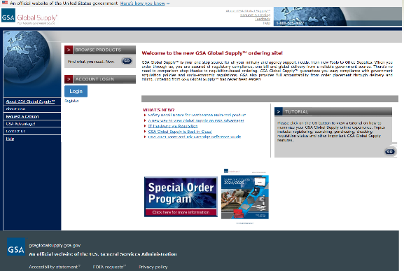
GSA Global Supply® Home Page
Notes:
This is a screenshot of the GSA Global Supply® home page. You’ll see that this is set up in a similar manner to many other online shopping sites. You have the ability to search for items or browse from specific product categories. The site also gives you the ability to “park” items in a shopping cart and send them forward to a supervisor for approval. You also have the ability to narrow your searches by selecting “green” attributes and/or the AbilityOne icon.

Slide 26
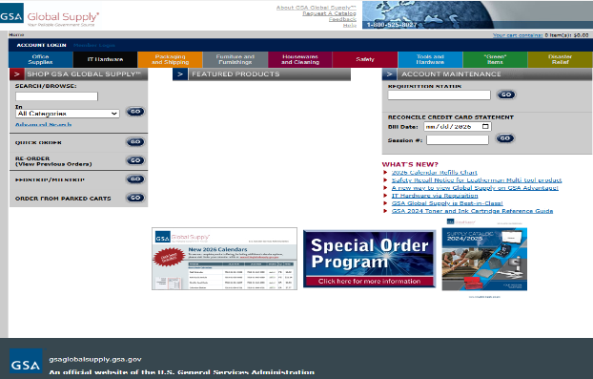
GSA Global Supply® Shopping Page
Notes:
This is a screenshot of the main shopping page. The arrow highlights the search box where you can type in the NSN if you know it, or a search term like copier paper. Note that at the bottom of the screen you have a link to a GSA Global Supply® catalog. You can view that online.

Slide 27
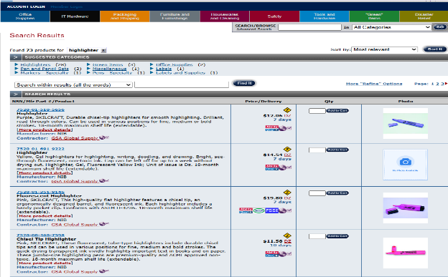
Search Results for Highlighter
Notes:
Here are the results of a search for highlighters. Note that for every item, the contractor is GSA Global Supply®. Everything you see is a simple requisition from GSA Global Supply®.

Slide 28
GSA Global Supply® – Ordering Methods Part 2
Website Ordering (Continued)
GSA Advantage!®
  http://www.gsaadvantage.gov
  Research and order all GSA Global Supply® items
  Order via DoDAAC / AAC and Government Purchase Card
  Site contains all requisition-based GSA Global Supply® items and acquisition-based items available from GSA Multiple Award Schedule vendors
Notes:
Another ordering option is the GSAAdvantage! website. This site includes full access to the items available via GSA Global Supply® on a requisition basis – as well as the millions of items available on an acquisition basis via the GSA Multiple Award Schedules program. Again, FAR Subpart 8.4 does apply to acquisition based items – so, we caution users to make sure they delineate what type of items they are purchasing on the GSAAdvantage! site. You have the ability to utilize either a DoDAAC or Government Purchase Card on GSA Advantage! ® If you are buying GSA Global Supply® items.

Slide 29
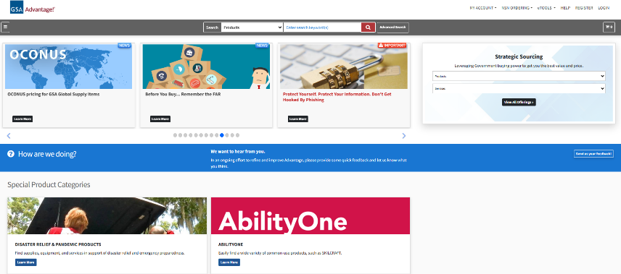
GSA Advantage! Home Page
Notes:
This is a screen shot of the GSAAdvantage! home page. You’ll see a search bar – as well as subcategories available under Products. You’ll also have the ability on this site to search by “other” attributes and AbilityOne. Users also have the ability to check requisition status via the NSN Ordering function at the top of the screen.
As with most sites GSA Advantage has Multi-Factor Authentication for improved site security, so we added a feature where you can register your PIV or CAC. Once you do that, you can login directly on this site or on GSA Global Supply because we’ll recognize your ID card.

Slide 30
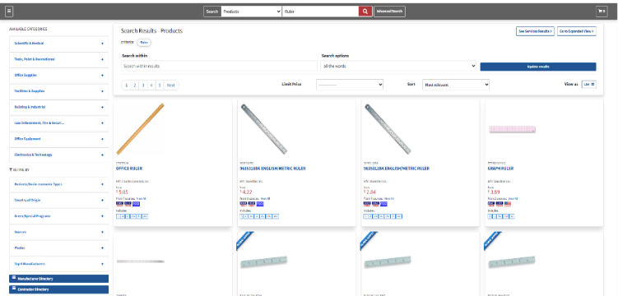
‘Ruler’ Search Results
Notes:
Here are the results from a search for a “ruler.” The first item is from GSA Global Supply®, and the arrow highlights the requisition basis for this purchase. But all the other option on the screen are from Schedule vendors. It’s easy to comparison shop based on price, minimum order or other factors. But just remember that all of the Schedule options are acquisitions and only the GSA Global Supply® choice is a simple requisition.

Slide 31
GSA Global Supply® – More Ordering Methods
Website Ordering
  FedMall
    https://piee.eb.mil/ Login through DLA’s Procurement Integrated Enterprise Environment PIEE
    Research and order GSA Global Supply® NSNs and part-numbered items
    Order via DoDAAC/AAC only for GSA Global Supply® items
Notes:
Finally, as far as web ordering, our customers will have access to the GSA Global Supply® product line on FedMall, the new website that replaced DOD Emall. GSA is working with DLA to ensure that our complete product line is available on this site – but, individuals are only able to purchase via DoDAAC.
Right now, all NSNs and all GSA part numbers are visible.

Slide 32
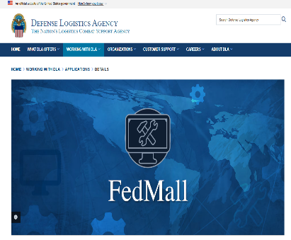
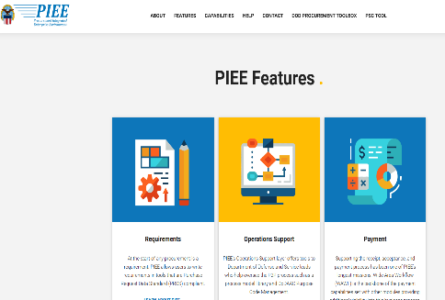
FedMall Homepage
Notes:
This is a screenshot of the FedMall homepage. If you’re required to use this site, you’ll probably want to check back regularly as DLA enhances its functionality.

Slide 33
GSA Global Supply® – Ordering Methods Part 3
Ordering by Phone:
National Customer Service Center
  800-488-3111
  9:00 p.m. Sunday to 9:30 p.m. Friday, Eastern Time
  Friendly, professional service
Notes:
Customers have the option of calling orders into a GSA Global Supply® Call Center. This resource is available from Sunday night to Friday night to serve customers worldwide. The Call Center is able to take orders utilizing a DoDAAC, AAC or Government Purchase Card.

Slide 34
Help Us Serve You Better and Faster
Many orders flow through DAAS (Defense Automated Addressing System) to GSA, without contact information
Use “Mark For” Date fields to insert contact info: name and phone number
This allows GSA to:
Clarify buyer’s needs regarding non-contract items (buy on demand)
Confirm quantity if there is a question on unit of issue
Arrange delivery and any special requirements
Ensure base access, if needed
Long-term: DLA and GSA to collect more complete contact info
Notes:
GSA works to serve you as efficiently as possible. Sometimes we hit an obstacle because we have no easy way to contact a customer. For instance, most MILSTRIP orders flow to us through DLMS and while we see the relevant DoDAAC for the ordering or billing party, we can’t easily reach a person. If it’s a “J” item and GSA is buying it, we may need to resolve questions about your order or confirm the quantity if it comes in multiple sizes. Or we ship the item and it gets hung up at the entry to your base. If we can’t call you to gain access, that order can be delayed or even cancelled. In the long-term, GSA and DLA will work together to gather that information and ensure that if flows to the shipping label. In the meantime, I suggest you and your colleagues use the “Mark For” data field in whatever ordering system you use to insert at least a first name and phone number. If you are ordering on the GSA websites, use the box for “Individual Receiving” info to give us a name and phone number.

Slide 35
CUSTOMER SERVICE
GSA Global Supply®

Slide 36
GSA Global Supply® – Customer Service
Our National Customer Service Center (NCSC) is available at 800-488-3111 from Sunday at 9 p.m. ET until Friday at 9:30 p.m. ET or via email at NCSCcustomer.service@gsa.gov.The full-service NCSC provides assistance and information to help make your requisitions simple and efficient. Check on current pricing, order status, billing information, tracking of shipments and more.
Order status visible 24/7 at https://ask.gsa.gov. Register and check at any time.
GSA Staff are located in forward supply OCONUS environments to support
your needs. Also onsite daily with DLA Agency Sustainment Operations Center. For contact details: http://www.gsa.gov/globalsupplyoconus
Notes:
As mentioned throughout the training, the National Customer Service Center is your one-stop shop for all questions pertaining to GSA Global Supply® orders. You can check on current pricing, order status, billing information, order tracking, and more. The NCSC is now open 24/5 from Sunday at 9P ET to Friday at 9:30P ET to assist all customers, both CONUS and OCONUS.
The second bullet is a great self-service option. You can visit ask.gsa.gov at any time and check the status on your GSA Global Supply® orders.
We also have staff in forward deployed environments to ensure that you have the on-site support that you need. For the most up to date contact information, please visit www.gsa.gov/globalsupplyoconus.

Slide 37
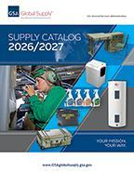
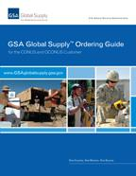
GSA Global Supply® - Publications
Visit gsa.gov/cmls to download free product brochures and reference guides.
Notes:
And, last but not least, GSA offers FREE publications. The Ordering Guide on your left is an overview of the ordering process and a useful “how to” for folks unfamiliar with our program. The Supply Catalog on the right is our current catalog that highlights nearly 9000 of our available products. Both are available to download or view via a flipbook now.
The new 2026-2027 catalog displaying approximately 11,000 of our most-popular items will be available online. To access an online copy of the catalog (flipbook or PDF), please visit www.gsa.gov/cmls. We hope it will serve as a handy, useful resource that simplifies your shopping and allows you to focus on your mission. As part of our commitment to sustainability, we designed this edition to serve customers for both FY 2026 and FY 2027. With the changes over the past year we are still working on options for printed copies; they may be available for print on demand.

Slide 38
Thank you
Iris Wright-Simpson
202-880-3405
Iris.Wright-Simpson@gsa.gov
Carla Correll
571-289-6761
Carla.Correll@gsa.gov

