Slide 1
Information Technology Category 101
ITC SOLUTIONS TRAINING

Slide 2
Agenda
GSA’s Information Technology Category (ITC)
Multiple Award Schedule (MAS)
Blanket Purchase Agreements (BPAs)
Governmentwide Acquisition Contracts (GWACs)
Buying Guides and Resources
GSA Support Tools

Slide 3


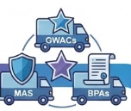

GSA IT Category Customer Journey
When customer agencies want to…
And need a fast, compliant purchase at a fair price…
They use ITC’s Best in Class vehicles like…
And use acquisition support services like…
Modernize and upgrade IT systems
Add new data and analytics capabilities
Improve system security
Build customer-facing digital experiences
Upgrade hardware, software, cloud and AI tools
IT Professional Services
Cybersecurity
Software / SaaS
Platforms / PaaS
Infrastructure / IaaS
Hardware
Telecom
Identity, Credential, and Access Mgmt Services
Multiple Award Schedule (MAS) IT Category
Governmentwide Acquisition Contracts (GWACs)
Blanket Purchase Agreements (BPAs)
In-house SMEs
Buying guides
Reusable templates
Contract language
Market research
Training

Slide 4





Value Proposition
Agencies benefit from choosing ITC because we offer a commitment to meet customer needs, easy access to the best solutions, cost savings, and compliance with Federal regulations.
Customer Commitment
Acquisition and IT subject matter expertise
Responsive customer support to assist with emerging tech needs
Training and decision-support tools available
Convenience
Variety & flexibility with uncompromising value & quality
Easy to identify and secure vendors, products and services
Achieve small business/socio-economic goals
Compliance
Align with complex federal regulations, laws, directives, and guidance
Reduce security and acquisition risks
Safeguard cyber assets and supply chains
Cost Savings
Reduce costs, save time and resources for the mission
Solutions with pre-negotiated & competitive pricing
Access to Best-In-Class offerings recommended by OMB

Slide 5
Benefits to Agencies
HELPING AGENCIES DELIVER SUCCESSFUL ACQUISITIONS
Program Management Benefits: Cost, Schedule, and Performance.
Smarter Cost Savings
Established Not-To-Exceed ceiling prices.
Prices have been determined "Fair and Reasonable".
Competition at the order level will further drive price discounts.
Reduce administrative costs by using pre-competed acquisition vehicles.
Faster Procurement Time
Support through the entire acquisition lifecycle (pre/post award).
Complementary scope and requirement reviews.
Market Research Assistance (M-RAS) and acquisition vehicle recommendations.
Faster acquisition awards (PALT) by using pre-competed acquisition vehicles.
Federal Market Strategy
Achieve socio-economic targets / credits (direct and indirect) awards.
Leveraging the buying power of the government thru Category Management.
Ability to access small business vendors of a variety of socio-economic categories for set-asides.
Consolidating Federal Procurement under EO 14240.
Compliance Focused
Compliant with ALL federal legislation, regulations (FAR), and policies.
Acquisition vehicles managed by GSA acquisition workforce professionals.
Compliant with Section 889 of the National Defense Authorization Act.
Additional agency regulations and policy requirements can be included at the order level.

Slide 6
Multiple Award Schedule (MAS)
Providing access to pre-vetted suppliers.
Incorporating supply chain risk mitigation.
Specialized Item Numbers for IT buying.

Slide 7


MAS
7.5M products and services
4,600+ vetted suppliers
Reduces buying cycles up to 50% vs. open market
80%+ small businesses
New suppliers added continuously
Supports firm fixed price, labor hours and time and materials.
Special Item Numbers (SINs) define technical performance requirements

Slide 8
MAS: Speed, Cost Savings, & Compliance
Acquire commercial information technology at fair and reasonable prices in less time than going the traditional full and open route.
Contract pricing based off of negotiated best commercial pricing and allowing agencies to further negotiate rates and pricing.
Established contractor compliance checklist that all vendors must comply with.
What baseline Supply Chain Risk Management (SCRM) requirements are included?
Kaspersky Lab
Section 889 (Part A & B)
Trade Agreements Act (TAA)
Made in America” (MiA) Country of Origin Designations
Using data analytics/AI Bots to search for potentially non-compliant items.
GSA blocks and removes non-compliant products.

Slide 9
MAS IT Available Offerings
IT Services
SIN 54151S - IT Professional Services
SIN 54151HACS - Cyber Security
SIN 54151HEAL - Health IT
IT Training
SIN 611420 – Information Technology Training
IT Software
SIN 511210 - IT Software Licenses
SIN 54151 - IT Software Maintenance
Cloud Services
SIN 518210C – Cloud Compute and Cloud-Related IT Professional Services, AI products and services
IT Hardware
SIN 33411 - IT Hardware
SIN 532420L - IT Leasing
SIN 811212 - Hardware Maintenance
Financial Management Services
SIN 518210FM – Financial Management Quality Service Management Office (FM QSMO) Core Financial Management Solutions and IT Professional Services
Electronic Commerce
SIN 54151ECOM - Electronic Commerce
IT Solutions
518210C - Cloud Computing and Cloud Related IT Professional Services
SIN 541519ICAM - ICAM (non-PIV) Products & Services
518210FM – Financial Management Quality Service Management Office (FM QSMO) Core Financial Management (FM) Solutions and
SIN 541519PIV - Personal Identity Verfication (PIV) Products & Services
541370GEO - Earth Observation Solutions
Telecom
SIN 517312 - Wireless Mobility Solutions
SIN 517410 - Commercial Satellite Communications Solutions
SIN 541370GEO - Earth Observation Solutions

Slide 10
MAS: Master Contract
Master IDIQ Contract Awarded under RFO FAR 12 – Acquisition of Commercial Items & GSAR Subpart 538.71 – Federal Supply Schedule Ordering Procedures.
Long-term government-wide “Potential 20 year” contract with commercial companies that provide access to ever changing commercial IT offerings.
Base schedule contract options are formally reviewed every five (5) years to ensure vendors remain compliant and commercial pricing remains competitive.
Industrial Funding Fee (IFF) (paid by Industry, not the customer). The IFF reimburses GSA for the costs of operating the Federal Supply Schedule program, as set forth in 40 U.S.C. The Fee is built into the MAS ceiling price for each line item awarded. The MAS contractor remits payment to GSA
Compliance with ALL applicable Federal Regulations and Policies.
Established End User License Agreements (EULA) for software. EULAs are incorporated at the contract level
Worldwide Coverage (CONUS/OCONUS) available depending on the terms and conditions of the contractor
Notes:
See links for FAR Overhaul FAR PART Deviations: FAR part 38 Removed and FAR 12 has been fundamentally re-engineered in its structure, scope, and operational mechanics to make federal buying faster, simpler, and more aligned with commercial practices. These changes reflect an effort to create a user-centric part that champions flexibility, and innovation when acquiring commercial products and services.
AND FAR part 38, Federal Supply Schedule Contracting, is removed in its entirety. Guidance and procedures for the Schedule program were moved from FAR part 38 and subpart 8.4 to GSAR part 538.

Slide 11
MAS: Schedule Ordering & Contract Pricing
MAS: Schedule Ordering
MAS: Contract Pricing
Using the eBuy system, agencies (buyers) may prepare and post Requests for Quotations (RFQs) for specific products and/or services.
Ordering via GSAR subpart 538.71
Vendors quote established rates.
Agencies further negotiate discounts at the order level.
Additional agency terms, conditions, and flow down clauses are allowed, but cannot conflict with the master MAS contract.
Order-Level Materials (OLMs) and Ancillary Supplies and Services (ANCILLARY) are both types of supplies and services that can be used to support a GSA Schedule contract or BPA.
Multiple Award Schedule (MAS) contracts include:
Pre-negotiated ceiling prices.
Pre-negotiated terms and conditions.
GSA prices for products and services are based on the best commercial pricing
Contracting officers negotiate to establish base pricing.
Agency negotiations at the order level further decrease established ceiling prices.

Slide 12
MAS: Ancillary & Order Level Materials
Ancillary Supplies and Services Special Item Number (SIN) is used for support supplies and services that are not covered by any other SIN on a schedule and complement a contractor's offerings/provide a total solution.
The price for these items is determined when the schedule or modification is negotiated.
Order-Level Materials (OLMs - GSAR 538.7104-2) SIN is used for supplies or services that are purchased to support a specific task or delivery order under MAS but are not known at award.
(1) They must not be the primary purpose of the order
(2) They must be clearly identified in the order as items not on the contractor’s FSS contract or FSS BPA; and
(3) A fair and reasonable price determination must be made for each authorized OLM, but is not required prior to award of the order;
Sold as Time & Materials (T&M)/Labor Hour under a Contract Line Item (CLIN). Only included in orders under authorized subcategories that have the OLM SIN - under Code G.

Slide 13
Ordering Procedures: GSAR 538.7103
EXCEEDS SAT
a) Unless a justification is executed and approved in accordance with 538.7104-3(b)—
(1) Publish an RFQ on GSA’s eBuy; or (2) Issue an RFQ to as many FSS contractors offering the product, service, or solution as practicable, to reasonably ensure that quotations will be received from at least three FSS contractors.
b) RFQs must describe the work to be performed and the basis on which selection will be made.
c) Fairly consider all quotations received by evaluating and making award according to the basis described in the RFQ.
MICRO-SAT
(a) When the product/service/solution is:
Clearly defined/available for purchase at a fixed-price place the order after— (1) Considering reasonably available information by Surveying 3+ contractors on GSA Advantage!®; OR Reviewing 3+ contract catalogs; OR Publishing an RFQ on GSA’s eBuy; OR Issuing an RFQ to 3+ contractors.
Not clearly defined/involves OLMs/Requires SOO/SOW/PWS/Not available for purchase at a fixed-price— (1) Publish an RFQ on GSA’s eBuy; or (2) Issue an RFQ to 3+ contractors.
BELOW MICRO
(a) Place order or establish BPA with any FSS contractor that can meet the need.
(b) Although not required to solicit from a specific number of FSS contractors, ordering activities should attempt to distribute orders among FSS contractors.

Slide 14
MAS Blanket Purchase Agreements
2GIT BPA (IT Hardware, Software, & Ancillary)
GSS BPA (Desktops/Laptops)
Printer BPA
SCRIPTS
DEOS

Slide 15
MAS: Blanket Purchase Agreement
The Multiple Award Schedule (MAS) Blanket Purchase Agreement (BPA) is a government vehicle that allows for the purchase of products and services through the MAS program.
An acquisition strategy to establish single or multi-award agreement in accordance with GSAR 538.7104-1 FSS Blanket purchase agreements with schedule contractor(s).
Agencies can establish tailor-made acquisition vehicles to deliver IT solutions.
Allows agencies to consolidate, and conduct enterprise approach buying, realizing economies of scale.
Ability to award complex multi-SIN and line item awards to buy services or products.
A BPA establishes terms applicable to future orders; it does not obligate funds. BPA uses estimated values and does not have ceilings/guarantees.

Slide 16





ITC Solutions
Offers secure, mission-critical, best-value, and compliant hardware and software solutions, emphasizing SCRM and vendors with strong SCRM plans; mitigating cybersecurity vulnerabilities associated with IT products. The scope includes commercial hardware, software, equipment purchases, maintenance, software licenses, and OLMs. More Information.
I10-year, Governmentwide BPA, established in partnership with the Office of Secretary of Defense. Provides supply chain risk illumination tools and services to mitigate the risks of fraud, abuse, foreign ownership control or influence, and supply chain exploitation. More Information & Ordering Guide.
Standard configurations for desktop and laptop computers, tablets, monitors, displays, controllers, connectors, cables, drivers, and adapters. Specs refreshed every 9 months based on industry updates and customer feedback. Click & buy through GSA AdvantageSelect. More information.
Integrated, enhanced, NIST-based SCRM requirements operational controls improve supply chain security. Scope includes printers, copiers, scanners, maintenance, parts, print management, toner/ink/paper, and related services. Click & buy through GSA AdvantageSelect. More information.
Leveraging commercial best practices, where
applicable for all business process and
procedures, this BPA is exclusively available for DoD utilization. It provides a commercial Cloud Service Offering (CSO) to modernize and unify legacy IT services, including DoD Enterprise Email and Portal Services.
.

Slide 17
MAS: BPA Features & Benefits
MAS: BPA Features
MAS: BPA Benefits
Since BPAs are not contracts, you can build in simple cancellation language to deal with poor performers without the termination for convenience or default complexities
The “Contract Disputes Act” does not have jurisdiction over BPA agreements.
BPAs do not have ceilings - they use estimated values.
Ability for agencies to combine repetitive orders under a BPA reduces administrative costs.
Adopting an enterprise-wide BPA approach can streamline operations and improve the ordering process across the agency allowing for standardization.
MAS provides standard terms, and conditions along with compliance, and awarding a BPA allows agencies to incorporate agency clauses.
Order Level Materials (OLM) must not be the primary purpose of the order and must be clearly identified in the order as items not on the contractor’s FSS contract/FSS BPA.
Ability to establish agreements with multiple vendors maintains competition.
Streamlined BPA ordering procedures.
Increased flexibility in acquiring services and products.
Increases flexibility to plan for anticipated purchases.
Set-asides can be done for small businesses and any social economic class as determined through market research.
Does not require a minimum guarantee, or maximum ceiling.
Agency wide ordering through an established BPA increases flexibility to meet mission needs.
Ability to on-ramp additional vendors.
BPA language can be written to allow addition of new technologies as they become available.

Slide 18
Governmentwide Acquisition Contracts (GWACs)
Polaris
Small Business
SDVOSB
WOSB
HUBZone
VETS 2
8(a) STARS III
Alliant2

Slide 19





GSA Contracts
Provides more than 1,000 vetted, qualified, certified 8(a) small disadvantaged businesses.
GWAC set-aside exclusively for Service-Disabled, Veteran-Owned Small Businesses (SDVOSB).
Access to highly experienced, qualified, pre-vetted industry partners for comprehensive emerging tech, IT services, and solutions. Alliant 3 coming soon.
IT services GWAC with small business, women-owned small businesses, HUBZone, and SDVOSB pools for set-asides.

Slide 20
GWAC’s Features & Benefits
GWAC Features
GWAC Benefits
Intentionally broad to encompass all IT related services
Includes language that will allow the scope to adapt to changes in the marketplace
Provides warranted COs with specialized training to become Ordering Contracting Officers (OCOs)
Ancillary support can include non-IT services/labor and equipment if integral and necessary.
Pre-competed contracts
Blanket Purchase Agreements
“Best in Class” (BIC) solutions
Full range of contract types
Low Contract Access Fee (CAF)
Allows agencies to streamline procurement lead time through access to pre-vetted, high-quality industry partners.
Orders can be issued in considerably less time than other types of procurements.
Meet diverse agency IT requirements, including new and emerging technologies.
Reduced administrative costs
Boost small businesses and provide socioeconomic credit to agency customers
Limited Protestability
Notes:
Sources: https://www.gsa.gov/system/files/GWAC%20Ordering%20Guide-2025.11.20.pdf / https://www.gsa.gov/technology/it-contract-vehicles-and-purchasing-programs/gwacs/vets-2 / https://vsc.gsa.gov/vsc/app-content-viewer/section/8#GWACs%20and%20MACs

Slide 21
GWAC vs MAS Comparison
GWAC
MAS IT
FAR 16.506 & 16.507
Ordering Governance
Protest Limits
Statutory authority
Delegation of Procurement Authority Required
Contractor Make-Up
Labor Categories & Ceiling Rates
Period of Performance
IT Services
Flexibility Parameters
Fair Opportunity
BPA
Far 8.4 Authority
Ordering Governance
Protests
Statutory Authority
Process to Use
Contractor Make-Up
Labor Categories & Rates
Period of Performance
Flexibility Parameters
Teaming
BPAs
Fair Opportunity
Circles that overlap have a commonality, while circles that do not overlap do not share any of the other circles' traits.
For more information, (click here)
Scope
BPAs

Slide 22
GWAC Ordering Procedures
Procedures for Placing Orders on our GWACs (FAR 16.5??
EXCEEDS SAT
Issue RFQ to all eligible BPA holders, or follow procedure for limiting sources
Select best value quote
Document best value determination and evidence of compliance with ordering procedures
MICRO-SAT
Provide fair opportunity to all BPA holders or document reasons for restricting consideration
Select best value quote
BELOW MICRO
Place order with BPA contractor
Distribute orders among BPA contractors

Slide 23
Buying & Support Tools
Ordering guidelines for MAS, BPAs & GWACs

Slide 24
Buying Resources
Conduct Research | Develop Documents | Ready to Buy
Acquisition Solutions Navigator Pricing Intelligence Suite Buying guides Steps to Performance Based Acquisition Acquisition Gateway | Market Research as a Service (MRAS) Build a Cost Estimate (IGCE) Document Builder | GSA Advantage GSA ebuy GSA Global Supply

Slide 25
Questions?

Slide 26
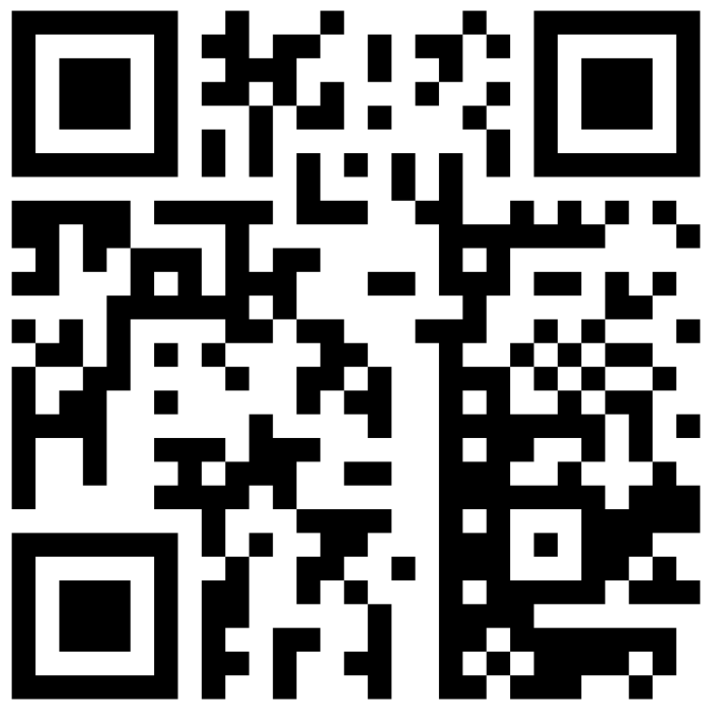
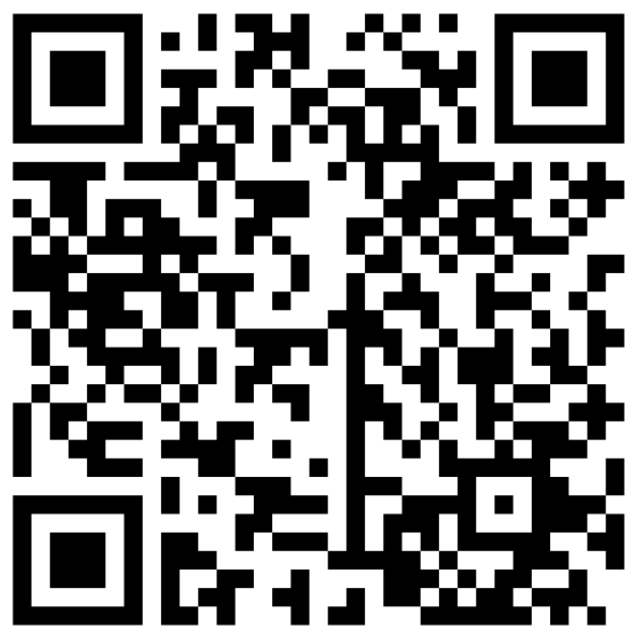
GSA Order Guides
Description: | QR Code:
Multiple Award Schedule Order Guidelines
Multiple Award Schedule Blanket Purchase Agreement

Slide 27
GSA Tools & Resources
SYSTEM | DESCRIPTION | MAS CONTRACTORS CAN: | GOVERNMENT BUYERS CAN:
eBuy | Electronic RFI/RFQ system | Tap into large customer base, access to RFI/RFQs | Request info, find sources, prepare RFI/RFQs
GSA eLibrary | Provides latest contract award information (GSA and VA schedules) | Research competition | Perform Market Research
GSA Advantage! ® | Online shopping and ordering system | Research competition, sell to the Federal Marketplace | Search for items, services, suppliers, perform market research, place orders, and compare features, prices, and delivery

Slide 28
U.S. General Services Administration Federal Acquisition Service
Office of Customer and Stakeholder Engagement (CASE)
https://buy.gsa.gov/help
Information Technology Category (ITC)
Customer Strategic Solutions Division (CSSD)
Inquiries can be sent to the ITC CSSD email box: ITCSSD@gsa.gov
For more information, visit: gsa.gov

Slide 29
MAS: CTA Comparison
CTA vs. Prime/Sub Teaming Arrangement
Comparison | Contractor Team Arrangement (Multiple Companies)
Contract | Each team member must have a MAS contract.
Distribution of Work | Each team member is responsible for duties outlined in the CTA document.
Privity of Contract | Each team member has privity of contract with the government and can interact directly us.
Invoicing | Each team member invoices the government buyer at unit prices or hourly rates as outlined in the task or delivery order, or blanket purchase agreement.
Scope of Work | Team members can offer total solutions quickly and easily.
Prime/ Subcontractor arrangement
Only the prime contractor must have a MAS contract.
The prime contractor cannot delegate responsibility for performance to subs
Only the prime contractor can interact with us. The prime contractor is responsible for subcontracting activities.
Prime contractors invoice the government buyer according to its MAS contract, which may include price reductions.
Prime contractors can only provide the supplies or services that were awarded on its MAS contract.

Slide 30


BPA Use Story
Air Force awarded a $5.7B IT Service Management, Service Desk, and end-user devices Blanket Purchase Agreements (BPA) using the Multiple Award Schedule (MAS).
ITC provided market research, scope reviews, technical SMEs, and lessons learned from previous Blanket Purchase Agreements.

Slide 31
ITC’s Governmentwide Acquisition Contracts and Blanket Purchase
Agreements give access to pre-vetted suppliers.

Slide 32



NOAA Use Case Scenario
NOAA Mission IT Services (NMITS) was a multi-award blanket purchase agreement approach awarded with a value of $2.1B to small businesses to compete on task orders. NMITS joins a family of IT acquisition vehicles tailor-made to deliver secure and compliant solutions.
ITC worked closely with NOAA during the entire acquisition life-cycle from pre to post-award. This helped the agency gain access to IT offerings from a variety of small business firms.

Slide 33


Envision 2024
Date: April 16, 2024
Agencies are exploring Post Quantum Cryptography (PQC) to protect their systems and implement OMB Memo M-23-02, Migrating to OPC (Nov. 18, 2022).
ITC hosted the inaugural Envision 2024 PQC readiness summit, attended by over 300 representatives from customer agencies and industry partners. The event featured a keynote from the Administrator and speakers from the White House, CISA, NIST, HHS, DOJ, GSA, and industry.
The summit developed additional resources to help agencies implement PQC and hear from the PQC experts.
ITC's extensive resources and subject matter expertise are invaluable assets that support agencies on their PQC journey, instilling confidence in successful implementation through unwavering customer commitment and compliance value.
Notes:
Several activities involved in preparing agencies for a post-quantum future are already in scope under our contracts, and some of our industry partners offer post-quantum computing services
For example, right now, agencies can use the managed security service under our Enterprise Infrastructure Solutions contract to conduct a prioritized inventory of their cryptographic systems.
Agencies can also use our Highly Adaptive Cybersecurity Services (HACS) Special Item Number (SIN) to acquire cyber experts who have been technically evaluated to do such inventories.
Additionally, the Multiple Award Schedule, IT Category (MAS-IT), connects agencies with vendors equipped with quantum capabilities. This ensures that as agencies prepare to transition to PQC, they have access to the latest technologies and services designed to protect against quantum threats.

Slide 34


SLTT Cybersecurity Grant Program
The $18M SLTT Cybersecurity Grant Program support efforts to help grant recipients utilize GSA solutions by developing outreach and engagement campaigns and training programs.

Slide 35

ITC is a key player and partner for agency IT modernization.
Cloud (XaaS): Order Guide
Zero Trust (ZT) Architecture: Buyers Guide
Post Quantum Computing (PQC)
Artificial Intelligence (AI): Buy AI
Machine Learning (ML)
Blockchain
Internet of Things (IoT)
Emerging Technologies

Slide 36
ITC Partners through MAS
ITC partners with agencies to deliver information technology solutions through the Multiple Award Schedule (MAS) and Governmentwide Acquisition Contracts (GWAC)
Managing $43.5B+ in government IT spending.
Saving customer agencies $2B each year.
Cost avoidance through established pricing.
Improving procurement acquisitions lead time.
Incorporating supply chain risk management.
Ensuring compliance with all regs and new policies
Information Technology Category (ITC)
Acquisition Solutions & Category Expertise
Assisted Acquisition Service (AAS)
Custom Support Services
Customer and Stakeholder Engagement (CASE)
Strategic
Relationships
Technology Transformation Service
(TTS)
Digital
Transformation

Slide 37
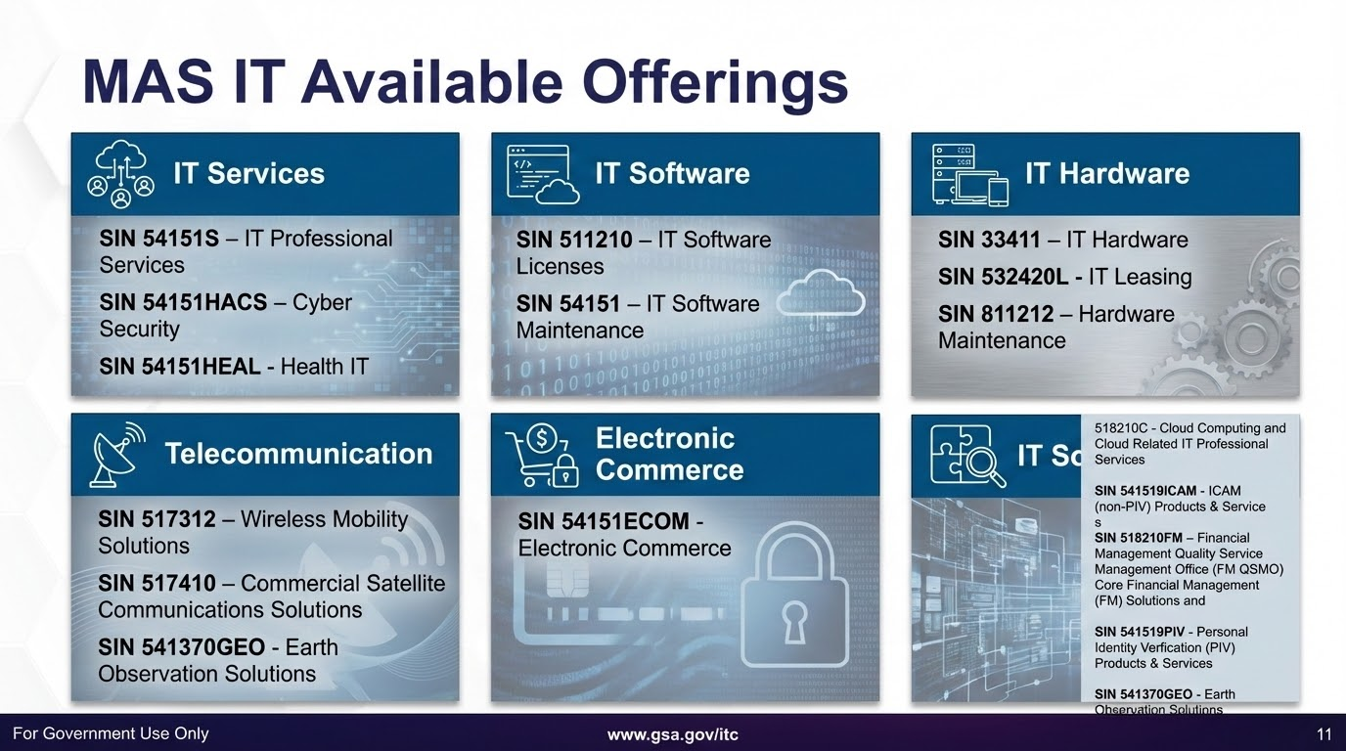
MAS IT Offerings

Slide 38
Ordering Procedures for Services: requiring a SOW FAR 8.405-2
MICRO-SAT
The ordering activity shall develop a statement of work, and shall provide the RFQ (including the statement of work and evaluation criteria) to at least three Schedule contractors that offer services that will meet the agency’s needs
Specify the type of order (i.e., firm-fixed-price, labor-hour) for the services identified in the statement of work
Limited Sources Justification, if applicable
Determine if a price reduction should be sought
Best value determination
BELOW MICRO
Ordering activities may place orders with any Federal Supply Schedule contractor that can meet the agency’s needs
Although not required to solicit from a specific number of Schedule contractors, ordering activities should attempt to distribute orders among contractors

Slide 39
MAS: Ancillary Supplies & Services
Ancillary Supplies and Services Special Item Number (SIN) is used for support supplies and services that are not covered by any other SIN on a schedule.
These supplies and services are intended to complement a contractor's offerings and provide a solution to a customer's needs. Here are some things to know about the Ancillary Supplies and Services SIN:
Pricing: The price for these items is determined when the schedule or modification is negotiated.
Incidentals: Ability to award incidental items at the schedule-contract level if they are routinely provided.
ANCILLARY | Supplies and/or services are support supplies and/or services which are not within the scope of any other SIN on this schedule.

Slide 40
Establishing a BPA for Supplies – GSAR 538.7102-2 & 538.7103
EXCEEDS SAT
Develop RFQ, including the basis of the award
Post to GSA eBuy OR provide to as many Schedule contractors as is practicable to ensure at least three quotes
Limited Sources Justification, if applicable
Shall seek price reduction (FAR 8.405-4)
Best value determination
BELOW SAT
Survey ≥ 3 contractors
Limited Sources Justification, if applicable
Determine if a price reduction should be sought
Best value determination

Slide 41
BPA Ordering Procedures: FAR 8.405-3
Procedures for Ordering from Multiple-Award Schedule BPAs (FAR 8.405-3(c))
EXCEEDS SAT
Issue RFQ to all eligible BPA holders, or follow procedure for limiting sources
Select best value quote
Document best value determination and evidence of compliance with ordering procedures
MICRO-SAT
Provide fair opportunity to all BPA holders or document reasons for restricting consideration
Select best value quote
BELOW MICRO
Place order with BPA contractor
Distribute orders among BPA contractors

Slide 42




ITC Customer Walk-through
And need to quickly, compliantly and at a fair price purchase
They use ITC’s Best-In-Class vehicles like…
And use ITC’s acquisition support services like…
When customer agencies want to…
IT Professional Services
Cybersecurity
Software / SaaS
Platforms / PaaS
Infrastructure / IaaS
Hardware
Telecom
Identity, Credential, and Access Mgmt Services
Multiple Award Schedule (MAS) IT Category
Governmentwide Acquisition Contracts (GWACs)
Blanket Purchase Agreements (BPAs)
In-house SMEs
Buying guides
Reusable templates
Contract language
Market research
Training
Modernize and upgrade IT systems
Add new data and analytics capabilities
Improve system security
Build customer-facing digital experiences
Upgrade hardware and implement AI tools

Slide 43
MAS ITC Available Offerings
IT Solutions
IT Hardware
Electronic
commerce
IT Services
IT Software
Telecommunication
518210C - Cloud Computing and Cloud Related IT Professional Services
SIN 541519ICAM - ICAM (non-PIV) Products & Service
s
518210FM – Financial Management Quality Service Management Office (FM QSMO) Core Financial Management (FM) Solutions and
SIN 541519PIV - Personal Identity Verfication (PIV) Products & Services
541370GEO - Earth Observation Solutions
SIN 54151S - IT Professional Services
SIN 54151HACS - Cyber Security
SIN 54151HEAL - Health IT
SIN 511210 - IT Software Licenses
SIN 54151 - IT Software Maintenance
SIN 33411 - IT Hardware
SIN 532420L - IT Leasing
SIN 811212 - Hardware Maintenance
SIN 517312 - Wireless Mobility Solutions
SIN 517410 - Commercial Satellite Communications Solutions
SIN 541370GEO - Earth Observation Solutions
SIN 54151ECOM - Electronic Commerce

Slide 44
ITC SCRM & BPA
Offers secure, mission-critical, best-value, and compliant hardware and software solutions, emphasizing SCRM and vendors with strong SCRM plans; mitigating cybersecurity vulnerabilities associated with IT products. The scope includes commercial hardware, software, equipment purchases, maintenance, software licenses, and OLMs. More Information
10-year, Governmentwide BPA, established in partnership with the Office of Secretary of Defense. Provides supply chain risk illumination tools and services to mitigate the risks of fraud, abuse, foreign ownership control or influence, and supply chain exploitation.
More Information & Ordering Guide
GSS- laptops and desktops
Standard configurations for desktop and laptop computers, tablets, monitors, displays, controllers, connectors, cables, drivers, and adapters. Specs refreshed every 9 months based on industry updates and customer feedback. Click & buy through GSA AdvantageSelect
More information
Printer BPA
Integrated, enhanced, NIST-based SCRM requirements operational controls improve supply chain security. Scope includes printers, copiers, scanners, maintenance, parts, print management, toner/ink/paper, and related services. Click & buy through GSA AdvantageSelect More information
Notes:
ASCEND: Cloud & Software Interact Community

Slide 45
Defense Enterprise Office Solution (DEOS)
Leveraging commercial best practices, where
applicable for all business process and
procedures, this BPA is exclusively available for DoD utilization. It provides a commercial Cloud Service Offering (CSO) to modernize and unify legacy IT services, including DoD Enterprise Email and Portal Services.
Notes:
ASCEND: Cloud & Software Interact Community

