Slide 1

Real Contracting Officer's Representative (COR) of the Federal Government
U.S. Department of Health and Human Services (HHS) &
U.S. General Services Administration (GSA)
January 27, 2026

Slide 2
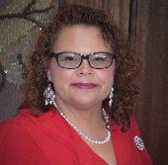


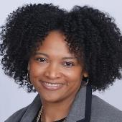
Speakers
Donna Sykes
Contract Specialist
Assistant Secretary for Administration
U.S. Department of Health and Human Services
Donna.Sykes@hhs.gov
Nicol Ford
Office of Centralized Acquisition Services
Program Analyst
General Services Administration
nicol.ford@gsa.gov
J.C. Schulte
Chief of Staff (Acting)
Office of the Chief Financial Officer
joseph.schulte@gsa.gov
Josilyn Reed
Event Coordinator, Office of Integrated Marketing (OIM)
Federal Acquisition Services, General Services Administration josilyn.reed@gsa.gov
Notes:
Slide for more than one presenter

Slide 3

What challenges do you think most COR's within the Federal Government experience?

Slide 4

Please share some mistakes even good CORs make.

Slide 5
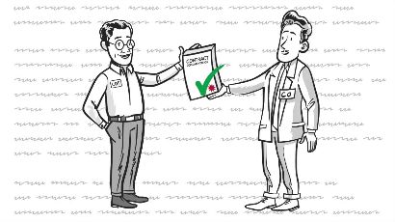

What advice do you have for CORs to make their work experience more efficient? (tips & tricks)

Slide 6

What is one of the strangest calls you've ever gotten/problem you've had to solve as a COR?

Slide 7

Are there any tools or resources that you especially like to use as a COR?

Slide 8
Resources
Resources
COR Toolkit: https://www.fai.gov/resources/cor-toolkit
Steps to Performance-Based Acquisition: https://buy.gsa.gov/spba
CALC+ Quick Rate: https://buy.gsa.gov/pricing/qr/mas
IGCE Tool https://hallways.cap.gsa.gov/app/#/igce

Slide 9
Thank You!
Questions?

Slide 10
GSA Starmark Logo

