Slide 1

Introduction to OASIS+
Acquisition Training for the Real World Winter 2026
Professional Services and Human Capital, Jan. 28, 2026

Slide 2

OASIS Plus Presenter
Brian Boothe
Professional Services Advisor
brian.boothe@gsa.gov

Slide 3
OASIS⁺ Multiple Award Contract

Slide 4

Agenda
01 Welcoming Remarks/Objectives
02 OASIS+ Contract Programs (6)
03 OASIS+ Unique Features / Benefits
04 OASIS+ Domains (13)
05 OASIS+ Ordering Procedures
06 Comparison of Choices –
OASIS+ and MAS
07 OASIS+ Buying Authority
08 Other Information and Resources

Slide 5
Course Objectives
To be able to identify the services available under the OASIS+ contract vehicle, how they are organized, and examples of what services can be procured
To understand the differences between OASIS+, other similar contract vehicles that offer the same or similar services (e.g., MAS), and other acquisition methods
To understand where to go for more information including updates on the program, next level of training (e.g. OASIS+ Delegation of Procurement Authority), and available resources.

Slide 6
What is OASIS⁺?
OASIS Plus Presenter

Slide 7
OASIS+ Definition
What is OASIS⁺?
One Acquisition Solution for Integrated Services Plus (OASIS+) is a government wide, multiple award, IDIQ acquisition program designed to address government agencies' mission needs for a full range of complex, non-IT service requirements that integrate multiple service disciplines and ancillary services and products.
This suite of contracts combines the scope of legacy OASIS; Building, Maintenance & Operations (BMO); and Human Capital & Training Solutions (HCaTS) under one program along with new areas of previously undefined services.

Slide 8
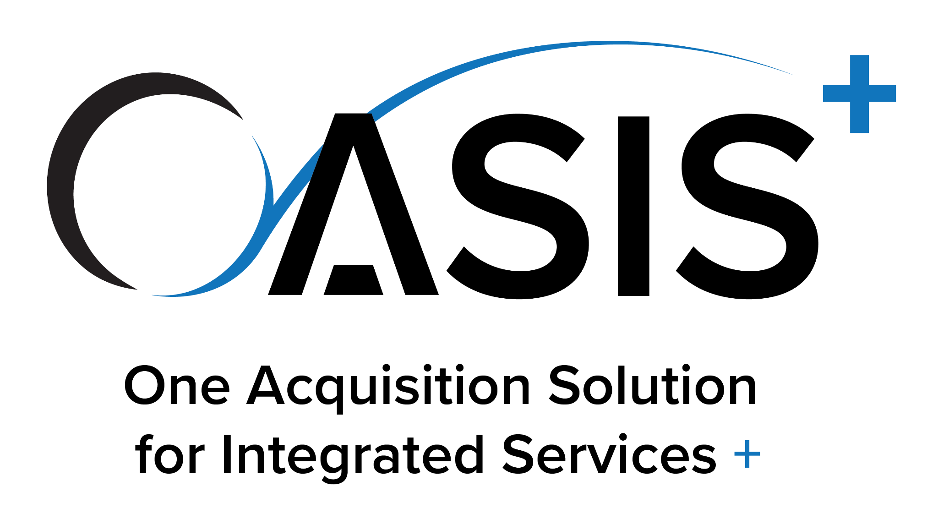
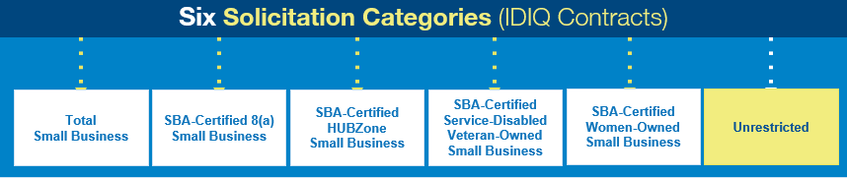

OASIS+ Six Solicitation Categories
A suite of governmentwide, multi-award IDIQ contracts designed to support Federal agency procurement requirements for a full range of non-IT, services-based requirements. The scope of each contract vehicle is categorized into “functional groupings” known as DOMAINs.

Slide 9
OASIS⁺ Unique Features & Benefits
Flexible / Expandable Domain-Based Structure (i.e., the scope can grow)
Global Access to Commercial and Noncommercial Non-IT Services
No Contract Ceiling or Cap on Orders
Industrial Base of Highly Qualified Contractors
10-Year Order Period (Base of 5 + One 5 year option)
On-Ramping After Initial Awards
Price Evaluation at the Contract Level
Best-in-Class (BIC) Tier 3 Spend Under Management (SUM) Credit
Ancillary labor and Other Direct Costs (ODCs) are allowed, with no cap
All contract types and hybrids are allowed
Responsibility determinations, EEO clearances, subcontracting plan oversight, and congressional notifications conducted at the IDIQ level*
*Refer to your agency policy regarding congressional notifications which may require additional procedures for orders.

Slide 10
OASIS⁺ Domains

Slide 11
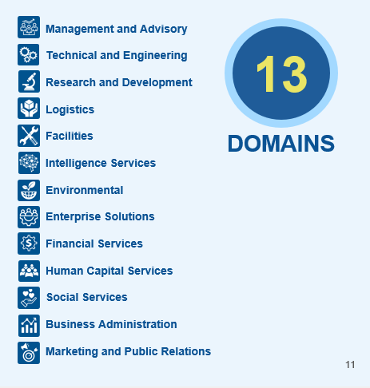
OASIS+ Description
OASIS⁺ Domains
OASIS⁺ contract scope is organized by Domains (functional groupings of related services)
Each Domain contains multiple contract line items (CLINS) aligned to North American Industry Classification System (NAICS) codes
The Fair Opportunity Pool is the awardees of a particular CLIN
OASIS+ contractors may qualify for award of some or all NAICS included in a specific Domain (provided they meet all qualifications for award)

Slide 12

OASIS⁺ Domains
Management and Advisory
Management and Advisory
NAICS CODES
541611
541612
541613
541614
541618
541620
541690
541990
Management and consulting services that can improve a federal agency’s performance, its endeavors to meet mission goals, and provide operating advice and assistance on administrative and management issues.
8 NAICS codes

Slide 13

OASIS⁺ Domains
Technical & Engineering
Technical & Engineering
NAICS CODES
336611
488190
488999
541310
541330
541330 Exception 1
541330 Exception 2
541330 Exception 3
541350
541360
541370
541380
541611
541690
541990
611512
Engineering, geoscience, or other technical professional skills, such as those performed by engineers, geologists, geophysicists, and technicians.
16 NAICS codes

Slide 14

OASIS⁺ Domains
Research & Development
Research & Development
NAICS CODES
541330
541330 Exception 1
541330 Exception 2
541330 Exception 3
541380
541611
541690
541713
541714
541715
541715 Exception 1
541715 Exception 2
541715 Exception 3
541720
541990
621511
Basic research, applied research and experimental development. Services include conducting R&D in: the physical, engineering and life sciences; Nanotechnology; Biotechnology; and social sciences and humanities.
16 NAICS codes

Slide 15

OASIS⁺ Domains
Logistics
Logistics
NAICS CODES
336611
481211
485991
485999
488111
488190
488999
492110
493110
493120
493190
541330
541614
541690
541990
561210
811114
811121
811198
Planning and designing, implementing, or operating systems or facilities for the movement of supplies, equipment or people by road, air, water, rail, or pipeline.
19 NAICS codes

Slide 16

OASIS⁺ Domains
Environmental
Environmental
NAICS CODES
541330
541360
541380
541620
541690
541990
561210
562112
562211
562910
562910 Exception 1
Services that typically involve multi-disciplined teams of scientists, engineers, and other technicians with expertise in areas, such as air and water quality, pollutant contamination, remediation, ecological restoration, and environmental law.
11 NAICS codes

Slide 17

OASIS⁺ Domains
Intelligence Services
Intelligence Services
NAICS CODES
541330
541330 Exception 1
541330 Exception 2
541330 Exception 3
541611
541614
541618
541690
541715
541715 Exception 1
541715 Exception 2
541715 Exception 3
541720
541990
561499
561611
Organizational and technological capabilities to improve situational awareness and enhance command and control strategies within defense and intelligence environments.
16 NAICS codes

Slide 18

OASIS⁺ Domains
Facilities
Facilities
NAICS CODES
238160
238210
238220
238290
238320
238990
485999
488190
488490
488999
531311
531312
541320
541330
541350
541611
541614
541690
541990
561210
561621
561710
561720
561730
561990
562111
562112
562211
811310
Services required to maintain and operate buildings, paved services, utilities infrastructure, and real property assets and equipment.
29 NAICS codes

Slide 19

OASIS⁺ Domains
Enterprise Solutions
Enterprise Solutions
NAICS CODES
336611
541330
541330 Exception 1
541330 Exception 2
541330 Exception 3
541611
541614
541620
541690
541715
541715 Exception 1
541715 Exception 2
541715 Exception 3
541990
561210
562910
562910 Exception 1
(Unrestricted Only) - Large, complex, integrated professional service requirements often spanning multiple disciplines and/or locations and requiring many different types of labor and expertise.
17 NAICS codes

Slide 20

OASIS⁺ Domains
Business Administration
Business Administration
NAICS CODES
541110
541199
541214
541611
541930
541990
561110
561320
561410
561439
561499
561611
561920
561990
611430
611699
This Domain includes requirements to provide assistance with administrative, clerical, and business management services. This includes an array of language services, document management, administrative support, and data services.
16 NAICS codes
Notes:
541110 Offices of Lawyers
541199 All Other Legal Services
541214 Payroll Services
541930 Translation and Interpretation Services
561110 Office Administrative Services
561320 Temporary Help Services
561611 Investigation Services
561920 Convention and Trade Show Organizers
611430 Professional and Management Development Training
611699 All Other Miscellaneous Schools and Instruction

Slide 21

OASIS⁺ Domains
Financial Services
Financial Services
NAICS CODES
522320
522390
524210
531210
531320
531390
541211
541213
541214
541219
541611
541990
561440
561450
813219
This Domain includes requirements designed to support financial objectives, such as accounting, budgeting, financial advising, loan servicing, asset management services and complementary financial services.
15 NAICS codes
Notes:
524210 Insurance Agencies and Brokerages
531210 Offices of Real Estate Agents and Brokers
531320 Offices of Real Estate Appraisers
531390 Other Activities Related to Real Estate
541211 Offices of Certified Public Accountants
541213 Tax Preparation Services
541214 Payroll Services
541219 Other Accounting Services
561440 Collection Agencies
561450 Credit Bureaus
813219 Other Grantmaking and Giving Services

Slide 22

OASIS⁺ Domains
Human Capital
Human Capital
NAICS CODES
541611
541612
541613
541618
541990
561311
561312
611310
611430
611513
611519
611699
611710
624310
This Domain includes training and development services, human capital strategy services, and organizational performance improvement. Services aim to support human capital objectives through hiring and talent acquisition, proper background investigations, and career and leadership development. Additionally, this functional area includes career services in employee monetary disbursement management, including those related to payroll, benefits, and retirement management.
14 NAICS codes
Notes:
541611 Administrative Management and General Management Consulting Services
541612 Human Resources Consulting Services
541613 Marketing Consulting Services
541618 Other Management Consulting Services
561311 Employment Placement Agencies
561312 Executive Search Services
611310 Colleges, Universities and Professional Schools
611430 Professional and Management Development Training
611513 Apprenticeship Training
611519 Other Technical and Trade Schools
611699 All Other Miscellaneous Schools and Instruction
611710 Educational Support Services
624310 Vocational Rehabilitation Services

Slide 23

OASIS⁺ Domains
Marketing and Public Relations
Marketing and Public Relations
NAICS CODES
512110
512120
512191
513130
513140
516110
516120
517410
519210
519290
541430
541611
541613
541810
541820
541830
541840
541850
541860
541870
541890
541910
541921
541922
541990
561422
561920
This Domain includes marketing & public relations services that span advertising, marketing, production and media services.
27 NAICS codes
Notes:
512110 Motion Picture and Video Production
512120 Motion Picture and Video Distribution
512191 Teleproduction and Other Postproduction Services
513130 Book Publishers
513140 Directory and Mailing List Publishers
516110 Radio Broadcasting Stations
516120 Television Broadcasting Stations
517410 Satellite Telecommunications
519210 Libraries and Archives
519290 Web Search Portals and All Other Information Services
541430 Graphic Design Services
541613 Marketing Consulting Services
541810 Advertising Agencies
541820 Public Relations Agencies
541830 Media Buying Agencies
541840 Media Representatives
541850 Indoor and Outdoor Display Advertising
541860 Direct Mail Advertising
541870 Advertising Material Distribution Services
541890 Other Services Related to Advertising
541910 Marketing Research and Public Opinion Polling
541921 Photography Studios, Portrait
541922 Commercial Photography
561422 Telemarketing Bureaus and Other Contact Centers
561920 Convention and Trade Show Organizers

Slide 24

OASIS⁺ Domains
Social Services
Social Services
NAICS CODES
524127
524128
524210
524291
524298
525120
525190
541219
541611
541930
541990
611710
624110
624120
624190
624221
624230
624310
813110
This Domain includes social services requirements. These requirements involve government services provided for the benefit of the community and society, such as education, medical care, and housing services. These public services aim to create more effective organizations, build stronger communities, and promote equality and opportunity.
19 NAICS codes
Notes:
524127 Direct Title Insurance Carriers
524128 Other Direct Insurance (except Life, Health and Medical) Carriers
524210 Insurance Agencies and Brokerages
524291 Claims Adjusting
524298 All Other Insurance Related Activities
525120 Health and Welfare Funds
525190 Other Insurance Funds
611710 Educational Support Services
624110 Child and Youth Services
624120 Services for the Elderly and Persons with Disabilities
624190 Other Individual and Family Services
624221 Temporary Shelters
624230 Emergency and Other Relief Services
624310 Vocational Rehabilitation Services
813110 Religious Organizations

Slide 25
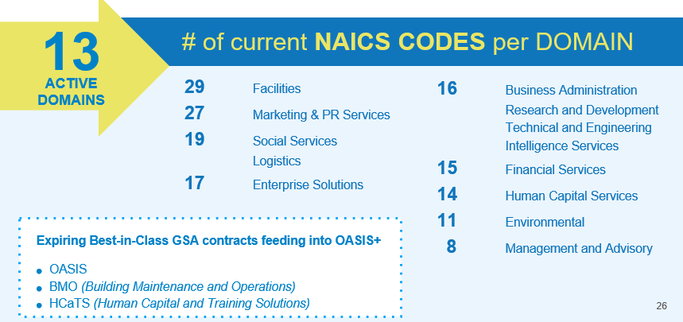
OASIS⁺ Key Domain Takeaways
Notes:
Speaker note: While Phase II domains went live on 12 January 2026, ordering from and getting adequate competition from these domains may take a little longer to get established. OCOs should plan for an adjustment period for vendors to onramp.

Slide 26
OASIS⁺ Ordering Procedures
1
2
3
4
Acquisition Planning | Market Research | Preparation | Solicitation, Evaluation, & Task Order Award
Determine if OASIS+ is the right fit Familiarize yourself with the OASIS+ scope, domains, labor categories, NAICS codes, and key features to fully understand the contracts. Research the OASIS+ contract features Explore the best contract for you by considering set-asides, contract types, performance periods, and order limits. Request a scope review GSA offers a free OASIS+ scope review to confirm if your requirement fits the contract scope. | Complete market research Explore the Federal market. Find data on business utilization, spending and use tools, and opportunities for subcontracting and joint ventures. Learn about pricing intelligence, scope reviews, and using GSA’s free Market Research as a Service (MRAS) resources to conduct Requests for Information (RFIs). | Obtain a Delegation of Procurement Authority (DPA) Be a warranted Contracting Officer as defined in FAR 2.101. Register (online) and attend OASIS+ DPA Training. Review the corresponding Delegation of Procurement Authority Ordering Guide for OASIS+. Submit documentation to GSA. Request DPA (online). | Develop and issue the solicitation Review the OASIS+ Ordering Guide, confirm requirements, create the solicitation, and release it via GSA eBuy. Award the task order Learn about the factors and requirements involved in proposal evaluation and task order award consideration. Manage the task order Understand the process for reassigning task orders, including admin, QA, subcontracting, evaluations, and closeout.

Slide 27
A Comparison of
Choices

Slide 28
OASIS⁺ A Quick Comparison
Features | MAS | OASIS+
Solicitation Procedures at the Master Contract Level and Commerciality | FAR Part 12, Acquisition of Commercial Products and Services and FAR Part 15, Contracting by Negotiation. Commercial only. | FAR 15, Contracting by Negotiation. Commercial and non-commercial services available.
Solicitation Closing Strategy & On-ramping | Open continuously, always accepting offers. | Solicitation closed after initial Phase 1 evaluations and awards. Reopening continuously for Phases 1 & 2 in Q2 FY2026.
Evaluation Methodology | Offers are awarded when the proposal is responsive to solicitation requirements, Offeror is technically capable, offerings are in scope of SINs proposed, and pricing is determined fair and reasonable. | All Qualified Offerors, with a Fair and Reasonable Price Offer must meet qualifying threshold using a combination of project and corporate-level criteria. Unique evaluation factors on a domain-by-domain basis. Same point-based, self-scoring scheme as HTRFRP with the differences being a required minimum score (qualifying threshold) and no cap on the number of awards.
Notes:
HTRFRP - Highest Technically Rated Proposal with a Fair and Reasonable Price

Slide 29
OASIS+ Comparison.
OASIS⁺ A Quick Comparison
Features | MAS | OASIS+
NAICS code assignment at the master contract level - Small Business size status | One preponderance NAICS assigned per contractor, based on their core business. Small Business size status reflective of that NAICS code. | One primary NAICS code assigned per contractors’ contract, multiple Contract Line Items (CLINs) and corresponding NAICS codes within each Domain (CLINs/NAICS are the fair opportunity pools). For Small Business (SB) IDIQs, Offerors only awarded CLINs where they represent as a SB concern for the size standard corresponding with each CLIN-associated NAICS code.
Scope | More than 250 available SINs, each with assigned NAICS associated with products/services offered under the SIN. | Domains are functionally aligned groupings of related non-IT services (ex: Tech and Engineering, Logistics, Management and Advisory, etc.), that include multiple, related, individual NAICS codes, referred to as FAIR OPPORTUNITY CLINs. Scope is professional and other Service Contract Labor Standards (SCLS) covered services. Does not include major construction or principal-purpose A&E services.
Contract Access Fee (CAF) | No direct CAF. Industrial Funding Fee (IFF) of 0.75% integrated into established MAS rates | 0.15% for all federal agencies. No separate negotiated rates.

Slide 30
OASIS+ Comparison..
OASIS⁺ A Quick Comparison
Features | MAS | OASIS+
Period of Performance Structure | Base of 5 years with three 5 year-options, and performance allowed on TOs for up to 5 years after master contract expiration. Orders may be placed up to the contract end date and are valid up to 60 months (including options) following the contract end date per clause 52.216-22 Indefinite Quantity. | Base of 5 years and one 5-year (or less) option. Task order PoP can extend up to 5 years and 6 months beyond the ordering period of the master contracts. IDIQ contract family end dates are coterminous.
Small Business Re-Representation Requirements at the Master Contract Level | Required by 52.219-28 60 to 120 days prior to the exercising of the option or for a novation or merger. | Required for the NAICS code corresponding with each awarded CLIN IAW 52.219-28, 60 to 120 days prior to the 5 year anniversary of the individual contract or for a novation or merger.
Dormant Status | Not applicable; cancellation clause is in the contract. | Dormant status and a cancellation clause are part of the contract terms and conditions.

Slide 31
OASIS+ Comparison…
OASIS⁺ A Quick Comparison
Features | MAS | OASIS+
Contract Structure | Unlimited contracts under the single MAS solicitation. | 6 IDIQ Contracts: Unrestricted Small Business (SB) SBA-Certified 8(a) SB SBA-Certified HUBZone SB SBA-Certified Service-Disabled Veteran-Owned SB SBA-Certified Women-Owned SB
Order Types Allowed | FFP, LH, T&M | FFP, LH, T&M, CR, Hybrids
Spend Under Management (SUM) | Tier 2, Multi-Agency Solution. Certain SINs and MAS BPAs are rated Tier 3 (BIC) | Tier 3, BIC solution
Protests | Protests allowed at any order dollar value. | Not allowed for in-scope orders less than $10 million.
Blanket Purchase Agreements | Allowed per GSAR 538.71 (prev. FAR 8.405-3) | Per RFO Guidance, OASIS+ now permits BPAs (16.507-2(c)(3)). (prev. Not allowed)
Notes:
For BPAs awarded to 8(a)s, offer and acceptance must occur at the BPA level and is not covered by the master contract. Under RFO 19.108-6 Basic ordering agreements and blanket purchase agreements:
(a) The contracting office must submit an offering letter for, and SBA must accept, each order under a basic ordering agreement (BOA) or a blanket purchase agreement (BPA) (see 12.201-1), in addition to the agency offering and SBA accepting the BOA or BPA itself.
(b) SBA will not accept for award on a sole-source basis any order that would cause the total dollar amount of orders issued under a specific BOA or BPA to exceed the competitive threshold amount in 19.108-7.
(c) Once an 8(a) participant's program term expires, the participant otherwise exits the 8(a) program, or becomes other than small for the NAICS code assigned under the BOA or the BPA, SBA will not accept new orders under the BOA or BPA for the participant.

Slide 32
OASIS⁺ Scope Reviews

Slide 33
OASIS⁺ Scope Reviews
GSA offers complimentary order level pre-solicitation scope reviews as part of our OASIS+ Program
Strongly recommended but not required
Helps ensure requirements are being placed under the appropriate contract vehicle
Scope Review Request Form

Slide 34
OASIS⁺ Buying Authority

Slide 35
OASIS+ Buy Authority.
OASIS⁺ Buying Authority
Orders placed under FAR 16.506 & 16.507 authority (GSA Class Deviation RFO 2025-16)
 | FAR Part 16.5 (OASIS+) | FAR Part 15
Solicitation Threshold | No limits; however, the recommended minimum order is the SAT ($350,000) | > SAT ($350,000) > $9M for commercial
Solicitation Period | No minimum required* Agency policy may differ | 30 days (non-commercial)
Synopsizing Required | Not required under RFO. | Yes, a synopsis is required under traditional FAR rules. Not required under RFO.
Formal Source Selection Evaluation Board (SSEB) Required | No | Yes, a formal SSEB is required under traditional FAR rules. Not required under RFO.
Conduct Discussions / Negotiations | Not required to set a competitive range and conduct formal “discussions” under 16.5, but negotiations are always encouraged! | Yes, discussions / negotiations required when establishing a competitive range.

Slide 36
OASIS⁺ Buying Authority
 | FAR Part 16.5 (OASIS+) | FAR Part 15
Source Selection | Agency discretion IAW FAR 16.507-2(a)(2) | Best Value Continuum
Contract formats | Task Order | Uniform Contract Format (UCF) required under traditional FAR rules. UCF is recommended, but not required under RFO.
Protests | Per FAR 16.508 Not authorized unless Order increases scope, period or maximum value of the contract or Order value is in excess of $10 million** May only be filed with GAO IAW FAR 33.105 Small business size status for set-aside orders (IAW FAR 19.201-2) | Authorized IAW FAR Part 33
Post Award | FAR 16.507-5(c) – for orders >$7.5 million Notifications and debriefings according to part 15 | Notifications IAW FAR Part 15.503 Pre-Award Debriefings IAW FAR Part 15.505 Post-Award Debriefings IAW FAR Part 15.506 RFO Pre-Award Notifications & Debriefings IAW 15.206 RFO Post-Award Notifications IAW 15.207-2 RFO Post-Award Debriefings IAW 15.301
** The $25M / $35M protest limit does not apply to orders placed under OASIS+ by any agency since GSA is the agency awarding the IDIQ contracts. OASIS+ orders are subject to the $10M threshold.

Slide 37
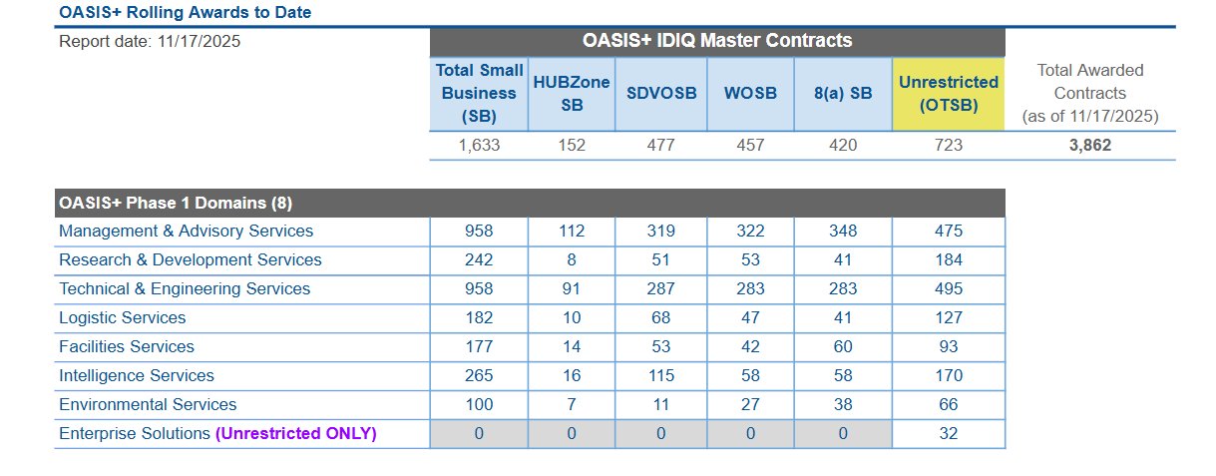
OASIS⁺ Awards by Contract & Domain
Note: OASIS+ Awardees have one or more Domains on their contract.

Slide 38
OASIS⁺ Delegation of Procurement Authority (DPA)
Ordering Contracting Officers (OCOs) must obtain a DPA prior to issuing task order solicitations under the OASIS+ Contract Vehicle. Ordering Contract Specialists assisting with solicitations in the OASIS+ task order management system must also attend DPA training. To obtain a DPA, the OCO must:
Attend OASIS+ DPA Training
Be a warranted Federal Contracting Officer per FAR 2.101
Formally apply for a DPA by providing the OCO Warrant Number and DPA Training certificate to GSA
Live OASIS+ DPA Training registration is available on OASIS+ website (Events and Training)
On Demand DPA Training is available through DAU/FAI CSOD under FAC 154
OASIS+ DPA Training also includes the link to the published OASIS+ Ordering Guide available on the OASIS+ website
All OASIS+ DPA Questions - Contact - OASISPLUSDPA@GSA.GOV

Slide 39
Resources

Slide 40
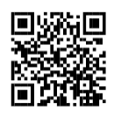
GSA Resources
Acquisition Planning
OASIS+ Website – one-stop shop!
OASIS+ Blog (Interact) – sign-up!
OASIS+ Fact Sheet (PDF)
OASIS+ Training
Request a Scope Review
Market Research Tools
Market Research as a Service (MRaS)
CALC+ Pricing Intelligence Suite
Data to Decision (D2D)
Preparation
Obtain an OASIS+ DPA
Solicitation, Evaluation, & Award
Review the OASIS+ Ordering Guide
Scan the QR code to check out the OASIS+ website for more information about the program

Slide 41
Social Media
BUY.GSA.GOV | Interact
Join the OASIS+ Interact Community
Follow us on X (formerly Twitter) @GSAProfServices
Follow us on LinkedIn #gsaprofessionalservices

Slide 42
Thank You!
Questions?

Slide 43
End of Presentation

