Slide 1
OneGov Strategy
One government.
One strategy.
Smarter buying.
Notes:
Hello, and thank you for joining us. We’re here to talk about how GSA’s OneGov Strategy is helping agencies buy smarter, modernize faster, and get better value from their IT investments.
This session isn’t just about procurement—it’s about transformation. Across government, agencies are working to simplify how they buy and manage technology. OneGov is GSA’s framework to make that easier: one coordinated approach that reduces duplication, improves transparency, and strengthens results for every agency.
When we act as one government instead of hundreds of separate buyers, we unlock real savings, stronger terms, and improved security. That’s what we mean when we say, Buy as One.

Slide 2



Presenters
Birgit Smeltzer
Ernest “Ro” Rosser
Jaime Martinez
Acting Director,
Office of IT Products
Subcategory
Office of Information
Technology Category
Chief, Cloud/Solutions
Development Branch,
Office of IT Products
Office of Information
Technology Category
Division Director,
Acquisition
Office of Information
Technology Category

Slide 3

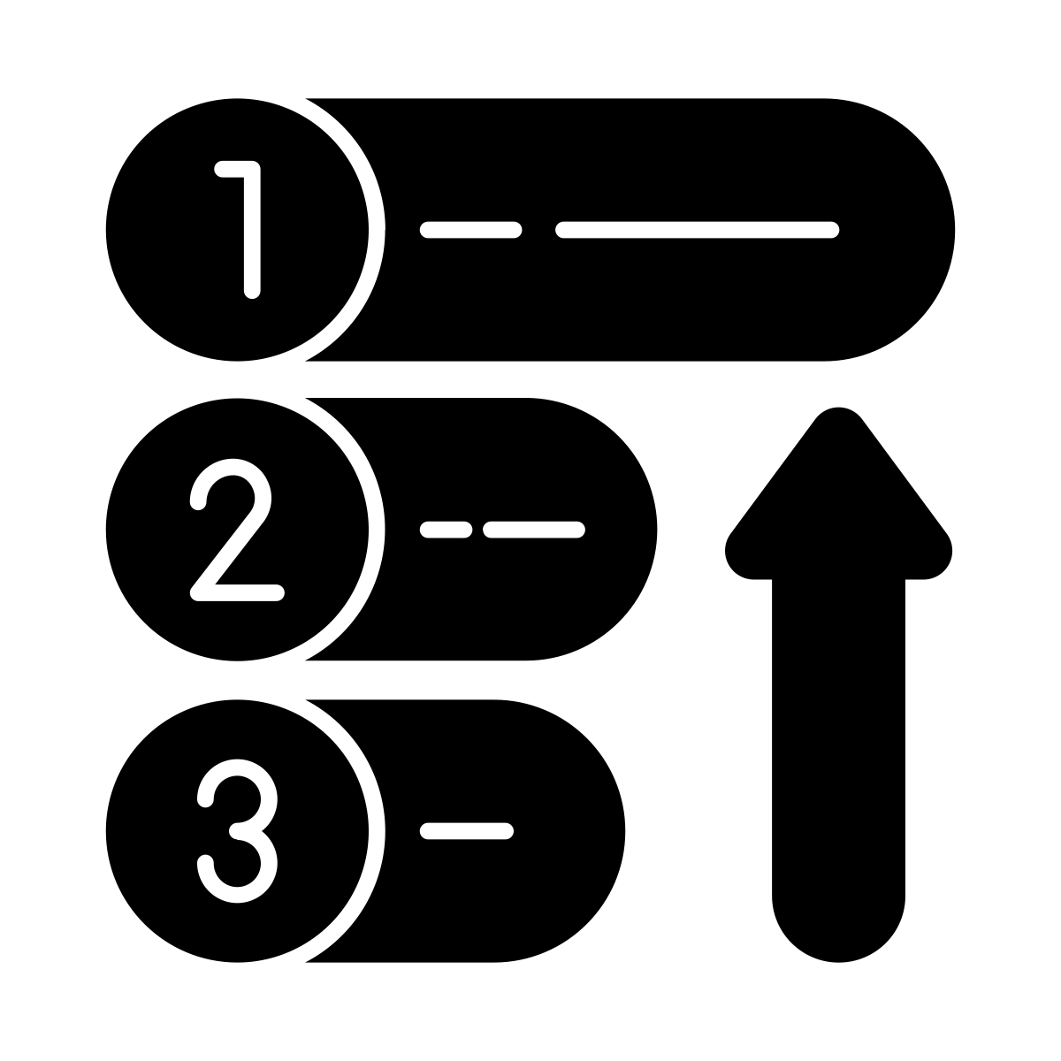


Agenda
The What, Why, When and How?
Priority Alignment
Initial Limited Time Offers
Driving Success Forward
Notes:
Over the next few slides, we’ll walk through what the OneGov Strategy is, why it matters, and how it’s already producing results across government. We’ll also highlight where we’re headed next—and how your agency can take advantage of the agreements and resources now available through OneGov.

Slide 4
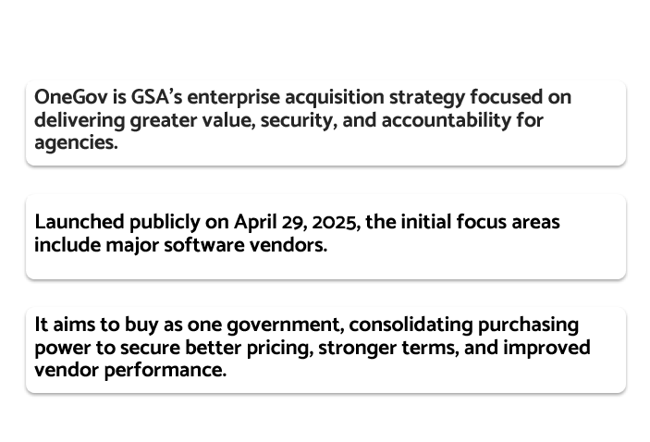
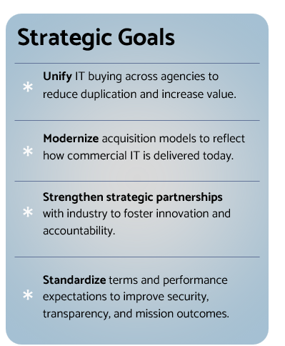
What is the OneGov Strategy?
Notes:
At its core, the OneGov Strategy is GSA’s governmentwide approach to modernizing how we buy and manage technology. It’s based on a simple idea: the federal government should act as one buyer when it comes to common IT needs.
Today, agencies often purchase the same software or services through separate contracts—each with different prices, terms, and performance requirements. That fragmentation drives up costs, limits visibility, and makes it harder to manage cybersecurity and industry partner accountability.
OneGov changes that. It unifies IT buying power under one coordinated approach—one that delivers consistent terms, stronger security, and better value for every agency.
We started with enterprise software—the area where duplication and inefficiency were most visible. From there, the model is expanding to include platforms, infrastructure, and cybersecurity.
OneGov is more than a policy—it’s a practical framework. It helps agencies access modern, secure solutions faster, while giving industry a clearer, more predictable path to partner with government.
It’s also about building trust. By buying as one, we send a unified demand signal to the market, making it easier for industry partners to offer their best pricing and performance up front—saving agencies time, money, and effort in the process.

Slide 5
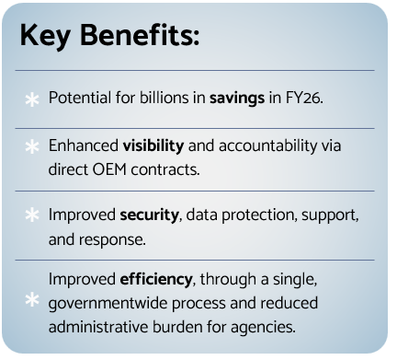
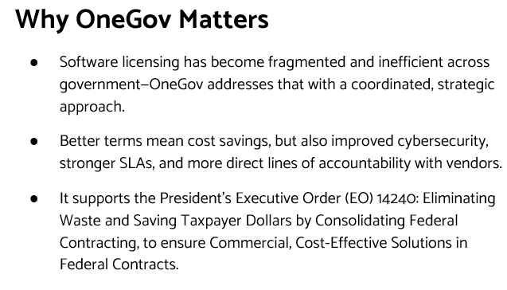
OneGov Strategy - “Buy As One”
Notes:
When we say Buy As One, we’re talking about more than just contracts. It’s a shift in how government approaches technology acquisition—moving from fragmented and reactive to coordinated, data-driven, and strategic.
For years, agencies have negotiated separate deals for the same software, often paying different prices for identical products. That’s not just inefficient—it makes it harder to plan and hold vendors accountable.
Under OneGov, the goal is to combine demand, share data, and negotiate directly with the Original Equipment Manufacturers who build and support the products we rely on.
That unified approach delivers four main advantages:
Better pricing, based on the government’s full buying power.
More Consistent terms, service performance, and accountability.
Improved security, through standardized protections and clearer vendor responsibilities.
Simpler engagement, saving time for both agencies and industry by reducing duplicative contracts and negotiations.
Buying as one gives us leverage and transparency. It ensures agencies of every size—whether a large department or a small commission—benefit from the same negotiated value.
And it strengthens accountability. When contracts are held directly with the OEM, responsibility for performance, security, and support sits where it belongs. That clarity builds confidence for both agencies and taxpayers.
The strategy directly supports Executive Order 14240, which calls on agencies to eliminate waste, consolidate procurement, and ensure commercial, cost-effective solutions. It’s GSA’s way of putting that directive into action.
Buy As One is about efficiency, fairness, and stewardship—showing that government can use its scale wisely to deliver better outcomes for every mission.

Slide 6
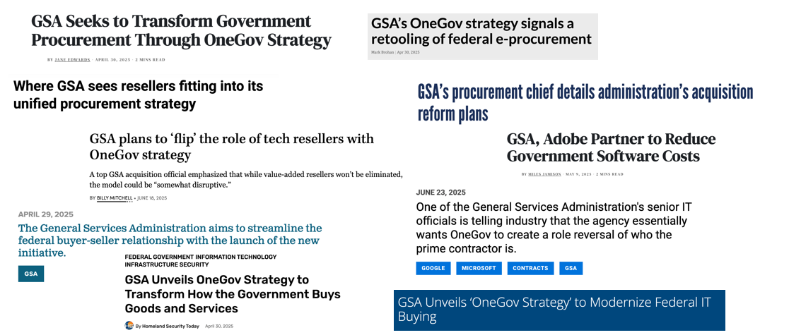
OneGov Strategy - In the news
Notes:
One of the clearest signs that this strategy is gaining momentum is the attention it’s getting across the federal IT and acquisition community.
OneGov has been featured widely — in trade publications, agency spotlights, and leadership forums — as a model for how coordinated government buying can deliver real results. Each story helps raise awareness and encourages more agencies to participate.

Slide 7


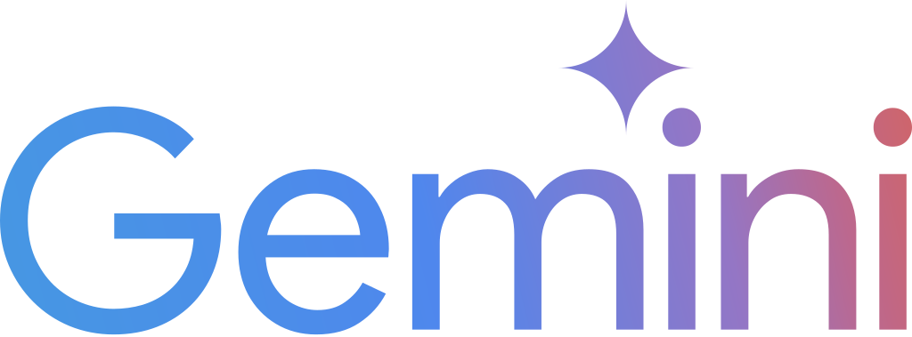

DOT’s OneGov success story
DOT awarded a five-year, $89M Google Workspace deal through GSA’s OneGov agreement
Achieved a 71% discount
Fast rollout: first users live in 30 days; full agency access in 60
Part of DOT’s “1DOT IT” transformation to modernize and centralize IT
Leaders say OneGov enabled the speed and scale to “get DOT to the finish line”
Notes:
You may have seen the coverage around DOT’s success with the Google Workspace agreement. That’s a great example of what’s possible when agencies tap into the OneGov framework.
DOT secured a five-year, $89 million deal that achieved a 71% discount — and they did it fast. The first users were live in 30 days, and full access was available in 60.
Leaders at DOT have said that OneGov gave them the scale and structure to “get to the finish line.” It shows how a coordinated, data-driven approach can translate directly into mission outcomes — saving money, accelerating modernization, and improving service delivery.
And that’s just one example. Every agreement we add, and every agency that participates, strengthens the case for OneGov and helps build the foundation for smarter, more unified buying across government.

Slide 8
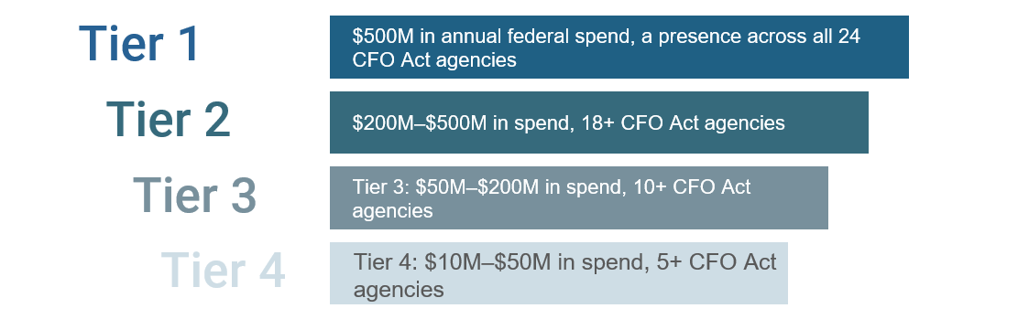
Tiers and IT Focus
The OneGov initiative has adopted a tiered model to prioritize OEM engagement based on governmentwide impact, spend, and agency footprint. Starting with software and cloud providers with FedRAMP-authorized cloud solutions (excluding on-premise offerings), this structures engagement into four tiers that reflective of relative scale and reach across the federal enterprise
Notes:
The next piece of the OneGov framework is how we focus our efforts — what we call our tiered engagement model.
The federal IT marketplace is vast, and not every software provider has the same governmentwide footprint or strategic importance. The tiered model helps us prioritize where to engage first, ensuring our resources are concentrated where they can deliver the greatest enterprise value.
Here’s how it works.
We’ve structured OneGov engagement into four tiers, based on overall government spend, agency reach, and impact on federal operations.
Tier 1 includes the largest OEMs with governmentwide contracts and mission-critical platforms — companies like Microsoft, Adobe, and Google. These providers touch nearly every agency and represent the greatest opportunity for standardization and savings.
Tier 2 covers OEMs with significant multi-agency use — often focused on specialized capabilities like cybersecurity, workflow, or analytics.
Tier 3 includes emerging or niche providers with growing federal adoption. These are innovators who may start with one or two agencies but can scale quickly under the OneGov model.
Tier 4 represents OEMs with smaller government footprints — typically those with between $10 million and $50 million in total spend across five or more CFO Act agencies.
The tiered model supports data-driven decision-making. As we collect more information on usage, cost, and performance, we can move OEMs up or down tiers based on measurable outcomes — keeping the strategy dynamic and accountable.
In short, this model gives us focus without rigidity. It lets us prioritize enterprise-scale contracts first, while still enabling innovation and competition from smaller players.
This is how we scale the strategy responsibly — starting where it matters most, then expanding outward as success compounds.

Slide 9
Direct Contract Vision
Privity of Contract - Single direct contract between GSA and OEM on the Multiple Award Schedule (MAS)
Reseller & Small Business Integration - Reseller, Integrator and Small Business support services built into the OEM catalog as subcontractors
Mandatory Use - Seeking OMB guidance for mandatory use for all federal agencies; single source for OEM's products and services
Price Reductions - Deep discounts from commercial pricing expected
Mature State - GSA will consolidate agency requirements and place orders on behalf of the government
Notes:
So, what does Buy As One look like in action? In the long run, it means direct contracts.
For years, agencies have often bought software through resellers — removed from the company that actually builds and supports the product. That distance created inefficiencies, added cost, and makes accountability harder to manage.
Under OneGov, GSA negotiates directly with the OEMs who design and deliver these technologies. Those agreements are then available for all agencies to use through the Multiple Award Schedule.
This approach gives agencies several key advantages:
Faster acquisition cycles because terms and pricing are already negotiated.
Stronger buying power by combining government demand under unified agreements that go well beyond the traditional thresholds.
Improved risk management through standardized language for cybersecurity, compliance, and performance.
Consistent pricing so every agency, regardless of size, gets the same negotiated value.
For industry, it provides clarity and predictability. OEMs know what’s expected, and resellers still have a defined role supporting delivery, integration, and mission services. The difference is that accountability and pricing now sit squarely at the top where it belongs.
This is a cleaner, more transparent model. Agencies gain speed and assurance, industry gains stability, and taxpayers gain value.
Direct contracting is how we take OneGov from principle to practice — aligning the government’s scale with the pace of the commercial IT world, while holding every partner to a common standard of quality and performance.

Slide 10
Benefits of MAS
US Government
Industry
Streamlined engagement with a single, coordinated governmentwide process instead of navigating multiple separate agency negotiations.
Clear and consistent requirements through standardized T&Cs, pricing structures, and compliance expectations.
Faster time to award due to pre-vetting and reduced administrative burden for each offeror.
Larger, more predictable demand signals driven by aggregated government needs and consolidated buying.
Less price variance pressure as unified purchasing reduces agency-by-agency renegotiation and one-off discount demands.
Improved relationship building with a centralized team that understands their portfolio and long-term roadmap.
Stronger buying power through coordinated, governmentwide negotiations that go beyond MAS’s $500K ceiling.
Consistent, fair, and reasonable pricing across agencies, reducing disparities for identical products.
Improved compliance and risk management through standardized terms & conditions.
Faster acquisition cycles with already approved and negotiated contracts with OEMs evaluated for experience, past performance, and quality control.
Greater transparency into pricing, terms, and vendor performance across government.
Reduced duplication of efforts—agencies no longer need to individually vet, negotiate, or reconcile terms.
Notes:
The Multiple Award Schedule — or MAS — remains central to how OneGov works. It’s the foundation that makes this strategy possible.
By using MAS, we’re able to streamline and scale our agreements with OEMs while keeping the acquisition process familiar and accessible to agencies.
Under the OneGov model, MAS offers clear advantages for both government and industry.
For agencies, it means:
Stronger buying power through coordinated, governmentwide negotiations that go beyond individual agency thresholds.
Fair, consistent pricing across agencies — no more paying different rates for the same product.
Improved compliance and risk management through standardized terms and conditions.
Faster acquisition cycles because the work of negotiating and vetting has already been done.
Greater transparency into pricing, vendor performance, and usage across government.
And for industry, the MAS framework simplifies engagement.
Fewer duplicative negotiations — one unified set of terms instead of dozens of separate agreements.
Predictable demand signals based on the government’s consolidated buying power.
A single, coordinated process that reduces administrative burden and allows companies to focus on delivery and innovation.
MAS is what allows OneGov to deliver scale with structure. It’s not reinventing federal procurement — it’s optimizing what already works, and using that platform to modernize how agencies and industry partner to achieve shared outcomes.

Slide 11
Impact
$508M
Cumulative savings achieved to date
19
# of active offers
Expanding Agency Awareness: Conducting targeted outreach to CIO, CAO, and procurement communities; integrating updates into IT Buyers CoP sessions, OEM briefings, and quarterly IT Category touchpoints.
Leveraging GSA’s AI platform to analyse FPDS data to understand spend type and product categories and contract expirations of the 24 CFO Act agencies across OneGov discount OEMs to appropriately target agences that could make use of the discounts
Notes:
Here’s what this strategy is delivering today.
Through OneGov, agencies have already achieved more than $500 million in cumulative savings — real, measurable results from unified buying and direct OEM negotiations.
We now have 19 active offers across major IT categories, including software, cloud services, cybersecurity, and digital tools. Each one represents negotiated terms and pricing that any agency can use right now.
We’re also expanding awareness and adoption across government. The ITVMO team is working closely with CIOs, CAOs, and procurement leaders to make sure every agency knows how to take advantage of these offers.
We’re using GSA’s AI-powered data tools to analyze federal spending patterns and contract expirations across the 24 CFO Act agencies. That helps us identify where opportunities exist — and when agencies can time their transitions to maximize value and avoid duplication.
This isn’t just about numbers on a slide. It’s about agencies getting what they need faster, for less, and with stronger performance guarantees. Every success strengthens the model and brings us closer to a truly unified federal IT marketplace.

Slide 12
Four Year Roadmap
FISCAL YEAR 2025 - 2028 INITIATIVE
Initiation & Program Launch: Launched in early 2025, the OneGov strategy defined GSA’s government-wide approach to modernizing IT acquisition and management.
Initial OEM Onboarding: Work with OEM to negotiate pricing and T&Cs and pave the way for direct contracts
Agency Engagement: Manage the collection of agency requirements
Consolidated Buying: Issue a govwide 12-month purchase orders
Four-year Maturity
Roadmap
Notes:
So where do we go from here?
This roadmap outlines how OneGov will continue to mature over the next four years — from early implementation to full governmentwide adoption.
We launched the program in early 2025 with a clear focus on software — establishing our first direct OEM agreements and proving that unified buying works.
That launch phase was about setting the foundation: negotiating initial pricing and terms, testing the process, and showing quick wins.
From here, we move into broader engagement and consolidation.
Agencies are now identifying requirements together, coordinating purchases, and timing renewals to align with existing OneGov agreements. This shift reduces duplication, smooths transitions, and maximizes savings potential.
Over the next two years, we’ll continue onboarding additional OEMs, expanding coverage across platforms, infrastructure, and cybersecurity.
By fiscal year 2028, the goal is a fully mature model — where federal IT buying operates as one coordinated ecosystem, supported by a consistent playbook and shared data.
Each year brings greater efficiency and greater value.
We’re creating a marketplace where agencies don’t have to start from scratch each time they buy software or cloud services — they can plug into a proven framework that delivers speed, transparency, and accountability.

Slide 13
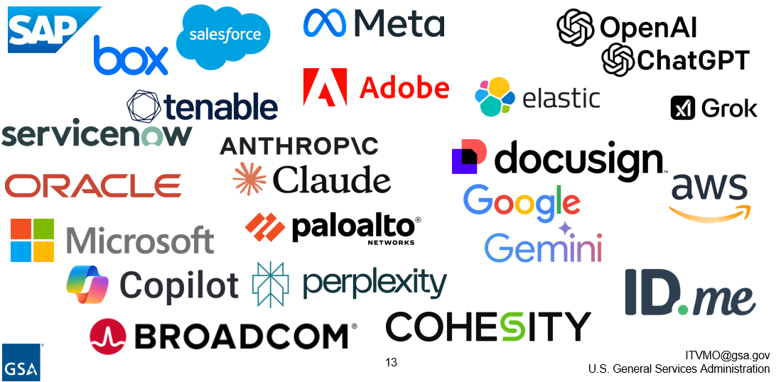
Negotiated Limited-Time Offers
Notes:
Here’s a look at the growing lineup of OneGov agreements now available to agencies.
We’ve negotiated offers with more than a dozen leading technology providers — from productivity and collaboration platforms to cybersecurity, AI, and cloud solutions.
Each of these represents a direct negotiation between GSA and the OEM, with pricing and terms that any agency can use. These are not pilot projects — they’re live, operational offers delivering results today.

Slide 14
Observations and Enterprise Insights
Limited Time Offers:
Unbundled deals allow for increased agency utilization
Extended availability of deals increases agency access
Include products that are currently used by agencies
Direct Contracts:
Need to define channel participation clearly
OEMs lack infrastructure to immediately assume reseller duties
Opportunity for increased OEM support through policy alignment
Notes:
As we’ve implemented these offers, we’ve learned a lot about what’s working — and where there’s room to refine the model.
On the limited-time offers, three things stand out:
First, unbundling deals has increased agency participation. The goal is for agencies to buy only what they need, when they need it.
Second, extending the availability period gives agencies more flexibility to plan purchases and renewals.
And third, these offers are most successful when they focus on products that agencies already use — making the transition simple and the benefits immediate.
On the direct contract side, we’ve identified a few important lessons:
We need to clearly define channel participation so that resellers and small businesses remain integral parts of the ecosystem.
Many OEMs are still building the internal infrastructure to manage direct federal contracting. That’s a growing edge — not a roadblock.
And there’s a real opportunity to strengthen alignment between OEM support, policy guidance, and agency adoption.
These insights are helping us fine-tune the approach, remove friction, and ensure the OneGov model continues to evolve in a way that works for agencies, industry, and taxpayers alike.

Slide 15
What’s Next?
UPCOMING INFORMATION SESSIONS
Ongoing Educational Webinars
gsa.gov/events
Agency Office Hours
Sign Up
NVSBC DC Metro Engagement Dinner & Training Academy
Wednesday February 11, 2026 from 06:30 PM - 20:30 PM
Alliance for Digital Innovation
Wednesday March 4, 2026 from 03:00 PM to 04:30 PM
AFCEA Monmouth
TBD - March
ITVMO Annual Summit
Tuesday, March 31, 2026
Multiple software OEMs in the pipeline
Expand beyond software: hardware, infrastructure, cybersecurity
Work with OMB to make OneGov mandatory for agency use
Continue advancing a unified approach to IT buying to lower costs and increase transparency
For updates and more information visit: https://itvmo.gsa.gov/onegov/
Notes:
So, what’s next for OneGov?
We’re continuing to expand the model — both in scope and in reach. Multiple new software OEMs are already in the pipeline, and we’re working closely with agencies to identify where the next set of agreements can have the biggest impact.
Again, we’re also broadening beyond software. The same coordinated approach that’s proven successful here will extend to hardware, infrastructure, and cybersecurity — helping agencies modernize across the full IT landscape.
GSA is partnering with OMB to explore policy guidance that would make OneGov the standard approach for common IT buying across government. That means more consistency, more transparency, and more value for agencies of every size.

Slide 16
Q&A
RESOURCES
For updates and more information visit: https://itvmo.gsa.gov/onegov/
Who should use the offers: Current Agreements
To get in touch: cloudinfo@gsa.gov for deal specific inquiries and itvmo@gsa.gov for general inquiries
Notes:
That brings us to your questions.
OneGov is an ongoing, evolving effort — and your feedback is an important part of shaping where it goes next. We know every agency’s situation is a little different, so this is the time to ask about how these agreements or processes can support your specific needs.
If you’d like to explore more after today’s session, you can visit itvmo.gsa.gov/onegov for updates, active agreements, and resources.
For deal-specific questions, reach out to cloudinfo@gsa.gov, and for general inquiries, itvmo@gsa.gov connects you directly with our team.
Whether you’re ready to adopt one of the current offers or just want to better understand how OneGov fits into your agency’s plans, we’re here to help make that process easier.
Thank you again for taking the time to be part of this conversation — and for your role in helping government buy smarter and deliver better results for the public.

