Slide 1


Quest for Clarity: Asking the Right Procurement Questions at the Right Time
Office of Integrated Marketing
July 15, 2024

Slide 2




Presenters
Monica Taylor
Senior Innovation Coach
Procurement Innovation Lab
DHS Office of the Chief Procurement Officer
Tracey Harriot
Protocol Lead
Procurement Innovation Lab
DHS Office of the Chief Procurement Officer

Slide 3



What?
So What?
BJECTIVES
This makes it difficult to meaningfully determine which vendor is best suited for the work.
Now What?
When issuing solicitations, we often use broad evaluation criteria that leads to industry submitting broad proposal responses.
This session will teach you how to formulate evaluation criteria that asks vendors the right questions so that you will receive better proposals and award to the best vendor possible.

Slide 4


Summer Camp Itinerary
Overview of the PIL.
The Quest for Clarity Begins!
Interview-Style Questions.
Camp Activity Time!
Campfire Knowledge Check.
S’more Ways to Make Procurements Efficient.
Periodic Table of Acquisition Innovations.
Wrap-Up for Your Next Adventure.

Slide 5

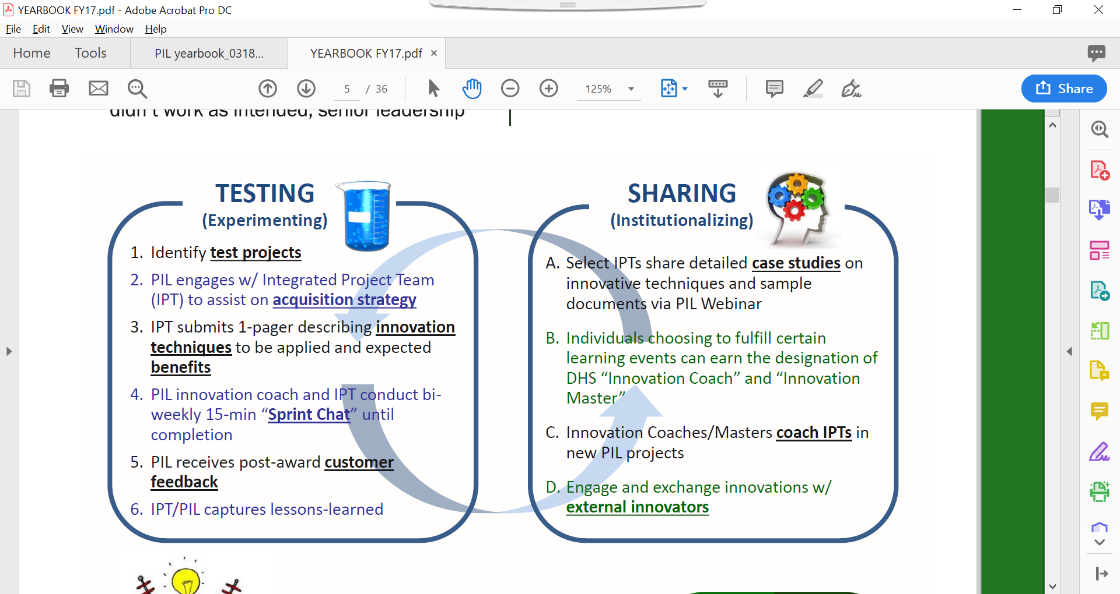
PIL Concept of Operations (ConOps)
What is the PIL?
A virtual lab where the DHS acquisition community can have a safe space to test new ideas, share lessons learned, and foster cultural change to promote innovation and managed risk-taking through a continuous feedback cycle.
PIL Mission:
To foster a culture of procurement excellent where smart risk-taking and innovation assure DHS mission success.
PIL Focus:
The obtain phase of the Acquisition cycle:
Solicitation → Evaluation → Award
  Lower entry barriers for non-traditional and innovative contractors.
  Shorten the time-to-award, thereby delivering capabilities to customers faster.
  Encourage competition by providing interested vendors with a better understanding of the goals and objectives for each procurement.
  Increase the likelihood of successful outcomes by focusing on evaluation techniques to identify the most qualified contractors.

Slide 6
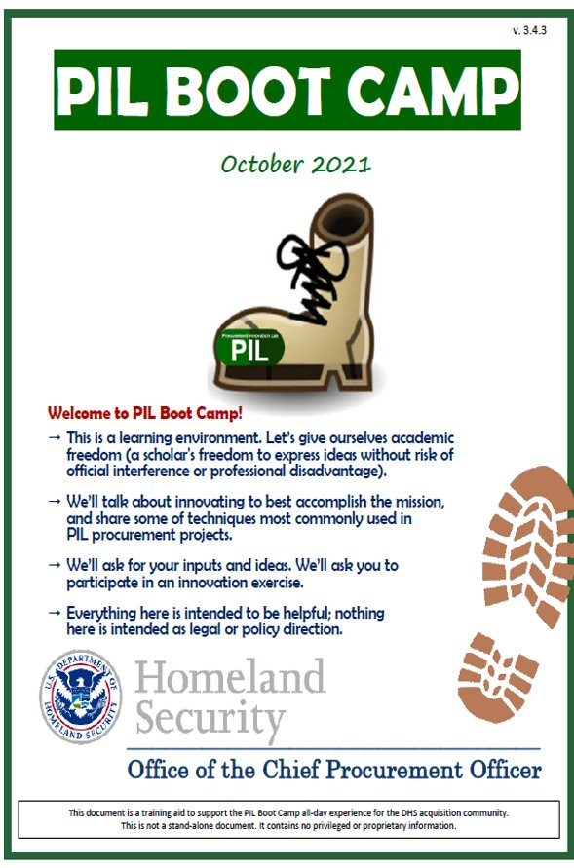
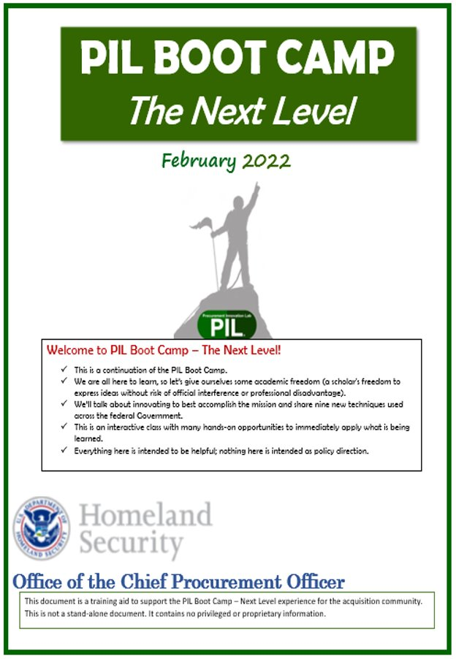

Foundational PIL Training
PIL Boot Camp & The Next Level
19 Successfully tested Techniques
Oral Presentations
Technical Demonstrations
Confidence Ratings
Down-Selects
Comparative Evaluations
Select Best-Suited, Then Negotiate
On-the-Spot Consensus
Streamlined Documentation
Discovery
Group Oral Debriefings
Betterment
Affordability
Mission Focused Evaluation Criteria
Involve End Users (JAM Sessions)
Highest Technically Rated with Fair and Reasonable Pricing
Rates Only Pricing
Share Evaluation Documentation
Enhanced Contract Type Conversation
Leveraging Procurement Flexibilities
1
-
10
11
-
19

Slide 7

The Quest for Clarity Begins!

Slide 8
Which question would you ask?
A friend invited you to a summer picnic at a Big Views Park outside of town. You’ve never been to this park before. While driving there, your phone lost its signal and now you need to stop at the next gas station to ask for directions.
Which question do you think will provide you with the best information to get to the park?
Question A:
Which way is the park?
Question B:
Which road and highways do I need to take to get to Big Views Park?

Slide 9



What are Interview-Style Questions?
Interview-style questions make your technical evaluations factors more meaningful.
Use your mission to provide context and ask targeted questions about areas such as the offeror’s related experience or a specific solution.
Can be used in Request for Information (RFIs), Market Research, Solicitations, and More!
Easier for program offices to articulate meaningful criteria.
Easier for offerors to understand requirements and provide relevant proposals.
Easier for evaluators to evaluate.

Slide 10

Fireside Stories with Real Use Cases
Explorer Logs with Interview-Style Questions

Slide 11



Using Interview-Style Questions for Market Research
Request for Information Sample from FLETC Enterprise Information Technology Support Services
RFI Text
What is the size and classification of your business (Identification of socio-economic status)?
What strategic sourcing vehicles (SSVs), government-wide acquisition contracts (GWACs), indefinite-delivery/indefinite-quantity (IDIQs)contracts, or other contract vehicles are you a part of?
What information would you need from FLETC to supply pricing estimates for the enterprise IT support services and solutions described in this RFI?
Many of the enterprise IT support services and solutions are delivered onsite, but FLETC is seeking cost and performance optimizations by utilizing remote workers when appropriate.
a. Can you support onsite and remote worker staffing to meet FLETC’s enterprise IT requirements?
b. How would you address geographic staffing challenges in remote locations like Brunswick, GA, and Artesia, NM, that require on site support?

Slide 12


Using Interview-Style Questions in Solicitations
Solicitation Sample from FEMA COVID-19 Vaccination Campaign (FAR 15.3)
Phase 1, Factor 1: Corporate Experience (Instructions to Offerors)
The Offeror shall submit a written submission, totaling no more than five (5) pages (excluding the cover page), detailing their EXPERIENCE by addressing the topics below.
Using specific examples that are verifiable, describe your corporate experience obtaining medical personnel with the following certifications to support national medical response efforts: Physician, Dentist, Pharmacist, Paramedic …
Using specific examples that are verifiable, describe your corporate experience deploying thousands of medical staff capable of safely administering a vaccine to patients across dispersed locations within a 72-hour period.
Using specific examples that are verifiable, describe your corporate experience staffing medical personnel to the 48 contiguous states within FEMA Regions 1-5 or Regions 6-10 in a saturated market.
If proposing for Regions 1-5, using specific examples that are verifiable, describe your corporate experience staffing medical personnel to the following U.S. territories in a saturated market: Puerto Rico and U.S. Virgin Islands (Region 2).
Using a specific example that is verifiable, describe an instance in your corporate experience where you did not meet contract requirements under performance of a medical services contract and how you identified, communicated, addressed, mitigated and resolved the failure.

Slide 13


Using Interview-Style Questions in Solicitations
Solicitation Sample from FLETC Transportation Services - Glynco GA (FAR 15.3)
Factor 1: Prior Experience (Instructions to Offerors)
In addition, offerors should incorporate a response to the questions below :
Background: The FLETC Glynco campus is located approximately five minutes north of Brunswick, Georgia in Glynn County and is equal distance between Savannah, Georgia, and Jacksonville, Florida. The Contractor shall provide the management, supervision, all personnel, equipment, tools, materials, and other items and services necessary to support the operation of the Transportation Motor Pool (TMP) in accordance with the performance work statement. These services are critical. Increased student load, Hurricane Evacuations of Students, Government Shutdowns and Re-Opening which causes heavy load of students returning to Center from airports and Long-Distance Off-Center Lodging requirements. All of these are issues that the Contractor must be able to handle.
Question 1: Schedule Changes: What experience does the offeror have managing schedule changes? How did you handle las minute schedule changes? How did the offeror handle things such as inclement weather? Share any lessons learned.
Question 2: Personnel Transport: What experience does the offeror have in transporting large student loads? How did your organization handle transporting large student loads timely when there were buses not working? Share Any lessons learned.

Slide 14


Using Interview-Style Questions in Solicitations
Solicitation Sample from USCG AUXDATA II (FAR 8.4)
Factor 2: Technical Solution (Evaluation of Offerors)
The Government will assess each Offeror’s demonstration for its confidence in the proposed technical solution and its ability to meet the mission needs of the Auxiliarists based on the technical demonstration and responses to questions. This includes the following characteristics:
Fitness: Does the technology address the problem at hand, or is it being used for an unintended purpose?
Simplicity: Is the design of the solution easily understood?
Usability: Is the solution intuitive and easy to use? Will individuals with little technical understanding be able to use it with minimum guidance?
Adaptability: How easily can the solution modified to meet new requirements or requirements of similar workforce management systems.

Slide 15

Camp Activity Time!
Interview-Style Questions in Practice

Slide 16



What are some ways you can ensure your team is asking the right questions when creating evaluation criteria?

Slide 17

Summer Vacation – Where Should We Go?!
It’s time for a summer vacation with a few of your favorite coworkers! The group is interested in booking a fun summer vacation for six adults. The group is looking for a 1-week stay but is not sure what type of lodging they want or what type of activities that may be available. The team has decided to conduct market research by issuing a Request for Information (RFI) on the official website for Travel Agents USA with the hope that various types of vacation facility vendors will respond.
Market Research Activity: Facilitate a meeting with your team to determine what interview-style questions the vacation facility vendors in a RFI that will help define our requirements and craft an effective evaluation strategy.

Slide 18
Summer Vacation – Where Should We Go?!
Requirements:
Questions to Vendors in RFI:

Slide 19



RFI Methods for Consideration
Have you used any other methods?!
Written response via email.
Digital Application RFI.
Phone Calls.

Slide 20

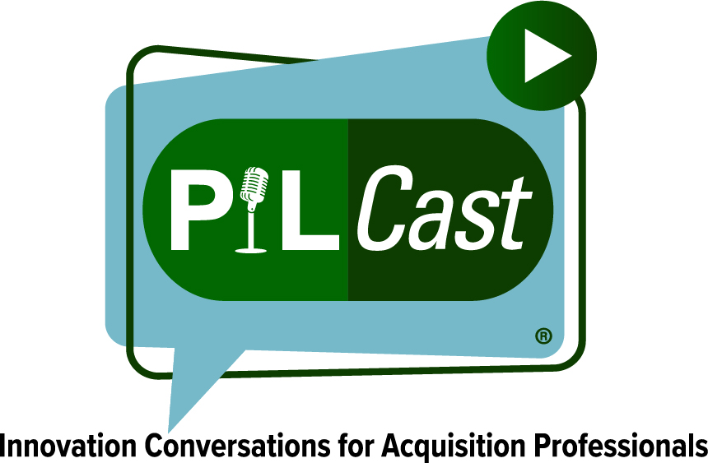





Digital Application RFI
Use a digital application for easy collection and analysis of meaningful vendor communication and feedback.
Ideal for –
    Seeking sources.
    Identifying small business and socioeconomic designations.
    Asking for specific capability information.
    Asking for feedback on draft documents.
    Following up after an industry day.
Benefits
Reduces submission costs for industry.
Reduces time to review for government teams.
#49

Slide 21

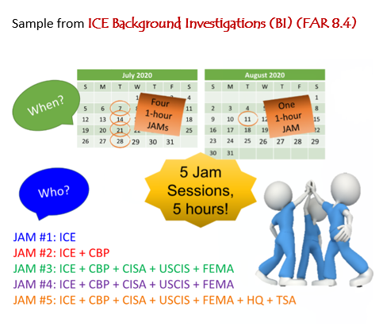

JAM Sessions
Joint Application Modeling (JAM) Sessions are one way of involving end users in your acquisition process.
Most often used for formulation of evaluation criteria, including the use of interview-style questions.
Short and Focused (1-2 hours max).
Other areas to use JAM Sessions:
  Requirements definition.
  Market Research/RFI Formulation.
  Acquisition Strategy.
  PR package creation.
  And more!

Slide 22

Summer Vacation – We Know What We Want!
The Summer Vacation requirements market research is complete! We now understand what is available in the marketplace and decided we want the following:
The group requires all-inclusive lodging for 6 adults for 7 days and 6 nights.
The group requires roundtrip airport transportation to and from the vacation destination.
The group desires no more than 2 adults per room.
The vacation must include daily group activities such as an aerobic class and swimming.
On-site food options must be available 24/7.
Solicitation Activity: Conduct a Jam Session to determine what interview-style questions the group will include in the solicitation that will help us evaluate the offerors’ proposals.

Slide 23
Summer Vacation – Jam Session
What should we consider evaluating?
How should we evaluate it?
Written vs Oral proposals?
Interview-Style Questions for the Solicitation’s Evaluation Criteria

Slide 24
Summer Vacation – What are our options?!
The Summer Vacation requirements has been posted on the Travel Agents USA website. The evaluation factors include the following interview-style questions:
Factor 1: Prior Experience (Written)
a. How has your location handled disruptions in food availability and food service interruptions? What were the results?
Factor 2: Technical Approach (Oral Presentation)
a. The group requires access to vegan and gluten-free dining options. How does your location ensure vegan and gluten-free options are always available?
b. What is your approach to handling overbookings? What steps are taken to minimize impact to travelers when rooms are unavailable?
Evaluation Activity: Determine which vendor best responded to our interview-style questions and will meet our requirements.

Slide 25

Summer Vacation – Vendor A
Vendor A: Whimsy Cove Retreat
Factor 1: Prior Experience Proposal
Whimsy Cove has an extensive supply chain including partnerships with local farms as well as nationwide distributors. During a tropical storm last year, we were not able to source bananas for our weekly banana pancakes breakfast special! Our team was quickly able to work with local farmers to source apples and changed our menu to apple pie pancakes instead. We were able to offer a similar style of breakfast special and guests loved it!
Factor 1: Prior Experience
a. How has your location handled disruptions in food availability and food service interruptions? What were the results?
Factor 2: Technical Approach
a. The group requires access to vegan and gluten-free dining options. How does your location ensure vegan and gluten-free options are always available?
b. What is your approach to handling overbookings? What steps are taken to minimize impact to travelers when rooms are unavailable?

Slide 26

Summer Vacation – Vendor A
Vendor A: Whimsy Cove Retreat
Factor 2: Technical Approach Proposal
Whimsy Cove offers delicious dining around the clock, including gluten-free, nut-free, dairy-free, and vegan options! We have dedicated storage and prep space to reduce cross-contamination as much as possible. We work with our supply chain managers to ensure multiple dietary options are available for every meal.
Whimsy Cove never overbooks! If a room is unavailable at time of arrival, guests are welcome to use all amenities until the room is ready. Although it has never happened before, we also have staff housing on-site that could be used for guest overflow.
Factor 1: Prior Experience
a. How has your location handled disruptions in food availability and food service interruptions? What were the results?
Factor 2: Technical Approach
a. The group requires access to vegan and gluten-free dining options. How does your location ensure vegan and gluten-free options are always available?
b. What is your approach to handling overbookings? What steps are taken to minimize impact to travelers when rooms are unavailable?

Slide 27

Summer Vacation – Vendor B
Vendor B: Relaxing Retreat
Factor 1: Prior Experience Proposal
Relaxing Retreat grows as many fruits, vegetables, and herbs as it can right here on our property. This helps ensure both the quality and availability of ingredients. We also have seven local suppliers that provide us with meat, dairy, and additional items.
When products become unavailable, our head chef changes the menu based on what items are on hand. We once had to change steak night to spaghetti night, but our guests seemed happy with the change.
Factor 1: Prior Experience
a. How has your location handled disruptions in food availability and food service interruptions? What were the results?
Factor 2: Technical Approach
a. The group requires access to vegan and gluten-free dining options. How does your location ensure vegan and gluten-free options are always available?
b. What is your approach to handling overbookings? What steps are taken to minimize impact to travelers when rooms are unavailable?

Slide 28

Summer Vacation – Vendor B
Vendor B: Relaxing Retreat
Factor 2: Technical Approach Proposal
As we grow much of our produce on our property, Relaxing Retreat always has vegan and gluten-free options on hand. Guests are welcome to pick fruit right off the trees for a healthy snack at any time!
Relaxing Retreat has 6 villas, and each villa has 8 standard rooms. Each room in the villas holds up to 3 guests. For a large group such as yours, if a room was not available, we would set up additional beds in the rooms we do have so that all have a place to sleep comfortably.
Factor 1: Prior Experience
a. How has your location handled disruptions in food availability and food service interruptions? What were the results?
Factor 2: Technical Approach
a. The group requires access to vegan and gluten-free dining options. How does your location ensure vegan and gluten-free options are always available?
b. What is your approach to handling overbookings? What steps are taken to minimize impact to travelers when rooms are unavailable?

Slide 29

Summer Vacation – Vendor C
Vendor C: Seaside Shanties
Factor 1: Prior Experience Proposal
Seaside Shanties is in a remote location and has experienced several food disruptions in the past. Once, a tree fell across the access road and we could not receive deliveries for a week! We were able to partner with local fisherman to have items delivered by boat instead. Not only that, but the fishermen also operated as a temporary shuttle for staff and guests to ensure normal operations during this time. Guests loved the sea shuttle so much, so we added it as a full-time option
for arrivals and departures!
Factor 1: Prior Experience
a. How has your location handled disruptions in food availability and food service interruptions? What were the results?
Factor 2: Technical Approach
a. The group requires access to vegan and gluten-free dining options. How does your location ensure vegan and gluten-free options are always available?
b. What is your approach to handling overbookings? What steps are taken to minimize impact to travelers when rooms are unavailable?

Slide 30

Summer Vacation – Vendor C
Vendor C: Seaside Shanties
Factor 2: Technical Approach Proposal
Seaside Shanties’ rotating menu is primarily focused on the availability of local fish. We offer a minimum of one vegetarian option per meal but can accommodate vegan preferences with advanced notice. Guests with gluten sensitivities will be happy to know we offer an extensive gluten-free menu at all times!
Seaside Shanties operates a second property one mile away called Beachside Bungalows. In the event of overbooking, we will provide lodging and services at this location. A shuttle between resorts is available daily from 9 am to 11 pm.
Factor 1: Prior Experience
a. How has your location handled disruptions in food availability and food service interruptions? What were the results?
Factor 2: Technical Approach
a. The group requires access to vegan and gluten-free dining options. How does your location ensure vegan and gluten-free options are always available?
b. What is your approach to handling overbookings? What steps are taken to minimize impact to travelers when rooms are unavailable?

Slide 31






Which Vendor would you pick?!
Vendor A: Whimsy Cove Retreat
Vendor B
Relaxing Retreat
Vendor C
Seaside Shanties

Slide 32

Vendor Feedback on Interview-Style Questions
“The three questions they asked were easy to answer and we got to share a lot about our experiences. We were able to answer effectively about some of our innovations and felt we addressed their need.”
“I will always take draft documentations and the opportunity to provide feedback on market research.”
“It was effective. Allowed the bidders to define a detailed outline that addressed the evaluation criteria and scope areas within the task area responses.”
“The 500-word limit made it difficult to convey all the different potential points that one might want to share in that. While there is some benefit to keeping it short and sweet, I felt that we had a really difficult time trying to convey as much as we might have wanted to in order to try to address each of the points an evaluator might be interested in... “
Share the Draft Solicitation with Industry!
“We thought it gave real life application to the RFP. It was a good attempt to get feedback from the contractors on their view of the solicitation and what input they had.”

Slide 33

Campfire Knowledge Check

Slide 34


Campfire Knowledge Check #1
Interview-Style Questions can be used:
In Request for Information (RFIs).
During Market Research One-on-Ones.
As a part of the solicitation evaluation criteria.
All of the Above.

Slide 35
Campfire Knowledge Check #2
True or False:
Interview-style questions can make your technical evaluation factors more meaningful.
True
False

Slide 36
Campfire Knowledge Check #3
Which of the following is a benefit of using Interview-Style Questions?
Easier for program offices to articulate meaningful criteria.
Easier for offerors to game the system and change the requirements.
Easier for offerors to understand requirements and provide relevant proposals.
Easier for evaluators to evaluate.
X

Slide 37

Campfire Questions?

Slide 38


S’More Ways to Make Your Procurements Efficient
Efficient Procurement Model

Slide 39
What?
So What?
BJECTIVES
No matter how perfect a team's evaluation documentation may be, longer timelines become costly for vendors which leads to increased doubt and the risk of a protest. Additionally, your agency's mission suffers.
Now What?
Use of innovative procurement techniques alone do not guarantee an efficient procurement.
This segment will teach the soft skills that need to be used in conjunction with the innovations to help your team achieve an efficient procurement timeline and mission success.

Slide 40


FEMA Doctrine Support Services

Slide 41

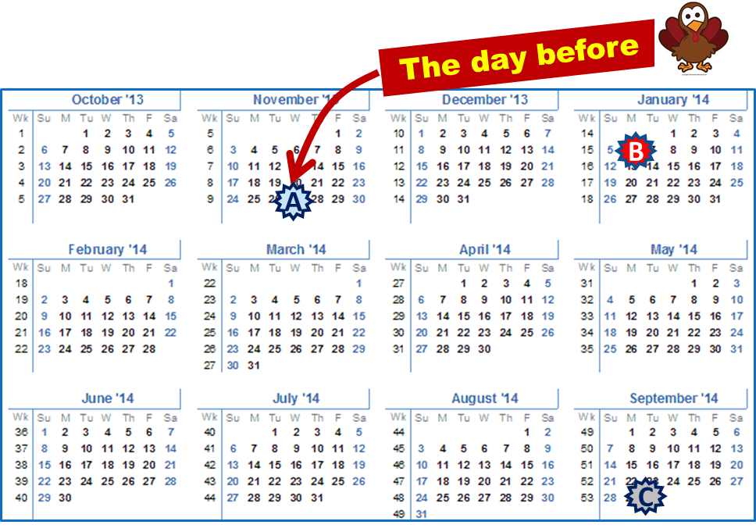
How FEMA Bought it Last Time
FEMA Doctrine Support Services
Open-Market, FAR 15.3, IDIQ, Single-Phase, $14M.
4 Factors – Technical Capability, Document Project Mgmt. Plan, Past Performance, Price.
  25 pages + PPQs + Resumes.
Traditional adjectival ratings (Outstanding, Good, etc.).
22 Proposals Received.
A
  RFP Issued
  Proposals Due (39 Days)
  Award (269 Days)
  Total = 308 Days
B
C

Slide 42

FEMA’s Recompete Approach
PHASE 1 - Written
Factor 1: 5-Page Relevant Experience
Factor 2: 5-Page Concept Paper
PHASE 2 – Oral Presentations
Factor 3: Oral Presentation on Tech & Mgmt.
Factor Questions: On-the-spot and interactive dialogue
Factor 4: Capability of Key Personnel
Factor 5: Past Performance
Factor 6: Price
18
7 Days
Advisory Down-Select
Interactive Dialogue!
3
  Tradeoff Selection Decision based on all Factors.

Slide 43
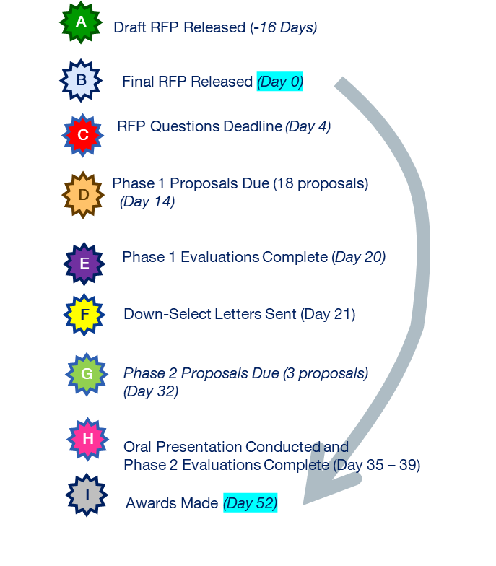
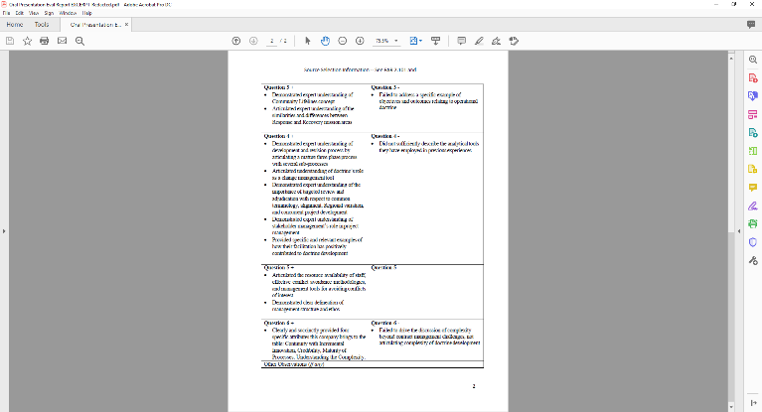
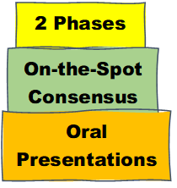
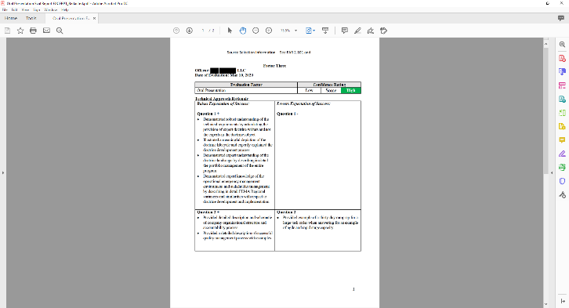
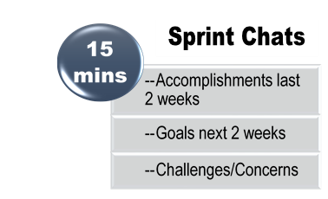
FEMA’s Streamlined Timeline
A
B
Streamlined Documentation
C
D
E
F
G
H
H
H
I

Slide 44

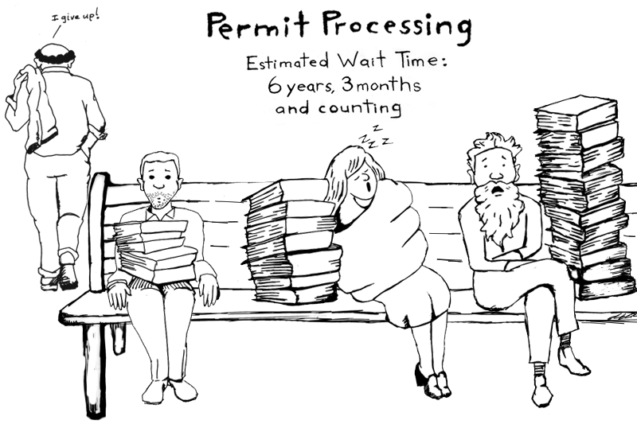
Efficient Procurement Model Innovations
Oral Presentations
Down-Selects (Advisory or Firm)
On-the-Spot Consensus
Confidence Ratings
Streamlined Documentation

Slide 45
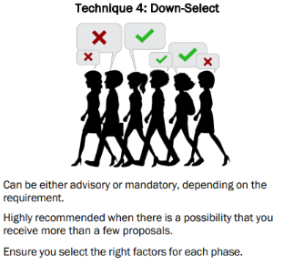


Efficient Procurement Model: Down-Selects
Innovation Technique 4 —
Down-Select
Implementing a phased proposal submission and evaluation process is a best practice for almost any procurement. Both types of down-selects (firm and advisory) save significant time, money, and risk by reducing the resources, documentation, and time for both Government and industry. This technique has been broadly adopted across the Federal government as its value proposition is easily felt by all stakeholders.
Power Skills
Ask vendors how they would like to be evaluated in each phase.
Understand the marketplace to determine the appropriate type of down-select.

Slide 46
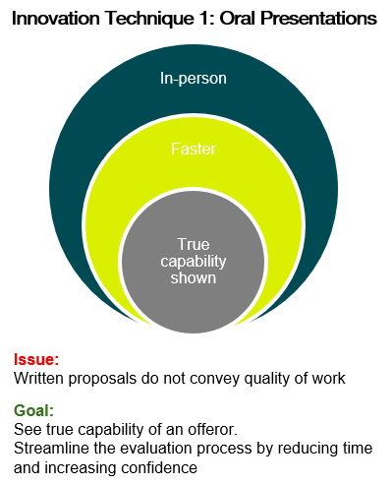

Efficient Procurement Model: Oral Presentations
Innovation Technique 1—
Oral Presentation
Oral Presentations provide an opportunity for small businesses and new entrants to the marketplace to compete for procurements more equitably with large businesses and incumbents. Oral Presentations can also save significant time for both government and industry in the formation and evaluation of proposals. For a procurement for products or services we recommend including a form of Oral Presentations, in part or in lieu of written proposals, to ensure vendors understand the work and propose a sound approach.
In-person/Virtual
Faster
True capability shown
Power Skills
Right-size the length of the oral presentation.
Be mindful of not burdening small businesses by right-sizing who is required to present.

Slide 47
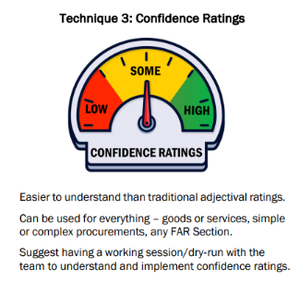

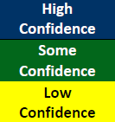
Efficient Procurement Model: Confidence Ratings
Innovation Technique 3 —
Confidence Ratings
Confidence Ratings in lieu of traditional adjectival ratings are a more efficient and effective way to conduct evaluations. Confidence ratings provide a flexible, more holistic approach to finding the best vendor. Evaluators focus on whether, per factor, the proposal instills high, some, or low confidence that the vendor understands the requirement, proposes a sound approach, and will be successful in performing the work.
Power Skills
Coordinate with evaluators to ensure understanding before releasing the solicitation.

Slide 48

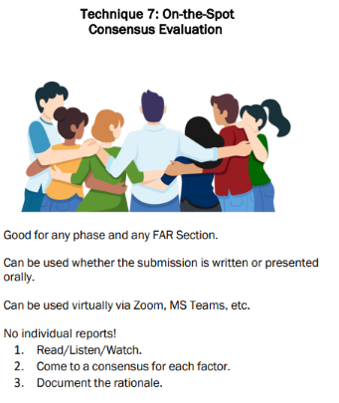
Efficient Procurement Model: On-the-Spot Consensus
Innovation Technique 7 —
On-the-Spot Consensus Evaluation
Skipping individual evaluator reports and going straight to consensus saves time and improves accuracy. After reviewing each proposal together, the team immediately documents the evaluation decision for each factor in real time before starting the evaluation of the next proposal. Consensus evaluation reports are completed in a matter of hours or days instead of weeks or months. The FAR does not require individual evaluator reports!
Power Skills
Have the Contracting Officer or Specialist serve as a facilitator.
Appoint a scribe who shares screen in real time.

Slide 49

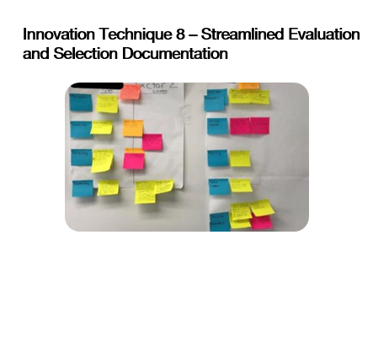
Efficient Procurement Model: Streamlined Documentation
Innovation Technique 8 —
Streamlined Evaluation and
Selection Documentation
Streamline the evaluation and selection documentation while providing a quality product. Focuses on what is important (the selection decision). Document decisions, not deliberations. Use bullet points to avoid complexity of long, narrative documentation. Note the discriminator (strong point or weak point) and perhaps state why that point matters to the Government. Nowhere does the FAR require that a tradeoff analysis or decision document be exhaustive or be a certain prescribed length or page count.
Use bullet points in lieu of long narrative documentation
Start with the end in mind and work backwards
Power Skills
Coordinate expectations with decision-makers and manage your risk!

Slide 50

Periodic Table of Acquisition Innovations

Slide 51
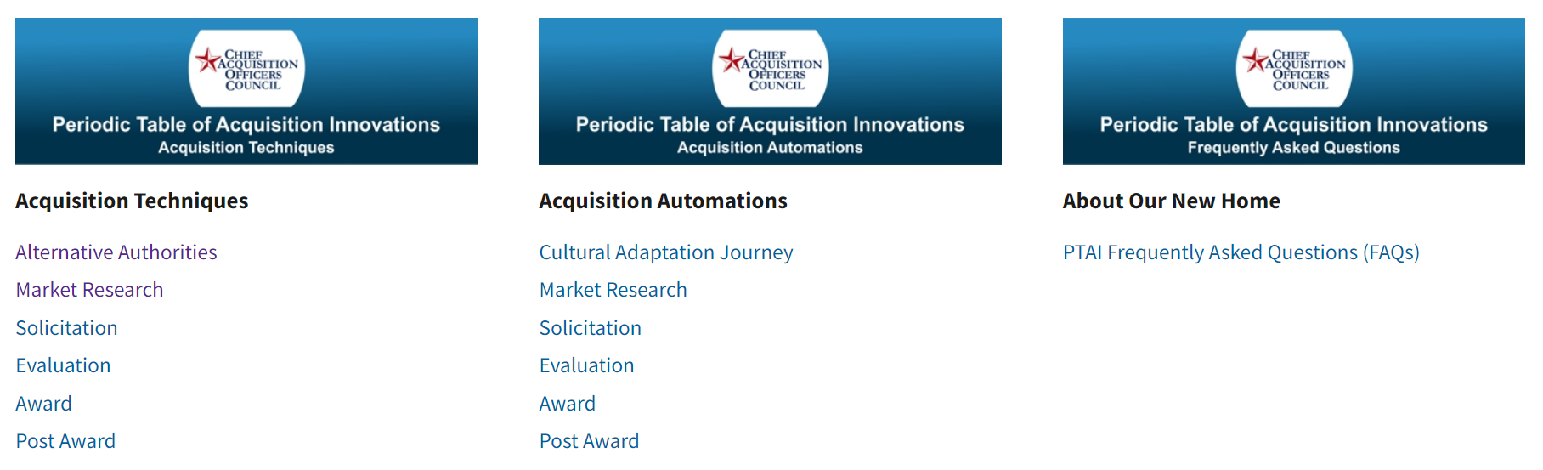
Periodic Table of Acquisition Innovations
Screenshot of
Real solicitation documents!
Real redacted technical reports!
Acquisition Techniques
Description
Problems Solved
Benefits of Use
Use Case and Documentation
https://acquisitiongateway.gov/periodic-table

Slide 52
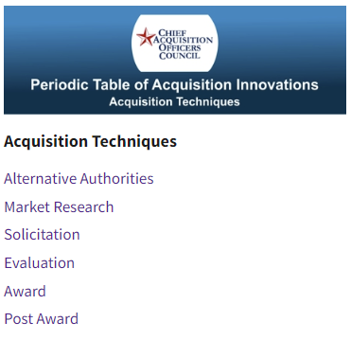
Navigate PTAI to Find Techniques!
Step 1: Find the Acquisition Techniques header
Step 2: Select a sub-heading to see related techniques
Note: A technique might not be where you think! You may have to open a couple sections to find what you are looking for.

Slide 53
Navigate PTAI to Find Techniques!
Market Research
Affordability
Interactive Q&A
Solicitation
Betterment
Discovery
Facilitated Requirements
One on Ones
Reverse Industry Day
Enhanced Contract Type Conversion
Fusion Procurements
HTRRP
Rates Only for Pricing Evaluation
Evaluation
Comparative Evaluation
Confidence Ratings
Down-Selects
Oral Presentations
Technical Demonstrations
Award
Brief Decision Documents
On-the-Spot Consensus
Oral Debriefings
Select Best-Suited, then Negotiate
Broad Agency Announcements
Challenge-Based Acquisitions
Commercial Simplified Development Procedures
Modular Contracting
On/off ramp
Remote Acquisitions
Self Scoring Model
Post Award
Award Term Incentives
Releasing the Selection Decision Document
Repositioning for Resilience
Demonstrations
Let’s look at Oral Presentations

Slide 54

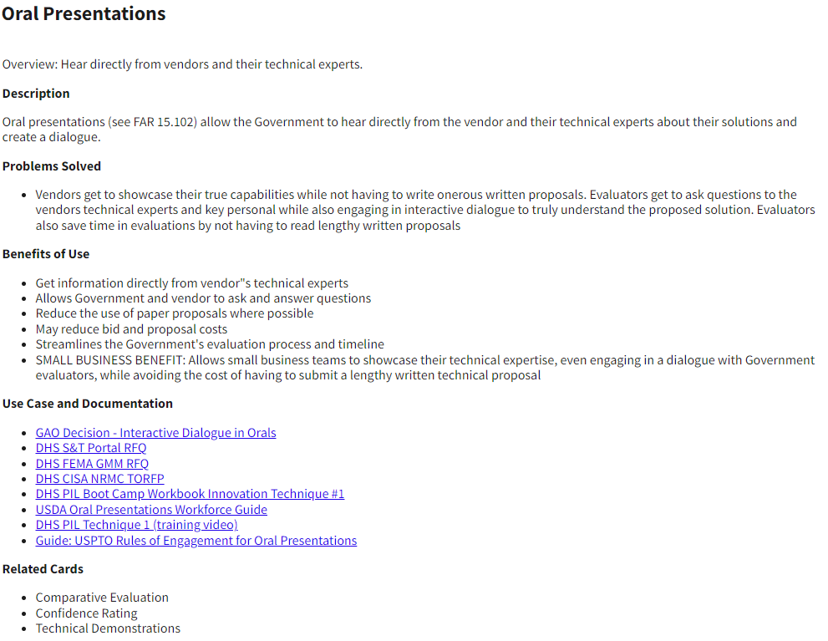
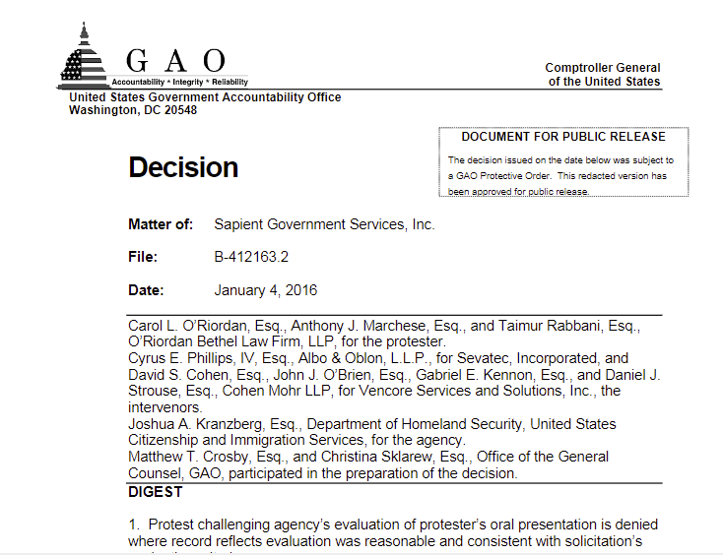
Navigate PTAI to Find Techniques!
PTAI
Acquisition Techniques
Evaluation
Oral Presentations
What is it?
What problem does it solve?
What’s in it for the team?
Are there real samples?
GAO cases included in Use Case section!
Compatible techniques?

Slide 55
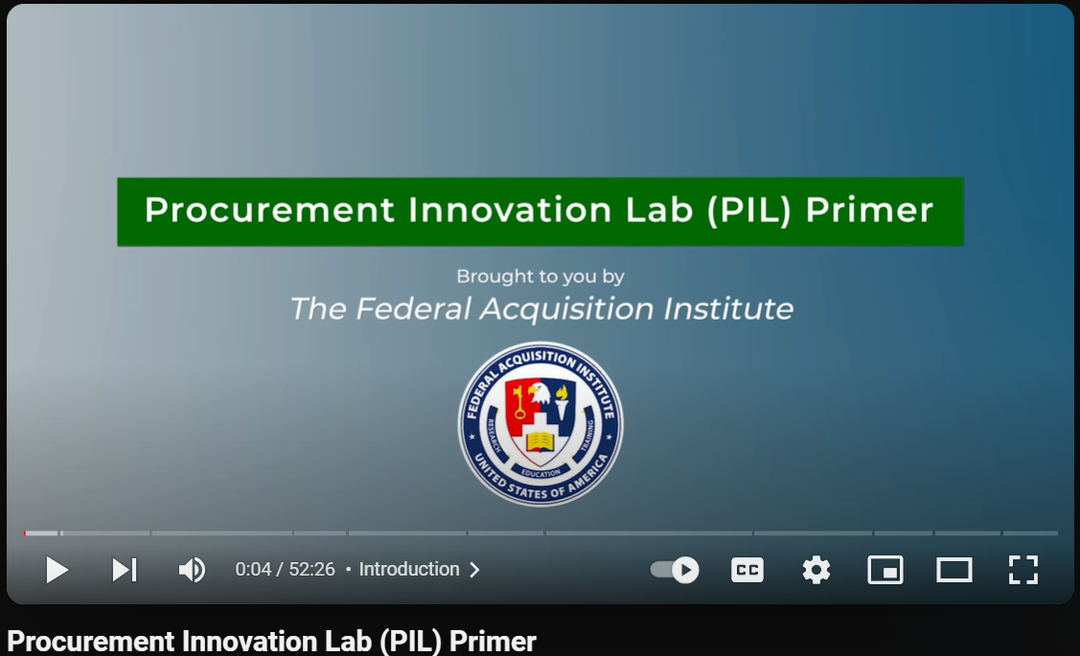
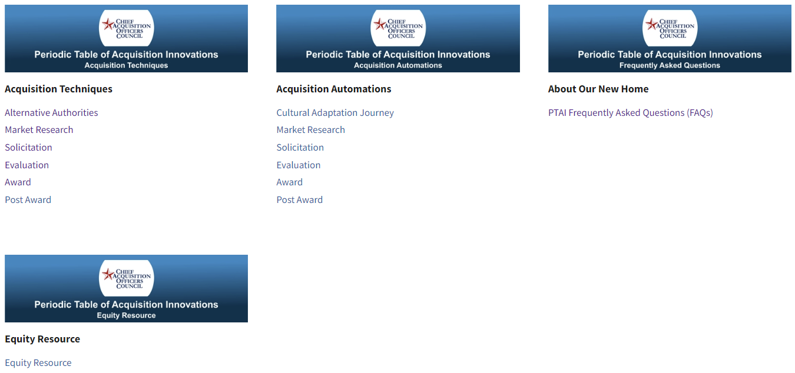


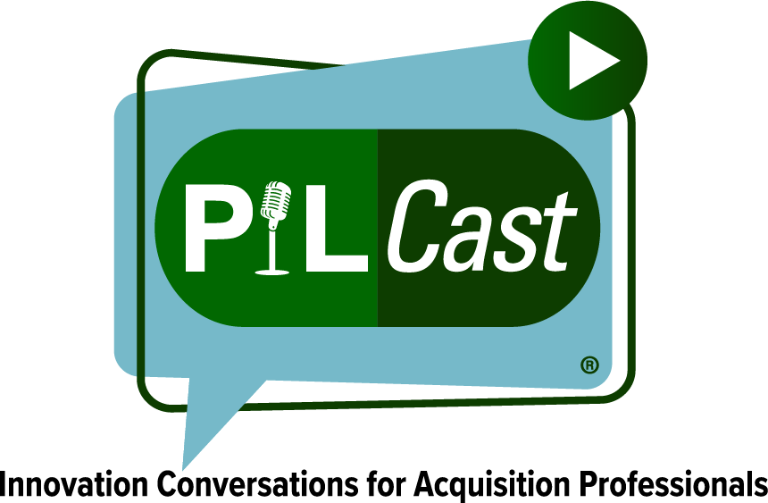

Additional Resources
PIL@hq.dhs.gov

Slide 56


Questions?
RFI
Requirements
Solicitations

Slide 57
Thank You!
Contact us at PIL@HQ.DHS.GOV
Monica Taylor: monica.taylor@hq.dhs.gov
Tracey Harriot: tracey.harriot@hq.dhs.gov
Office of Integrated Marketing

