Slide 1

Revolutionary FAR Overhaul Overview
Acquisition Training for the Real World Winter 2026
Office of Government-wide Policy, January 29, 2026
Notes:
Join our Acquisition Training for the Real World session in order to:
Communicate the intention and status of the Revolutionary FAR Overhaul
Learn what the RFO calls for with regard to agency regulations and policy
Understand the new SAG framework and FAR Companion purpose and intent
Hear about the new flexibilities and role of discretion provided through the RFO as an opportunity for the practitioner to more effectively meet mission
Get a tease for part two, including resources available

Slide 2



FAR Overhaul Presenters
Nick West
Deputy Director OGP
Nicholas.West@gsa.gov
Danielle Mouw
RFO Team & GSA PILOTS Testing & Coaching
Danielle.Mouw@gsa.gov
Monica Taylor
RFO Practitioner Workstream
Monica.Taylor@gsa.gov

Slide 3
Foundations & Principles
The Revolutionary FAR Overhaul
Comprehensive overhaul of the Federal Acquisition Regulations (FAR), which was first published in 1984.
The RFO initiative:
  Returns the FAR to its statutory roots;
  Rewrites it in plain language;
  Removes non-statutory rules (unless essential for sound procurement); and
  Creates non-regulatory buying guides that provide practical strategies grounded in best practices.
Notes:
Nick

Slide 4
Foundations & Principles
Core Theme of the RFO
What’s a major theme from these EOs?
Increased use of the governmentwide contracts for commercial products and services, such as Federal Supply Schedule ordering procedures (GSAR 538.71) and ordering procedures for multiple-award Governmentwide contracts (FAR 16.507)
Executive Orders and OMB Memos:
Executive Order 14275 — Restoring Common Sense to Federal Procurement
  OMB Memo 25-26 — Overhauling the Federal Acquisition Regulation
Executive Order 14271 — Ensuring Commercial, Cost-Effective Solutions
Executive Order 14240, Eliminating Waste and Saving Taxpayer Dollars Dollars by Consolidating Procurement
Notes:
Nick

Slide 5
Foundations & Principles
Clear Direction to Source within Federal Marketplace First
RFO 10
  "Agencies must procure commercial products and commercial services to the maximum extent practicable and prioritize procuring commercial products and commercial services on an existing governmentwide contract".
RFO 12
  “If commercial products or commercial services that meet agency needs are available from any priority source identified in part 8, including existing contracts awarded for Governmentwide use (e.g., the Federal Supply Schedules and Governmentwide acquisition contracts), procure the commercial products or commercial services from that source.”
EO 14271 - Ensuring Commercial, Cost-Effective Solutions in Federal Contracts
  “Agencies shall procure commercially available products and services, including those that can be modified to fill agencies' needs, to the maximum extent practicable”
RFO 8
  Must use existing governmentwide contracts and BPAs that are “required use” and must* consider existing governmentwide contracts and BPAs that are otherwise part of Category Management principles.
Notes:
Nick

Slide 6
Progress, Milestones & Next Steps
The RFO
49 Model Deviations were issued to allow immediate use while formal rulemaking proceeds.
Agency Implementation
Agency adoption varies - Implementation contingent on agency-issued deviations.
Codified FAR
RFO
Phase 1
Model deviations
Agency issued deviations
Phase 2
Rule-making
New codified FAR
Codified FAR
Issue class deviations to immediately adopt and use overhauled FAR.
Conduct formal rulemaking to codify streamlined regulations.
Notes:
Nick

Slide 7
Agency Policies & Procedures
Streamlining Agency Acquisition Regulations
Agencies should streamline their FAR supplements to minimize regulations that are not based in statute or executive order and align with the FAR Council's deviation guidance as the FAR is streamlined and reformed.
Agency alignment should also address policies that further implement their regulatory supplements.
Agencies are encouraged to conduct tests where deviations or strategies in buying guides present ways of doing business that are new to the agency.
Notes:
Nick

Slide 8

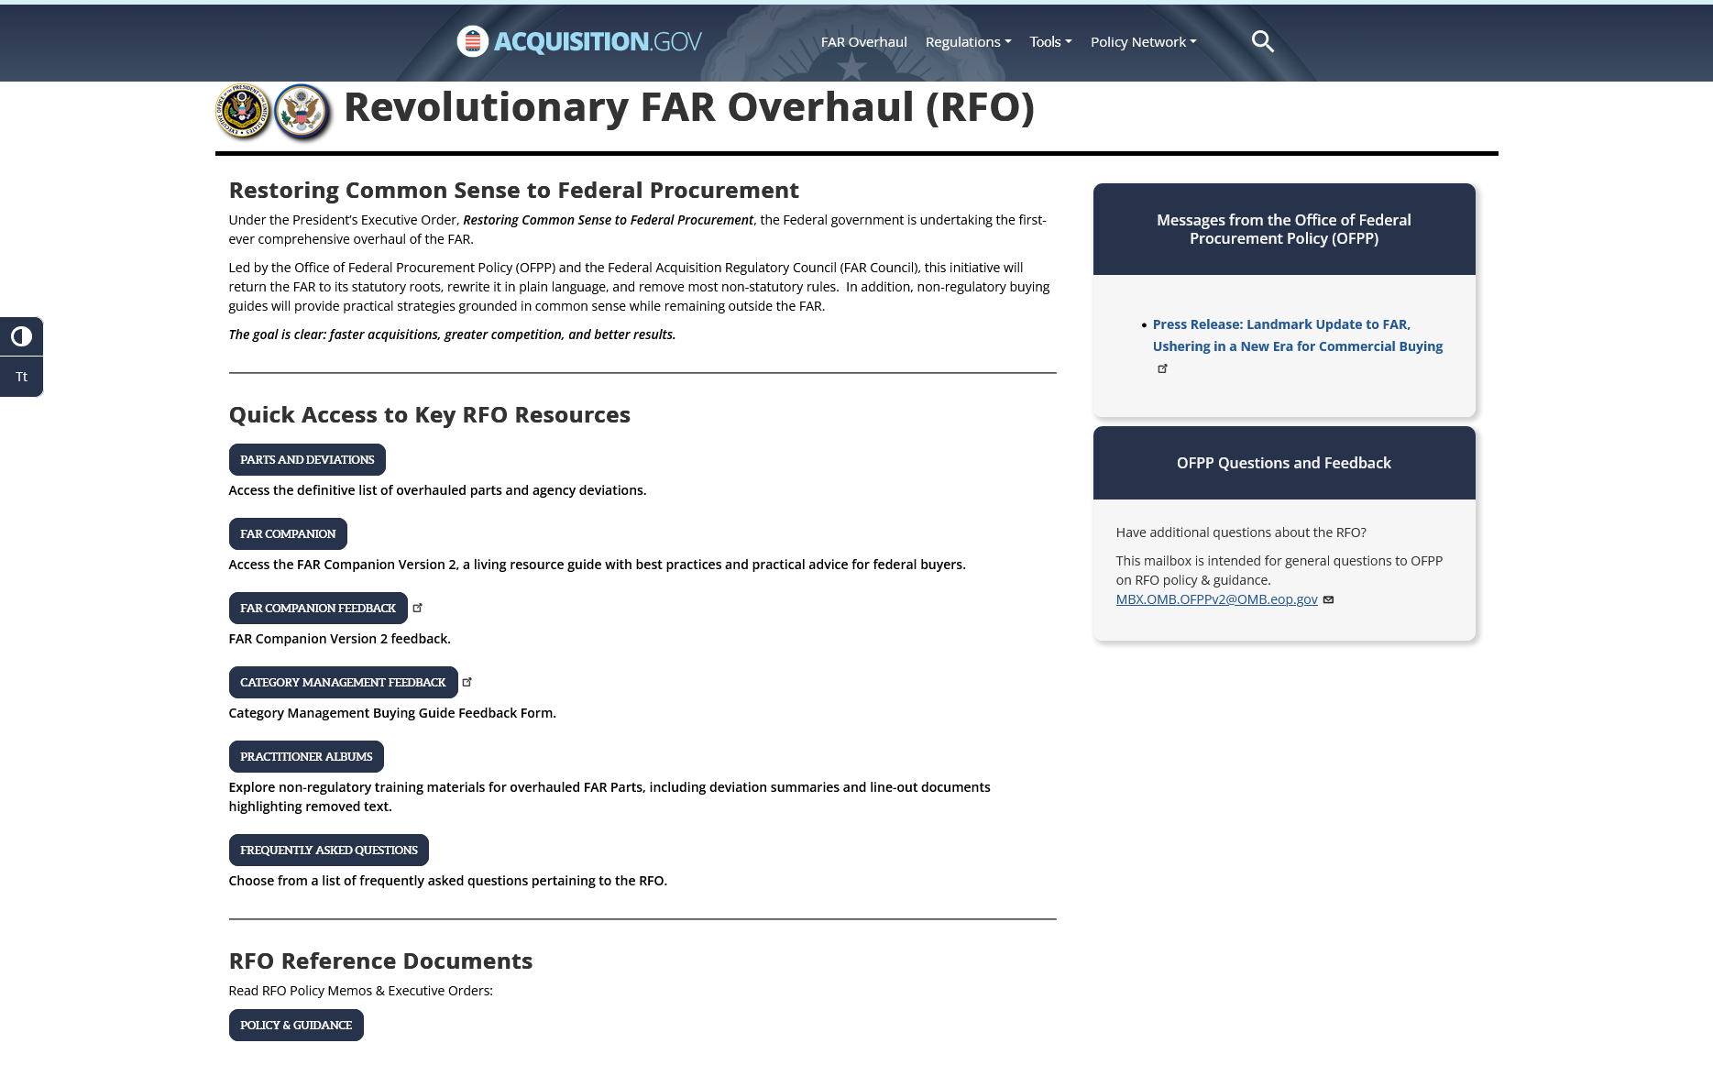
RFO Website
Navigating the FAR
Overhauled FAR parts and Agency deviations
Central location for all RFO resources: https://www.acquisition.gov/far-overhaul
FAR Companion
Practitioner Albums – Change Summaries and Resources
Notes:
Monica

Slide 9
The FAR Framework
The RFO
The FAR Framework
RFO 1.101 Framework
(a) The System is a collection of acquisition regulations and guidance, and consists of the following:
(1) The Federal Acquisition Regulation (FAR), which is a single acquisition regulation for all acquisitions (see 2.101), and all executive agencies. The FAR is located at 48 CFR chapter 1.
(2) Agency acquisition regulations that implement or supplement the FAR (see 48 CFR chapters 2 through 99); and
(3) Acquisition guides, which show best practices (FAR Companion).
(b) The System does not include internal guidance supplementing agency acquisition regulations described in paragraph (a)(2) of this section.
Notes:
Monica

Slide 10

The FAR Framework
The RFO
FAR Framework
REGULATORY
NON-REGULATORY
Streamlined FAR
Agency Regulations
FAR Companion*
Category Management Buying Guide*
* Living resources that will be regularly updated to reflect evolving best practices and the changing way that commercial supplies and services are purchased.
Notes:
Monica

Slide 11
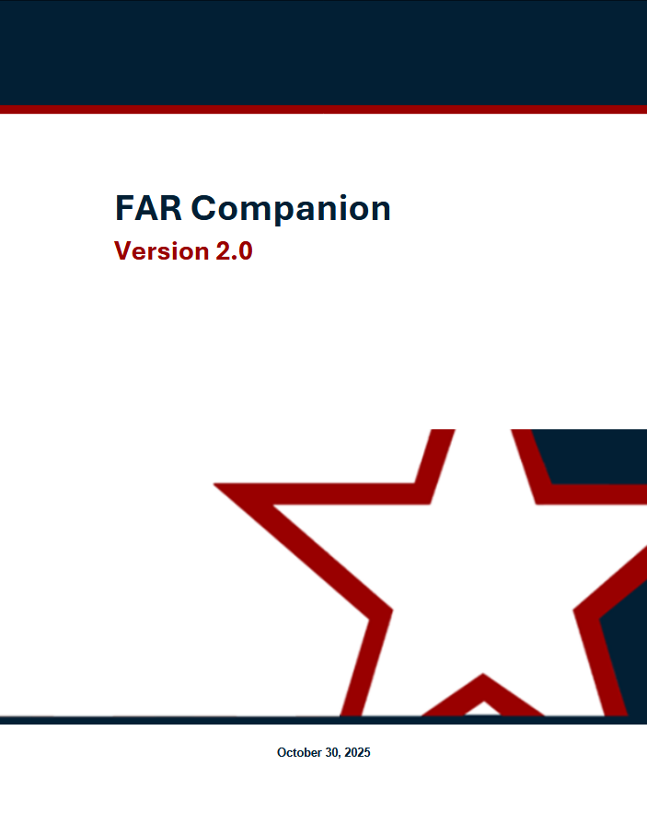
Empowering the AWF
Regulatory and Non-Regulatory Resources
FAR Companion
Applying Sound Business Judgment
The FAR Companion will work in concert with the FAR, agency supplements and the Category Management Buying Guide.
The FAR Council's Foreword to the FAR Companion charges acquisition professionals to maximize use of their sound business judgment and discretion when policies are not statutorily prescribed.
Novel approaches and innovative applications that comply with the FAR, even if not specifically referenced in the FAR Companion, are permissible and encouraged. Acquisition professionals are encouraged to share their tested practices and new approaches by contacting SAGTesting@gsa.gov or submitting them to the Periodic Table of Acquisition Innovations (PTAI).
Notes:
Danielle

Slide 12
Empowering the AWF
FAR Companion
Designed to enhance the efficiency and effectiveness of federal buying by:
Consolidating practitioner insights in one place from a variety of helpful sources saving buyers time in finding and leveraging best practices;
Preserving a number of policies and “how to” procedures formerly mandated in the pre-streamlined FAR that continue to reflect good stewardship but are more appropriately applied with discretion as part of problem-solving and are not a “one-size-fits-all” mandate;
Building the confidence of the acquisition workforce to take managed risks, by providing advice – not direction – and avoiding compliance requirements that create a fear of protests; and
Creating an agile and efficient governmentwide resource to highlight and evolve proven acquisition practices and reduce the amount of guidance needed from agencies.
Notes:
Danielle

Slide 13
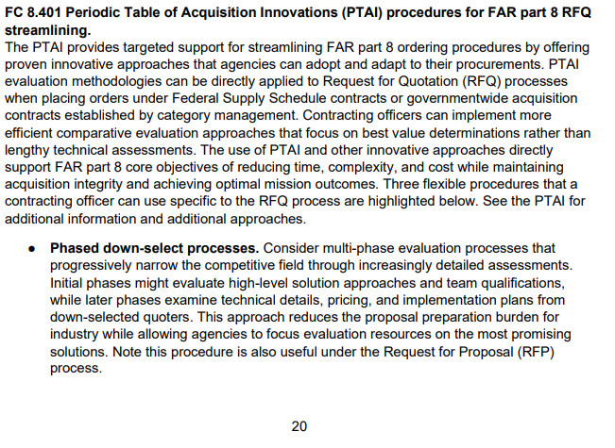
Empowering the AWF
FAR Companion Excerpt
The FAR Companion mirrors the structure of the FAR to make finding guidance intuitive and straightforward.
Each FAR Companion part corresponds directly to a FAR part.
Each FAR Companion part contains annotations that provide:
  Key principles;
  Proven practices;
  Explanatory material; and
  Implementation guidance.
Notes:
Danielle

Slide 14
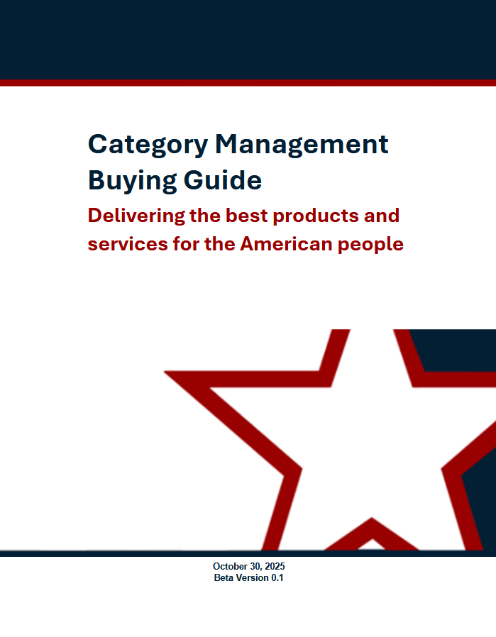
The FAR Framework
Category Management Buying Guide
The Category Management Buying Guide:
Works in concert with the FAR, FAR Companion and agency supplements highlighting sector-specific buying tips for navigating government-wide contracts.
Helps maximize centralized ordering of common spend
and recognizing the efficiency and cost benefits of leveraging previously negotiated terms and conditions.
The guide promotes:
Commercial Utilization
Prioritization of Existing Government-wide Contracts and Blanket Purchase Agreements (BPAs)
Simplicity and Efficiency
Adaptability
Notes:
Danielle

Slide 15
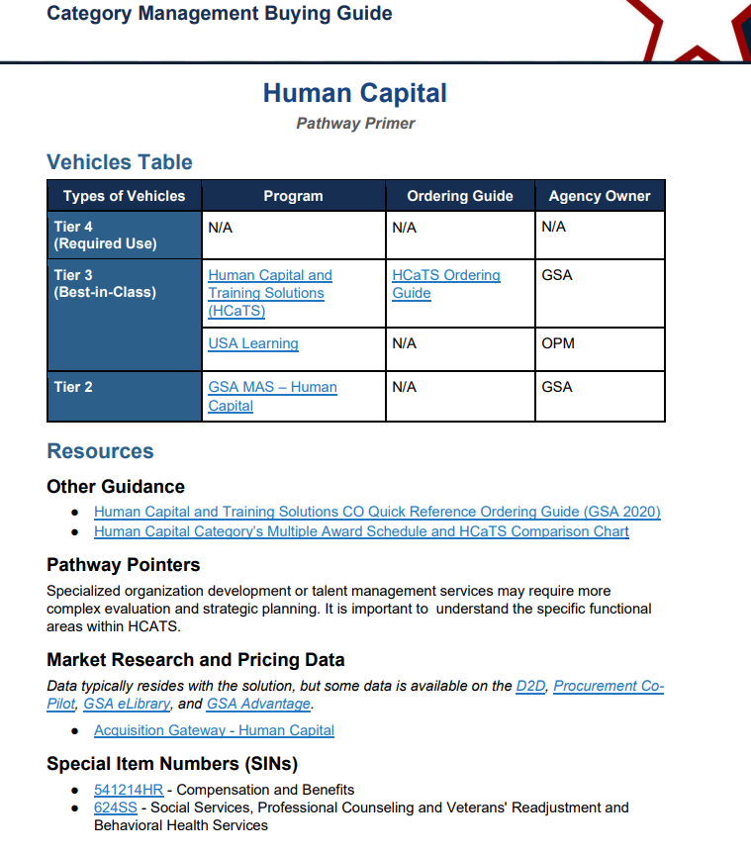
The FAR Framework
Category Management Buying Guide Excerpt
The Category Management Buying Guide provides:
Category Management Vehicles
Resources such as:
  Vehicle Guidance
  Pathway Pointers
  Market Research and Pricing Data
  SINs
Notes:
Danielle

Slide 16
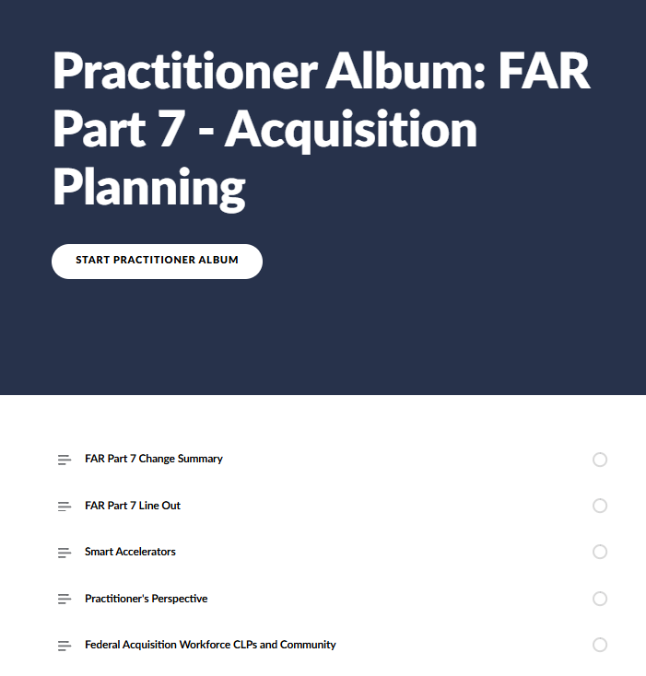
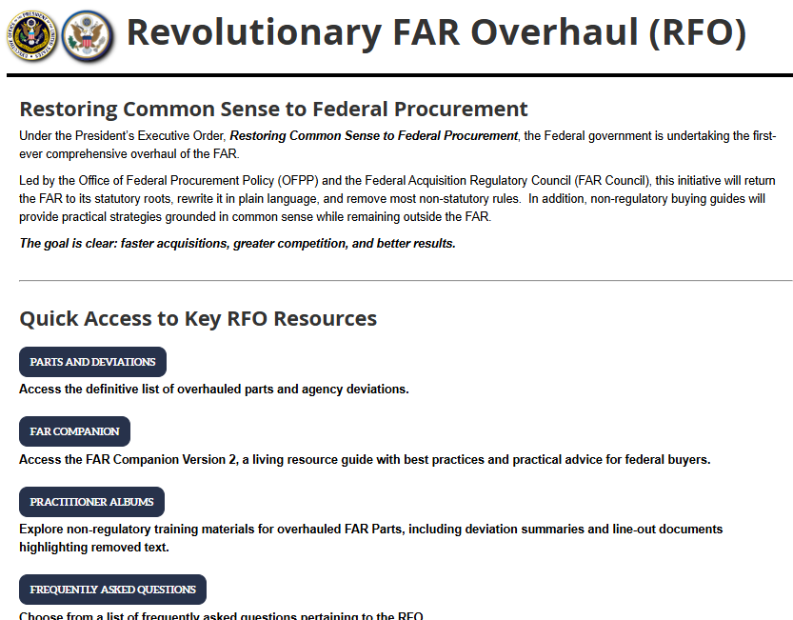
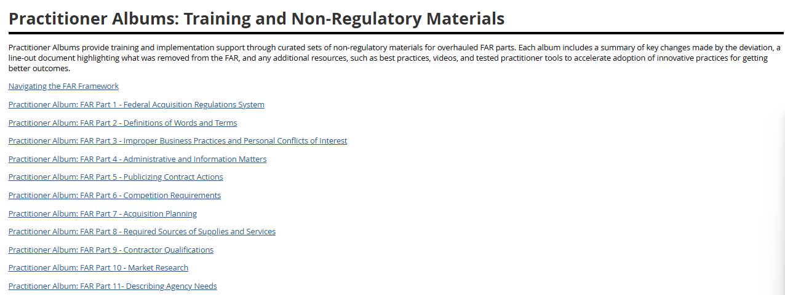
Practitioner Albums
Empowering the AWF
Practitioner Albums provide:
Change Summary
Line-out
Smart Accelerators
Practitioner's Perspective
Access to CLPs and Community
Attend Session 2 to hear about more practitioner resources!
Notes:
Monica

Slide 17
Revolutionary FAR Overhaul
What’s Next?
Additional guidance, resources, and learning assets are being developed and shared.
  Best practices and tools for applying innovation and streamlining the acquisition lifecycle.
Sunset of Agency RFO-related class deviations as the new codified FAR is formalized.
Notes:
Monica

Slide 18
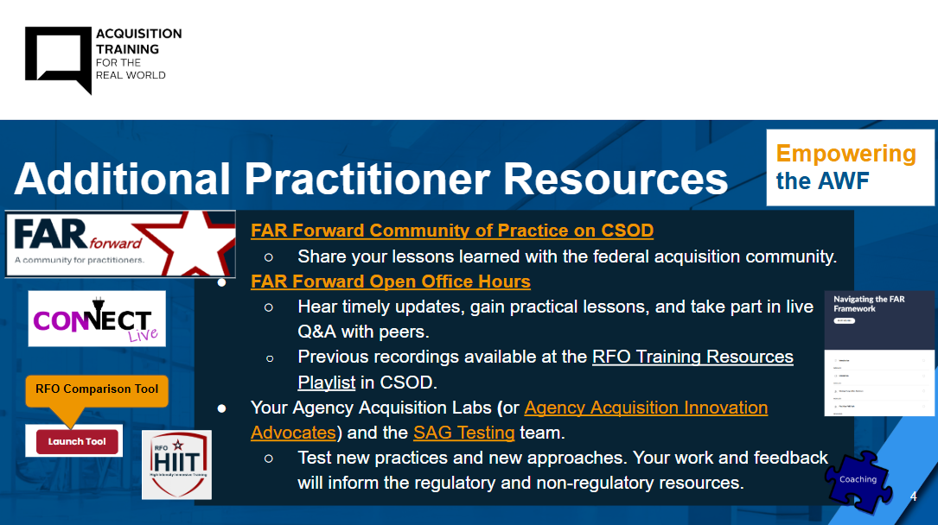
Session 2 Preview
Deeper Dive into the Revolutionary FAR Overhaul
Learn of key FAR changes that impact practice (parts 7, 8.4 (GSAR 538) - light on FSS given separate session, 12, 15, 16, and 19) at high level
Learn more about resources available to the AWF
Notes:
Monica

Slide 19
Thank You!
Questions?

