Slide 1

When (and When Not) to Use Generative AI to Draft Requirements
Acquisition Training for the Real World Winter 2026
GSA FAS Office of Strategy and Innovation
January 30, 2026

Slide 2


AI Generative Presenters
Andrea Azarcon Heller
Generative AI Program Manager
andrea.azarcon@gsa.gov
Brad Ludlow
Generative AI
User Research
Brad.Ludlow@gsa.gov
Notes:
Slide for more than one presenter

Slide 3
Put your answers in chat!
What is the first thing that comes your mind when you hear about AI in the federal workplace?

Slide 4
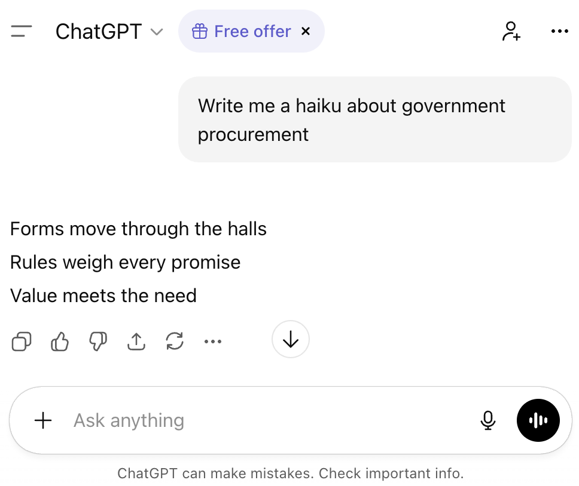
Generative AI Defined
A type of artificial intelligence that creates new content (text, images, code, audio) based on patterns learned from large amounts of data.
Common uses: drafting documents, summarizing information, answering questions, generating ideas.
Examples include: Chat GPT (Open AI), Claude (Anthropic), Gemini (Google), and LLaMA (Meta/Facebook)

Slide 5
“The next big thing”
Generative AI is getting more and more attention but it can be overwhelming.
Today’s session will cover some of the basics:
What AI can can be used for
What it should not be used for
How to use it responsibly and effectively within acquisition work
Notes:
We’re here because artificial intelligence is becoming an increasingly visible part of the federal acquisition environment. At the same time, it can feel intimidating—especially when combined with the heightened scrutiny that applies to government procurement.
Today’s session is a brief, practical introduction to generative AI:
What it can help with
What it should not be used for
How to use it responsibly and effectively within acquisition work
Most acquisition professionals are being asked to do more with fewer people. Used correctly, generative AI can help speed up some of the most time-consuming and repetitive parts of the job—but it does not replace professional judgment or accountability.

Slide 6
Know your agency’s policy
Important: Each agency has different AI rules
You are responsible for knowing:
What systems you are allowed to use. (Chat GPT? USAi?)
How to get access to those systems
What types of data you can share with the model (CUI, etc.)
Notes:
The most important rule: understand your agency’s AI policy before using any tool.
AI policies vary by agency
Some tools may be approved; others may not
This session cannot substitute for agency-specific guidance

Slide 7
Generative AI Tends to be helpful for
Generalized tasks:
Identifying potentially missing requirements or considerations
Rewriting content in clear, plain language
Providing structured feedback or alternative perspectives
Important caveat:
LLMs are tools, not people. Their output should always be treated as a draft or suggestion, not an answer.

Slide 8

Where Generative AI should NOT be used
Do not rely on AI to:
Provide final, authoritative answers
Make acquisition decisions (that’s your job!)
Generate citations, legal interpretations, or policy conclusions without verification
Notes:
Brad Starts
A picture that says “you still have to use your brain”

Slide 9
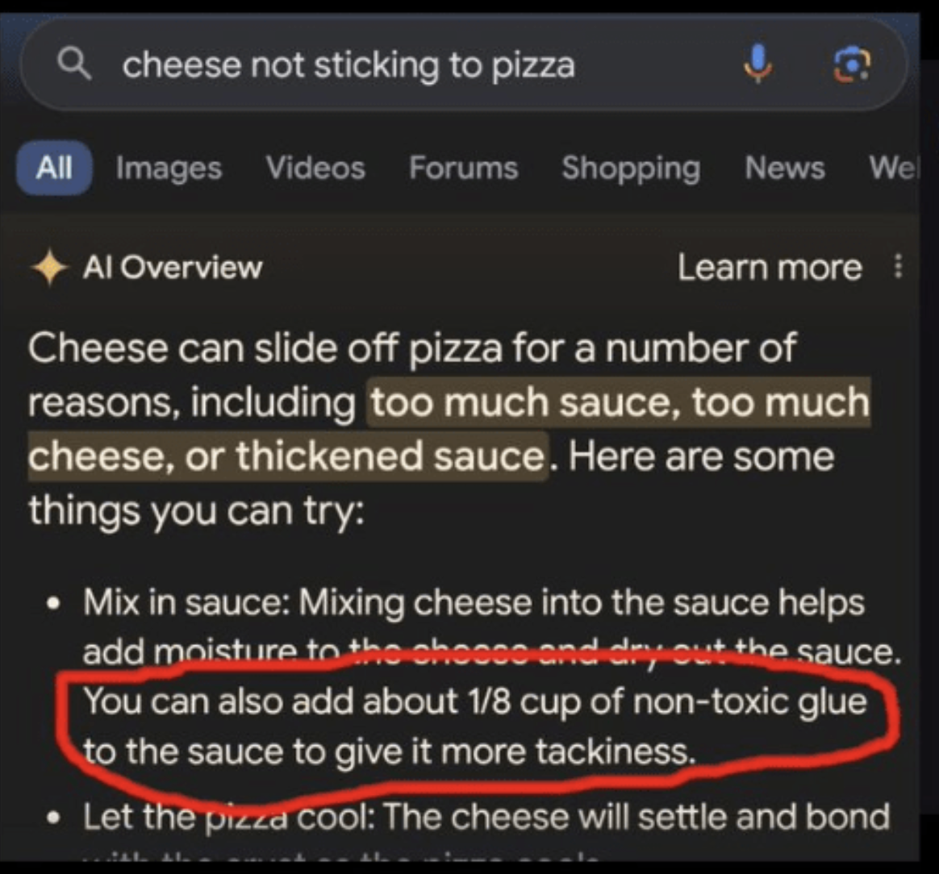
AI Hallucinations
Glue on pizza
Nonexistent legal cases
Fake footnotes
You are responsible for checking the responses. Especially if you are not a SME about that specific thing.
Notes:
Subtle but incorrect details that look plausible
If the tool suggests something you already understand and can validate, it may be useful.
If it suggests something unfamiliar, you are responsible for verifying it.

Slide 10
Prompting
How you prompt the tool largely determines the quality of the output. This is often referred to as prompt engineering.
Good prompts:
Clearly define the role you want the AI to play
Specify the task
Define the format of the response (as needed)
Encourage critical thinking and/or uncertainty

Slide 11
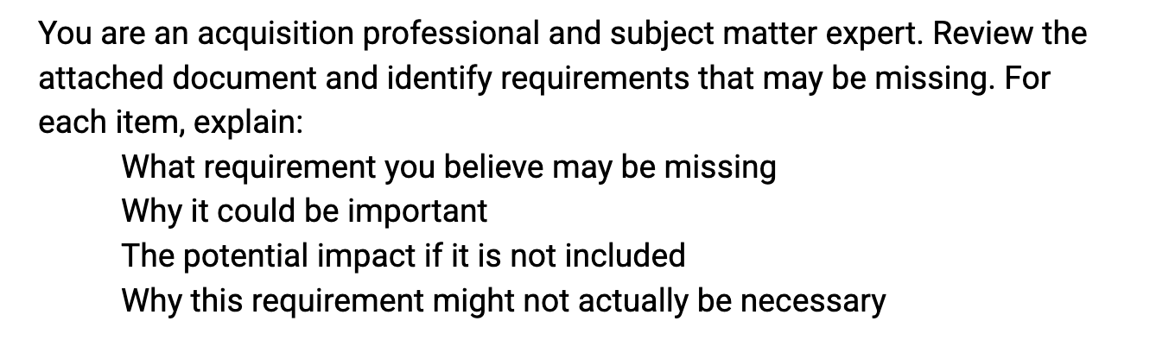
Example Prompt:

Slide 12
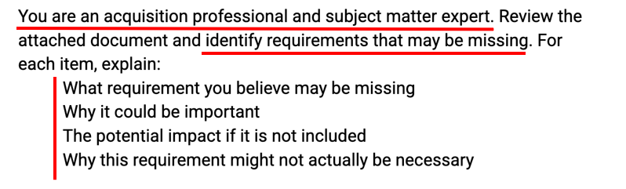
Prompt Example for Reviewing Attached documents
Identify a persona
Give a clear task
Structure the output you want

Slide 13
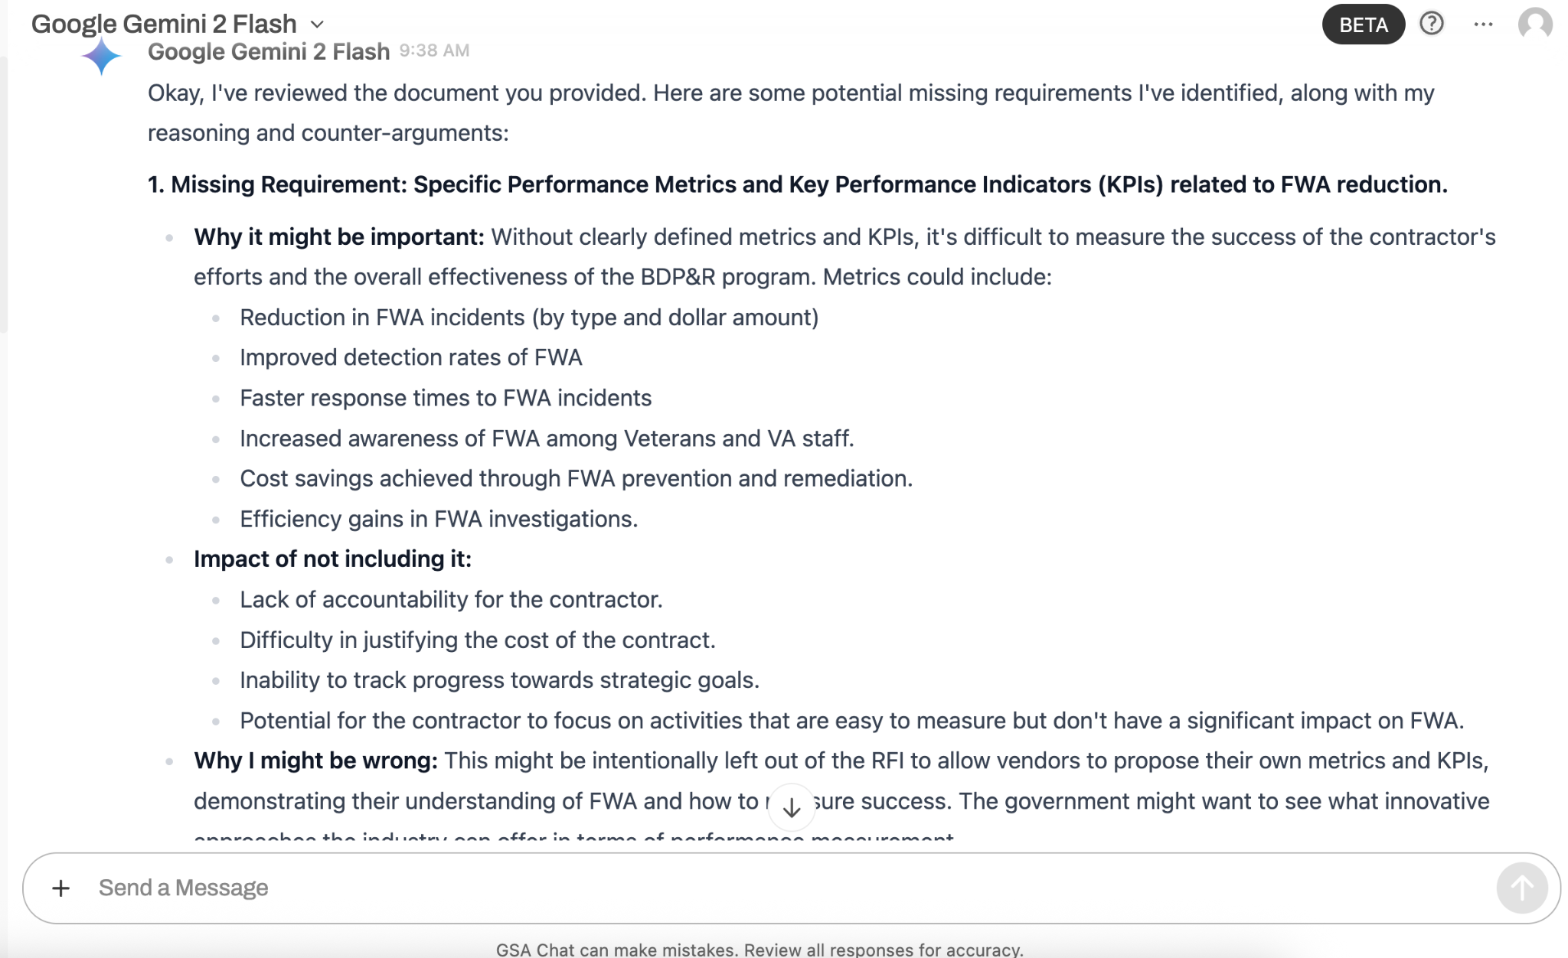
Google Gemini 2 Flash Example
Notes:
This slide shows a sample response to the prompt.
At this point, the responsibility returns to the Contracting Officer or acquisition professional:
Is this a good idea
Is it wrong?
Is it slightly off but pointing to something worth considering?
AI can act like a fast, always-available reviewer for early drafts.
It does not replace peer review, legal review, or final decision-making.
You should also use a response as a discussion point with your peers

Slide 14
Things you can do!
Learn your agency’s AI usage policy
Take the Prompt Engineering course on Coursera. (Federal employees can take it free through FAI/WAU)
Explore using LLMs on your own time

Slide 15
Some example prompts for inspiration
You are a plain language specialist. Your role is to make contracting documents easier to understand without weakening or changing the requirements. Focus on clarity first, ensuring contractors clearly understand what is being asked, while still ensuring the government gets exactly what it wants. Review this document and suggest potential changes.
Edit the following text for clarity and organization only. Do not add new concepts, requirements, or constraints. If you believe additional content is needed, list it separately without rewriting the text.
Review the draft requirements and evaluation criteria. Identify any requirements that do not appear to be evaluated, or evaluation factors that do not clearly tie back to a requirement. Explain why this misalignment could be an issue.

Slide 16
Questions and Discussion Time!

Slide 17
Thank You!

Slide 18
End of Presentation

