Slide 1


MISSION POSSIBLE:
MASTERING ACQUISITION BEST PRACTICES
November 18, 2024
Office of Integrated Marketing
Continuing your Acquisition Journey

Slide 2
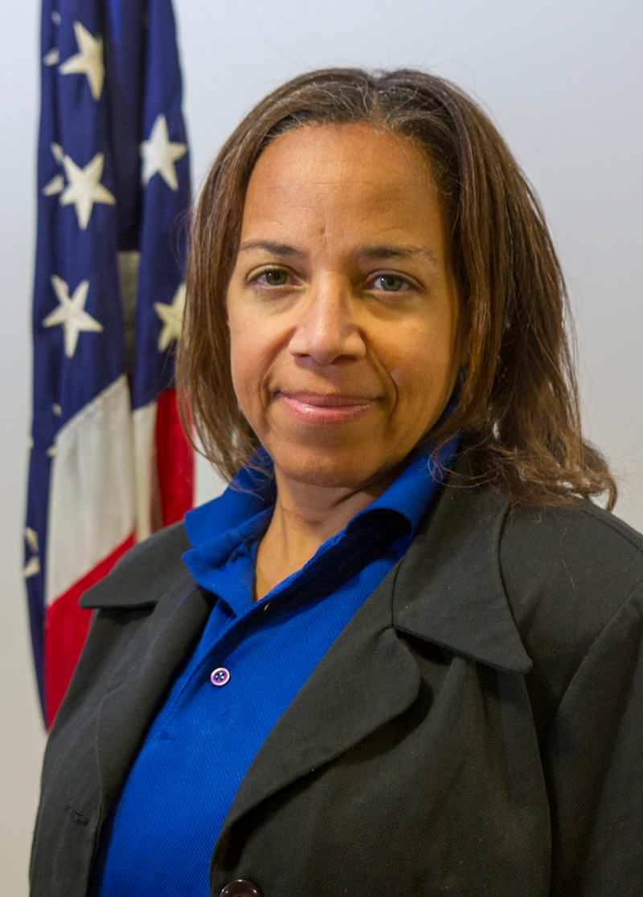
Presenter
Lenear Bassett-King
Management and Program Analyst
National Oceanic and Atmospheric Administration (NOAA)

Slide 3



MASTERING ACQUISITION
BEST PRACTICES:
No need to go rogue and cause unwanted fallout!
PRESENTATION

Slide 4


















ON LEAVE!
GONE FISHING!
Notes:
There you are…happily hiding in plain sight! Gone fishing with no worries…being happy, using up your leave! And you start to suspect something is just not right.

Slide 5






HELP! HELP! HELP!
TRUSTED PROCUREMENT OFFICIAL…
RESPOND…OVER….
Should we listen to the message?

Slide 6



THANKS FOR ANSWERING…
WE NEED YOU BACK HERE ASAP….
CHAOS ENSUES!
YOU ARE OUR EXPERTS…
OUR TRUSTY ACQUISITION TEAM!
DECISIONS MUST BE MADE!
Notes:
In code, the message says:

Slide 7






WHAT’S POSSIBLE?
Your mission, should you choose to accept it, is to use these tools to support your agency in being innovative and successful … (FAR 1.102)

Slide 8




MISSION POSSIBLE: CLICK PLAY TO ACCEPT THIS MISSION…
Notes:
Our organizations have many diverse missions, in a world of priorities, lives at stake, and resources that might be limited. We can’t do it without you!

Slide 9


LOOK CLOSELY
…the Secrets to a…
Successful Acquisition!

Slide 10



?
Keys to Success?
CLICK HERE
Notes:
Unmask the key to success

Slide 11
TOOLS WE NEED TO SUCCEED – FOCUS ON RESULTS:
IDENTIFY THE PROBLEM
ORGANIZE THE TEAM
ASK INDUSTRY – MARKET RESEARCH
DEVELOP THE REQUIREMENTS
DETERMINE WHO WILL SOLVE THE PROBLEM (GOVERNMENT OR INDUSTRY)
DOES THIS IMPACT THE PROGRAM AND WHAT ARE ASSOCIATED COSTS (COST ESTIMATING)?
ESTIMATE THE NEEDS FOR THE ACQUISITION PORTIONS (IGCEs)
CONDUCT RECONNAISSANCE – INDUSTRY CAPABILITIES
FORMULATE THE STRATEGY, SHARE AND NEGOTIATE THE DEAL
EXECUTE THE CONTRACT - HAVE THE CONTRACTOR SUCCEED (QC), MONITOR AND MEASURE (QAS) AND HAVE THE GOVERNMENT MISSION BE FULFILLED (RESULTS THAT PROVE THE PROBLEM IS SOLVED) CAPTURE LESSONS LEARNED
AGENDA SLIDE
Notes:
Placeholder Questions to ask - Is this an Investment? Part of a Program? A Major Investment? What is our need? Do you have a Problem Statement? How will you know you are on the right track???

Slide 12


LET’S GET TO WORK…
Notes:
Let’s Goooooooo!

Slide 13
WHAT WE NEED…
ACCOMPLISH THIS MISSION BY CONTRACTING…
TO ACHIEVE RESULTS WITH YOUR TEAM!

Slide 14
WHAT WE NEED – ACCOMPLISH THIS MISSION
WHO’S ON THE TEAM (R&R – NO NOT REST AND RELAXATION; INSTEAD ROLES AND RESPONSIBILITIES)
STAKEHOLDERS AND CUSTOMERS
ABOUT IGCEs, THEIR PURPOSE AND THE BACKGROUND TO UNDERSTAND HOW IT SUPPORTS THE ACQUISITION LIFECYCLE
TO IDENTIFY THE ROLES AND RESPONSIBILITIES OF KEY PLAYERS IN THE IGCE DEVELOPMENT PROCESS
TO ENSURE THAT IGCEs CONTAIN KEY INFORMATION CONSISTENT WITH GOOD COST ESTIMATING PRACTICES
TO REQUIRE THAT IGCEs DOCUMENT DATA SOURCES, METHODOLOGY, AND ASSUMPTIONS, AND TAKE STEPS TO HELP ENSURE THAT GUIDANCE IS FOLLOWED ON ALL ACQUISITIONS ABOVE THE SIMPLIFIED ACQUISITION THRESHOLD.

Slide 15

WE CAN’T MEASURE EVERYTHING
LET’S TALK ABOUT RISK MANAGEMENT
According to the GAO, it’s important
“…that standards are not set so high that they could drive up the cost of service or too low that they may act as a disincentive to good contract performance.”

Slide 16


RISK-BALANCE
Balance

Slide 17











REMEMBER WHEN WE THOUGHT IT WAS… IMPOSSIBLE?
Notes:
What are some things you thought it would be impossible to accomplish?

Slide 18




PAY CLOSE ATTENTION…
It’s Possible:
Use the tools and discover

Slide 19
PROBLEM SOLVING = PRODUCING RESULTS
What’s YOUR PROBLEM???
An acquisition strategy used to structure all aspects of an acquisition around the purpose of the work to be performed.
What matters to your organization—tied to mission success?
What problem is your organization trying to solve?
Link acquisition to mission and performance objectives
Define (at a high level) desired results
Decide what constitutes success
Determine the current level of performance
Determine any budget constraints

Slide 20

BRAIN TEASER 1
WHAT CAN BE STOLEN, MISTAKEN, OR ALTERED, YET NEVER LEAVES YOU YOUR ENTIRE LIFE?
Notes:
Your identity

Slide 21

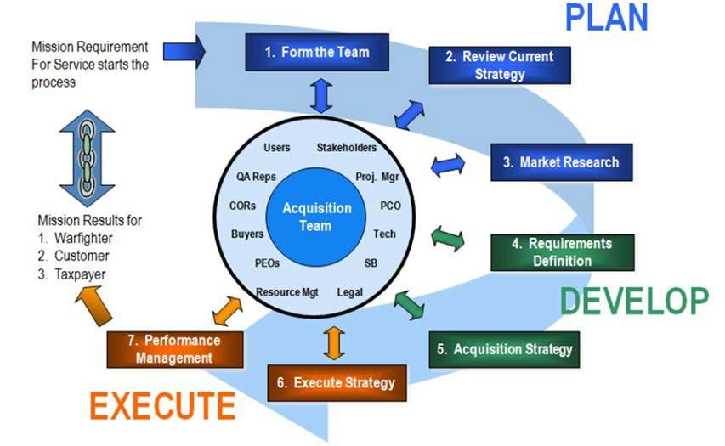
TOGETHER!
FAR 1.102(c) provides:
The Acquisition Team consists of all participants in Government acquisition including not only representatives of the technical, supply, and procurement communities but also the customers they serve, and the contractors who provide the products and services.
Ensure senior management involvement & support
Tap multi-disciplinary expertise
Define roles & responsibilities
Develop rules of conduct
Empower team members
Identify stakeholders and nurture consensus
Develop and maintain the knowledge base over the project life
Incentives for team members

Slide 22

ASK INDUSTRY!
Conduct Market Research!
Contractual
  Research existing contract vehicles to see if they can be used to meet your needs
  There are many GWACs, MACs, and GSA Schedules out there. Generally, if you look hard enough or ask enough people, you can find somebody else has already done all of the work for you.
Technical
  Research to find out possible solutions and involve your team members in market research
  Research the public-sector to see what has worked for your counter-parts in other agencies
  Research your industry before structuring the acquisition—what’s available in the commercial marketplace?

Slide 23
ACTIVITY 1
Problem Statement Exercise

Slide 24
REMEMBER PERFORMANCE BASED?
WHAT ARE THE ELEMENTS OF PERFORMANCE-BASED CONTRACTING (PBC)?
  GOVERNMENT PROTOCOLS REQUIRE:
    ESTABLISH REQUIREMENTS IN A RESULTS ORIENTED MANNER
    ENSURE THAT CONTRACT MEASURES AND EXPECTATIONS ARE MEASURABLE AND CORRESPOND TO WORK REQUIREMENTS
    ENSURE THAT QUALITY ASSURANCE SURVEILLANCE PLANS ARE TAILORED TO CONTRACT OBJECTIVES
    INCORPORATE COST CONSTRAINTS OR COST INCENTIVES
  ACQUISITION GUIDE
    PERFORMANCE BASED CONTRACTING GUIDES – PROVIDES GUIDANCE ON STRUCTURING EFFECTIVE INCENTIVES

Slide 25
JUST THE FACTS, MA’AM
WHAT DO I NEED FROM THE CONTRACTOR?
  WHAT RESULTS DO WE NEED?
  WHY DO WE NEED THEM?
  WHEN DO WE NEED THEM?
HOW WILL WE KNOW THEY’RE GOOD RESULTS WHEN WE GET THEM?

Slide 26
HOW WILL WE MANAGE PERFORMANCE?
REVIEW THE SUCCESS DETERMINANTS (CAPABILITIES OF MARKETPLACE)
RELY ON COMMERCIAL QUALITY STANDARDS (MARKET RESEARCH)
HAVE THE CONTRACTOR PROPOSE THE METRICS AND THE QA PLAN
SELECT ONLY A FEW MEANINGFUL MEASURES ON WHICH TO JUDGE SUCCESS
CAREFULLY APPLY CONTRACT-TYPE ORDER OF PRECEDENCE

Slide 27
WHY PERFORMANCE BASED?
TO ACHIEVE RESULTS AND IMPROVE BUSINESS RESULTS BECAUSE OF PERFORMANCE MEASURES AND PERFORMANCE STANDARDS
TO INCREASE CUSTOMER SATISFACTION DUE TO OUTCOME AND RESULTS ACHIEVE
TO MOTIVATE CONTRACTORS TO OFFER THEIR BEST VALUE, INNOVATIVE SOLUTIONS AND COMPETITIVE PRICES.
TO MOVE AWAY FROM TEDIOUS DETAILED SPECIFICATIONS AND USE A PWS OR SOO THAT STATES THE GOVERNMENT PROBLEM AND CONTRACTOR DELIVER TO PERFORMANCE OUTCOMES.
TO SHIFT PROBLEM SOLVING OR “HOW TO” RISK TO THE CONTRACTOR.
TO IMPROVE COMMUNICATION WITH CONTRACTORS BECAUSE YOU ARE MANAGING THE CONTRACT RELATIONSHIP NOT THE CONTRACTOR (ENCOURAGES FREQUENT COMMUNICATION BETWEEN COR AND CONTRACTOR).
TO LESSEN CONTRACT ADMINISTRATION BECAUSE OF GOVERNMENT IS NOW SURVEILLING CONTRACTOR’S QUALITY CONTROL (QC) USING A QUALITY ASSURANCE SURVEILLANCE PLAN (QASP)—A PERFORMANCE MANAGEMENT METHODOLOGY TIED TO PERFORMANCE OBJECTIVES.
Notes:
PBC is a behavioral change. Therefore, you should involve all acquisition individuals early in the process and establish your team. The teams needs to start building some synergy with the acquisition – becoming one with the acquisition.
Current Process
Government “Solves” the Problem in SOW
Good SOW is a Tight SOW!
Take Last RFP, Close Loop Holes
Industry – Responds to Government Solicitation
Restate Line for Line From SOW
State Why You Are “Uniquely Qualified” to Do What Government Directed
Change in process:
SOO replaces the PWS
Government States overall Objective/Problem and Constraints in the SOO
Offerors provides their solution in a PWS
Based on Unique Solution
Provide Performance Measures, Metrics and QCP
Pre PBC
Wrote detailed SOW and described how to perform.
Relied on the type of contract.
Did not require results.
Took responsibility for failure if specified input was delivered.
Adversarial relationship with the contractor.
Present – PBC
Write PWS/SOO state desired outcome
Mission/objective first and contract type is secondary.
Contracting for results.
Monitor performance to get outcome.
Manage the contract relationship.

Slide 28
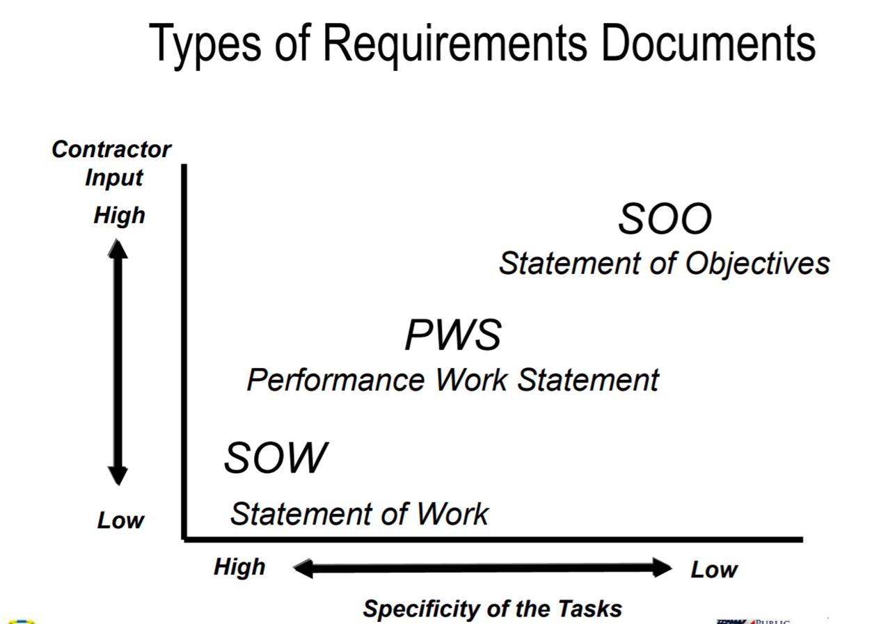
ARTICULATING THE GOVERNMENT’S NEEDS

Slide 29
PB METHODOLOGY
Job Analysis
Performance Requirements Summary (PRS)
Performance
Work
Statement
(PWS)
Task Standard Acceptable Surveillance Incentives
Quality Methods/
Levels Measures
Quality Assurance
Surveillance
Plan (QASP)
Positive &
Negative
Incentives
Notes:
The flow chart illustrates the key steps in a performance based acquisition. The first step is a job analysis, which means describing the key parts of a job to be performed. This flows into the actual Performance Work Statement which is the overall term for the document output of a performance based process. A key part of the performance work statement is the performance requirements summary. Elements of the performance requirements summary include the task, the standard to be measured against, the acceptable quality level, the surveillance methods and measures and any incentives. As a subset of the performance requirements summary, the quality assurance surveillance plan or QASP (pronounced quasp) includes the standard, the acceptable quality level and the surveillance methods. The incentives may be either positive or negative.

Slide 30
DEVELOP THE PWS
CONDUCT JOB ANALYSIS
APPLY THE “SO-WHAT?” TEST
CAPTURE THE RESULTS OF THE ANALYSIS IN A MATRIX
DESIRED OUTCOME
PERFORMANCE STANDARD
ACCEPTABLE QUALITY LEVEL
MONITORING METHOD

Slide 31
TIPS TO REMEMBER ABOUT DEVELOPING THE PWS…
IF THE GOVERNMENT WRITES THE PWS…
LET THE CONTRACTOR SOLVE THE PROBLEM
“WRITING IS HARD! VERY FEW PEOPLE IN MOST ORGANIZATIONS HAVE THE SKILL AND INTEREST TO WRITE GOOD REQUIREMENTS. FIND THESE PEOPLE, PRAISE THEM, AND PROMOTE THEM SO THEY CAN NEVER LEAVE.
USE TEMPLATES!
GSA HAS DOZENS OF ESTABLISHED TEMPLATES FOR JUST ABOUT EVERY TYPE OF ACQUISITION, INCLUDING ACQUISITION PLANS, REQUEST FOR QUOTE, REQUEST FOR PROPOSALS, COST ESTIMATES, AND DETERMINATIONS & FINDINGS.

Slide 32


PWS PITFALLS
“LET’S START WITH THE OLD SOW.” (CUT-AND-PASTE)
“CONTRACTOR SHALL DO X WHEN DIRECTED BY THE GOVERNMENT.” [OR “TO THE SATISFACTION OF THE COR.”]
“WE NEED A SAMPLE SOO FROM ANOTHER AGENCY.”
“WE NEED TO PLACE A TASK ORDER AGAINST A MOBIS 874 SCHEDULE CONTRACT. PLEASE PROVIDE THE SAMPLE MOBIS PWS.”
“WE ARE UNIQUE…”

Slide 33

SCENARIO 1
Fire Drill

Slide 34
IF YOU CAN’T PWS, THEN STATEMENT OF OBJECTIVES (SOO)!
BEGIN WITH THE ACQUISITION’S “ELEVATOR MESSAGE”
DESCRIBE THE SCOPE
WRITE THE (SHARED) PERFORMANCE OBJECTIVES
IDENTIFY CONSTRAINTS
DEVELOP THE BACKGROUND
MAKE THE FINAL CHECKS AND MAINTAIN PERSPECTIVE

Slide 35
CONTENTS OF THE SOO…
PURPOSE
SCOPE OR MISSION
PERIOD AND PLACE OF PERFORMANCE
BACKGROUND
PERFORMANCE OBJECTIVES (REQUIRED RESULTS)
ANY OPERATING CONSTRAINTS

Slide 36
KEY POINTS FOR THE REQUIREMENTS DOCUMENTS: PWS OR SOO
Know the outcome desired.
Plan for the acquisition upfront.
Program Manager/team should conduct an analysis - Use the team to refine the requirement
Perform market research to understand
    Commercial practices
    Tasks needed to achieve results
    Standards
    Incentives
    Similar acquisitions conducted by other agencies
Describe the outcome to be achieved to the contractor making sure that the contractor is allowed to solve the problem.
List specific tasks that must be performed to achieve the outcome.
Emphasis on the use of specified deliverables.
Establish specific standards.
Build in a validation mechanism for acceptance.
Team writes and reviews the PWS.
Consider the issuance of draft solicitations to refine the PWS.

Slide 37


CHECKPOINT 1
Where are we?

Slide 38
SCENARIO 2
SOO STATEMENT - SCOPE

Slide 39
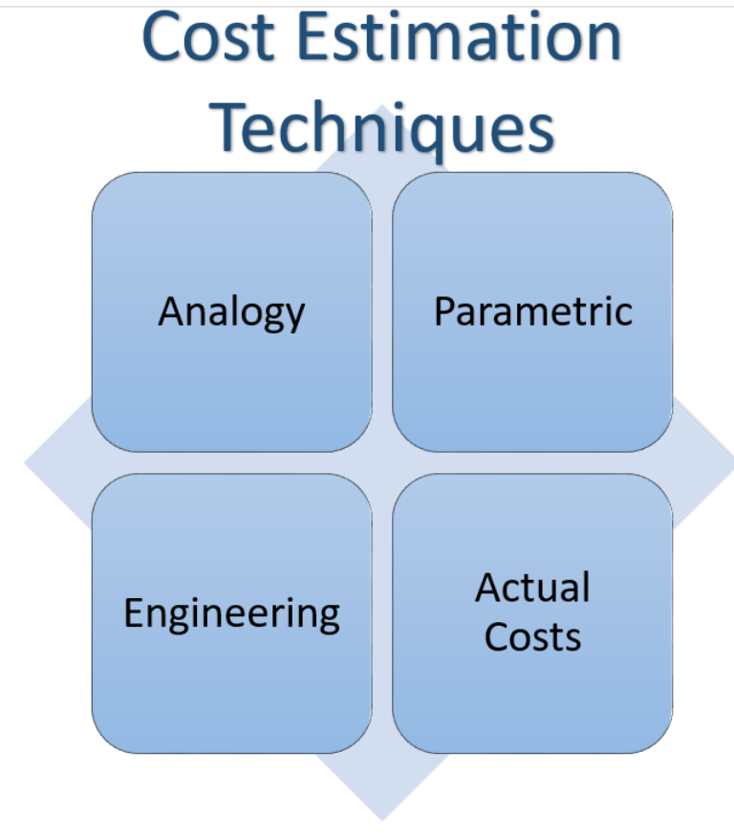
COST ESTIMATING – METHODOLOGIES AND TECHNIQUES
CERs A mathematical relationship that defines cost as a function of one or more variables such as performance, operating characteristics, physical characteristics, etc.

Slide 40
COST ESTIMATING FOR YOUR PROGRAM
DEFINITIONS VARY:
COST ESTIMATE: THE SUMMATION OF INDIVIDUAL COST ELEMENTS, USING ESTABLISHED METHODS AND VALID DATA, TO ESTIMATE THE FUTURE COSTS OF AN ITEM, PRODUCT, PROGRAM, PROCUREMENT, OR TASK, BASED ON WHAT IS KNOWN TODAY.
COST ESTIMATING: THE PROCESS OF COLLECTING AND ANALYZING HISTORICAL DATA AND APPLYING QUANTITATIVE MODELS, TECHNIQUES, TOOLS, AND DATABASES TO PREDICT THE FUTURE COST OF AN ITEM, PRODUCT, PROGRAM, PROCUREMENT, OR TASK.
A COST ESTIMATE IS AN EVALUATION AND ANALYSIS OF FUTURE COSTS GENERALLY DERIVED BY RELATING HISTORICAL COST, PERFORMANCE, SCHEDULE AND TECHNICAL DATA OF SIMILAR ITEMS OR SERVICES.
KEY: DOES MY AGENCY HAVE GUIDANCE? METHODOLOGIES FOR ESTIMATING AND CAPITAL PLANNING
Notes:
Acquisition Requirements Roadmap Tool Suite (ARRT): (https://www.dau.edu/tools/Documents/SAM/resources/ARRT_Home.html; and The ARRT Cost Estimation is a tool that guides you through the process of estimating costs of services detailed in the Performance Work Statement and helps you create an Independent Government Cost Estimate (IGCE)(not commercial)
GAO-20-195G, Cost Estimating and Assessment Guide: Best Practice by Developing and Managing Program Cost (https://www.gao.gov/products/gao-20-195g), 476 pages
Commerce Guide: https://www.commerce.gov/sites/default/files/2024-03/Department%20of%20Commerce%20Cost%20Estimating%20Guide%20Version%201.1.pdf
DAU - https://www.dau.edu/acquipedia-article/cost-estimation-methods

Slide 41

JOB ANALYSIS AND COST ESTIMATING
Process: Job Analysis to PWS to QASP
Systematic approach to analyzing a task
Step-by-step review of the requirement from contractor perspective
  Inputs (people, facilities, material)
  Process (work performed using those inputs)
  Output

Slide 42
WORK ANALYSIS AND COST ESTIMATING
Use tree diagram (sometimes referred to as Work Breakdown Structures (WBS)) to break tasks into subtasks, organized from the general to the specific.
Looks organizational, but is functional. Shows the task, not who performs the task.
Captures required tasks from organizational analysis, not extraneous tasks.
Limit to top three levels to avoid defining method of accomplishment.

Slide 43
WORK BREAKDOWN STRUCTURE EXAMPLE – TREE DIAGRAM
Perform Custodial Service
1
Dust
Horizontal
Surfaces
Clean Floors
Clean Bathroom Fixtures
2
4
3
Clean Hard Floors
Clean Carpeted Floors
3.1
3.2
Vacuum
Carpet
Shampoo
Carpet
Sweep Hard
Floors
Mop Hard
Floors
Wax Hard
Floors
3.1.1
3.1.2
3.1.3
3.2.1
3.2.2
Notes:
This is another example of a tree diagram. Each box on top contains a higher level task than the subtasks in the lower boxes. In this example, the top level box and two of the three subtasks shown below it are blank. The middle box is labeled “Clean Floors” and there are two subtask boxes shown below it. One is unlabeled but is above two even lower subtasks labeled “Vacuum carpet” and “Shampoo carpet.” The other is labeled “clean hardwood floors” with subtasks below it labeled “Sweep hard floors,” “Mop hard floors,” and “Wax hard floors.”

Slide 44
USING TREE DIAGRAM IN WORK ANALYSIS
For each box in the tree diagram (e.g., “4.1.1”), prepare a work (activity) analysis in three sections:
  Input (what starts a job)
  Work (task performed using those inputs)
  Output (all the things or services produced, which can be an input for another numbered task)

Slide 45
WORK ANALYSIS EXAMPLE
Task 4.1.1: Perform Requested Remedial Equipment Maintenance
INPUT | WORK | OUTPUT
Equipment Repair Request | 1. Determine Request Validity | Form XXX “Work Pending”
 | 2. Document Request
* Telephone | 3. Dispatch Repair Person | Form YYY “Repairs In-Process”
* Written | 4. Diagnose Malfunction
* Walk-in | 5. Repair Malfunction | * Equipment Repaired
 |  | Complete “Service Log “ Form #ZZZ

Slide 46

CHECKPOINT 2
Where are we?

Slide 47
BRAIN TEASER 2
YOU DO NOT WANT TO HAVE IT, BUT WHEN YOU DO HAVE IT, YOU DO NOT WANT TO LOSE IT. WHAT IS IT?
Notes:
A lawsuit

Slide 48
WE NEED TO ACQUIRE SOMETHING –
NOW WHAT?
What do we need?
How much of X do we need?
How much will X cost?
Can we afford X?
What’s in the Budget?
Is X included in our Capital Planning, Estimating?
What if we can’t acquire X now?
IGCE – HERE WE GO….

Slide 49
INDEPENDENT GOVERNMENT COST ESTIMATE (IGCE) DEFINITION
DEFINITION:
AN INDEPENDENT GOVERNMENT COST ESTIMATE (IGCE) IS COST ESTIMATE DEVELOPED BY THE REQUIRING OFFICE, BASED ON THE REQUIREMENTS OF THE PERFORMANCE WORK STATEMENT (PWS), STATEMENT OF OBJECTIVES (SOO) OR STATEMENT OF WORK (SOW). THE PURPOSE OF THE IGCE IS TO DEVELOP AN ASSESSMENT OF THE PROBABLE COST OF SUPPLIES AND SERVICES BEING ACQUIRED AND TO HELP DETERMINE THE REASONABLENESS OF AN OFFEROR’S PROPOSED COSTS AND THE OFFEROR’S UNDERSTANDING OF THE WORK.
A SUFFICIENTLY DETAILED AND ACCURATE IGCE ESTABLISHES A REALISTIC BUDGET AND ASSISTS IN THE ACQUISITION REVIEW, VALIDATION, PRIORITIZATION, AND APPROVAL OF REQUIREMENTS TO MEET MISSION NEED.
Notes:
GSA Pricing Intelligence Suite (https://buy.gsa.gov/pricing/)

Slide 50
INDEPENDENT GOVERNMENT COST ESTIMATE (IGCE) – WHEN AND WHO?
AN IGCE IS USED DURING ALL PHASES OF A PROGRAM TO INCLUDE LIFE CYCLE COST AND TOTAL OPERATING COST OF A ACQUISITION PROJECT, AS WELL AS MORE LIMITED ESTIMATES RELATED TO A SUBSET OF A CURRENT CONTRACT OR EVEN FOR A CONTRACT OPTION PERIOD WITHIN AN OVERALL PERIOD OF PERFORMANCE;
ALL ACQUISITION TEAM MEMBERS ARE RESPONSIBLE FOR DEVELOPING AN IGCE THAT WILL FORWARD THE ACQUISITION OBJECTIVES. THAT REQUIRES THE GOVERNMENT TO DO ITS DUE DILIGENCE TO ENSURE IT PROCURES SUPPLIES AND SERVICES OF THE BEST VALUE, INCLUDING CONDUCTING MARKET RESEARCH, DEVELOPING AN IGCE BASED ON THAT RESEARCH, AND USING THAT INFORMATION TO AFFECT AWARDING CONTRACTS/ORDERS AT COSTS/PRICES IN THE GOVERNMENT’S BEST INTERESTS.

Slide 51
INDEPENDENT GOVERNMENT COST ESTIMATE (IGCE) – REMINDER!
AN IGCE IS:
DEVELOPED BY THE GOVERNMENT WITHOUT CONTRACTOR INFLUENCE;
AN AID IN ACHIEVING BEST VALUE AND SHARED CONTRACT RISK;
BASED ON MARKET RESEARCH;
AN ANALYSIS OF REASONABLE AND REQUIRED RESOURCES TO PERFORM THE CONTRACT;
THE PROJECTED, ANTICIPATED, OR PROBABLE COST/PRICE OF A PROPOSED FEDERAL ACQUISITION; AND
A BENCHMARK FOR ESTABLISHING COST/PRICE ANALYSIS.

Slide 52
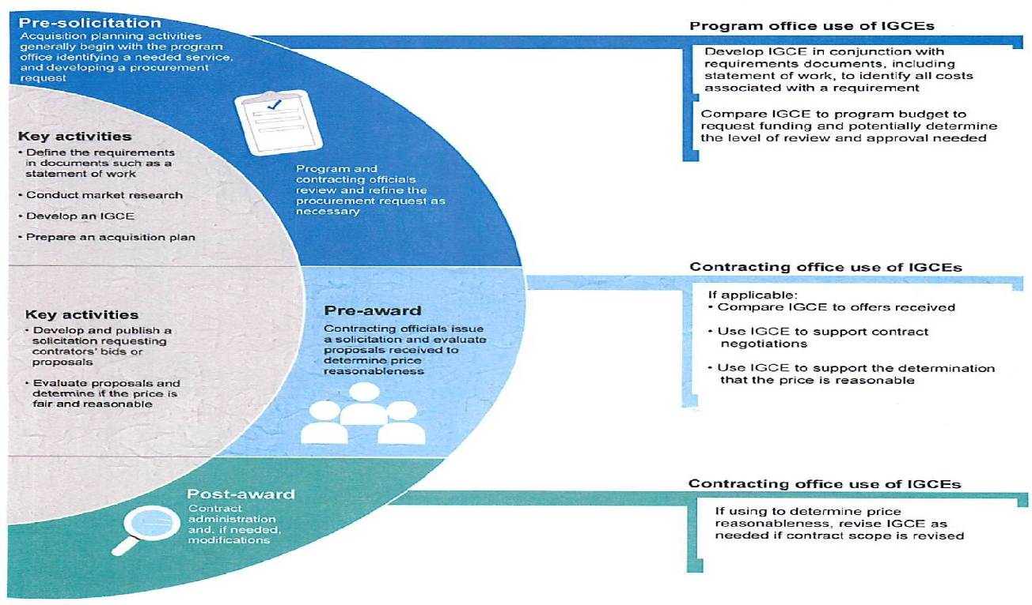
HOW IGCE SUPPORTS ACQUISITION LIFECYCLE
Source: Independent Government Cost Estimate (IGCE) Handbook for Services Acquisition, OSD, Department of Defense

Slide 53
HOW IGCE SUPPORTS PROGRAM OFFICE
IGCE Developers is required to consider the following:
In the narrative of the IGCE, answer the five primary questions:
    How was the estimate made?
    What assumptions were made?
    What information/tools were used?
    Where was the information obtained from?
    How did previous estimates compare with prices paid?
  Prior to being accepted, the IGCE preparer ensures that:
    The IGCE contains enough detail to assist the Contracting Officer (CO) or Cost/Price Team in the evaluation of the reasonableness of offered prices during the Source Selection process;
    The IGCE provides sufficient narrative and analytical detail, to include reference material, to support its preparation;
    The IGCE includes a certification that the Government developed the IGCE independently prior to seeking any formal proposals from contractors.

Slide 54
ASSUMPTIONS FOR IGCEs
IGCE Developers must do the following:
Conduct market research to determine the elements of cost for the item or services.
Engage with the seller or the manufacturer's authorized representative in writing if the merchandise is from the gray market. If it is from the gray market do not proceed with purchase from that source. If not gray market, proceed with procuring good. Document findings in the procurement file either way.
Promptly inspect the goods received to ensure they are in proper working order, are not are not old, counterfeit, or discontinued models.
Accept the goods, as appropriate. If any goods or services are suspected to be gray market goods, contact the ISSO/ITSO as soon as it is discovered.

Slide 55
BE REASONABLE! RIGHT?
The IGCE is an estimate of the reasonable costs that a contractor may bear in performing the required services or providing the supplies. A cost is considered "reasonable" if it reflects the action that a prudent business person would have taken at the time the cost was incurred. An IGCE is not the lowest or the highest possible estimated cost/price for performance; it is the Governments projection of the cost of the program. Upon receipt of application/proposals there may be a significant difference between the IGCE and proposed costs by the offeror.
There should be sufficient information (rationale and assumptions) in the IGCE to allow for the explanation of differences between the IGCE and an offered price. Significant discrepancies between the IGCE and the Applicant/Offeror’s proposal should be documented.

Slide 56
TIPS TO REMEMBER: IGCE
In Preparation:
  Ensure that all cost elements for goods and services for each task/requirement or development outcome is included in the IGCE.
  Employ proper data collection and estimating methodology (remember the Myth Busting Memos)!
  Document data sources, assumptions, constraints, methodology, and subject matter expert (SME) inputs.
  Use salient characteristics as opposed to brand name to obtain quotations;
  IGCE should be revised based on new price/cost information and revised/new requirements.
  DO NOT share the IGCE with anyone outside the designated procurement team. The document is procurement sensitive and access is on a “need-to-know” basis and must be safeguarded as required by the Federal Acquisition Regulation (FAR).
  DO NOT reveal information which may give any one organization an unfair competitive advantage.
  DO NOT use a preferred organization’s quotation as the IGCE
  When unsure, seek guidance from the Contracting Officer

Slide 57
COST ESTIMATING AND IGCES ARE
NOT EQUAL
It might seem these are synonymous, and they are not…
Examples…

Slide 58

CHECKPOINT 3
Where are we?

Slide 59
SCENARIO 3
COSTS of YOUR NEED

Slide 60


WHAT DO YOU NOTICE?

Slide 61
WHO’S WATCHING
GAO - https://www.gao.gov/products/gao-17-398
Federal internal control standards say that transactions should be completely and accurately recorded to maintain their relevance for making decisions.
The Usefulness of IGCEs in Acquisition Planning Varied, and Most Did Not Include Supporting Documentation
In the 62 contracts we reviewed with IGCEs, the usefulness of IGCEs in acquisition planning varied and most did not include supporting documentation with details, such as the information sources and methodologies used, that could help contracting officers more effectively use IGCEs. Most of the IGCEs in GAO’s review—49 of 62—were not well-documented, which in some cases limited their usefulness to contracting officers; these officers had to perform additional, inefficient steps to validate IGCEs so they could be used. Only two of the agencies in our review (Army and DHS) had department-level guidance on what details to document in the IGCEs.
GAO
Cost estimating Guidance
Notes:
GAO-17-398, Service Contracts: Agencies Should Take Steps to More Effectively Use Independent Government Cost Estimates (https://www.gao.gov/assets/gao-17-398.pdf)
GAO-20-195G, Cost Estimating and Assessment Guide: Best Practice by Developing and Managing Program Cost (https://www.gao.gov/products/gao-20-195g)

Slide 62
BRAIN TEASER 3
WHAT GOES THROUGH CITIES AND FIELDS, BUT NEVER MOVES?
Notes:
A road

Slide 63
KEY POINTS FOR DEVELOPING METRICS AND STANDARDS
Team should conduct market research on commercial metrics and performance standards.
Team should know what they view as a successful outcome.
Performance standards should be measurable, meaningful, easy to apply and attainable.
Define your metrics - measure the contractor’s performance.
Metrics and performance standards should have a basis - commercial standards or Gov’t required standards so rely on commercial quality standards, if available.
When doing a SOO, have the contractor propose the PRS.

Slide 64
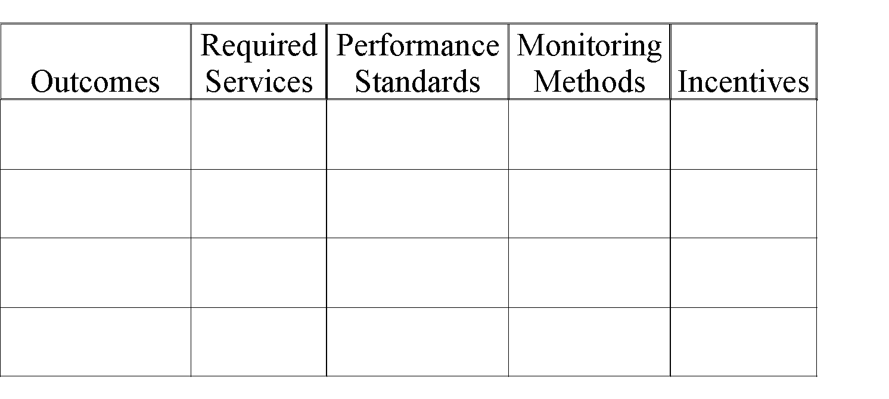
PERFORMANCE BASED MATRIX TEMPLATE

Slide 65

CHECKPOINT 4
Where are we?

Slide 66
SCENARIO 4
Begin to Fill in a Matrix
SOO SECTION PERFORMANCE OBJECTIVE – DEVELOP ONE FOR YOUR PROJECT…
Notes:
Source of Template:

Slide 67

MYTHS TO DISPEL
PBS IS A NEW TREND IN ACQUISITION.
PBC IS VERY VAGUE AND UNSPECIFIC
PBC IS A CONTRACT TYPE.
PBC IS THE RESPONSIBILITY OF THE CONTRACTING OFFICER.
PBC IS COMPLEX AND NOT WORTH THE TIME.
PBC LEAVES US POWERLESS.
PBC EQUALS NO DIRECTION.
FIRST AIRPLANES PROCURED FROM THE WRIGHT BROTHERS USING PB SOW.
OUTCOME SPECIFIC NOT PROCESS SPECIFIC.
ANY CONTRACT TYPE MAY BE USED. THE SOW IS FOCUSED ON RESULTS.
IT IS JOINT TEAM EFFORT – PROGRAM MANAGER NEEDS TO KNOW THE OUTCOME AND WRITE THE SOW IN A PERFORMANCE-BASED MANNER.
IT FORCES US TO WORK HARD UPFRONT TO ENSURE THE TIME INVESTED IS WORTH AND RESULTS ARE ACHIEVED.
GIVES US POWER TO ACHIEVE THE OUTCOME.
TEAM CAN GIVE OUTCOME ORIENTED GUIDANCE - WHAT GUIDANCE BUT NOT HOW TO GUIDANCE.
MYTHS:
REALITY:

Slide 68


ACQUISITION WORD SCRAMBLE
SIAUNCTOIIQ
TMTESEIA
URLSTSE
TSOCS
SERIPC
PANRMRCEFEO
RNIMUSTQEREE
Notes:
Source: https://www.kiddoworksheets.com/worksheet-generator-word-scramble/

Slide 69


SELECT THE RIGHT CONTRACTOR!
Compete the selection; use down-selection
Use oral proposals/quotes and other opportunities to communicate
Emphasize past performance in evaluation
Require and evaluate contractor’s QC plan
Use best-value evaluation and source selection
Prevent conflicts of interest

Slide 70

RESULTS ORIENTATION: WHAT’S THE OUTCOME?
The standards of measurement that are results-oriented:
  quality of work or product
  quantity of work or product
  accessibility
  timeliness
  accuracy
  customer satisfaction
  not unduly burdensome

Slide 71

PARTNERING
Meet with the contractor to identify ways to improve efficiency and reduce the effect of the "cost drivers."
The contractor and government work together to identify more effective and efficient ways to measure and manage the program.
Establish a Customer Process Improvement Working Group that includes contractor, program, and contracting representatives.

Slide 72

METRICS – DID CONTRACTOR ACCOMPLISH
THE OUTCOME AND HOW TO PROVE IT?
Performance indicators and standards
Collect, track, and share data
Conduct surveillance systemically
Document results
Review periodically and jointly with the contractor
“Are we measuring the right things?”
Recommend use of Contractor owned automated tools
If not owned by the contractor and proposed at time of award, be prepared to pay for the tool
Some agencies have their own tools. Make sure that you can extend the license to contractors
Use an IV&V contractor to sample the data from the contractor
Send the monthly results of the metrics to stakeholders so there are no surprises when it comes time to pay the contractor
In general, contractors prefer metrics because they have control over their own destiny in terms of meeting their metrics and can obtain a very high fee amount relative to subject evaluations

Slide 73
EXAMPLE:
Provide taxi service -
Old type SOW: drive to passenger pickup, pull over to curb, put vehicle in park, wait for passenger, open door, drive to destination.
New PWS: pickup passengers on time
better > pickup passengers within five minutes of an agreed upon time
Standard could be 95% on time (within the five minutes)
Metrics would be percentage of pickups that comply with the standard (or the percent that don’t)
Failure to perform within the standard would result in a contract price reduction.

Slide 74
ARE WE ASKING THE RIGHT QUESTIONS?
“It is important to keep the focus of the meetings on improving performance, not evaluating people. Each meeting should start with the questions, “Are we measuring the right thing?” and “How are we doing?” It is important to continually revisit the success measures the team identified during Step Two. Other important questions are:
  Is the acquisition achieving its cost, schedule, and performance goals?
  Is the contractor meeting or exceeding the contract's performance-based requirements?
  How effective is the contractor's performance in meeting or contributing to the agency's program performance goals?
  Are there problems or issues that we can address to mitigate risk?
There should be time in each meeting where the agency asks, “Is there anything we are requiring that is affecting the job you can do in terms of quality, cost, schedule, or delivering the solution?” Actions discussed should be recorded for the convenience of all parties, with responsibilities and due dates assigned.”
Notes:
Source: Steps to PBA, Step 7 (https://buy.gsa.gov/spba/steps?step=manage-performance)

Slide 75
ACTIVITY 2
RETURN TO FILL IN THE MATRIX…
WHAT QUESTIONS MIGHT YOU ASK ABOUT YOUR PROJECT?
PERFORMANCE STANDARD ACCEPTABLE QUALITY LEVEL (AQL) METHOD OF SURVEILLANCE PERFORMANCE INCENTIVE

Slide 76
BRAIN TEASER 4
WHAT CAN YOU KEEP AFTER GIVING TO SOMEONE?
Notes:
Your word

Slide 77



WE MADE IT?
ALMOST THERE….

Slide 78


LESSONS LEARNED…
Steps to Performance Based…(link)
Establish the team
Decide what problem needs solving
Examine private-sector and public-sector solutions
Develop a PWS or SOO
Decide how to measure and manage performance
Select the right contractor
Manage performance

Slide 79


RECAP OUR MISSION!
Culture change and Teamwork
Start early with planning – Program Planning, Market Research, Cost Estimating, Problem Solving, Developing Requirements, IGCEs
Manage performance not process
Manage the contract not the people
Use the QASP
Partner
Capture Lessons Learned and Implement

Slide 80


QUESTION: HOW WILL YOU HAVE IT BE POSSIBLE?
Notes:
What’s one new idea you got from this session. Drop into the chat!

Slide 81






UNTIL THE NEXT MISSION….
Keep learning, share your lessons learned, make waves and add to your toolkit!

Slide 82







GONE FISHING AGAIN!
There’s always next time you’ll be needed…

Slide 83
RESOURCES

Slide 84

FAR REFERENCES:
FAR 1.102, STATEMENT OF GUIDING PRINCIPLES
FAR PART 2, DEFINITION
FAR PART 7 ACQUISITION PLANNING
FAR PART 10, MARKET RESEARCH
FAR PART 16, TYPES OF CONTRACTS
FAR PART 11, DESCRIBING AGENCY REQUIREMENTS
FAR PART 37, SERVICE CONTRACTING – RECOGNIZES USE OF SOO WHEN PWS IS NOT SUITABLE
FAR PART 46, QUALITY ASSURANCE. – NOTE: THIS IS NOT THE ONLY CONTRACT QUALITY REQUIREMENT THAT CAN BE USED PER FAR.
Notes:
FAR 1.102 Statement of Guiding Principles for the Federal Acquisition System -states that the FAR is to deliver on a timely basis the best value product or service to the customer while maintaining the public’s trust and fulfilling public policy objectives. The participants in this process should work together as a team and should be empowered to make decisions within their area of responsibility.
FAR Part 2 is the definition section and defines PBC.
FAR Part 7, Acquisition Planning
(notably Subpart 7.5- Inherently Governmental Functions – For example: make sure you are not asking a contractor to determine what supplies or services are to be acquired by the Government and provisions at 7.105 Contents of an Acquisition Plan - (6) Product or service descriptions. Explain the choice of product or service description types (including performance-based contracting descriptions) to be used in the acquisition.
FAR Part 10, Market Research prescribes policies and procedures for conducting market research
FAR Part 11, Describing Agency Requirements (11.106- Purchase descriptions for service contracts and 11.101 Order of precedence for requirements documents.
(a) Agencies may select from existing requirements documents, modify or combine existing requirements documents, or create new requirements documents to meet agency needs, using the following order of precedence.
(1) Documents mandated for use by law.
(2) Performance-oriented documents.
(3) Detailed design-oriented documents.
(4) Standards, specifications and related publications issued by the Government outside the Defense or Federal series for the non-repetitive acquisition of items.

Slide 85


QUESTIONS?

Slide 86

THANK YOU!
Office of Integrated Marketing
Continuing your Acquisition Journey

