Slide 1


Fall Into Success:
Discover the New OASIS+ and Acquisition Solutions Navigator
November 19, 2024
Office of Integrated Marketing
Continuing your Acquisition Journey

Slide 2



Presenter:
Bill Niess
OASIS+ Program Manager
Office of Professional Services and Human Capital Categories (PSHC)
Notes:
[updated as needed]
Thank you for joining us today. My name is _________. I'm the ____________.

Slide 3
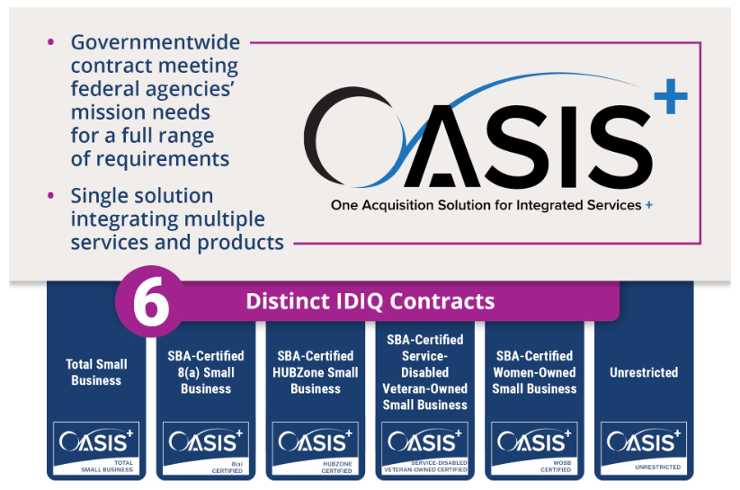
What is OASIS+
OASIS+ is a suite of six governmentwide, multiple-award contracts designed to support federal agencies’ procurement requirements for services-based solutions.
OASIS+ is a single solution integrating complex, non-IT services.
Five (5) contracts for Small Businesses
Notes:
OASIS+ is an acronym for “One Acquisition Solution for Integrated Services Plus”
OASIS+ is the follow-on or successor program to GSA’s legacy OASIS program deployed in 2015.
OASIS+ is a government-wide multiple award contract or “MAC”.
OASIS+ is also an indefinite quantity contract or “IDIQ”.
So you might hear OASIS+ referred to using those acronyms.
OASIS+ consists of 6 separate and distinct IDIQ contracts. 5 of them are for SBs:
Total SB, 8(a) SB, HUBZone SB, SDVOSB, WOSB, and UR
As a point of comparison, the legacy OASIS Program consists of 3 IDIQ contracts: SB, 8(a), and UR
OASIS+ is designed to provide government agencies with an expanded range of services to meet their specific requirements or mission needs.

Slide 4
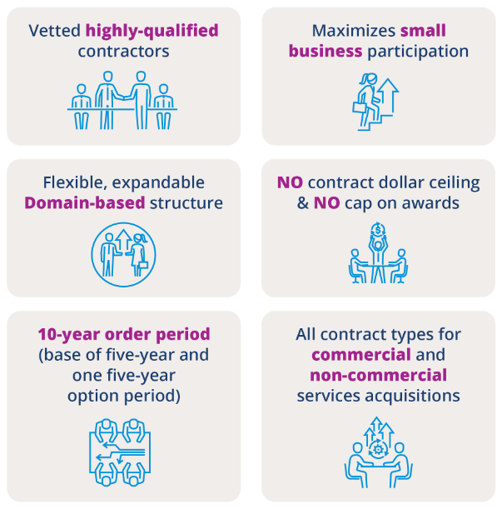

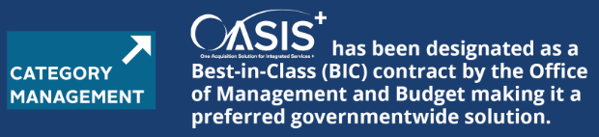



Unique Features of OASIS+
April 2024
Best-in-Class (BIC) is a government-wide designation for acquisition solutions that can be used by multiple agencies and satisfies key criteria defined by OMB.
Key BIC evaluation criteria include demonstrated use of category and performance management strategies and third-party validation.
OMB Memo M-19-13 -- “Category Management: Making Smarter Use of Common Contract Solutions and Practices”, March 20, 2019.
Notes:
Why Use OASIS+?
[This slide highlights the reason or “business case” for using the OASIS+ contracts.]
[Summarize the graphic on the left side - 6 items]
[Mention that OASIS+ supports both CONUS and OCONUS places of performance]
[The right side of this slide notes that OASIS+ was designated by OMB’s Office of Federal Procurement Policy (OMB-OFPP) as a Best in Class contract in April 2024 (pre-award!).
Many agencies mandate that their Ordering Officials use BIC contracts
Most agency HCAs have BIC usage targets in their annual performance plans
The slide shows a link to OMB Circular M-19-13 (more info about Category Mgmt)

Slide 5

OASIS+ is not …
Not Multiple Award Schedule (MAS)
  FAR 38 & 8.4 (MAS - Federal Supply Schedule Contracting)
  FAR 16.505 (OASIS+)
Not for Information Technology, Construction, or Architect & Engineering contracts
Not limited to standard labor categories or pre-negotiated labor rates
  For sole-source T&M / LH orders, OCOs may review negotiated ceiling rates for standard labor categories
Not capped by total value at the IDIQ master contract or task order level
Not limited to a fixed number of contractors (no cap on the number of awards)
Notes:
However …
GSA believes OASIS+ is a great solution
OASIS+ uses a different FAR buying authority versus MAS
OASIS+ is not for IT, construction, or A/E requirements
[The last three bullets are actually positives for OASIS+]

Slide 6
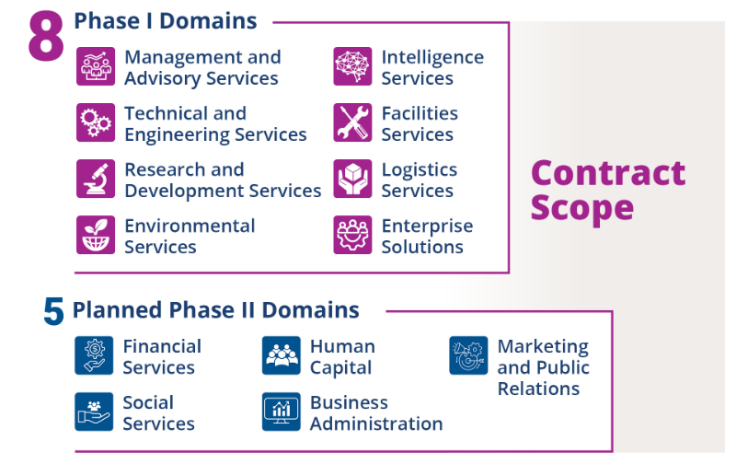
OASIS+ Domains
OASIS+ contract scope is organized by Domains or functional groupings of related services.
Each Domain contains multiple North American Industry Classification System (NAICS) codes.
OASIS+ contractors may qualify for award of some or all NAICS included in a specific Domain (provided they meet all qualifications for award).
Ordering Contracting Officers select:
      OASIS+ IDIQ Contract;
      OASIS+ Domain; and the
      NAICS code that best represents the scope of their requirement.
Fair Opportunity is conducted at the CLIN/individual NAICS code level.
Notes:
So let’s dive in begin to examine the OASIS+ contract program structure …
OASIS+ contract scope is organized by domains
Domains are logical groupings of related NAICS codes
7 domains appear on the 5 OASIS+ small business IDIQ contracts
1 domain (Enterprise Solutions) appears on only the Unrestricted IDIQ
Next Steps
8 domains in OASIS+ Phase 1 (rolling contract awards in progress (FY24Q4-FY25Q2)
5 new domains planned for Phase 2 (PSHC plans to release RFPs in FY25Q4; initial focus is Financial Services and HC/Training.
Focus – Agency Ordering Officials select: the IDIQ contract – the Doman – the NAICS code
NASA example = NAICS 541611 appears in multiple domains (M& A. The T&E Domain might be preferred for a NASA req

Slide 7
Let’s take a closer look at these OASIS+ Domains …
Notes:
[transition slide]

Slide 8
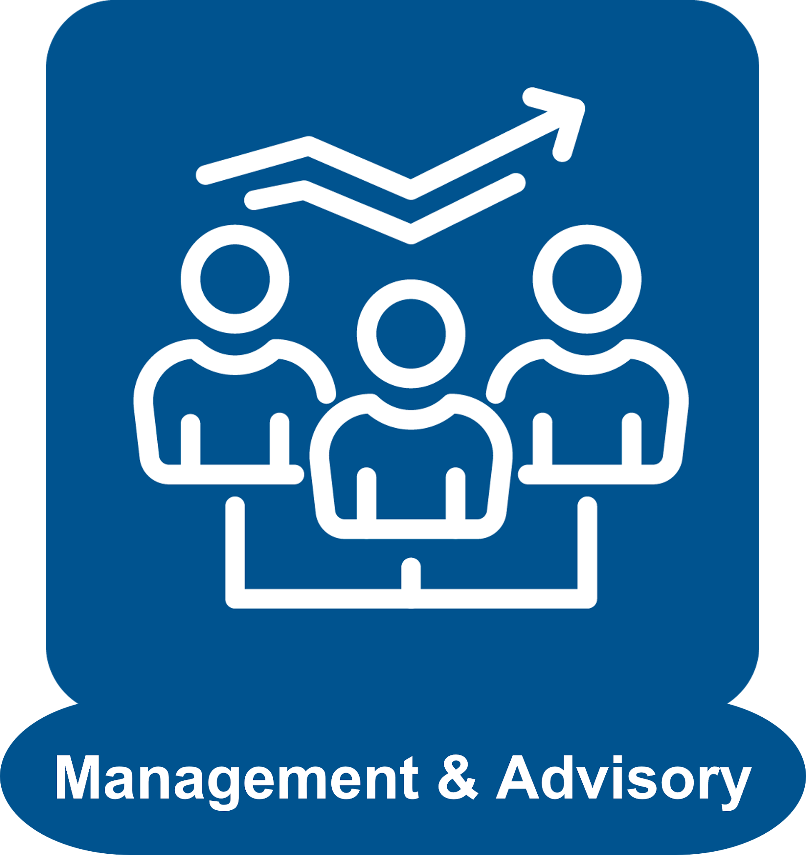



OASIS+ Domains – Phase 1
This Domain includes a full range of management and consulting services that can improve a federal agency’s performance, aid its endeavors to meet mission goals, and provide operating advice and assistance on administrative and management issues. [8 NAICS codes]
This Domain includes requirements to provide specific engineering, geoscience, or other technical professional skills, such as those performed by engineers, geologists, geophysicists, and technicians, required to handle specific operating conditions and problems for the benefit of the government.
[16 NAICS codes]
This Domain includes any requirements in support of R&D activities aimed at achieving either specific or general objectives. The term R&D includes basic research, applied research and experimental development. Services include conducting R&D in: the physical, engineering and life sciences; nanotechnology; biotechnology; and social sciences and humanities. [16 NAICS codes]
This Domain includes comprehensive logistics solutions, including planning, designing, implementing, or operating systems or facilities for the movement of supplies, equipment, or people by road, air, water, rail, or pipeline.
[19 NAICS codes]
OASIS
BMO
HCaTS
Expanded Scope

Slide 9




OASIS+ Domains – Phase 1 (cont’d)
This Domain focuses on Command, Control, Communications, Intelligence, Surveillance, and Reconnaissance mission requirements. Organizational and technological capabilities improve situational awareness and enhance command and control strategies within defense and intelligence environments. [16 NAICS codes]
This Domain include any and all services required to maintain and operate buildings, paved services, utilities infrastructure, and real property assets and equipment. Examples: major facilities support such as DOD installations, hospitals, cemeteries, and other federal or industrial real property.
[29 NAICS Codes]
Requirements typically involve multidisciplinary teams of scientists, engineers, and other technicians with expertise in areas such as air and water quality, climate change, asbestos contamination, remediation, ecological restoration, and environmental law.
[11 NAICS codes]
This Domain includes requirements that are large-dollar, wide-reaching, and highly complex in scope, often spanning multiple disciplines and/or locations, and requiring many different types of labor and expertise. By design, this Domain shares overlapping NAICS with other Domains. The minimum order threshold for task orders issued through this Domain is $250 Million total estimated value (including the base and all option periods). [17 NAICS codes]
OASIS+ Unrestricted
contract family only.
OASIS
BMO
HCaTS
Expanded Scope

Slide 10
So, let’s pull this all together...

Slide 11













OASIS+ Contract Framework
OASIS+ Phase #1 Domains (8)
Initial Contract Awards / NTP = FY25 Q1/Q2
Reopen RFPs (Continuous On-Ramping) = FY25 Q3
OASIS+ Phase #2 Domains (5)
Release Solicitations = FY25 Q4
Initial Contract Awards / NTP = FY26
OASIS+ IDIQ Contracts (6)
OASIS+ Total Small Business
2. OASIS+ HUBZone
3. OASIS+ SDVOSB
Logistics Services
Technical & Engineering Services
Management & Advisory Services
Intelligence Services
Research & Development Services
Facilities Services
Marketing & PR Services
Environmental Services
Business Administration Services
Enterprise Solutions
Social Services
Human Capital Services
Financial Services
4. OASIS+ WOSB
5. OASIS+ 8(a)
6. OASIS+ Unrestricted
NAICS Codes:
8
16
16
19
29
16
11
17
TBD
TBD
TBD
TBD
TBD
OASIS
BMO
HCaTS
Expanded Scope
‹#›
Expiring GSA Contracts Providing Scope to OASIS+

Slide 12
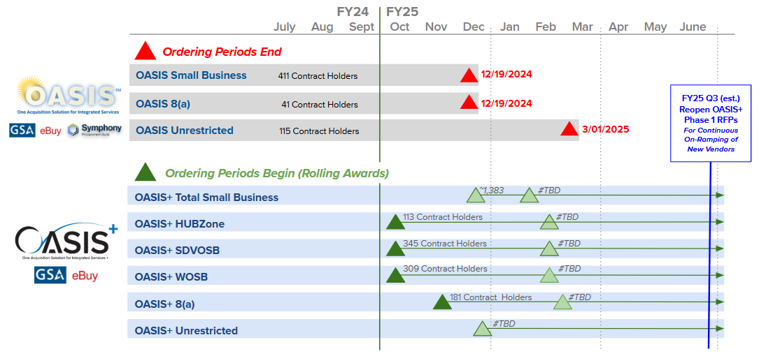
Timelines – OASIS and OASIS+

Slide 13







OASIS+ Ordering Procedures
Acquisition Planning
Market Research
Preparation
Solicitation, Evaluation, & Task Order Award
Determine if OASIS+ is the right fit
Get familiar with the OASIS+ scope, domains, labor categories, NAICS codes and additional features to ensure you fully understand the contracts.
Research the OASIS+ contract features
Explore which OASIS+ IDIQ contract is right for you, taking into consideration factors like small business set asides, contract types, period of performance and order limitations.
Request a scope review
GSA offers an optional (and free) OASIS+ scope review that helps determine if your requirement (SOW, PWS, SOO) is within scope of the contract you are considering.
Complete market research
Explore the Federal market. Find data on business utilization, spending and use tools, and opportunities for subcontracting and joint ventures.
Learn about pricing intelligence, scope reviews, and using GSA’s free Market Research as a Service (MRAS) resources to conduct Requests for Information (RFIs).
Obtain a Delegation of Procurement Authority (DPA)
Be a warranted Contracting Officer as defined in FAR 2.101.
Register (online) and attend OASIS+ DPA Training.
Review the corresponding Delegation of Procurement Authority Ordering Guide for OASIS+.
Submit documentation to GSA.
Request DPA (online).
Develop and issue the solicitation
Review the OASIS+ Ordering Guide, confirm solicitation requirements and considerations, create the task order solicitation, and release it through GSA eBuy.
Award the task order
Learn about the factors and requirements involved in proposal evaluation and task order award consideration.
Manage the task order
Understand the process of reassigning task orders for administration, quality assurance, UR subcontracting plans, performance evaluation, and task order closeout.

Slide 14
Resources

Slide 15
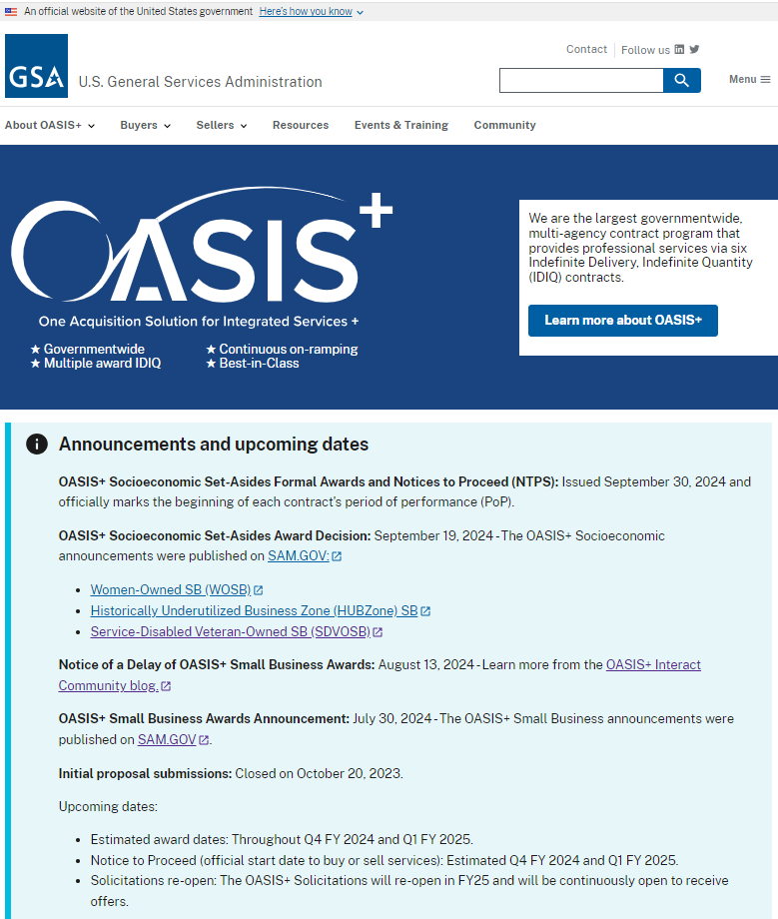
OASIS+ Additional Resources
2024 Pacific Defense Contracting Summit (October 28, 2024)
Acquisition Planning
  OASIS+ Website – one-stop shop!
  OASIS+ Blog (Interact) – sign-up!
  OASIS+ Fact Sheet (PDF)
  OASIS+ Training
  Request a Scope Review
Market Research Tools
  Market Research as a Service (MRaS)
  CALC+ Pricing Intelligence Suite
  OASIS+ Scope Reviews
Preparation
  Obtain an OASIS+ DPA
Solicitation, Evaluation, & Award
  Review the OASIS+ Ordering Guide
https://www.gsa.gov/oasis-plus/
Notes:
All of the above will be available via a link the OASIS+ Website, along with other information.

Slide 16






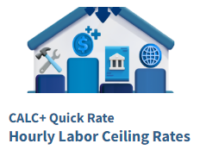
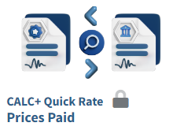



How GSA-PSHC Delivers …
Manages FAS’s $56 billion+ professional services and charge card acquisition marketplaces
Administers
  6,000+ contracts and industry partners
  7 million+ travel, purchase, and fleet charge card accounts
Trains & provides acquisition support services to federal acquisition professionals & programs
Delivers access to services pricing data & leading practices through easy to use digital tools
Serves as the Federal Category Manager for professional services
Leads the Federal Better Contracting Initiative (BCI) for improving services requirements development
Acquisition Programs:
HCaTS
Support:
Tools:

Slide 17


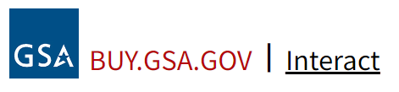

Join the OASIS+ Interact Community
Thank you!
Questions?
oasisplus@gsa.gov
Follow us on X (formerly Twitter)
@GSAProfServices
Follow us on LinkedIn
#gsaprofessionalservices

Slide 18


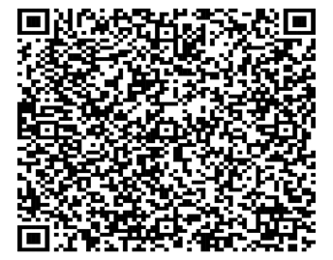


Presenter: Acquisition Solutions Navigator
Mark King
GSA Customer Service Director, NASA Accounts
Office of Customer Accounts and Stakeholder Engagement (CASE)

Slide 19
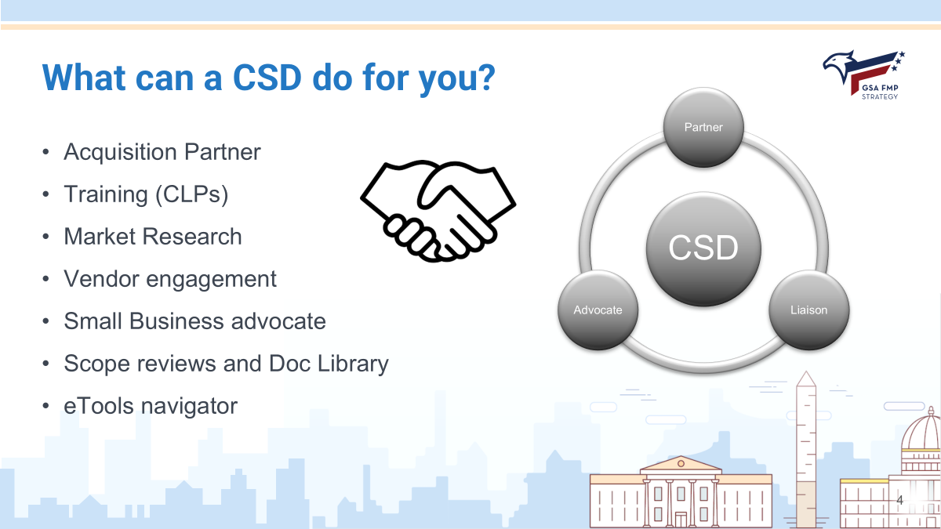

Slide 20


Agenda
●What IS Buy, really?
●Registration & Profile
●Overview of Buy tools
●Acquisition Solutions Navigator
●LIVE demo
●Q&A
Notes:
Agenda
Today we will discuss:
FOR TRAINERS - Why it is important to train customers on buy.gsa.gov (this bullet is for training trainers)
Some new features that have recently deployed in buy.gsa.gov
How to get access to buy, and a quick overview of what is contained therein.
How to register and set up your profile.
What buy.gsa.gov is best for
A look at each of the buy.gsa.gov tools (note: you can choose to do this live, or using the static slides in this deck)
On the next slide, you’ll see a breakdown of the Buy tools we’ll discuss later on. Some of these you might have used before when they lived elsewhere, but now reside within buy.gsa.gov.
For Trainers
Your general goal for a buy.gsa.gov overview is to:
Give the customer an introduction to what buy.gsa.gov is and what needs it fulfills.
Make the customer want more!
This training is intended to get them to want you to offer them follow on trainings for the pricing intelligence suite and the acquisition solutions navigator.

Slide 21
Have you ever found yourself needing to…
…perform an independent government cost estimate (IGCE) for a procurement or proposal?
…locate or compare sources of supply, maybe even entire contract vehicles?
…create documents such as a quality assurance or market research plan?
…coordinate with other professionals about updates to a program?
Notes:
“Selling” buy
This slide is intended to allow you to articulate just how valuable buy can be. You are connecting with your audience by asking them if they have ever had to do things (that we all know they probably have had to do) that buy makes easier for them.
This is your opportunity to connect and really sell the value.
The next slide works in tandem with this slide.
For Trainers
Remove this text if you are showing this to customers
This type of slide has proven very effective for piquing the interest of customers who may not be familiar with just how much buy.gsa.gov can do.
Trainers should understand their audiences and the tasks they perform, and customize these two slides accordingly. An audience that spends time doing pricing work will be more interested in the capabilities of the pricing suite. Meanwhile, an audience that spends time finding sources might care more about the acquisition solutions navigator.

Slide 22
You can do all that and more with buy.gsa.gov!
Create a Cost Estimate (IGCE)
Find or Compare Sources
Interact with Communities
The Pricing Intelligence Suite has pricing data from multiple sources, being updated constantly!
The Acquisition Solutions Navigator (ASN) lets you research individual contracts, and even compare entire vehicles!
Interact(R) brings people together across government and industry for discussion and knowledge sharing!
Notes:
“Selling” buy
On the previous slide you asked users whether or not they had ever needed to
…perform an independent government cost estimate (IGCE) for a procurement or proposal?
…locate or compare sources of supply, maybe even entire contract vehicles?
…create documents such as a quality assurance or market research plan?
…coordinate with other professionals about updates to a program?
Here, you are telling them that buy.gsa.gov has tools for doing all that and more.
They can use the tools in the pricing intelligence suite to do IGCEs.
They can use the ASN for researching sources.
They can use Interact to join groups and discuss topics of interest.
For Trainers
As noted in the previous slide, tailor these selling points based on the tasks your audiences typically perform.

Slide 23
What’s in the toolbox?
Index of Main buy.gsa.gov Tools
1
Pricing Intelligence Suite
CALC+ QuickRate
CALC+ Prices Paid
CALC+ BLS
CALC+ IGCE
Jump point to access City Pairs and D2D
2
Acquisition Solution Navigator (ASN)
Compare Contract Vehicles
Search Contracts & Vendors
3
Buy.GSA.gov Document Tools
Document Library
Document Builder
4
Interact
Notes:
Index of buy.gsa.gov tools:
Here is a grouping of what you will see today as we explore buy.gsa.gov
Pricing Suite
CALC+ Quick Rate; - which displays schedule prices - not-to-exceed ceiling prices
CALC+ Prices Paid; - which is a data source that displays prices paid information from all our GSA GWACs
CALC+ BLS; - this is where you can find wage rate information from the Dept. of Labor’s Bureau of Labor Statistics
CALC+ IGCE Tool - where you can build Independent Govt. Cost Estimates.
Acquisition Solutions Navigator
Compare Contract Vehicles - deployed in the summer of 2024, this capability allows users to compare entire contract vehicles
Search Contracts & Vendors - this capability lets users search for specific contracts by keyword, and get information about them.
Document Tools
Document Library - Browse hundreds of templates for useful contract and project documents.
Document builder - an up and coming tool that allows users to build documents based on previously loaded templates.
Interact - FAS’ homegrown social networking platform.

Slide 24
Access and Overview

Slide 25
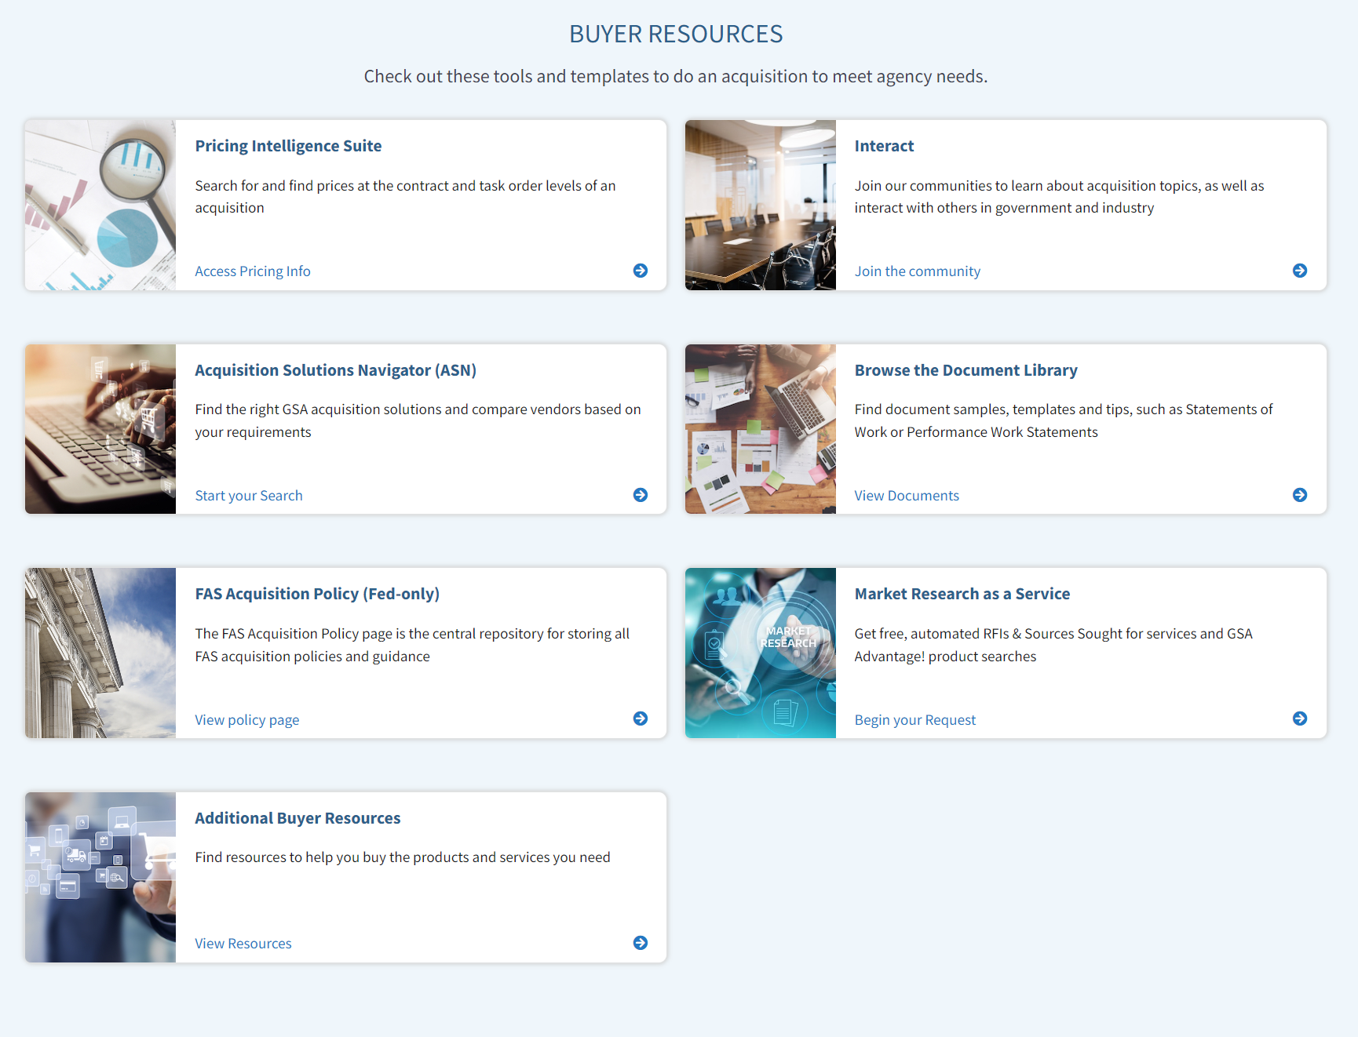
Buy.gsa.gov
Your GSA resources in one place.
Notes:
Navigate the site.
This is what you’ll see when you navigate to the landing site for Buy.GSA.gov.
You’ll see information and tools arranged in tiles, tabs, and menus. And today, I’m going to give you a basic orientation of the site itself.
But first, I wanted to point out these tools are regularly being updated. We encourage your feedback. If you have input / suggestions on how to make them better, please submit them to DX@gsa.gov (Don’t worry about copying that down now… I’ll have that address for you on a slide at the end of this block of the presentation)

Slide 26
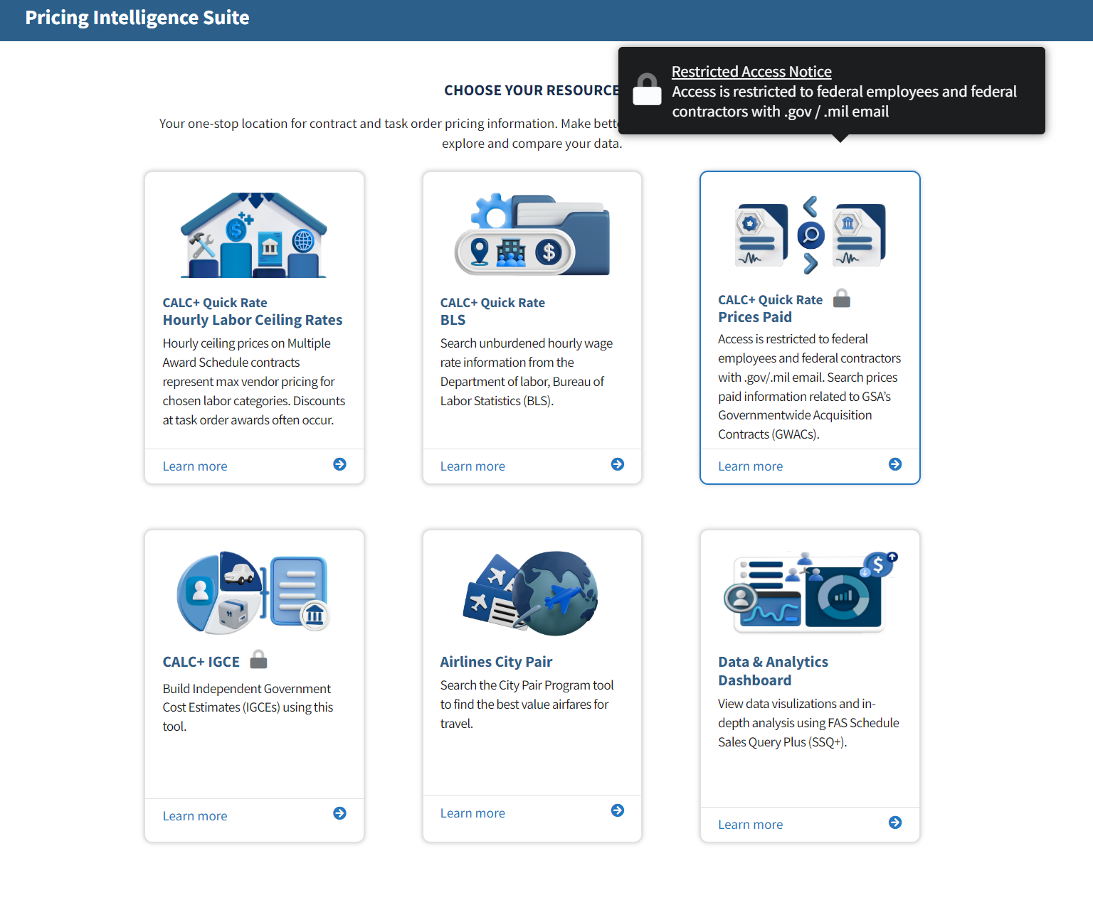
Open to All vs. Registration Required
Notes:
Restricted vs. Open Access
Let’s look at access to Buy.
There is a simple answer to these questions: “Who uses these tools on Buy?” “Who were they curated for?”
Everyone. Everyone can use Buy. The tools were intended to be used by industry and government employees.
There are NO industry specific tools.
That being said, there are tools that are only accessible to users after registration.
For example, in order to use the functionality of the Interact site, you have to be a registered member to post to the platform or ask questions of the community forums. Although, view access is granted to everyone who visits the various forums found on the Interact site.
Another example would be that certain pricing suite tools contain data that only authorized federal users can access. This means that a GSA vendor can be registered for the Buy.GSA site but not be granted access to the restricted tools under the pricing suite.
This will be clearer when we get to the demonstration portion of this presentation.

Slide 27
Registration and Profile

Slide 28
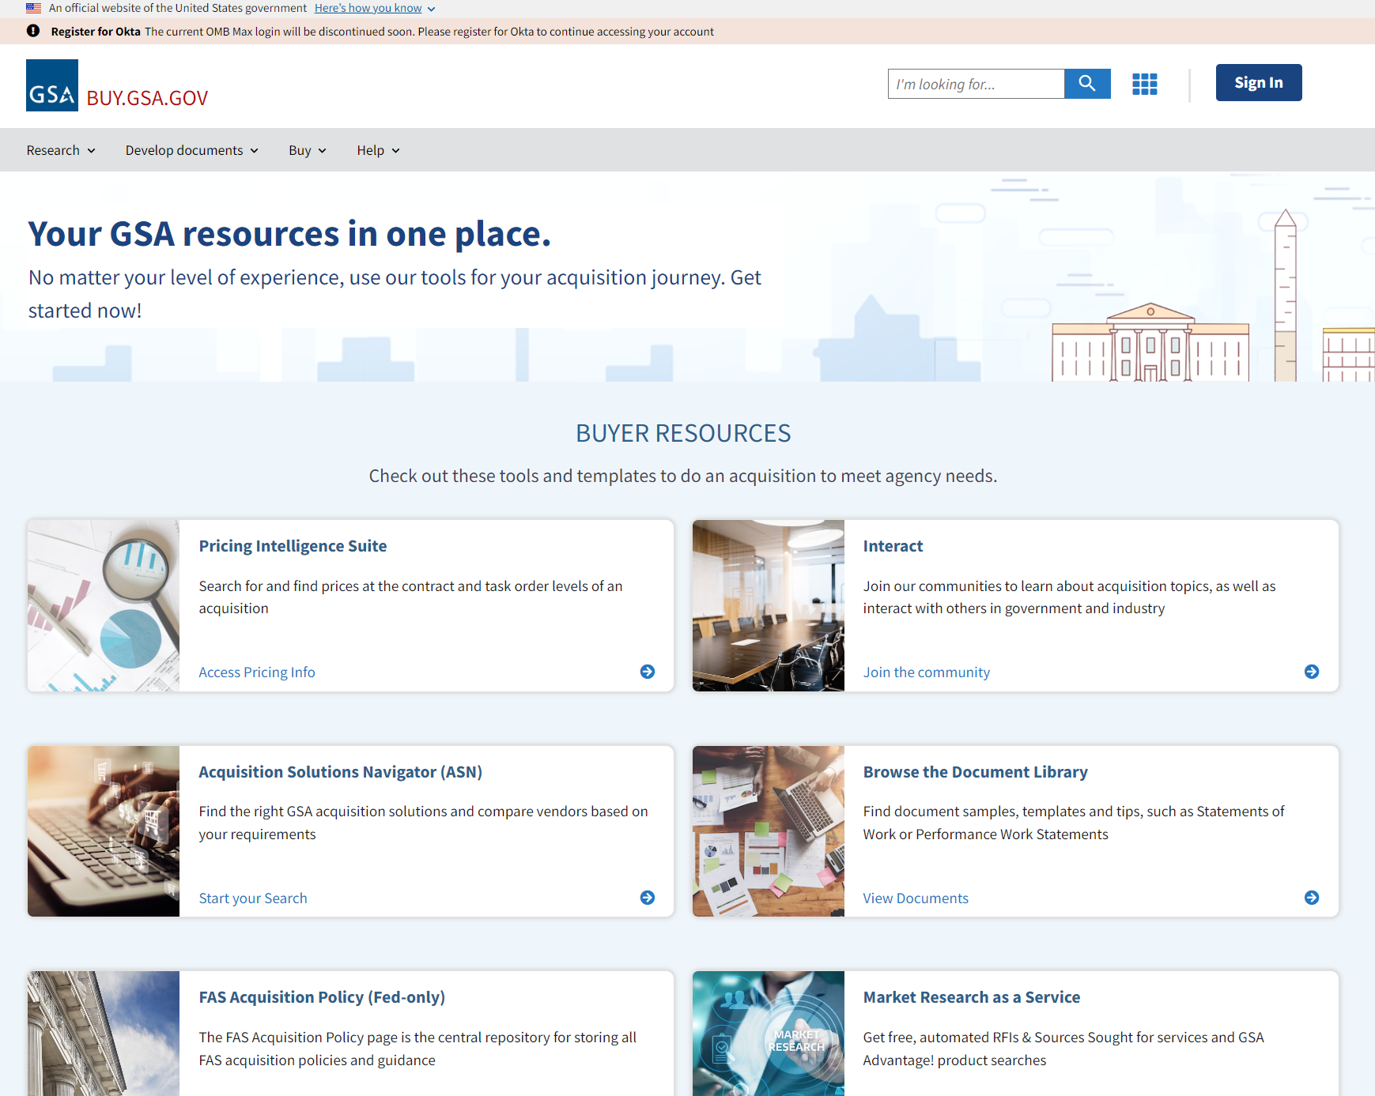
Registering and Signing In
Notes:
Registration & Profile
Now that we know there are some benefits to being registered - like gaining more access to tools - let’s talk briefly about how to register and the types of registration.
To register, select the “sign-in” button from the top right on the home page.
OMB Max is being decommissioned at the end of the year, so all registrations will be FAS ID via Okta. This option already exists as the main “sign on”, so emphasize that anyone who already registered this way doesn’t have to do anything new. It’s only folks who never created a FAS ID and only used OMB Max that would need to do something different.
For Trainers:
Note: FAS ID is something that FAS hasn’t done a great job branding or training on. This deck has extra slides you can use to illustrate the registration process if you need them.

Slide 29
Benefits of a Buy Profile
Fed Only
Save Resources
Interact Groups
Access Prices Paid and IGCE
Access FAS Acquisition Policy Library
Download Documents
Create Projects
Collaborate with Teams
Join
Engagement
Save posts
Create content
Notes:
Profiles:
The benefits in creating a profile are:
Some parts of Buy require being logged in, before you can use all the capabilities.
When logged in, you also have the Ability to save resources to your account (e.g.
Whether that be documents that you made in the Doc/ Lib. or Doc. Builder.
You can organize your content under “projects”
Work collaboratively with teammates on a project
There is also benefit in Interact:
Join groups, participate in groups, save posts
Create content (if groups are open to such)
Fed Only
Some of the data in buy.gsa.gov is only available to federal users, so just having a profile will not get you access if you are an industry user.

Slide 30
What is Buy, really?

Slide 31
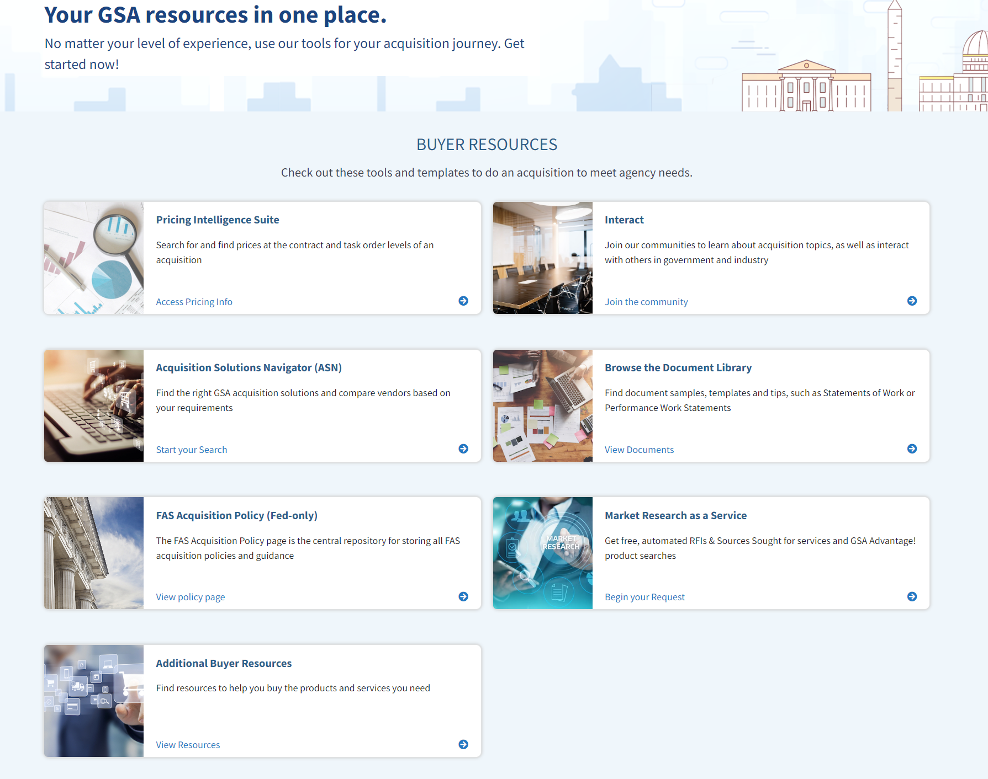
Buy is…
PRE-SOLICITATION
Market Research
Acquisition Toolbox
Community of Acq Professionals
Notes:
What IS Buy, really?
Buy is PRE-SOLICITATION. All the stuff up front. Research, IGCE, pricing… and there’s CALC which is kind of an exception in that it can be used to fact check proposals. You can use it to determine fair and reasonable.
Buy is MARKET RESEARCH.
Like the Acquisition Solutions Navigator (ASN) is designed to help users do market research by searching NAICS, SIN, Vendor Name, (UEI) Unique Entity Identifier or Contract Number… and our government contract database will provide recommendations.
Buy is a literal ACQUISITION TOOLBOX.
There are a lot of features here that people are NOT aware of. Between all the major tools, we’ve given you the ability to research vendors, SINs, NAICs, descriptions, pricing related to various services and then templates and documents that you can use to jump start your acquisition file. So, Buy is all your GSA resources in one place. All these tools you need, conveniently located.
And then Buy is also a COMMUNITY of ACQ PROFESSIONALS.
Of course, I’m talking about Interact. It’s an online community and forum for industry, federal buyers, and other stakeholders to connect and communicate.
The pricing suite is extremely popular. As of September 2024, CALC+IGCE is over 50% of the traffic on Buy.
Acquisition Solutions Navigator has two main paths focused on conducting market research... The first, “compare contract vehicles” is for users who want to compare the key elements of one contract vehicle (such as Multiple Award Schedules) to another contract vehicle (such as OASIS). The second path, “Search Contracts and Vendors” allows users to research specific contracts based on their award information, vendor details, and contract history. Both tools have features like (1) comparing groups, (2) exporting reports, and (3) navigation to and between other buy.gsa.gov market research tools.. And all of that is built right into the tool. ASN is focused on market research and curating a plan for a procurement. The ASN tool allows users to search for a need and filter down to a niche set of results based on your requirements. So, there are use cases where a user wants a pull or full list of offerings for other analytic or research purposes, see references to eLibrary or the SAM.gov DataBank (FPDS report builder).
“How is the ASN Contract History page different from the SAM.gov DataBank (FPDS Report Builder)” - The ASN Contract History page is focused on market research in a central location to allow a user to minimize the need to conduct searches across a variation of systems while still not getting their needs met. The contract history page was designed for market research and represents a specially curated set of information that GSA customers typically reference from FPDS when conducting market research. In the case where a user is looking for a full list of FPDS contract history or desires to develop a customized report, that user should utilize the SAM.gov DataBank for Contract Data
“How is ASN different from eLibrary?” – eLibrary is also under the purview of the Buy team, and is the GSA rolodex of contract offerings. It is designed to be the catalog of all offerings available.

Slide 32
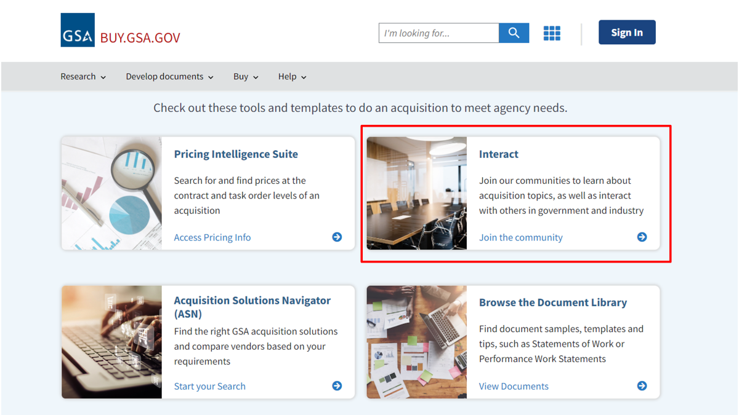

Slide 33
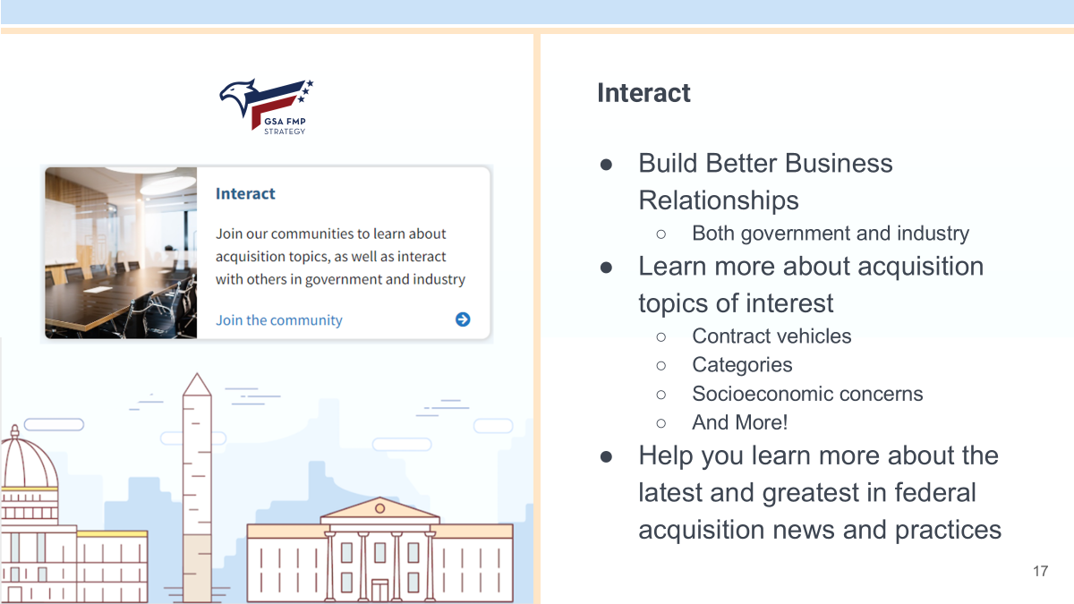

Slide 34
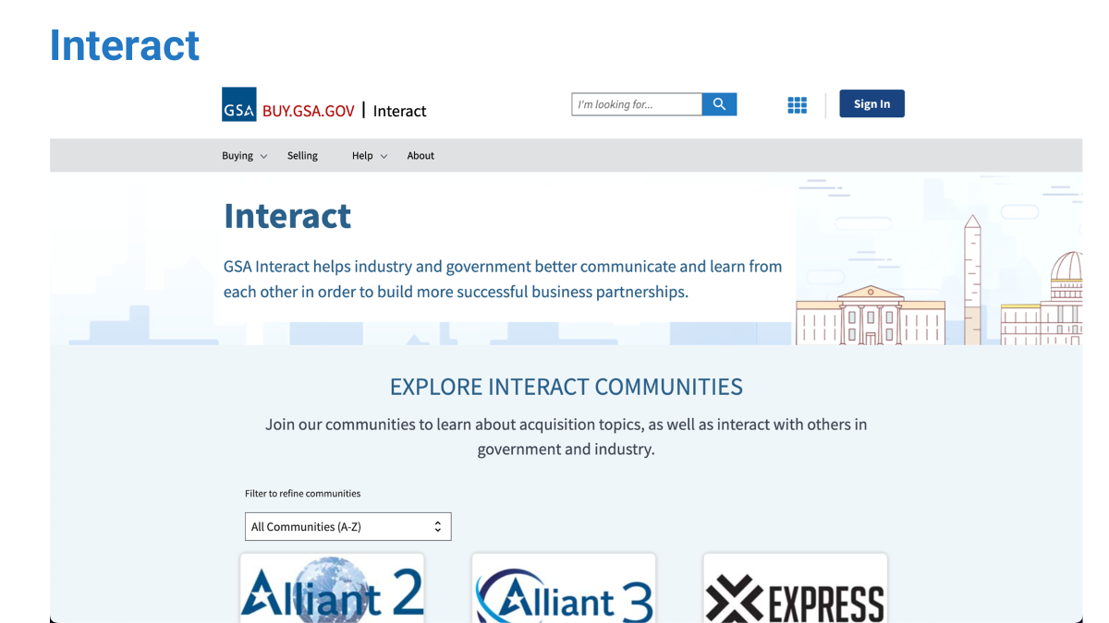

Slide 35
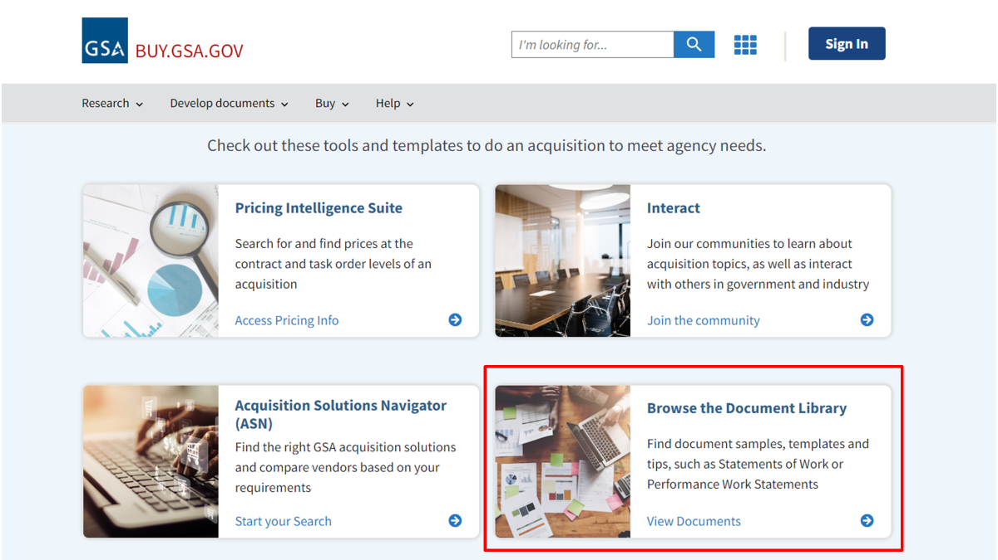

Slide 36
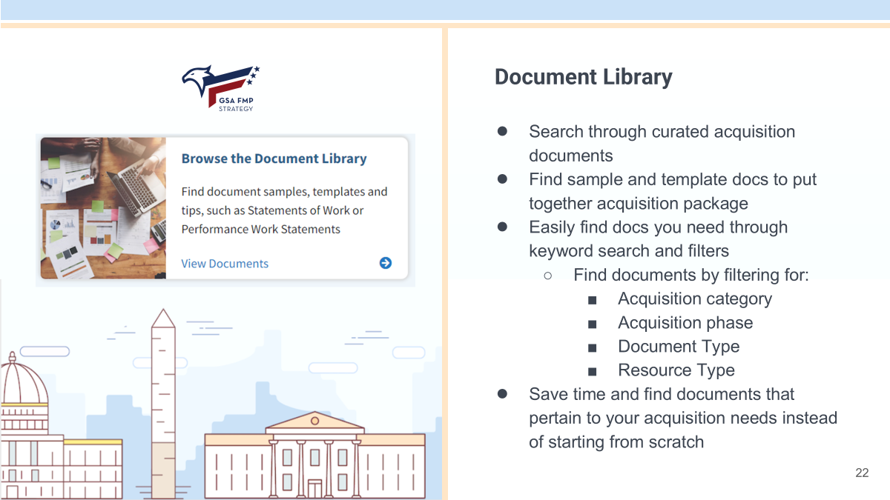

Slide 37
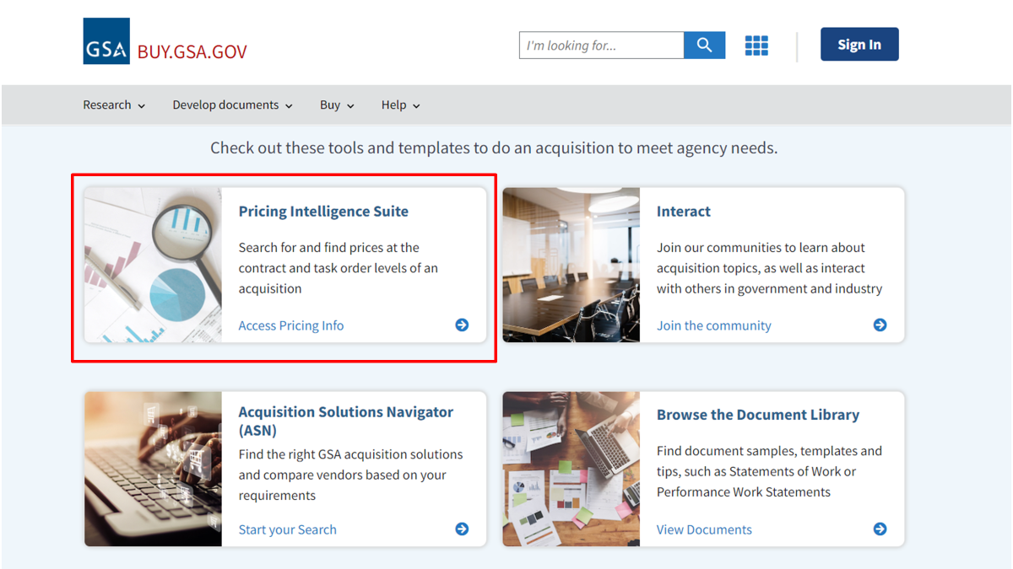

Slide 38
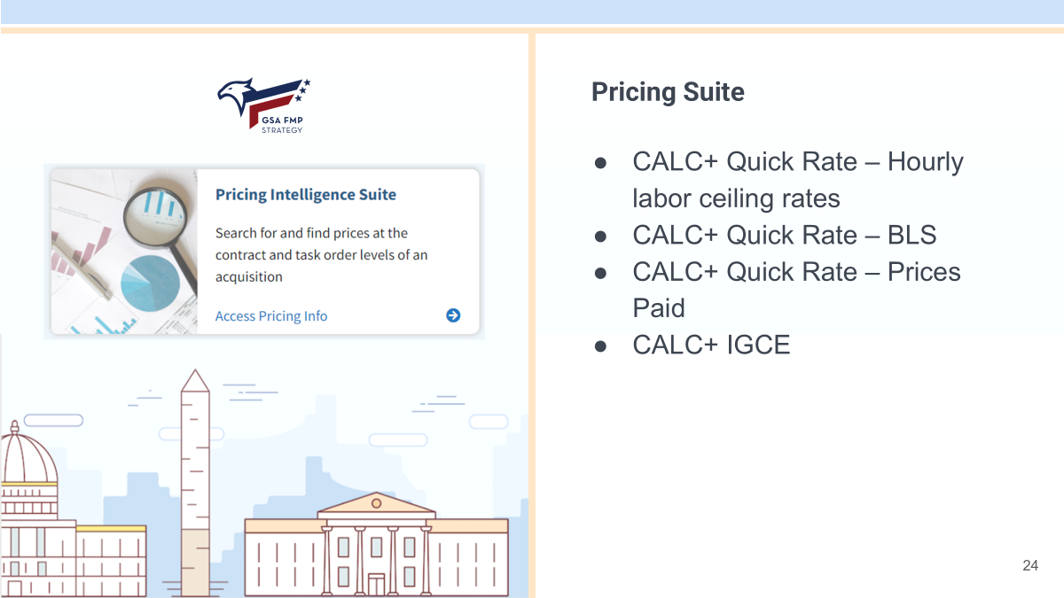

Slide 39
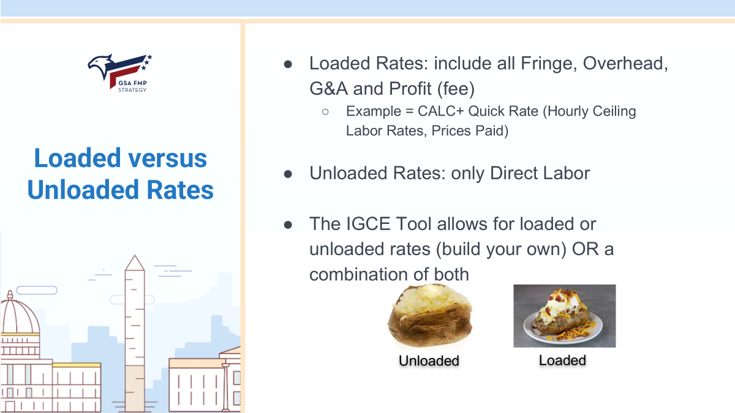
Notes:
Loaded versus Unloaded rates
Labor rates are like a baked potato. Loaded rates, like a loaded baked potato, include everything. Unloaded labor rates include ONLY direct labor. It’s just the potato.
Note: BLS data is not loaded, and you will need to load the rates yourself using the IGCE tool.

Slide 40
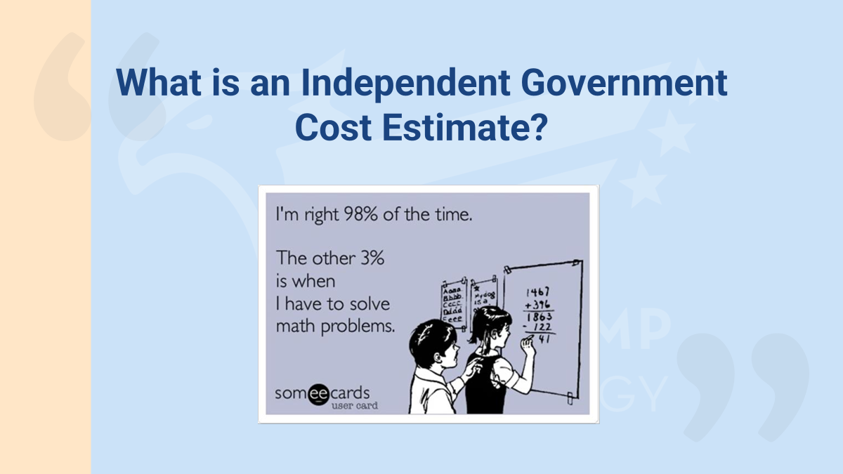
Notes:
What is an Independent Government Cost Estimate? The IGCE is a cost estimate developed by the Government Requiring Activity, based on the requirements of the Performance Work Statement (PWS) or Statement of Work (SOW). An IGCE is required for every new acquisition that exceeds the simplified acquisition threshold (SAT). Reference IGCE Handbook for Services Acquisition-February 2018.
Per the Federal Acquisition Regulations (FAR): “Independent government estimate (IGE),”...means the Government’s estimate of the projected price or cost that a contractor would incur in the successful performance of a contract. Note: IGE and IGCE are terms used interchangeably, but they are essentially the same.
Now we’ll go into an IGCE and some case studies for the pricing tools.

Slide 41
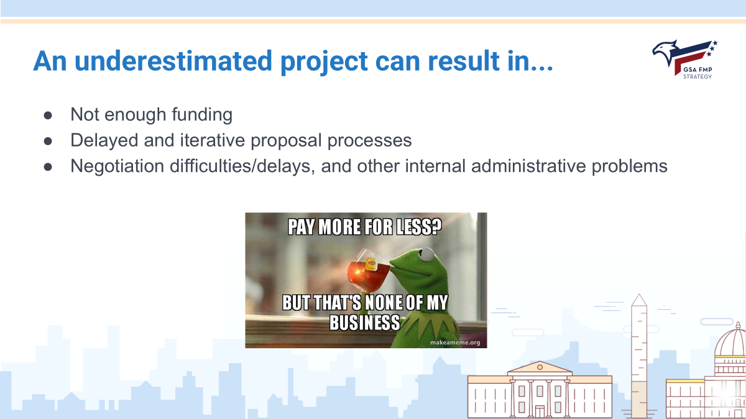
Notes:
An underestimated project can result in…
●Anti-deficiency = BAD
●Delays = extended Procurement Acquisition Lead Times (PALT) times, negative impact on mission. Program-YOU might not care about the PALT, but your contracting folks are measured on this!

Slide 42
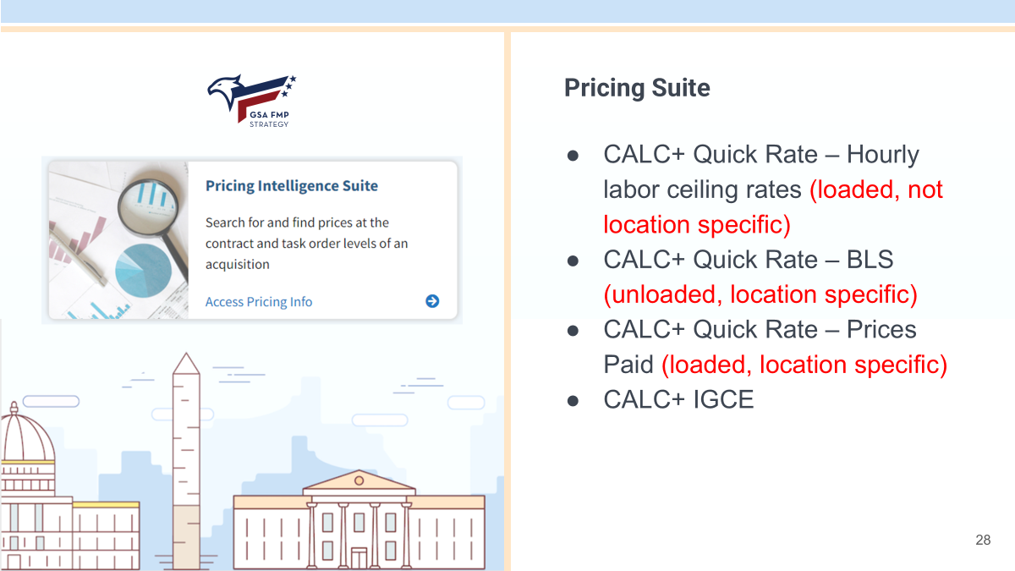

Slide 43
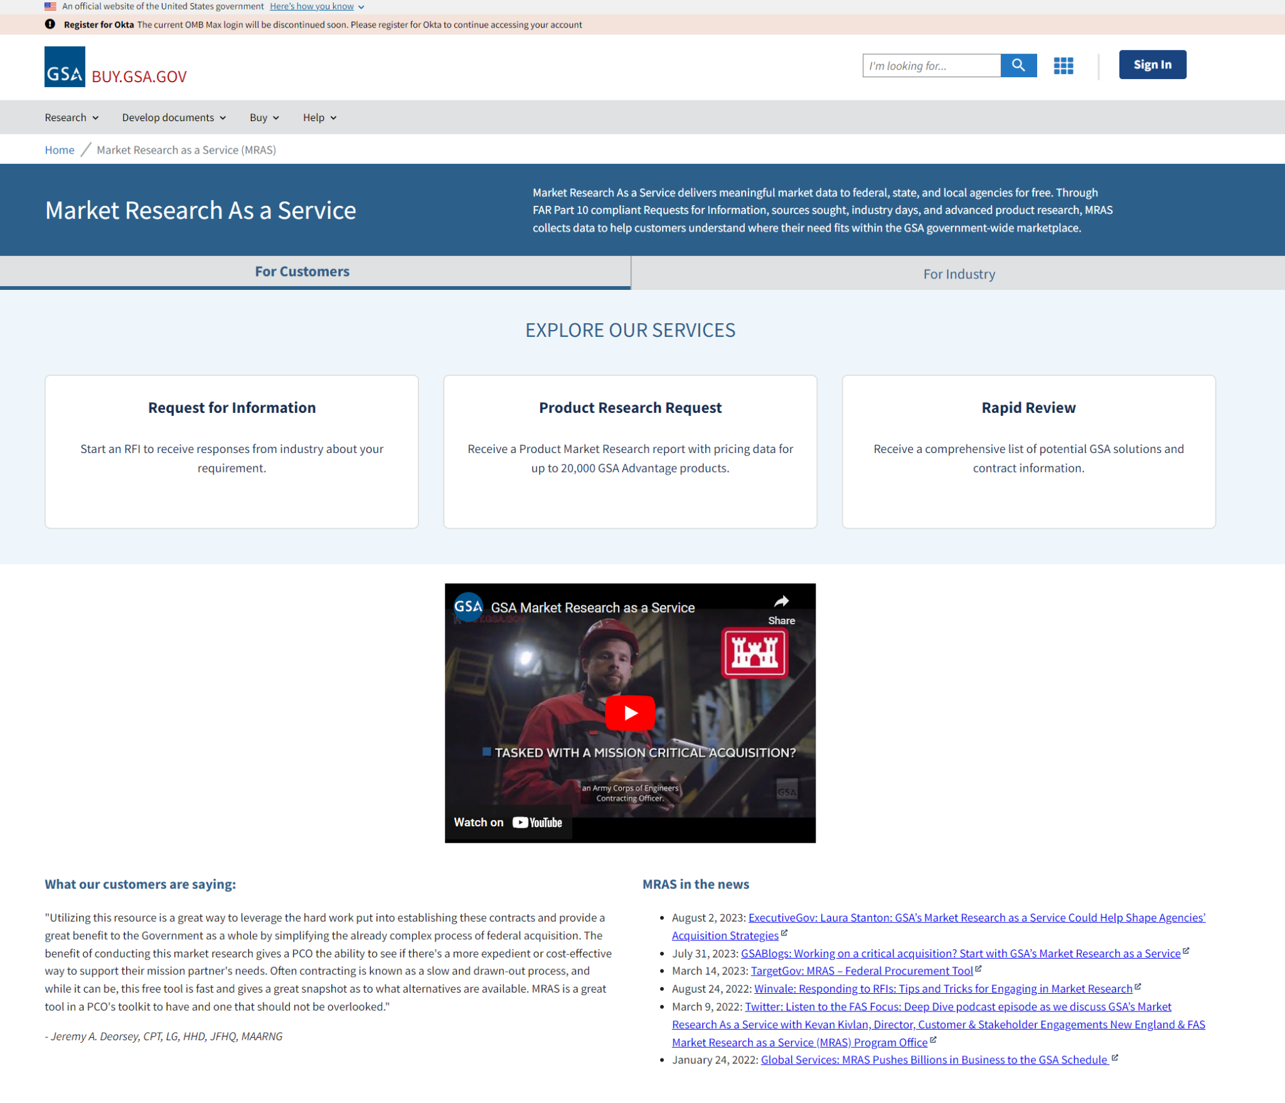
Market Research as a Service
Notes:
Market Research as a Service
Market Research as a Service (MRAS) allows you to request…

Slide 44
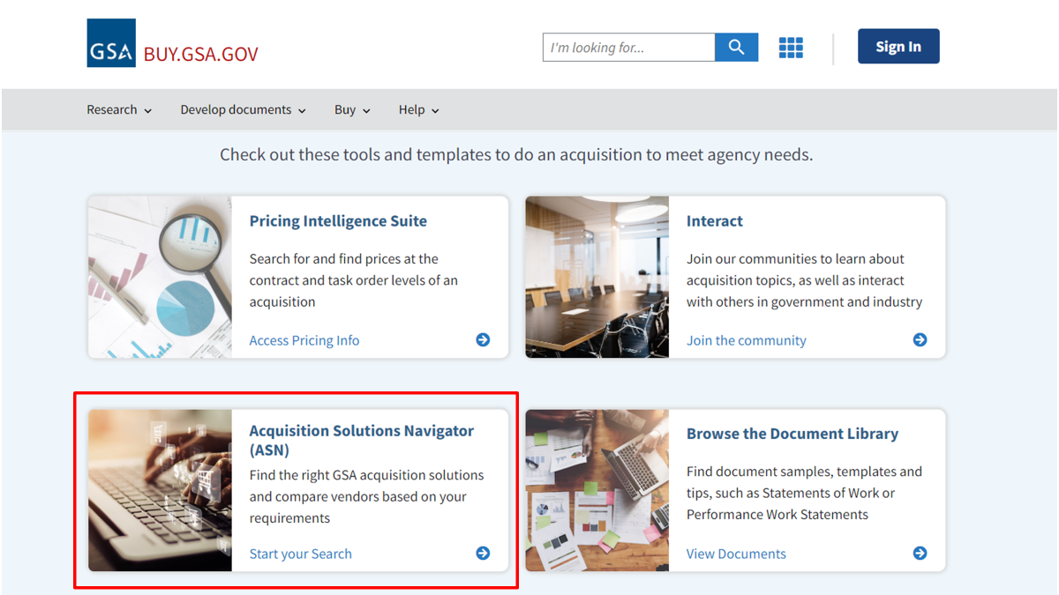

Slide 45
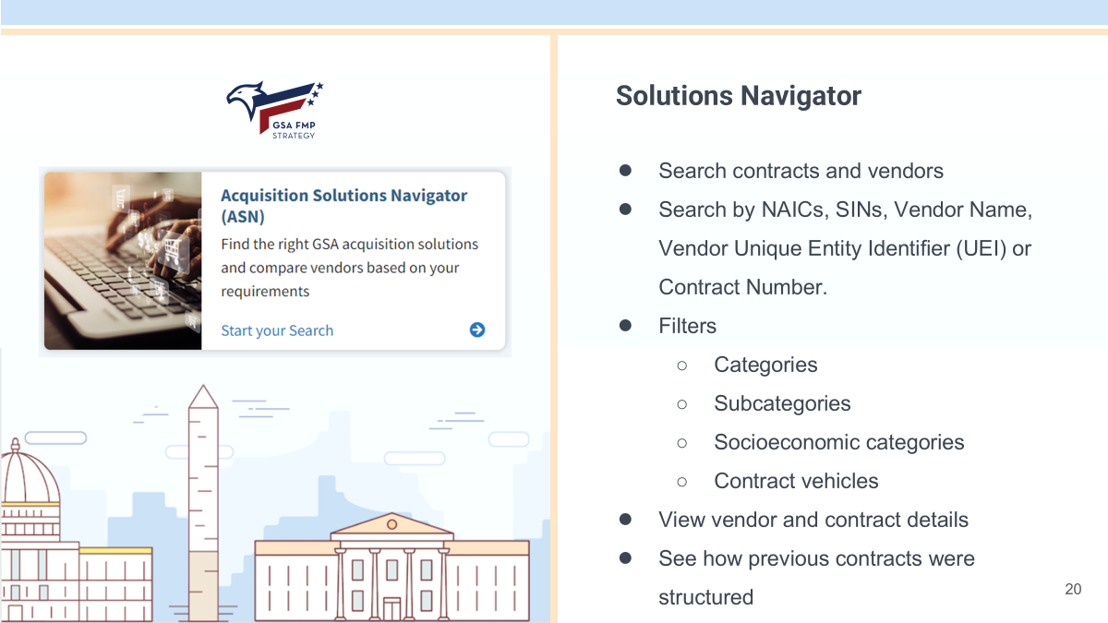

Slide 46
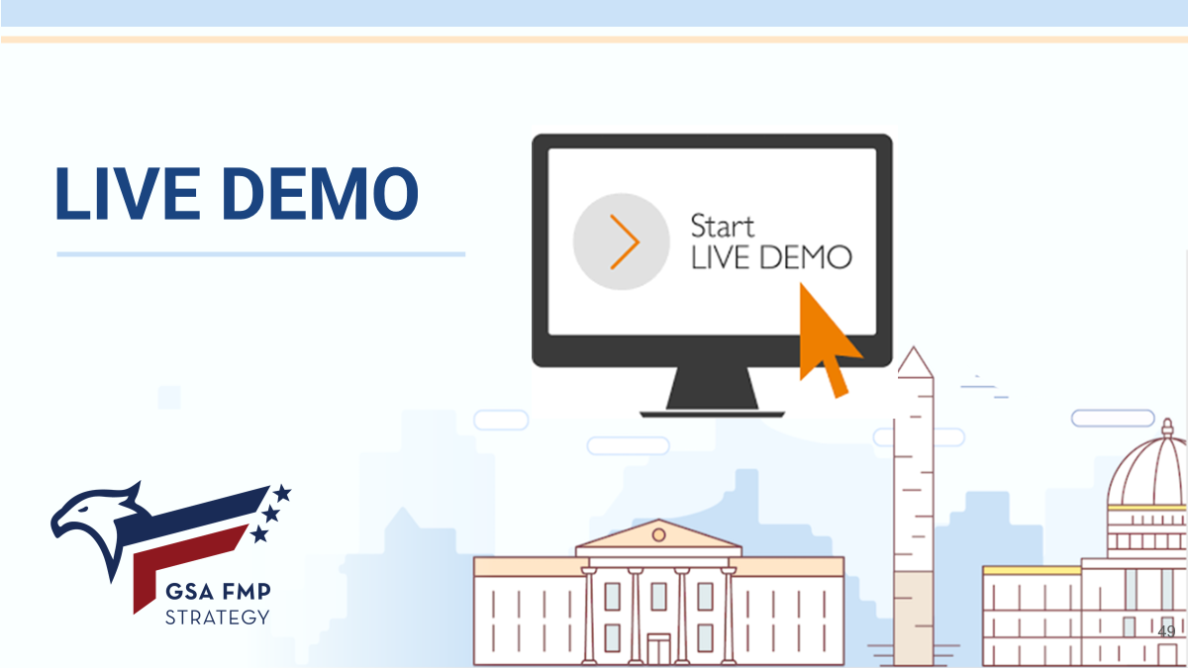


Slide 47
Questions?

Slide 48

THANK YOU!
Office of Integrated Marketing
Continuing your Acquisition Journey

