Slide 1
Harvesting Excellence:
Uncovering the Real CORs of the Federal Government
November 22, 2024
Office of Integrated Marketing
Continuing your Acquisition Journey

Slide 2
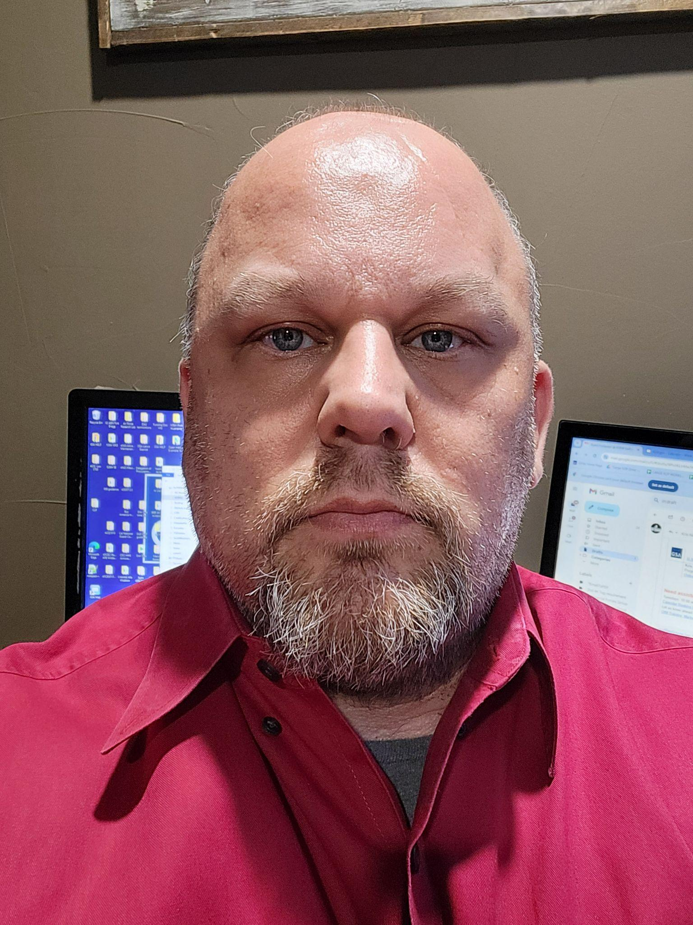
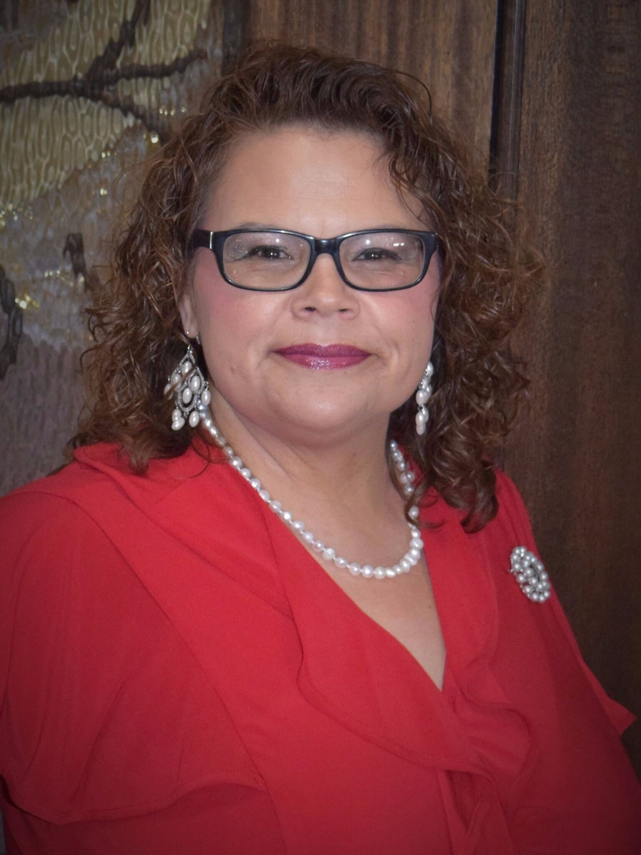
Panelists:
Kusuma Aralere
Andrea Azarcon-Heller
Jack Brothers
Crystal Palacios
Donna Sykes

Slide 3
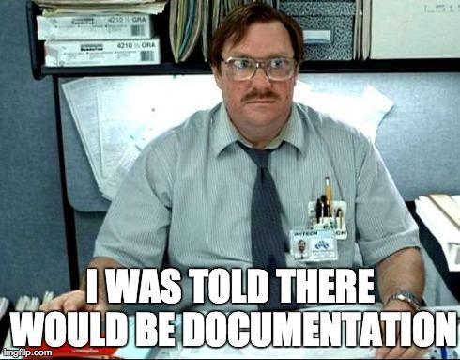
Please share some mistakes even good CORs make.
Notes:
Not keeping a (spending register) spreadsheet and tracking every invoice.
Not getting on the planning / requirement team.
Not finding out the expectations of a new CO when you begin working with them
Waiting until the last minute to document issues related to performance (CPARS is too late!)
Not clearly understanding the role of your COR authority, things you CAN and CANNOT control.
Not getting connected to the PM and the CO
Not having clear guidelines for contractors so you can hold them accountable
Unhelpful CPARS - underqualified vendor - delivered late - needed to be held accountable - but because they were able to remedy could not give a negative CPARS
Not focusing on details & planning
Kristy (to update, if needed) -
Not recognizing that every CO is different
Not reading the contract (and definitely the QASP - Quality Assurance Surveillance Plan) in their entirety. This is the most important document for assessing contractor performance.
You are not a COR until you receive that letter of appointment (not during the requirements development process).
_______
Donna -
Not immediately documenting situation/issue “I’ll get around to do that” and then facts, times, dates, and responses can become fuzzy.
Assuming versus verifying; this can creep up on you after being a COR for awhile OR being a COR on several contracts at one time & getting some of the tasks/outcomes/deliverables confused from contract to contract.
Not open to new ways of doing things. Just because previous contractor did it this way doesn’t mean there isn’t equally other correct ways to do it and still get the desired outcome for the Government.

Slide 4
What challenges do you think most CORs within the Federal Government experience?
Notes:
It’s another duty / an extra role on top of other responsibilities.
It’s undervalued.
Lack of training,
lack of clear communication
There are not enough CORs.
Each CO is different / has a different style that the COR has to learn.
Kristy - to update
Definitely “other duties as assigned for many CORs
The formal training teaches “what” a COR does but not necessarily “how”
You don’t know what you don’t know - learn by experience and from mistakes (which can be painful)
Not understanding COR responsibilities versus CO responsibilities
Once people find out you’re a COR, expect to be a COR foreverrrrr
____
Donna
COR is THE HARDEST MOST INVOLVED job in the life cycle of a contract.
Having to stand your ground to higher ranking/leadership as being the AUTHORIZED authority (besides the CO) on the contract. Appointed and NOT them.
Not always “liked” and having to be the bad cop by pointing out discrepancies or failure to comply issues.
CORs input not being valued or even asked for
On certain types of contracts, having to “learn” to a certain level what the contactor does

Slide 5
What suggestions do you have for CORs to make their work experience more efficient? (tips & tricks)
Notes:
Team Work = You do not need to reinvent the wheel. You can use what is already there. The content (SOWs, SOOs, etc.) is shared on the Acquisition Gateway etc.
YES! Use the tools and resources that are available, pricing suite at buy.gsa.gov, IGCE tool, etc.
Stay organized
Join COR community of practice (CoP) in Max.gov
Kristy - to update
Understand where your resources are (For example,https://www.fai.gov/resources/cor-toolkit#training)
Organization is key (shared drives)
Understand records management requirements
Document everything in writing (for example, send a follow-up email summarizing any oral discussions)
If all else fails, Marry a CO (like me :)) for in-house expertise.
____
Donna
Stay consistent
Not personal - it’s professional
On the fence about something - ask seasoned CORs for their input and suggestions
If all else fails, become a CS/CO (like me) to see the other side of the coin so to speak

Slide 6
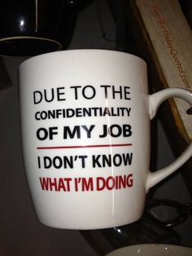
What is one of the strangest calls you've ever gotten/problem you've had to solve as a COR?
Notes:
“Do we have to take drug tests?”
The vendor lose the commissioner’s printer. 6 months to notify
SES who wanted full report of every COR action (without being granted NDA); another COR who wanted to know how to solve issues related to impending shutdown…
Vendor asked where are my printers? CO & COR had to look through the building to find out which printers belong to which vendor. Closet of printers
Kristy - to update
A contractor offered to take me to dinner at an expensive country club. Obviously I declined, not only because of the gifts rules, but because of the optics (though I think his interest was personal lol)
____
Donna
A global pandemic brought about many new challenges & changes in processes/procedures and innovative ways of getting the work done.
Wasn’t strange but was challenging to building in new but yet unknown funding options and standards
Contractor requesting the COR to be removed because they were doing their job in writing up discrepancies
Contractor calling for help in bidding on a different contract and inviting me to come work for them. I didn’t help and I did notify CO.

Slide 7
What is one little “innocent thing” that can “blow up”
on you if you’re not careful?
Notes:
Jack: PII story

Slide 8
What advice would you offer to someone just starting out as a COR or considering a career in the COR field?
Notes:
Jack: Start out with working on “product” contracts

Slide 9
What do you see for the future in COR responsibilities? What is changing?

Slide 10
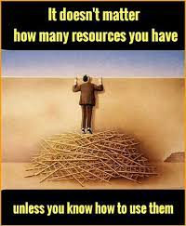
Are there any tools or resources that you especially like to use as a COR?
Notes:
Acquisition Planning package: https://www.gsa.gov/buying-selling/new-to-gsa-acquisitions/how-to-buy-through-gsa/acquisition-planning-package-overview/facilities-acquisition-planning-package/facilities-maintenance-and-repair-acquisition-planning-package
Every agency has different tools.
Shared drives with organized folders.
Spreadsheets to track things
Word docs for notes
Salesforce
For CLPs - Public Contracting Institute does “Fun with the FAR” (52 CLPs) https://publiccontractinginstitute.com/events/
Buy.gsa.gov (IGCE Tool, CALC tool)
COR CoP
FAI COR toolkit
__________
Donna
Checklists, spreadsheets, and calendar reminders. Helped me stay organized and on track so due dates, exercise options, and expiration did not sneak up on me. CORs are the busiest
Market Research is so helpful and you can pull from … how is this service or product buy being done by others??? What do I like about their way and incorporate into my PWS/SOO/SOW.
Don’t be afraid to see how other federal agencies accomplish and how civilian sector accomplishes
Innovation

Slide 11
Resources
COR Toolkit: https://www.fai.gov/resources/cor-toolkit Steps to Performance-Based Acquisition: https://buy.gsa.gov/spba
CALC+ Quick Rate: https://buy.gsa.gov/pricing/qr/mas
IGCE Tool : https://buy.gsa.gov/pricing/

Slide 12
Live Demo

Slide 13
Questions?

Slide 14
THANK YOU!
Office of Integrated Marketing
Continuing your Acquisition Journey

