Slide 1

Steps to Performance Based Requirements
Acquisition Training for the Real World Winter 2026

Slide 2

Jonathan Evans
Supervisory Portfolio Manager & Principal Facilitator
Center of Excellence for Outcome-Based Contracting
Office of Professional Services & Human Capital Categories
GSA Federal Acquisition Service

Slide 3
Training Overview
Performance Based Acquisition
Action - Result - Context ARC
Ambiguity in Writing
Plain Language
Requirements ALWAYS Have Standards

Slide 4
"Performance-based Acquisition" (PBA) means an acquisition structured around the results to be achieved as opposed to the manner by which the work is to be performed. - FAR 2.101
What is PBA?

Slide 5
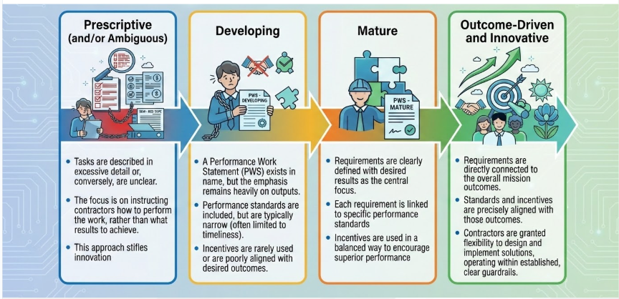
PBA Continuum Defined

Slide 6

When acquiring services, including acquisition of commercial services using the procedures in part 12, agencies must —
  Use performance-based acquisition methods to the maximum extent practicable
FAR 37.101-1

Slide 7
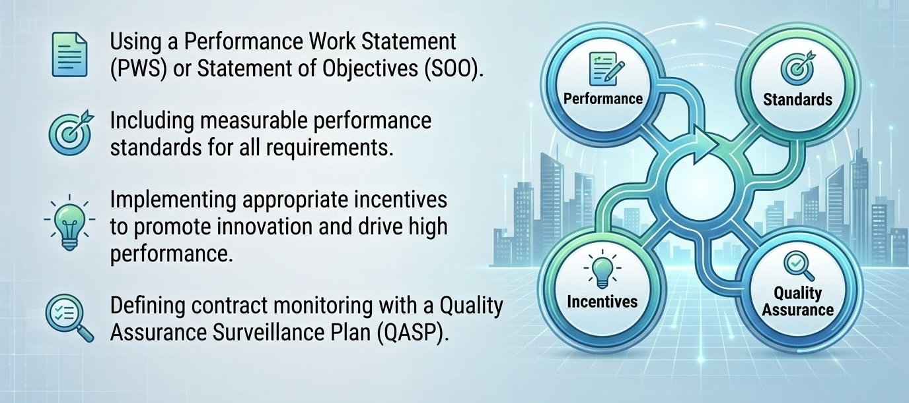
4 Key Elements to PBA

Slide 8
Key Element 1:
Use a Performance Work Statement (PWS)

Slide 9
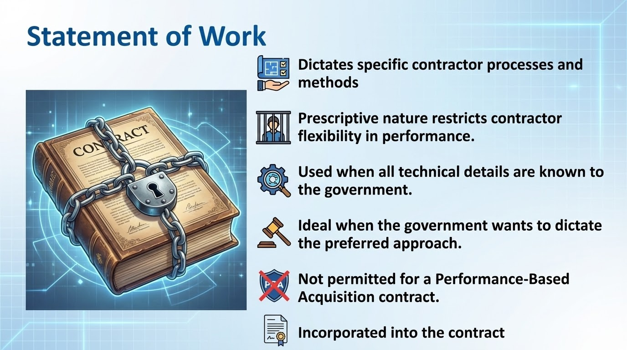
Statement of Work

Slide 10
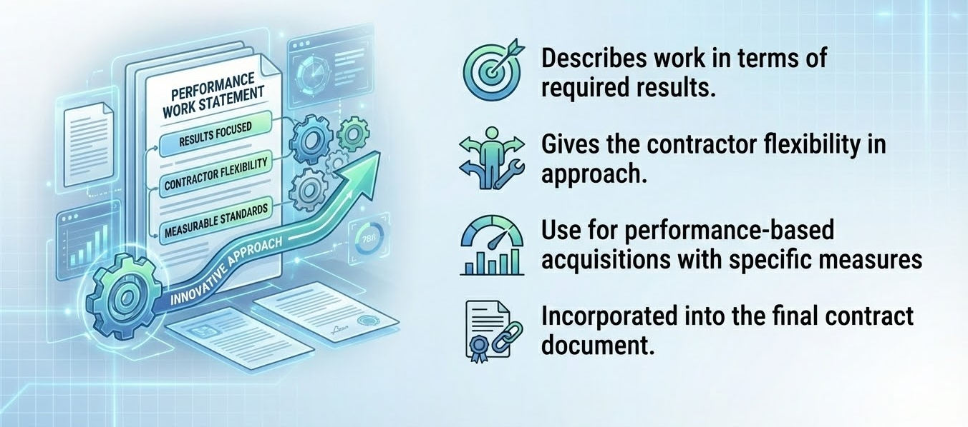
Performance Work Statement

Slide 11
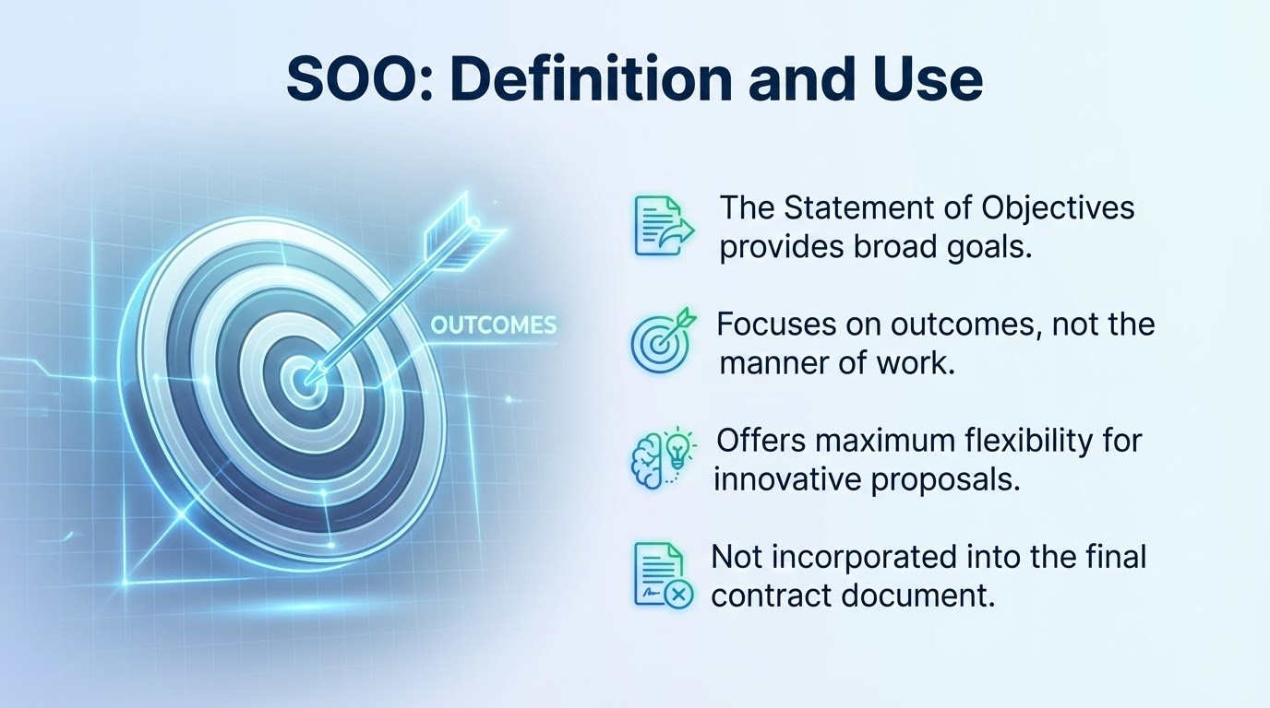
Statement of Objectives

Slide 12
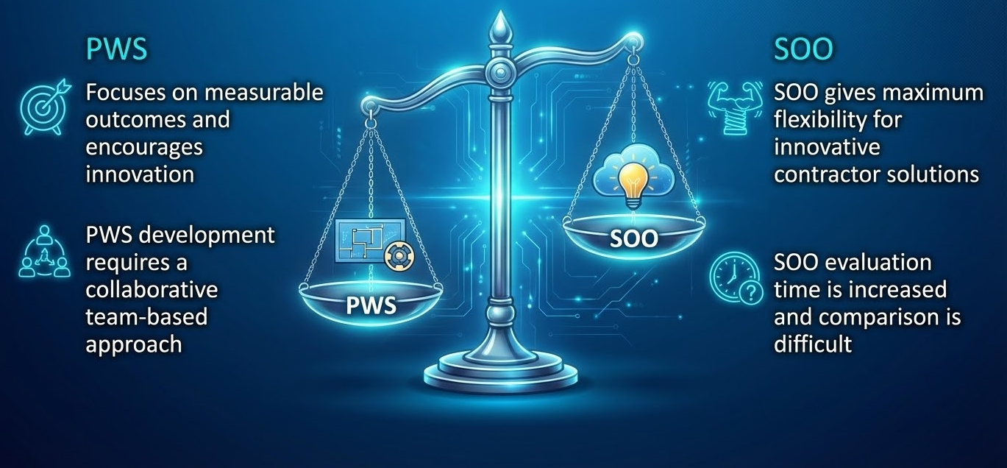
Weighing In: PWS or SOO?

Slide 13
Key Element 2:
Include Meaningful & Measurable Performance Standards

Slide 14
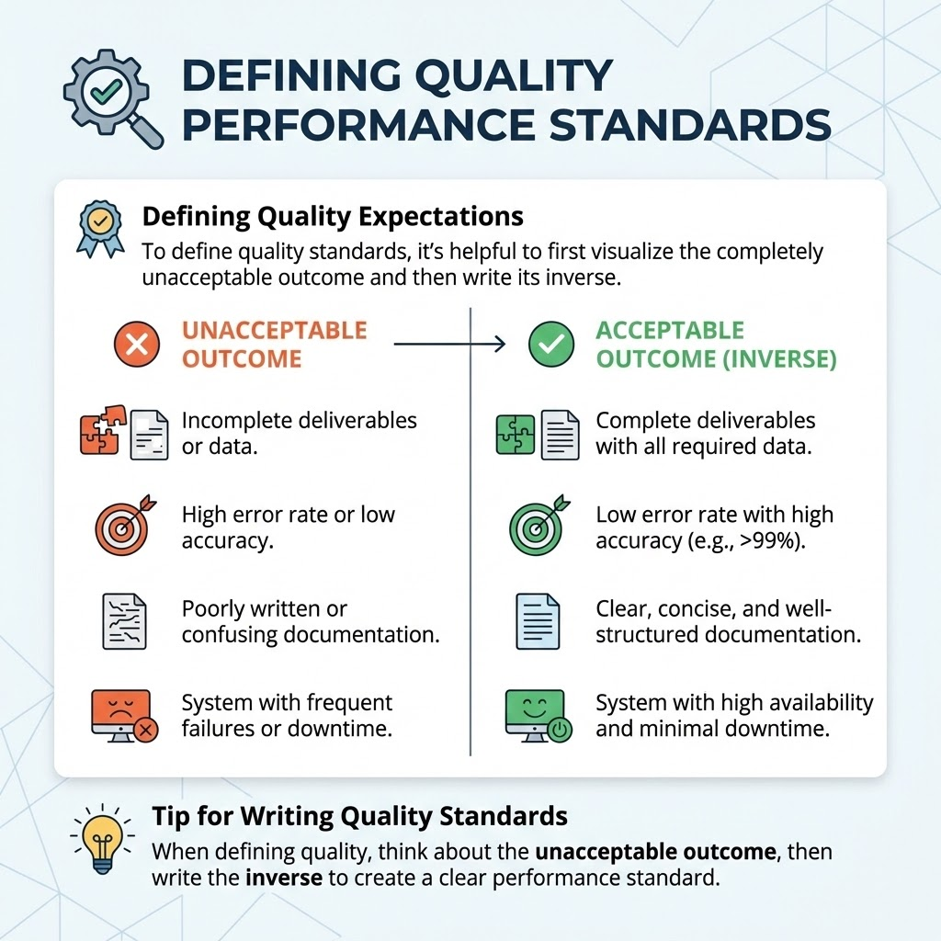
Performance Standards & Acceptable Quality Levels (AQLs)
Standards for ALL requirements
More than just timeliness - what about quality?
Leverage commercial standards to the maximum extent possible
Conduct Market Research on your draft requirements and standards
Standards and AQLs go in the PWS

Slide 15
Key Element 3:
Incentives Tied to Outcome-Based Metrics

Slide 16
Incentivizing Performance
“Structure contracts to include incentives tied directly to these outcome-based metrics, rewarding contractors for exceeding targets and addressing performance shortfalls when metrics aren't met.” - FAR Companion
Incentivizing higher quality performance STARTS with well-written, clear requirement and standards.
Layering performance incentives and formal incentive type contracts on top may be advantageous, but only if the foundations of the contract are solid.

Slide 17
Key Element 4:
Incentives Tied to Outcome-Based Metrics

Slide 18
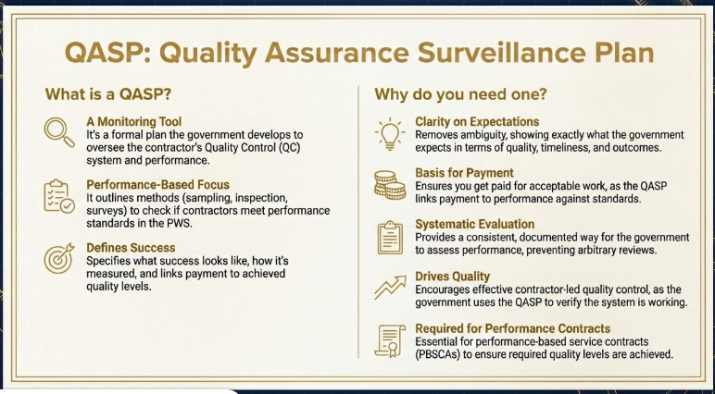
18

Slide 19
This is a lot, where do I start?

Slide 20
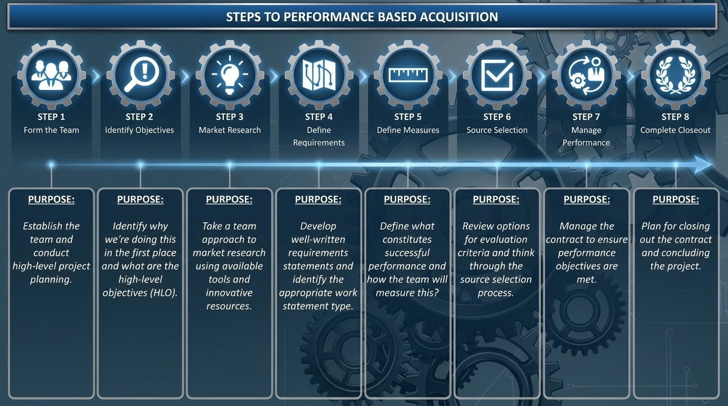
20

Slide 21
Work Statement Writing Tips

Slide 22
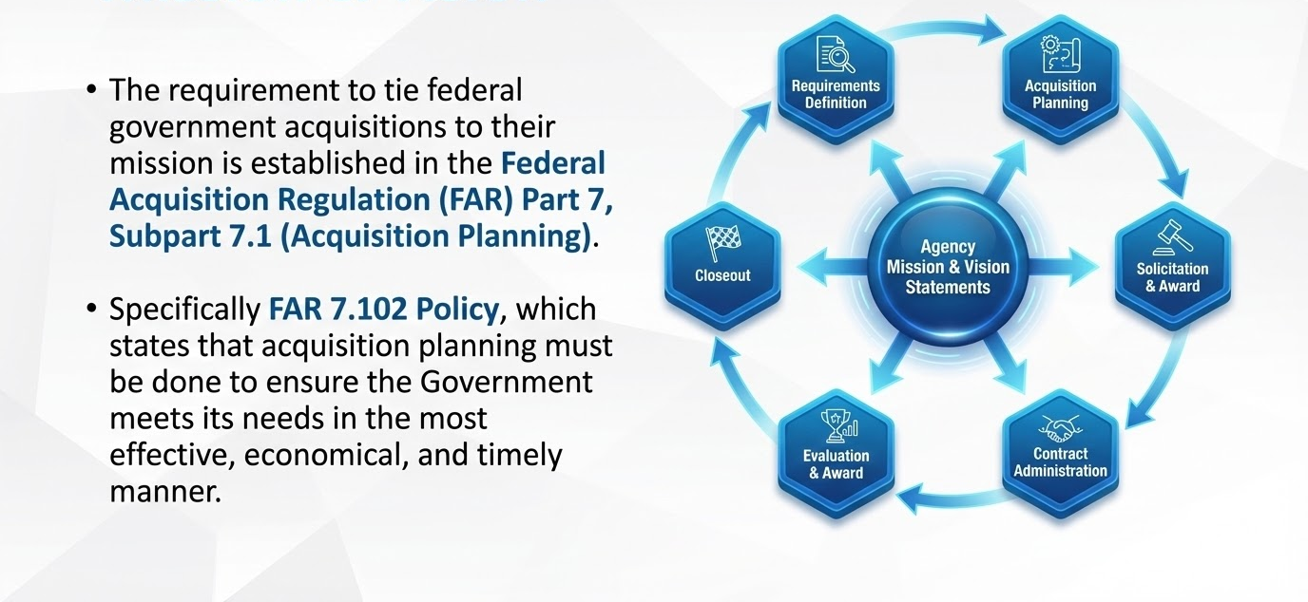
Mission and Vision

Slide 23
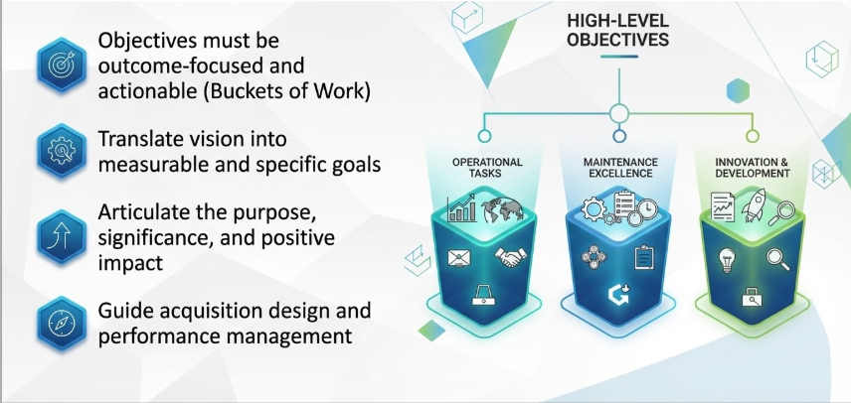
High Level Objectives

Slide 24
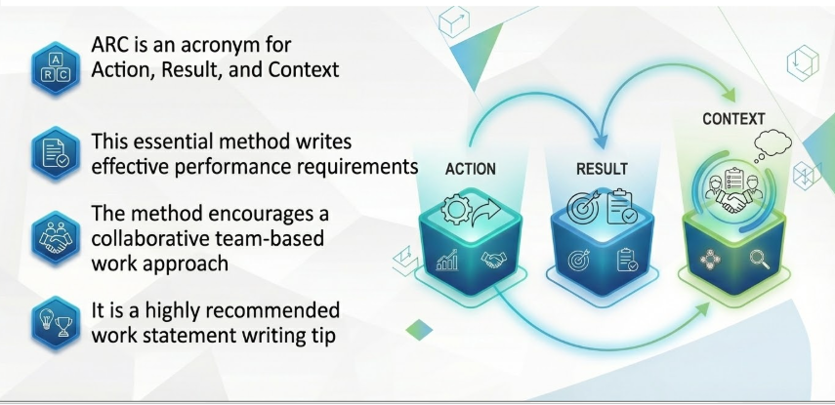
ARC Statements

Slide 25
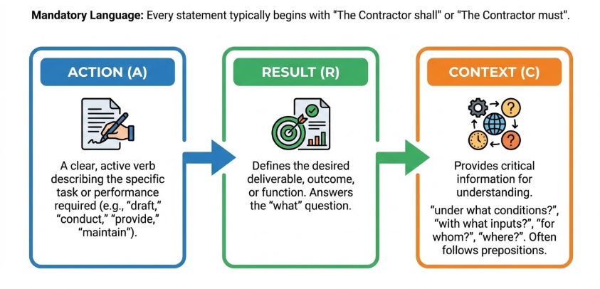
Components of the ARC Method

Slide 26
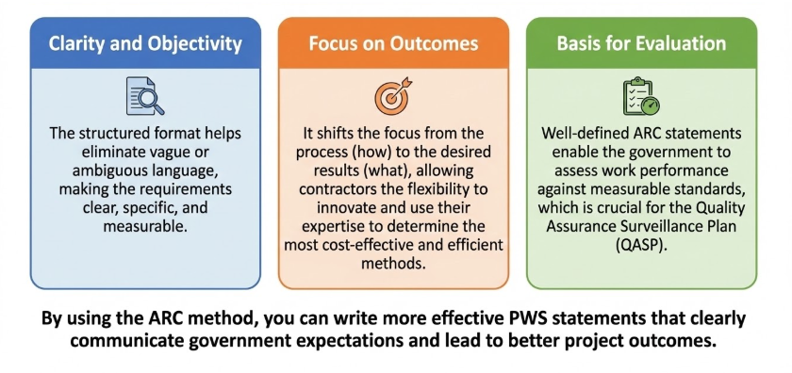
Why Use the ARC Method?

Slide 27
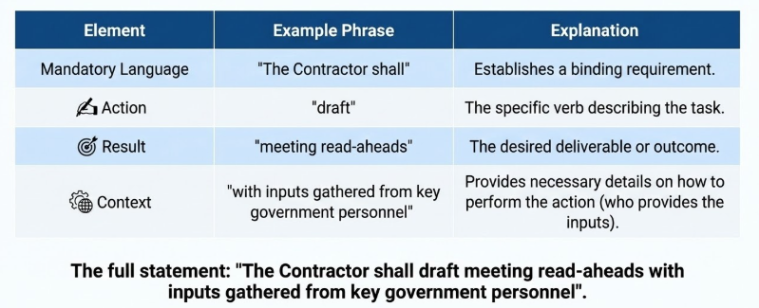
Breakdown of the ARC Statement

Slide 28
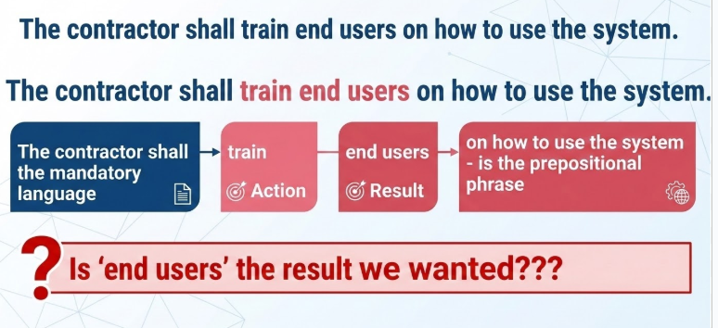
Breakdown of an ARC Statement

Slide 29
ARC Example #1 Discussion
Original Statement:
The contractor shall train system end users on how to use the system.
Revised Statement(s):
The contractor shall provide training to end-users on how to use the system.
…
The contractor shall deliver a user manual for all aspects of the system.
NOTE: Everything following a preposition is context. Some prepositions: to, for, by, with, around, on, under, so (that), after, through, of, at, in, between…

Slide 30
ARC Example #1 Discussion 1
Original Statement:
The contractor shall be required to create or implement approaches to gather internal or external agency data through data collection, surveys, or questionnaires.
Revised Statement:
The contractor shall create data collection methodologies (for internal or external data used in support of Agency Projects and Programs.

Slide 31
ARC Example #2 Discussion
Original Statement:
Assistance shall be provided for the conduct of logistical support meetings.
Revision to Focus on Outcomes:
C.4.4.1 The Contractor shall schedule meetings to include all necessary stakeholders and a clear purpose and agenda
C.4.4.2 The Contractor shall record meeting minutes for all support meetings
C.4.4.3 The Contractor shall draft meeting read-aheads that include inputs gathered from key government personnel

Slide 32
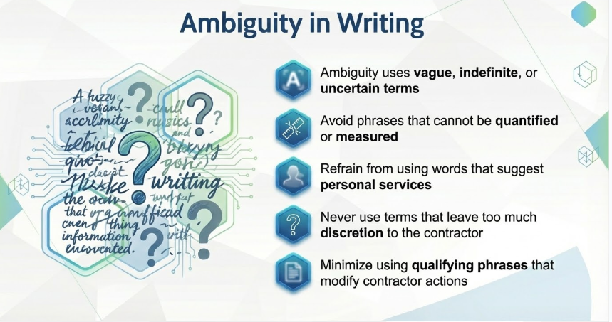
32

Slide 33
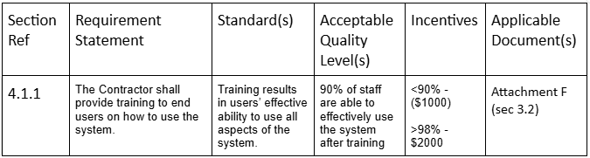
NO GIANT PARAGRAPHS
BACKGROUND
Mission & Vision go here
SCOPE OF WORK
HIGH LEVEL OBJECTIVES
  High Level Objective Statement 1 -> why, what results, outcomes
  High Level Objective Statement 2
PERFORMANCE REQUIREMENTS
  Task Area 1 (aligned with objective 1)
Broad context for multiple requirements
    The Contractor shall action RESULT context
      Additional context as needed (e.g. Number of users)
    The Contractor shall action RESULT context
PERFORMANCE REQUIREMENTS SUMMARY TABLE
Use
  Short sentences & bullets
  Lists
  Tables
  Bold, Italics, Underline
Write for your specific audience
  Balance technical and plain language
  Write for the vendor you’ve never worked with before
Stop using government jargon!
Notes:
eBuy Open
RFQ1362167 Narcotic and Explosive Dog Services for Sierra Army Depot Herlong, CA Department of the Army
and RFQ1367416 AMIS, Zebra and Quagga Mussel Canine Detection

Slide 34
Are there additional resources to help?

Slide 35
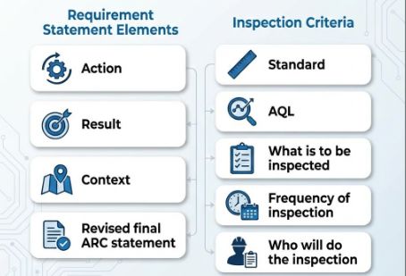
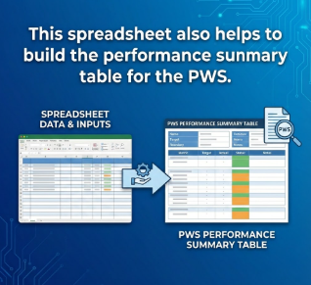
ARC Spreadsheet

Slide 36
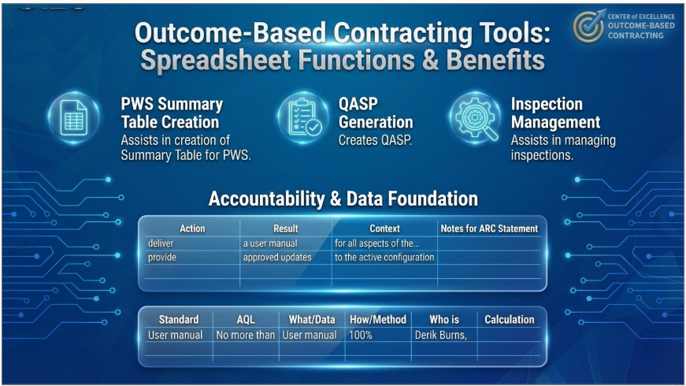
ARC Spreadsheet 1

Slide 37
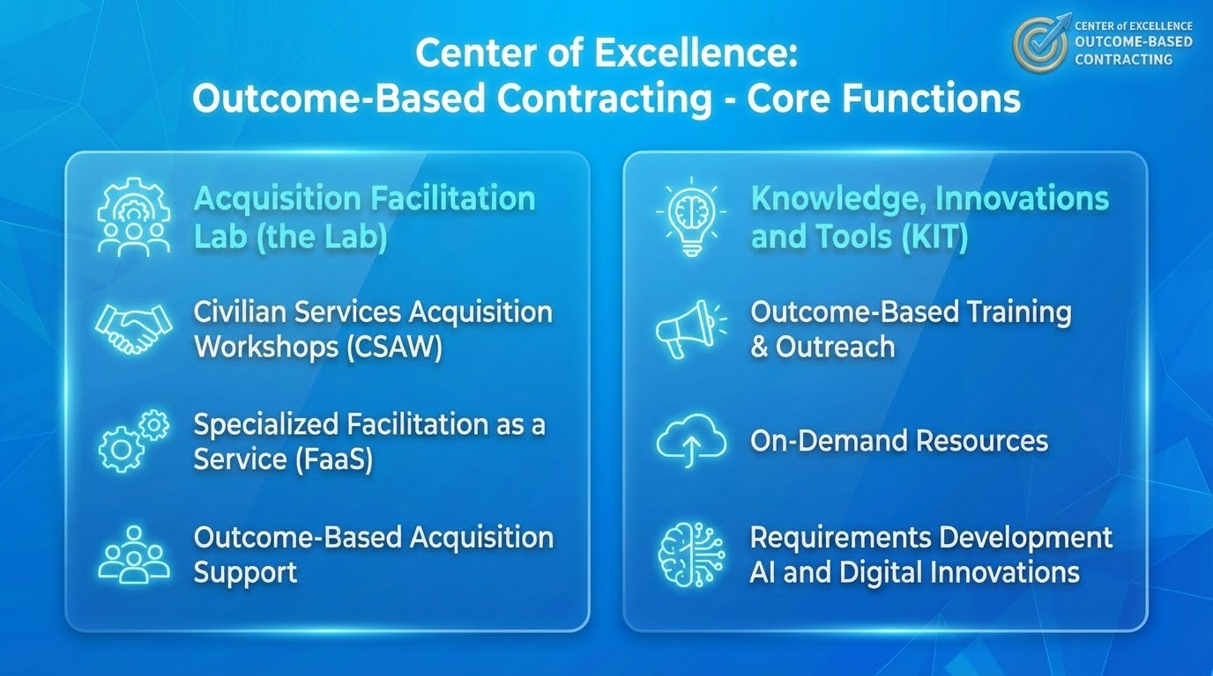
Center of Excellence for Outcome-Based Contracting

Slide 38
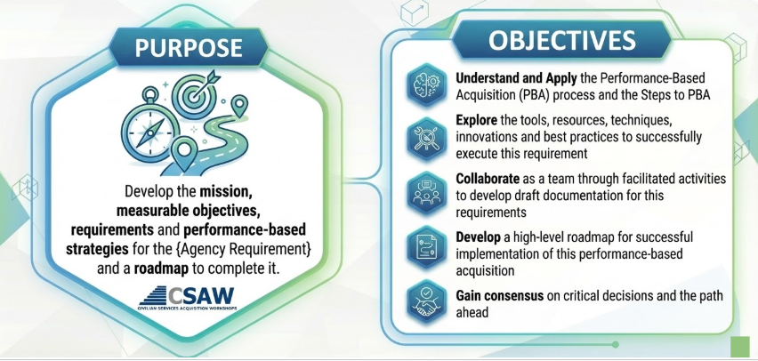
Center of Excellence CSAW

Slide 39
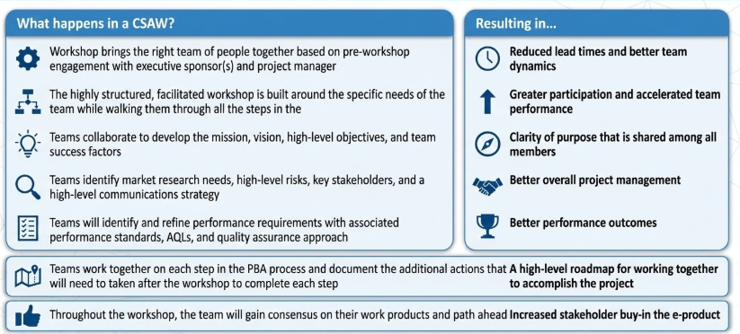
Workshop Benefits

Slide 40
Contact Us: csaw@gsa.gov
Thank You!
Jonathan Evans
Supervisory Portfolio Manager & Principal Facilitator
Center of Excellence for Outcome-Based Contracting
Office of Professional Services & Human Capital Categories
GSA Federal Acquisition Service

Slide 41
41

