Slide 1
Small Business Works 2022:
Administration Priority Session Equity in Procurement Closing the Gap Panel Session
Day 1: July 26, 2022
U.S. General Services Administration

Slide 2
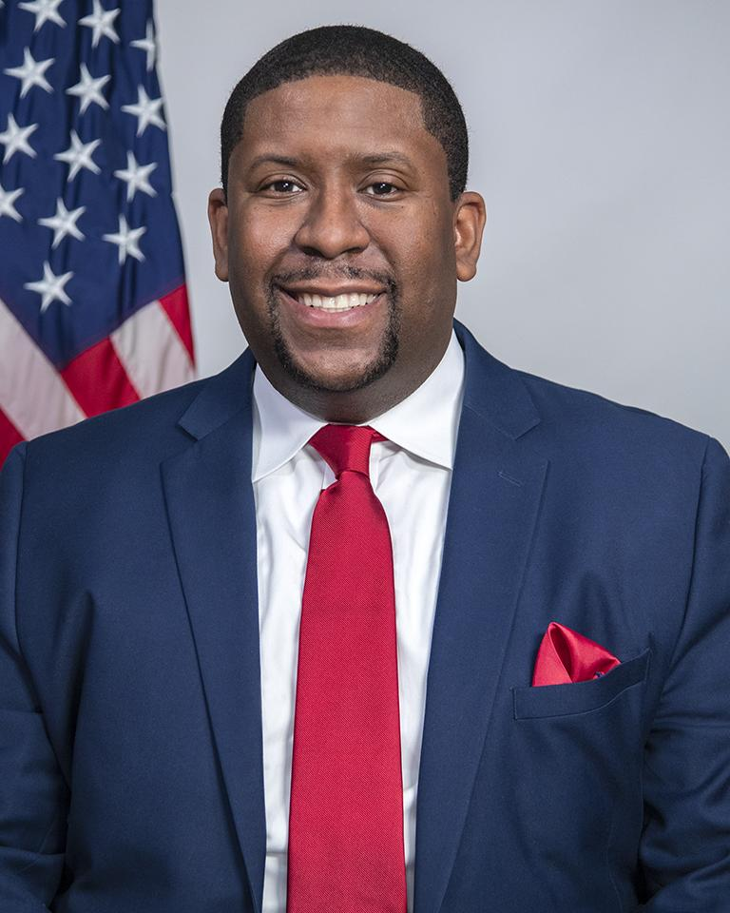
TODAY’S MODERATOR
Exodie C. Roe, III
OSDBU Associate Administrator
U.S. General Services Administration

Slide 3
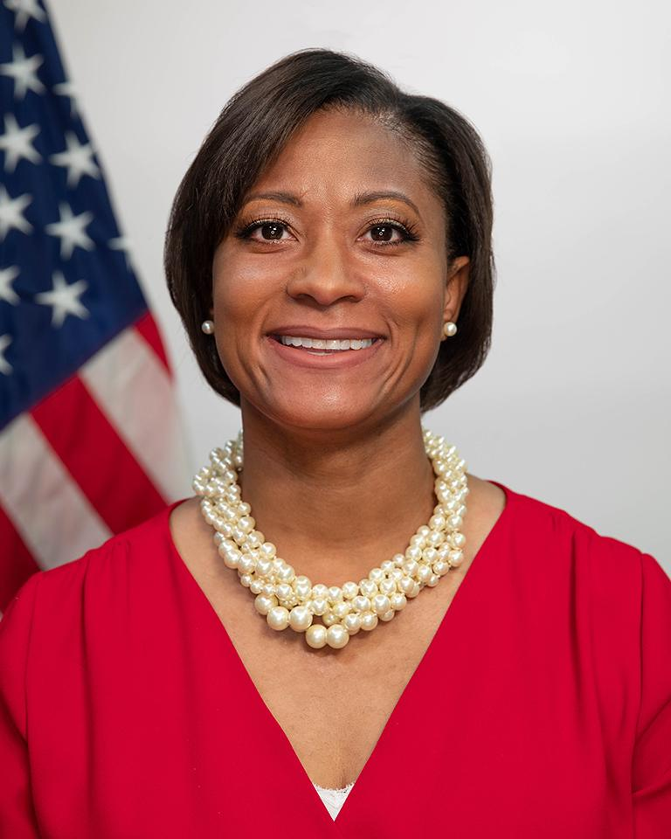
TODAY’S PANELISTS
Krystal Brumfield
Associate Administrator, OGP
U.S. General Services Administration

Slide 4
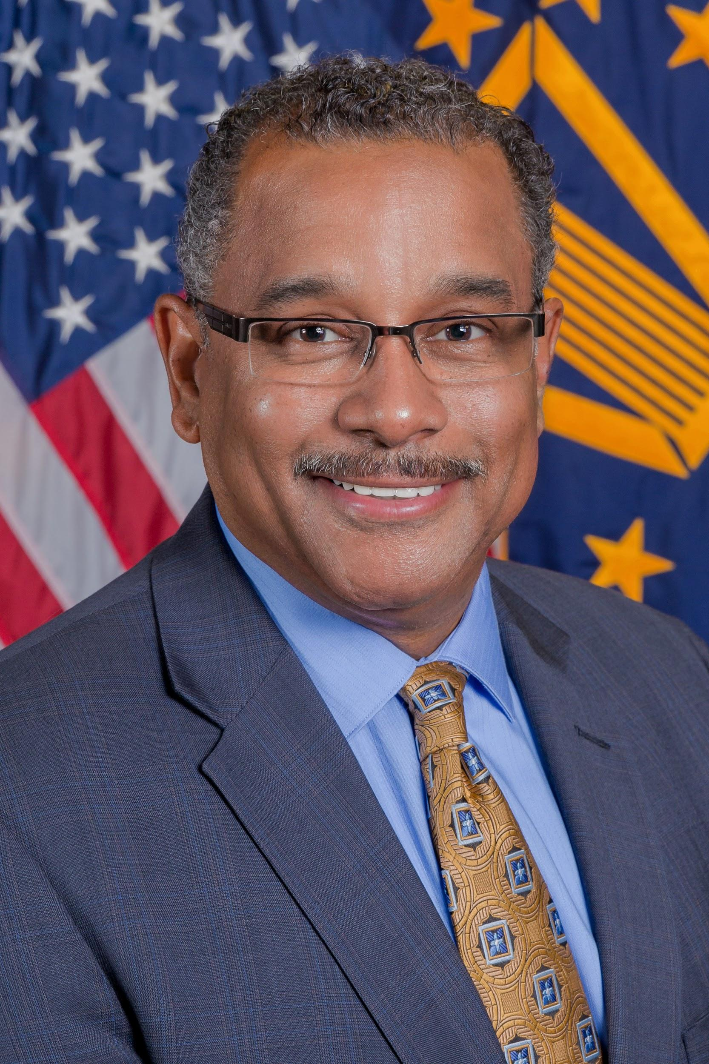
TODAY’S PANELISTS
Antonio Doss
Deputy Administrator
Office of Government Contracting and Business Development
U.S. Small Business Administration

Slide 5
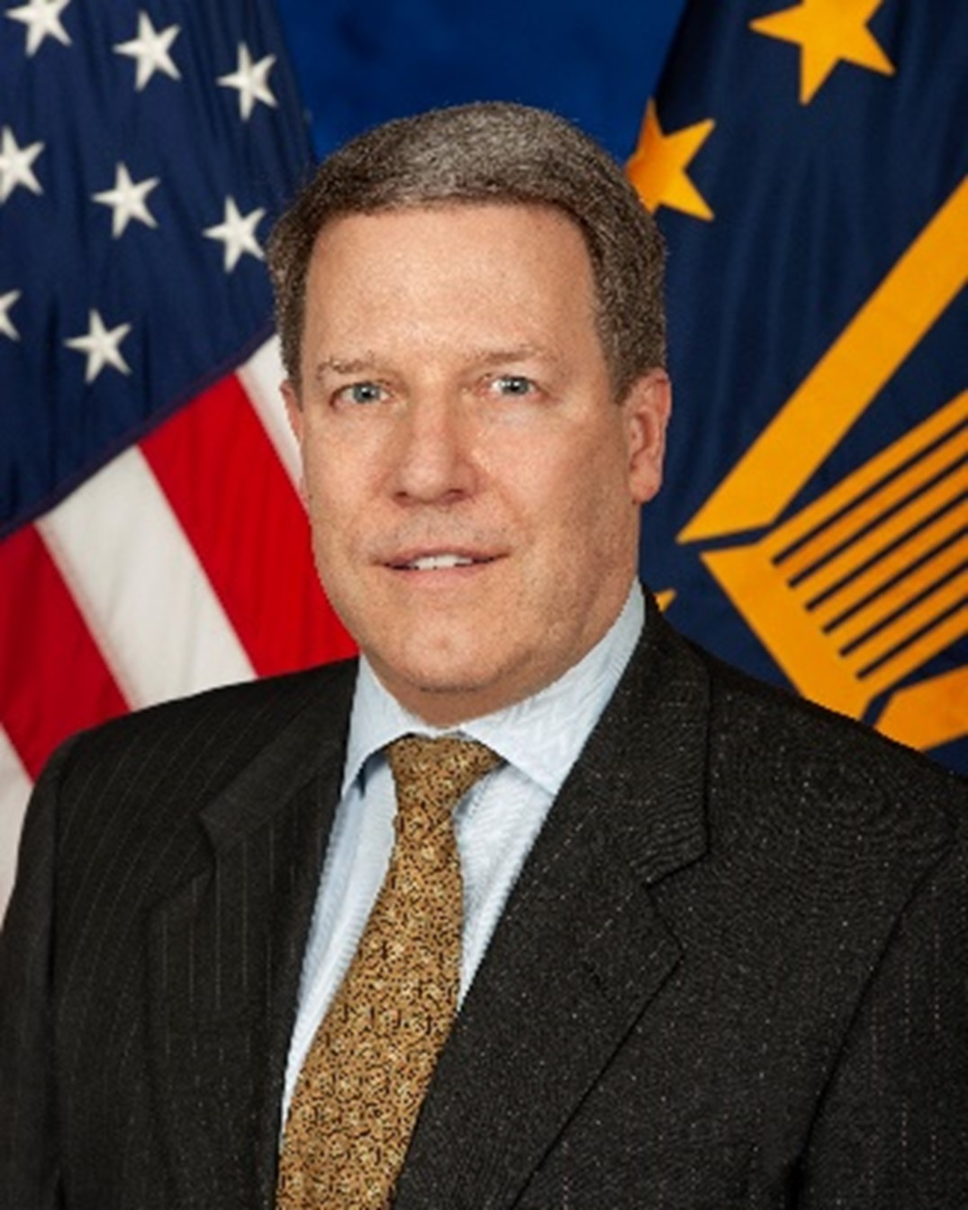
TODAY’S PANELISTS
Michael Parrish
VA Principal Executive Director and Chief Acquisition Officer
U.S. Department of Veterans Affairs

Slide 6
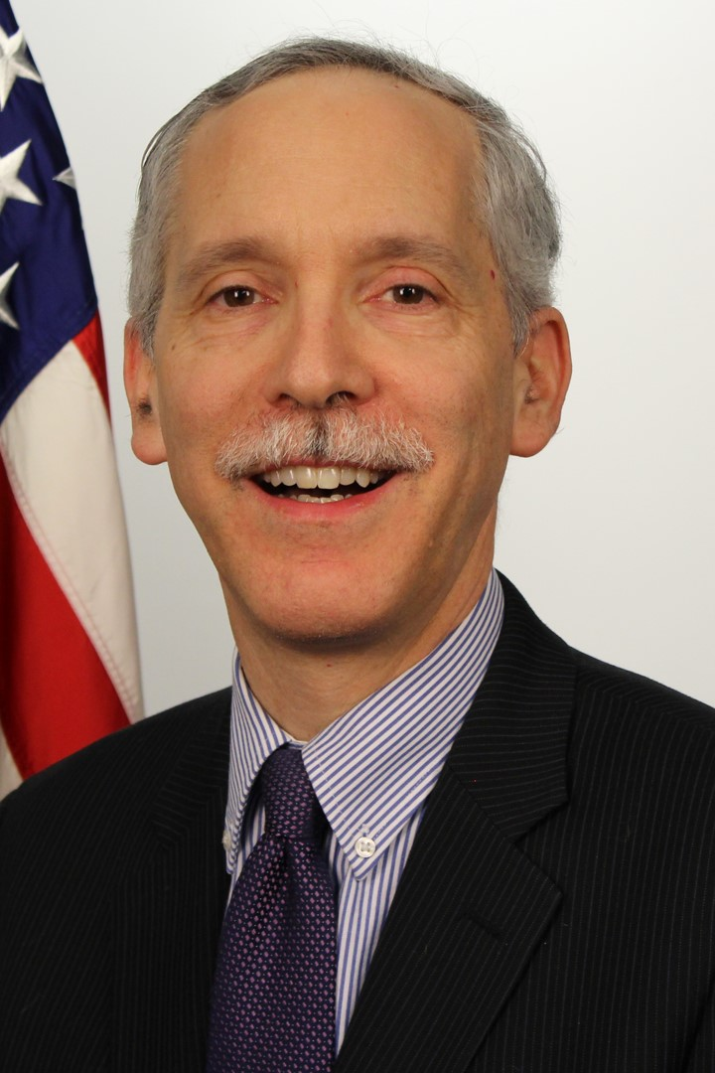
TODAY’S PANELISTS
Matthew Blum
Associate Administrator
Office of Federal Procurement Policy
Office of Management and Budget

Slide 7
Question 1:
Since the Biden-Harris’ Administration issued an executive order to increase the share of contracts going to disadvantage business by 50% by 2025, what steps has your agency taken to achieve that goal?

Slide 8
Question 2
As data-driven decision making becomes the norm in government, how agencies use data to achieve policy goals will garner increasing scrutiny. Please identify how your agency plans to apply enhanced data analytics to their procurement portfolios, positioned to make tactical decisions that promote equity?

Slide 9
Question 3
We know measurable successes from DEIA initiatives such as increasing supplier diversity and improving the post award experience will take time to achieve, what successes can be achieved short term to increase DEIA for small businesses in procurement?

Slide 10
Final thoughts

Slide 11
Questions?

Slide 12
Thank You!

