Slide 1
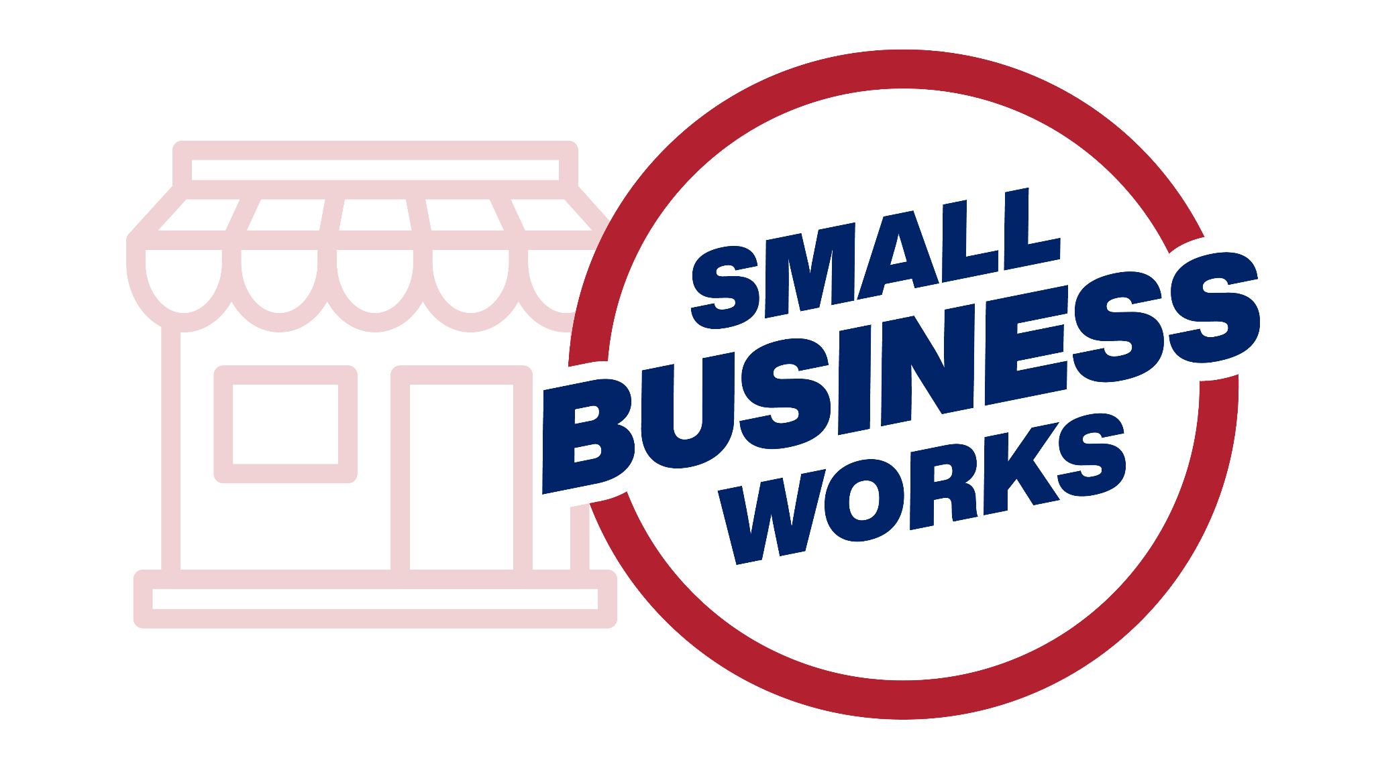
Small Business Works 2022:
Navigating Equity in Procurement
U.S. General Services Administration

Slide 2
Advancing Contracting Opportunities for Small Businesses
Michelle Leshe
Procurement Analyst
U.S. General Services Administration

Slide 3
POLL
Notes:
I want to start today off with a questions to think about how small business impacts us personally. So please take a look at the screen and respond to the following:
How many people here have family members
who are small business owners or
family members who are employed by a small business
How many people here:
have owned a small business in the past
are small business owner now?
want to own a small business in the future
not applicable
Thank you for taking the time to respond to the poll. we can see here that even though we work in the farthest thing from a small business here in government, small businesses have an impact on our daily personal lives through our relationships and for some, even our future plans.
I have a quick personal story I’d like to share about how small business has impacted me: my grandfather was the SDVOSB owner of an ocean towing firm. My father worked for him for the majority of my life. Small business is near and dear to my heart/ their efforts helped propel my life’s successes.
They did work at both the prime and subcontractor levels for the Department of the Navy and Marine Corp. So I have seen firsthand the impacts government procurement can have on small businesses and their families. And No I was never a CO on any of their contracts!
Next Slide

Slide 4
Diversity, Equity and Inclusion: A Brief History
1942: Small business Program established
1947: Congress declared: “a fair proportion of the total purchases and contracts for supplies and services for the Government shall be placed with small business concerns.”
1953: Small Business Act passed, SBA created
1971: Minority Business Enterprise Program (eventually became SDB in 1978)
1977: Set aside program created
1979: WOSB Program
1997: HUBZone Program
2003: SDVOSB Program
Notes:
In order to know where we’re going I like to establish where we’re coming from, where we’ve been. So Now we’ll zoom out and take a look at a brief history of small business in government.
Small business has been a priority in government starting as far back as 1942. Diversity equity and inclusion initiatives followed along in the years after. Looking back, we can see inclusive policy is not new the federal procurement priorities, and we see it annually prioritized with our focus on achieving socio economic and small business goals.
Some key dates I’d like to point out: The Small Business Act was passed by Congress and signed into law by President Eisenhower in 1953.
The legislation created the modern template for federal small business policy, including the establishment of the Small Business Administration itself. SBA was created as an independent agency of the federal government to aid, counsel, assist and protect the interests of small business concerns. The goal of its creation was to preserve free competitive enterprise and maintain and strengthen the overall economy of our nation
We can see from the history here that it started with small businesses and expanded over time to include the various socioeconomic programs. Diversity equity and inclusion initiatives in procurement are a long standing tradition of the US Government.
Next Slide

Slide 5
Diversity, Equity and Inclusion: Now
January 2021: Executive Order 13895: Advancing Racial Equity and Support for Underserved Communities through the Federal Government
June 2021: Tulsa Race Massacre speech
December 2021: Memorandum M-22-03 Advancing Equity in Federal Procurement
Notes:
Now let's take a look at the current state of Diversity, equity and inclusion in procurement, and where we want to go.
On screen I have listed the most consequential policies that will have an impact on diversity equity and inclusion in government procurement moving forward. We’ll break down just how important these orders and memorandums are in the following slides.
next slide

Slide 6
Advancing Racial Equity and Support for Underserved Communities through the Federal Government (Executive Order 13895)
“Make Federal Contracting and procurement opportunities more readily available to all eligible vendors and to remove barriers faced by underserved individuals and communities”
Notes:
First, we have Executive order 13895 entitled Advancing Racial Equity and Support for Underserved Communities through the Federal Government, which was issued January 20, 2021.
The Executive Order calls on us to Make Federal Contracting and procurement opportunities more readily available to all eligible vendors and to remove barriers faced by underserved individuals and communities”
What constitutes an underserved community per this order? “those who have been marginalized, and adversely affected by persistent poverty and inequality, to include persons of color”
And how are we to go about achieving this? By identifying and removing barriers to procurement, and engaging with members of underserved communities.
We will discuss more specific examples of how to achieve these goals later in the presentation.
next slide

Slide 7
Tulsa Race Massacre Speech
Imagine all those hotels and [diners] and mom-and-pop shops that could been — have been passed down this past hundred years. Imagine what could have been done for Black families in Greenwood: financial security and generational wealth.
Source: https://www.whitehouse.gov/briefing-room/speeches-remarks/2021/06/02/remarks-by-president-biden-commemorating-the-100th-anniversary-of-the-tulsa-race-massacre/
Notes:
The next milestone in DEI initiatives is the speech given by the president in June 2021. This speech commemorated the 100 years that have passed since Tulsa Race Masacre, when mobs of white residents, some of whom had been deputized and given weapons by city officials, attacked Black residents and destroyed homes and businesses of the Greenwood District in Tulsa, Oklahoma, Also known as the Tulsa race riot] or the Black Wall Street massacre. This event is considered one of "the single worst incident[s] of racial violence in American history"
The attackers burned and destroyed more than 35 square blocks of the neighborhood which at the time was one of the wealthiest Black communities in the United States
In this speech the President acknowledged the atrocities of the events, and reflected on the great loss of generational wealth and financial security for the black families of Greenwood, Oklahoma.
It was announced in this speech of the presidents intent to increase the spend to small disadvantaged businesses to 15% by the year 2025. This is notable as the current spend has hovered around 10%
next slide

Slide 8
M-22-03: Five management actions
11% of Federal Contract spend to SDBs in FY22
Review Category management practices
Increase new entrants to Federal marketplace
Inclusion of Small Business Contracting Goals in SES Performance plans
Ensure OSDBU has access to senior leadership
Notes:
In follow up to the executive order and the Tulsa Speech, memorandum M-22-03 was issued which implements steps to achieve the president's commitment to increase spending to SDBs to 15% by FY2025. Remember that. 15% by 2025.
To assist the government in achieving this goal, OMB provided 5 management actions. Each agency is to follow these actions to implement the commitments to diversity, equity and inclusion.
In the next slides we’ll take a closer look at each prescribed action, discuss its impacts on DEI and you as contracting professional.
Next slide.

Slide 9
M-22-03: Five management actions
11% of Federal Contract spend to SDBs in FY22
Review Category management practices
Increase new entrants to Federal marketplace
Inclusion of Small Business Contracting Goals in SES Performance plans
Ensure OSDBU has access to senior leadership
Notes:
My main focus will be on management actions that will have a direct impact on acquisition staff in the audience today. Which I’ve identified as items 1-3. I will review items 4 and 5 but these generally fall outside of the control of the audience here today.
next slide.

Slide 10
Management Action #1
Agree with SBA on agency-specific SDB contracting goal for FY22 that will allow the Federal Government to cumulatively award at least 11% of Federal contract spend to SDBs in FY22
Notes:
Agree with SBA on agency-specific SDB contracting goal for FY22 that will allow the Federal Government to cumulatively award at least 11% of Federal contract spend to SDBs in FY22
Wow that was a mouthful. Let me break this down. Part one, Agree with SBA on agency Specific contracting goals:
For those of you who do not know, every year GSA and other federal agencies negotiate their small business goals with the SBA. GSA is represented by the Associate Administrator of OSDBU. Other agencies may be represented by OSDBU as well, for specifics on this process reach out to your OSDBU office.
Part two of this initiative: cumulatively award 11% of contract spend to SDBs in FY22

Slide 11
Governmentwide Goals
FY 2022 Government Wide Small and Socio Economic Small Business Goals | Prime Goal
Small Business | 23%
Small Disadvantaged Business | 11%
Woman Owned Small Business | 5%
Service Disabled Veteran Owned | 3%
HUBZone Small Business | 3%
Notes:
Recall t that the goal is ultimately to achieve 15% spend governmentwide to SDBs by 2025. However, we know the government is a large ship that takes time to turn and cannot pivot overnight. We are not leaping to 15% immediately but rather taking a stepped approach. which is why this first management action starts with achieving a cumulative 11% spend this year.
For context, In FY20, 10.45% of Federal agencies’ total eligible contract spend went to SDBs and in FY21 achievement figures were recently released and we learned that last fiscal year government wide we achieved 11.01% in spend to SDBs, the goal was 5%

Slide 12
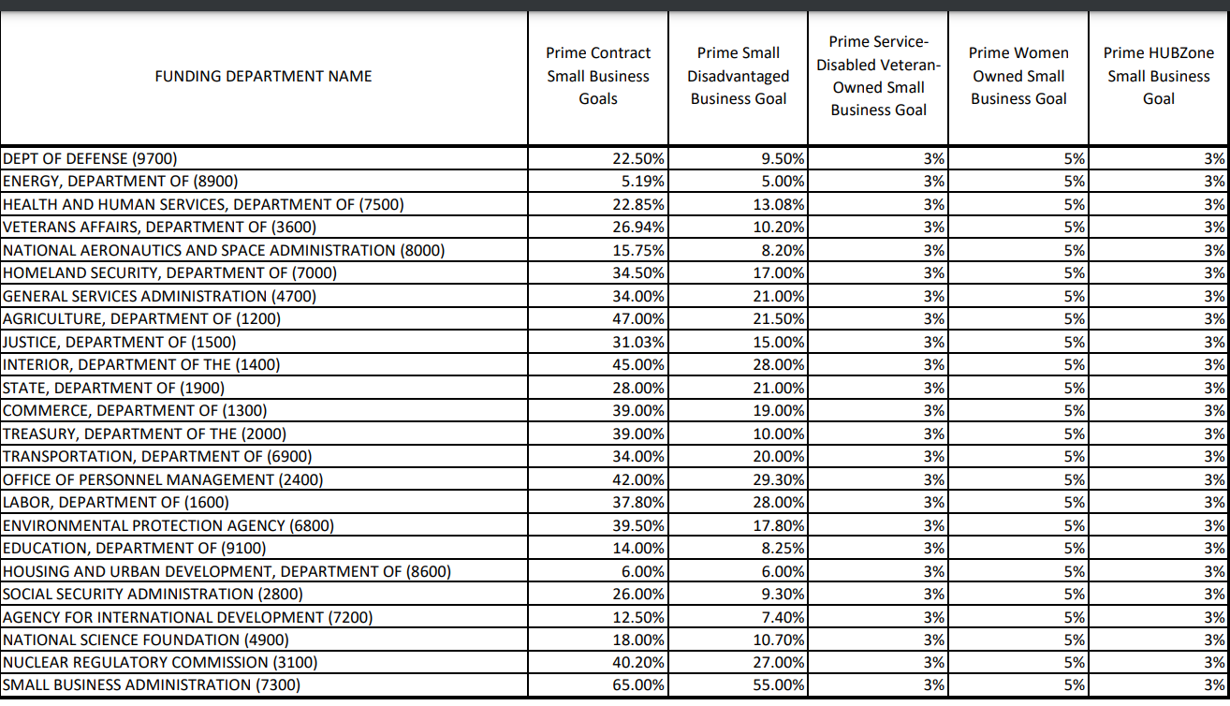
Slide title
Notes:
To find your agency’s goals, contact your OSDBU office or go to the SBA website linked at the bottom of the screen.
You may notice some agencies have considerably higher small business and SDB goals. Take a look at SBA on the bottom of the screen which has a goal of 65% for small business and 55% for SDB vs Department of Defenses 22.5% and 9.5%. These allocations are determined by a mix of the size of the budget of the agency and the types of goods and services that are procured. Taken together across the Government, GSA and other agencies’ goals should result in the award of 11% of total eligible contract spending to going SDBs.
Ultimately Increasing Federal spending with SDBs can accelerate inclusive entrepreneurship, narrow wealth gaps, and create a more dynamic and resilient supplier base. And This is just the beginning of the momentum for diversity equity and inclusion. While these first steps focus on SDB spend, In FY23, SBA plans to identify possible increases in spending for our other socioeconomic categories including WOSBs, SDVOSBs, and HUBZone contractors

Slide 13
Management Action #2
Review and adjust category management stewardship practices to boost contracting opportunities for SDBs and other socioeconomic small businesses
Notes:
Management action number 2 is to review and adjust category management stewardship practices to boost contracting opportunities for SDBs and other socioeconomic small businesses.
OMB recognizes contracting staff have to juggle many competing priorities. The following updates have been made to category management policy to ease the tension between cm goals and small business goals.

Slide 14
Revision/Update and purpose of change
Revision/Update | Purpose of change
A new Tier 2-Socioeconomic Small Business (SB) SUM measure takes effect at the beginning of FY 2022 (retroactive to October 1, 2021) to give agencies automatic credit towards agency category management goals for all awards made to certified and self-certified socioeconomic small businesses | Empowering the workforce to pursue the best acquisition strategy for reaching underserved small business communities helps to maximize awards to socioeconomic small businesses
Category management plans shall not prioritize spending on “Best in Class” (BIC) solutions at the expense of meeting socioeconomic small business goals and providing maximum practicable opportunity to small businesses | Ensuring that use of BIC solutions is balanced with decentralized contracts and other strategies that are necessary to increase diversity within the agency’s small business supplier base advances equity in procurement
Notes:
The first revision creates a new tier 2 socioeconomic small business Spend under management measure which took effect in October 1, 2021 to give agencies credit toward CM goals for all awards made to socioeconomic small businesses. This means every award to SDVOSB, WOSB, HUBZONES, and SDBs will give the same credit in category management as placing an order against GSA schedule or other multi agency contracts not designated Best In Class
The purpose of this change is to empower the workforce to pursue the best acquisition strategy for reaching underserved small business communities and maximize awards to socioeconomic small businesses
Secondly, it is stated that category management plans shall not prioritize spending on best in class solutions at the expense of meeting sb goals.
The purpose of this change is to ensure that use of BIC solutions is balanced with decentralized contracts and other strategies that are necessary to increase diversity within the agency’s small business supplier base which advances equity in procurement

Slide 15
Category Management Goals
Small
Business
Goals
>
“The achievement of socioeconomic and other small business goals shall be prioritized over achievement of category management goals if the achievement of both goals is not possible.”
Notes:
It is further clarified in the memo that the achievement of socioeconomic and other small business goals shall be prioritized over achievement of category management goals if the achievement of both goals is not possible. In layman's terms, small business goals are the priority to achieve.

Slide 16
Revision/Update and Purpose of change
Revision/Update | Purpose of change
Agencies are reminded to establish and implement category management plans consistent with statutory socioeconomic responsibilities and the need to diversify the agencies’ small business supplier base | Using category management practices to promote industry-specific best practices reduces burdens on small business vendors and reinforces small business goal achievement
Notes:
The third revision I want to point out is OMB wants to remind each agency to establish and implement category management plans consistent with statutory socioeconomic responsibilities and the need to diversify the agencies’ small business supplier base.
The purpose of this change is to use category management practices to promote industry-specific best practices thereby reducing burdens on small business vendors and reinforcing small business goal achievement.
There has been a significant reduction in the diversity and size of the small business supplier base, which I’ll address more in the next management action.
Ultimately the purpose of these changes to category management is to provide additional flexibility to the acquisition workforce to help you meet your various goals and at the same time taking steps to reduce barriers to small businesses in the federal acquisition arena.
Additional measures were taken to make adjustments to category management stewardship, and I encourage you all to read the memo in its entirety to get the full scope, however I have narrowed it down to those points that directly impact your day to day work, as well as agencies goals and concerns.
next slide

Slide 17
Management Action #3
Increase the number of new entrants to the Federal marketplace and reverse the general decline in the small business supplier base
Notes:
Management item #3 is to Increase the number of new entrants to the Federal marketplace and reverse the general decline in the small business supplier base, that i mentioned on the previous slide
recent studies have shown Fewer and fewer small businesses are participating in the federal procurement marketplace. From 2010 to 2019, there was a 38% decline in the number of small businesses providing products and services to the federal government. This shrinkage has been partly driven by a dramatic drop in the number of new small business entrants into federal contracting. A 2018 analysis found a 72% decline from 2005 to 2016.
If we combine this data with information from the SBA for the most recent year, the number of new small business entrants into federal contracting declined by 79% from 2005 to 2019.
Now, I am not here to demonize category management. Category management has saved agencies $27.3 billion from fy 17 to FY19 And OMB reported that category management had reduced the number of “potentially duplicative contracts” by nearly 31,000.
However It was originally estimated that only 5% of those 31,000 contracts “were designated small business contracts”
Subsequent GAO analysis, however, found that OMB miscalculated the impact on the small business community and found that over 53% of the contracts that had been eliminated were previously won by small businesses.
That’s worth restating: of the 31,000 contracts eliminated by category management, over half had previously been won and performed by small businesses.
Next slide.

Slide 18
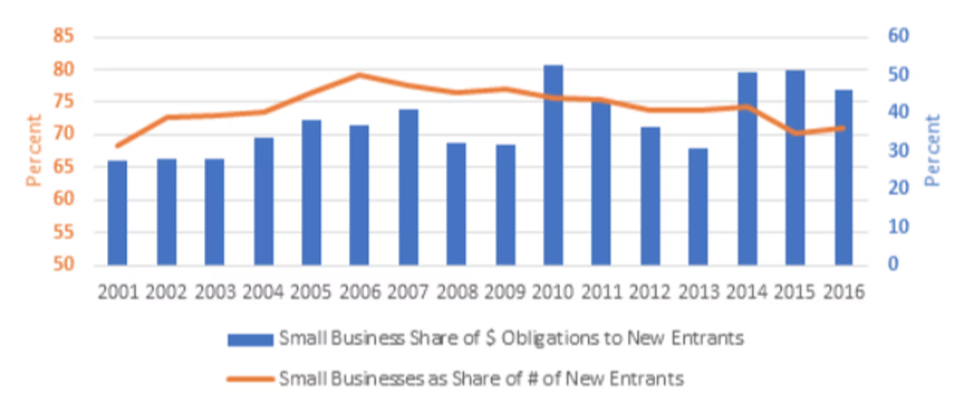
Shrinking Competition: Small Business Share of New Entrants Falls Even as Small Business Share of Contract Dollars Has Risen
source: https://bipartisanpolicy.org/report/supporting-small-business-and-strengthening-the-economy-through-procurement-reform/
Notes:
Now, While spend to small business has not declined, With Fewer small businesses entering the procurement marketplace, the small business allocation must go somewhere, which results in greater concentration. The chart on screen illustrates this. The blue bars are the spend going to new entrant businesses, and the yellow line shows the number of those that are small business, we can see a steady decline from the peak in 2006 around 80%, to about 46% in 2016.
What does this mean? It means there are a few lucky small businesses receiving a disproportionate share of the small business spend. This means less competition—which is in direct opposition of the original intent of the Small Business Act and the core idea of American economic dynamism- that we are at our strongest and most secure when the nation has a robust small business community.

Slide 19
Government-wide Efforts
New entrant management tools
Strengthened procurement forecasting capabilities
Improved data management
Increased transparency for federal agencies and interested businesses
Notes:
In an effort to combat this trend the following government wide efforts are being implemented.
New entrant management tools are being developed
Strengthened procurement forecasting capabilities
Improved data management
Increased transparency for Federal Agencies and interested businesses
These are being handled by OMB and SBA. GSA will play a role in improved data management along with other agencie
To learn more about the government wide efforts, read through the memorandum in its entirety and stay tuned for updates throughout the fiscal years to come.
In general they will be working to create and improve tools small businesses can use to pursue contracting opportunities.
Next slide.

Slide 20
What Can You Do?
Engage with OSDBU and SBA early in acquisition process
Meet with new small businesses
Increase innovative business practices outlined on Periodic Table of Acquisition Innovations
reverse industry days
market research 1-1s
interactive Q&As
Notes:
What I want to spend some time on today is the agency level efforts that were outlined in the memo. What concrete steps can you as contracting professionals at every agency, take to shore up the small business supplier base?
I’m happy to see this listed at the top, I didn’t put this at the top simply because I’m OSDBU I swear this is how its written…. But the first recommendation is to Engage with OSDBU and SBA early in the acquisition process. You may say, michelle I dont know who my OSDBU representative is? An easy way to find them is to go to your agency website and search for “small business”
The next recommendation is for contracting staff to Meet with new small businesses. OSDBU can help you with this. The SBTA in your region regularly takes capabilities briefs which are meetings with small businesses that gives them the opportunity to engage with SBTA and let us know what their company core competencies are. These meetings are enhanced when contracting staff attends and the small business is grateful for the opportunity. I was a contracting officer for a number of years prior to coming to OSDBU so I speak from experience when I say I know in contracting we can become disconnected from the impact our work is having, as we’re primarily sitting behind a desk, not seeing the fruits of our effort in real life. Meeting with small businesses changed that for me. It personalized it. It increased my job satisfaction to make these connections with companies. I encourage you to take the time to meet with companies both for their benefit and your own. a great way to get started with this is if you receive an inquiry off the forecast from a company, invite them to a capability briefing with you and the technical staff. Even if the award opportunity is passed. You will likely have another need for a similar service in the future. If you are uneasy about meeting with vendors, invite the SBTA as well to join or talk to them for pointers on how to make the most of these meetings.
Next suggestions is Increase innovative business practices. You can find a listing of innovative strategies for all stages of the acquisition process at the Periodic Table of Acquisition Innovations. Some examples provided for OSDBUs favorite stage of the acquisition process, market research, include reverse industry days, market research 1-1s, and interactive Q&A sessions with vendors. Engage with your SBTA to help implement these methods. Or come up with your own, we encourage you to be creative and proactive.

Slide 21
What Can You Do? (cont.)
Conduct data driven outreach
Track percentage of contract spending under SAT that is set aside for SB
Strengthen oversight on subcontracting plans
Use Acquisition 360 survey
Notes:
in procurement:
4. Conduct data driven outreach. Make commitments for data-driven outreach, including, where practicable, crowdsourcing tools that allow for dynamic community engagement and supplier scouting targeted at participation in underserved communities. Current examples of these sorts of tools include your agency’s forecast, usaspending.gov, and SAM.GOV. Additional tools discussed in the previous governmentwide slide will be forthcoming
5. OMB recommends tracking the percentage of contract spending under SAT that is set aside for SB, this may not be an individual effort but rather handled at the office level
6. Strengthen oversight on subcontracting plans, we here at OSDBU could dedicate an entire presentation to this topic. For today let this serve as a reminder that Subcontracting is a tremendous avenue for small business to become involved in federal contracting. More government funds are spent with small businesses through subk than prime contracting.
Additionally, agencies are measured both on prime goal achievement and subk goal achievement. Subcontracts are a material part of the contract and we should be scrutinizing the plans and subsequent reports that are submitted. It is not a paperwork exercise. Your OSDBU SBTA can assist you with talking points to address with the contractor where they are deficient
7. and finally, proactively use the acquisition 360 survey to understand better how contractors and potential contractors from underserved communities experience the federal contracting process. This provides a standardized survey instrument to facilitate feedback. The FAR Council will soon release a final rule to encourage the use of the Acquisition 360 tool.

Slide 22
Figure 5: Small Business Reasons for Not Applying for Federal Contracts
Notes:
In the study mentioned in previous slides, they also provided results of a survey for reasons why small businesses are not participating federal procurement. I found this really fascinating.
Federal process too time consuming
insufficient information on federal contract opportunities
Federal process is too complicated
they feel their success unlikely because small businesses are not adequately prioritized
Some of these items are outside of the scope of your control. The Federal process is complicated and takes some significant learning investment on the part of small businesses to learn. However things like insufficient information on opportunities is something that is within your power to help by keeping the forecast updated, responding to inquiries and making time to engage with small businesses.
You can also help with the issue of “Success is unlikely because small businesses are not adequately prioritized” by continuing to do everything within your power where practicable to maximize opportunities to small businesses.
For more information you can read the study itself which is linked at the bottom of the page on slide 13, it was a really good read and informed much of today’s presentation.
next slide

Slide 23
Management Actions #4 and #5
4. Include the achievement of small business contracting goals as a part of the performance plans for key Senior Executive Service (SES) officials
5. Ensure agency small business contracting offices have access to senior leadership
Notes:
The last two management principles being implemented are here. #4 Include the achievement of small business contracting goals as a part of the performance plans for key Senior Executive Service (SES) officials and #5 Ensure agency small business contracting offices have access to senior leadership. These are items that your leadership team has responsibility to implement.

Slide 24
Additional steps you can take to promote Diversity, Equity and Inclusion…
Notes:
We have already touched on several steps in previous slides about what you as an individual can do to make a difference in diversity equity and inclusion measures. The remaining slides will provide some additional suggestions that you can take in your day to day to be proactively inclusive of socioeconomic status businesses.

Slide 25
May, Should and Shall…
Orders and BPAs (Part 8)
CO may use discretion to set aside orders/BPAs to small business
Ordering activities may consider socioeconomic status… should consider at least one small business
Contracts (Part 19)
CO should consider agency progress in fulfilling its small business goals
Rule of 2...CO shall set aside any acquisition over the SAT...
Notes:
t I want to briefly refresh on the authorities pertaining to small business. The FAR provides a good deal of latitude to contracting officers about procedures they MAY do. I would empower you to use these optional authorities to favor small business.
Under part 8:
We often see contracting officers using their discretion to not set something aside. I challenge you to use your discretion to do more socioeconomic set asides.
When it comes to establishing contracts, under part 19 remember there is no order of precedence when determining which socioeconomic program to use for an acquisition. FAR 19.203(d) states In determining which socioeconomic program to use for an acquisition, the contracting officer should consider, at a minimum-
(1) Results of market research that was done to determine if there are socioeconomic firms capable of satisfying the agency’s requirement; and
(2) Agency progress in fulfilling its small business goals.This one is particularly important now with our ever increasing goals. we should be keeping an eye on both agency achievement of goals throughout the year as well as customer agencies we serve.

Slide 26
Acquisition Planning Tips
Use small business factors as permitted by your agency as a source selection factor
Become familiar with WOSB NAICS for the set-asides
Review historical award data
Sole source authority for socioeconomic programs
Notes:
On this slide, I have some quick tips on methods to consider socioeconomic small business and small business in acquisition planning.
Consider using small business factors as permitted by your agency as a source selection factor. This may include giving additional consideration to SESB or subcontracting plan robustness.
Set asides for WOSB can only be used for certain NAICS codes, bookmark this link to check if your acquisition is eligible as part of market research.
Review historical award data of previous years to plan ahead for next year’s acquisitions. Evaluate what vehicles were used? What does the industrial base for WOSB and HUBZone, for example, look like on those vehicles. Is it robust? If not what can be done to help? Consider using other vehicles with a better base or open market if necessary.
And finally, we know that competition is a key metric that is tracked and results in lower prices, but also remember that the FAR does allow for sole source authority for socioeconomic programs. It must be approved in accordance with the regulations and may not be encouraged, but it under certain circumstances, may be a good fit.
Next slide

Slide 27
Acquisition Planning Tips (Cont.)
Read recent memo issued June 29th, Strategies for Meeting and Exceeding the SDB Goal for FY22
Use existing and open market contracts to reach a mix of new entrant SDBs
Review SAT Awards
Maximize use the 8(a) program
SBAs 8(a) no-contracts list of eligible firms
Take advantage of other tools to award to SDBs
Consider WOSB or HUBZone Set asdies
Notes:
On June 29th, OMB issued another memo entitled Strategies for meeting and Exceeding the SDB Goal for FY22. There are a number of great suggestions therein and I encourage you to read the memo in its entirety, it is linked on this slide. I have highlighted some of the strategies they recommend here.
Use existing and open market contracts to reach a mix of new entrant SDBs
Analysis of data in the Federal Procurement Data System suggests that almost half of contract dollars under the SAT is not going to small businesses, despite the statutory requirement to automatically set aside work under the SAT for small businesses unless the contracting officer determines the “rule of two” cannot be met. This underutilization includes awards for products and services in industries where small businesses are typically well represented.
Maximize the use of the 8(a) program. 8(a) contractors are all SDBs. the 8(a) program provides a fast an easy way to award contracts that cannot be protested. Consider sourcing your next acquisition from SBAs list of a8(a) contractors who have not yet received an award
And last but not least take advantage of other tools to award to SDBs. Almost 70 percent of WOSBs are also SDB contractors and 67 percent of HUBZone-certified small businesses are SDBs. When awards are made to WOSBs or HUBZone firms, there is a high likelihood that the action will also reach an SDB – serving two or more underserved communities with one action.

Slide 28
Takeaways...
Increased socioeconomic spends coming
$650 Billion Government wide
Remember- What you do matters!
Notes:
What I hope you;ll take a way from this presentation: The Federal Government is the largest consumer of goods and services in the world, spending more than $650 billion each year. This purchasing power makes Federal procurement a powerful tool to support small business growth and build generational wealth throughout the United States, including for firms owned by underrepresented individuals. As contracting officers, you are uniquely positioned to make a direct impact on the lives and livelihoods of diverse small businesses and employees.
next slide

Slide 29
Questions?

Slide 30
Thank You!

