Slide 1
Office of Integrated Marketing
Agile Contracting -
Nimbly Work your Way to Success
February 6th, 2024

Slide 2
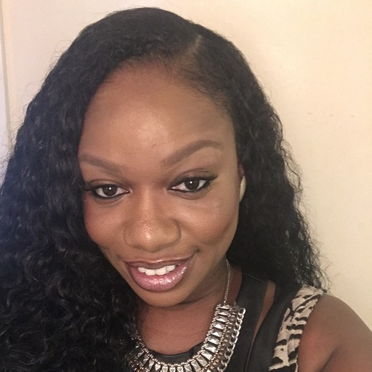
👋 Hello and welcome!
Ashley Owens
(she/her)
Senior Digital Acquisition Strategist
GSA Service Delivery Team
GSA IT
Notes:
Ashley (she/her) is an evangelist for the use of modern procurement methods and the application of Agile methods to digital technology services and product acquisition. She prides herself in sharing “real talk” with her procurement clients and recognizes that contracting officers are the “tip of the spear” in IT transformation.
Prior to her current role, she served as GSA 18F’s Acting Executive Director and Director of the GSA 18F Acquisition Chapter, was a lead Contracting Officer at the Food and Nutrition Service, and a Contracting Officer at the U.S. Forest Service.
Ashley lives in Atlanta, GA and holds an MBA and Bachelor’s from South Carolina State University.
The Service Delivery team works with GSA programs to help deliver digital services that are easy to use and support.

Slide 3
Today we’re going to talk about:
What user-centered procurement is
Who makes it happen
Why it matters
What is the process
But first, a quick poll.
Notes:
Post award, these are some of the things that we’ll expect in projects going forward.

Slide 4
🗳️⏰: Have you heard of user-centered procurement?
Notes:
And this bring us to the next poll question…
Has your company practiced user-centered design?
Yes, we have user experience designers on all of our projects
Yes, depending on a project’s need, we practice user-centered design
No, this isn’t a practice that our company employs

Slide 5
What is agile acquisition?
Notes:
Agile Acquisition is the application of agile methods to the entire lifecycle of satisfying government needs - from identifying the need through satisfying the need and the closeout of the contract
Procurement: the process of awarding a contract to purchase products and services from a vendor(s))
User Centered Procurement - understanding user needs to determine what products and/or services to purchase

Slide 6
agile acquisition (noun)
the application of agile methods to the entire lifecycle of satisfying government needs - from identifying the need through satisfying the need and the closeout of the contract
Notes:
Ashley
User-centered procurement (noun)
a process of awarding a contract that utilizes the needs of end users to determine what products and/or services to purchase from a contractor(s)
understanding user needs before procurement, and engaging users throughout the design and development process to iteratively deliver products that meet users’ needs

Slide 7
What is user-centered procurement?

Slide 8
User-centered procurement (noun)
the process of understanding user needs to determine what products and/or services to buy
Notes:
Ashley
User-centered procurement (noun)
a process of awarding a contract that utilizes the needs of end users to determine what products and/or services to purchase from a contractor(s)
understanding user needs before procurement, and engaging users throughout the design and development process to iteratively deliver products that meet users’ needs
Procurement: the process of awarding a contract to purchase products and services from a vendor(s))
User Centered Procurement - understanding user needs to determine what products and/or services to purchase

Slide 9
Why it matters?

Slide 10
Why it matters?
GSA program offices, tech, design, and acquisition work as a cross functional team (a modern integrated project team (IPT))
Acquisition workforce understands how to and the importance of facilitating the IPT through the user-centered procurement lifecycle
Altering project/procurement intake: understanding user needs at the start of a project; and how to choose the acquisition strategy best for user need
Connecting with strong industry partners and shaping the industry to focus on UX
Contracts structured to support iterative, user-centered delivery
It derisks procurements
It structures contracts to allow for flexibility and industry collaboration
It reduces burden and task completion time
It encourages delivery of working software
It often saves money

Slide 11
Agile Contracting Strategy v Waterfall
FROM WATERFALL
Assessment Phase I
Implementation Phase II
TO AGILE
Months

Slide 12
Who do we need for user-centered procurement?

Slide 13
We need everyone.

Slide 14
Contracting Officer
Tech Lead
Security Lead
COR
Product Owner
And everyone has a role to play.
Notes:
All of the people who will be needed to bring your product to life should be involved in the research planning and execution.
The product owner is the key person for any software project, and must be a government employee. The product owner works with users, stakeholders, technologists, and the vendor to envision the direction for the product, with an eye toward delivering value to end users as quickly as possible.
The product owner doesn’t need to be a strong technologist. Instead, they should know the users of the system, the business (for example, Medicaid insurance or DMV services), and policy constraints.

Slide 15
Integrated Project Team
Contracting Office
Program Office
+
GSA IT
IS

Slide 16
Integrated Product Team
Agile SMEs
Contracting Office
Advisors
Procurement team is the owner of the process
Program Office
+
GSA IT
Product owner is the owner of the “thing”
Tech lead + Security

Slide 17
A Cross-functional Team to Support the Acquisition
IPT
Agile SME
Post-award
Project lead / product owner
Contracting Officer
Contracting Specialist
Contracting Officer’s Representative
Tech Lead
Product manager
User experience design
Content designer
Engineering
Acq Strategist
Someone to review contractor code against established QASP or to monitor vendor performance if not a custom-built solution

Slide 18
User-centered Contract Lifecycle
Requirements definition
Market Research
Acquisition Strategy
Solicitation
Vendor Sub-
mission
Problem statement + product vision
User research + technical discovery
Build, buy, or blend
Draft RFx and official / formal RFx
Closeout
Contract Administration
Award
Evaluation
Iterative design + development
SME/usability testing or oral interviews
Notes:
Ashley
These are really feedback loops and validation points
Acq works here bc of ALL OF US
Our agile principles inherently derisk contracts and give partners better vendor outcomes
Best practices to expect
Not developing requirements
Starting off with product framing
Validating problem statements with user research
Builds - SOOs
Buys - SOWs with scorecards
COTS - Sandbox access versus demos
Descriptive than prescriptive
Key personnel
Flexibility into the contract
Solicitations looked like dissertations - contracts are supposed to solve problems

Slide 19
Requirements Definition Product Framing
Requirements definition
Problem statement and product vision

Slide 20
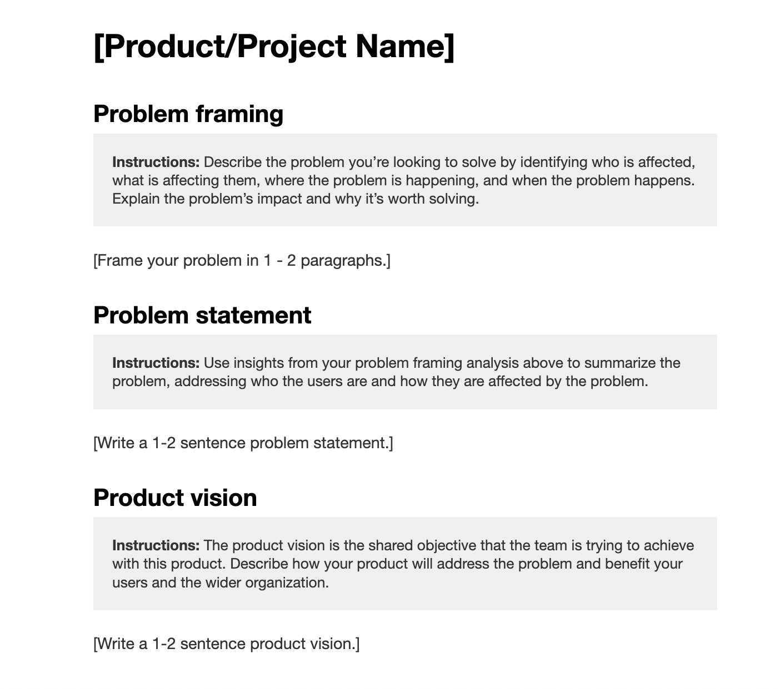
Product Framing
Image placeholder of prototype
Clarify the problem space, intended audience, and a basic definition of success for the product
Document a shared understanding of the vision and scope of a specific product or feature set the team will build/buy
Product framing template

Slide 21
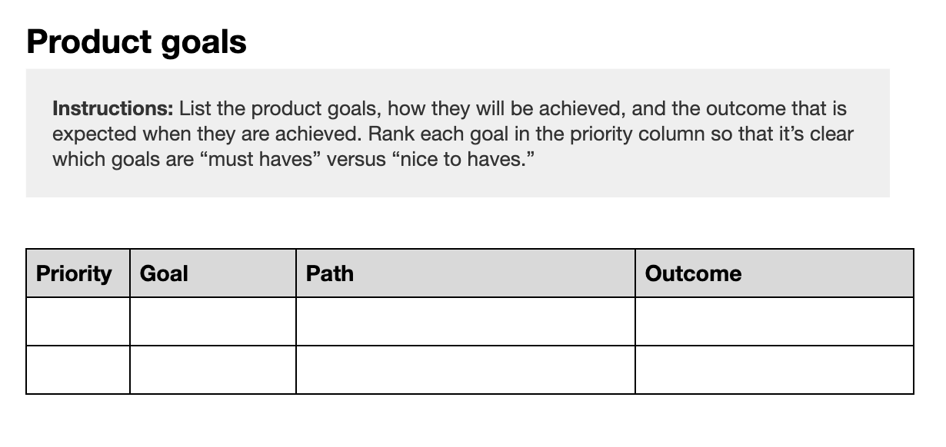
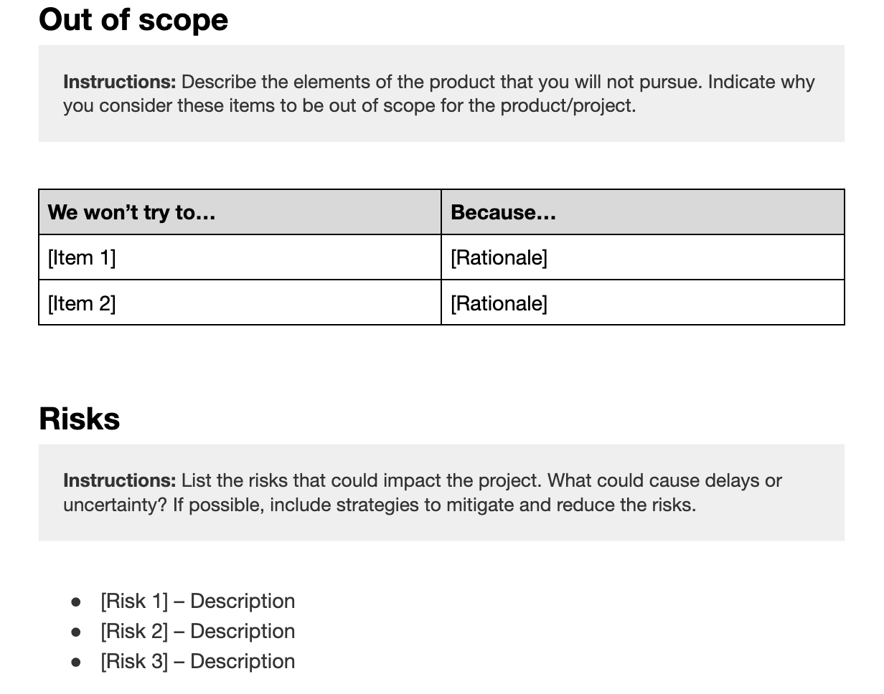
Product Framing
Image placeholder of prototype
Communicate the outcomes that the product must create, and their relative priority of each of those outcomes
Product framing template

Slide 22
Market Research User Research/Discovery

Slide 23
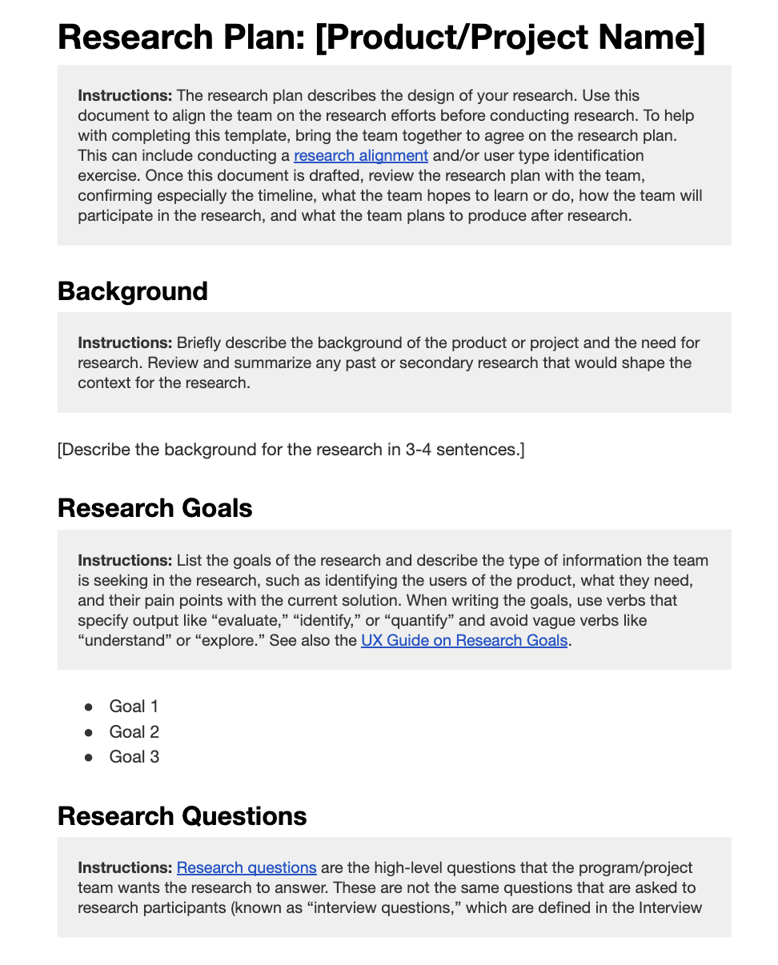
User Research
Image placeholder of prototype
Describe the design of your research and formulate a research plan, including questions the team wants answered, methods the team will employ, how the team will contribute, and interview guides
Determine who the team wants to learn from (users, customers, stakeholders, etc) and invite them to participate
Manage research logistics (times, places, tools, and people)
User research template

Slide 24
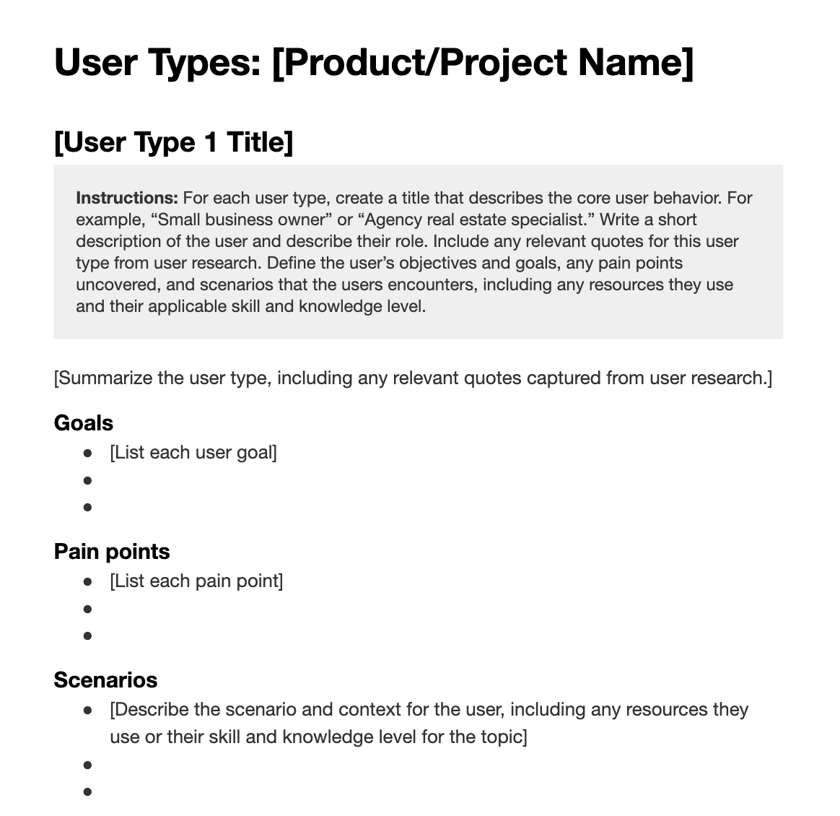
User Research
Image placeholder of prototype
Analyze and synthesize the findings and insights from user research and group them by high-level user types
Increase the team’s understanding of their different users
Validate and modify product decisions to better meet user needs
User types template

Slide 25
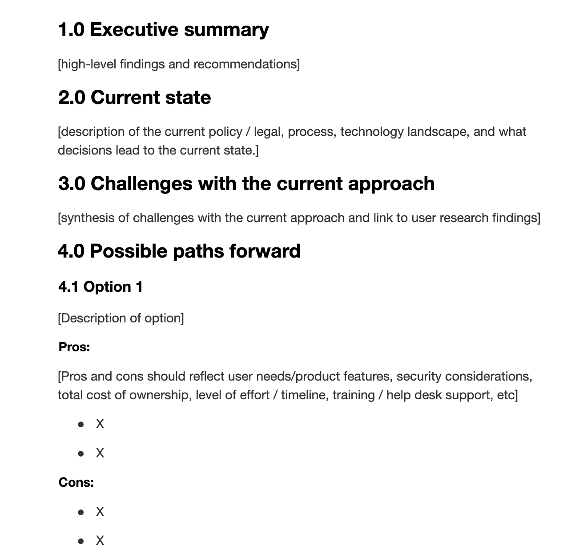
Technical Discovery
Image placeholder of prototype
Document technical options based on the user research
Outline pros and cons
Goal: Help GSA make a technology decision based on the best available information at the time
Technical alternatives template

Slide 26
Acquisition Strategy Build, Buy, or Blend
Requirements definition
Problem statement and product vision
Market research
User research and technical discovery
Acquisition strategy
Build, buy, or blend decision-making
Notes:
Ashley

Slide 27
Build, Buy, or Blend
Create your own customized solution.
Build
This is the ultimate decision point
Recommendation is from the Technical alternatives doc completed
Determines what you are going to buy
Existing solutions/Commercial Off The Shelf (COTS)
Buy
Thoughtful combination
Blend
Sample acquisition plan

Slide 28
Solicitation Draft RFx + RFx + Feedback Loops
Requirements definition
Problem statement and product vision
Market research
User research and technical discovery
Acquisition strategy
Build, buy, or blend decision-making
Solicitation
Draft RFI and formal RFQ
Notes:
Ashley

Slide 29
Solicitation
Statement of Objectives (SOO)
Custom
This is the formal execution of the Build, Buy, Blend decision
Work statement determined by Build, Buy, or Blend decision
The initial solicitation should be used as a draft for a Request for Information (RFI)
Statement of Work (SOW, clearly defining configuration vs customization)
COTS
Thoughtful combination
Blend
Agile contract format

Slide 30
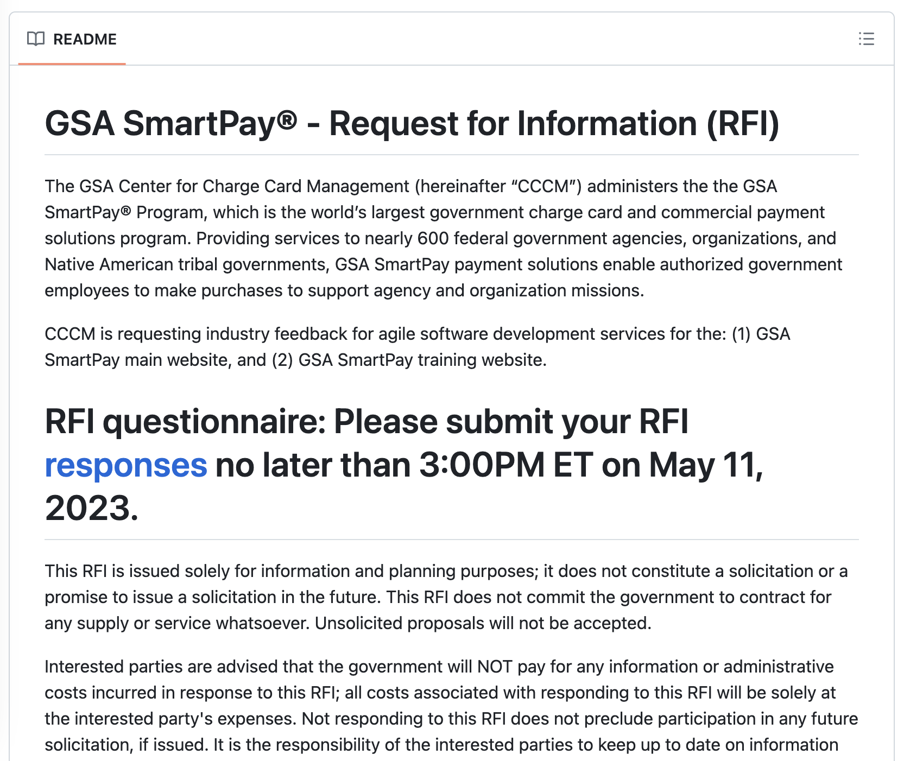
Draft Solicitation
Another validation point to the Build, Buy, Blend decision
Informs the formal solicitation with industry feedback

Slide 31
Evaluation
Requirements definition
Problem statement and product vision
Market research
User research and technical discovery
Acquisition strategy
Build, buy, or blend decision-making
Solicitation
Draft RFI and formal RFQ
Evaluation
SME/user reviews and vendor interviews

Slide 32
Evaluation
Technical approach
Including user research plan, interview protocol, and usability testing approach
Staffing approach
Key personnel project manager and technical lead
UX lead
Similar experience
3 code repositories
Technical approach
Custom
2 Code repository
Similar experience examples
COTS
Scorecards
Sandbox usability testing
User experience approach
Research plan
Interview protocol
Usability testing approach
Sample findings summary
Notes:
Jenn
Post award, these are some of the things that we’ll expect in projects going forward.

Slide 33
Award
Requirements definition
Problem statement and product vision
Market research
User research and technical discovery
Acquisition strategy
Build, buy, or blend decision-making
Solicitation
Draft RFI and formal RFQ
Evaluation
SME/user reviews and vendor interviews
Award
Award notification and next steps

Slide 34
Post-award
Meeting the quality assessment surveillance plan (QASP) provided by gov
Shifting from requirements to user research and understanding user needs
Adhering to GSA design standards and US Web Design System
Implementing accessibility best practices and testing
Developing products iteratively with incremental releases
Defaulting to open source / code repository best practices
Notes:
Jenn
Post award, these are some of the things that we’ll expect in projects going forward.

Slide 35
Additional Resources

Slide 36
Making Procurement Joyful™
Intake: Product Framing Template
User Research: User Research Template, User Synthesis
Market Research: Technical Alternatives Template
Acquisition Strategy: Build, Buy, or Blend?
Evaluation (UX): Guidelines
Evaluation (Code Review): Code Review Template
Solicitation: Agile Contract Format Template
Post Award: Quality Assurance Surveillance Plan

Slide 37
Interested in using the user-centered procurement approach for your next acquisition?
Get in touch with us at servicedelivery@gsa.gov.

Slide 38
Questions?

Slide 39
Thank you!

