Slide 1
Emergency Acquisition Basic Ordering Agreements
Office of Acquisition Operations (QMA)
presented by
Michael Sands

Slide 2
Introduction
Who we are
QMA falls under GSA’s Federal Acquisition Service (FAS).
FAS’s mission is to make agencies more effective at what they do by providing expertise, management, and optimal acquisition solutions.
Who we support
Primarily we support other Federal agencies; however, GSA allows other non-federal government entities to utilize its contracting vehicles and sources of supply under certain circumstances.
QMA assumed responsibility for emergency acquisitions in support of other Federal agencies in FY21.

Slide 3
Agenda
Explain what BOA’s are, how they work, and who can use them
Discuss the recently executed Emergency Acquisition (EA) Basic Ordering Agreements (BOA’s)
Review the scope of the EA BOA’s along with the benefits of using them
Ordering Process and Example Requirement
Summary / Q&A

Slide 4
Basic Ordering Agreements
Federal Acquisition Regulations (FAR) 16.703 (emphasis added)
BOA’s are written instruments of understanding, negotiated between an agency, contracting activity, or contracting office and a contractor, that contains (1) terms and clauses applying to future contracts (orders) between the parties during its term, (2) a description, as specific as practicable, of supplies or services to be provided, and (3) methods for pricing, issuing, and delivering future orders under the basic ordering agreement. A basic ordering agreement is not a contract.
BOA’s are effective instruments for expediting contracting activities for uncertain requirements in which specific quantities, items, and prices are not known at the time of execution of the agreement.

Slide 5
QMA’s EA Basic Ordering Agreements
BOA’s were initially considered to assist QMA with rapidly procuring supplies and services in support of FEMA. During Acquisition Planning and market research, it became clear these vehicles could also offer value to all levels of government in times of emergency.
These BOA’s may be used, free of charge, by all Federal agencies, state & local, tribal, and territorial governments.
QMA executed eighteen (18) BOA’s with vendors from diverse industries and locations to ensure FEMA and other government entities would have a pool of experienced and capable vendors to procure commercial supplies and services from in times of emergency.
Of the 18 BOA’s executed, 17 of the vendors are Small Businesses.

Slide 6
Scope
QMA’s EA BOA’s may be used to rapidly procure just about any commercial supply or service, so long as the requirement is in support of an emergency.
QMA’s definition of emergency is broader than that found in the FAR which requires a Presidential declaration.
If a given requirement is determined an emergency by an agency or government entity, or a Presidential declaration is made, your requirement for commercial supplies or services is likely within the scope of this BOA.
Should there be questions about scope or use of these BOA’s, contact the EA BOA Contracting Officer (see Contacts slide).

Slide 7
Benefits
QMA’s EA BOA’s include guidance and step-by-step instructions for authorized users to follow when soliciting, evaluating, and awarding requirements.
Flexibility is built into the BOA’s allowing users to incorporate their own unique terms and conditions for each requirement (packaging, delivery, response times, additional clauses & provisions…etc.).
These BOA’s do not contain price lists or item catalogs; therefore, users can solicit just about any commercial supply or service, and vendors can quote based on current market conditions.
Use of these BOA’s is not system-dependent (emailed RFQ’s and award notices are the norm), and vendors have been prepared to adapt to unique agency requirements and procedures.

Slide 8
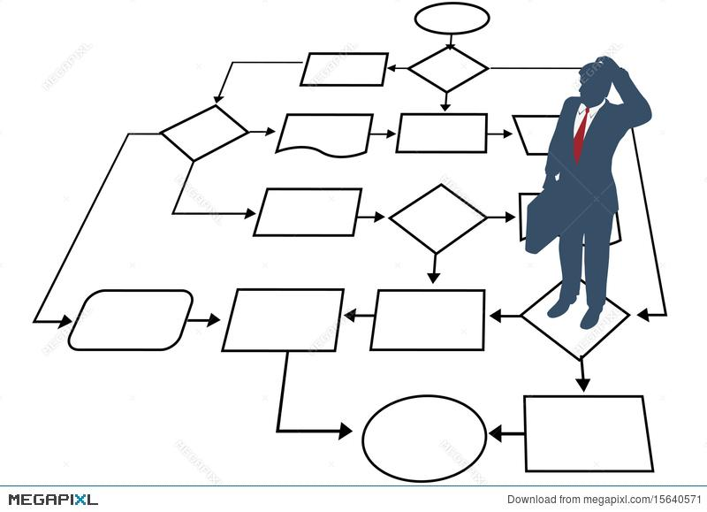
Process Flow
Identification of need
Describe/Define requirement
Market Research & Acquisition Planning
Review & Approval
Draft solicitation
Review & Approval
Publish/distribute solicitation
Evaluate quotes/offers
Draft award decision
Review & Approval
Send order/contract to awardee for signature
CO countersigns award document
Distribute award to awardee
Publish award notice
Performance completed
Payment issued
Close out order/contract

Slide 9
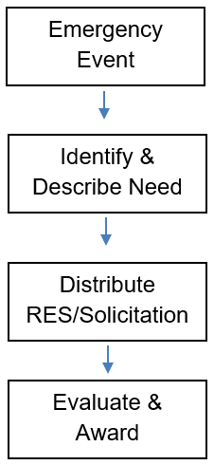
EA BOA Process Flow
QMA has already performed the market research, acquisition planning, and responsibility determinations to streamline ordering procedures for users.
The BOA was synopsized through SAM.gov and provided fair opportunity.
Authorized users may jump right into their solicitations after they have identified their emergency requirement and adequately described their need.
Rapid response times, evaluation procedures, and delivery terms are present in the BOA allowing streamlined competition and awards.

Slide 10
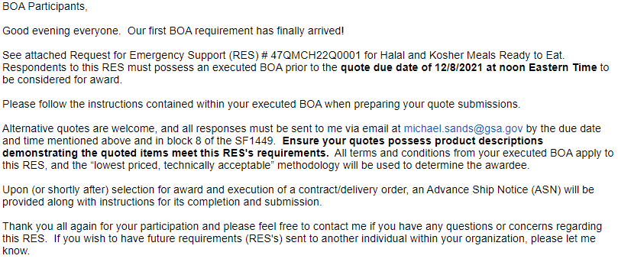
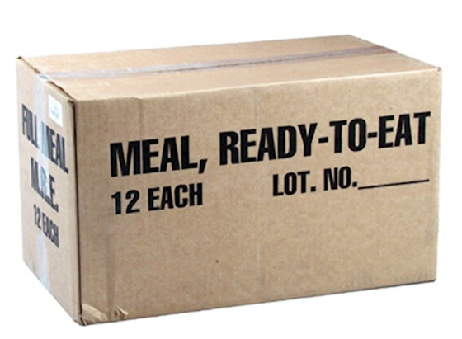
Example Requirement

Slide 11
References & Contacts
https://www.acquisition.gov/far/part-16#FAR_16_703
A copy of the BOA and Master Contact List of BOA Participants will be distributed with this slide deck to all participants after the meeting.
QMA EA Contracting Officer:
Michael Sands, 786-795-3259, michael.sands@gsa.gov

Slide 12
Final slide with two images

