Slide 1
Emergency Acquisition Basic Ordering Agreements
presented by
Reagan Criddle

Slide 2
Introduction
Who we are
  The Emergency Acquisition team falls under GSA’s Federal Acquisition Service (FAS) Office of Shared Services Delivery (FD).
  FD strives to be the federal government’s most trusted shared-services provider, delivering reliable solutions that keep customer agencies mission-focused while making operations simpler, faster, and more cost effective.
Who we support
  Primarily we support other Federal agencies; however, GSA allows other non-federal government entities to utilize its contracting vehicles and sources of supply under certain circumstances.

Slide 3
Agenda
Explain what BOAs are, how they work, and who can use them
Discuss the Emergency Acquisition (EA) Basic Ordering Agreements (BOAs)
Review the scope of the EA BOAs along with the benefits of using them
Discuss the Ordering Process and Example Requirements
Summary & Data
Q&A

Slide 4
Basic Ordering Agreements
Federal Acquisition Regulations (FAR) 16.703(a) (GSA Class Deviation RFO-2025-17)
BOAs are written instruments of understanding, negotiated between an agency, contracting activity, or contracting office and a contractor, that contains (1) terms and clauses applying to future contracts (orders) between the parties during its term, (2) a description, as specific as practicable, of supplies or services to be provided, and (3) methods for pricing, issuing, and delivering future orders under the basic ordering agreement. A basic ordering agreement is not a contract.
BOAs are effective instruments for expediting contracting activities for uncertain requirements in which specific quantities, items, and prices are not known at the time of execution of the agreement.

Slide 5
FAS’s EA Basic Ordering Agreements
BOAs were initially considered to assist FAS with rapidly procuring supplies and services in support of FEMA. During Acquisition Planning and market research, it became clear these vehicles could also offer value to other Federal agencies in times of emergency.
  These BOAs may be used, free of charge, by all Federal agencies.
FAS executed 19 BOAs with vendors from diverse industries and locations to ensure FEMA and other Federal agencies would have a pool of experienced and capable vendors to procure commercial supplies and services from in times of emergency.
  Of the 19 BOA’s executed, 15 of the vendors are Small Businesses.
The current EA BOA ordering period expires on 12/31/2026. FAS is in the process of setting up another suite of follow-on EA BOAs.

Slide 6
Scope
FAS’s EA BOAs may be used to rapidly procure just about any commercial supply or service, so long as the requirement is in support of an emergency.
  The EA BOA definition of “emergency” is broader that the FAR definition. No Presidential declaration required for EA BOA use.
If a given requirement is determined an emergency by an agency, or a Presidential declaration is made, your requirement for commercial supplies or services is likely within the scope of this BOA.
  Questions about scope of the use of these BOAs? Contact the EA BOA Contracting Officer (see Contacts slide).
Notes:
The term “Emergency” used within this agreement means events which meet the definition found in FAR 2.101 OR any situation which, if not corrected immediately, will result in unnecessary expenditure of funds, property damage, personal injury, or interruption of agency functions.

Slide 7
Benefits
Easy to use
Flexible to unique situations and buyers
Offers competitive pricing without sacrificing quality or time
Regularly managed pool of BOA Holders
No price lists or item catalogs
Rapid Response & Delivery Timeframes

Slide 8
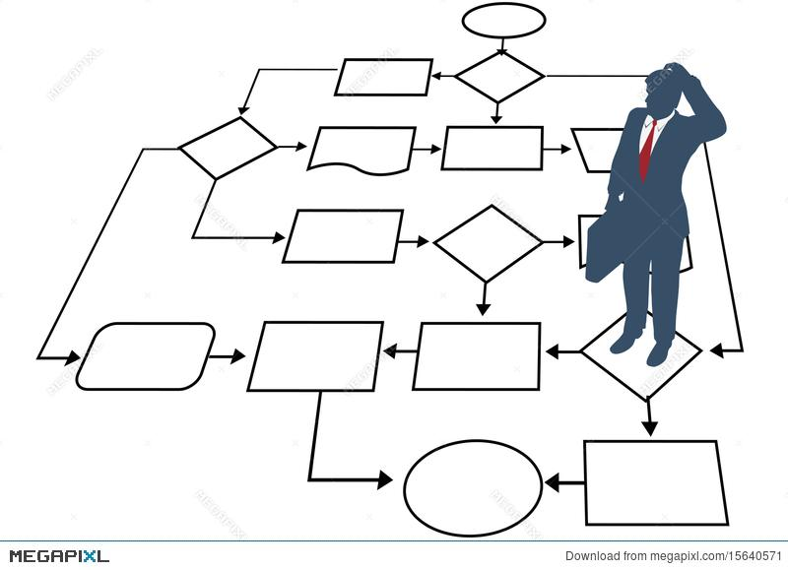
Typical Acquisition
Process Flow
Identification of need
Describe/Define requirement
Market Research & Acquisition Planning
Review & Approval
Draft solicitation
Review & Approval
Publish/distribute solicitation
Evaluate quotes/offers
Draft award decision
Review & Approval
Send order/contract to awardee for signature
CO countersigns award document
Distribute award to awardee
Publish award notice

Slide 9
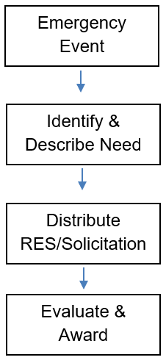

EA BOA Process Flow
FAS has already performed the market research, acquisition planning, and responsibility determinations to streamline ordering procedures for users.
The BOA was synopsized through SAM.gov and provided fair opportunity, but additional posting/competition requirements may apply.
Authorized users may jump right into their solicitations after they have identified their emergency requirement and adequately described their need, and addressed FAR posting and competition requirements (FAR Parts 5 & 6).
Rapid response times, evaluation procedures, and delivery terms are present in the BOA allowing streamlined competition and awards.

Slide 10
Posting & Competition (FAR Parts 5 & 6)
BOAs are not contracts. Although posted to SAM.gov for full and open competition, BOA orders must still meet FAR Part 5 and 6 posting and competition requirements.
  FAR 16.703-3(d)(1) states: “Before issuing an order under a basic ordering agreement, the contracting officer must –
  (i) Obtain competition IAW part 6;
  FAR 16.703-3(d)(2) states: “Contracting Officers must –
  (iv) Comply with part 5’s publicizing and response time requirements when part 5 also requires a synopsis;
What does this mean for the EA BOA?
  Agencies can follow standard FAR 5 & 6 posting and competition requirements or limit competition IAW FAR part 6.103.

Slide 11
Posting & Competition (FAR Parts 5 & 6) cont.
Agencies can post and compete requirements IAW FAR parts 5 & 6.
  Follow standard acquisition process
  If apparent awardee is an EA BOA holder, agency would complete the EA BOA ordering process for order placement
Emergency requirements typically do not allow for standard posting/competition timelines, which for BOAs can be 30-40 days IAW FAR 5.2(d) Table 5-3.
  When expedited acquisition process time is required, agencies can utilize a Justification and Approval (J&A) IAW FAR 6.103-2 – Unusual and Compelling Urgency

Slide 12
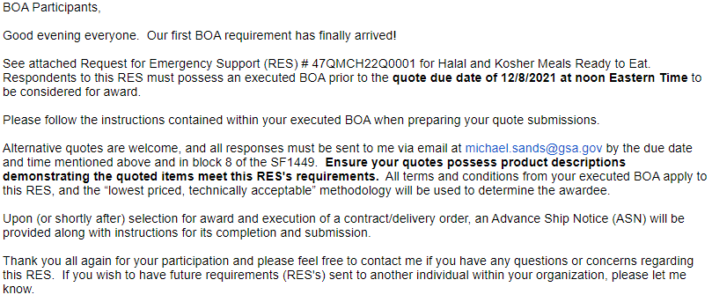
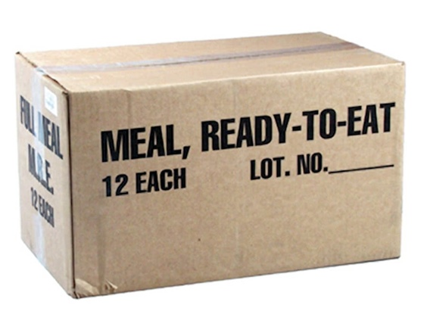
Example Requirement

Slide 13
Summary & Data
FAS’s EA BOAs offer a streamlined approach to commercial purchases during emergencies.
Any Federal agency can use, free of charge.
No price lists or item catalogs
The EA BOAs have been used to rapidly purchase meals, COVID test kits, sheltering items, Joint Field Office (JFO) kits, and pandemic kits.
Rapid process with competitive pricing - competitive quotes received on all solicitations
Average savings of ~20% in FY25, ~33% in FY24, ~39% in FY23, and ~32% in FY22

Slide 14
References & Contacts
FAR 16.703 Basic Ordering Agreements
A copy of the BOA and Master Contact List of BOA Participants may be found at the link below:
Emergency Acquisition Basic Ordering Agreements (EA BOAs)
GSA EA Contracting Officers:
Reagan Criddle, 312-208-4834, reagan.criddle@gsa.gov

