Slide 1
Small Business Works 2022:
Best Practices for Finding Socioeconomic Vendors to Meet Requirements
Day 2: July 27, 2022
U.S. General Services Administration

Slide 2
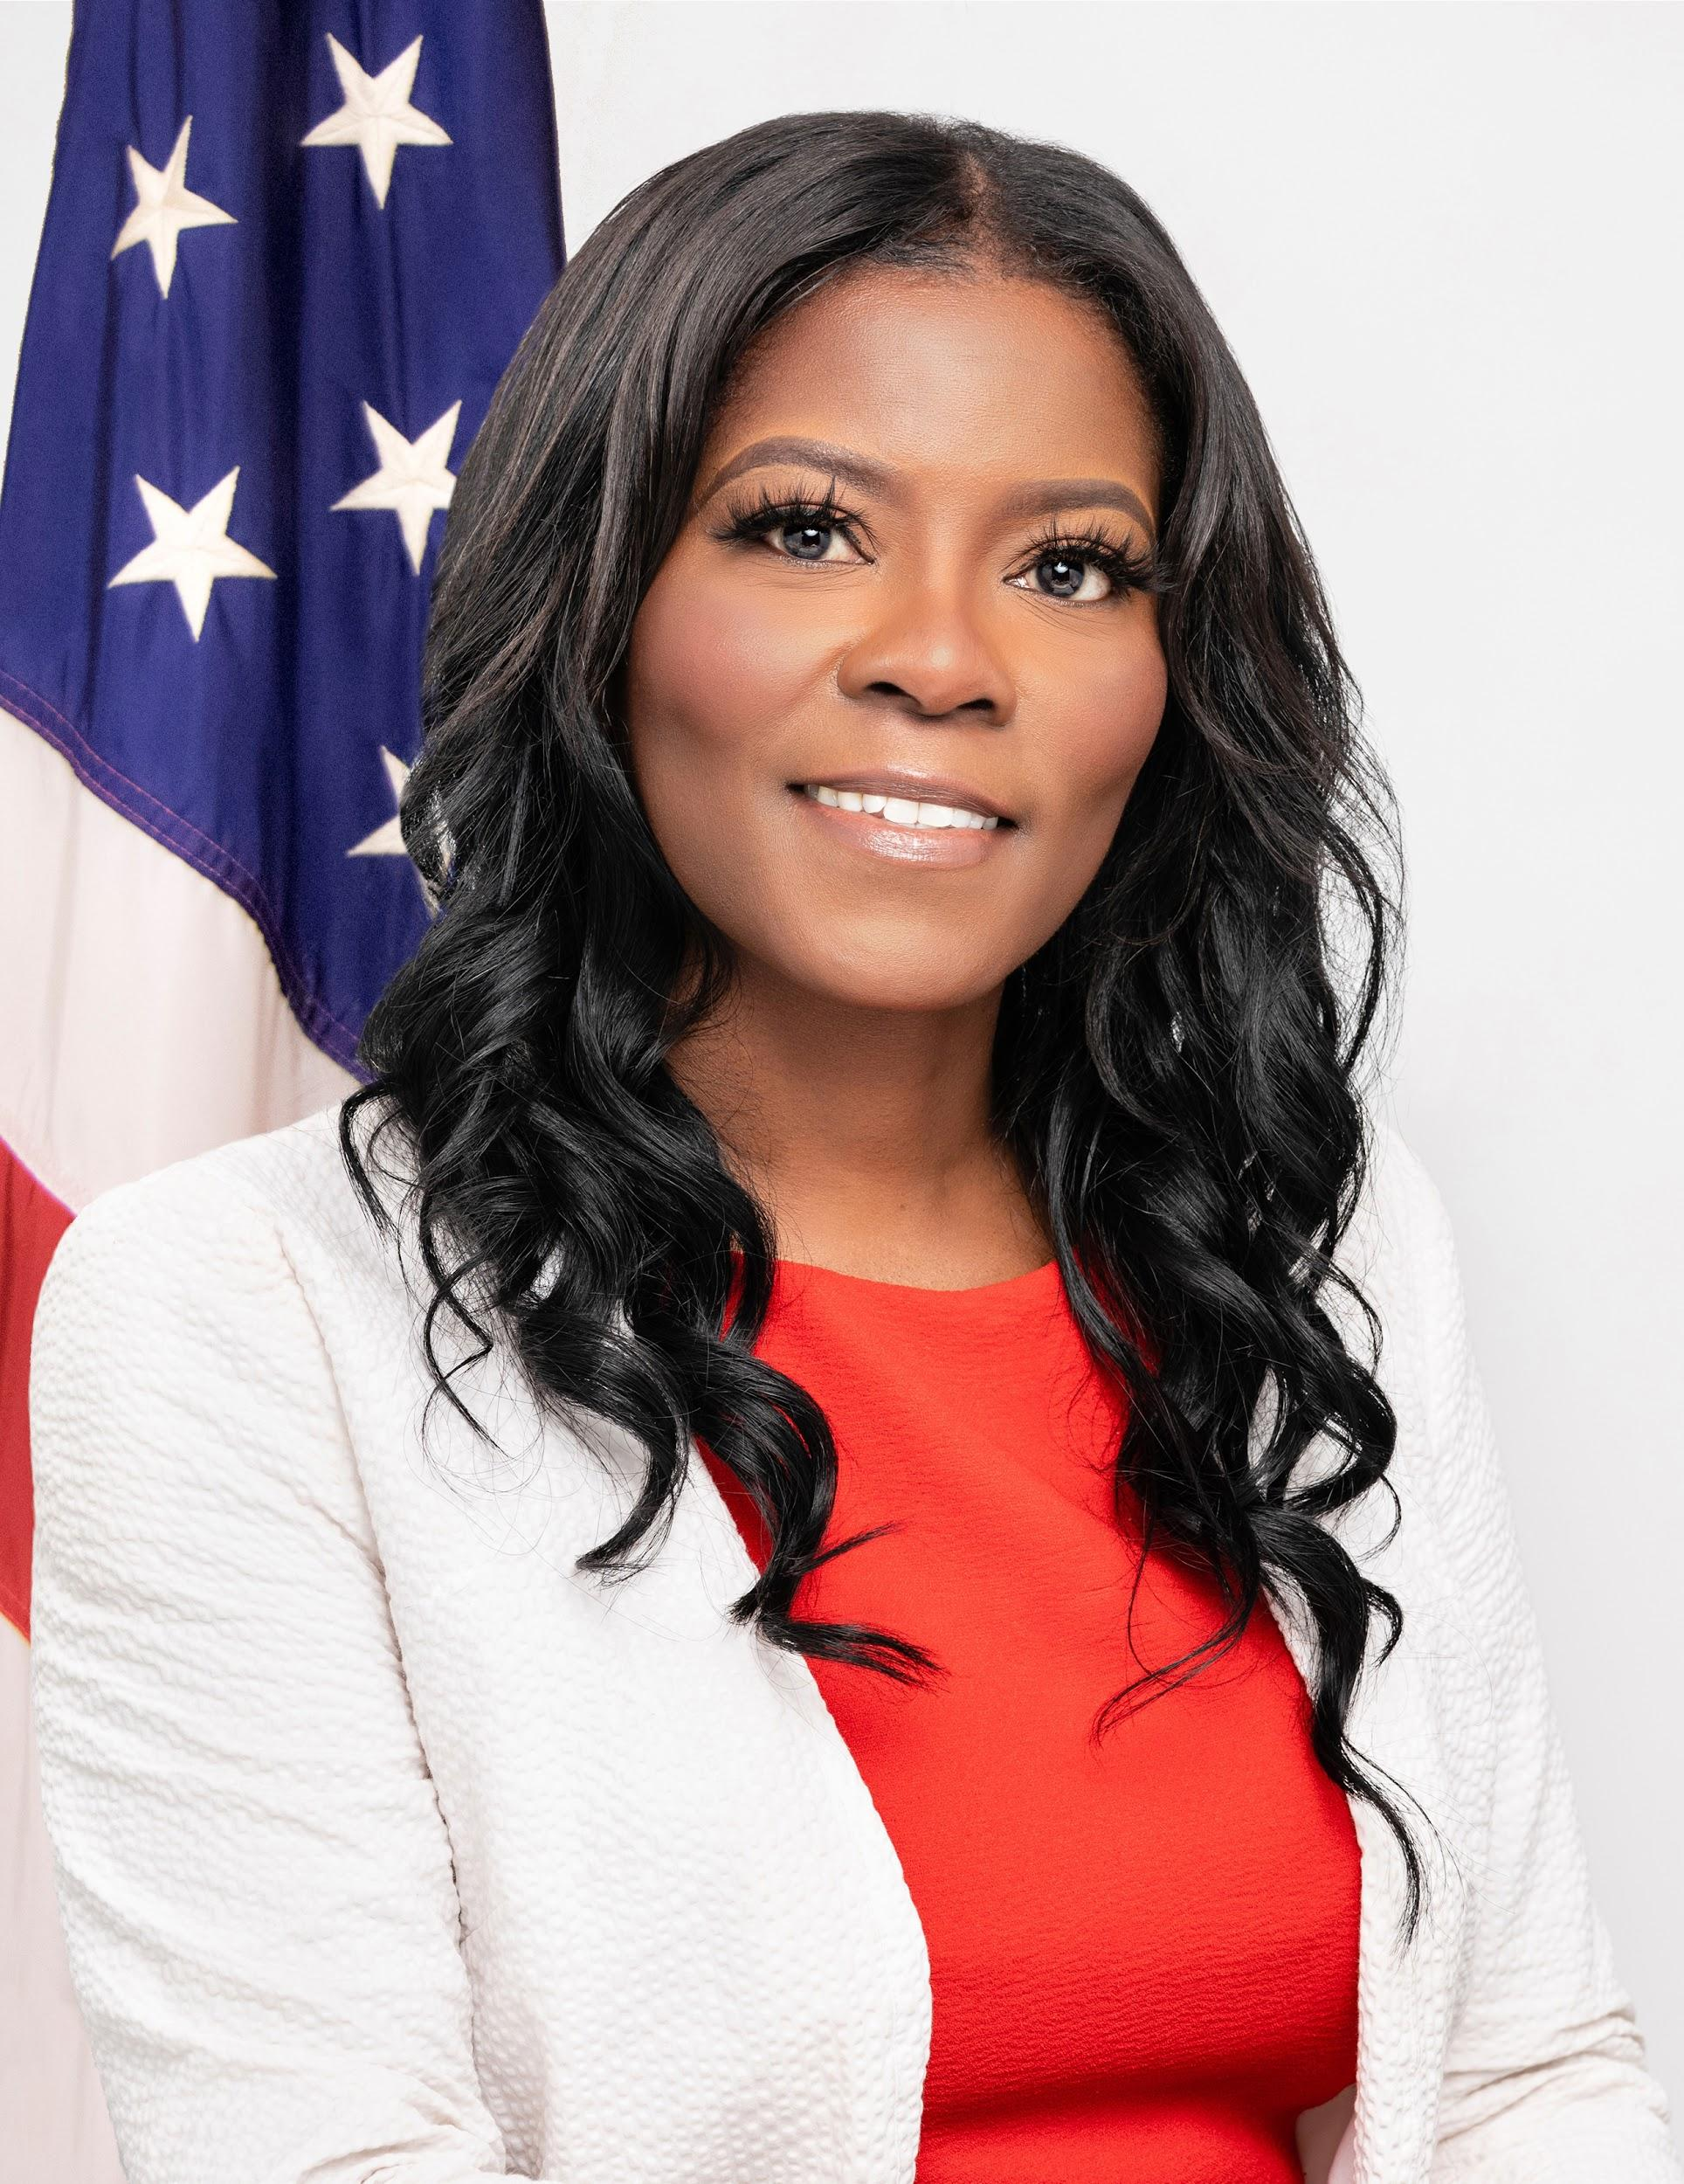
TODAY’S MODERATOR
Chasity Ash
Supervisory Small Business Technical Adviser
U.S. General Services Administration

Slide 3
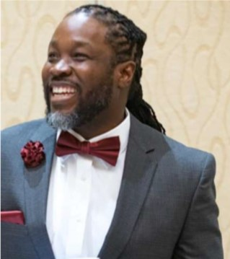
TODAY’S PANELISTS
DiJon Ferdinand
Assistant Division Chief
Office of Acquisition Management
U.S. Bureau of the Census

Slide 4
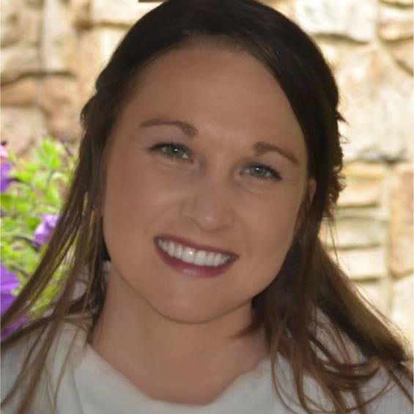
TODAY’S PANELISTS
Michelle Burnett
Executive Director
HUBZone Contractors National Council

Slide 5
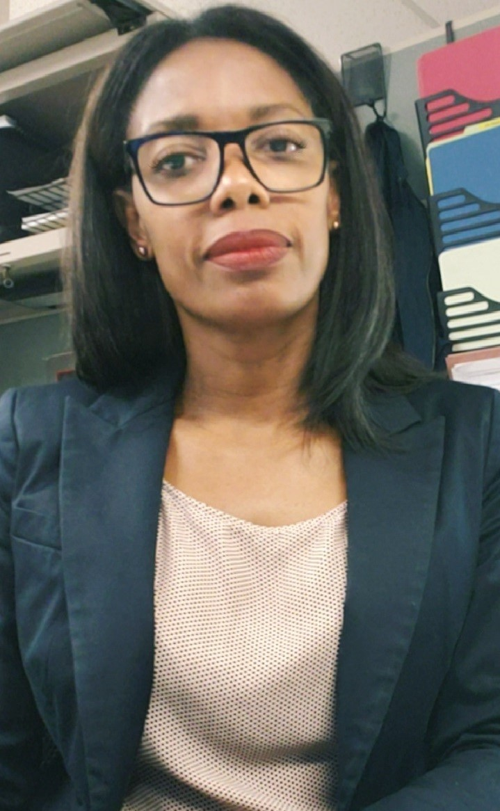
TODAY’S PANELISTS
Tamela Lewis
Procurement Analyst
Office of Government Contracting – Area II
U.S. Small Business Administration

Slide 6
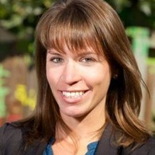
TODAY’S PANELISTS
Laura Maas
HubZone Program Manager, Continuing Eligibility
Office of Government Contracting and Business Development
U.S. Small Business Administration

Slide 7
Question 1:
How can your organization help the Acquisition workforce to find qualified Socioeconomic Vendors to meet their requirements?

Slide 8
Question 2
Why do you feel it’s so hard/challenging for the Acquisition workforce to meet its socio-economic goals?
(i.e.lack of market research, restrictive PWS/SOW)

Slide 9
Question 3
Are there any new programs, policies, or initiatives being created to promote socioeconomic programs?

Slide 10
Final thoughts

Slide 11
Questions?

Slide 12
Thank You!

