Slide 1
Bridging CO and PM workflows
NOAA & GSA
April 2026

Slide 2
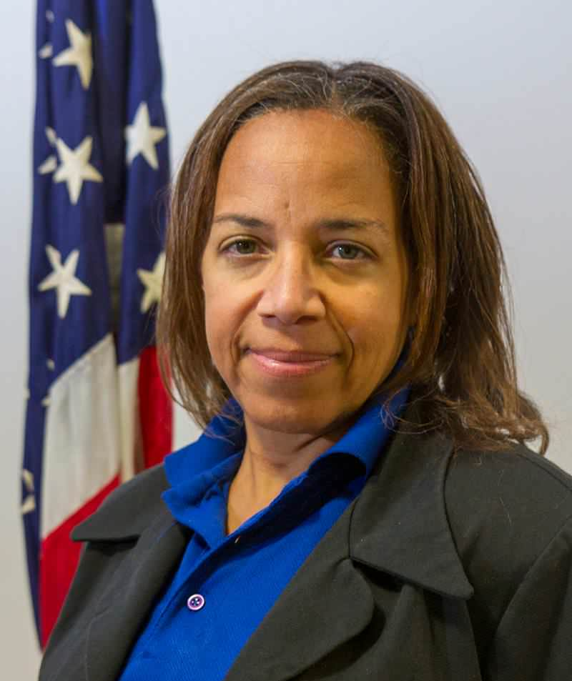

Speakers
Lenear Bassett-King (NOAA )
Management and Program Analyst
lenear.bassett-king@noaa.gov
Nicol Ford (GSA)
Program Analyst
COR / PM
nicol.ford@gsa.gov

Slide 3
Please share a time when a CO / PM partnership worked really well? What contributed to this success?

Slide 4
What challenges have you overcome as a CO / PM?

Slide 5
What advice would you give someone who is new to working in a CO / PM relationship?
Notes:
Nicol first for this slide.

Slide 6
How does the government get everyone onboard to work as a team?
Notes:
Call on Lenear first. Maybe Nicol does not talk to this.

Slide 7
Please share some best communication tips.

Slide 8
Has anyone had a time when nothing was working on a contract?

Slide 9
How do lessons learned become best practices?

Slide 10
What is your biggest tip for working successfully in a CO / PM relationship?

Slide 11
Thank You

Slide 12
GSA Starmark Logo – America 250

