Slide 1
Buying Guide for the Multiple Award Schedule (MAS) Program
Enhanced SIN Office Supply 4th Generation Solution (OS4)
April 2026

Slide 2
Document Overview
Overview
Ordering Procedures
Setting up a BPA
How to Buy FSSI OS4 Products
Points of Contact

Slide 3
SIN 339940OS4 OS4 Office Products and Supplies:
339940OS4 Offerors may offer their entire commercial catalog, or may offer a select, limited line of office products. Office products include, but are not limited to items such as: pens, pencils, markers, xerographic paper, printer paper, fax paper, 3D printing filaments and resins, binders, tape, envelopes, shredders, helical-scan, longitudinally oriented video tapes, video cassettes, reel to reel audio tapes, blank endless loop audio cartridge tapes, magnetic tape audio recording cassette, computer tape, reel, cartridge, cassette, diskettes, disk packs, disk cartridges, anti-glare/anti-radiation screens (VDT), ergonomic workstations products, cleaning equipment and supplies (head cleaners, disk drive cleaners, monitor cleaners, toner wipes, mini-vacuums, etc.) optical disks, CD-ROMS, DVD-ROMS, flash drives, external hard drives, physical storage, security, protective and related ADP supplies, and toner cartridges. Toner cartridge offerors must provide arrangements for empty toner
cartridges to be returned from customers. This may include prepaid shipping labels in the products packaging and/or rebates.
NOTE: Toner cartridges are the ONLY remanufactured item(s) allowable under this SIN.
Cooperative Purchasing: No
Set Aside: No
FSC/PSC Code: 7510
Maximum Order: $250,000
NAICS
Number Description Business Size
322230 Stationery Product Manufacturing 750 employees
339940 Office Supplies (except Paper) Manufacturing 750 employees
FSSI OS4 Overview
Comprise of Enhanced SIN, also known as OS4.
OS4 consists of one SIN: 339940OS4.
339940OS4 is an Office Supplies and Services solution.
SIN is continuously open to new offers.
A list of current contractors can be found at
www.gsa.gov/os4

Slide 4
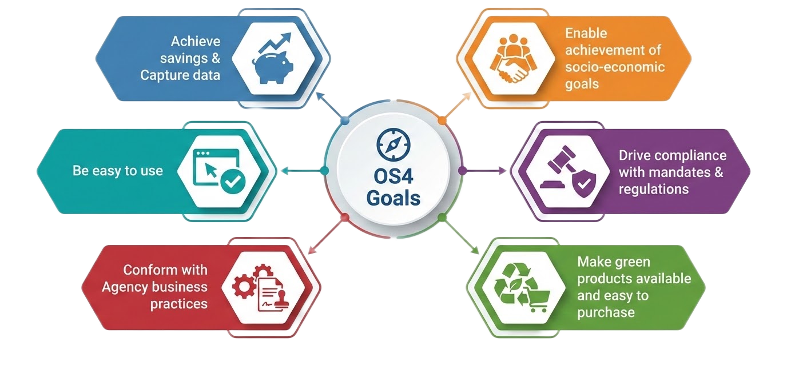
OS4 Goals

Slide 5
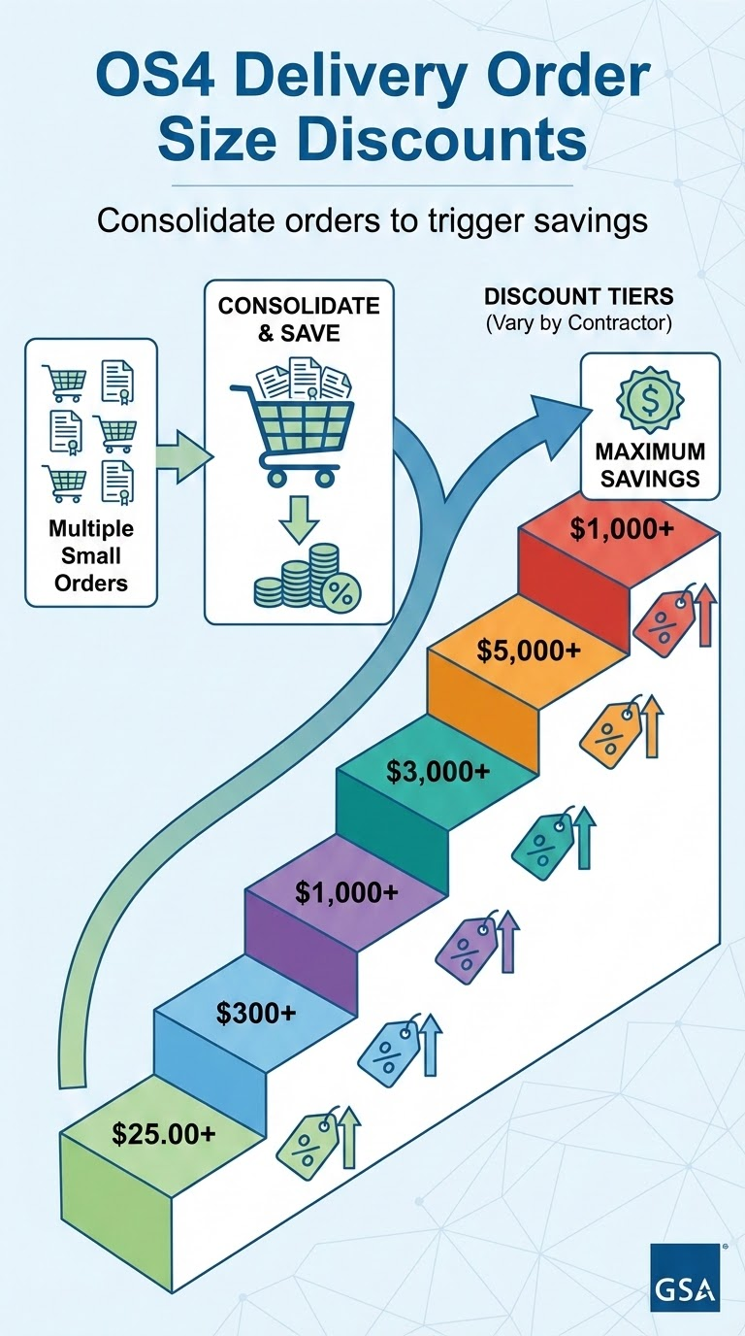
OS4 Discounts
OS4 Delivery Order size discounts:
Consolidate orders and save as discounts are triggered on individual orders starting at $25.00 for some vendors
Discounts for some vendors start at $300
Discounts increase at $1,000, $3,000, $5,000, and $10,000 orders depending on contractor
$10,000

Slide 6
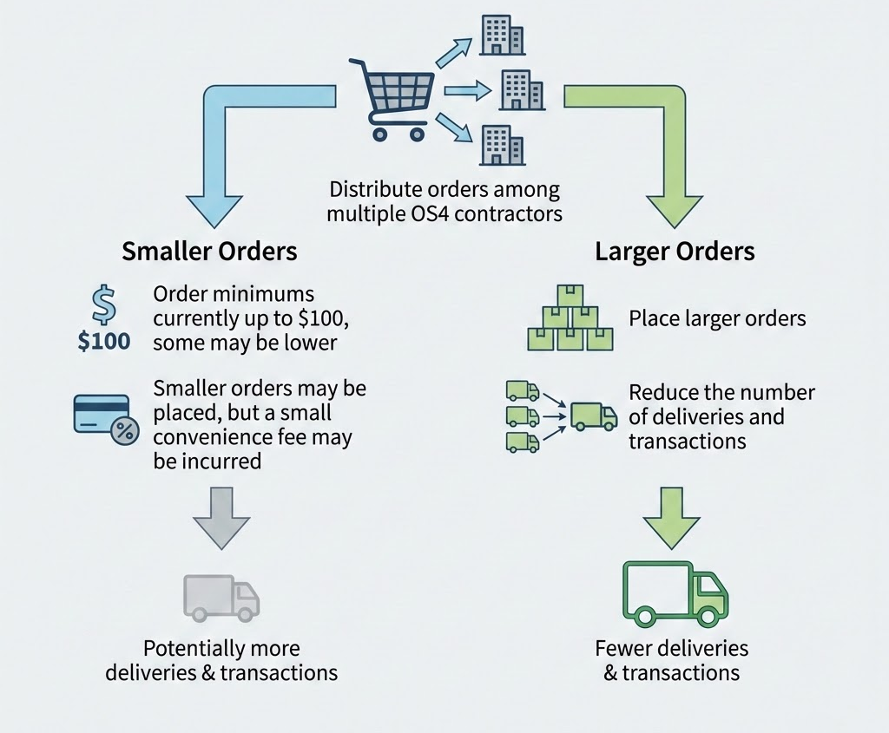
Ordering Procedure
For Orders At Or Below the Micro Purchase Threshold

Slide 7

Frequently Asked Questions
At or below the SAT
What if the office supply I want to buy is not on OS4?
In general, the OS4 program includes a wide range of products, brands; however,
By purchasing office supplies through OS4, customers are able to ensure that they are meeting all relevant mandates and procurement regulations
We recommend purchasing a similar item to the office supply you are intending to buy

Slide 8

Frequently Asked Questions
At or below the SAT
What if my order doesn’t meet the minimum purchasing requirement?
The minimum purchasing amount is currently up to $100 (may be lower depending on vendor)
We recommend that you pool together other purchases in your office using the "Park Cart" feature on GSA Advantage
Develop a strategy to purchase more items less frequently, planning ahead, so that you are making larger purchases.
Remember, order minimums result in added value: better prices and less shipping waste

Slide 9
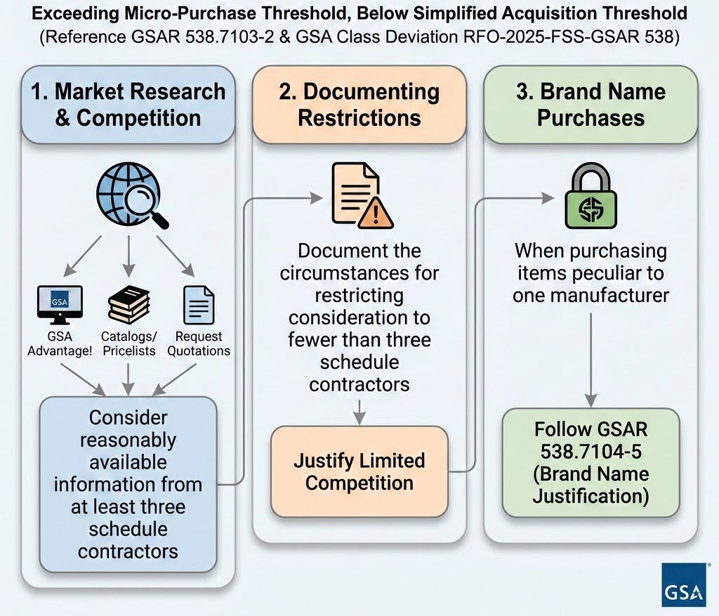
Ordering Procedure
For Orders Exceeding the Micro Purchase Threshold but Below the SAT

Slide 10
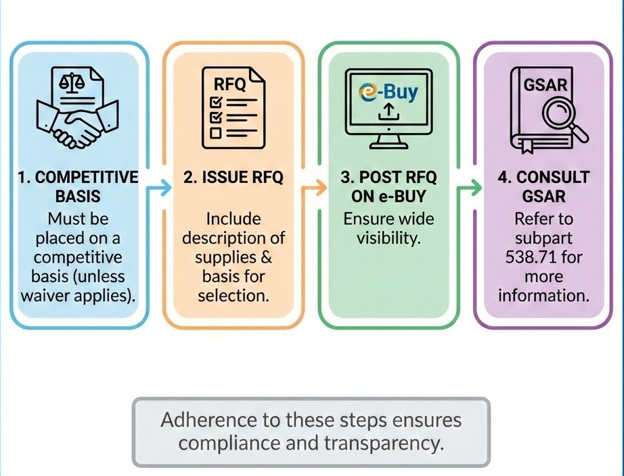
Ordering Procedure
For Orders Exceeding the SAT

Slide 11
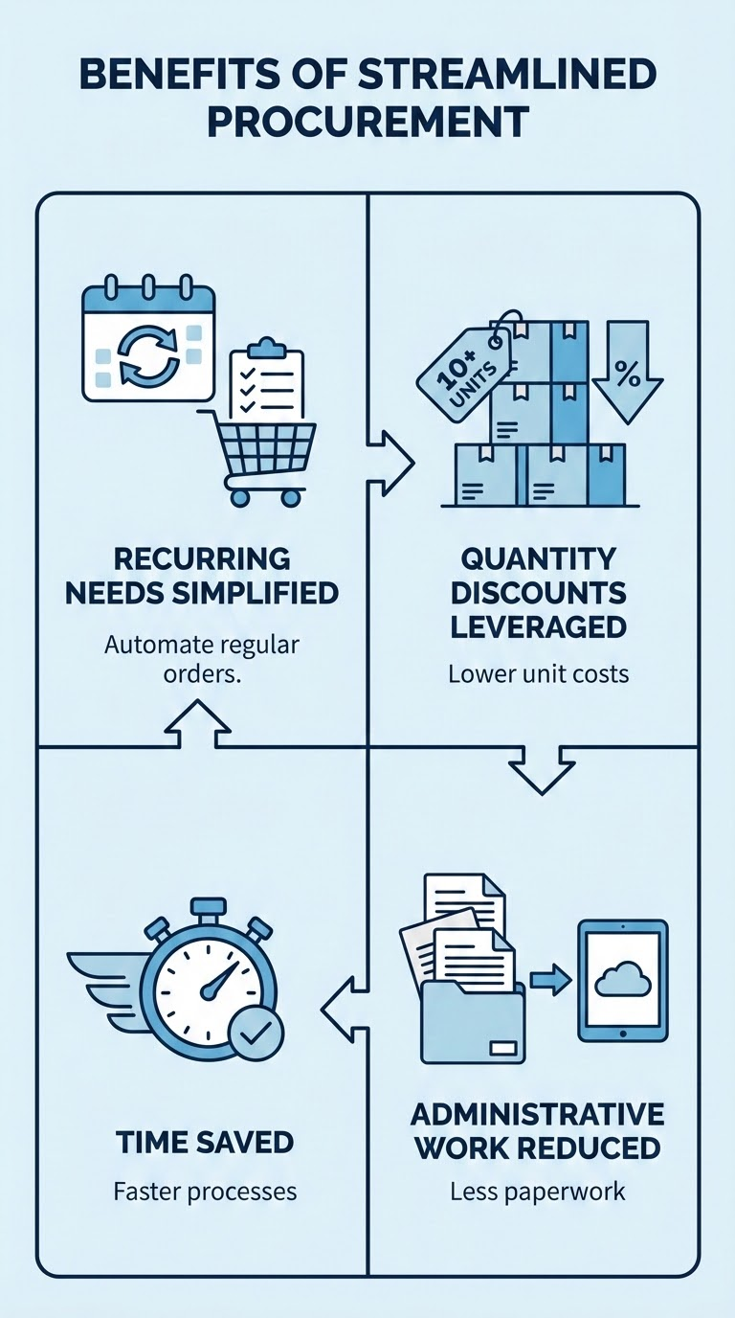
Establishing BPAs on OS4
In accordance with GSAR 538.7104-1 (GSA Class Deviation RFO-2025-FSS-GSAR 538), ordering activities may establish Blanket Purchase Agreements (BPAs) under any GSA Schedule contract. GSA Schedules simplify the filling of recurring needs for supplies and services, while leveraging ordering activities’ buying power by taking advantage of quantity discounts, saving administrative time, and reducing paperwork.
To establish BPAs, ordering activities evaluate different contractors on Schedule for a particular category of supply or service, then establish an ongoing agreement for repetitive orders from the selected contractor.

Slide 12
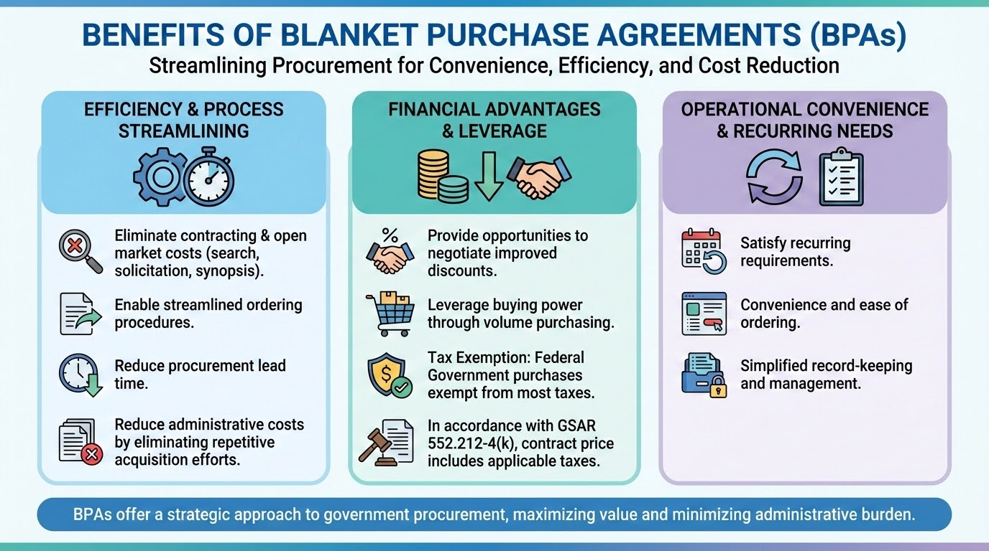

Slide 13
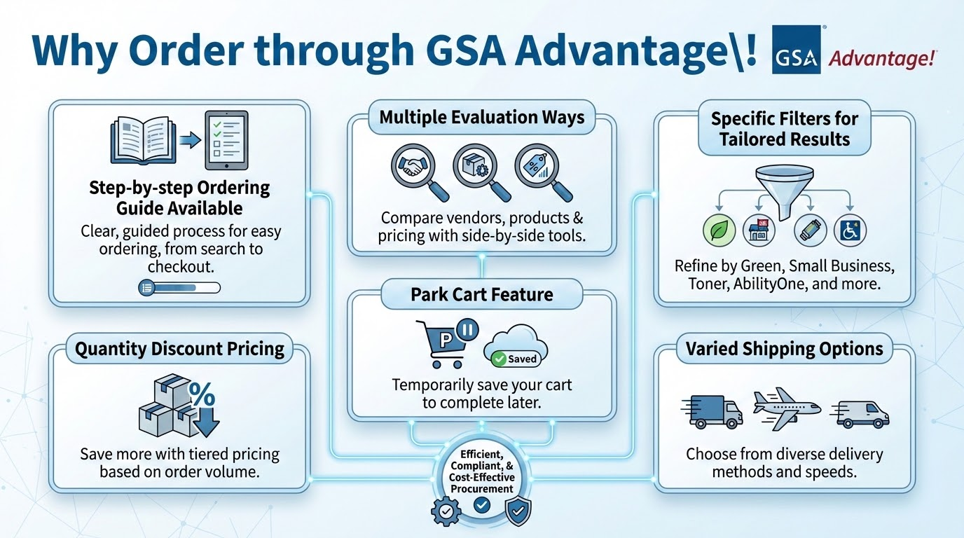

Slide 14
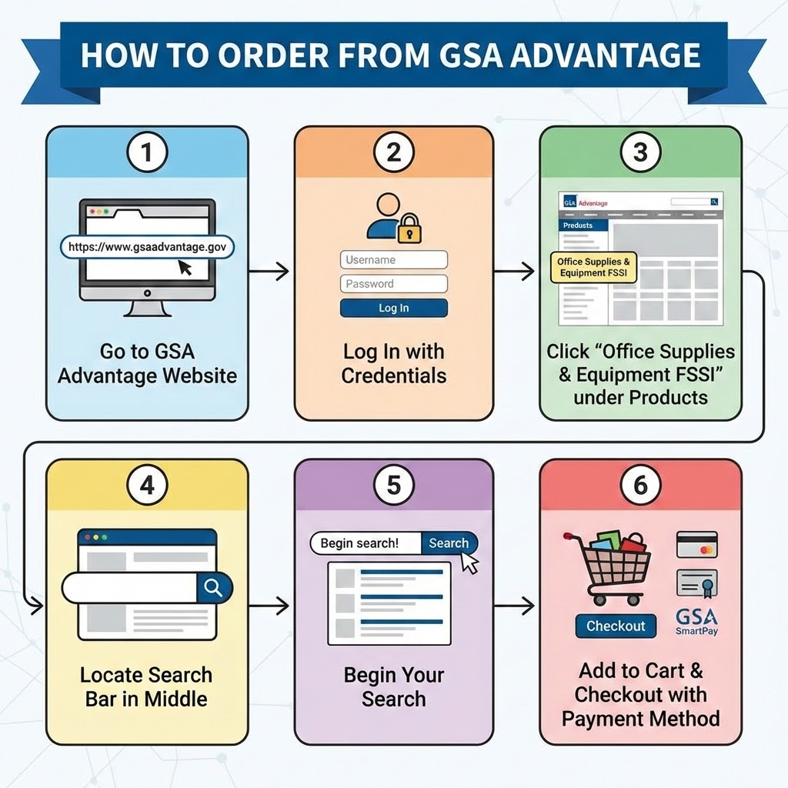
Step-by-Step Guidance:
Go to gsaadvantage.gov
Login
From the home page, click "Office Supplies & Equipment FSSI" under "Products" on the left.
Find the Search Bar
Begin Your Search
Check out using your payment method.
For more details, see the GSA Advantage Purchasing Guide for OS4.

Slide 15
Delivery or Service Issues?
Contact the National Customer Service Center (NCSC)
The NCSC can help find the answers you’re looking for, whether you’re an agency customer seeking support on an existing order, an industry vendor seeking to explore opportunities for your business, or someone trying to learn more about how we help government agencies purchase goods and services.
CALL
The NCSC is available Sunday 9:00 pm - Friday 9:30 pm Eastern time.
1-800-488-3111
CHAT LIVE
The NCSC is available Sunday 9:00 pm - Friday 9:30 pm Eastern time.
EMAIL
The NCSC will get back to you within one business day.
ncsccustomer.service@gsa.gov
Chat Now

Slide 16
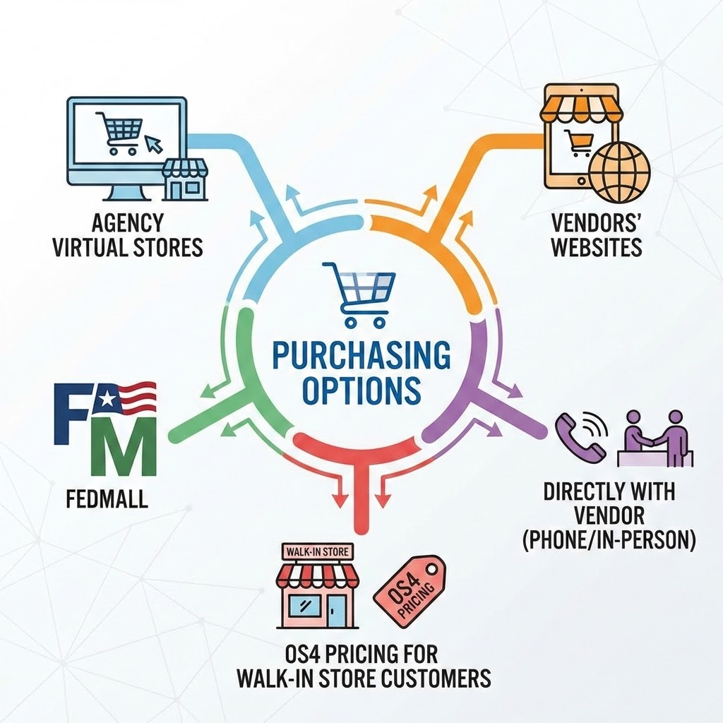
Other Purchasing Channels Available
Agency virtual stores
Vendors' websites
FedMall
Directly with the vendor (via phone or in-person)
OS4 pricing for walk-in store customers
However, GSA Advantage! is the simplest to use and best for tracking agency spend!

Slide 17
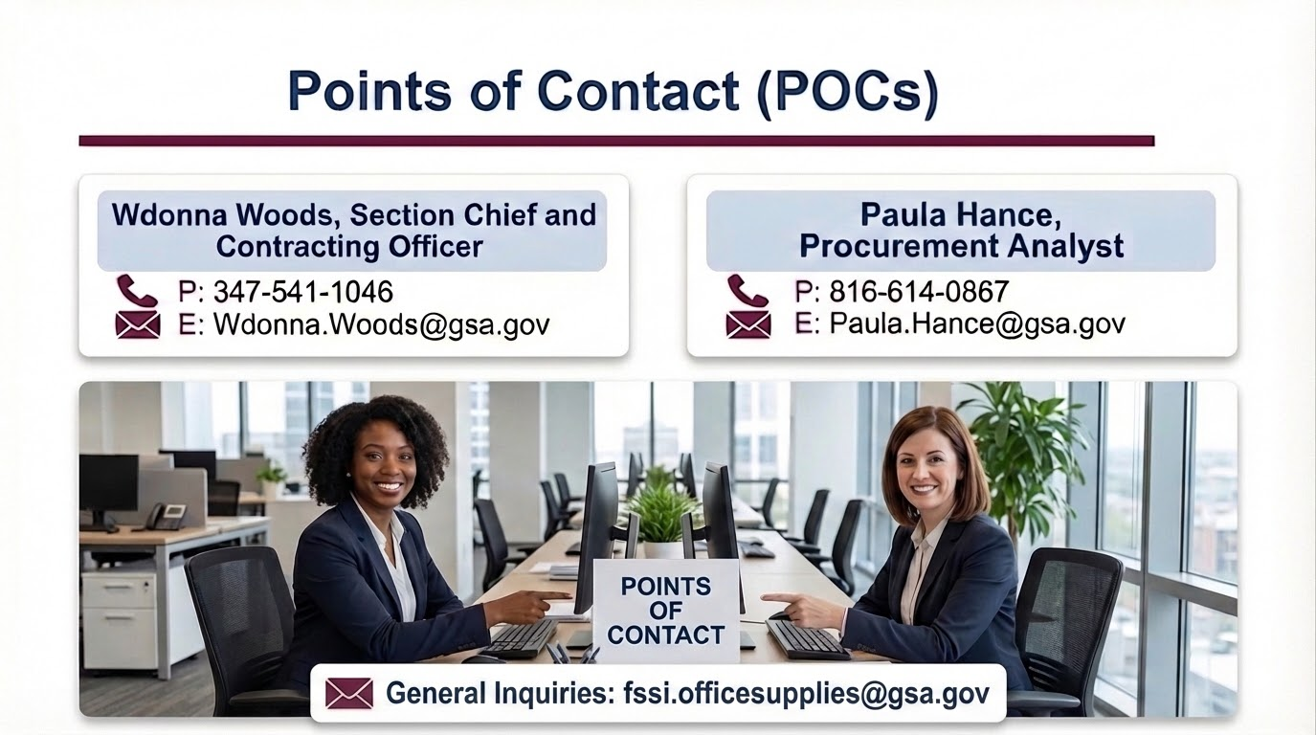
Points of Contact (POCs)

