Slide 1
FAST 2024
Emerging Innovations and Trends
May 14th

Slide 2
Polls

Slide 3
Tom Howder

Slide 4
Enhancing Government Procurement through Supplier Diversity
GSA Information Technology Category

Slide 5
Opening Remarks
Cheryl Thornton-Cameron
Executive Director
Office of Acquisition/Supply Chain Risk Management/Governance Operations
Information Technology Category (ITC)

Slide 6
ITC Leads in Supplier Diversity!

Slide 7
“Making It Easier” under the Multiple Award Schedule
Startup Springboard
Makes it easier for companies with fewer than two years of experience or financial statements to submit for a Multiple Award Schedule (MAS) contract
Formally unique to MAS IT, now open to all MAS categories
FASt Lane
Eligible vendors get shorter processing times for contract actions that directly support federal agency requirements.
Agency customers get fast access to emerging technologies and innovative offerings.
Effectively Awarding and Streamlining eOffers (EASE) Pilot
Launched in Spring 2022 to directly support DEIA objectives within the Biden-Harris Administration executive orders and GSA Strategic Plan
Eligible vendors are provided concierge support to achieve shorter eOffer processing times.

Slide 8
DEIA in Governmentwide Acquisition Contracts (GWACs)
Alliant 2 established subcontracting goals to encourage robust small business collaboration.
8(a) STARS III: A small business set-aside contract that provides flexible access to a large, diverse pool of 8(a) vendors
VETS 2: Only GWAC set aside exclusively for Service-Disabled, Veteran-Owned Small Businesses (SDVOSB)
Polaris
Will be a small business GWAC with four unique set aside pools: Small Business, Women-Owned Small Business, HUBzone Business, and SDVOSB
Offers are under evaluation; awards are planned to begin in FY24.

Slide 9
Interested in contacting the ITC Acquisition Team?
Email: FAStLane@gsa.gov
For more information, visit: gsa.gov/FAST

Slide 10
FAST 2024 Innovation in Source Selection

Slide 11
Building the Evaluation Criteria: What do you want for dinner?
Step 1 Get the requirements. No seriously, GET THE REQUIREMENTS.
You can’t make a decision if you don’t know what your customer wants.
It’s even worse when you discover THEY don’t know what they want!
Notes:
How many times have you encountered this situation? Share with me in the reactions.

Slide 12
Building the Evaluation Criteria: What do you want for dinner? Continued
Step 2 Once you know your customer’s wants, now is the time to pick their brains and find out what they don’t want.
Are they allergic to anything?
Which places did they hate?
Try not to let them get away with “I’ll eat whatever” because that rarely ends well. In life and in procurements.
Notes:
This discussion is Delicate right? It’s a mix of art and science. Maybe it’s Alchemy? I don’t know, but it isn’t easy.

Slide 13
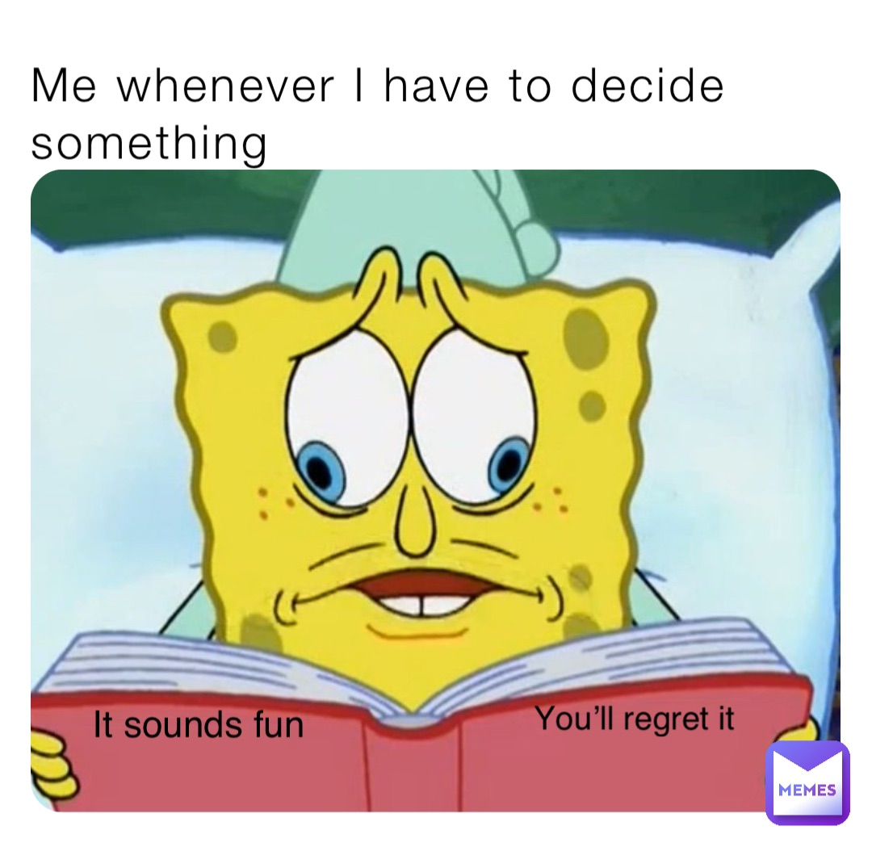
Building the Evaluation Criteria: What do you want for dinner? continued
Step 3 Sort the options into definable categories such as:
Quality
Performance
Capability
Schedule, etc.
You’re defining the evaluation criteria for the requirements.
Notes:
Make it manageable and meaningful. You probably don’t need 22 factors.

Slide 14
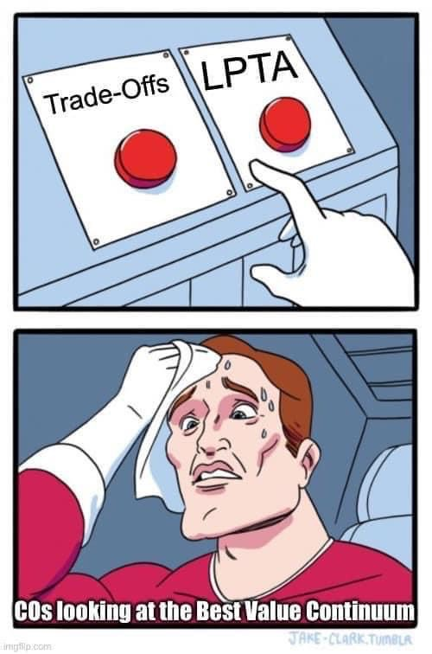
Deciding the Evaluation Criteria
How complex is the requirement?
Not complex
Complex
Tradeoffs
Lowest Price Technically Acceptable
Tradeoffs
No, seriously. Tradeoffs.
Notes:
Here is a decision tree that can help you approach your requirement.

Slide 15
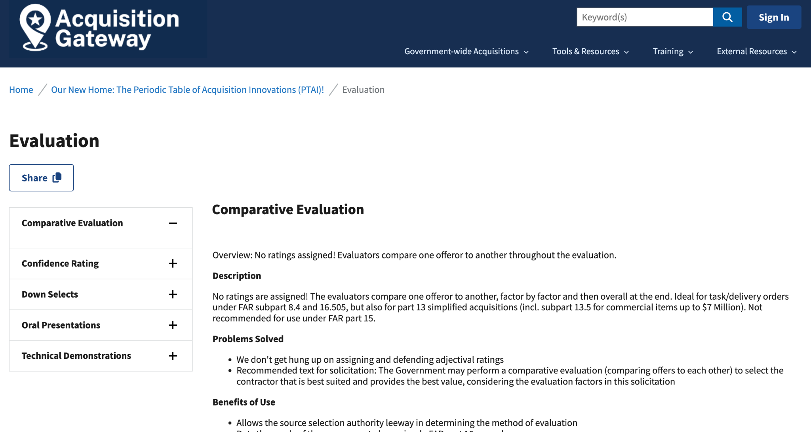
Need help?
Check out the Periodic Table of Innovations on AcquisitionGateway.gov
Notes:
This is an awesome resource you need to check out and even bookmark.

Slide 16
Evaluation Methods
(you can use one or more of these)
Notes:
Comparative Evaluation
Confidence Ratings
Down Selects
Oral Presentations
Technical Demonstration

Slide 17
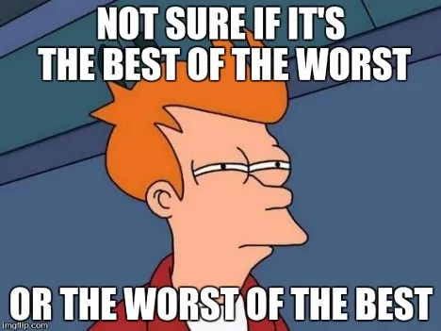
Comparative Evaluation
Apples to Apples, Oranges to Oranges
No ratings assigned!
Not recommended for FAR Part 15 procurements
Notes:
What do you mean there aren’t ratings assigned?! We don’t get hung up on assigning and defending adjectival ratings
Allows the source selection authority leeway in determining the method of evaluation.
The evaluators compare one offeror to another, factor by factor and then overall at the end. Ideal for task/delivery orders under FAR subpart 8.4 and 16.505, but also for part 13 simplified acquisitions (incl. subpart 13.5 for commercial items up to $7 Million). Not recommended for use under FAR part 15.

Slide 18
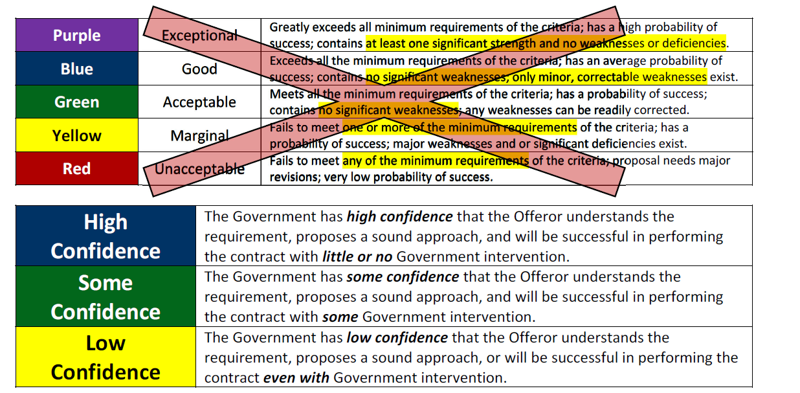
Confidence Ratings
Not complicated – no value matrix
Only requires a few bullets to support rating – No long drawn out paragraphs!
Notes:
It’s like Yoda said: “Do or do not. There is no try.”
You’re probably thinking about it in this way already - use that framework
How will you justify the difference between something that uses a bigger scale?
(SPOILER ALERT: it will be hard and time consuming)

Slide 19
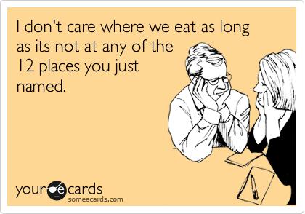
Down Selects
Where do you wanna eat? I Know Places…
Use multiple phases (usually two but not always) with smaller numbers of companies proceeding to the next phase
The Government does not get as overwhelmed with bulky proposal submissions, resulting in a streamlined process and cleaner documentation at the very end
Notes:
I’m going to down select dinner. I don’t know what my End Game is yet, but I’m going to down select based on I don’t want to drive to the other side of town to get it. I’m going to Stay Stay Stay nearby.

Slide 20
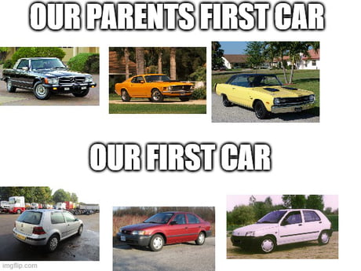
Oral Presentations
Mom/Dad, This is My Plan to Get A Red Car With Your Money!
Allows the Government to hear directly from the vendor and their technical experts about their solutions and create a dialogue
Notes:
Speak now, vendor!
Vendors get to showcase their true capabilities while not having to write onerous written proposals.
Evaluators get to ask questions to the vendors technical experts and key personal while also engaging in interactive dialogue to truly understand the proposed solution.
Evaluators also save time in evaluations by not having to read lengthy written proposals

Slide 21
Technical Demonstrations
Hold My Coffee While I Press This Button
Similar yet different from Oral Presentations
Buyers see, feel, and test solutions before buying
Notes:
This is where the government goes “This is me trying to use the product”
Seeing the solution in action provides more verifiable information than reading about it on paper.
Vendors can more easily showcase their solutions

Slide 22
Documentation Tips for Source Selection
(you can use one or more of these)
Notes:
Comparative Evaluation
Confidence Ratings
Down Selects
Oral Presentations
Technical Demonstration

Slide 23
Documentation tip! On-the-spot Consensus
How this works
The evaluation team reads the proposals and/or attends the oral presentation)
The evaluation team then collectively evaluates the proposal and immediately documents the evaluation decision in real time
The evaluation team repeats that two step process for each proposal
But…how do I document the evaluation decision in real time?
Notes:
Are you Ready for it? Here’s a practical documentation tip.

Slide 24
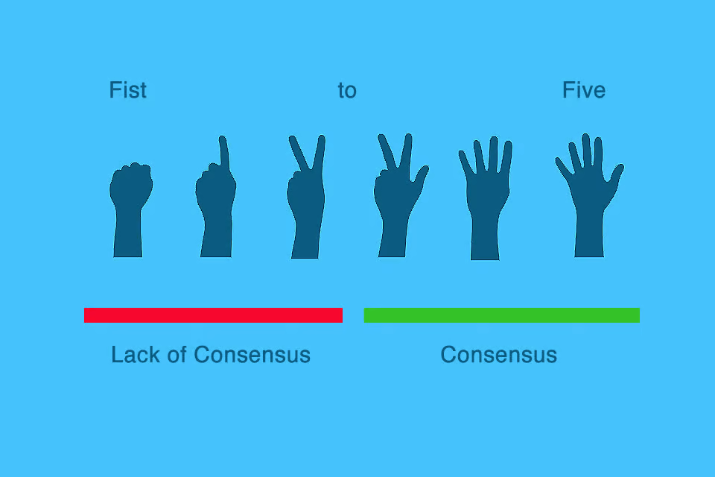
Documentation tip! On-the-spot Consensus continued
Document decisions not deliberations
5 Finger Consensus
Annotations
Notes:
Take screenshot in virtual meeting of five-finger consensus, document the decision and date/time made.

Slide 25
title
Informed Majority exercise
Why?
Make decisions about wording in an efficient and effective manner
Ensure that all voices are heard
Time to create and discuss alternatives.
Notes:
Andrea: once the team gets a first draft of a statement (which you already have per the previous slide), I then ask for any recommended changes (we’ll take a few minutes to think about what changes we want to suggest). The objective is to get all the changes first before discussing any one of them. I record each requested change in a pen color different from the original to highlight the change.
I ask the group to agree that, with wording changes, we want to use a process that helps us avoid spending a lot of time debating them. To manage the discussion, I will ask someone who wants the change to speak for the change by giving a reason why the change should be made. If no one speaks for it, the change is dropped because clearly no one supports it.
If someone does speak for the change, I then ask someone to speak for leaving the wording as is. If no one speaks for leaving the wording as it is, then the change is made by acclimation since there is no disagreement.
If someone speaks for leaving the wording as is, I then ask for additional comments.
If a statement has several alternatives, I’ll ask someone to speak for each alternative and for someone to speak for leaving the wording as is. As before, if no one speaks for an alternative, the alternative is dropped.
Once all comments have been made, I then call for a vote and go with the majority. The point of voting on wording changes is to go with the will of the group and to avoid significant time spent on wordsmithing.
If there are multiple alternatives and no alternative receives a majority of those voting, then all but the top two alternatives are dropped, and I ask for comments for the two alternatives. A re-vote is done.
Once all decisions are made about the wording, I rewrite the statement and seek confirmation for acceptance, typically using the 5-finger consensus method taught in The Effective Facilitator.
The point of informed majority is to make decisions about wording in an efficient and effective manner, while ensuring that all voices are heard and time is given to create and discuss alternatives. Once I have used a process a couple of times with a group, they tend to catch on right away and welcome the structure to help guide their decision making.
What questions do you have so far?

Slide 26
Next we VOTE!
No majority after vote, keep top 2 options and vote again.
Once all decisions are made about the wording, the statement is rewritten and we will seek confirmation for acceptance with the 5-finger consensus.
5 Finger Consensus

Slide 27
Example-Informed Majority Exercise
Mission: The point of informed majority is to make decisions about wording in an efficient and effective manner, while ensuring that all voices are heard and time is given to create and discuss alternatives.
Edits
Person one: change “point” to mission
Person two: delete “efficient”
Notes:
Andrea: here is an example of working on a Mission statement (even if we’re doing Vision today, this is to show you what the process looks like before we do it).

Slide 28
Example-Informed Majority Exercise continued
Mission: The point of informed majority is to make decisions about wording in an efficient and effective manner, while ensuring that all voices are heard and time is given to create and discuss alternatives.
Edits
Person one: change “point” to mission
Lobbies for edit, other agree. Change is made.
Person two: delete “efficient”
Decides not to lobby for edit and no one else volunteers. Efficient remains
Notes:
Once the team gets a first draft of a statement, I then ask for any recommended changes. The objective is to get all the changes first before discussing any one of them. I record each requested change in a pen color different from the original to highlight the change.
I ask the group to agree that, with wording changes, we want to use a process that helps us avoid spending a lot of time debating them. To manage the discussion, I will ask someone who wants the change to speak for the change by giving a reason why the change should be made. If no one speaks for it, the change is dropped because clearly no one supports it.
If someone does speak for the change, I then ask someone to speak for leaving the wording as is. If no one speaks for leaving the wording as it is, then the change is made by acclimation since there is no disagreement.
If someone speaks for leaving the wording as is, I then ask for additional comments.
If a statement has several alternatives, I’ll ask someone to speak for each alternative and for someone to speak for leaving the wording as is. As before, if no one speaks for an alternative, the alternative is dropped.
Once all comments have been made, I then call for a vote and go with the majority. The point of voting on wording changes is to go with the will of the group and to avoid significant time spent on wordsmithing.
If there are multiple alternatives and no alternative receives a majority of those voting, then all but the top two alternatives are dropped, and I ask for comments for the two alternatives. A re-vote is done.
Once all decisions are made about the wording, I rewrite the statement and seek confirmation for acceptance, typically using the 5-finger consensus method taught in The Effective Facilitator.
The point of informed majority is to make decisions about wording in an efficient and effective manner, while ensuring that all voices are heard and time is given to create and discuss alternatives. Once I have used a process a couple of times with a group, they tend to catch on right away and welcome the structure to help guide their decision making.

Slide 29
Example-Informed Majority Exercise continued continued
New Edited Mission: The mission of informed majority is to make decisions about wording in an efficient and effective manner, while ensuring that all voices are heard and time is given to create and discuss alternatives.

Slide 30
Questions?

Slide 31
Thank You!
Andrea Azarcon Heller
andrea.azarcon@gsa.gov
For more information, visit: gsa.gov/FAST

Slide 32
Break

Slide 33
Cybersecurity/C-SCRM in Procurement: Policy Roundup

Slide 34
Cybersecurity/C-SCRM in Procurement: Policy Roundup continued
Tom Smith
SCRM Service Center Director
Office of Information Technology Category
Michael Thompson
GSA C-SCRM Program Management Office
Office of Government-wide Policy

Slide 35
The Headlines
“Companies Take a Closer Look at Supply Chains After Recent Cyberattacks”
“Experts Warn of Growing Threat From Supply Chain Attacks After High-Profile Breach”
“Zero-day, supply-chain attacks drove data breach high for 2023”
“CISA says US government agency was hacked thanks to ‘end of life’ software”
“Most data breaches on enterprise attack the supply chain”
“Seeking government contracts? Get your cyber act together”
Notes:
Sources:
https://www.wsj.com/articles/cyber-chiefs-are-wary-of-vendor-security-a09cc57e
https://www.csoonline.com/article/1298730/zero-day-supply-chain-attacks-drove-data-breach-high-for-2023.html
https://www.techradar.com/pro/security/most-data-breaches-on-enterprise-attack-the-supply-chain
https://federalnewsnetwork.com/commentary/2023/10/seeking-government-contracts-get-your-cyber-act-together/
https://techcrunch.com/2023/12/06/cisa-says-us-government-agency-was-hacked-thanks-to-end-of-life-software/

Slide 36
The Numbers
More than 2,200 Cybersecurity Attacks daily
40%
Increase in Cyber-Attacks Targeting Government Agencies between March and May 2023
43%
of cyber attacks are aimed at small businesses, but only 14% are prepared to defend themselves
$10.5 trillion
Cybercrime will cost companies worldwide annually by 2025
600% Increase in number of supply chain attacks
Notes:
Transition to Slide 5: The increase in frequency and impact of supply chain disruptions and incidents led directly to numerous legislative and executive actions in the last ten years. Federal executive branch agencies are now mandated to implement C-SCRM practices based on NIST standards and guidance. Here are some of the major legislative, executive, and regulatory actions that direct agencies to improve the management of their supply chain cybersecurity risks.

Slide 37
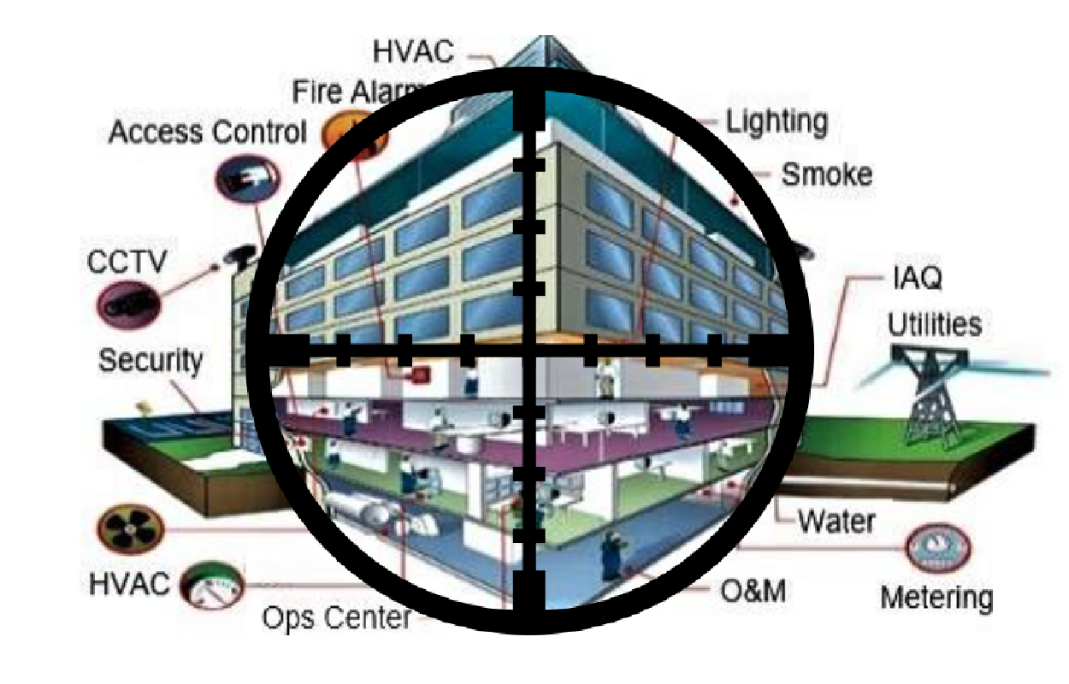
Critical Infrastructure Sectors in the Crosshairs
GAO Report 21-171, Federal Agencies Need To Take Urgent Action to Manage Supply Chain Risks
14 / 23 agencies no SCRM practices
House Select Committee on Strategic Competition Between U.S. and Chinese Communist Party (Feb 2024)
Volt Typhoon
NSM on Critical Infrastructure Security and Resilience (Apr 2024)

Slide 38
Cybersecurity is a Critical Priority
Executive Orders
OMB Memos
FAR
Agency (GSA)
Operationalize
Executive Order on America’s Supply Chains
Executive Order on Improving the Nation’s Cybersecurity
Executive Order on Initiative to Bolster Cybersecurity of U.S. Ports
Securing the Information and Communications Technology and Services Supply Chain
M-22-18 - Enhancing the Security of the Software Supply Chain through Secure Software
Development Practices
M-23-16 - Update to Enhancing the Security of the Software Supply Chain
CISA Common Form - Software Attestation & Artifact Repository
Current Rules
- FASCSA Orders
- Cyber Threat & Incident Reporting
- Cyber Reqs for Fed Info Systems
Over the Horizon
- Secure Software
- Semiconductor Prohibition
- Federal Acq Supply Chain Security Act
- Controlled Unclassified Information
- Unmanned Aerial Systems
14 Total
C-SCRM FAR Cases
Education and Training for Acquisition Workforce
(FAI FCS 102 & 103)
Acquisition Workforce Guidance - Implementation of FASCSA Orders
MV-23-02 - Ensuring Only Approved Software is Acquired and Used at GSA
GSAM - Identify, assess, respond, monitor/control critical ICT risk
Commercial Supply Chain Illumination Tools
Vendor Risk Assessment Reports
SOP on Prohibited Items
GSA C-SCRM Executive Board
GSA SCRM Review Board
Incorporating C-SCRM Plans in Solicitations
C-SCRM Language in Procurement Contracts
Notes:
Key Takeaways:
Impact to Vendors
Cost & Increasing Liability
Calculus for remaining in Government market
Flow downs to subcontractors, third party
Impact to Workforce
Guidance & Training
Vendor engagement
Information Sharing Internally
Impact to Systems
Modifications
Records
Interagency & Intra agency Dependencies

Slide 39
Operationalizing C-SCRM in IT Procurement
1
Adding contract clauses, reducing burden on AWF
IAE preparation and training on SAM for deciding officials
Readiness Preparation for Implementation, SOP for Post Orders
FAI FCS 103 Removal and Exclusion Authority
Implementation of FASC Exclusion Orders
2
Cyber Threat & Incident Reporting & Information Sharing
Industry webinars on changes to FAR, cybersecurity incident reporting
Focus group for industry listening session
Outreach and engagements with CISA
3
Standardizing Cyber Reqs for Fed Info Systems
Industry webinars on changes to FAR
Get updated contact information for programs impacted
4
Supply Chain Software Security
Further implementation of Cybersecurity EO, incorporating requirements into FAR
Expectation of attestations/ artifacts for critical software

Slide 40
Operationalizing C-SCRM in IT Procurement
Cyber risk evaluation
C-SCRM Plan evaluation
Compliance Risks evaluation
Questionnaire evaluation
Evaluate based on responses to minimum required questions for product, service, or product/service offering
Potential consultation, review & training with offerors
Optional risk based
Evaluate based on minimum required controls for product, service, or product /service offering
Annual update submission of C-SCRM Plan and questionnaire
Potential consultation, review & training with offerors
Use Vendor Risk Assessment or automated tools to ensure no concerns with Section 889, FCC prohibited entities, FASC Exclusion or Removal order
Solicitation, Evaluation, & Award Phase (Pre-award/Pre-performance) Support

Slide 41
A More Secure and Resilient Federal Ecosystem
Stay informed!
Implement security controls and monitor for changes, adapting often to the ever-changing threat landscape and new technologies
Follow Governance, Risk, and Compliance (GRC) best practices
Utilize the many resources available to you
Explore strategies to prepare your organization for evolving C-SCRM policy and regulatory landscape
Participate in the Rulemaking Process
Ask Questions

Slide 42
Resources
Empowering Small and Medium-Sized Businesses (SMB): A Resource Guide for Developing a Resilient Supply Chain Risk Management Plan
Moving the U.S. Government Towards Zero Trust Cybersecurity Principles
Make a difference. Submit your comments and let your voice be heard.
NIST Trustworthy & Responsible Artificial Intelligence Resource Center (AIRC)
Generative AI and Specialized Computing Infrastructure Acquisition Resource Guide
NIST Computer Security Resource Center
FAR Open Case Status
OMB Guidance Memorandum
CISA Cybersecurity Directives

Slide 43
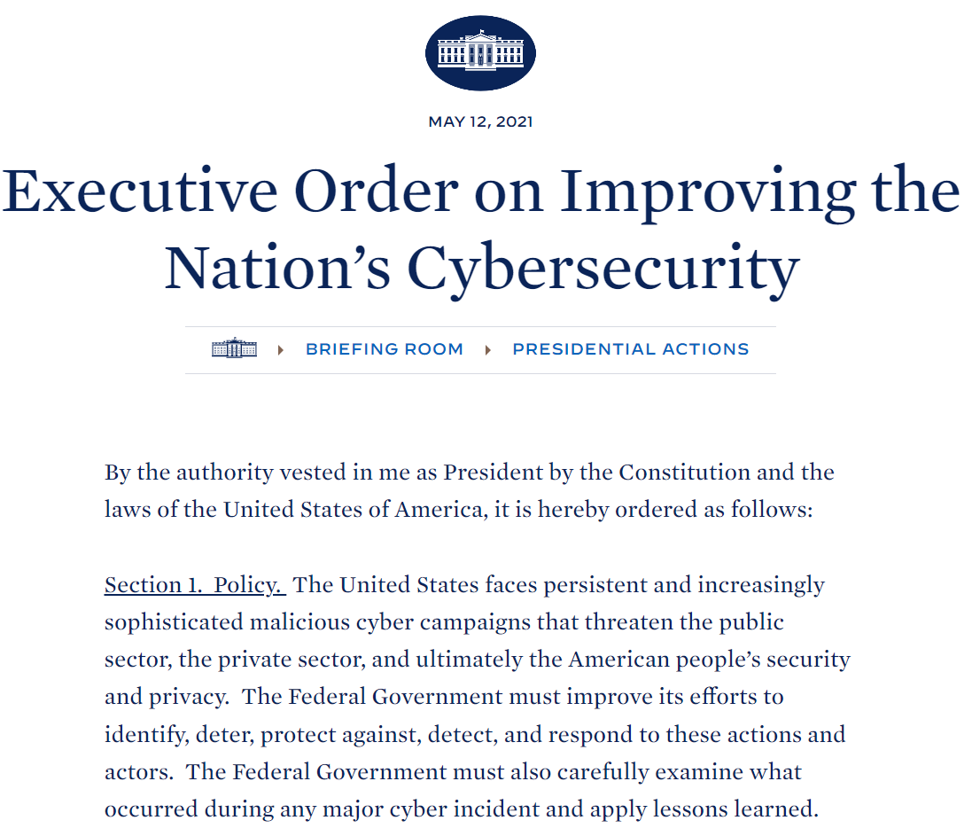
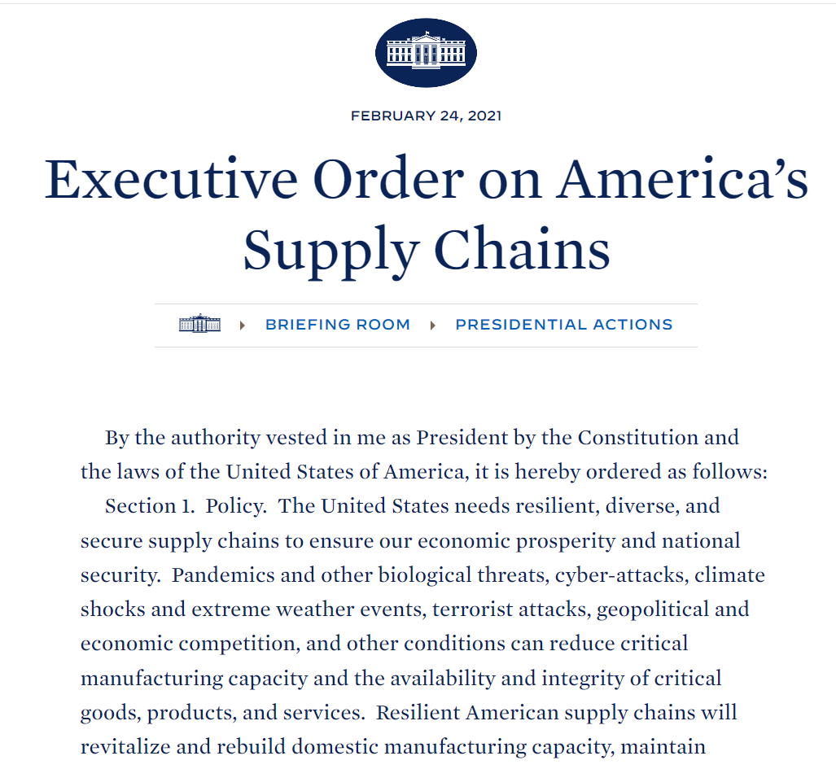
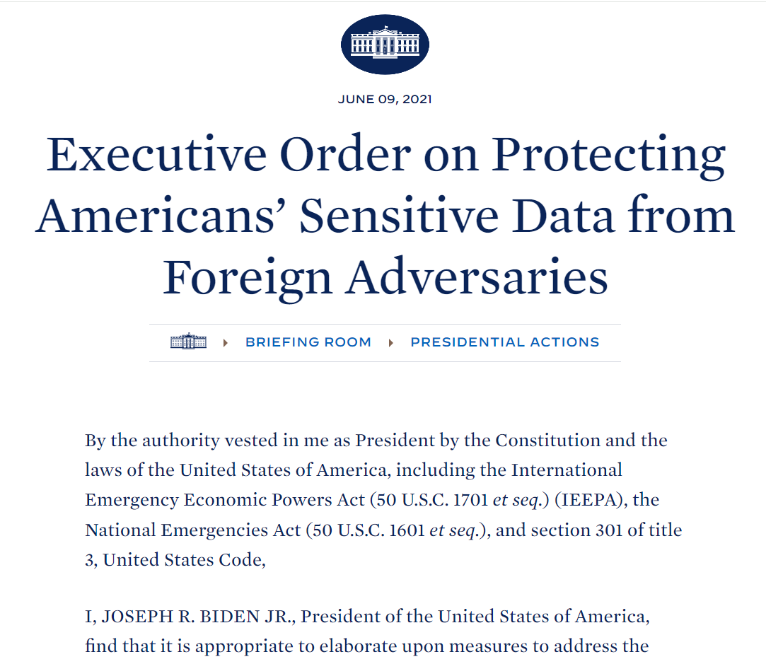
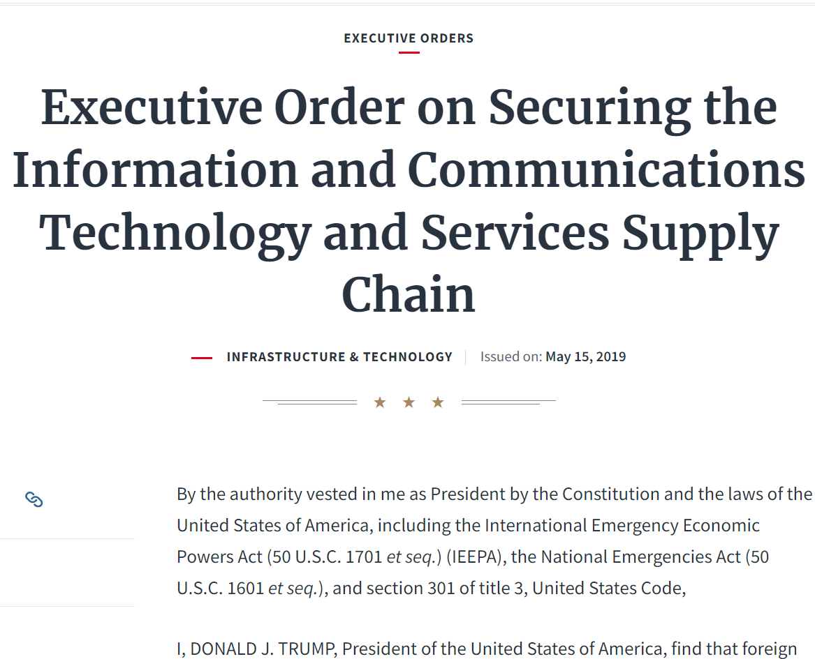
Federal Requirements & Guidance

Slide 44
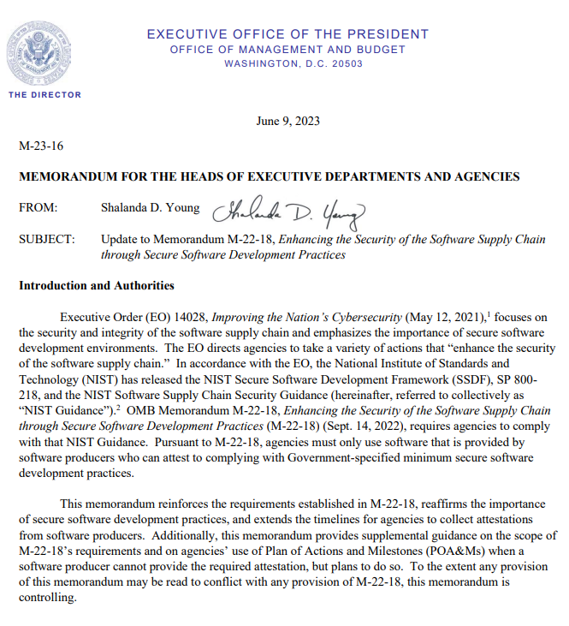
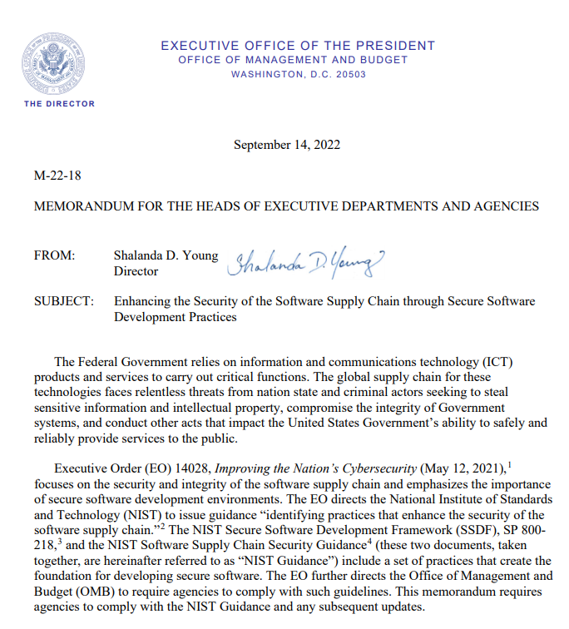
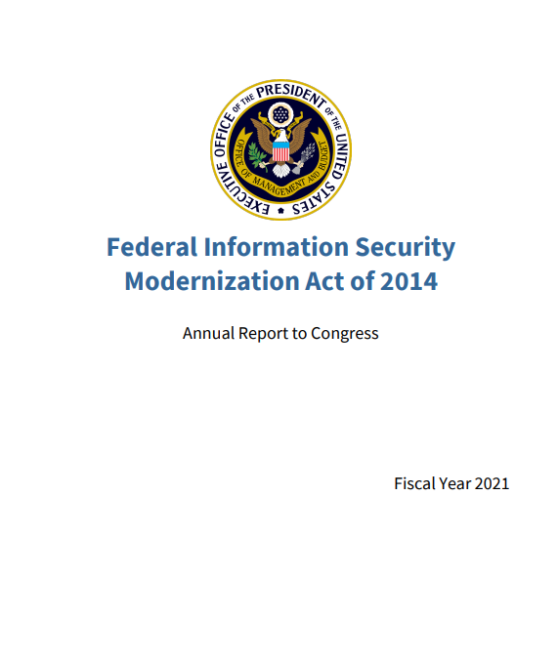
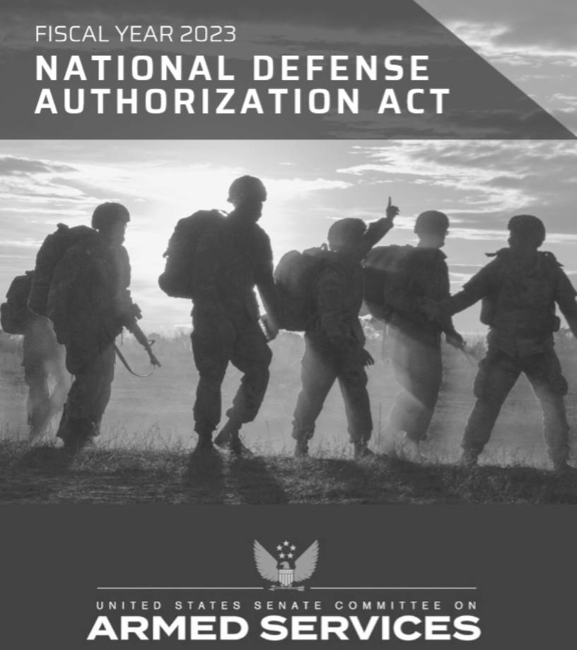
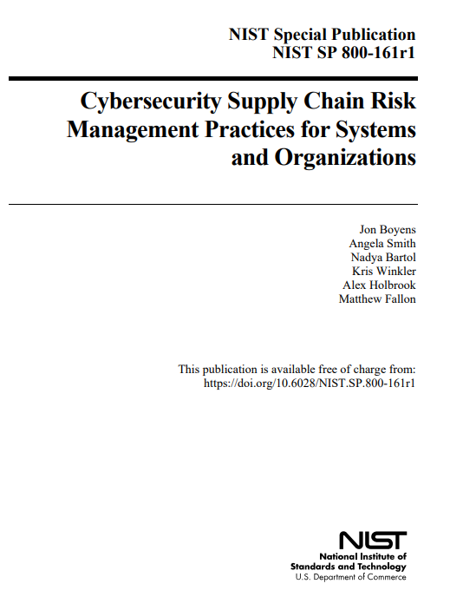
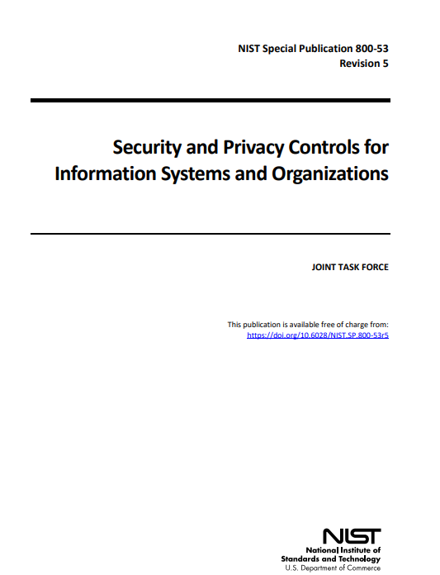
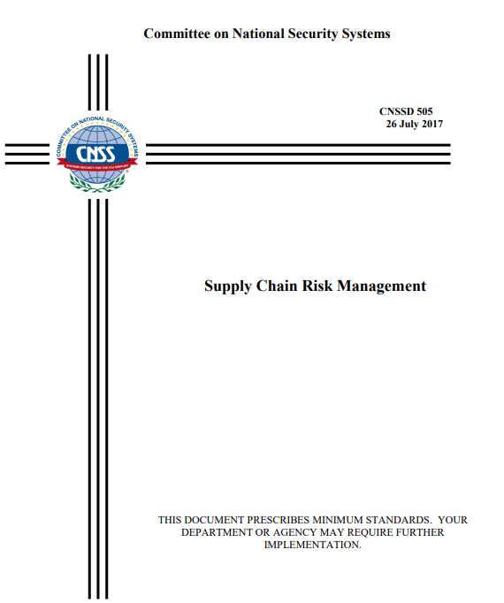
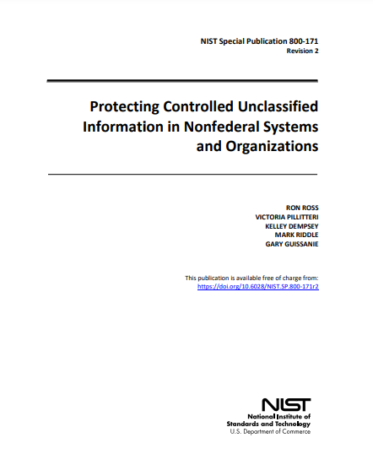
Federal Requirements & Guidance continued

Slide 45
Thank you! Questions?

Slide 46
Tom Smith
SCRM Service Center Director
thomasl.smith@gsa.gov
Michael Thompson
GSA C-SCRM Program Management Office
michael.thompson@gsa.gov
For more information, visit: gsa.gov/FAST

Slide 47
How to Buy Cloud
for Government
Skip Jentsch
GSA Schedule Cloud SIN Lead

Slide 48
What Does the GSA Cloud Team do for Agencies?
No Charge Market Research as a Service (MRAS).
Agencies fill out a questionnaire.
GSA publishes an RFI on the agency’s behalf.
GSA then receives, collates and reports results.
No Charge cloud acquisition strategy guidance.
Scope review of agency Cloud SOO, SOW, RFI, RFP, RFQ.
Choosing a contract type to fit Pay as You Go (PAYG) cloud rates.
Curators of GSA’s Cloud Special Item Number SIN (518210C).
Hundreds of offerings available from cloud service providers (CSPs) and resellers.
Content Moderators of the GSA Cloud Information Center (CIC) at cic.gsa.gov.
Contains cloud requirements templates for downloading.

Slide 49
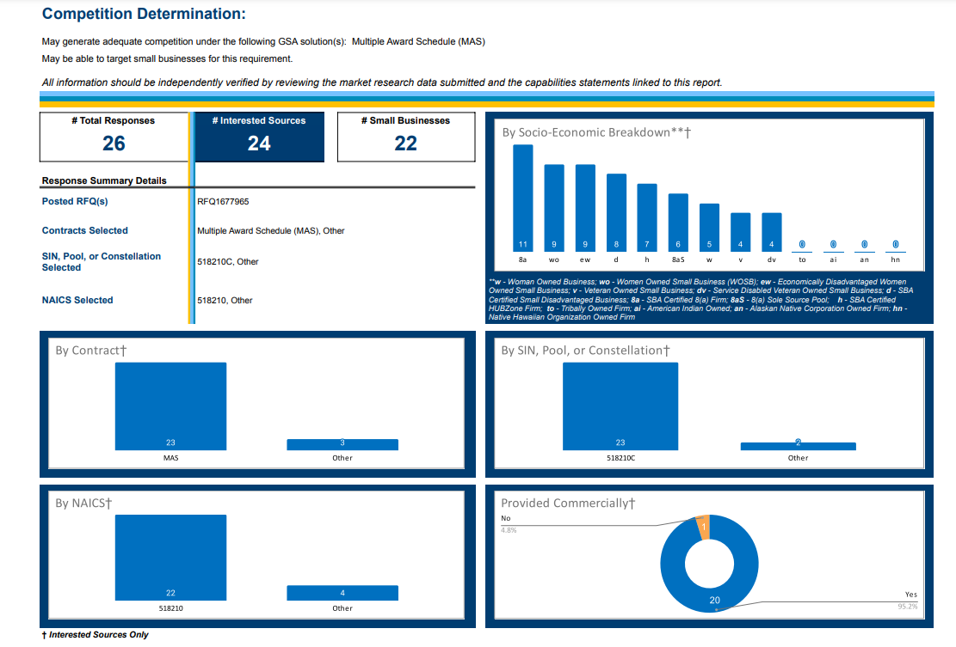
GSA Market Research as a Service (MRAS)

Slide 50
How to Add Network Servers - On Premises
Steps to Add Servers to IT Infrastructure
Order Servers
Receive Shipment of Servers
Unload and Unbox Servers
Rack and Stack Servers
Physically Wire Servers
Install an Operating System on the Servers

Slide 51
How to Add Network Servers - In the Cloud
Steps to add cloud IT infrastructure:
Provision Servers
Done

Slide 52
Cloud Service Models
On Premises IT Infrastructure = Non-cloud
IaaS = Infrastructure as a service
A rented “bare metal”computer in the cloud
PaaS = Platform as a service
IaaS plus additional components like operating systems, languages, databases
SaaS = Software as a service
Example is email as a service (EaaS)

Slide 53
How Cloud Computing is Sold
By the seconds, minutes, hours or days, etc.
By a Defined Long Term, for IaaS/PaaS.
Sometimes called a “Reservation”.
A longer-term purchase commitment of about 1-3 years.
Available at a steep discount of as much as 30%-70%.
May span multiple government fiscal years and/or extend beyond the period of performance (POP) of the cloud contract, causing funding/contracting issues.
By the User Seat per Day, Month or Year, in the case of SaaS / EaaS.
By the IaaS/PaaS Operation or Transaction; often priced as dollars per millions of operations like read/write operations or up/downloads.

Slide 54
Using the GSA Schedule for Cloud
The largest governmentwide contract of any kind.
GSA Schedule Cloud Special Item Number (SIN)518210C is the cloud subset of the Schedule.
All listings meet the NIST Definition of Cloud Computing (NIST SP 800-145).
Includes hundreds of thousands of individual offerings from nearly 800 vendors.
Also contains cloud-focused labor hours.
The SIN features new Consumption-based Ordering with a Requirements Task Order feature that allows for incremental funding of cloud.
Continuous onboarding of new technology and vendors.
A technical evaluation of each vendor proposal by the GSA Cloud Team determines whether the cloud offering meets the NIST definition of cloud computing. POC: cloudinfo@gsa.gov

Slide 55
Contracting for Cloud
Consider a broadly defined requirements document.
Such as a Statement of Objectives (SOO).
Instead of a Performance Work Statement (PWS).
Instead of a Statement of Work (SOW).
Because a broader requirement will allow vendors to propose their entire IaaS/PaaS cloud catalog for your IT shop to choose from.
Bottom line: Consider requirements to be capabilities-based instead of performance-based.
Consider awarding a BPA against the GSA Schedule
May be used to execute multiple Orders, each order carrying its own funding.
Consider refraining from making a FedRAMP Authorization a requirement.
Making it a requirement may expose your acquisition to a protest from non-FedRAMPed vendors.
Instead, you might score respondents on their current FedRAMP status.
The best funding for cloud
May be flexible working capital or other no-year funds.
Not appropriation funding that does not span fiscal years.

Slide 56
Suggested Language for Contracting for Cloud
Request for Quotations Number {{Insert RFQ number}}.
Issued to: Contractors under the General Services Administration (GSA) Multiple Award Schedule Information Technology (MAS IT), Cloud Computing and Cloud Related IT Professional Services Special Item Number (the Cloud SIN) 518210C.
The Contractor’s Basic GSA Schedule contract is applicable to the order awarded under this RFQ.
This RFQ seeks contractors holding the MAS IT Cloud SIN (518210C). The contractor may utilize other SINs in order to submit a quote for a complete solution.
Conducted under Federal Acquisition Regulation (FAR) 8.4.

Slide 57
Cloud as a Small Business Set Aside
Cloud is often sold via small resellers and not directly by a large CSP.
The Small Business Administration (SBA) considers cloud a service, not a product. Per CFR 121.1203(d)(3)
Therefore none of the usual “product” set aside strategies are valid.
Example: The Non-Manufacturing Rule (NMR), CFR 121.406.
Therefore a cloud set aside might not be defensible against a solicitation Q&A or a protest by a large CSP.

Slide 58
Choosing a Contract Type for Cloud
Blanket Purchase Order (BPA) for Cloud with Multiple Orders
A BPA has no funding attached to it.
Orders are not written at exact moment of the BPA award; each carries its own funding.
This effectively funds cloud incrementally with the issuance of each order.
Many government cloud acquisitions made today are made via BPA.
Contract with Optional Contract Line Item(s) (CLIN(s))
Optional CLINs may be funded individually as they are exercised.
Optional CLINs may contain a Not to Exceed (NTE) provision to guard against exceeding funding amount.

Slide 59
New GSA Ordering Procedures for Cloud
A Requirements Task Order (RTO) may be issued for cloud.
These procedures were defined by GSA’s Acquisition Letter (AL) MV-21-06 of December, 2021.
Applies only to orders issued under contracts or BPAs that are awarded against the GSA Schedule Cloud SIN 518210C.
Guidance is published in…
Appendix A of the Cloud SIN 518210C Ordering Guide.
See also the GSA Reference Guide for guidance for using these special ordering procedures, including suggested CLIN examples.
Citation is GSAR Clause 552.238.199.
The GSAR clause 552.238.199 specifies…
…GSA consumption-based ordering procedures for cloud
…all cloud services under the agency’s contract or BPA are considered firm-fixed-price.
…the Ordering Activity may allot funds incrementally as the bona fide need arises for predefined and established fixed-priced procurement requirements on individual CLINs.
Currently this is the only governmentwide cloud-specific regulatory cover for buying cloud on a consumption basis.

Slide 60
Resources continued

Slide 61
Resources continued 3
A recorded one hour expanded version of this How to Buy Cloud presentation:
https://youtu.be/MZRPfKs8gro?si=eiHtxIKuAH1HzYrx
A recorded webinar titled How to Get a Cloud/Software Small Business onto the GSA Schedule:
https://youtu.be/_UdCdMZ4_ks?si=ackCapVD_wV02dnw
The Cloud Information Center site for downloading cloud requirements templates and for guidance on using the new cloud ordering procedures:
https://cic.gsa.gov/resources/templates
GSA Cloud Team contact page:
gsa.gov/cloud

Slide 62
Resources continued 2
POC for the contemplated Ascend governmentwide cloud Blanket Purchase Agreement (BPA): cloudenterprisewide@gsa.gov
Visit and subscribe to the Software and Cloud Interact blog page for updates from GSA on cloud subjects for both agencies and industry partners: https://buy.gsa.gov/interact/community/205/activity-feed

Slide 63
Skip Jentsch
GSA Schedule Cloud SIN 518210C Lead
(202) 617-5356
skip.jentsch@gsa.gov
Contact the GSA Cloud Team at
cloudinfo@gsa.gov
For more information, visit: gsa.gov/FAST

Slide 64
FAST 2024 Innovative Market Research using GSA Tools

Slide 65
Chantel Rutland
Office of Customer Care
FAS | Office of Customer & Stakeholder Engagement
chantel.rutland@gsa.gov

Slide 66
Why Conduct Market Research?
To start the conversation
To make informed decisions
To ensure regulatory compliance
To drive mission capabilities
To understand and begin to act

Slide 67
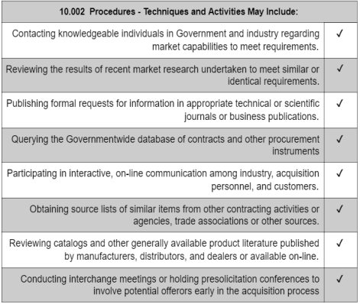
The FAR and Market Research Practices
FAR Part 10: outlines common market research practices but none are mandatory.
The acquisition team can choose new market research methods to:
To remain relevant, gain efficiency, and innovate
To understand market constraints and recognize opportunities
www.acquisition.gov/far/part-10

Slide 68
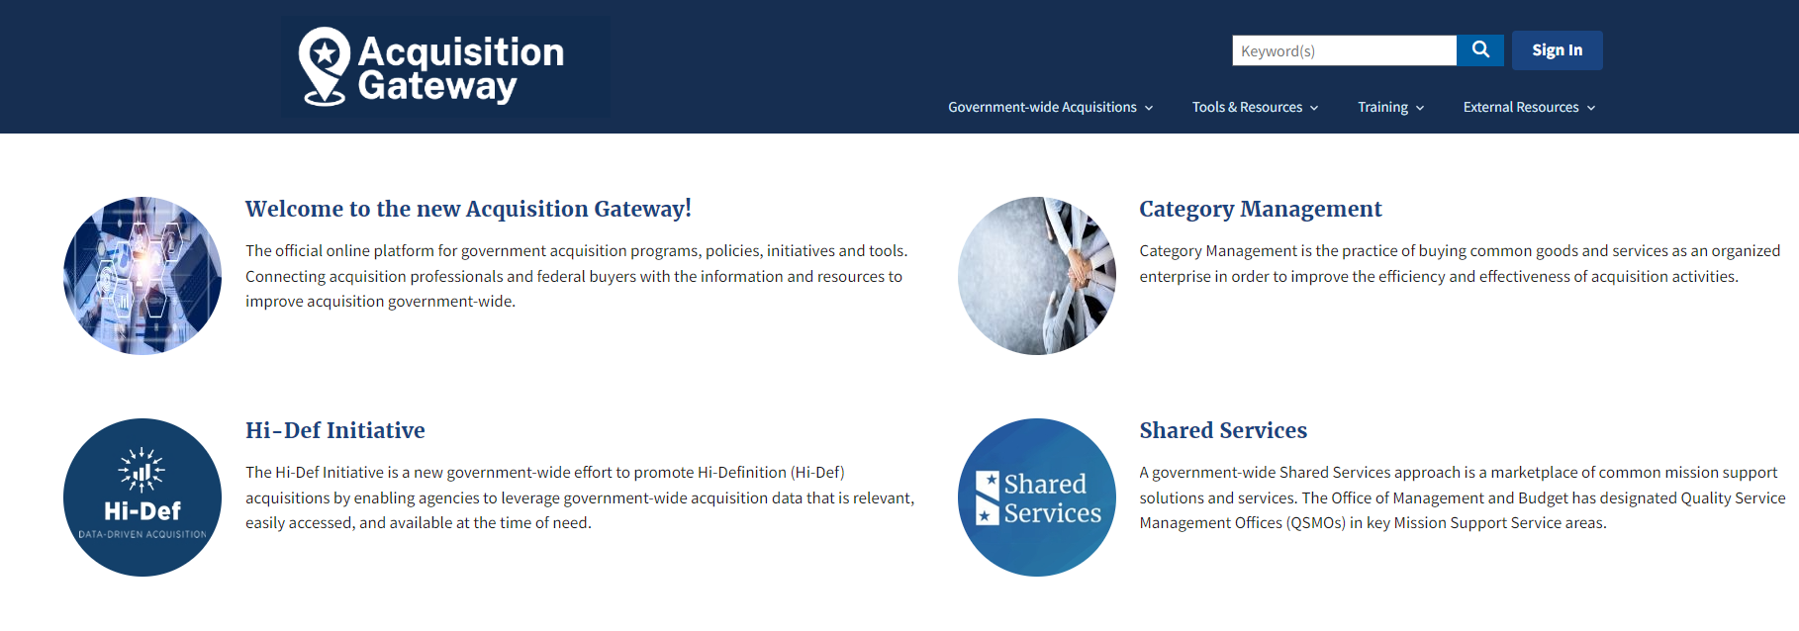
GSA Market Research Tools
GSA’s Market Expertise:
Government Wide Category Managers
Other Acquisition Professional
Internal Experts
GSA’s Online Tools:
Interact
Acquisition Gateway
Advantage
eBuy
Pricing Central
Search GSA Contracts
eLibrary
Market Research As a Service

Slide 69
What is Market Research As a Service (MRAS)?
MRAS uses the latest research techniques to help agencies visualize the competition and socioeconomic responses that they can expect if they use GSA’s acquisition vehicles.
MRAS helps agencies to:
Reduce acquisition time
Align Agency needs with GSA contracts and solutions
Identify the business size appropriate for the requirement

Slide 70
Objectives of MRAS
To make market research easier for all stakeholders.
Creating Government-wide efficiencies in Acquisition Planning = Taxpayer savings.
To give industry a voice.
To provide accurate data that summarizes the marketplace
Listening to stakeholder feedback to continuously improve our services.

Slide 71
Benefits of MRAS
Acquisition Professionals
Provides agencies with visuals and data they can include in reports to Small Business.
Provides agencies with narratives they can leverage for Acquisition Planning.
Gives agencies an outlook on whether competition and socio-economic participation is likely.
Industry
Visibility as a potential source in front of customers.
Access to GSA and Agency Points of Contacts.
Responses to RFIs lead to additional business; 50% or more of the requirements we research go to a GSA contract holder

Slide 72
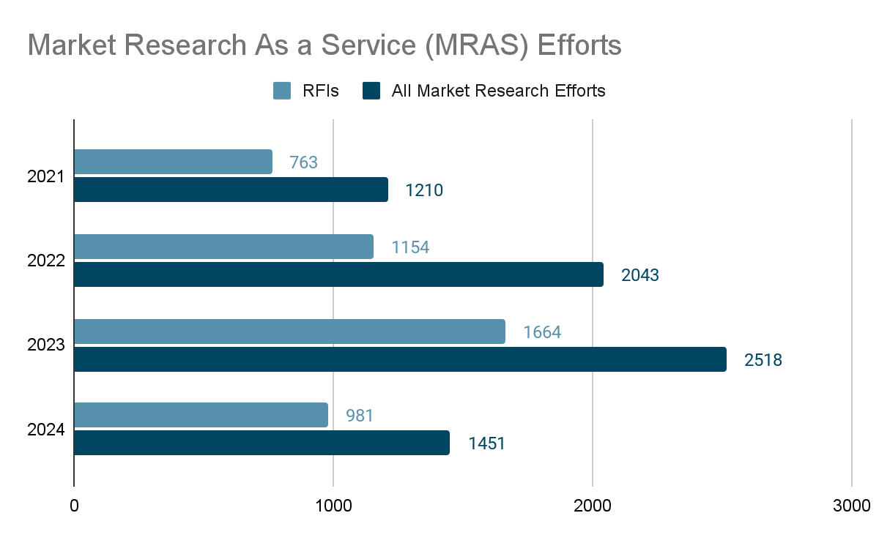
MRAS Program Successes
Awards
Over $56 Billion market research opportunities awarded to GSA Contract Holders.
Top Customers
Air Force
Army
Navy
Top Categories Researched
Professional Services
Information Technology
Facilities

Slide 73
MRAS Success Story
Customer: Department of Homeland Security (DHS), Office of the Chief Information Officer (OCIO)
Requirement: The Department of Homeland Security (DHS) seeks to establish a Microsoft Enterprise License Agreement (ELA) Blanket Purchase Agreement (BPA) to provide access to all Microsoft product offerings listed on the Contractor’s General Services Administration (GSA) Schedule.
Results:
Complete market report in 2 weeks, identifying 5 interested sources including 1 small business.
Award was made to a GSA contract holder for $1.3 Billion total lifetime value.
Notes:
https://fas.lightning.force.com/lightning/r/Opportunity/0063d000002FEbOAAW/view
https://drive.google.com/file/d/19OgpOD8UDRSKyicIM1KXBe8lvRgwbjms/view

Slide 74
Available Service Options
GSA Advantage Product Market Research
Rapid Review
Request for Information/Market Research Report
Industry Engagement
Search up to 20,000 items on GSA Advantage at once
Identifies if your requirement fits the scope of existing GSA acquisition solutions in 24-48 hours.
Streamlines the RFI process and consolidates the results into one report with visuals.
Targeted industry engagement regarding Agency specific requirements during MRAS Industry sessions.

Slide 75
Initiating Your Request
PWS and IGCE
PWS, SOW or informal statement
NAICs and SIN
NAICs: Required
SIN: Optional
Competition requirement
Choose from Small Business Set aside or Full and Open
Technical Questions
Include Technical questions for more robust data when identifying qualified vendors
A template is available to download in the form

Slide 76
Product Market Search (PMR)
Search up to 20,000 parts at once
Receive all the GSA Advantage! data
Enhanced commodity market report on demand
Builds part number based market reports quickly
Includes One-on-One CSD Review of Report
****A list of part numbers/descriptions will need to be uploaded with your request
Notes:
https://feedback.gsa.gov/jfe/preview/previewId/4d5b83dd-f639-4e1c-9ac4-47b5618b6ab3/SV_2c8junKC9AI9VWK?Q_CHL=preview&Q_SurveyVersionID=current

Slide 77
Rapid Review
Market Research results in 24 hours or less
NAICS results based on the requirement description
Review of Multiple Award Schedule and subcategories
Up to 5 applicable GSA contracts ranked by compatibility, includes Best In Class GSA contracts
Notes:
https://feedback.gsa.gov/jfe/preview/previewId/4d5b83dd-f639-4e1c-9ac4-47b5618b6ab3/SV_2c8junKC9AI9VWK?Q_CHL=preview&Q_SurveyVersionID=current

Slide 78
Draft RFI
Technical Questions can be added and customized based on the customer’s needs.
We include a link to the requirements documents in the RFI
We gather small business and vendor socio-economic data in the survey.
Notes:
https://feedback.gsa.gov/jfe/preview/previewId/4d5b83dd-f639-4e1c-9ac4-47b5618b6ab3/SV_2c8junKC9AI9VWK?Q_CHL=preview&Q_SurveyVersionID=current

Slide 79
Sample MRAS RFI Report
Notes:
https://drive.google.com/file/d/1-FkwpMX2Wuw-08PHNml-wfpI_2IMdYWU/view

Slide 80
What our Customers are Saying….
"MRAS helped me avoid doing it the way it's always been done before."
"I am very satisfied with this process,...I am extremely happy with the results and plan to utilize the services again....I will share this positive experience with other supervisors in my organization and encourage them to utilize these services as well. Great Job!"
“...I used MRAS and in 10 days, had 40 people respond. GSA then went over the report and did a deep dive to identify specific socioeconomic factors. It was very helpful!"
"...the customer utilized the MRAS RFI process to determine their overall acquisition strategy. The MRAS program has proven to be a value added program!
80

Slide 81
MRAS Resources
Email Us: RFI@Research.GSA.gov
Visit: Buy.GSA.gov/MRAS
Contact For Assistance: www.GSA.gov/CSD
Training: www.GSA.gov/events
For more information, visit: gsa.gov/FAST

Slide 82
FAST 2024 GSA Advantage

Slide 83
Mark King
GSA Customer Service Director
NASA Accounts
Mark.King@gsa.gov

Slide 84
GSA Advantage!
What is GSA Advantage?
Online Product Superstore - opened in 1994
Offerings from GSA and VA Schedule contracts – also includes GSA Global Supply items
Serves a dual function:
eCommerce Purchasing tool
Market Research tool
Ideal for product purchases off of federal schedules
Catalog of over 80M+ products
Think “Acquisition”
Gov’t to Vendor Transaction
It’s like Amazon.com for Government Customers

Slide 85
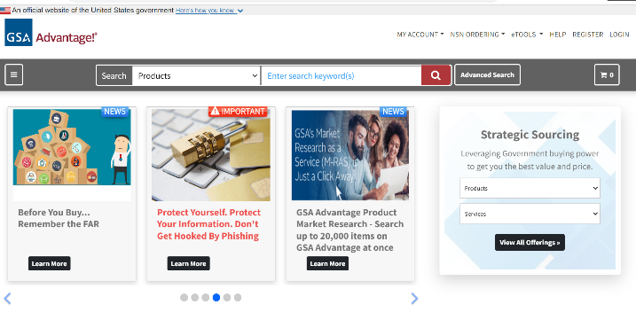
GSA Advantage! Navigating the Online System
Homepage Functionality – gsaadvantage.gov
Website:
https://www.gsaadvantage.gov
Primary Assistance:
GSA Advantage Customer Service
* 877-472-3777, option 2
* GSA.Advantage@gsa.gov

Slide 86
GSA Advantage! Navigating the Online System 1
Homepage Functionality – Registration and Login
Benefits of a Login:
Load/save a cart
Saves your information for future purchases (purchase card, addresses, etc)
Share a cart
History of past orders
Order status

Slide 87
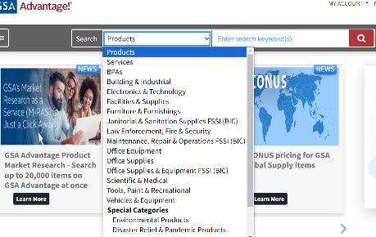
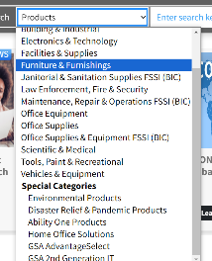
GSA Advantage! Navigating the Online System
Performing a Search
Dropdown Menu Search
16 basic categories
Search Bar:
Open search
Dropdown Menu Search:
16 basic categories
6 special categories
Open Search
Dropdown Menu Search
6 special categories

Slide 88
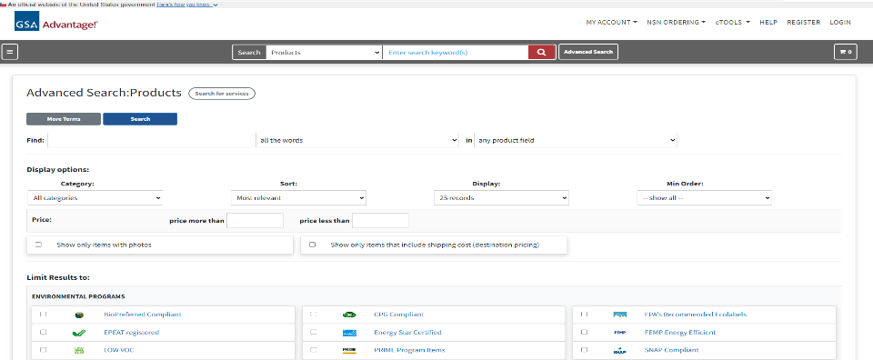
GSA Advantage! Navigating the Online System 2
Advanced Search

Slide 89
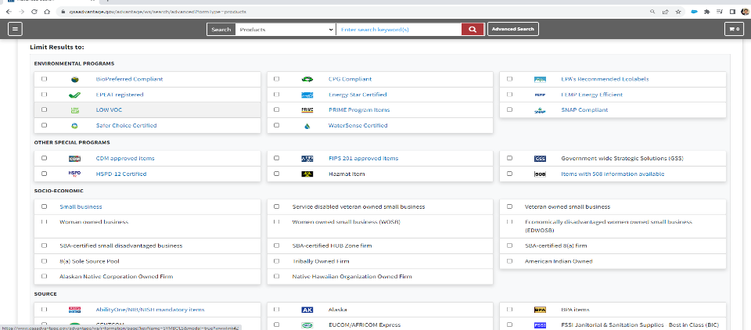
GSA Advantage! Navigating the Online System 3

Slide 90
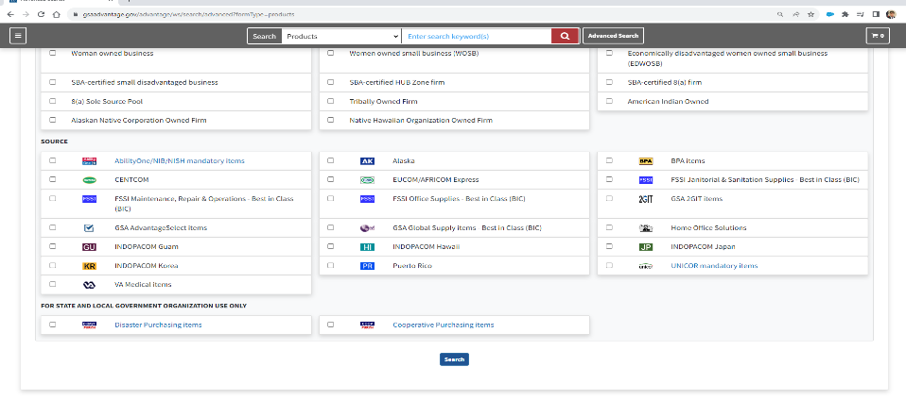
GSA Advantage! Navigating the Online System 4

Slide 91
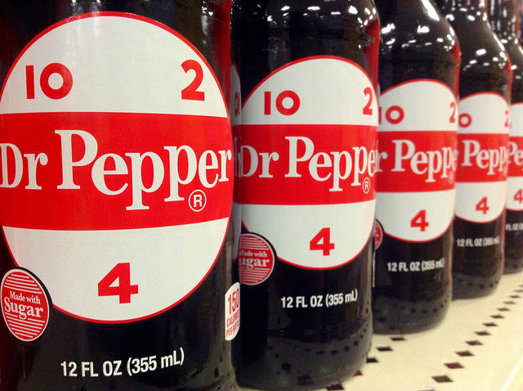
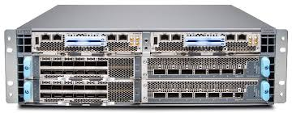
Example – Juniper Switches for S&L in Waco TX
Waco TX (birthplace of Dr. Pepper)
Juniper Switches (IT I promise)
Data Center switching architecture
Estimated: $1.3M
Actual: $817K

Slide 92
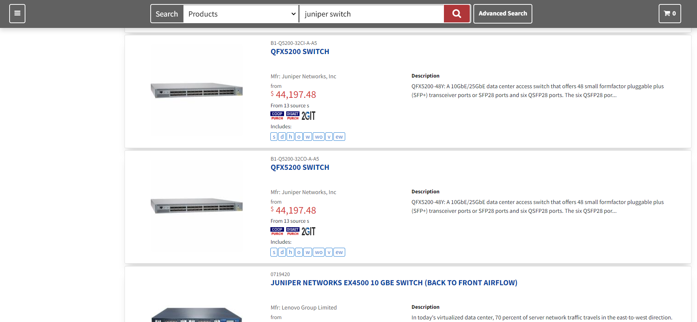
GSA Advantage! Navigating the Online System – Product Comparison

Slide 93
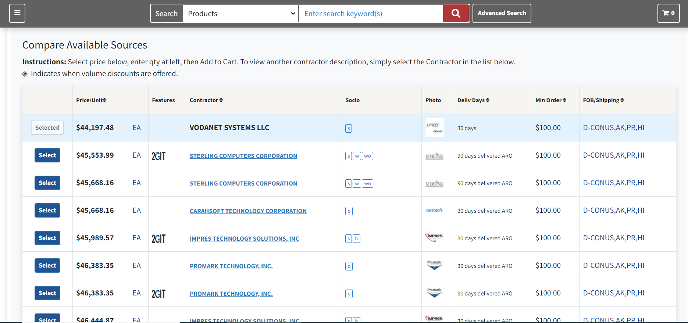
GSA Advantage! Navigating the Online System – Product Comparison 5

Slide 94
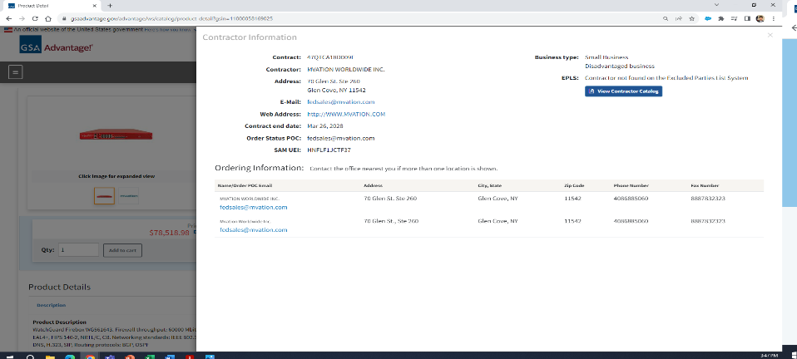
GSA Advantage! Navigating the Online System – Product Comparison 6
Set-Aside requirement?
Vendor Integrity Check?

Slide 95
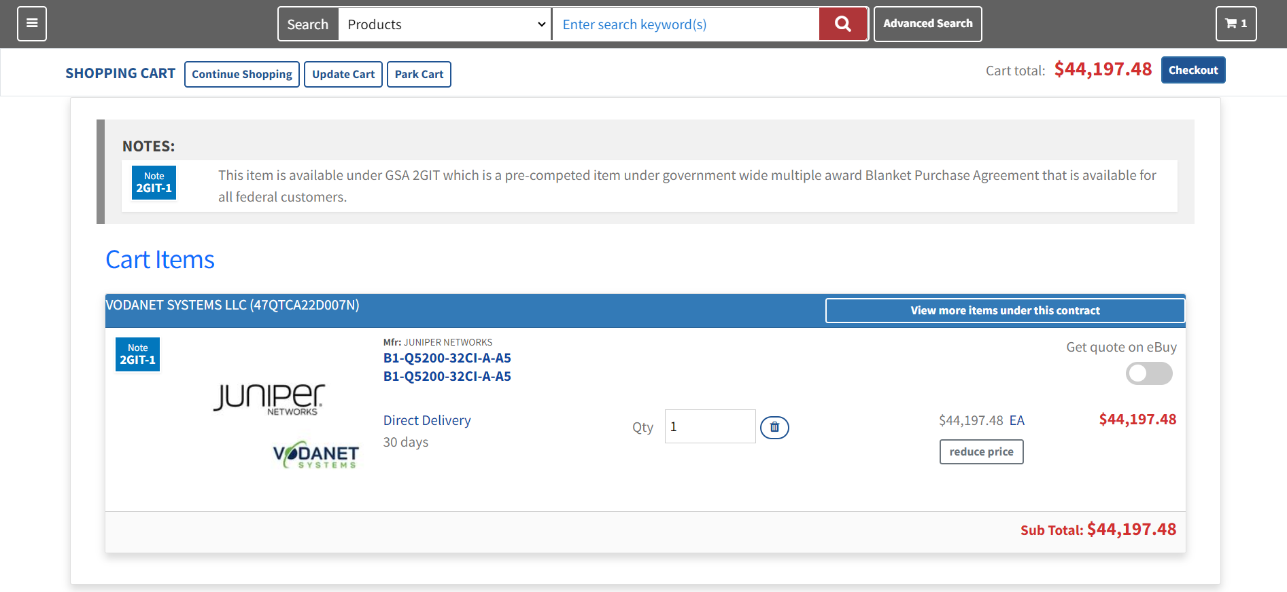
GSA Advantage! Navigating the Online System 7
High dollar/ quantity?

Slide 96
GSA Advantage! Takeaway Points
Takeaway Points:
Analogy:
“It’s like Amazon.com for Government Customers”
ePurchasing Tool:
Make online purchases
Access to MAS and VA Schedules products/services
Some Global Supply items available
Market Research Tool:
Quick product look-up
See how many companies sell it
View Schedule pricing

Slide 97
Thank You Everyone!
Mark King
Customer Service Director – NASA Accounts
Mark.King@gsa.gov
For more information, visit: gsa.gov/FAST

Slide 98
Thank You So Much!
For more information, visit: gsa.gov/FAST

