Slide 1
FAST 2024
Emerging Innovations and Trends
May 15th

Slide 2
Polls

Slide 3
Delivery-Automating FAS Acquisition
Erville Koehler
Assistant Commissioner, General Supplies and Services

Slide 4
FAST 2024 Delivery-Automating FAS Acquisition

Slide 5
Topics
# | Topic
4 | Demand Data
5 | Delivery Statistics
6 | Advantage Suspensions
7 | Requisition Channel - Scorecard
8 | Perfect Order Fulfillment (POF) Metric
9 | Customer Order Cancellation

Slide 6
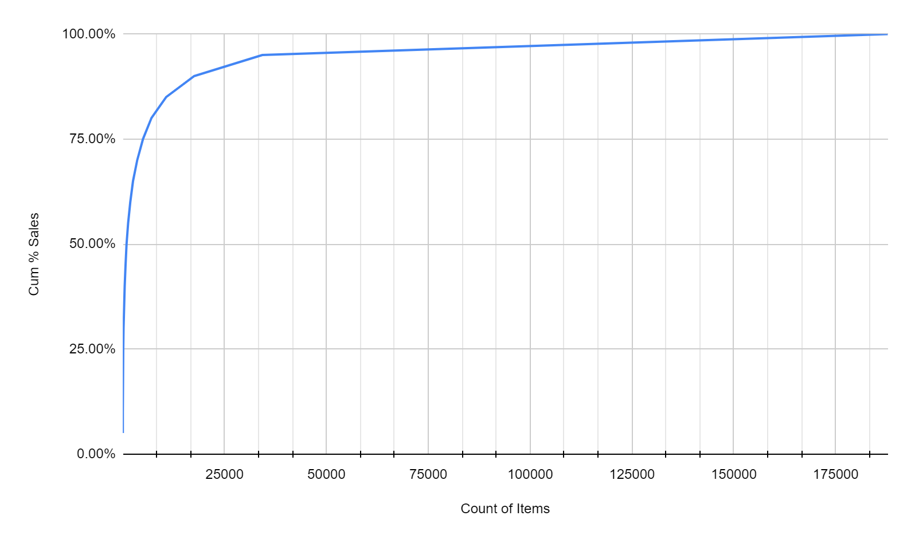
Demand Data
Count | % Items | Cum % Sales
8 | 0.0% | 5.00%
21 | 0.0% | 10.00%
50 | 0.0% | 15.00%
88 | 0.0% | 20.00%
139 | 0.1% | 25.00%
211 | 0.1% | 30.00%
325 | 0.2% | 35.00%
478 | 0.3% | 40.00%
680 | 0.4% | 45.00%
951 | 0.5% | 50.00%
1,331 | 0.7% | 55.00%
1,846 | 1.0% | 60.00%
2,532 | 1.3% | 65.00%
3,555 | 1.9% | 70.00%
4,984 | 2.7% | 75.00%
7,053 | 3.8% | 80.00%
10,667 | 5.7% | 85.00%
17,540 | 9.3% | 90.00%
34,272 | 18.2% | 95.00%
187,800 | 100.0% | 100.00%
Over half of the ~Billion Dollars in Annual sales captured in the data is represented by 951 items across GSS and ITC
This information is published to VSC and Interact bi-monthly.
Check it out at this link: https://vsc.gsa.gov/vsc/app-content-viewer/section/150
Scroll down to Demand Data
Notes:
NEW! Based on 3-2024 Demand Data Publication

Slide 7
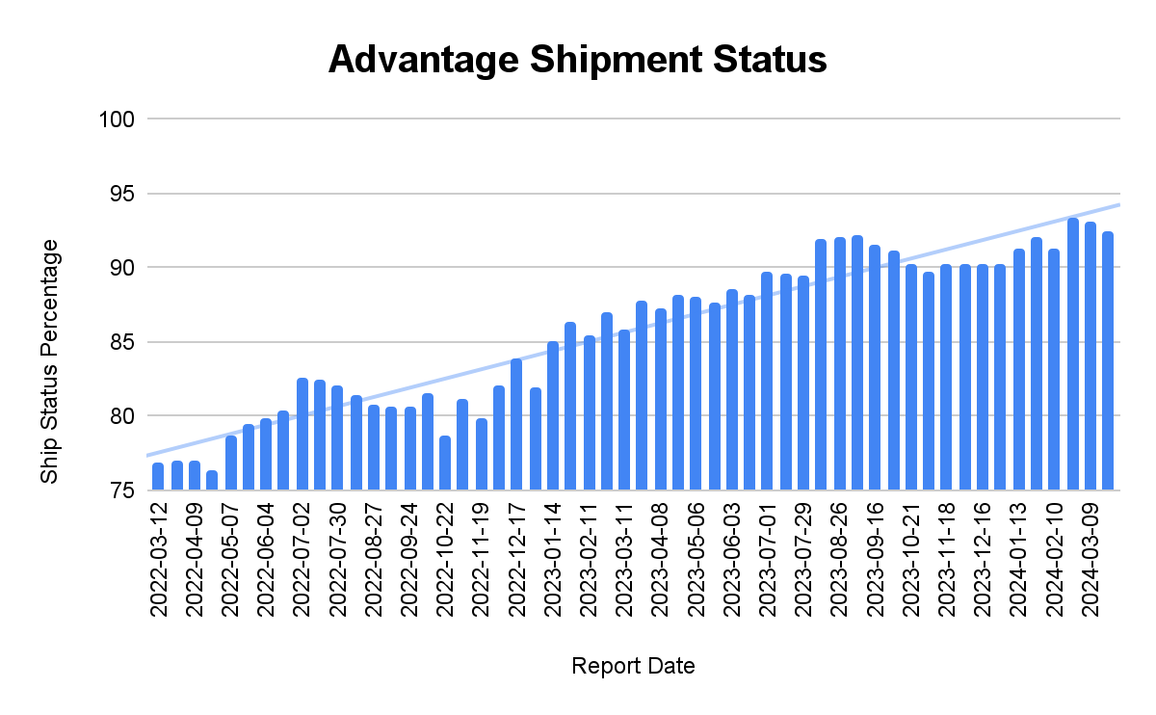
Delivery Statistics
Results of our focus on delivery……
Revenue in 000’s | YTD AP06 FY2023 ACTUAL | YTD AP06 FY2024 ACTUAL | vs. 2022 | % DIFF
ASSISTED SOLUTIONS | $185,062 | $202,869 | $17,807 | 9.6%
SCHEDULES | $26,886 | $32,275 | $5,389 | 20.0%
PROPERTY | $18,272 | $20,452 | $2,180 | 11.9%
RETAIL | $203,361 | $259,582 | $56,221 | 27.6%
SUPPLY CHAIN | $357,157 | $395,478 | $38,321 | 10.7%
TOTAL GSS REVENUE | $798,587 | $913,159 | $114,572 | 14.3%

Slide 8
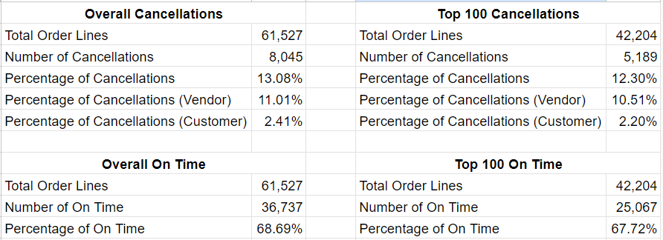
Advantage Suspensions
Per Cycle
~1550 Passing Scorecards
~1200 No Orders Notices
~50 Failures
Notices of Suspension FY23/24
523 Distinct Contracts
Suspension Actions
Suspended –125
Reinstated - 78
Deleted - 47
13%
68.9%

Slide 9
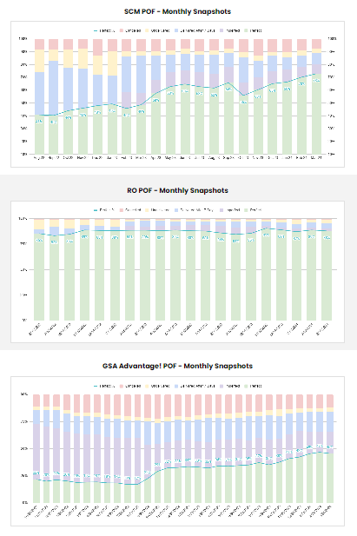
POF Metric
Perfect Order Fulfillment (POF):
Measures quality and timeliness of fulfilling Customer orders
Ensures we’re improving delivery to our Customers
Establishes an unforgivingly high standard for “perfection”:
Any order cancelled for any reason is not perfect
Any order with an NCSC case of any type is not perfect
Any order where the contractor fails to provide status is not perfect
Any order, regardless of contract lead time, that takes longer than 7 days to fulfill, is not perfect
Drives us to improve toward exceeding Customer expectations

Slide 10
Customer Order Cancellations
Don
The pink bar on our POF charts represents cancellations
GSA Advantage! cancellations spiked due to covid-related supply issues but are now being driven down below pre-covide levels

Slide 11
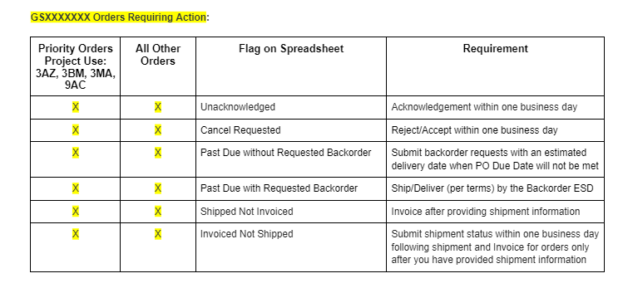
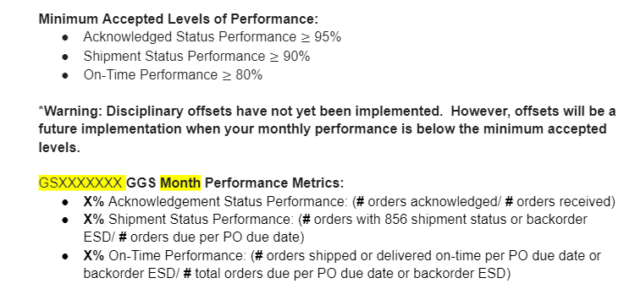
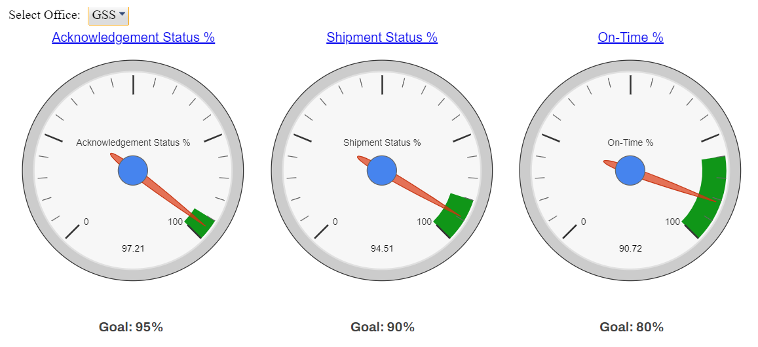
Requisition Channel - Scorecard and Dashboard
No Order Left Behind
Weekly Email
POs requiring Order Status
GGS Scorecard
Monthly Email with 3 key measures
Acknowledgement, Shipment, On-Time
GGS Dashboard
Quick view of current performance to target

Slide 12
Questions?
Trista Verga trista.verga@gsa.gov
Or
Shaun Hartman shaun.hartman@gsa.gov
For more information, visit: gsa.gov/FAST

Slide 13
Asking the Right Questions: Tips on Creating Effective RFIs and Solicitation Documents
DHS, Procurement Innovation Lab

Slide 14
Who We Are
Scott Simpson
Digital Transformation Lead
Monica Taylor
Senior Innovation Coach
Chase Knechtel
APCP Detailee

Slide 15
PIL ConOps
What is the PIL?
A virtual lab where the DHS acquisition community can have a safe space to test new ideas, share lessons learned, and foster cultural change to promote innovation and managed risk-taking through a continuous feedback cycle.
PIL Mission:
To foster a culture of procurement excellent where smart risk-taking and innovation assure DHS mission success.
PIL Focus:
The obtain phase of the Acquisition cycle:
Solicitation 🡪 Evaluation 🡪 Award
FAR-based
flexibilities
Lower entry barriers for non-traditional and innovative contractors.
Shorten the time-to-award, thereby delivering capabilities to customers faster.
Encourage competition by providing interested vendors with a better understanding of the goals and objectives for each procurement.
Increase the likelihood of successful outcomes by focusing on evaluation techniques to identify the most qualified contractors.

Slide 16
How to Use Interview-Style Questions
Interview-style questions make your technical evaluations factors more meaningful by asking questions.
Use your mission to provide context and ask targeted questions about the offeror’s related experience.
Can also be used in RFIs for Market Research.
Easier for program offices to articulate meaningful criteria.
Easier for offerors to understand requirements and provide relevant proposals.
Easier for evaluators to evaluate.

Slide 17
How to Use Interview-Style Questions continued
Solicitation Sample from FEMA COVID-19 Vaccination Campaign (FAR 15.3)
Phase 1, Factor 1: Corporate Experience (Instructions to Offerors)
The Offeror shall submit a written submission, totaling no more than five (5) pages (excluding the cover page), detailing their EXPERIENCE by addressing the topics below.
Using specific examples that are verifiable, describe your corporate experience obtaining medical personnel with the following certifications to support national medical response efforts: Physician, Dentist, Pharmacist, Paramedic …
Using specific examples that are verifiable, describe your corporate experience deploying thousands of medical staff capable of safely administering a vaccine to patients across dispersed locations within a 72-hour period.
Using specific examples that are verifiable, describe your corporate experience staffing medical personnel to the 48 contiguous states within FEMA Regions 1-5 or Regions 6-10 in a saturated market.
If proposing for Regions 1-5, using specific examples that are verifiable, describe your corporate experience staffing medical personnel to the following U.S. territories in a saturated market: Puerto Rico and U.S. Virgin Islands (Region 2).
Using a specific example that is verifiable, describe an instance in your corporate experience where you did not meet contract requirements under performance of a medical services contract and how you identified, communicated, addressed, mitigated and resolved the failure.

Slide 18
How to Use Interview-Style Questions continued 2
Solicitation Sample from USCG AUXDATA II (FAR 8.4)
Factor 2: Technical Solution (Evaluation of Offerors)
The Government will assess each Offeror’s demonstration for its confidence in the proposed technical solution and its ability to meet the mission needs of the Auxiliarists based on the technical demonstration and responses to questions. This includes the following characteristics:
Fitness: Does the technology address the problem at hand, or is it being used for an unintended purpose?
Simplicity: Is the design of the solution easily understood?
Usability: Is the solution intuitive and easy to use? Will individuals with little technical understanding be able to use it with minimum guidance?
Adaptability: How easily can the solution modified to meet new requirements or requirements of similar workforce management systems.

Slide 19
Interview-Style Questions for Market Research
What is the size and classification of your business (Identification of socio-economic status)?
What strategic sourcing vehicles (SSVs), government-wide acquisition contracts (GWACs), indefinite-delivery/indefinite-quantity (IDIQs)contracts, or other contract vehicles are you a part of?
What information would you need from FLETC to supply pricing estimates for the enterprise IT support services and solutions described in this RFI?
Many of the enterprise IT support services and solutions are delivered onsite, but FLETC is seeking cost and performance optimizations by utilizing remote workers when appropriate.
a. Can you support onsite and remote worker staffing to meet FLETC’s enterprise IT requirements?
b. How would you address geographic staffing challenges in remote locations like Brunswick, GA, and Artesia, NM, that require on site support?

Slide 20
Now it’s YOUR Turn!
The Government has a new need to procure self-driving cars.
What are some interview style questions we could put into an RFI?

Slide 21
Form Based Request for Information (RFI)
Use a forms application for easy collection and analysis of meaningful vendor communication and feedback.
Ideal for –
Seeking sources.
Identifying small business and socioeconomic designations.
Asking for specific capability information.
Asking for feedback on draft documents.
Following up after an industry day.
#49

Slide 22
Now it’s YOUR Turn! 2
Market Research is complete, and the Government is ready to write a solicitation for self-driving cars.
State some of the core requirements for the solicitation’s evaluation criteria as interview-style questions.
Factor 1: Technical
Factor 2: Experience

Slide 23
RFI
Requirements
Solicitations

Slide 24
Thank You!
You can reach out to us at: pil@hq.dhs.gov
Scott Simpson: scott.simpson@hq.dhs.gov
Monica Taylor: monica.taylor@hq.dhs.gov
Chase Knetchel: chase.knetchel@hq.dhs.gov
www.dhs.gov/pil
For more information, visit: gsa.gov/FAST

Slide 25
FAST 2024 Better Contracting Initiative (BCI) & CSAWs

Slide 26
Better Contracting Initiative

Slide 27
Better Contracting Initiative continued
Saving Money and Avoiding Waste by Getting Contract Requirements Right the First Time.
“...Over the coming months, GSA will continue to sponsor a series of facilitated requirements development and acquisition planning workshops for services contracts with acquisition teams across the Government. GSA will also partner with the agencies’ acquisition leadership to help train individuals that can facilitate workshops within their own agencies.”

Slide 28
Good Fit Customer Requirements
What is a CSAW?
For the last four years, GSA, through FAS’s Office of Professional Services & Human Capital Categories, has been offering facilitated requirements development and acquisition planning workshops, known as Civilian Services Acquisition Workshops (CSAWs).
These workshops are built around an agency’s specific acquisition and its multi-functional integrated procurement team (IPT). The workshop walks the complete team through the performance-based acquisition (PBA) process.
At the end of the workshop the team will have a vision, mission, and high level measurable objectives for their agency’s requirement. The team will also have begun the development of requirements, performance standards, and performance-based strategies, as well as have crafted a plan for completing each of these components.
We have provided over 35 workshops, representing over $33 Billion in services spend.
- Workshop is most effective for acquisition teams that have sufficient lead time (18 months to 2 years)
- Total Lifecycle Value >= $50M (or requirement is significantly complex or mission critical)
- Preponderance is a SERVICES requirement; Requirement Categories have included: Professional Services, Information Technology, Facilities & Construction, Medical, Transportation & Logistics, Environmental
- Full commitment from Agency Leadership + Contracting Office & Program Office
GSA Outreach
November 2023: PMC Challenge Cards issued
January 19, 2024: Inventory of procurements and personnel to be trained
January 16, 2024: OSDBU Council briefed
January 25, 2024: PMA webinar on BCI hosted
March 3 - 6, 2024: NCMA Nexus

Slide 29
Good Fit for a Facilitator
CSAW Certification
We are currently working on an updated memo outlining the certification requirements for individuals who will be facilitating requirements development and acquisition planning workshops (CSAWs) across government.
There are two certifications, one for co-facilitators who would assist certified facilitators throughout the workshop and facilitate various modules. The other for facilitators who also have demonstrated knowledge and experience in federal acquisition and can provide coaching to teams, specifically around performance-based acquisition.
We are working with FAI on a path to convert these certifications into FAC Credentials in the future.
We currently estimate that to become a CSAW Facilitator will take a minimum of 195 hours. To become a CSAW Co-Facilitator will take a minimum of 119 hours. These estimates are subject to change and assume that the individual has not completed any of the training previously.
Characteristics:
Enjoy working with people
Think quickly and logically
Communicate clearly and expressively
Practice active listening skills
Convey warmth
Demonstrate self-confidence
Have a business orientation
Experience:
Current or former 1102
Conducts training
FAC-C and/or FAC P/PM or DAWIA
Expectations:
Capacity to facilitate 2 or more workshops a year

Slide 30
Performance-Based Acquisition

Slide 31
4 KEY ELEMENTS OF PBA
Uses a Performance Work Statement (PWS) or Statement of Objectives (SOO)
Includes measurable performance standards for all performance requirements
Provides appropriate incentives to drive higher performance and/or promote innovation
Utilizes a Quality Assurance Surveillance Plan (QASP) to define how the contract will be monitored (see FAR 46.4)

Slide 32
STEPS TO PERFORMANCE BASED ACQUISITION
STEP 1
Form the Team
STEP 2
Identify Objectives
STEP 3
Market Research
STEP 4
Develop Work Statement
STEP 5
Define Measures
STEP 6
Source Selection
STEP 7
Manage Performance
STEP 8
Complete Closeout
PURPOSE: Establish the team and conduct high-level project planning. POTENTIAL OUTPUTS: - Project Vision, Mission & Team Success Factors - Stakeholder ID & Analysis - High-Level Communications Plan - High-Level Risk ID - Project Charter | PURPOSE: Identify why we’re doing this in the first place and what are the high-level objectives (HLO). POTENTIAL OUTPUTS: - Review/analyze current approach - Tie project into Agency Mission / Strategy - Establish High-Level Objective | PURPOSE: A team approach to market research using available tools and innovative resources. POTENTIAL OUTPUTS: - ID Market Research Topics / Questions - Team market research assignments - Draft MR document - Draft IPT Master Schedule | PURPOSE: Well-written requirements statements and identifying the appropriate work statement type. POTENTIAL OUTPUTS: - Draft Performance Requirements Statements - Draft Work Statement Template Selection - ID Solicitation Requirements | PURPOSE: What constitutes successful performance and how does the team measure this? POTENTIAL OUTPUTS: - Develop performance standards and possible incentives - Review acquisition strategy alternatives | PURPOSE: Review options for evaluation criteria and think through the source selection process. POTENTIAL OUTPUTS: - Explore innovative source selection approaches - ID Tech Eval criteria | PURPOSE: Managing the contract to ensure performance objectives are met. POTENTIAL OUTPUTS: - Draft Risk Management Plan - QASP vs. QAP - Performance tracking approach - Roles & Responsibilities - Change & Transition Management | PURPOSE: Considerations for closing out the contract and concluding the project. POTENTIAL OUTPUTS: - Lessons Learned - Celebrate Success - Document in CPARs
Notes:
https://pba.app.cloud.gov/app/#/pba

Slide 33
Contact Us
Jonathan Evans
CSAW Program Manager & Senior Facilitator
Office of Professional Services & Human Capital Categories
GSA Federal Acquisition Service
Email: csaw@gsa.gov
For more information, visit: gsa.gov/csaw

Slide 34
Break

Slide 35
OASIS+: The Next Generation Services MAC
Bill Niess
OASIS+ Program Manager
Office of Professional Services and Human Capital (PSHC)
Federal Acquisition Service (FAS)
U.S. General Services Administration (GSA)
william.niess@gsa.gov
OASISPlus@gsa.gov

Slide 36
What is OASIS+
One Acquisition Solution for Integrated Services Plus (OASIS+) is a government wide, multiple award, IDIQ acquisition program that provides best-in-class contracts and vendors who offer customer agencies a full range of integrated professional services to help them meet their mission requirements.
Using a phased approach, OASIS+ will eventually combine the scope of:
OASIS (SB, 8(a), and UR);
Building, Maintenance & Operations (BMO);
Human Capital & Training Solutions (HCaTS); and
New areas of previously undefined services.

Slide 37
OASIS+ Contracts
OASIS+ consists of six (6) separate and distinct IDIQ contracts:
Total Small Business (SB)
SBA-Certified 8(a) Small Business (8(a))
SBA-Certified HUBZone Small Business (HZ)
SBA-Certified Service-Disabled Veteran-Owned Small Business (SDVOSB)
SBA-Certified Women-Owned Small Business Small Business (WOSB)
Unrestricted (UR)

Slide 38
OASIS+ Unique Features
Domains
Flexible/Expandable Domain-Based Structure
Industrial Base of Highly Qualified Contractors
Global Access to Commercial & Non-Commercial Services
10-Year Order Period
(Base of 5 + One 5 Year Option Period)
No Contract Ceiling or
Cap on Awards
Open On-Ramping
After Initial Awards
On-Ramps
Technology Based Ordering & Market Research Tools
Price Evaluation at the Contract Level
Category Mgmt Update:
OMB-OFPP designated OASIS+ as a BIC solution on 4/22/2024!
Notes:
Price Evaluation – OASIS+ = Sampling of labor cats/rates versus MAS price lists
CMMC – Was an evaluation factor during OASIS+ proposal evaluation.

Slide 39
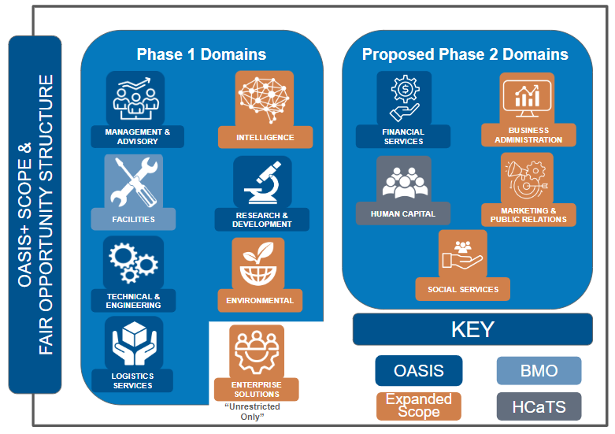
OASIS+ Domains
The scope of each OASIS+ contract is categorized into functional groupings known as Domains.
Eight (8) Domains are in the Phase I OASIS+ contracts
Contract Awards / NTP – FY24 (Q3/4)
Open Continuous – FY25+
Five (5) Domains are planned for Phase II OASIS+ contracts
Contract Awards / NTP – FY25/26
Open Continuous – FY27+
BOLO
BOLO

Slide 40
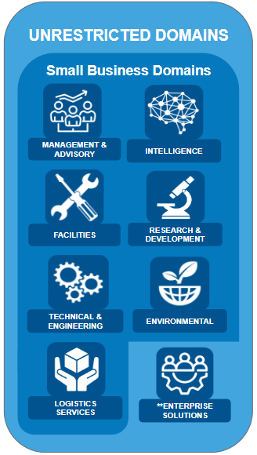
OASIS+ Domains – cont’d
Domains are based on groupings of North American Industry Classification System (NAICS) codes.
Each Domain contains multiple NAICS codes. OASIS+ Contractors may qualify for award of some or all NAICS included in the specific Domain (provided they meet all qualifications for award).
Ordering Contracting Officers (OCOs) will:
Obtain Delegation of Procurement Authority (DPA) Certification from GSA;
Determine the appropriate OASIS+ contract vehicle;
Select the appropriate Domain; and
Select the appropriate NAICS that best represents the scope of their requirement.
NOTE: Fair Opportunity is provided at the individual NAICS level.

Slide 41
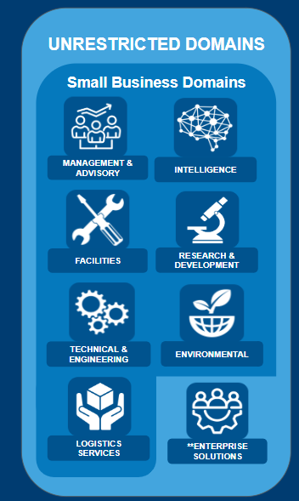
Navigate to the OASIS+ Website, review the OASIS+ Ordering Guide, obtain OASIS+ DPA Certification, login to Symphony, and …
OASIS+
Task Order Process
Ordering Official
Perspective

Slide 42
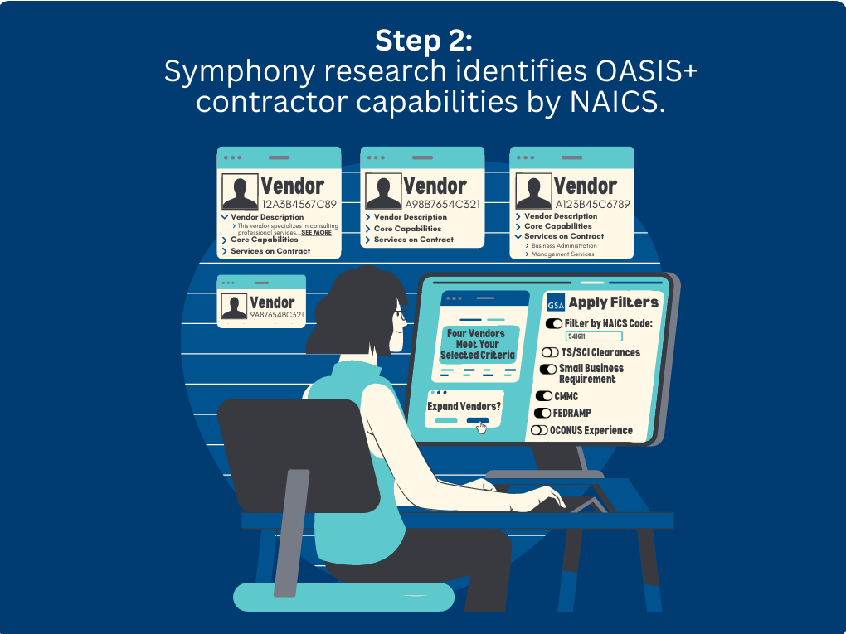
OASIS+
Task Order Process
Ordering Official
Perspective

Slide 43
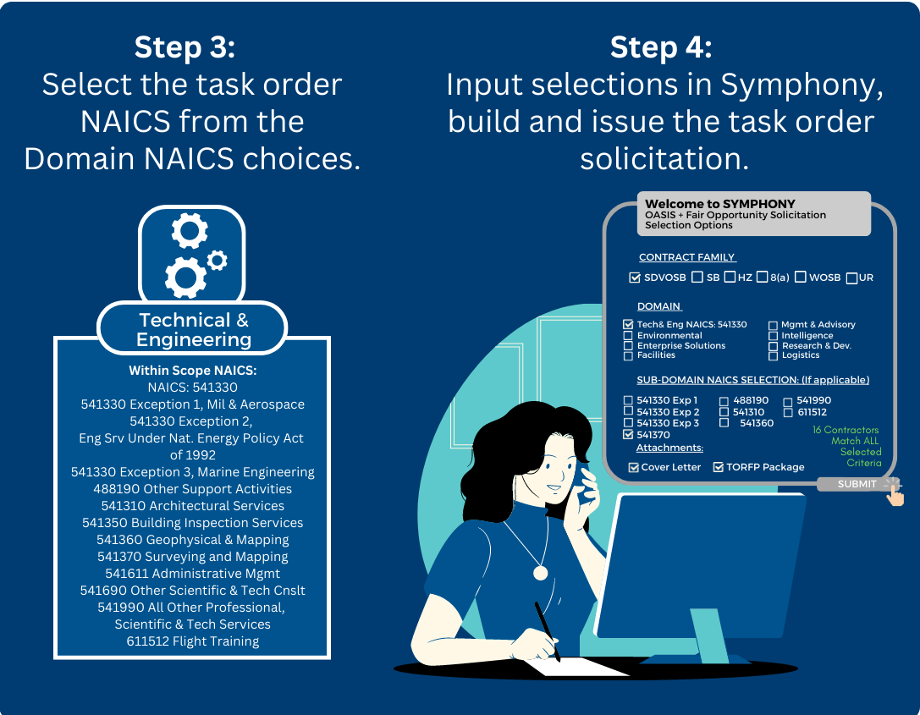
OASIS+
Task Order Process continued
Ordering Official
Perspective

Slide 44
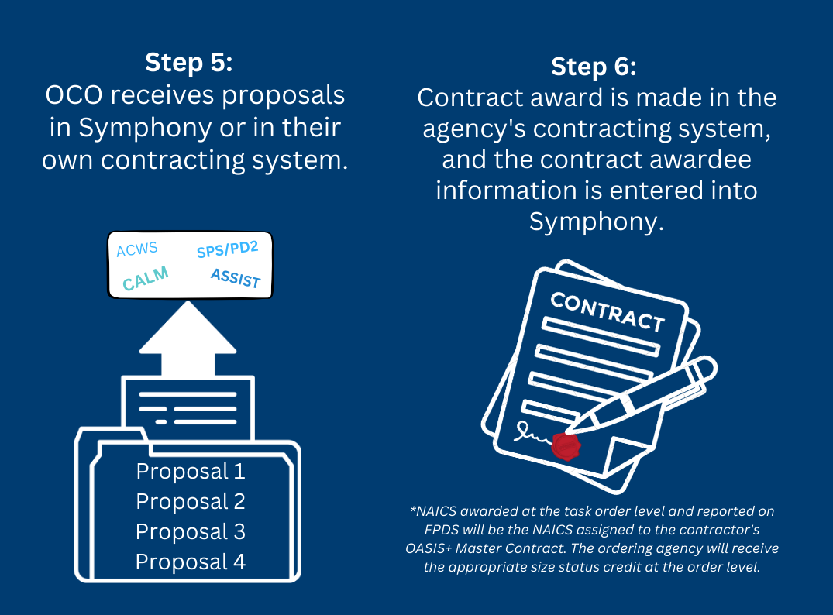
OASIS+
Task Order Process continued 2
Ordering Official
Perspective

Slide 45
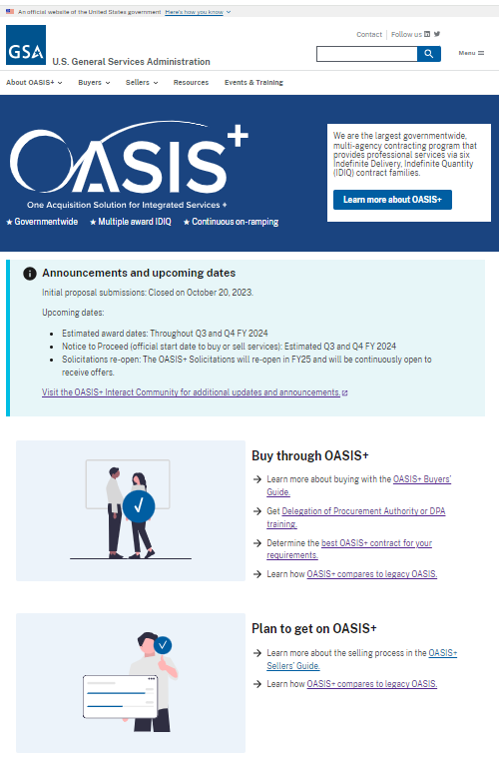
OASIS+ Resources
New (3/20/2024)
OASIS+ Website:
https://www.gsa.gov/oasis-plus/
OASIS+ Ordering Guide:
https://www.gsa.gov/oasis-plus/ordering-guide/
OASIS+ Events & Training
https://www.gsa.gov/oasis-plus/events-training/
OASIS+ Email:
OASISPlus@gsa.gov
OASIS+ Interact Community (blog):
https://buy.gsa.gov/interact/community/196/activity-feed

Slide 46
OASIS+ Goals for FY24
Deliver recurring updates to program stakeholders via the GSA Interact blog and briefings
Develop/deploy a new OASIS+ website: https://www.gsa.gov/oasis-plus
Develop/publish the OASIS+ Ordering Guide on the new website: https://www.gsa.gov/oasis-plus/ordering-guide/
Develop/deliver OASIS+ events and training
Intro to OASIS+ (for customers / industry)
Delegation of Procurement Authority (for customers)
Symphony – Task Order Management (for customers / industry)
Achieve Category Management Best-in-Class (BIC) Designation for OASIS+ prior to contract awards [4/22/2024]
Perform GSA Systems Configuration / Integration
Symphony – Proposal Evaluation (for PSHC)
CALM – Contract Award Workspace (for PSHC)
Symphony – Task Order Mgmt (for customers / industry)
Evaluate proposals, award contracts, and issue Notice to Proceed (NTP) dates by OASIS+ contract family:
Late Q3 – Total Small Business (SB)
Early Q4 – HUBZone, SDVOSB, and WOSB
Mid Q4 – 8(a)
Late Q4 – UR

Slide 47
OASIS+ High-Level Milestone Chart (FY21-25)
Market Research
Acquisition Planning
Release Draft RFPs
Release Final RFPs
OSP/Symphony webinars
Stakeholder Communications
Task Order Activity Continues
OASIS+ PMR #1
OASIS+ Phase 1 “Open Continuous”
OASIS+ Phase 2
FY21
FY23
FY25
Today
FY22
FY24
Prepare Draft RFPs
Proposal Evaluation (Q1-4)
Ordering Guide/DPA Training (Q2-4)
BIC Designation (Q2-3)
Contract Awards/NTPs (Q3/4)
Task Order Activity Begins (Q3/4)
Expiration Dates – Legacy OASIS Contracts
Name | Contract Holders | Expires
OASIS SB | 488 | 12/19/2024
OASIS 8(a) | 115 | 12/19/2024
OASIS UR | 147 | 3/01/2025

Slide 48
Polls 2

Slide 49
Bill Niess
OASIS+ Program Manager
Office of Professional Services and Human Capital (PSHC)
Federal Acquisition Service (FAS)
U.S. General Services Administration (GSA)
Email – william.niess@gsa.gov
Group Email – OASISPlus@gsa.gov
OASIS+ Website: https://www.gsa.gov/oasis-plus/
For more information, visit: gsa.gov/FAST

Slide 50
FAST 2024 Energy Savings Performance Contracts (ESPC) ENABLE

Slide 51
GSA ESPC ENABLE PROGRAM - Agenda
What are ESPCs? What is ESPC ENABLE?
Advantages of ESPCs With ENABLE
What ESPC ENABLE Offers Agencies
ESPC ENABLE Procurement Cycle
GSA and ESPC ENABLE
ESPC Campaign and SCEP
Resources
Points of Contact
Questions

Slide 52
Energy Savings Performance Contracts (ESPC)
Acronyms
FEMP – Federal Energy Management Program (DOE)
SCEP – State and Community Energy Programs (DOE)
ECM – Energy or Water Conservation Measure
M&V – Measurement and Verification
O&M – Operations and Maintenance
NOO – Notice Of Opprotunity
NOITA – Notice of intent to award task order
IGA – Investment Grade Audit
DOE – Department of Energy

Slide 53
What are ESPCs? What is ESPC ENABLE?
Energy Savings Performance Contracts (ESPCs) are contracts that allow
agencies to do energy projects with no upfront capital cost and no special appropriations from Congress
Well-suited to meet the needs of a wide variety of federal facilities
No specific size or cost restrictions
Best or only funding option available for some projects
0%-100% Funding
Notes:
Energy Savings Performance Contracts (ESPCs) are contracts that allow
agencies to do energy projects with no upfront capital cost and no special appropriations from Congress
ESPC ENABLE well-suited to meet the needs of a wide variety of federal facilities
There are no specific size or cost restrictions
Projects have ranged from around $200,000 to $18 million
Facilities ranging from less than 200,000 square feet up to 2.1 million
square feet
Best or only funding option available for some projects
0%-100% Funding

Slide 54
What are ESPCs? What is ESPC ENABLE? (Cont.)
Pre-established procurement and technical tools to administer projects
through the General Services Administration (GSA) Schedule, SIN 334512.
Tools and templates are available to streamline the process
FEMP ENABLE team will review ESCO savings and cost estimates
and M&V plans
Notes:
Pre-established procurement and technical tools to administer projects
through the General Services Administration (GSA) Schedule, SIN 334512.
A number of tools and templates are available to streamline the process to
help agencies expedite project development and award
Templates, IGA tool
No preliminary assessment
FEMP ENABLE team will review ESCO savings and cost estimates
and M&V plans

Slide 55
Advantages of ESPCs With ENABLE
Zero upfront capital costs to the agency
ECMs designed and installed by an energy service company (ESCO)
Guaranteed energy cost savings sufficient to pay for the project
Measurement and verification (M&V)
Notes:
Zero upfront capital costs to the agency
ECMs designed and installed by an energy service company (ESCO)
Guaranteed energy cost savings sufficient to pay for the project
Measurement and verification (M&V) component to ensure that energy
savings are achieved

Slide 56
What ESPC ENABLE Offers Agencies
Streamlined selection and acquisitions process
Standardized tools and contract templates
Qualified pool of vendors
Support and resources
Appropriate streamlined level of M&V and annual reporting
Notes:
Streamlined selection and acquisitions process using a proven contracting
method widely used by federal contracting officers.
Standardized tools and contract templates to speed the award process and
ensure a more consistent understanding of how to execute projects
Qualified pool of vendors, including several small business firms and solar
developers, that can provide project financing opportunities for federal
customers.
Support and resources in identifying and developing projects, and
navigating the procurement process.
Appropriate streamlined level of M&V and annual reporting

Slide 57
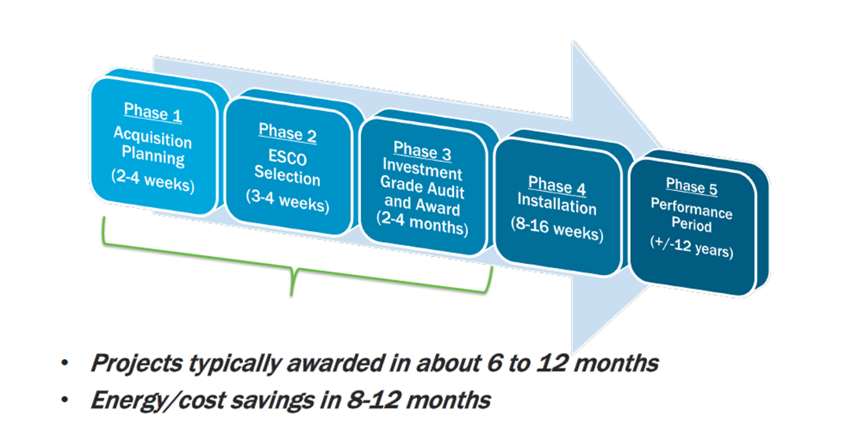
ESPC ENABLE: Process Cycle
Notes:
The simplified process complies with all legislative and statutory requirements
and includes the following steps:
Agency posts Request for Quotation / NOO on GSA eBuy (or GSA Contract
Opportunities, formerly FedBizOpps, for site-specific).
Interested contractors respond with qualifications and price evaluation component.
Agency authorizes contractor to perform Investment Grade Audit (IGA) utilizing
FEMP-provided survey tools.
Contractor presents final proposal that includes an overview of the
proposed project, the audit findings and savings guarantees, M&V
plan, and a price proposal.
Agency and contractor reach agreement on the price and Scope of Work.
Ordering agency issues a task order.
ESCO installs ECMs and, after agency acceptance of the work, the
guarantee/performance period begins.
Annual M&V reporting
Five Phases Of The ESPC ENABLE Process Cycle

Slide 58
GSA and ENABLE
The ESPC ENABLE program offers a streamlined procurement process
using the General Services Administration (GSA) Supply Schedule Special
Identification Number 334512.
Action Plan for Promoting Schedule Contract
Hybrid Sales / Marketing Model for Business Development: FAR 8.4
Capturing Non-Schedule Customer Spend
Forming Partnership between Government and Industry
Notes:
The ESPC ENABLE program offers a streamlined procurement process
using the General Services Administration (GSA) Supply Schedule Special
Identification Number 334512.
Action Plan for Promoting Schedule Contract
Hybrid Sales / Marketing Model for Business Development: FAR 8.4
Selling Points: Benefits to Using Schedules:
Saves EVERYONE time and money
Capturing Non-Schedule Customer Spend:
Generates revenue for your Schedule contract: best value to customer
Forming Partnership between Government and Industry:
Developing innovative solutions to make Schedules more competitive

Slide 59
ENABLE Isn’t For Everyone
ENABLE is currently offered to FEDERAL agencies only.
GSA and the DOE are currently working on a program for cooperative
purchasing eligible agencies.
MUSH – Municipalities, Universities, Schools, and Hospitals.
…More to come!
Notes:
ENABLE is currently offered to FEDERAL agencies only.
GSA and the DOE are currently working on a program for cooperative
purchasing eligible agencies.
MUSH – Municipalities, Universities, Schools, and Hospitals.
MUSH is a concept that falls under the Office of State and Community
Energy Programs (SCEP) to support agencies that are not eligible for the
ENABLE program.
…More to come!

Slide 60
ESPC Campaign and SCEP
Office of State and Community Energy Programs (SCEP)
Engages public sector building owners across the municipal and state
governments, universities and colleges, schools, and hospitals (MUSH)
Notes:
One of the U.S. Department of Energy's (DOE) primary forums for helping
state and local governments implement cost-effective and productive energy
systems for American homes, communities, businesses, and industries is the
Office of State and Community Energy Programs (SCEP).
The Energy Savings Performance Contracting (ESPC) Campaign engages public
sector building owners across the municipal and state governments, universities
and colleges, schools, and hospitals (MUSH) market and other market
stakeholders to expand and enhance the use of ESPC to achieve significant
energy, environmental, and cost savings benefits.

Slide 61
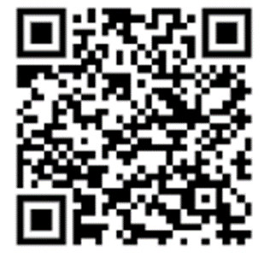
ESPC Campaign and SCEP continued
Sign Up: Obtain a Partner Agreement from DOE or a Campaign Leader in your
state and email the signed form to the ESPC Campaign inbox
Learn More: Fill out the Expression of Interest Form on the ESPC Campaign
website, or email the ESPC Campaign team
www.energy.gov/scep/espc-campaign
ESPCcampaign@hq.doe.gov

Slide 62
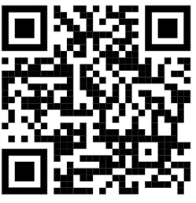
Resources
Energy Savings Performance Contract (ESPC):
http://energy.gov/eere/femp/espc-enable
Selector for ENABLE : https://esco-selector-enable.ornl.gov
Federal Energy Management Program Investment Grade Audit Tool:
https://www.energy.gov/eere/femp/downloads/federal-energy-management-
program-investment-grade-audit-tool

Slide 63
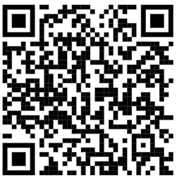
Resources continued
National Energy Conservation and Policy Act (NECPA), 42, U.S.C. 8287
(Established ESPC)
FAR Clauses 52.223-15 ENERGY EFFICIENCY IN ENERGY-CONSUMING
PRODUCTS (MAY 2020)
DOE Qualified List of Energy Service Companies

Slide 64
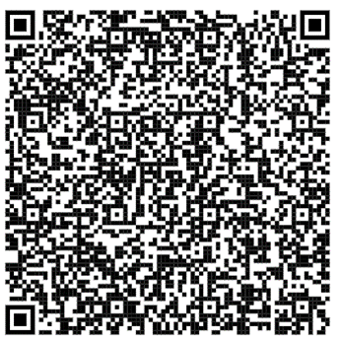
Contact Information - GSA
Michael Brown
Contracting Officer, MAS Contracting Division
MAS General Products Branch, Section 2 (QSCADB)
Office of Contract Operations
General Supplies and Services
Federal Acquisition Service
Email: michael.s.brown@gsa.gov
Phone: (817) 850-8340
Cell: (682) 346-4335
For more information, visit: gsa.gov/FAST

Slide 65
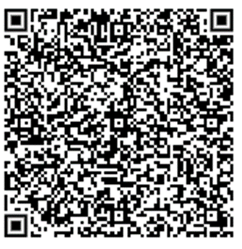
Point of Contact - FEMP
Ira Birnbaum
Program Manager, FEMP/ENABLE
U.S. Department of Energy
Office of Infrastructure
Washington, DC
Mobile: 202-304-4940
Ira.Birnbaum@hq.doe.gov
For more information, visit: gsa.gov/FAST

Slide 66
Point of Contact – FEMP continued
Sam Espinosa
FEMP – Contracting SME
Mobile: 505-463-0942
samespinosa@comcast.net
For more information, visit: gsa.gov/FAST

Slide 67
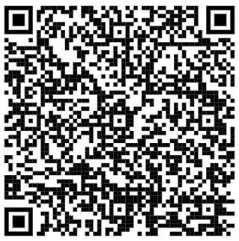
Point of Contact - SCEP
Laura Carpenter
Program Manager, SCEP
U.S. Department of Energy
Office of Energy Efficiency & Renewable Energy
Washington, DC
Phone: 240-449-5059
laura.carpenter@hq.doe.gov
For more information, visit: gsa.gov/FAST

Slide 68
For more information, visit: gsa.gov/FAST

Slide 69
GSA Helping Tribal Governments Meet Contracting and Ordering Needs
May 2024

Slide 70
In this course, you’ll learn about:
GSA’s role in Native American Affairs
GSA Programs available to Tribes
Multiple Award Schedule (MAS)
Travel Programs
Fleet Management and Electrification
Surplus Personal Property
Computers for Learning
GSA eTools
Helpful Links
Notes:
Today my presentation will cover a variety of things, but mostly from the Buyer perspective.

Slide 71
Native American Affairs
GSA supports tribes and tribal organizations through:
Delivering cost savings for products and services
Reducing administrative burden on Tribal Governments
Supporting Native Owned Businesses
Notes:
GSA established….

Slide 72
Authorities for Tribal Policy- Federally Recognized
The following authorities support Tribal use of GSA solutions*:
*Each authority has specific criteria that must be met to support eligibility and actual ordering/use of the GSA solution.
25 U.S.C. Chapter 27 Tribally Controlled Schools Act
23 U.S.C. § 207
Tribal transportation self-governance program
25 U.S.C. chapter 18 Indian Health Care Improvement Act
25 U.S.C. chapter 43 Native American Housing Assistance and Self Determination Act (NAHASDA)
25 U.S.C. chapter 46 Indian Self-Determination and Education Assistance Act (ISDEAA)
Notes:
So how do we do that? There are a couple ways-
In this slide you will see 5 various authorities allowing Tribes and Tribal Organizations, including Alaska Native Corporations eligibility to use our resources. The layout in which these authorities are presented on the screen does not dictate more authority over another, Each one of these Authorities allow Tribes that are Federally Recognized to use GSA– but it's important to note that *Each authority has specific criteria that must be satisfied in order to support eligibility and actual ordering/use of the GSA solution.
For example:
The Indian Self-Determination and Education Assistance Act (ISDEAA) commonly referred to as 638 Authority. Or Public law 638.
The purpose of this act was for tribes to administer their treaty benefits on their own behalf… empowering their self governance and removing the administrative responsibilities off of the federal government… but still holding the federal government responsible financially.
Instead of micromanaging Tribes- the Federal government, allows tribes to manage themselves so they can become independent.
This elevates a Tribe to the same authority as the federal agency providing the funds- for example, like the department of interior.
When a tribal customer comes to GSA with ISDEAA funds, we look at them like they are a federal customer, receiving privileges and authorities just like the rest of the department of interior.

Slide 73
Tribal Ordering Through GSA
25 USC § 5324: Contract or Grant Provisions and Administration
Access to Federal sources of supply [25 usc 450j(a)] | A tribal organization carrying out a contract, grant, or cooperative agreement under this subchapter shall be deemed an executive agency when carrying out such contract, grant, or agreement and the employees of the tribal organization shall be eligible to have access to such sources of supply on the same basis as employees of an executive agency have such access.
Applicability of Federal contracting laws and regulations; waiver of requirements [25 usc 450j(a)] | Contracts and cooperative agreements entered into with tribal organizations pursuant to section 450f of this title shall not be subject to Federal contracting or cooperative agreement laws (including any regulations), except to the extent that such laws expressly apply to Indian tribes.
Contract or Grant Provisions & Administrations - Applicability of Federal contracting laws and regulations; waiver of requirements [25 usc 450j(a)] | Notwithstanding any other provision of law, subject to paragraph (3), the contracts and cooperative agreements entered into with tribal organizations pursuant to section 450f of this title shall not be subject to Federal contracting or cooperative agreement laws (including any regulations), except to the extent that such laws expressly apply to Indian tribes
Contract or Grant Provisions & Administrations - Access to Federal sources of supply [25 usc 450j(k)] | A tribal organization carrying out a contract, grant, or cooperative agreement under this subchapter shall be deemed an executive agency when carrying out such contract, grant, or agreement and the employees of the tribal organization shall be eligible to have access to such sources of supply on the same basis as employees of an executive agency have such access.
Notes:
Now using the 638 Funds example, the money can be delivered to Tribes in 3 different ways:
Through Federal Grants,
Through Contracts
And also through Compacts
The difference between these funds, the grants, contracts and compacts is the level of flexibility they get with those funds- and how they get to use them….
This slide was designed to show you how unique Tribal customers really are…
Most of the time, when folks hear Grants— because GSA doesn’t issue Grants from a FAS perspective… we think… “hmmm… how can that be?”
This slide and authority show how GSA accepts Federal grant funds from Tribes– like ARP funds, CARES ACT Funds, BIL funds, ect. … and how Tribes, under these provisions and authorities can use their funds through GSA>

Slide 74
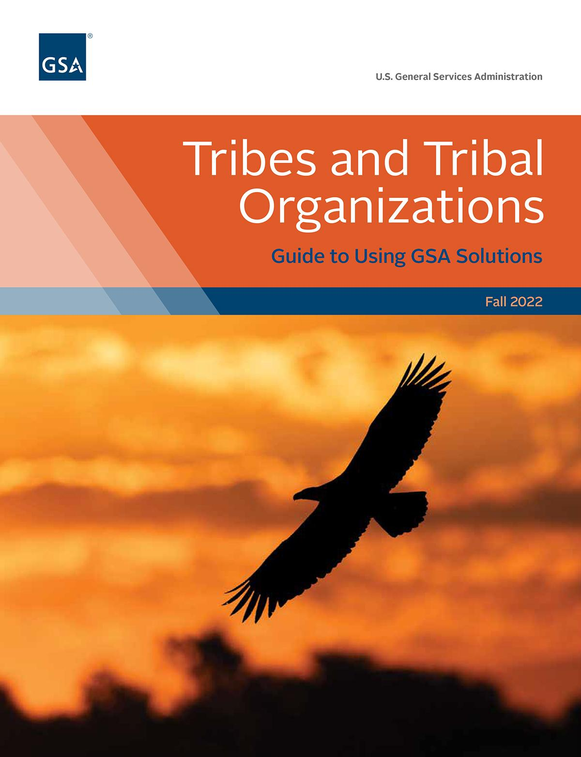
Tribes and Tribal Organization Guide
Provides practical guidance for successful use
Discusses various authorities that support tribes' and tribal organizations’ use of GSA sources and programs
Identifies GSA sources, programs, and resources available and how to use them
Download a copy of the guide at gsa.gov/tribal under “Getting Started”
Notes:
AT THIS TIME, I’D LIKE TO MENTION OUR NEW GUIDE FOR TRIBES & TRIBAL ORGANIZATIONS. A COLLEAGE OF MINE ALONG WITH ANOTHER INDIVIDUAL WITH OUR OFFICE OF GOV’T-WIDE POLICY, REIMAGINED THIS NEW DOCUMENT. YOU CAN GET YOUR COPY AT OUR TRIBAL WEBSITE. THIS GUIDE WAS DEVELOPED FOR YOUR ATTENDANCE TODAY YOU WILL BE RECEIVING 1 CLP AND WILL BE GETTING A CERTIFICATE EMAILED TO YOU. THIS EMAIL WILL ALSO INCLUDE A DIGITAL COPY OF THIS GUIDE AND THE SLIDES FROM THIS SESSION.

Slide 75
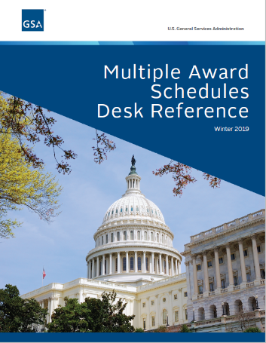
Multiple Award Schedule
BUYERS
SELLERS
Provide access to commercial products and services
Sell products, services, and solutions at pre-negotiated prices
Getting a MAS contract is required in order to sell to government agencies
GSA Advantage: used to purchase products only
eBuy: used to purchase products and services
Five (5) year contract with option to renew 3 five-year options (up to 20-year contract)
Organizations owned by Tribal organizations classify as 8(a)
Roadmap to get a MAS contract
Notes:
LET’S TALK ABOUT THE GSA MULTIPLE AWARD SCHEDULE PROGRAM
GSA does not have services or products sitting on a shelf… however, THERE ARE thousands of COMPANIES WHO OFFER THE PRODUCT OR THE SERVICE … that GSA has contracts with…
so through them, we can offer products and services across the Federal Government, including Federally Recognized Tribes through these INDEFINITE DELIVERY, INDEFINITE QUANTITY CONTRACTs- ALLOWING YOU TO COMPETE THESE COMPANIES TO GET DEEPER DISCOUNTS.
Customers can place an order through one of our contracts available- the contract can last up to 5 years with 3, five year options. So for those requirements that are recurring, this might be a great option for Tribes and Tribal communities.
Over 80% of our contracts are held by small businesses- we have 328 Native Owned Businesses currently on contract but are always looking to expand our vendor pool.

Slide 76
Products Available Through MAS
Appliances and Food Services
Building and Industrial Materials
Facilities Supplies
Food Service Equipment
Furniture
Information Technology Products
Laboratory Animals/Equipment
Law enforcement, Fire, and Security Products
Clinic/Medical Equipment
Office Supplies and Equipment
Protective equipment
Scientific Equipment
Tools and Hardware
Vehicles and Support Equipment
For a complete list of products available through the Multiple Award Schedule, visit GSA eLibrary
Notes:
Tribes use these funds to place orders through GSA Advantage for office supplies and furniture.

Slide 77
Services available through MAS
Advertising and Marketing Services
Disaster Relief
Environmental Services
Facilities Maintenance
Financial and Business Solutions
Human Resources
Information Technology Services
Language Services
Logistics Services
Management and Consulting Services (including Training)
Office Services
Professional Engineering Services
Scientific Services
Security Services
Social Services
Temporary Administrative and Professional Services
Including Grants Management
For a complete list of products available through the Multiple Award Schedule, visit GSA eLibrary
Notes:
HERE ARE EXAMPLES OF SERVICES YOU CAN FIND UNDER A GSA CONTRACT. BUT THIS IS JUST THE TIP OF THE ICEBERG
auditing, grant management,
Or emergency management,
I have also seen tribes purchase facility support services…
For more information about the Multiple Award Schedule and available contracts under which compacts, contracts or grant funds, please see the appendix and or reach out to me at the end of the presentation.

Slide 78
GSA eTools - Market Research Tools
GSA eLibrary
Centralized online resource to identify businesses using GSA and VA acquisition solutions Updated nightly to ensure accuracy
Buy.GSA.gov
Designed to help agency customers navigate the acquisition process (document, IGCE, pricing development) Helps industry bring supplies into the federal marketplace
Market Research as a Service
MRAS delivers market data to federal, state, and local agencies Provides automated RFIs and Sources Sought or develop customized requirements
Notes:
LETS TALK ABOUT OUR ETOOLS.
WE HAVE 3 ONLINE PURCHASING ELECTRONIC TOOLS, OR ETOOLS WE CALL THEM.
GSA ADVANTAGE – THIS IS OUR ONLINE SHOPPING WEBSITE
GSA E-BUY – THIS IS OUR ONLINE REQUEST FOR QUOTES/REQUEST FOR INFORMATION SYSTEM
GSA GLOBAL SUPPLY – REQUISITION BASED WEBSITE
WE ALSO HAVE TOOLS YOU CAN USE TO CONDUCT YOUR MARKET RESEARCH.
GSA E-LIBRARY – WHERE YOU CAN FIND CONTRACT & CONTRACTOR INFORMATION
BUY.GSA.GOV – OUR NEWEST WEBSITE
ACQUISITION GATEWAY
MARKET RESEARCH AS A SERVICE (MRAS)
(NEXT SLIDE)

Slide 79
GSA eTools - Purchasing Tools
GSA Advantage®
The government’s central online shopping superstore Millions of products and services from thousands of federal contractors Discounted prices
GSA eBuy
Acquisition tool used to achieve competition, best pricing, and value All acquisitions are FAR compliant Solicit information, requirements, and/or large dollar items
GSA Global Supply®
Offers requisition-based ordering for over 800,000 products daily All items are compliant with federal regulations Single consolidated bill for transparency and compliance
Notes:
LETS TALK ABOUT OUR ETOOLS.
WE HAVE 3 ONLINE PURCHASING ELECTRONIC TOOLS, OR ETOOLS WE CALL THEM.
GSA ADVANTAGE – THIS IS OUR ONLINE SHOPPING WEBSITE
GSA E-BUY – THIS IS OUR ONLINE REQUEST FOR QUOTES/REQUEST FOR INFORMATION SYSTEM
GSA GLOBAL SUPPLY – REQUISITION BASED WEBSITE
WE ALSO HAVE TOOLS YOU CAN USE TO CONDUCT YOUR MARKET RESEARCH.
GSA E-LIBRARY – WHERE YOU CAN FIND CONTRACT & CONTRACTOR INFORMATION
BUY.GSA.GOV – OUR NEWEST WEBSITE
ACQUISITION GATEWAY
MARKET RESEARCH AS A SERVICE (MRAS)
(NEXT SLIDE)

Slide 80
Travel Programs
The City Pair Program, along with the FedRooms Program provides a best-in-class portal to purchase airfare and hotels for official Government travel.
Fully refundable tickets
No advance purchase required
No change fees or cancelation penalties
Stable prices which enables accurate travel budgeting
No blackout dates
Fares priced on one-way routes, permitting agencies to plan multiple destinations
For more information, visit GSA Travel Programs
Notes:
The preferred form of payment is the government travel charge card or centrally-billed account (FTR 301-72.3), however, the contract carrier also agrees to accept payment through Government Transportation Requests (GTRs). GTRs may be used to pay for international air travel and other travel related expenses. For domestic air travel, GTRs may be used only under special circumstances and for travel related expenses. Special circumstances are defined as acts of God, emergency situations, and when purchasing a domestic ticket in the USA in conjunction with travel that originated overseas.

Slide 81
SmartPay®
The GSA SmartPay® Program provides options for purchases, travel and fleet missions within your communities with no upfront cost to use.
Purchase
Procure, order, or pay for general supplies or services for official government use Purchase card holders must be recommended by their supervisor and complete a mandatory training before a purchase card is issued.
Travel
Mandatory use for authorized travel expenses while on official tribal government travel (unless an exception is provided) Applicants subject to a creditworthiness check and must complete training prior to card issuance
Fleet
Used to purchase fuel, maintenance, and repair tribal government owned/operated motor vehicles Generally assigned to a vehicle or fleet office, rather than an individual
For more information, visit GSA SmartPay
Notes:
On of our other commonly used programs throughout GSA for Tribes and Tribal Organizations, is our SmartPay Program.
Currently the SmartPay program serves more than 560 federal agencies, organizations, and Native American tribes and tribal organizations across the world
Business lines of charge card solutions, including purchase, travel and fleet

Slide 82
Fleet Management
GSA Fleet provides comprehensive fleet management services to the federal government.
Fleet Electrification
Short-Term Rentals
Vehicle Leasing
Vehicle Purchasing
GSA Fleet FAQ for Tribes
For more information, visit GSA Fleet Management
Notes:
READ THE SLIDE

Slide 83
Fleet Electrification
GSA is maximizing use of Electric Vehicles (EVs) through it’s Fleet Electrification initiative
GSA provides:
Assistance with purchasing or leasing alternative fuel vehicles
A source to buy and install charging infrastructure
Notes:
https://www.gsa.gov/system/files/GSA%20Fleet%20FAQs%20for%20Tribes_March%2022%202023.pdf

Slide 84
Short-Term Rentals
GSA offers STRs for both Vehicles and Equipment
WebSTR is used to:
Submit a vehicle or equipment rental request
Track requests
Accept quotes
View rental histories
Vehicle Examples: Busses, Cars, Conventional Tractors, Trucks, and more
Equipment Types: Dump Trucks, Excavators, Forklifts, Generators, Light Towers, and more
GSA Fleet Short-Term Rental (STR) Program supplies vehicles and equipment and manages procurement for all federal agencies.
Notes:
https://www.gsa.gov/system/files/GSA%20Fleet%20FAQs%20for%20Tribes_March%2022%202023.pdf

Slide 85
Vehicle Leasing Program
Lease quality vehicles from GSA to meet your needs
Many federal agencies, international organizations, contractors, and other entities are eligible to lease through GSA Fleet.
Contact local Fleet Representative to learn more
Use GSA Fleet Drive-thru to select and secure leases
Notes:
Right Vehicle, Right Price, and Great Service
You can use GSA Fleet to lease a wide variety of vehicle and fuel types for your agency. GSA Fleet adheres to minimum replacement criteria [PDF - 405 KB] so that you have the best vehicle for your fleet.
Our end-to-end fleet management services include:
Vehicle acquisition and disposal
Maintenance control and accident management
Loss prevention and fuel services
A fleet management system with detailed and accurate data
We serve participating federal agencies with full-service leases at all-inclusive rates.
A Billing Office Activity Address Code (BOAAC) is needed to utilize this program - without a BOAAC, this program cannot be used. A tribes/tribal organizations and tribally controlled schools must first make sure they have a good BOAC. Visit the Vehicle Leasing Program website for more information.

Slide 86
Vehicle Purchasing Program
What is the Vehicle Purchasing Program?
Use GSA Fleet to purchase vehicles to meet your needs
Choose equipment and color options
Compare vehicle models
GSA Fleet completes all contracting actions
Auto Choice
Auto Auctions
Buy auto products at over 24% discount off dealer invoice annually
Used to sell over 30,000 used Fleet vehicles each year to the public
Notes:
AUTO CHOICE – AutoChoice is an online vehicle ordering tool that helps you choose the right vehickes to meet your mission.
Tribes, TDHEs & Tribally Controlled Schools can purchase vehicles once they obtain an Activity Address Code (AAC) and register to set up an account in AutoChoice.
Benefits – configure vehicle, choose optional equip, side by side comparison, calculate total price, order online and check status online.
In AutoChoice you can check your order status, find fuel ratings, choose dealerships, and run reports. Types of vehicles – buses, light trucks, ambulances, AFVs, sedans, med/heavy trucks, wheelchair vans, light trucks w/vocational bodies and wreckers and carriers
Vehicles purchased through AutoChoice are built to order with a delivery time frame based on the vehicle type, equipment, color choices and delivery location.
WHO MAY USE:

Slide 87
Surplus Personal Property Program
Federal agencies dispose of surplus personal property
Includes all types of property except:
Land or other real property
Certain naval vessels;
Records of the federal government
Personal Property Management System used to search for and select personal property
Additional Examples: Agriculture machinery, boats, lab equipment, motor vehicles, tools, and more
For more information, visit ppms.gov
Notes:
READ THE SLIDE
https://docs.google.com/presentation/d/18EZNvTsrSHoaWA9zSiAOw9ud28a4p-xIrvaCljHItX0/edit?usp=sharing

Slide 88
Computers for Learning Program
GSA encourages the reuse of computers for Tribal Schools and nonprofit educational organizations
All educational organizations must:
Be a school or educational non-profit (Pre-K through 12th Grade) in a U.S. territory
Have a NCES Number
Be able to provide proof of eligibility and upload documentation to the portal
Eligible schools can register using the Computers for Learning Registration online portal
For more information, visit computersforlearning.gov

Slide 89
FAS Assisted Acquisition Service
Do you have money and need help spending it?
GSA, provides Assisted Acquisition Services for projects over $5 million.
Assisted acquisition services, or AAS, is a full-spectrum, cradle-to-grave acquisition, project, and financial management service provider.
AAS supports all contract types except *Construction *As defined by FAR 36
For more information, visit aas.gsa.gov

Slide 90
Helpful Links GSA Native American Affairs
Learn more about GSA:
GSA's Native American Affairs landing page
Multiple Award Schedule (MAS)
SmartPay®
Travel Programs
Fleet Management
Personal Property
Global Supply®
Advantage!®
Market Research as a Service (M-RAS)
BUY.GSA.GOV
Notes:
Another thing we have done is broken down additional helpful links from a Buyer and a Seller's perspective on this slide.
The Native American Affairs website was just updated this year and has helpful information there that you can find as well.
As GSA continues to grow support for Tribes and Tribal Businesses, the website will continue to receive updates and enhancements.

Slide 91
Jessi Jagne
FAS Tribal Program Advisor
jessi.jagne@gsa.gov
253-266-5304
For more information, visit: gsa.gov/FAST

Slide 92
Thank You Have a good day!
For more information, visit: gsa.gov/FAST

