Slide 1
FAST 2024
Emerging Innovations and Trends
May 16th

Slide 2
Polls

Slide 3
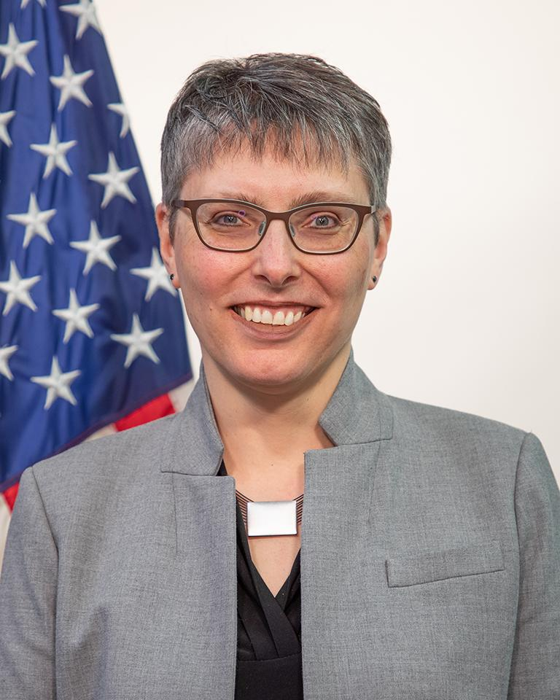
Laura Stanton

Slide 4
Panel:
Zero Trust Architecture
C-SCRM/SCRM
Cybersecurity
Artificial Intelligence

Slide 5
FAST 2024
Emerging Technology
Cyber Attacks! Bad Actors in Action: Are You Prepared?
Terence Rountree
Director, IT Security Division
Office of Information Technology Category (ITC)

Slide 6
Agenda
Impact of Cyber Attacks
GSA Solutions
How GSA’s Solutions Can Help Combat Cyber Attacks
Resources We Provide
Q & A

Slide 7
Impact of Cyber Attacks

Slide 8
Cyber Incident #1: Ivanti
Ivanti discloses critical vulnerabilities
Agencies take action and report identified vulnerabilities to CISA
January 10, 2024
January 22 - March 1, 2024
January 19 - February 9, 2024
June 1, 2024
Cybersecurity and Infrastructure Security Agency issues Emergency Directive 24-01 and Supplemental Directions
CISA provides a status report to the Secretary of Homeland Security, the National Cyber Director, the Director of the Office of Management and Budget, and the Federal Chief Information Security Officer
Notes:
Information Source: https://www.cisa.gov/news-events/directives/ed-24-01-mitigate-ivanti-connect-secure-and-ivanti-policy-secure-vulnerabilities

Slide 9
Cyber Incident #2: The Mr. Cooper Group
Mr. Cooper Group data breach occurs
Mr. Cooper Group shuts down all systems
October 30 - November 1, 2023
October 31, 2023
October 31, 2023
Until November 2025
Mr. Cooper Group detects unauthorized access in its network systems
Mr. Cooper Group provides two years of free credit monitoring and identity protection services to any former or current Mr. Cooper customer
Notes:
Information Source: https://www.securityweek.com/mr-cooper-data-breach-impacts-14-7-million-individuals/

Slide 10
GSA Solutions and How They Can Help Combat Cyber Attacks

Slide 11
GSA Solutions
Multiple Award Schedule (MAS)
Supports proactive and reactive cybersecurity activities
600+ technically evaluated cybersecurity vendors
Majority of vendors are small business
Organized into five subgroups
GSA Advantage!®
Support CISA's CDM Program goals
DHS CISA Approved Products List (APL)
GSA’s Best-in-Class IT Hardware and Software SINs

Slide 12
Solutions for Ivanti: HACS SIN
The HACS SIN offers many cybersecurity services that align with steps outlined in CISA’s Emergency Directive 24-01.

Slide 13
Solutions for Ivanti: CDM Tools
CDM Tools allow agencies to procure cybersecurity products, specifically within the Asset Management capability, to respond to CISA Emergency Directive 24-01 and similar directives.

Slide 14
Solutions for Mr. Cooper Group: HACS SIN
The HACS SIN offers a multitude of cybersecurity services to respond to and recover from this type of attack.

Slide 15
Solutions for Mr. Cooper Group: CDM Tools
CDM Tools within the following capability areas may help protect agencies against critical data breaches:
Identity and Access Management
Network Management
Data Protection Management

Slide 16
GSA Resources

Slide 17
Advanced Persistent Threat (APT) Buyer’s Guide

Slide 18
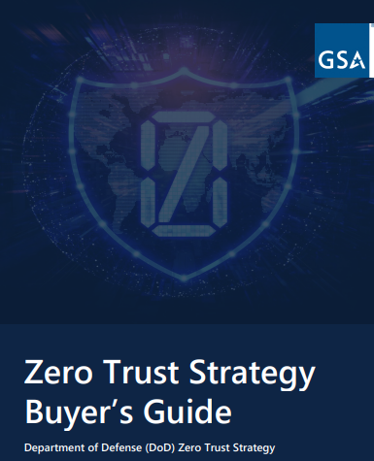
Zero Trust Architecture (ZTA) Buyer’s Guides

Slide 19
Application Security Testing (AST) Buyer’s Guide

Slide 20
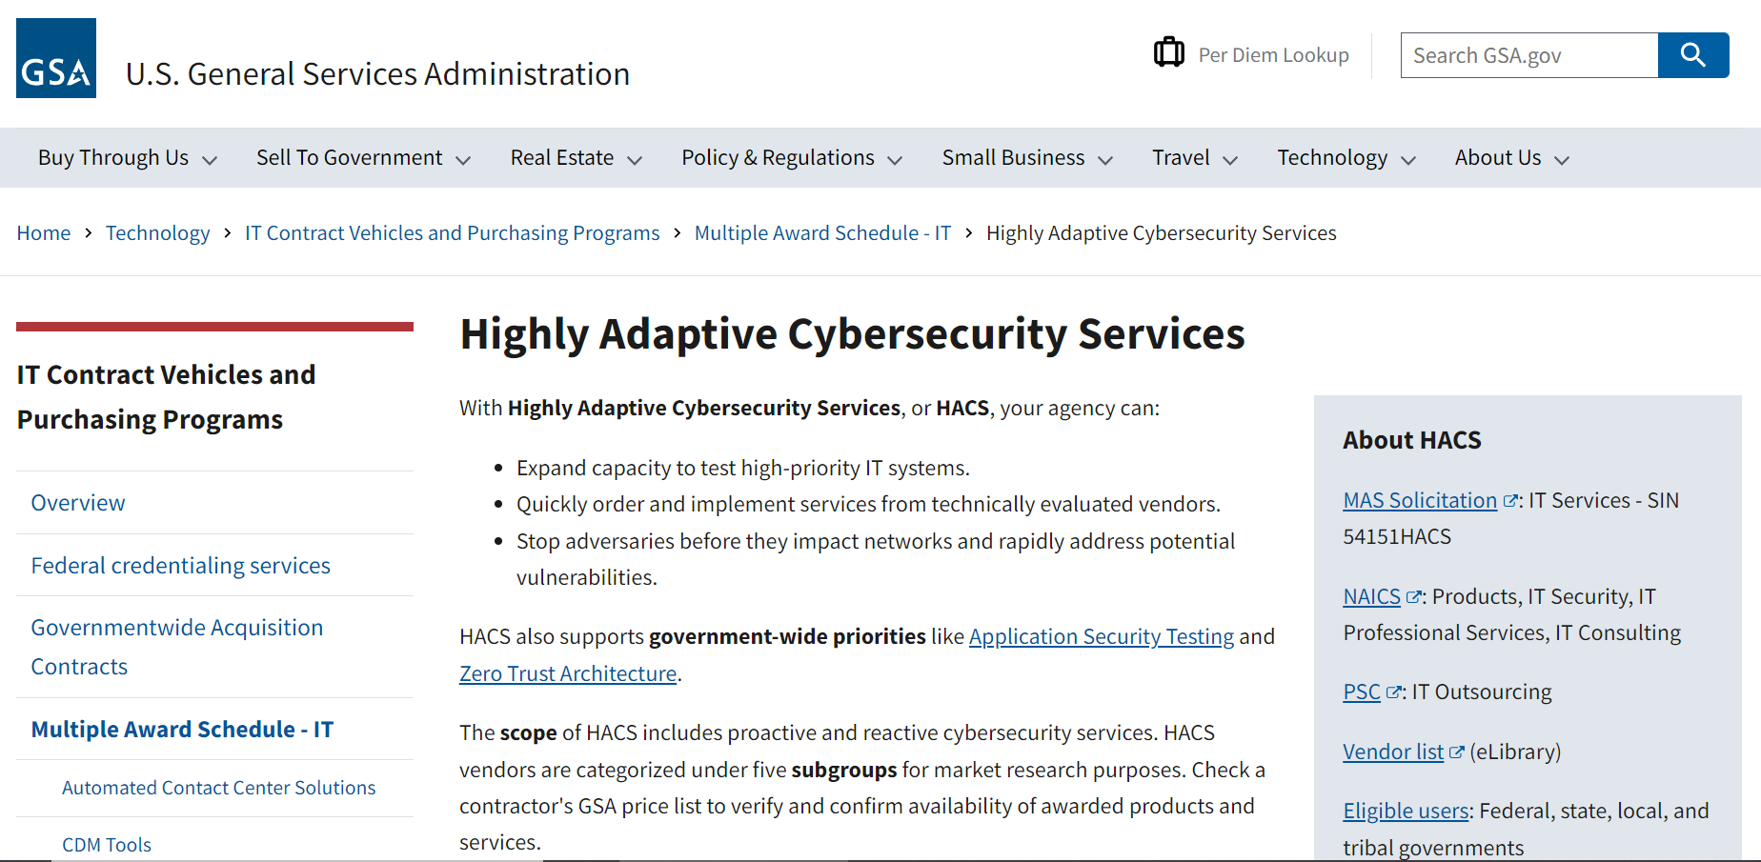
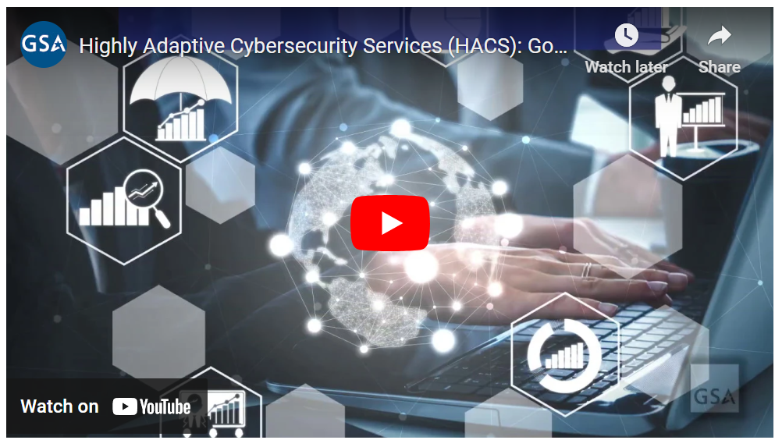
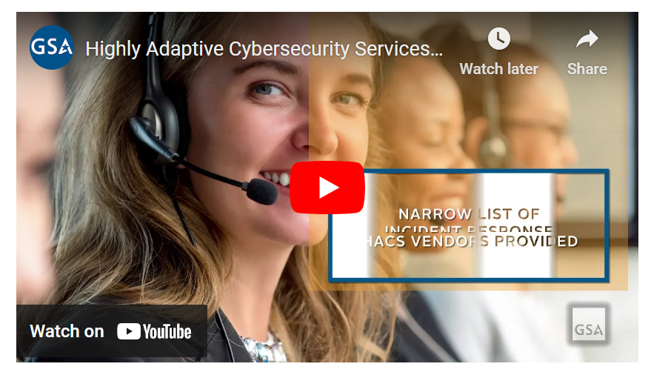
Further Resources
Dedicated Websites
GSA eLibrary
GSA eBuy
GSA eBuy Open
GSAAdvantage!®
GSA eTools
www.gsa.gov/HACS
www.gsa.gov/ZTA
www.gsa.gov/AST
www.gsa.gov/ITSecurity
HACS Ordering Guide
Independent Government Cost Estimate Tool
Request for Quote (RFQ) Template
Statement of Work (SOW) Templates
Informational & Use Case Videos
HACS Toolkit

Slide 21
Q & A

Slide 22
Information Technology Category (ITC)
Our Customer Service Solutions Division (CSSD) stands ready to support agencies with their IT requirements.
For more information, reach out to itcssd@gsa.gov.
For more information, visit: gsa.gov/FAST

Slide 23
FAST 2024
VA Federal Supply Schedules (FSS) for Medical and Healthcare
WWW.FSS.VA.GOV

Slide 24
Agenda
FSS Program - Category Management
Tier 2 Spend Under Management (SUM)
Nine FSS Schedules
New Pricing Flexibilities for Staffing Services
Improved Market Research Tools
eTools
Contact Information
Q&A
WWW.FSS.VA.GOV

Slide 25
M-19-13 Category Management
Agencies shall undertake five key category management actions to better position themselves to bring spending under management and leverage common contract solutions and practices:
1. Annually establish plans to reduce unaligned spend and increase the use of BIC solutions for common goods and services, consistent with small business and other statutory socio-economic responsibilities;
2. Develop effective vendor management strategies to improve communications with contractors, especially those that support mission-critical functions;
3. Implement demand management strategies to eliminate inefficient purchasing and consumption behaviors;
4. Share data across the Federal Government to differentiate quality and value of products and services in making buying decisions; and
5. Train and develop the workforce in category management principles and practices.
M-19-13: Category Management: Making Smarter Use of Common Contract Solutions and Practices, issued Mar 20, 2019.
FSS qualifies as Tier 2 Spend Under Management (SUM)

Slide 26
Federal Supply Schedules Overview
VA FSS began in 1960. In February 2022, General Services Administration (GSA) assigned VA Secretary to manage the Medical and Healthcare Multiple Award Schedule Program for the federal government
Supports 370 contracting offices and approximately 8,000+ acquisition personnel
$18.9B in acquisition support procured using FSS contracts in FY23
$12.4B VA and $6.5B Other Government Agencies (OGA)
41% increase since 2017
Approximately 1,700 contracts, 800,000 items and services at fair and reasonable prices searchable on the web
Multiple Award Schedule (MAS) – all offers provided the same opportunity for a contract
Commercial Medical & Healthcare Products & Services using Open & Continuous Solicitations
Multi-Year Contracts
5-year base + 5-year option for most schedules
Schedule 65 I B (Pharmaceuticals) has no option period
Schedule 66 III (Cost per Test) has 5-year base + 3, 5-year options
Notes:
FSS was established in 1960 by GSA.
Our schedules are for commercial products and services;
we have approximately 1 million commercial products & services falling under 9 Schedules on over 1600 contracts with total sales in FY22 of $18 billion (VA = $11b, OGA = $6bil)

Slide 27
Program Considerations
Trade Agreements Act (TAA) – Limits FSS to contracting only for U.S.-made or TAA designated country end products
Vets First Program – FSS online search tool (CCST) helps identify Veteran Owned Small Businesses
217 FSS contracts with Vet Businesses (VOSB & SDVOSB), making up 13% of all FSS contractors
Schedules meet Vets First Rule of Two when multiple FSS contractors sell same/like products
Procurement Action Lead-Time (PALT) – subject to workload and staffing levels
Contract Award – 180 days (non-Services) and for 240 days (Services)
Contract Modifications – 60 days
Top 3 Schedules in FY23 (Sales)
65IB – Pharmaceuticals - $15.7B
65IIA – Medical Surgical Equipment and Supplies - $1.5B
621I – Allied and Professional Temporary Healthcare Staffing - $636.6M
Ordering Eligibility
Open to all Federal agencies and to State & Local Gov’t under Stafford Act for disaster preparedness, national emergency, and disaster response

Slide 28
Authority to use FSS
Schedule are open to:
Federal agencies (military and civilian),
Mixed ownership government corporations as identified in 31 U.S.C. § 9101,
District of Columbia,
Qualified nonprofit agencies for the blind or other severely handicapped individuals
State and local governments – Under GSA Disaster Purchasing Program - 'State or local government' includes any State, local, regional, or tribal government, or any instrumentality thereof
First Responders, City Govt., County Govt.
County Boards of Health
Local elementary, middle, and high schools operated by public school boards
Public colleges, community colleges, technical colleges
Public universities that provide at least a two-year program that offers a degree or offers credit toward such a degree.
Contractors authorized under FAR 51 and many more.
All eligible entities are outlined in GSA Order 4800.2I.
Information on the GSA Disaster Program: https://www.gsa.gov/buying-selling/purchasing-programs/gsa-schedules/schedule-buyers/state-and-local-governments/state-and-local-disaster-purchasing
Order Language: State and Local Government buyers must include the following language in all orders to FSS contractors:
“This order is placed under GSA/VA Schedule Number "insert number here" under the authority of the GSA Disaster Purchasing Program. The products and services purchased will be used in preparation or response to disasters or recovery from major disaster declared by the President, or recovery from terrorism or nuclear, biological, chemical, or radiological attack."
Term “State or Local Govt” Excludes contractors or grantees of state or local governments.

Slide 29
FSS Overview - Schedules
We
How we service healthcare needs

Slide 30
Pricing Flexibilities for Staffing
As a result of COVID based price fluctuations, we have incorporated pricing flexibilities into the schedule. This allows the ordering level CO, with proper justification, to award price adjustments in excess of the not-to-exceed (ceiling) price awarded at the base FSS contract level

Slide 31
Market Research
Contract Catalog Search Tool
FSS Contract Number | Payment/ Delivery Information
Contractor Name | Available Discounts
Contract Effective Dates | Warranty Information
Contractor Points of Contact | Product SIN, Item #, Description, & Pricing
Contracting Officer Information | Socioeconomic Categories
CCST Section | Includes (as of May 2023)
Medical/Surgical Catalog | Over 800,000 Med/Surg Line Items
Pharmaceutical Catalog | Over 15,000 Pharmaceutical Line Items
Socioeconomic Search Area | 1,200+ Small Businesses; 150+ SDVOSBs, 210+ VOSBs
Configured Item Catalog Area | <20 vendors with custom/configured catalogs Access CCST here: www.va.gov/nac

Slide 32
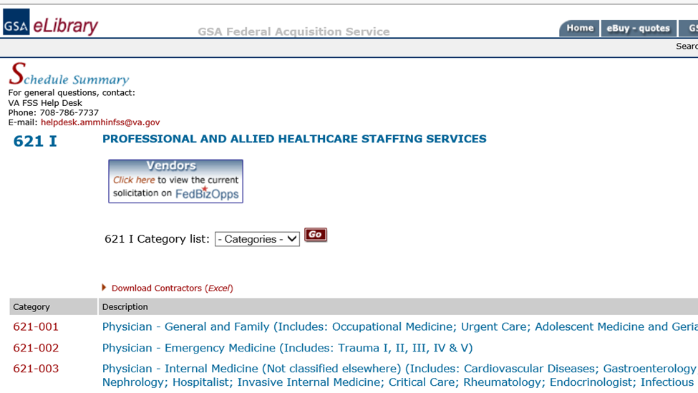
Market Research
Clicking on Schedule name “621I” will list all SINs under Schedule 621I. Below is a sample of 57 categories and subcategories.

Slide 33
Tools
eTools
NAC Contract Catalog Search Tool (CCST)
Comprehensive online listing of the National Acquisition Center’s (NAC) healthcare-related contract vehicles
GSA eLibrary
Research database to identify sources (“yellow pages” for FSS contractors)
Links directly to contractor products/pricing on GSA Advantage
GSA Advantage
Product superstore (Amazon.com of gov’t shopping) & market research tool
Can save items to shopping cart to purchase directly from FSS contractors, to forward your cart to someone else or to check out to GSA eBuy
GSA eBuy
Online RFQ system: post/compete requirement, obtain quotes, issue orders
Can compete requirements amongst FSS contractors, including set-asides
Notes:
SIN = Special Item Numbers: Each of our schedules contains SINs which are broad product categories. Think of SINs as chapters in a product catalog or category filters on a shopping site. Some examples of SIN categories on our patient mobility schedule include SINs for manual wheelchairs, powered wheelchairs, motorized scooters, crutches, canes, etc.
GSA eLibrary:
Contains schedule listings, including SIN descriptions and FSS contractors information
Contractor info includes points of contact, terms and conditions, and direct link to products/pricing on GSA Advantage
GSA Advantage: Robust search engine and filters, including business types
GSA eBuy:

Slide 34
Steps to Obtaining an FSS Contract
Download the schedule solicitation and complete all required documents, including registering at SAM.gov .
Submit your proposal via e-mail to FSSOffersandExtensions@va.gov.
Be sure to visit our Electronic Acceptance of FSS Offers web page for complete details on submission format and logistics.
Be timely and complete in your response to requests for information and clarification from your assigned Contract Specialist.
Be ready to negotiate your best offer for a successful FSS contract award.
5) VA’s Federal Supply Schedule can be found at: www.fss.va.gov

Slide 35
Useful Links
FSS Home Page: http://www.fss.va.gov/
VA Schedule Programs: https://www.va.gov/opal/nac/fss/schedules.asp
Prospective Contractors: https://www.va.gov/opal/nac/fss/prospective.asp
Getting on Schedule: https://www.va.gov/opal/nac/fss/gettingOnSchedule.asp
Offer Submission: https://www.va.gov/opal/nac/fss/eOffers.asp
Contractor Responsibilities: https://www.va.gov/opal/nac/fss/responsibilities.asp
Contracting Opportunities - SAM.gov: https://sam.gov/
VA Pathfinder: www.pathfinder.va.gov

Slide 36
FSS Contacts
Director - Daniel.shearer2@va.gov
Chief, Contracting Support Division – Diana.Lawal@va.gov, Acting
Chief, Program Management and Resource Support – Diana.Lawal@va.gov, Acting
Chief Medical Surgical Team A –James.Booth@va.gov
Lead Contract Specialist –Heath.Krida@va.gov
Chief, Medical Surgical Team B – Deborah.Zuckswerth@va.gov
Lead Contract Specialist – Joshua.Ladwig@va.gov
Chief, Medical Surgical Team C – Isabel.Uribe@va.gov
Lead Contract Specialist – (Vacant)
Chief, Pharmaceutical/Dental Team A – Trevor.Martin@va.gov
Lead Contract Specialist – Ursula.Douglas2@va.gov
Chief, Pharmaceutical/Dental Team B – Diana.Lawal@va.gov
Lead Contract Specialist – (vacant)
Chief, Services Team – William.Satterfield@va.gov
Lead Contract Specialist – Aretha.Spurlock@va.gov
HelpDesk – fss.help@va.gov or (708) 786-7737

Slide 37
VA FSS Points of Contact
Director - Daniel.shearer2@va.gov
Management Support – Karen.De Luna@va.gov
Management Support – Sebastian.Elapumkal@va.gov
Chief, Contracting Support – Diana.Lawal@va.gov, Acting
Chief, Program Management and Resource Support – (Vacant)
Chief Medical Surgical Team A –James.Booth@va.gov
Lead Contract Specialist –Heath.Krida@va.gov
Chief, Medical Surgical Team B – Deborah.Zuckswerth@va.gov
Lead Contract Specialist – Joshua.Ladwig@va.gov
Chief, Medical Surgical Team C – Isabel.Uribe@va.gov
Lead Contract Specialist – (Vacant)
Chief, Pharmaceutical/Dental Team A – Trevor.Martin@va.gov
Lead Contract Specialist – Ursula.Douglas2@va.gov
Chief, Pharmaceutical/Dental Team B – Diana.Lawal@va.gov
Lead Contract Specialist – (Vacant)
Chief, Services Team – William.Satterfield@va.gov
Lead Contract Specialist – Aretha.Spurlock@va.gov
HelpDesk – fss.help@va.gov or (708) 786-7737

Slide 38
Break

Slide 39
FAST 2024
FAS Pricing Process Improvement

Slide 40
FAS Pricing Process Improvement
Erville Koehler
Assistant Commissioner, General Supplies and Services

Slide 41
FAS Pricing Process Improvement
Brandy Leath
Senior Contracting Officer, General Supplies and Services

Slide 42
Agenda
Evaluation and Substantiation of Pricing Algorithms
Pricing Model Example
Pricing Model Impact on Small & Disadvantaged Businesses
Demand Data Concentration

Slide 43
Pricing Algorithm Comparison
Minimizing pricing risk while maximizing the amount of prices that can be algorithmically validated
Option # | Option0: | Option1: | Option2: | Option3a: | Option3b: | Option3c: | Option3d: | Option3e: | PAT1: | PAT2:
Max Diff* | 2.29 | 2.29 | 0.60 | 0.60 | 0.60 | 0.60 | 0.60 | 0.60 | 0.60 | 0.60
Avg Diff* | 0.10 | 0.12 | 0.06 | 0.31 | 0.31 | 0.35 | 0.31 | 0.35 | 0.21 | 0.03
Median* | 0.11 | 0.13 | 0.08 | 0.33 | 0.33 | 0.38 | 0.33 | 0.36 | 0.20 | 0.03
75th % Diff* | 0.21 | 0.23 | 0.15 | 0.45 | 0.45 | 0.49 | 0.45 | 0.47 | 0.32 | 0.12
95th % Diff* | 0.36 | 0.36 | 0.28 | 0.53 | 0.53 | 0.55 | 0.53 | 0.54 | 0.50 | 0.26
Acceptance % | 64.1% | 83.0% | 34.2% | 85.9% | 85.9% | 82.3% | 86.1% | 87.7% | 70.3% | 50.6%
Notes:
Talking Points: Pricing Algorithm Comparison
You can trust GSA pricing because we use a rigorously tested model that includes prices paid, catalog data, and factors for inflation and a range of service levels.
Introduction to Model Improvement:
Introduce the new pricing model, emphasizing its improvements over the current lowest price model.
Highlight the expansion of acceptable pricing ranges and the increased inclusion of products within the calculated Market Threshold.
Calculation of Differentials:
Describe the process of calculating differentials for each sampled item.
Explain that the differential measures the percent change between the proposed price and the central tendency value of that item.
Measurement Metrics:
Highlight the metrics used to measure differentials, including maximum, average, median, 75th percentile, and 95th percentile.
Emphasize how these metrics provide a comprehensive understanding of the pricing risk allowed by the new model across different scenarios
Pricing Algorithm Options:
Discuss how the various options offers a significant improvement in minimizing pricing risk compared to other options.
Highlight its high acceptance rate as an indicator of its effectiveness.
Emphasize the balance between risk reduction and algorithmic validation with Option 3c.
Focus on the high acceptance rate (87.7%) coupled with relatively low pricing differentials across various percentiles.
Highlight its potential for maximizing algorithmically validated prices while ensuring market acceptance.

Slide 44
Pricing Algorithm Comparison Methodology
For every one of the 181K sampled items, for each model tested, compute the model’s “Differential” to estimate the price risk allowed by the model for that particular item
Statistics like the “95th % of Diff” of .54 for Option 3e tell us:
Acceptance % Tells us what proportion of the 181K sample offers would have been accepted by each model
Model Threshold Price
$150
Estimate of “Centricity”
$100.00
Differential
.5
“For Option 3e, 95% of the thresholds created for the 181K examples were at or below 54 percent above the estimated centricity of the horizontal data”
44
Notes:
Talking Points: Pricing Algorithm Comparison Methodology
Focus on Central Tendency:
Explain the concept of central tendency and its importance in the new pricing model.
The central tendency is a statistic that represents the middle value for each item's population. For each item, the average of the MAS TDR median price, catalog median price, transaction median price, and commercial catalog minimum price is taken to determine the central tendency value.
Discuss how the central tendency statistic represents the middle value for each item's population, providing a more accurate baseline for pricing decisions.
The differential was measured to calculate the percent change between the proposed price and the central tendency of that item. The maximum, average, median, 75th percentile, and 95th percentile differentials were measured for each model.
Performance of Option 3e:
Focus on the performance of Option 3e, showcasing its effectiveness in managing pricing risk.
Highlight the statistic that 95% of the thresholds created for the 181K examples were at or below 54 percent above the estimated centricity of the data, indicating a high level of accuracy and reliability.
Impact on Market Coverage:
Discuss the broader implications of the new model's ability to bring significantly more products within its calculated Market Threshold.
Explain how this expanded coverage can lead to increased market penetration and revenue growth opportunities.

Slide 45
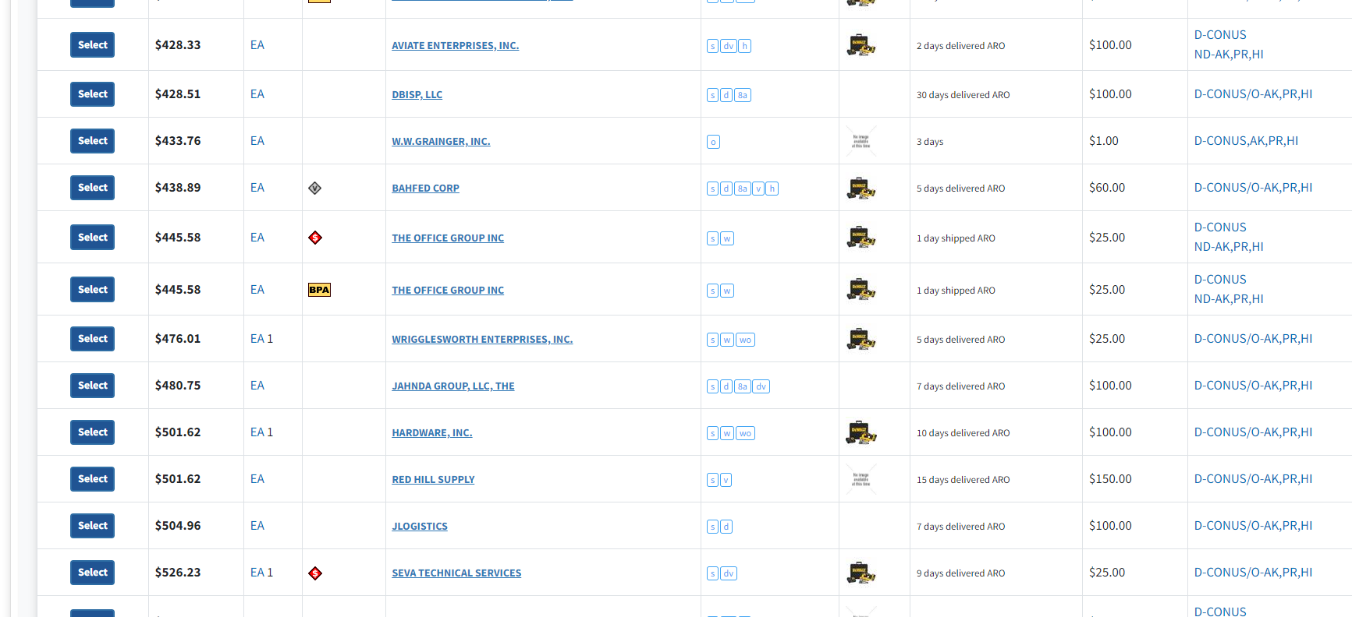
Option 3d Model Example: Dewalt DCS334P1
Contractor X
$301.04 to $677.20 for this item on Advantage. With 3 day delivery and a one dollar minimum order amount, Contractor X’s offer meets CO determination of “competitive”
Notes:
Talking Points: Option 3d Model Example
Introduction to Slide:
Let us discuss how the new model is applied to assist in making a fair and reasonable determination on an item proposed at $433.76, considering competitive pricing ranging from $301.04 to $677.20 for the same item.
Understanding the Offer:
This item, offered by Contractor X, is priced at $433.76. However, competitive pricing for the same item ranges from $301.04 to $677.20.
Consideration of Additional Factors:
In making a fair and reasonable determination, it's essential to consider factors such as delivery time and minimum order amount. In this case, Contractor X offers a 3-day delivery and a one-dollar minimum order amount.
Evaluation of Competitive Offer:
Despite the proposed price of $433.76, Contractor X's offer is deemed competitive due to its ability to meet delivery requirements and the minimum order amount.
Comparison with Competitive Range:
While the proposed price falls within the competitive pricing range, it's crucial to evaluate it in the context of additional factors and market dynamics.
Transition:
Let's talk about how the new algorithm is applied to Contractor X’s offer and how the offer price is determined competitive (next slide)

Slide 46
Option 3d Model Example
Dewalt DCS334P1 - Offer Price $433.76
Average of
TDR Median Price $368.36
Catalog Average Price + CPI $466.05
Catalog Minimum Price + CPI $328.14
Target Price
$387.52
4P Price-based allowance of
120%
Threshold Price
$465.02
Results
Price deemed acceptable based on model applied
Previous 4P Market Threshold was $383.41
Contractor X’s Mod XXX offered reduced prices for 94 items previously rejected for price alone. 24 of these items are now determined fair and reasonable and accepted as offered.
This formula was the winner/result of the testing conducted on Slide 4. The new algorithm (Option3e) is almost identical
Notes:
Talking Points: Formula Transparency
Introduction to Slide:
One of the core principles of the pricing model is transparency. We believe in sharing the pricing formula so that everyone understands the methodology behind it, fostering trust in the model. Today, we'll explore the process of making a fair and reasonable determination on an item proposed at $433.76, considering a competitive pricing range of $301.04 to $677.20 for the same item.
Understanding Competitive Context:
As I previously discussed Contractor X's offer of $433.76 for a Dewalt DCS334P1 was found to be within a competitive pricing range that spans from $301.04 to $677.20.
Evaluation of Additional Factors:
In addition to price, we also consider factors such as delivery time and minimum order amount. Contractor X's offer includes a 3-day delivery and a one-dollar minimum order amount.
Confirmation of Competitive Offer:
Based on the competitive pricing range and additional factors like delivery speed and minimum order amount, Contractor X's offer is deemed competitive.
Differentiating from Lowest Price Technically Acceptable (LPRC):
It's important to note that our pricing formula differs from LPRC. While LPRC focuses solely on the lowest price, our formula considers a broader range of factors to ensure fairness and reasonableness.
Balancing Cost and Value:
In determining fairness and reasonableness, we aim to strike a balance between cost and value. Contractor X's offer may fall within the middle of the competitive pricing range, but its additional features add value for the customer.
Transparency in Determination:
Our goal is to ensure transparency in the determination process, allowing stakeholders to understand how pricing decisions are made and why certain offers are deemed competitive.
Tighter Control for High-Demand Items
Discuss the model’s approach to high-demand items: Option 3d applies incrementally tighter controls for items with significant annual demand values exceeding $100K and $1M. This ensures that pricing decisions are aligned with market demand.
Example of Pricing Adjustment
Provide an example to illustrate the model’s impact: For instance, consider an item priced at $301.04 initially. Under the 3d model, the price adjusts to $677.20 on Advantage. Despite the increase, Contractor X’s offer, with its competitive features, meets the CO determination of ‘competitive’.
R6 Pilot Effort Results
Highlight the results of the R6 Pilot Effort: During the R6 Pilot Effort, Contractor X’s Mod XXX offered reduced prices for 94 items previously rejected solely for price reasons. Remarkably, 24 of these items are now determined Fair and Reasonable and accepted as offered, showcasing the efficacy of the new model.

Slide 47
Model Impact on Small & Disadvantaged Businesses
Socioeconomic Subset | 4P Approvals | New Model Approvals | Added Approvals
SMALL BUSINESS | 6,978,352 | 10,343,429 | 3,365,077
WOMENOWNED | 2,501,817 | 4,417,946 | 1,916,129
VETEROWNED | 1,304,268 | 1,891,409 | 587,141
SELFCERTSDB | 641,318 | 1,155,212 | 513,894
SBACERTHUBZ | 645,640 | 1,123,842 | 478,202
SERVDISABVET | 856,787 | 1,285,002 | 428,215
MINORITYOWNED | 640,504 | 943,070 | 302,566
HISPANICOWNED | 282,112 | 571,642 | 289,530
EMERGRELIEF | 74,733 | 171,943 | 97,210
BLACKAMEROWN | 310,213 | 403,211 | 92,998
SBA8ACERT | 103,766 | 155,622 | 51,856
SBACERTIF | 212,171 | 245,264 | 33,093
ASIANAMEROWN | 19,724 | 38,684 | 18,960
LARGEBUSINESS | 1,405,662 | 1,729,811 | 324,149
Small Business has been the primary beneficiary of the new pricing model in Market Threshold Approvals!
Notes:
Talking Points: Pricing Model Impact on Small & Disadvantaged Business
Slide Introduction:
The implementation of the new pricing model has led to significant increases in market threshold approvals across various socioeconomic subsets.
The data reflects the tangible benefits our model has brought to businesses of all sizes and backgrounds.
There are several benefits of the new pricing model for businesses, such as improved pricing accuracy, reduced pricing risk, and enhanced market competitiveness.
These benefits can ultimately drive bottom-line results and support long-term business success.
Explore the Impact on Small Businesses:
Small businesses have been the primary beneficiary of the new pricing model, with approvals increasing by 3,365,077 for 4P subset.
Empowering Women-Owned Businesses:
Women-owned businesses have also seen substantial growth in approvals, with an increase of 1,916,129 under the new model.
Supporting Veteran-Owned Enterprises:
Veteran-owned enterprises have experienced a notable rise in approvals, with an increase of 587,141 under the new pricing model.
Expanding Opportunities for Various Socioeconomic Subsets:
The new pricing model has opened doors for various subsets, including businesses such as Self Certified Small Disadvantaged, SBA Certified HubZone, and Service Disabled Veterans, with approvals increasing by 513,894, 478,202, and 428,215 respectively.
Promoting Diversity and Inclusion:
Approvals for minority-owned and Hispanic-owned businesses have surged by 302,566 and 289,530 respectively, demonstrating the model's commitment to diversity and inclusion.
Addressing Emergencies and Relief Efforts:
The new pricing model has played a crucial role in supporting emergency relief efforts, with approvals for EMERGRELIEF subset increasing by 97,210.
Ensuring Fair Opportunities:
Approval increases for subsets such as Black American Owned, SBA 8A Certified, and SBA Certified businesses (SBACERTIF) underscore the model's dedication to ensuring fair opportunities for all businesses.

Slide 48
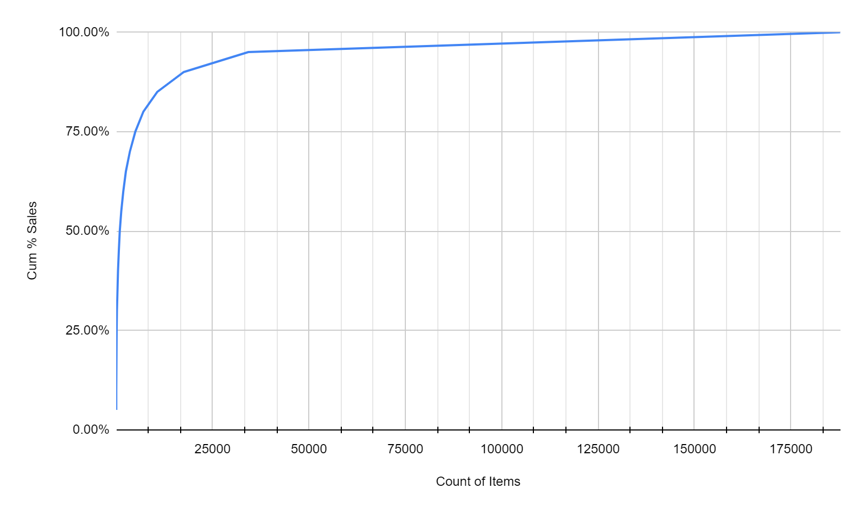
Demand Data Concentration
Count | % Items | Cum % Sales
8 | 0.0% | 5.00%
21 | 0.0% | 10.00%
50 | 0.0% | 15.00%
88 | 0.0% | 20.00%
139 | 0.1% | 25.00%
211 | 0.1% | 30.00%
325 | 0.2% | 35.00%
478 | 0.3% | 40.00%
680 | 0.4% | 45.00%
951 | 0.5% | 50.00%
1,331 | 0.7% | 55.00%
1,846 | 1.0% | 60.00%
2,532 | 1.3% | 65.00%
3,555 | 1.9% | 70.00%
4,984 | 2.7% | 75.00%
7,053 | 3.8% | 80.00%
10,667 | 5.7% | 85.00%
17,540 | 9.3% | 90.00%
34,272 | 18.2% | 95.00%
187,800 | 100.0% | 100.00%
Over half of the ~Billion Dollars in Annual sales in the data is represented by approximately 951 items across GSS and ITC
This information is published to VSC and Interact bi-monthly.
Check it out at this link: https://vsc.gsa.gov/vsc/app-content-viewer/section/150
Scroll down to Demand Data
Notes:
Talking Points: Based on 3-2024 Demand Data Publication
Importance of Sales Data Analysis:
Continually analyzing sales data and customer behavior is essential for optimizing algorithms and pricing strategies.
By understanding purchasing patterns and trends, we can make informed decisions to improve the algorithm's effectiveness and maximize profitability.
It’s important to continually analyze sales data and customer behavior to optimize the algorithm.
Significance of Sales Data Table:
Let's take a closer look at the sales data table to understand its significance.
This table illustrates the distribution of sales across different items, providing valuable insights into market dynamics and performance by showing the percentage of items and cumulative sales represented.
Distribution of Sales:
It's evident from the table that sales are not evenly distributed across all items.
A significant portion of sales, up to 90%, is concentrated within a relatively small percentage of items.
This concentration highlights the importance of identifying and prioritizing these high-performing items for optimization and strategic focus.
Identifying High-Performing Items:
Despite having a large number of items, a substantial portion of sales, up to 90%, is derived from just 9.3% of the items.
This underscores the need to identify and prioritize these high-performing items to maximize revenue and profitability.
By focusing our efforts on optimizing pricing and strategies for these items, we can drive greater overall success and market competitiveness.
Transition:
GSA has an initiative to publish all items with known sales data to the GSA Vendor Support Center, enhancing transparency and accessibility for stakeholders by providing access to valuable demand and pricing data
Stakeholders can access this valuable information directly on the VSC website by simply navigating to the VSC website posted here and scroll down until you reach the section titled Demand Data.

Slide 49
Demand Data Concentration
Publishing all items with known sales to GSA Vendor Support Center website
Demand Group identifies sales potential and Average Transaction price provides a rough indication of “competitive” pricing
Notes:
Talking Points: Publishing top selling items
Introduction
Now that we’ve discussed GSA’s initiative to publish all items with known sales data to the VSC website, let’s explore how this data can be used.
Understanding the Context:
The data here reflects the Demand Group’s analysis, which identifies sales potential based on historical trends, market conditions, and other relevant factors. It serves as a cornerstone for effective decision-making and market analysis, empowering stakeholders to stay competitive and responsive to market demands.
Having access to demand data allows contractors, government agencies, and end-users to gauge the popularity and market demand for specific items, enabling more strategic procurement and pricing strategies.
Furthermore, by understanding demand patterns, stakeholders can better anticipate market trends, optimize inventory levels, and adjust procurement strategies to meet evolving customer needs.
Managing High-Demand Items (Published on VSC):
For high-demand items, the model adjusts pricing tolerances to ensure competitiveness while maximizing profitability.
Emphasizes the importance of maintaining competitive pricing for these items to capitalize on their popularity and drive revenue.
Managing Variability for Low-Demand Items (Published on VSC):
For low-demand items, the model may allow for greater pricing flexibility to stimulate demand and clear inventory.
Highlights the importance of implementing dynamic pricing strategies to optimize revenue for these items.

Slide 50
Questions?
Brandy Leath
brandy.leath@gsa.gov
For more information, visit: gsa.gov/FAST

Slide 51
FAST 2024:
Charging Ahead
Turbocharging Your Expertise in Infrastructure

Slide 52
Joseph Mirisola (he/him)
Program Analyst (Zero-Emission Vehicle Team)
GSA Fleet
Office of Travel, Transportation, and Logistics
joe.mirisola@gsa.gov
www.gsa.gov/ElectrifyTheFleet

Slide 53
U.S Vehicle Electrification Initiative
FAST Act of 2015 designated AFV corridors
E.O. 14037 (50% of auto sales ZEVs by 2030)
Infrastructure Bill - $7.5B for ZEV Charging across U.S. (NEVI Program)
Inflation Reduction Act (EV tax credits and encouragement of domestic production)
Advancing EV Market
E.O. 14057 (100% of light-duty vehicle acquisitions as ZEV by 2027; 100% of all acquisitions by 2035)
Federal Fleet electrifying today
GSA providing EVSE acquisition pathways to support ZEVs
Agencies are piloting and building out electric vehicle infrastructure at Federally-occupied Facilities.
Leading by Example
Notes:
The U>S. government is advancing the EV market from multiple angles.
The grid is getting cleaner. Over 80% of new capacity added to the grid in 2021 came from renewable sources. Wind and solar prices continue to decline and are now the lowest cost source of new electricity generation in the US - cheaper even than many existing coal and gas plants. These cost declines are not showing any signs of ending - in 2021 alone wind costs decreased by 13% and solar costs by 7%. EIA expects renewables to account for 22% of U.S. electricity generation in 2022
Section 1413 of the FAST Act signed into law on December 4, 2015, required the Secretary to designate national EV charging, hydrogen, propane, and natural gas fueling corridors. the corridor designations had to identify near-and long-term need for, and location of, EV charging infrastructure looking to place them in strategic locations along major national highways to improve mobility of passenger and commercial vehicles that employ electric, among other fuel types. Under the infrastructure bill, even more AFV Corridors were designated, this time with $5B inffunding directed to designated EV Alternative Fuel Corridors which will be handled by the states and serve as the backbone for the nations electric vehicle charging network. What does this mean, more places t charge! Thought that bill there will also be 2.5B Discretionary Grant Program for Charging and Fueling Infrastructure, which will ensure charger deployment will go towards providing EV charging access in rural, underserved and overburdened communities.
President Biden’s Bipartisan Infrastructure Law invests $7.5 billion in EV charging, $10 billion in clean transportation, and over $7 billion in EV battery components, critical minerals, and materials. These programs complement the Inflation Reduction Act’s landmark support for advanced batteries and new and expanded tax credits for purchases of EVs and to support installations of charging infrastructure, as well as dozens of other federal initiatives designed to drive domestic manufacturing and build a national network of EV charging. The result is that the future of American transportation is on track to be cleaner, safer, more affordable, and more reliable than ever before.
ZEV Orders are 10% of Total, in FY21 they surpassed 1%, in 2021 in the US they were only 1.36% (not bad considering we’re a working fleet and many ZEVs are in luxury brands)
Biden Administration taking lead on advancing the EV Market
Executive Order 14037 (50% of auto sales ZEVs by 2030. This already has support with over half a dozen OEMs already publicly stating they can meet this goal ad hundreds of billions of dollars of investment )
Executive Order 14057 (100% government light duty acquisitions ZEVs by 2027 and 100% all government acquisitions ZEVs by 2035)
Infrastructure Bill establishes the NEVI program providing $7.5 billion for ZEV charging across the U.S.
$5 billion will go towards the public national charging network
$2.5 billion is for competitive grants to fill gaps in charging coverage
All state plans have been approved
Domestic Battery production
Big push to increase content that is made in America
The EV Strategic Mgt Act signed by Senate in Oct. directs GSA to coordinate with the heads of agencies to develop a comprehensive, strategic plan for federal electric vehicle fleet battery management and to report to and brief Congress regarding the plan and its implementation across agencies.
$2.8B in grants (funding through BIL) for projects to expand U.S. manufacturing of batteries for electric vehicles and domestic mineral production
CAFE stds - NHTSAs new proposed CAFE standards for model year 2024-26 will reduce fuel use by more than 200 billion gallons through 2050, as compared to continuing under the old standards. Increasing vehicle efficiency and reducing fuel use will save American families and consumers money at the pump.
The federal government is leading by example
EO 14057 requires 100% ZEV acquisitions by 2027, and 100% of all acquisitions by 2035
We are focusing on ZEV acquisitions now as part of annual intermediate targets, so that we are on our way to meeting our goals now
We are doing this as part of a broader federal climate plan which includes carbon free electricity, climate resilient infrastructure and operations and eventually netzero emissions buildings by 2050.
Even in the absence of funding, agencies and GSA are working to build out infrastructure in Federal Facilities which is an essential first step in electrifying the fleet.

Slide 54
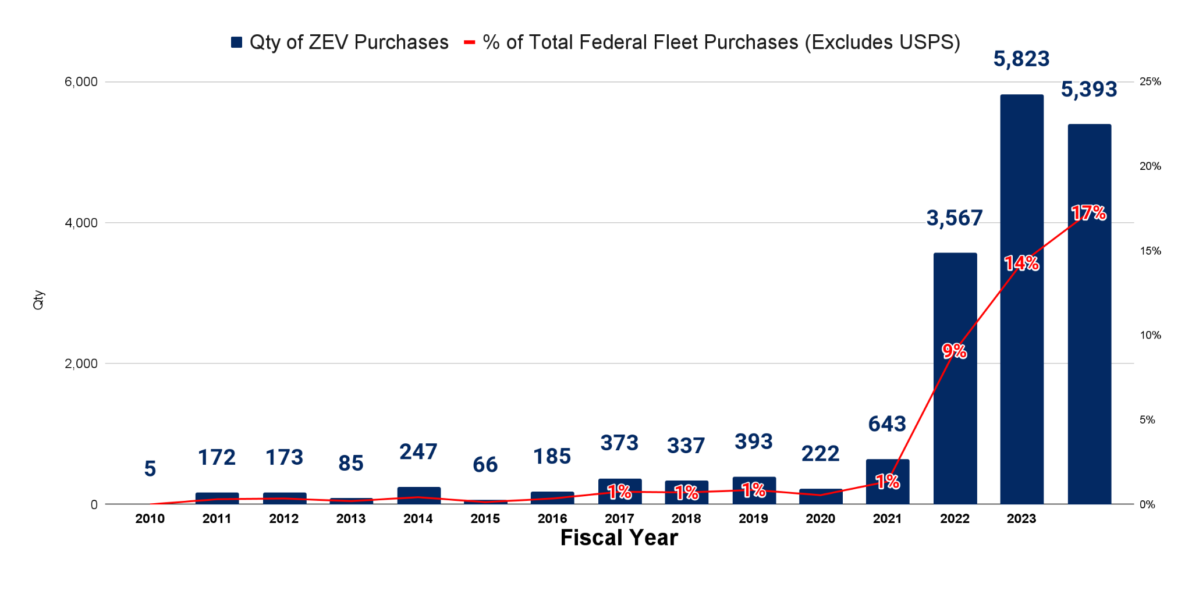
Federal Fleet Zero-Emission Vehicle Orders
2024 as of 4/1/24

Slide 55
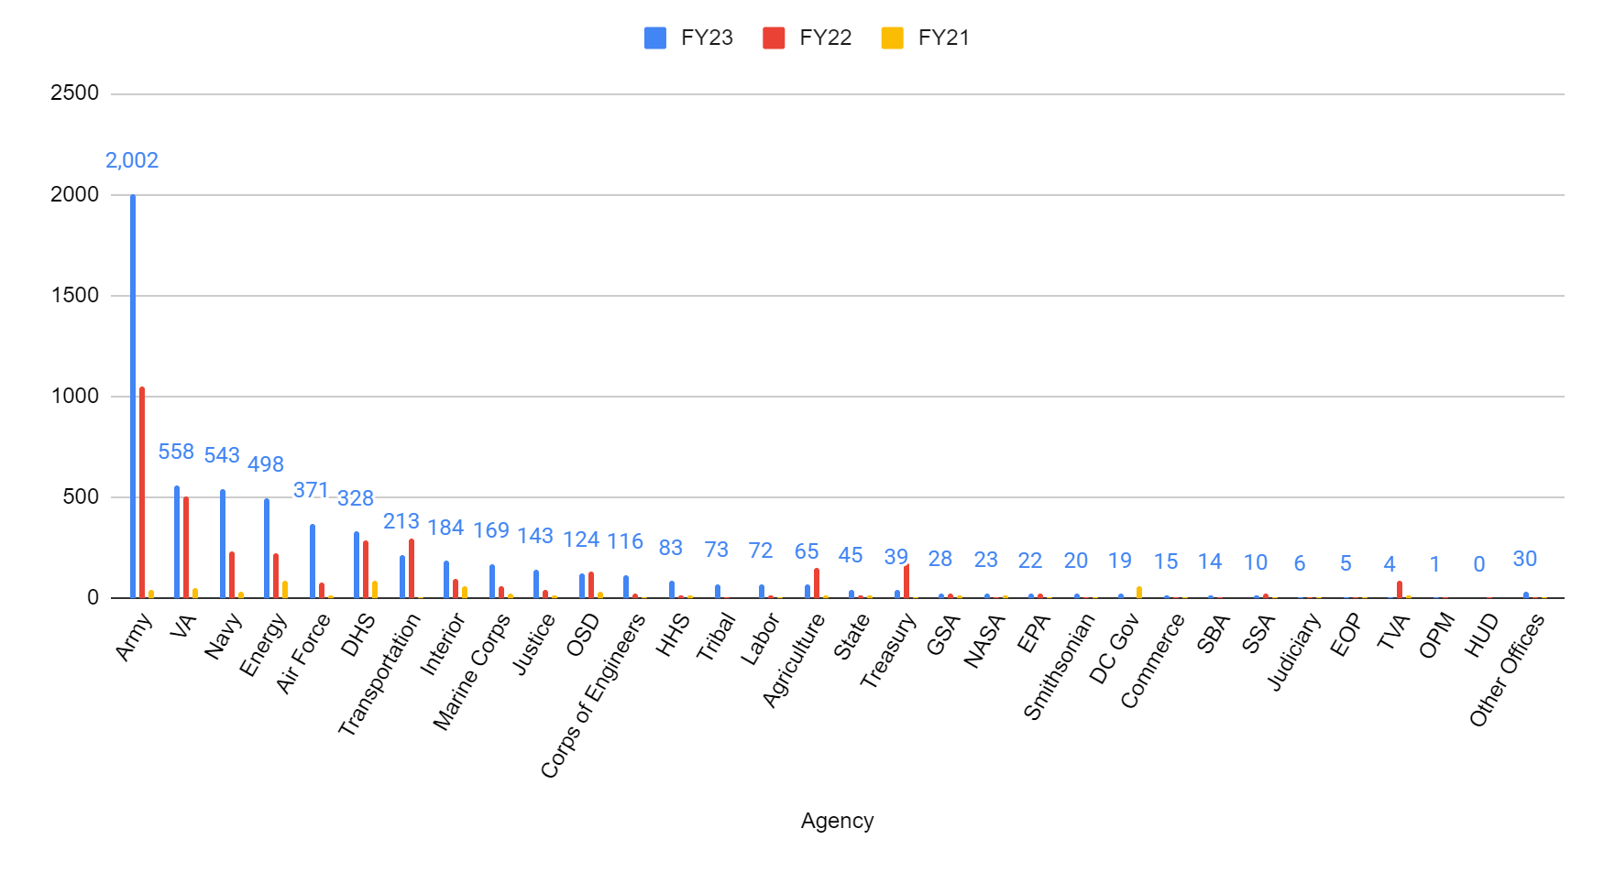
ZEV Orders by Agency

Slide 56
Types of Electric Vehicles
PHEV
Plug-in Hybrid Electric Vehicle
HEV
Hybrid
Electric Vehicle
Emissions
BEV
Battery
Electric Vehicle
Fuels
Electricity
Gasoline
Notes:
BEVs
100% electric
Rnages 100-400+ miles
0 emissions
PHEVs
Gas+electric
Small battery pack, All electric range: 20-50 miles
Total range (with gas): 310-640 miles

Slide 57
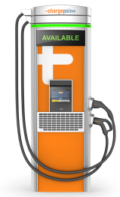
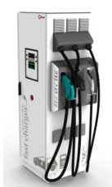
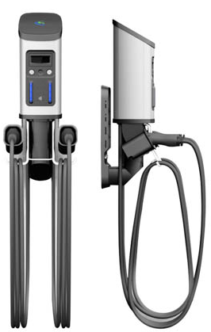
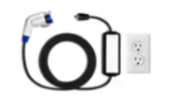
Types of EV Charging Stations
Level-1 Charging
110V/120V
Level-2 Charging
208V/240V
DC Fast Charger
208V/480V
NEMA 15
J1772
Tesla CCS CHAdeMO
Majority use J1772
4-6 miles per hour charge time
$0-$3K
Majority use J1772
10-20 miles per hour charge time
$500-$12,000
Majority use CCS
50-90 miles in 30 minutes
$32,000+
Notes:
BEVs can charge with all three types, Most PHEVs cannot charge on L3s except Hyundai Santa Fe & Mitsubishi Outlander
L2
Teslas come with adapter
L3
Teslas come with adapter
Nissan Leaf uses CHAdeMo

Slide 58
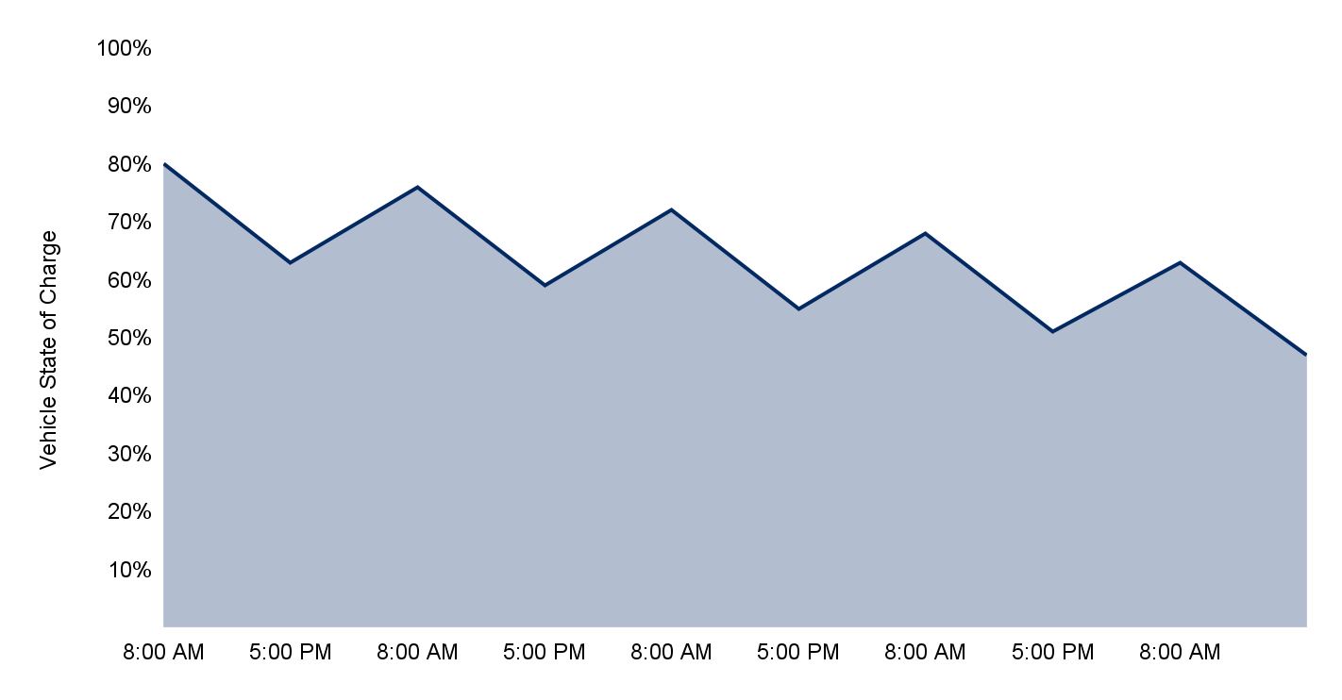
Example Week - Level 1 Charging
Ford F-150 Lightning (200 miles)
40 mi.
40 mi.
40 mi.
40 mi.
40 mi.
Monday Tuesday Wednesday Thursday Friday

Slide 59
GSA’s One Stop EV Charging Solution
Charging Station BPAs/ MAS Offerings
Installation & Infrastructure Design/Build IDIQs
Hardware offerings for Level 1, 2 & DC Fast
Ancillary product services
Federal IT security compliance
Product onboarding & offboarding
Feasibility studies & site assessments
Construction and design/build
EVSE Installation
Electrical infrastructure upgrades
Testing, commissioning & utility coordination
FAR 51 Deviation allows IDIQ contractors to buy from BPAs
gsa.gov/electrifythefleet

Slide 60
EVSE BPA Product Offerings
Levels 1 & 2 (CLINs 0001-0002)
Level 3/DC Fast (CLIN 0003)
Solar & Portable (CLINs 0004-0005)
Software & Network Plans (CLINs 0007-0008)
Notes:
Network capabilities

Slide 61
FedRAMP Estimated Authorization Timeline
As of 04/30/24
3
5
Atom Power
03/28/2024
ChargePoint
01/23/2024
Chargie
01/23/2024
FedRAMP Authorizations
Estimated Completion Dates:
Solutions In-Process
Q4 FY24
Blink
EVGateway
Siemens DepotFinity
Q1 FY25
BP Pulse
Loop (FedRAMP Moderate)
**EV Connect removed on 4/25/24
*(Based on Firm Submitted Timelines & Subject to Change)

Slide 62
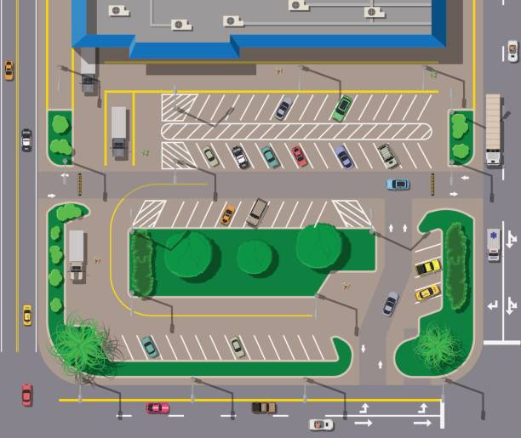
Other EVSE BPA Offerings
CLIN 0006: EVSE Site Planning & Ancillary Services
CLIN 0009: Operation, Repair & Maintenance Plans
CLIN 0010: Other Non-Conventional Solutions
CLIN 0011: Accessories and Component Parts
Charging as a Service offerings for Level 2 and Level 3/DC Fast stations
Notes:
What can CLIN 0006 cover?
Station Activation
Affixing or Securing Station
Commissioning
Facility Design/Preparation
Permitting/Inspection
Project Management
Site Assessment
Site Validation
Strategic Planning
Utility Coordination
CRUCIAL to communicate with utilities early on in the process

Slide 63
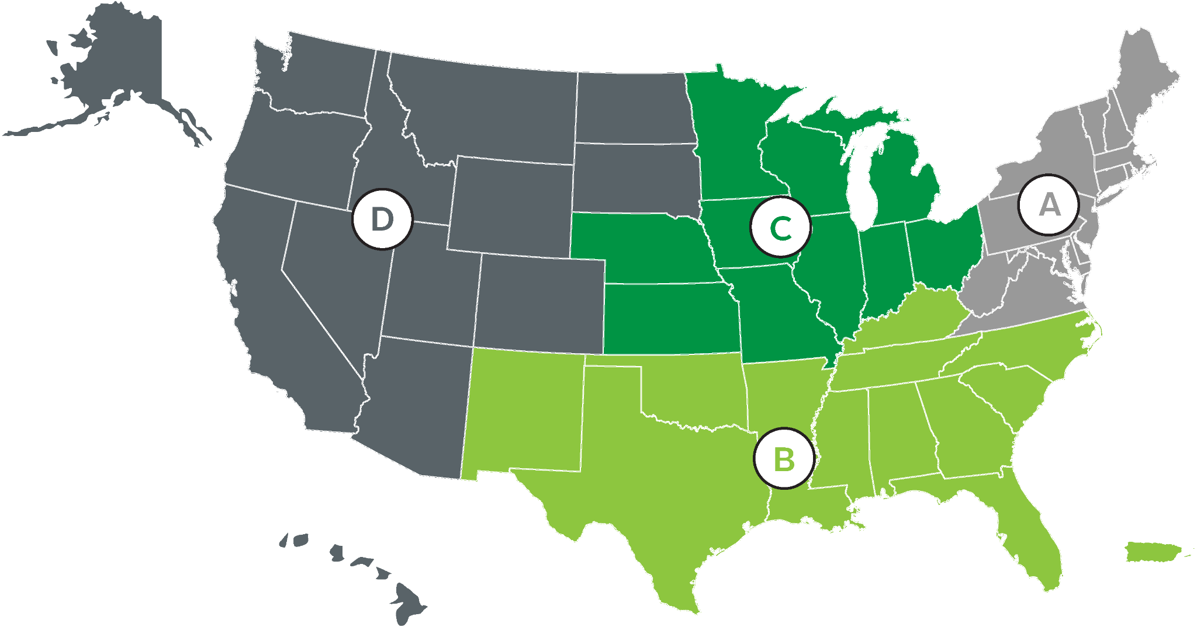
Governmentwide EVSE Design/Build
& Construction IDIQ
Covers any Federal agency location
Four Geographic Zones
$500 million total ceiling per Geographic Zone
1 year base with four 1-year option periods
Total Small Business Set Aside
Notes:
Covers any Federal agency location
Including GSA controlled space and non-GSA controlled space
Four Geographic Zones
$500 million total ceiling per Geographic Zone
Across all IDIQ contracts within each Geographic Zone
1 year base with four 1-year option periods
Total Small Business Set Aside
Most IDIQ contractors are socioeconomic small businesses

Slide 64
EVSE Ordering Path Options
What is needed?
Install & Procure EVSE
(complete design, build and construction of install, EVSE hardware purchased by install company for streamlined procurement)
Procure EVSE
(hardware, basic install, site preparation, station activation & assembly)
Where is it needed?
GSA-Managed Space
GSA-Leased Space
Non-GSA-Managed Space
GSA Multi-Site Requests
All Spaces
How can you work with GSA?
Agency works with local GSA Facility Manager
Agency works with GSA PBS EVSE Solutions Team (pbs-evse-solutions@gsa.gov)
Agency orders from GSA FAS BPA (www.gsa.gov/evse)

Slide 65
Buying from BPA Holders
1
2
3
For a full list of available products, vendor information, and ordering guide
Determine Acquisition Threshold
Orders < $10K: can be placed directly with any BPA Holder that can meet the need.
Orders > $10K and < $250K: must provide each BPA holder a fair opportunity.
Orders > $250K: send Request for Quote to all BPA Holders that offer needed product/service. SOWs are required for services (CLIN 006)
Exceptions: Orders above $10K can be placed directly if determined and documented that only 1 BPA holder can meet need.
Agency or IDIQ Holder Places Order Against BPA with BPA Holder
Billing/Payment can be made through Third-Party Payment Processing
Visit gsa.gov/evse
Notes:
Remember to list salient characteristics for EV charging stations; if you see it, submit an RFI
Listening but can’t police
It is the responsibility of the task order contractor, they can do an agency protest, GAO etc.

Slide 66
Non-Traditional Funding Opportunities
State/local government and utility incentives
Leverage Utility agreements
Energy Savings Performance Contracts
EVSE can be included if:
The vendor is agreeable.
Project financing can cover the cost within the allowable 25 year term.
Check with your Agency legal counsel!
DOE’s EV Utility Finder
Federal Funding Programs
(only some apply to federal agencies)
Notes:
Local incentives can support feds, tribes or facilities in disadvantaged communities
Bipartisan Infrastructure Bill: States Receive $7.5B in EVSE Funding, State Fact Sheets detail funding each state will receive.
Use the Department of Energy’s Utility Energy Service Contracts (UESCs) and EV Utility Finder Tool to find local utility partners offering EVSE financing and incentives.
Research applicable tariffs that may allow you to leverage a GSA Areawide Public Utility Contracts (AWC) to install EVSE and other infrastructure.
GSA PBS in Colorado is partnering with local utility Xcel Energy. Through its EV Infrastructure Incentive Program, Xcel Energy provides funding and installation support for conduit, electrical panel upgrades, transformers and any other make-ready infrastructure needed.
This is a starting point for you
Incentives were manually filtered to maximize relevance to federal fleet managers. If no incentives are relevant to your state or local jurisdiction, you may want to start with our list of sources.
Data sources included the Department of Energy’s Alternative Fuel Data Center (AFDC), Database for State Incentives on Renewable Energy (DSIRE), Plug In America, and National Conference of State Legislatures (NCSL)

Slide 67
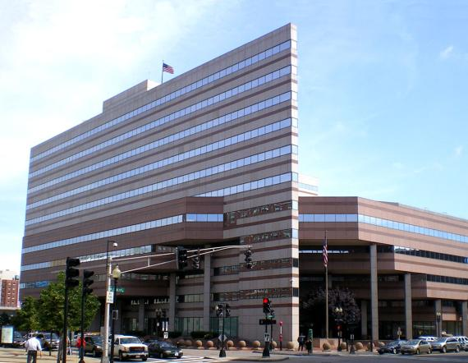
Sites in Action
John Joseph Moakley US Courthouse
Status: Site Host Agreement Approved.
Scope: 18 level 2 ports
Funding: IRA
Leveraged utility incentives
Thomas O’Neill Federal Building
Status: Site Host Agreement Approved
Scope: 68 level 2 ports
Funding: IRA and RWA
Leveraged utility incentives

Slide 68
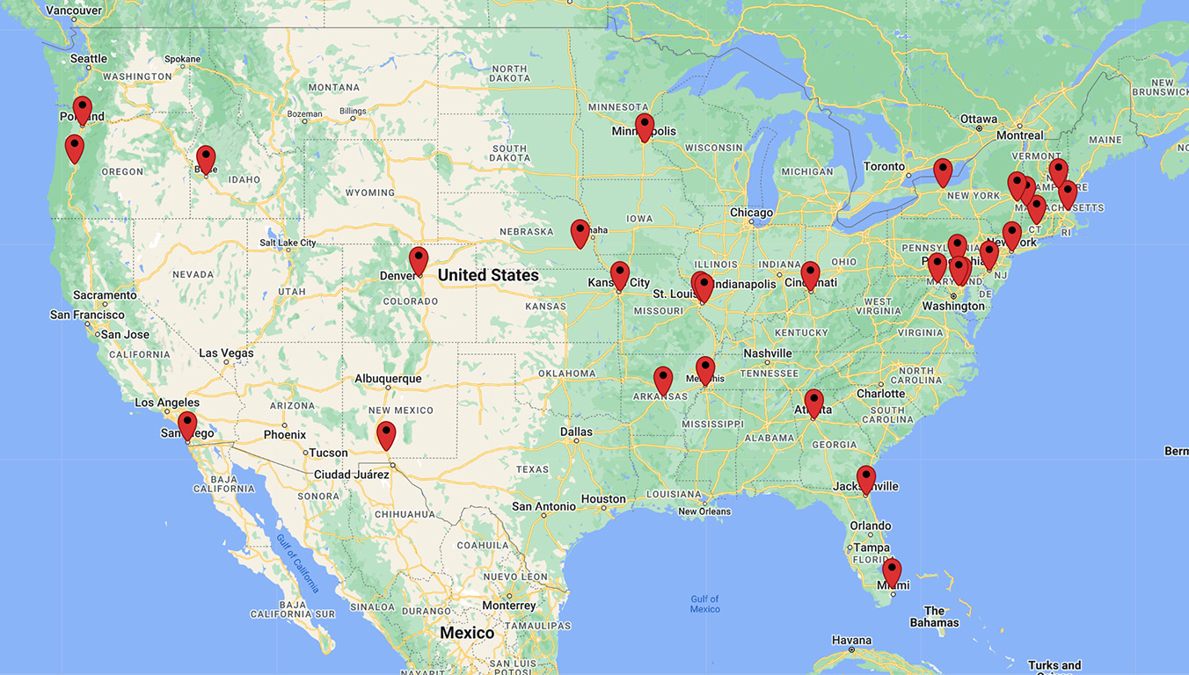
Next Up - 782 New Federal Charging Ports!
Visit gsa.gov/ChargingPorts for more info!

Slide 69
Resources
Website
Gsa.gov/electrifythefleet
Contact Us
GSAFleetAFVteam@gsa.gov
(ZEVs, EVSE & ZEV deployment)
PBS-EVSE-Solutions@gsa.gov
(EVSE Design, Construction & Install)

Slide 70
Links
gsa.gov/electrifythefleet
gsa.gov/evse
gsa.gov/chargingports
https://www.energy.gov/eere/femp/articles/ev-utility-finder-ev-u-finder
GSAFleetAFVteam@gsa.gov
PBS-EVSE-Solutions@gsa.gov

Slide 71
Questions?
For more information, visit: gsa.gov/FAST

Slide 72
FAST 2024
The IDEA Act

Slide 73
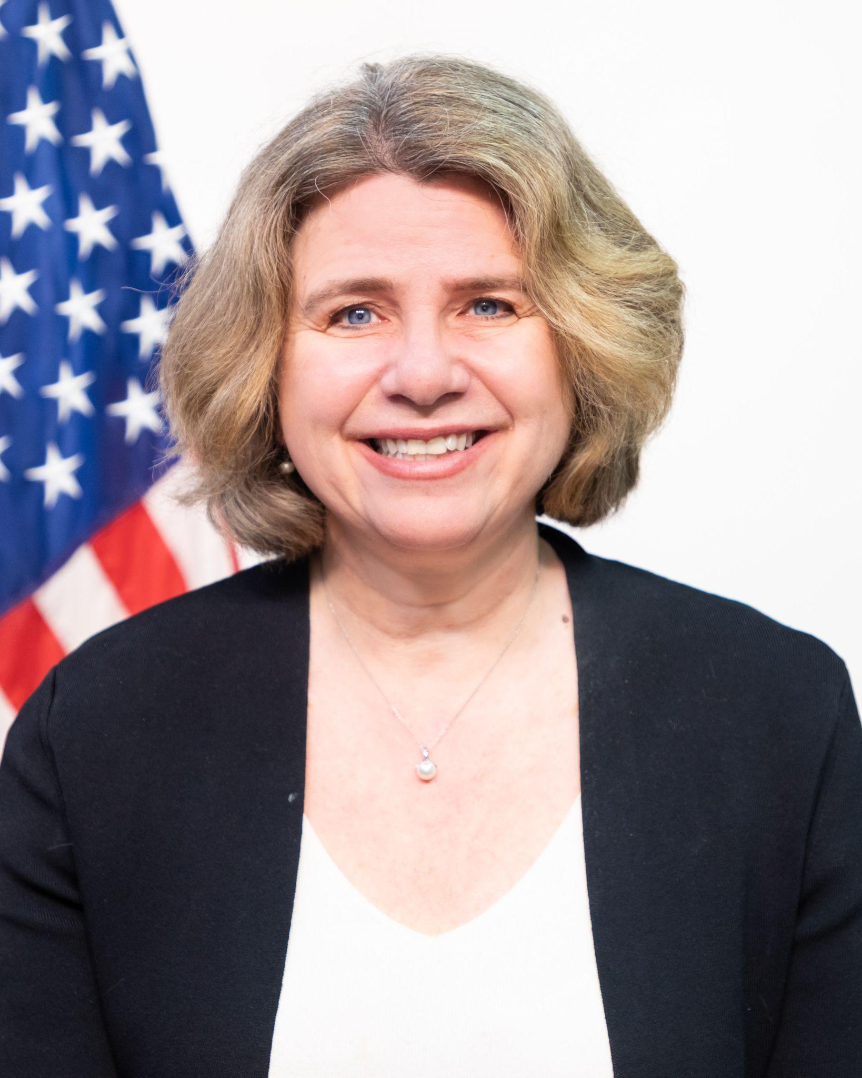
Laurie MacNamara
Director of Market Development & Partnerships
U.S. General Services Administration (GSA)
Laurie.macnamara@gsa.gov
Jacob Parcell
Director, Innovation Portfolio Division
TTS Solutions
U.S. General Services Administration (GSA)
jacob.parcell@gsa.gov
Star Vanamali
Director of Outreach and Marketing
Technology Transformation Services (TTS)
U.S. General Services Administration (GSA)
star.vanamali@gsa.gov

Slide 74
TTS Overview
Vision: Trusted, modern government experiences for all.
Largest agency independent technology organization in the government
Over 26 products and services
Partnered with almost every agency in government
Focused on public-facing shared digital services that provide building blocks that help agencies deliver better government experiences to the public, reducing risk, time, cost, and creating economies of scale across agency boundaries.
Mission: Design and deliver a digital government with and for the American public.
Goal: Help agencies meet the needs of the public in seamless, secure, and equitable ways.

Slide 75
What is in TTS?
But what does this actually mean?
How do we help agencies?
PRODUCTS.
Shared infrastructure and tooling that help agencies deliver faster.
10x
api.data.gov
Benefits Studio
Cloud.gov
DAP
Digital.gov
FedRAMP
Login.gov
Notify.gov
Search.gov
Touchpoints
USWDS
PLATFORMS.
Interagency experiences that create cohesion and economies of scale.
Citizen Science
Challenge.gov
Data.gov
eRegulations
FAC
IAE/SAM
Made in America
USAGov
Vote.gov
PEOPLE.
Discovery, implementation, and consulting to catalyze agency progress.
18F
Centers of Excellence
Presidential Innovation Fellows
U.S. Digital Corps
Notes:
TTS operates three main categories of shared products and services:
Products – Shared infrastructure and tooling that help agencies deliver faster. TTS provides building blocks and tooling that are commonly needed in the development and delivery of government digital services.
Examples of these: US Web Design System, search.gov, and FedRAMP.
Platforms – Interagency experiences that create cohesion and economies of scale. When the public needs to interact with potentially multiple agencies around a same or similar need, TTS builds and operates government-wide platforms to enable and centralize those interactions.
Examples of these: USA.gov, vote.gov, and data.gov
People – Discovery, implementation, and consulting to catalyze agency progress. When agencies need expertise to help to define, plan, and execute a vision for digital services that deliver good, human-centered customer experiences, TTS partners with the agency while also building capacity.
And while we have great people across TTS, what we mean when we say people we specifically are talking about the consulting organizations with TTS: 18F and the Centers of Excellence, and the fellowship programs within TTS: the Presidential Innovation Fellows or PIF, and a newer TTS program, the US. Digital Corps.

Slide 76
Many TTS products support better digital experiences
PRODUCTS.
Shared infrastructure and tooling that help agencies deliver faster.
10x
api.data.gov
Benefits Studio
Cloud.gov
DAP
Digital.gov
FedRAMP
Login.gov
Notify.gov
Search.gov
Touchpoints
USWDS
PLATFORMS.
Interagency experiences that create cohesion and economies of scale.
Citizen Science
Challenge.gov
Data.gov
eRegulations
FAC
IAE/SAM
Made in America
USAGov
Vote.gov
PEOPLE.
Discovery, implementation, and consulting to catalyze agency progress.
18F
Centers of Excellence
Presidential Innovation Fellows
U.S. Digital Corps
Notes:
TTS operates three main categories of shared products and services:
Products – Shared infrastructure and tooling that help agencies deliver faster. TTS provides building blocks and tooling that are commonly needed in the development and delivery of government digital services.
Examples of these: US Web Design System, search.gov, and FedRAMP.
Platforms – Interagency experiences that create cohesion and economies of scale. When the public needs to interact with potentially multiple agencies around a same or similar need, TTS builds and operates government-wide platforms to enable and centralize those interactions.
Examples of these: USA.gov, vote.gov, and data.gov
People – Discovery, implementation, and consulting to catalyze agency progress. When agencies need expertise to help to define, plan, and execute a vision for digital services that deliver good, human-centered customer experiences, TTS partners with the agency while also building capacity.
And while we have great people across TTS, what we mean when we say people we specifically are talking about the consulting organizations with TTS: 18F and the Centers of Excellence, and the fellowship programs within TTS: the Presidential Innovation Fellows or PIF, and a newer TTS program, the US. Digital Corps.

Slide 77
TTS and digital experience
When agencies want to offer human-centered digital solutions that meet legislative and policy requirements, TTS provides tools and programs for every step of their modernization journeys.
Government agency recognizes a need for a better digital experience
Gather user feedback and data insight of current digital solution
Ensure digital solutions are accessible and meet Section 508 standards
Ensure a consistent look and host websites on secure and modern infrastructure
Ensure web content follows plain language standards
Ensure solution has intuitive navigation and enable easy and secure access to government services.
Add search and SEO to their digital solution
Add self-service options such as digital forms and e-signature capabilities (from commercially available options)
Government agency has better and more compliant digital solution!
TTS Consulting and Fellowships can partner with agencies from concept to execution and support digital experience work.

Slide 78
Q&A
For further information about TTS and digital experience, please contact Emily White at emily.white@gsa.gov.

Slide 79
Thank You!
For more information, visit: gsa.gov/FAST

