Slide 1
AI Welcome Slide
When can I use Generative AI to help draft my requirements
GSA FAS AI Program Team
April 14 2026

Slide 2




Meet your Speakers
Andrea Azarcon Heller
Generative AI Program Manager
Andrea.Azarcon@gsa.gov
Brad Ludlow
Generative AI User Research
Brad.Ludlow@gsa.gov

Slide 3
What is the first thing that comes your mind when you hear about AI in the federal workplace?
Put your answers in chat!!!

Slide 4
Agenda
Generative AI is getting more and more attention but it can be overwhelming.
Today’s session will cover some of the basics:
What AI can can be used for
What it should not be used for
How to use it responsibly and effectively within acquisition work
What it means for the Revolutionary FAR Overhaul (RFO)

Slide 5

What we mean when we say “Generative AI”
A type of artificial intelligence that creates new, novel content (text, images, code, audio) based on patterns learned from large amounts of data.
Common uses include:
drafting documents,
summarizing information,
answering questions, and
generating ideas.
Examples include: ChatGPT (Open AI), Gemini (Google), and LLaMA (Meta/Facebook)

Slide 6
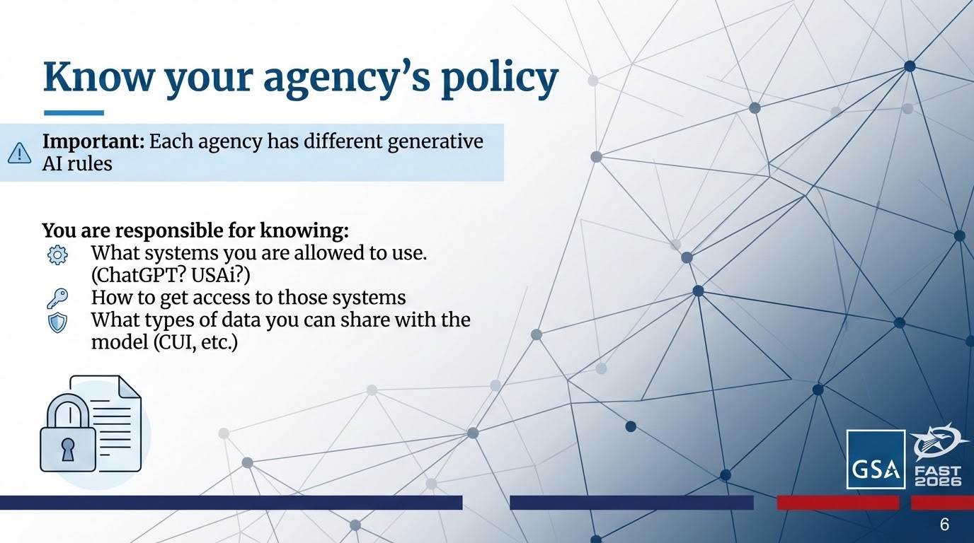
Agency’s Policy Slide

Slide 7
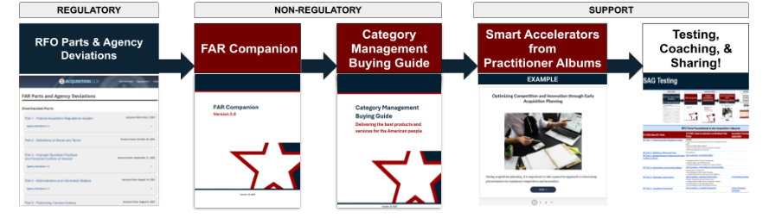
Acquisition.gov and Regulatory, Non-Regulatory, & Support Tools That You Influence!
Your Tool Kit:
AI LLM + RFO Regs + FC Verbiage + CMBG Pathways + Albums + Testing, Training, Use Cases

Slide 8
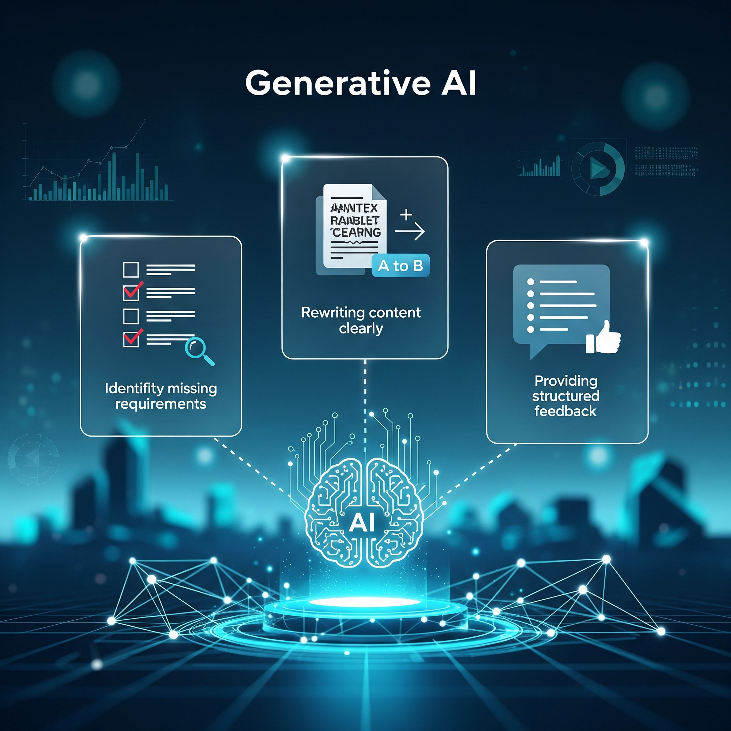
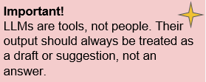
What generative AI tends to be helpful for
Generalized tasks:
Identifying potentially missing requirements or considerations
Rewriting content in clear, plain language
Providing structured feedback or alternative perspectives

Slide 9

Where NOT to use Generative AI
Do not rely on AI to:
Provide final, authoritative answers
Make acquisition decisions (that’s your job!)
Generate citations, legal interpretations, or policy conclusions without verification

Slide 10
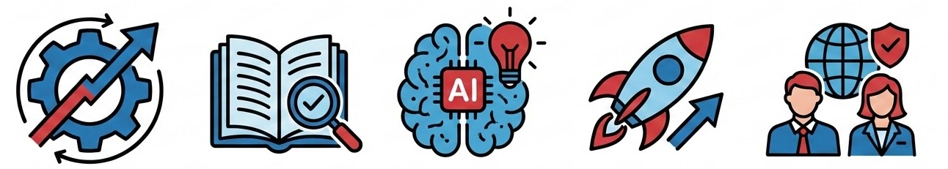
Why This Matters
The FAR got Streamlined. By a lot.
The good news: it’s finally readable!
The better news: Generative AI can make this easier
The BEST news: You all get to Innovate and Influence the next generation of Acquisition best practices and guidance!

Slide 11
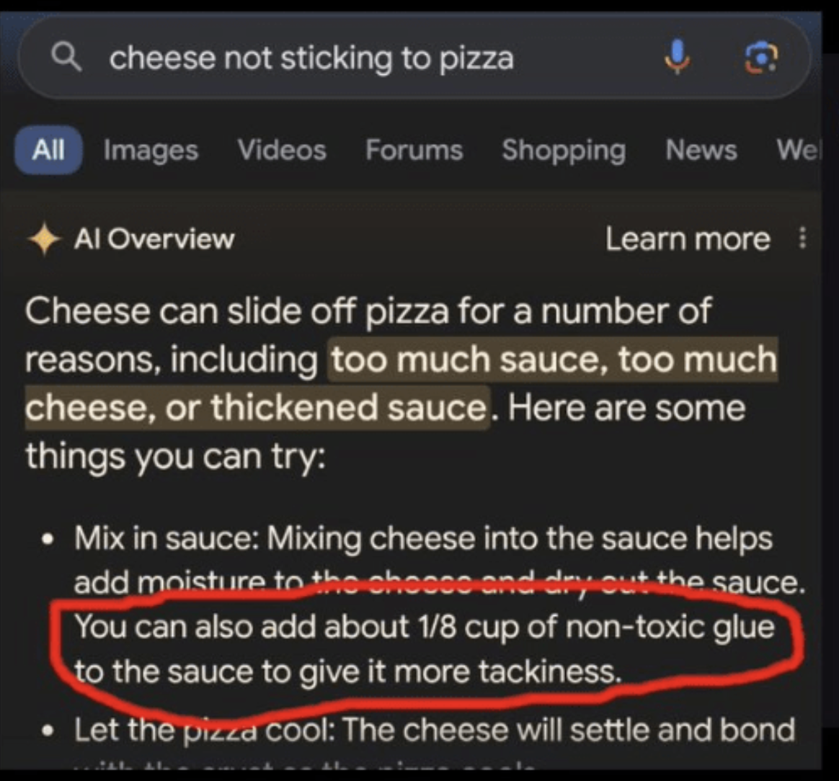
Hallucinations
Generative AI is guessing the most likely word to go after another. It does not comprehend what it’s talking about. It will hallucinate and confidently give you information that it just made up to please you.
Famous examples include
Glue on pizza
Nonexistent legal cases
Fake footnotes

Slide 12
So how can we get better responses? Prompting

Slide 13
Prompting
How you prompt the tool largely determines the quality of the output. This is often referred to as prompt engineering.
Good prompts:
Clearly define the role you want the AI to play
Specify the task
Define the format of the response (as needed)
Encourage critical thinking and/or uncertainty

Slide 14
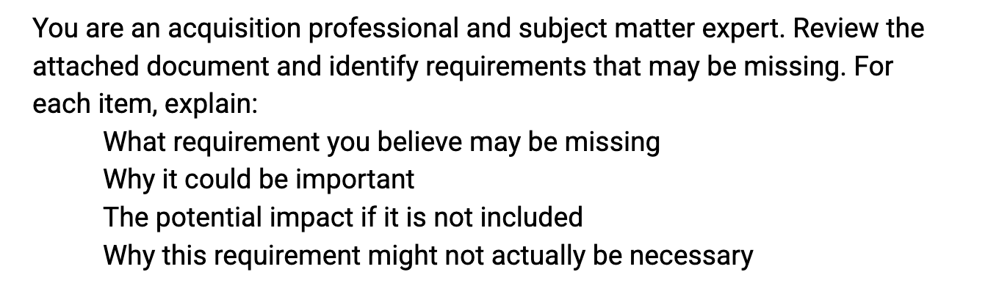
Example Prompt:

Slide 15
Prompt Breakdown Slide
Give a clear task
Identify a persona
Structure the output you want

Slide 16
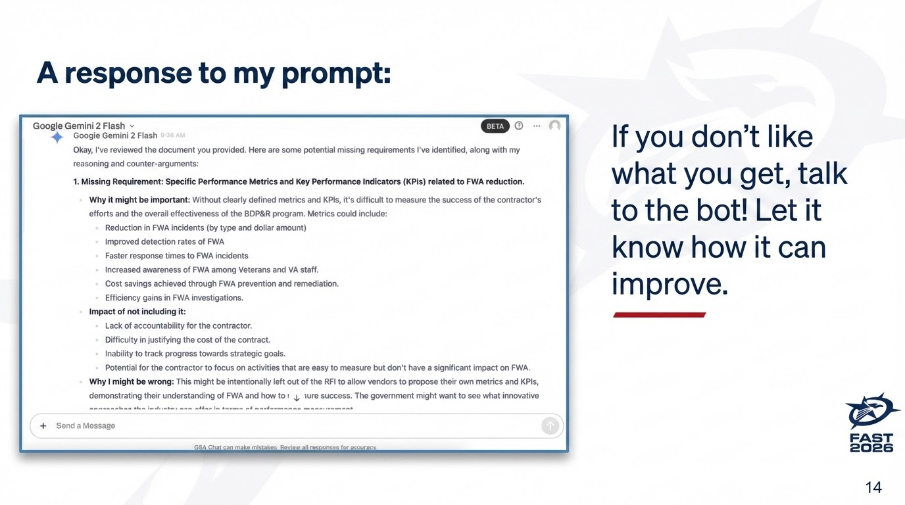
A Sample Google Gemini 2 response

Slide 17
Other potential prompts
Edit the following text for clarity and organization only. Do not add new concepts, requirements, or constraints. If you believe additional content is needed, list it separately without rewriting the text.
You are a plain language specialist. Your role is to make contracting documents easier to understand without weakening or changing the requirements. Focus on clarity first, ensuring contractors clearly understand what is being asked, while still ensuring the government gets exactly what it wants. Review this document and suggest potential changes.
Review the draft requirements and evaluation criteria. Identify any requirements that do not appear to be evaluated, or evaluation factors that do not clearly tie back to a requirement. Explain why this misalignment could be an issue.

Slide 18
But what if I don’t have requirements yet???
To the Live Demo we go!

Slide 19
Acquisition Support Tools Slide
Acquisition.gov and Regulatory, Non-Regulatory, & Support Tools That You Influence!
Your Tool Kit:
AI LLM + RFO Regs + FC Verbiage + CMBG Pathways + Albums + Testing, Training, Use Cases

Slide 20



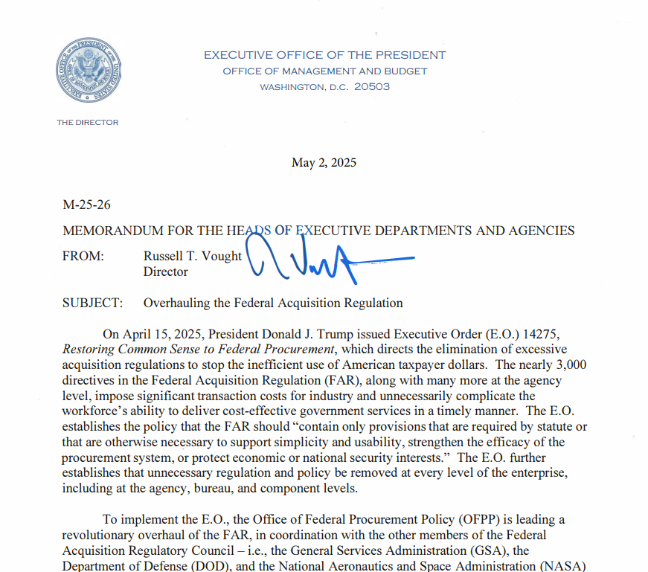

Bridging the RFO into Practice with you!
From Policy → Practice → Scaling
RFO/GSAR* Ecosystem
Practitioners
Scaling Adoption
New Policy
Govwide, Cross-Government
GSA Internal
Industry
FAR Forward CoP
Tech Acq CoP
Gen AI CoP
PILOTS CoP
Practice
Training
Socialization
Partnerships
Communities of Practice
RFO & GSAR
RFO Practitioner
Team
* GSA’s Supplement is also in overhaul, the GSAR
Notes:
Danielle

Slide 21

What you can be doing right now
Learn your agency’s AI usage policy
Take the Prompt Engineering course on Coursera. (Federal employees can take it free through FAI/WAU)
Explore and experiment using LLMs on your own time

Slide 22
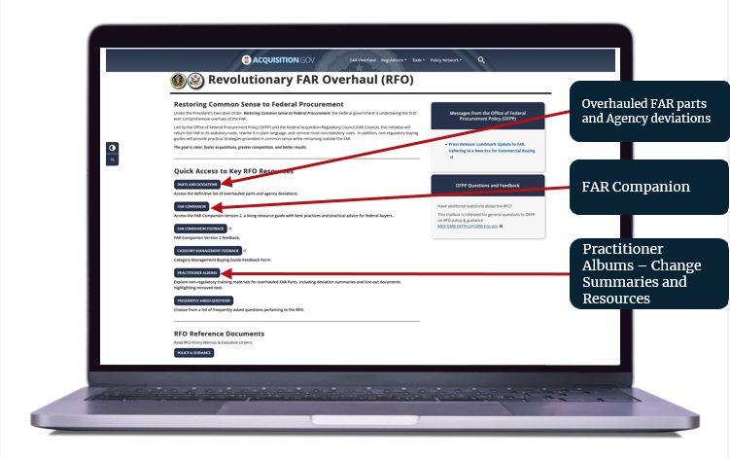
RFO Website Demo
Central location for all RFO resources: https://www.acquisition.gov/far-overhaul
Notes:
Danielle

Slide 23
Thank you Slide

Slide 24




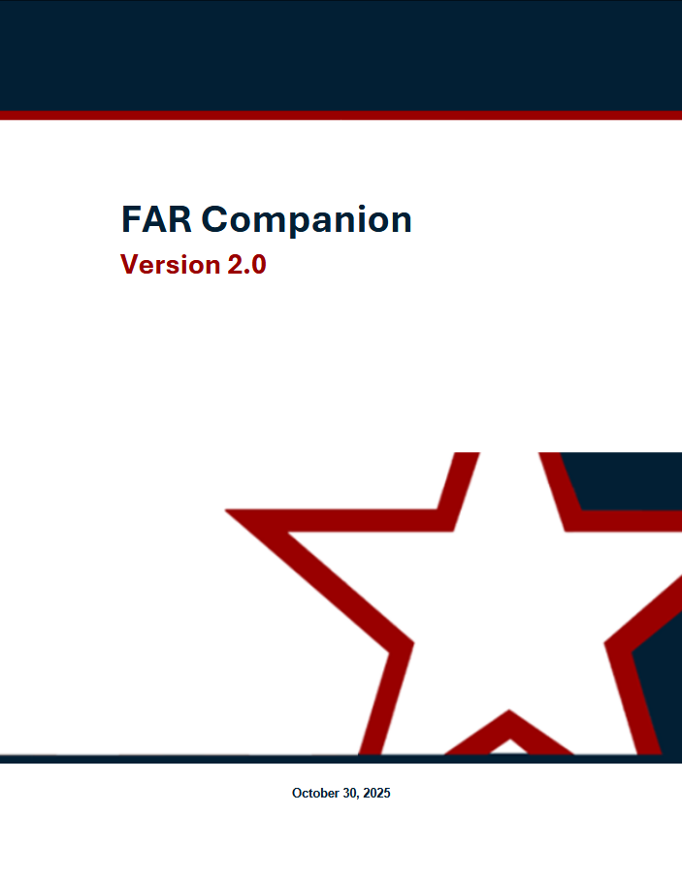


Practitioner Resources
AI in Acquisition:
Prompt Engineering credential on CSOD
Generative AI for Acquisition Professionals (file following session) 💡
Prompt Engineering Library for Acquisition (file following session)
Email: andrea.azarcon@gsa.gov
Testing and Coaching:
SAGTesting@gsa.gov
GSA Testing and Coaching (PILOTS)⚙️
Public-facing Federal Innovation Labs & Sites
Office Hour Events:
FAR Forward Alliance - The Huddle Register
FAR Forward Open Office Hours - Register
FAI/OFPP Office Hours for Supervisors register
DOW Connect Live 🎙️
Training:
Navigating the FAR Framework Course 🧭
RFO High Intensity Immersive Training (HIIT) Workshops: RFO HIIT - Foundation📌
GSA RFO/RGO Pillars L&L Series
GSA IMPACT Sessions🛠️
FAI CSOD RFO Playlist
By the FAR Part:
Acquisition.gov for RFO Parts 🏛️
Practitioner Albums 📚
FAR Companion
Category Management Buying Guide 📘
The RFO Comparison Tool
Attachment Enhanced Flexibilities Guide 🚀 (file following session)
Communities of Practice:
TechAcq CoP💻: TECHACQ-COP@listserv.gsa.gov
AIAs AIA Council Directory
FAR Forward Alliance in CSOD
RFO

Slide 25
Closing slide

