Slide 1
Elevate your Acquisitions with Procurement
Consolidation
Customer and Stake Holder Engagment
April 15, 2026

Slide 2


Speakers
Josilyn Reed
Event Coordinator
Office of Integrated Marketing (OIM)
Jose Palos
Marketing Program Manager
Office of Integrated Marketing (OIM)

Slide 3
Agenda
Procurement Consolidation Overview
Implementation and Impact
Communication and Training Strategy
Q&A / Closeout

Slide 4
Procurement Consolidation Plan
Procurement Consolidation is governed by Executive Order 14240 and the OMB Procurement Consolidation Implementation Plan
The effort asks agencies for data to help understand the big picture, and where there could be potential savings delivered.
The OMB implementation memo suggests there should be two major groupings.

Slide 5
Two Workstreams
Workstream 1
Government-Wide IDVs and Shared Services
Agencies retain internal contracting authority while prioritizing the use of existing governmentwide contract vehicles and shared acquisition services.
Workstream 2
Assisted and Centralized Acquisition
Agencies may elect to receive centralized acquisition support from GSA for planning, strategy development, or contract execution.

Slide 6
Workstream 1
Agency led execution providing many governmentwide vehicles.
For example: Schedules, GWACs, Governmentwide IDIQs like OASIS+, etc.
Offers number of shared service solutions managing central support providing streamlined efficiency for agencies.
For example: GO.gov, Fleet, GSA SmartPay, City Pairs, etc.
The plan provides agencies with data, advisement, and recommendations
Solutions are available to support agency objectives
Agencies determine how to meet consolidation targets

Slide 7
FAR 8.104
Establishes prioritization of existing sources and contracts
Supports use of governmentwide acquisition and solutions
Aligns with Procurement Consolidation objectives
Will be reflected in future regulatory updates

Slide 8
Workstream 2
Provides assisted acquisition to customer agencies.
For example: RWAs, requisitions, assisted acquisition, etc.
Within FAS, every business portfolio has a version of assisted acquisition business.
Largest is AAS: high-dollar, high-complex actions where we provide contracting staff and program support (eg. CORs).
For many years, customers have asked for acquisition support on lower dollar actions
For example: common use products/services.
Establishment of OCAS to fill the gap.

Slide 9
Procurement Consolidation Overview
Josilyn Reed, Events Management Specialist

Slide 10
Workstream 2 (Continued)
Unlike workstream 1, solutions available on “opt-in” basis.
Provide assisted acquisition as customer agencies ask for assistance.
To ensure transition success, we want to understand:
Overall federal marketplace,
Contracts that agencies currently have,
When these contracts come up for renewal, so we can work with agencies to understand a transition solution.
We want to look at data and identify where to best support agencies requesting assistance.

Slide 11
Implementation and Impact
Jose Palos, Marketing and Communications Program Manager

Slide 12
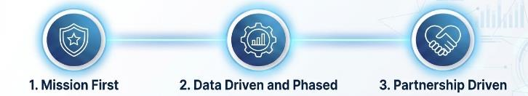

Engagement Philosophy
GSA’s ROLE - THE PORTFOLIO ACQUISITION ADVISOR
Similar to a ‘Financial Advisor’ - Partner with agencies and category managers to review acquisition and optimize outcomes for both workstreams through data-driven recommendations.

Slide 13
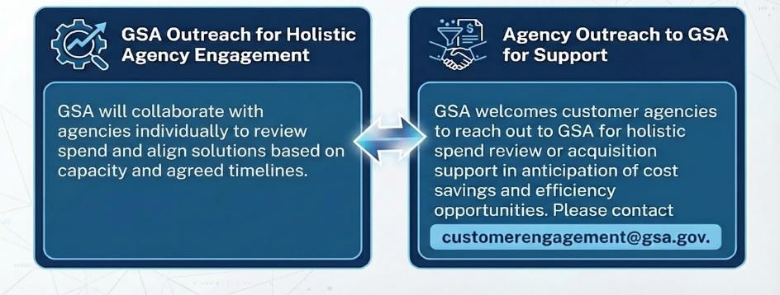
Agency Engagement
Establishing Open Communication Channels
Outreach for Holistic Agency Engagement
Agency Outreach to GSA for Support
We will collaborate with agencies individually to review spend and align solutions based on capacity and agreed timelines.
We welcomes customer agencies to reach out to GSA for holistic spend review or acquisition support in anticipation of cost savings and efficiency opportunities. Please contact.
customerengagement@gsa.gov

Slide 14
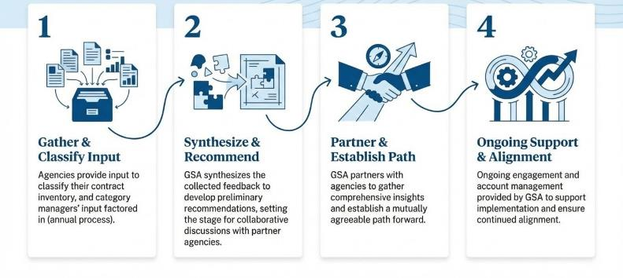
Engagement Process
Gather & Classify Input
Agencies provide input to classify their contract inventory, and category managers’ input factored in (annual process).
Synthesize & Recommend
Synthesizes the collected feedback to develop preliminary recommendations, setting the stage for collaborative discussions with partner agencies.
Partner & Establish Path
Partners with agencies to gather comprehensive insights and establish the path forward.
Ongoing Support & Alignment
Ongoing engagement and account management provided to support implementation and ensure continued alignment.

Slide 15
Impact of Successful Implementation
Short Term:
Achieve savings of over $1 billion
Drive administrative savings through process standardization as agencies place and manage their own orders, without creating overlapping contracts.
Eliminate Contract Duplication
Enable Demand Management
Reduce agency involvement in acquisition management, freeing resources to focus on mission priorities
Long Term:
On-going spend optimization achieving nearly $4B in savings
Reduce agency spending by leveraging consolidation and volume purchasing
Provide compliant acquisition solutions that save agencies time and money while directly supporting mission outcomes.
Cement through
Revolutionary FAR Overhaul;
Federal Management Regulations;
Federal Travel Regulations ;
President’s Management Agenda

Slide 16
Your Role
Consolidation is a team sport - Although a small group of people will work the engagement and transition plan:
Consolidation requires the entire workforce's contributions and collaboration for success.
Everyone's efforts ensure excellent service delivery as new customers join
Onboarding more customers creates exciting new missions to support.
This provides a great opportunity to impact service delivery across government
Greater Impact on Government’s Mission - as we on-board more spend and customers we will have new exciting missions to support and have the opportunity to have great impact in service deliver across the Federal Government.

Slide 17
Wins
Workstream 1 - Government-Wide IDVs and Shared Services
Projected savings from consolidation of 5 contracts is $64 M.
163 task orders totaling $228M agreed for transition to government-wide contracts for a pilot agency.
Create solutions to encourage customers to leverage governmentwide solutions
OneGov: eg - Adobe, Google, Salesforce (70-90% discounts)
Software as a Shared Services: Go.Gov ($2B)
Workstream 2 - Assisted and Centralized Acquisition
Centralized 908 contracts across Pilot Agencies (valued at ~$1.5B), achieving $6.5M in savings through increased visibility and reduced software license and support services spend.
Developed and deployed Automated Intake Tool to streamline procurement intake and triage

Slide 18
Future Communication and Training Strategy

Slide 19
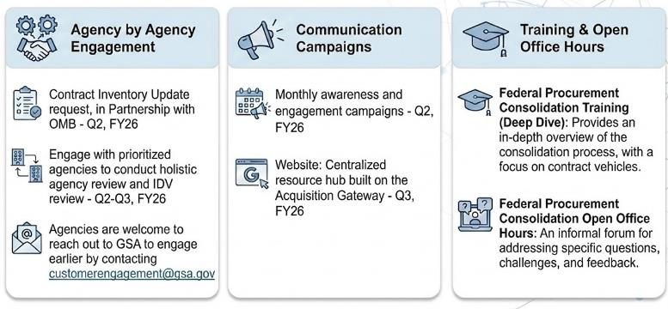
Next Steps
Contract Inventory Update request, in partnership with OMB
Engage with agencies to conduct holistic agency review and IDV review
Agencies are welcome to engage earlier by contacting customerengagement@gsa.gov
Monthly awareness and engagement campaigns
Website: Centralized resource hub built on the Acquisition Gateway
Federal Procurement Consolidation Training (Deep Dive): Provides an in-depth overview of the consolidation process, with a focus on contract vehicles.
Federal Procurement Consolidation Open Office Hours: An informal forum for addressing specific questions, challenges, and feedback.

Slide 20
Next Steps Continued
Forward Look
Next Training Session:
Procurement Consolidation Information Session: RFO
April 21, 2026 1 PM EST
Open Office Hours: April 21, 2026 2 PM EST
Future Look
Every other Tuesday
Procurement Consolidation Training 1 PM EST
Each session features a specific GSA offering supporting procurement consolidation
Each training session is 1 CLP
Open Office Hours 2 PM EST
Procurement website launch

Slide 21
Q& A
and Thank you!

Slide 22
GSA Starmark Logo – America 250

