Slide 1
RFO Welcome Slide
The Revolutionary FAR Overhaul and…
What it Means for your Acquisition Strategy
Office of Government-wide Policy, April 14, 2026 @ 9am EST

Slide 2


Meet your Speakers
Danielle Mouw
RFO Team & GSA PILOTS Testing & Coaching Lab
Danielle.Mouw@gsa.gov
Monica Taylor
RFO Practitioner Workstream & Coach
Monica.Taylor@gsa.gov
Notes:
Monica

Slide 3
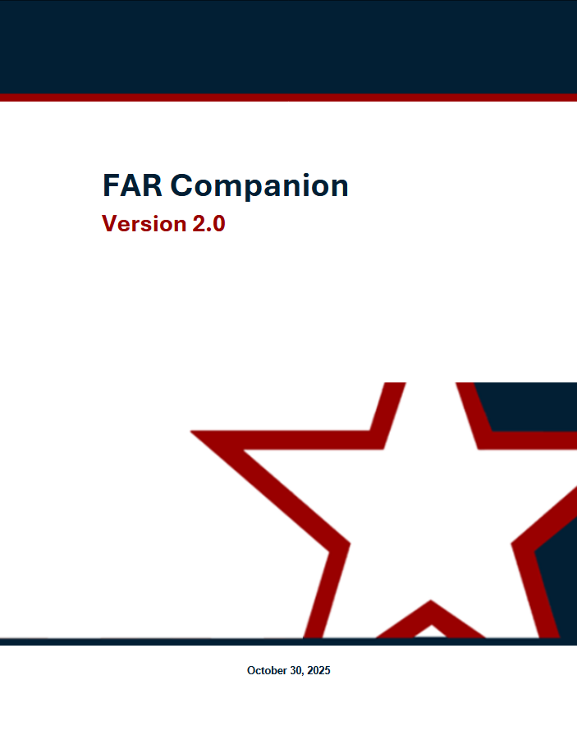

The Revolutionary FAR Overhaul (RFO)
RFO
Restores and reemphasizes CO Discretion for faster acquisitions, greater competition, and better outcomes for mission delivery.
The Revolutionary FAR Overhaul (RFO)
Most comprehensive overhaul of the Federal Acquisition Regulations since it was 1st published in 1984
The RFO initiative:
Returns the FAR to its statutory roots;
Rewrites it in plain language;
Removes non-statutory rules (unless essential for sound procurement); and
Creates non-regulatory buying guides that provide practical strategies grounded in best practices.
The RFO is grounded in these EOs - check them out!
Executive Order 14275 — Restoring Common Sense to Federal Procurement
OMB Memo 25-26 — Overhauling the Federal Acquisition Regulation
Executive Order 14271 — Ensuring Commercial, Cost-Effective Solutions
Executive Order 14240 — Eliminating Waste and Saving Taxpayer Dollars by Consolidating Procurement
Notes:
Monica

Slide 4

The RFO has given us a new Framework!
RFO 1.101 Framework
REGULATORY
NON-REGULATORY
Streamlined FAR
Agency Regulations
FAR Companion*
Category Management Buying Guide*
* Living resources that will be regularly updated to reflect evolving best practices and the changing way that commercial supplies and services are purchased.
Notes:
Monica

Slide 5



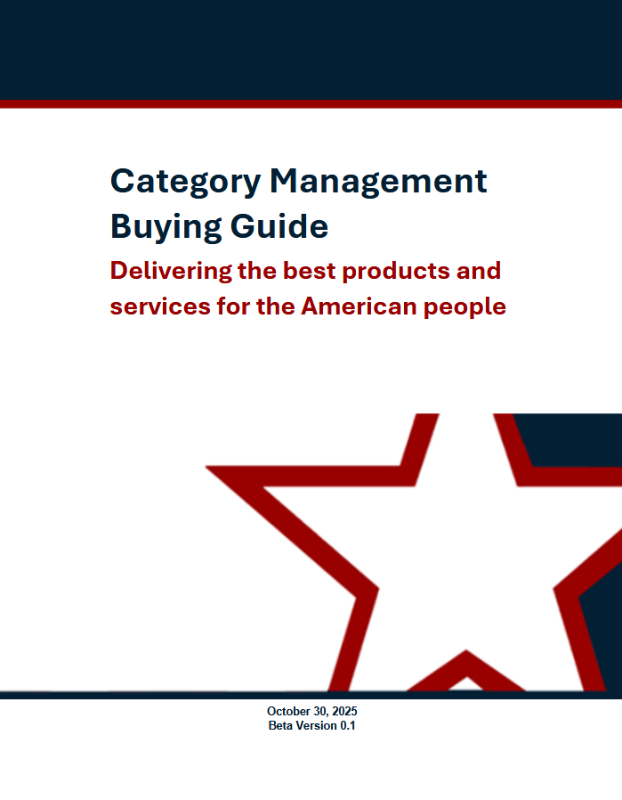

The RFO & Icon Key
Your New FAR ToolKit
Non-Regulatory Best Practice Resources
REGULATORY
Revolutionary FAR Overhaul
(RFO)
FAR Companion Guide (FC)
FC
RFO
FC
Agency Supplement or Agency Policy
Category Management Buying Guide (CMBG)
CMBG
Smart
Smart Accelerator (SA)
SA
Accelerator

Slide 6


📌 Have you ever received a physical copy of the FAR?
Before:
Now:
FAR 1.102(d) The role of each member of the Acquisition Team is to exercise personal initiative and sound business judgment in providing the best value product or service to meet the customer’s needs. In exercising initiative, Government members of the Acquisition Team may assume if a specific strategy, practice, policy or procedure is in the best interests of the Government and is not addressed in the FAR, nor prohibited by law (statute or case law), Executive order or other regulation, that the strategy, practice, policy or procedure is a permissible exercise of authority.
If a strategy is in the Government’s interest and not prohibited by law, Executive Order, or other regulation, you are allowed to use it. — This was always there!
Notes:
Monica

Slide 7
Where are we today? The FAR Overhaul
49 Model Deviations were issued to allow immediate use while formal rulemaking proceeds.
Agency Implementation - Agency adoption varies - Implementation contingent on agency-issued deviations.
Original Codified FAR
RFO
Phase 1
Model deviations
Agency issued deviations
Phase 2
Rule-making
New codified FAR
Issue class deviations to immediately adopt and use overhauled FAR.
Conduct formal rulemaking to codify streamlined regulations.
Notes:
Monica

Slide 8
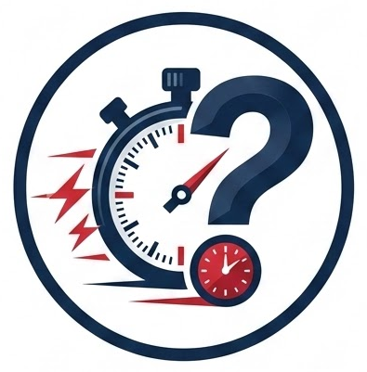
RFO 1: Federal Acquisition Regulations System
RFO
Quick Trivia: How Do you Check to see if your agency issued model deviations?
Answer: You can locate your agency issued deviations on Acquisition.gov which we will demo next.
Notes:
Monica

Slide 9
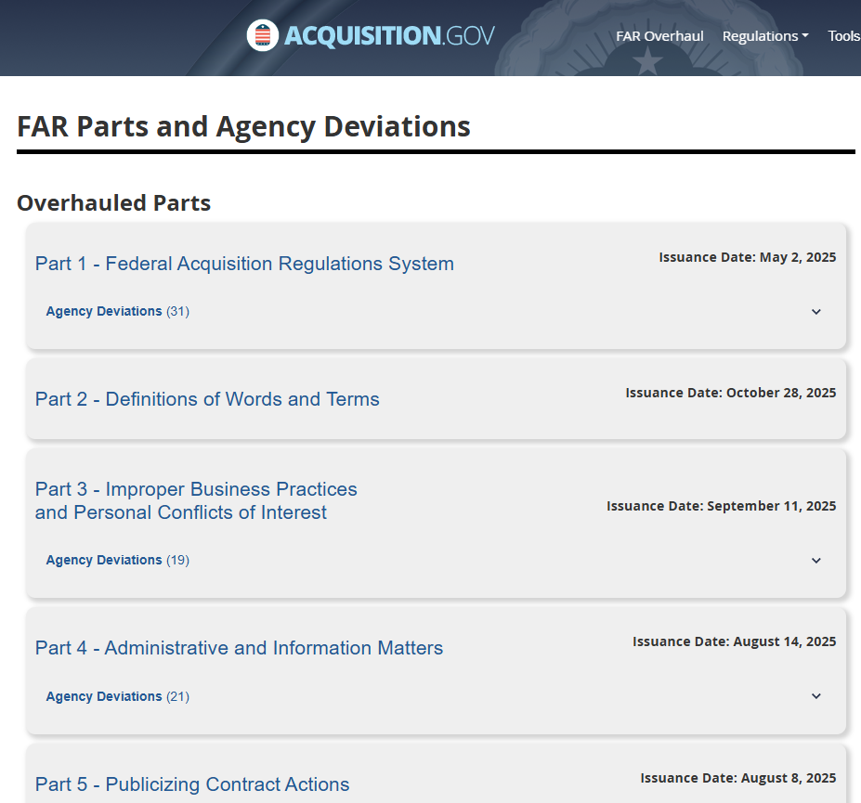
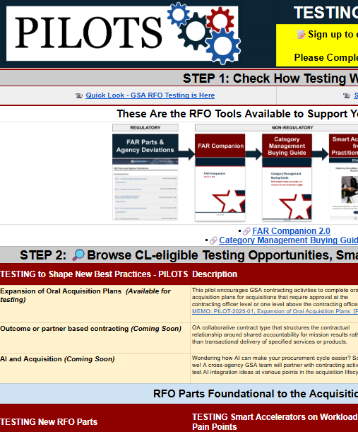
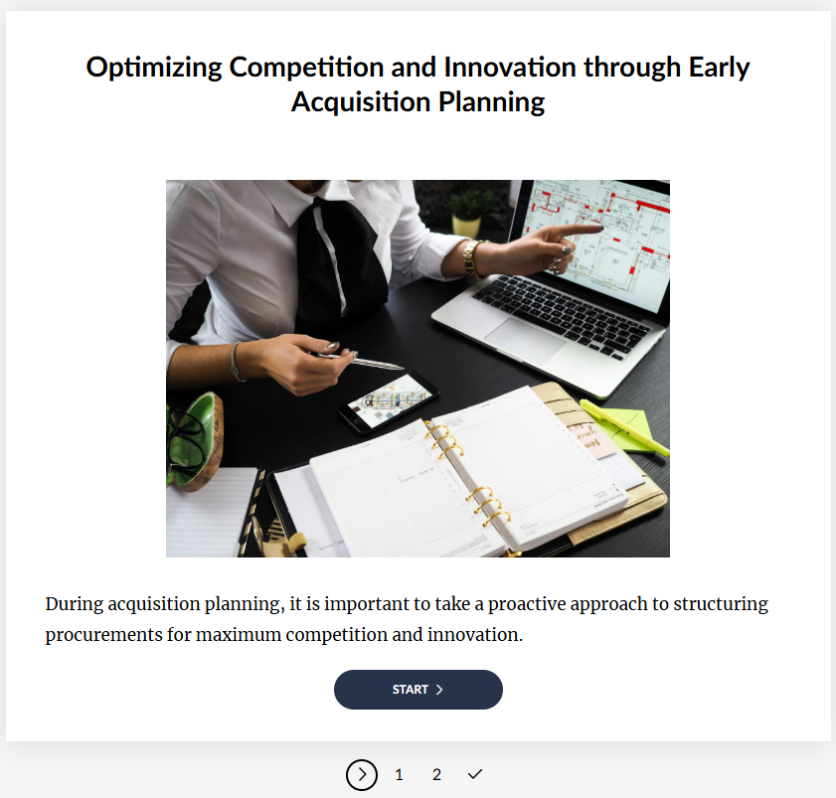
The new RFO Framework:
Acq.gov and Regulatory, Non-Regulatory, & Support Tools
RFO 1.101 Framework
Under the new RFO Framework, you have new Regulations and Agency guidance giving you cover to use your Discretion and all new Best Practice Tools, like the FAR Companion to help you meet the mission.
REGULATORY (REQUIRED)
NON-REGULATORY (RECOMMENDED, NOT REQUIRED)
SUPPORT
RFO Parts, GSAR, GSA Acq Handbook
Agency Deviations
FAR Companion
Category Management Buying Guide
Smart Accelerators from
Practitioner Albums
Testing, Training & Coaching
EXAMPLE
Notes:
Danielle

Slide 10



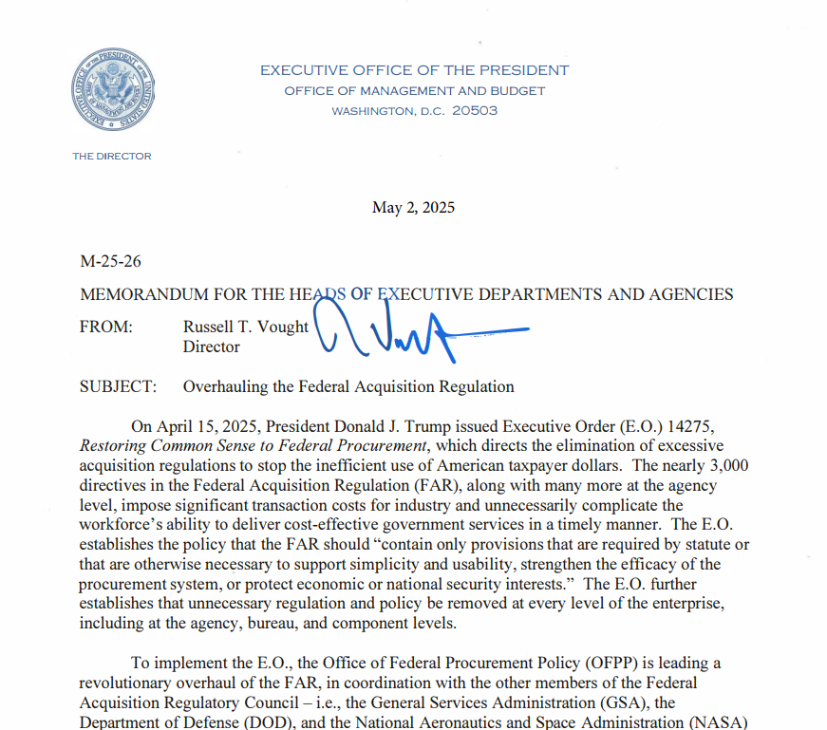

RFO GSAR Ecosystem Chart
Bridging the RFO into Practice with you!
From Policy → Practice → Scaling
RFO/GSAR* Ecosystem
Practitioners
Scaling Adoption
Govwide, Cross-Government
GSA Internal
Industry
FAR Forward CoP
Tech Acq CoP
Gen AI CoP
PILOTS CoP
New Policy
Practice
Training
Socialization
Partnerships
Communities of Practice
RFO & GSAR
RFO Practitioner
Team
* GSA’s Supplement is also in overhaul, the GSAR
Notes:
Danielle

Slide 11

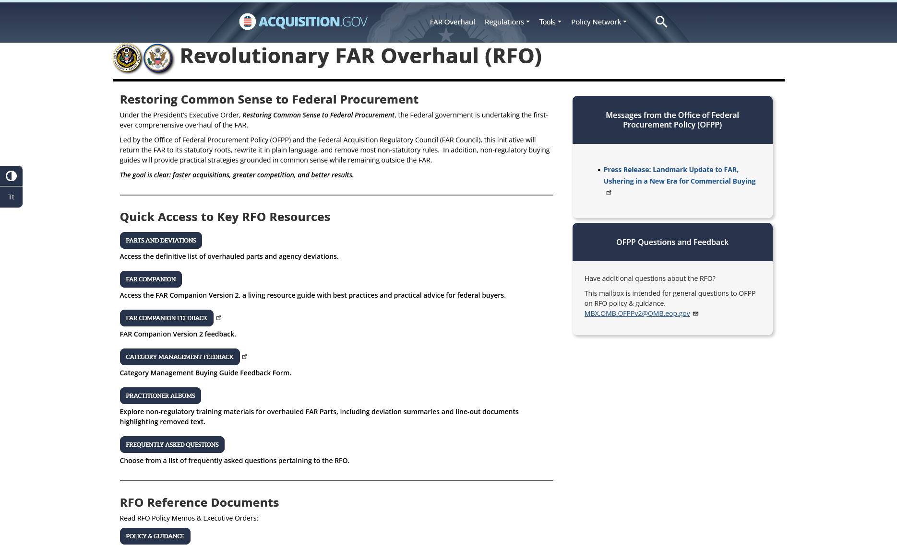
RFO Website Demo
Overhauled FAR parts and Agency deviations
FAR Companion
Central location for all RFO resources: https://www.acquisition.gov/far-overhaul
Practitioner Albums – Change Summaries and Resources
Notes:
Danielle

Slide 12
Discretionary Practice: FAR Companion
RFO
Applying Sound Business Judgment
The FAR Companion will work in concert with the FAR, agency supplements and the Category Management Buying Guide.
The FAR Council's Foreword to the FAR Companion charges acquisition professionals to maximize use of their sound business judgment and discretion when policies are not statutorily prescribed.
The FAR Companion is not:
Mandatory compliance requirements.
Intended to carry legal authority nor intended to serve as the basis for protests or legal actions.

Slide 13
Discretionary Practice: Category Management Buying Guide
CMBG
Works in concert with the FAR, FAR Companion and agency supplements highlighting sector-specific buying tips for navigating government-wide contracts.
It is organized by Categories of Spend, or What you are Buying.
Helps maximize centralized ordering of common spend
and recognizing the efficiency and cost benefits of leveraging previously negotiated terms and conditions from precompeted vehicles.

Slide 14
FAR Companion & Category Management Buying Guide
CMBG
Quick Trivia: How do you feel about the FAR Companion and Category Management Buying Guide informing your acquisition strategy?
Notes:
Danielle ends tees up Monica

Slide 15
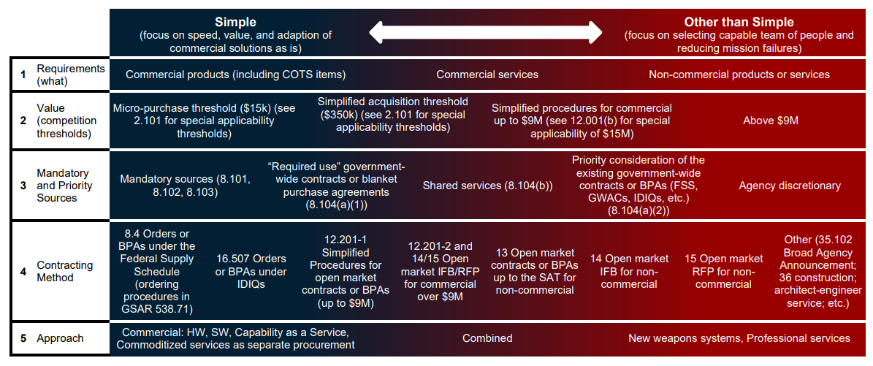
RFO Walkthrough Chart
Right-Sized Planning and Commercial-First Procurement Strategy: What does the RFO Mean for your Acquisition Strategy?
RFO Parts 7, 10, 8, 12
FAR Companion
Category Management Buying Guide
Smart Accelerators from
Practitioner Albums
Testing, Training & Coaching
EXAMPLE
Oral Acquisition Plans (FC 7.102(a))
Let’s Dive into all of the above!
Notes:
Monica

Slide 16
RFO Parts 7, 8, 10 & 12: Right-Sized Planning and Commercial-First Procurement Strategy
RFO 7
Establishes comprehensive acquisition planning requirements that emphasize early planning, streamlined procedures for common contract types, mandatory small business considerations, and comparative analysis for equipment acquisitions to ensure the most advantageous approach for the Government.
RFO 10
"Agencies must procure commercial products and commercial services to the maximum extent practicable and prioritize procuring commercial products and commercial services on an existing governmentwide contract".
RFO 12
“If commercial products or commercial services that meet agency needs are available from any priority source identified in part 8, including existing contracts awarded for Governmentwide use (e.g., the Federal Supply Schedules and Governmentwide acquisition contracts), procure the commercial products or commercial services from that source.”
RFO 8
Must use existing governmentwide contracts and BPAs that are “required use” and must* consider existing governmentwide contracts and BPAs that are otherwise part of Category Management principles.
Notes:
Monica

Slide 17


Acquisition Planning is Strengthened by Good Market Research
People Collaboration Over Paper Documentation is Essential to Mission Success.
Acquisition Complexity Informs Acquisition Planning
The RFO shifts acquisition planning from a…
RFO 10 - Market Research is an element of Acquisition Planning. It informs requirements, contract type selection, evaluation criteria, competition approach.
one driven by understanding requirements, demanding meaningful, collaborative actions to efficiently realize the mission's need.
document-centric
process
Codified FAR 7.105 Contents of written acquisition plans, RFO 7.102 Requirements, and FC 7.104(c) Contents of acquisition plans
Codified FAR 10.002 Procedures, RFO 10.001 Market research requirements, and FC 10.001(b) Sources for market research
[RFO image needed]
Notes:
Monica

Slide 18
RFO 7 - Acquisition Planning and RFO 10 - Market Research
RFO 7.102 Requirements*.
(a) Agencies must perform acquisition planning for all acquisitions. Agencies should establish procedures to determine when a written or oral acquisition plan is required (see 7.103). The record of the acquisition plan must be appropriate for the type of acquisition and document decisions and actions to ensure-
(1) Information is available for making informed decisions at each step in the acquisition process;
(2) There is clear support for all actions taken;
(3) Necessary information is available for reviews or investigations; and
(4) Essential facts are available in case litigation arises.
…
(d) A written plan is required for cost reimbursement and other high-risk contracts other than firm-fixed-price contracts. Agencies may require written plans for firm-fixed-price contracts as appropriate.
RFO 10.001 Market research requirements*.
(b) Agencies must conduct market research appropriate to the circumstances before—
…
(2) Soliciting offers for acquisitions with an estimated value over the simplified acquisition threshold; or
(3) Awarding a task or delivery order over the simplified acquisition threshold.
(e) Agencies must document the results of market research in a manner that suits the acquisition’s size and complexity.
Notes:
Monica

Slide 19
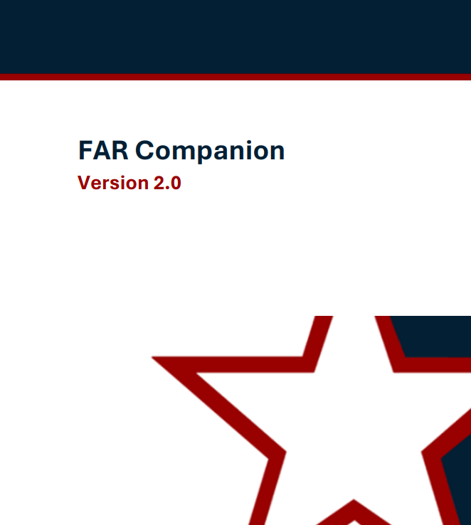
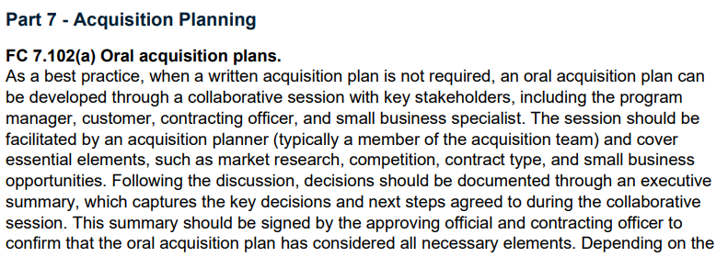
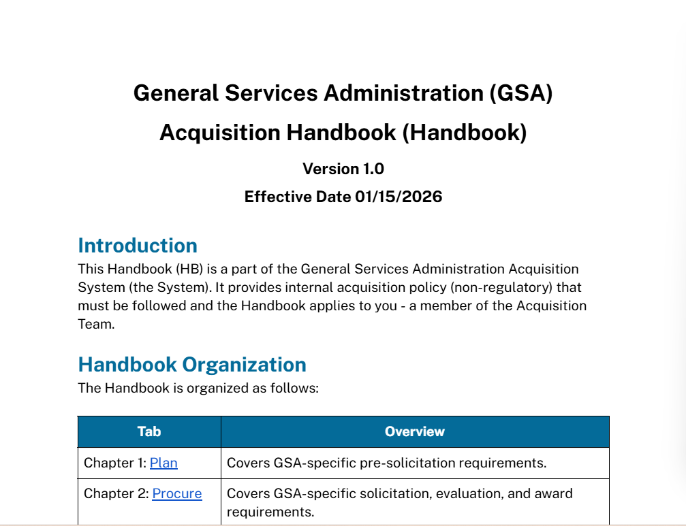
Streamline your Acquisition Planning - Spotlight on Oral Acquisition Plans
Smart
SA
Accelerator
This flexibility encourages GSA contracting activities to utilize oral acqusition plans for certain acquisitions
Smart Accelerators from
Practitioner Album 7
GSA Acquisition Handbook
RFO 7
EXAMPLE
Oral Acquisition Plans (FC 7.102(a))
Use Case: Elements of an Oral Plan
GSA Federal Aquisition Service IT Requirements Oral AP
What are you buying?
What is the acquisition history?
What is the dollar value?
What is the period of performance (including options)?
What are your market research findings?
Sources
Competition…
Planned contract type
Performance-based outcomes
Small business participation
Pre-existing contracts
What are the anticipated source selection procedures?
LPTA, Tradeoff, HTR-FRP, Other
What are the anticipated evaluation criteria?
Risks/other considerations?
Notes:
M & D

Slide 20
CMBG Walkthrough
Using the Category Management Buying Guide in your Work
CMBG
Step 1) Validate Requirement Step 4) Vet Pre-Competed Vehicles
Step 2) Verify Required Sources Step 5) Venture into Open Market
Step 3) Validate Dollar Threshold
The Category Management Buying Guide Continuum is a framework that helps implement the RFO's new acquisition planning mindset by providing a structure to scale your actions and focus your effort. You can:
Streamline the process by using efficient contract vehicles for the simple components.
Focus your time and effort on planning and procuring the unique elements.
Accelerate your timeline and reduce overall risk.
Let’s check it out
Navigating the Procurement Continuum
Most procurements fall between "Simple" and "Complex." Your objective as an acquisition professional is to bridge that gap. Always look for ways to deconstruct complex requirements into smaller, more manageable components to simplify the process and accelerate execution
Notes:
Monica

Slide 21
RFO 7 and RFO 10 CMBG
RFO 7 - Acquisition Planning & RFO 10 - Market Research & the Category Management Buying Guide
CMBG
Category Management Buying Guide Continuum
Right Sized Planning. Adjust for Complexity.
Notes:
Monica

Slide 22
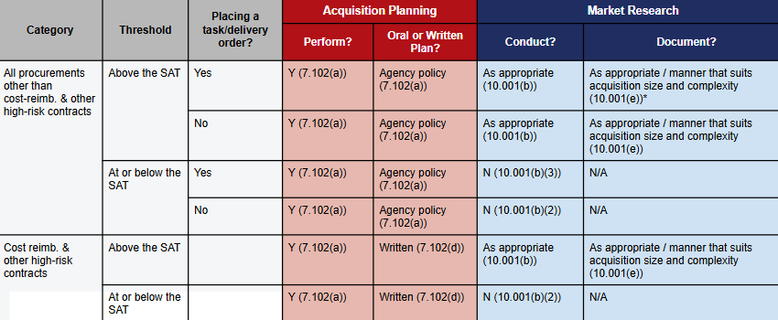
RFO 7 - Acquisition Planning and RFO 10 - Market Research Contd.
Market Research & Acquisition Planning Chart
Transforming the process
Right-sized planning & documentation: Understanding written plans and detailed reports are not always required, depedning on contract type and risk
Threshold Flexibility: For acquisitions up to the Simplified Acquisition Threshold (SAT), formal market research is not a mandatory prerequisite before soliciting offers. This accelerates the front-end of the procurement cycle.
Leveraging Existing Vehicles: When using Federal Supply Schedules (FSS), GWACs or Multiple-Award Contracts established via Category Management, you can bypass the formal written market research report. These vehicles are pre-vetted, saving significant administrative time.
Let’s dive in
Notes:
Monica

Slide 23
RFO 7 - Acquisition Planning and RFO 10 - Market Research Contd..
Category | Threshold | Placing a task/delivery order? | Acquisition Planning |  | Market Research
 |  |  | Perform? | Oral or Written Plan? | Conduct? | Document?
All procurements other than cost-reimb. & other high-risk contracts | Above the SAT | Yes | Y (7.102(a)) | Agency policy (7.102(a)) | As appropriate (10.001(b)) | As appropriate / manner that suits acquisition size and complexity (10.001(e))*
 |  | No | Y (7.102(a)) | Agency policy (7.102(a)) | As appropriate (10.001(b)) | As appropriate / manner that suits acquisition size and complexity (10.001(e))
 | At or below the SAT | Yes | Y (7.102(a)) | Agency policy (7.102(a)) | N (10.001(b)(3)) | N/A
 |  | No | Y (7.102(a)) | Agency policy (7.102(a)) | N (10.001(b)(2)) | N/A
Cost reimb. & other high-risk contracts | Above the SAT |  | Y (7.102(a)) | Written (7.102(d)) | As appropriate (10.001(b)) | As appropriate / manner that suits acquisition size and complexity (10.001(e))
 | At or below the SAT |  | Y (7.102(a)) | Written (7.102(d)) | N (10.001(b)(2)) | N/A
*FC 10.001 Commercial acquisitions.
Under FAR 10.001, market research is not required prior to soliciting offers for acquisitions with an estimated value up to the simplified acquisition threshold. Further, a written market research report is not required prior to placing an order for commercial products or services under existing Federal Supply Schedule contracts or governmentwide acquisition contracts established by category management. The contracting officer’s award documentation can serve as sufficient documentation of market research depending on the size and complexity of the acquisition. Refer to the applicable ordering procedures of the contract vehicle for specific guidance.
Notes:
Monica

Slide 24
Streamline your Acquisition Planning
Quick Trivia: What opportunities can you identify to streamline your Acquisition Planning?
Notes:
Monica

Slide 25
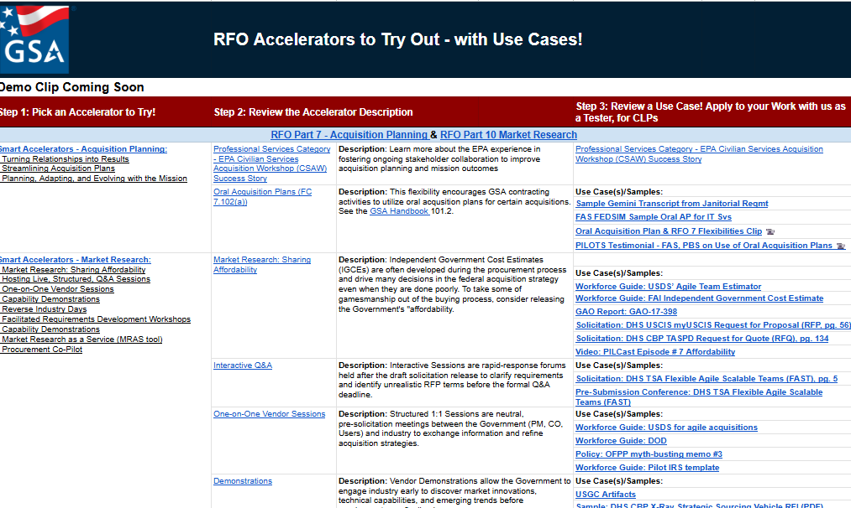
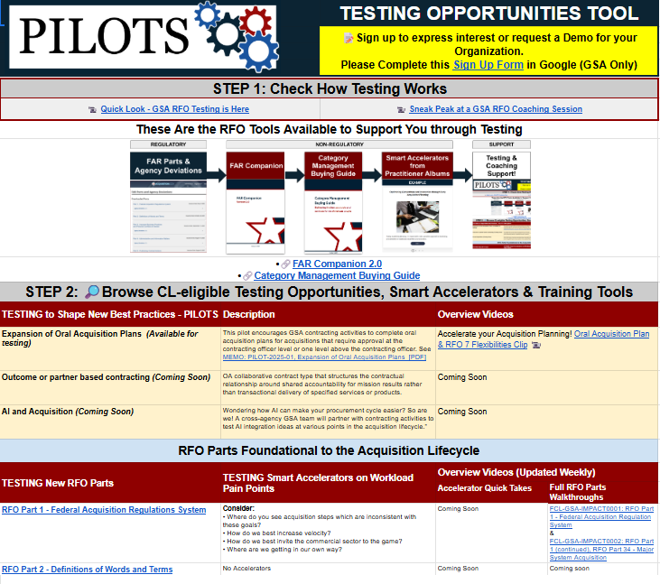
At GSA: Overview of New Testing Opportunities Tool:
Any Pain Point for the AWF can be a Testing Opportunity for Coaching Support and talking with your local AIA or lab (if available) is a great start!
GSA Testers come talk with us!
Non-GSA ers email SAGTesting@gsa.gov
The GSA Testing Opportunities Listing provides ideas based on the evolving Regulatory and Non-Regulatory Environment.
Check out Use Case Library via Testing Opportunities Tool curated from the PTAI and real learning artifacts from our testers
Notes:
M & D

Slide 26
Summary: RFO parts
RFO 1 - Federal Acquisition Regulations System: Implements a new Framework & Tools that emphasizes discretion to the CO
RFO 7 - Acquisition Planning & RFO 10 - Market Research: Encourage COs to right size their Market Research documentation and Acquisition Planning approaches to the risk of the procurement.
Tailor your acquisition planning
Use the Simple vs. Other-than-Simple Continuum as a guide!
Your decisions in market research must logically support decisions for contract type
Use market research strategically
Market research is key intelligence that must guide contract and risk decisions
RFO 12 - Acquisition of Commercial Products & Services: One Commercial FAR Part for Streamlined Flexibility.
RFO 8 - Required Sources of Supplies and Services: Sets the Source! Ordering procedures for the FSS are now in GSAR 538.71 & More Discretion over Competition and Strategy.
Collaboration is Key
The RFO moves acquisition planning from a document-centric process to one driven by understanding requirements and demanding meaningful, collaborative actions to efficiently realize the mission's need.
Keep the momentum going! Become familiar with the flexibilities under RFO parts 12, 8, 16, and 15! These may have impacts on your acquisition strategy!

Slide 27





Practitioner Resources
AI in Acquisition:
Prompt Engineering credential on CSOD
Generative AI for Acquisition Professionals (file following session) 💡
Prompt Engineering Library for Acquisition (file following session)
Email: andrea.azarcon@gsa.gov
Testing and Coaching:
SAGTesting@gsa.gov
GSA Testing and Coaching (PILOTS)⚙️
Public-facing Federal Innovation Labs & Sites
Office Hour Events:
FAR Forward Alliance - The Huddle Register
FAR Forward Open Office Hours - Register
FAI/OFPP Office Hours for Supervisors register
DOW Connect Live 🎙️
Training:
Navigating the FAR Framework Course 🧭
RFO High Intensity Immersive Training (HIIT) Workshops: RFO HIIT - Foundation📌
GSA RFO/RGO Pillars L&L Series
GSA IMPACT Sessions🛠️
FAI CSOD RFO Playlist
By the FAR Part:
Acquisition.gov for RFO Parts 🏛️
Practitioner Albums 📚
FAR Companion
Category Management Buying Guide 📘
The RFO Comparison Tool
Attachment Enhanced Flexibilities Guide 🚀 (file following session)
Communities of Practice:
TechAcq CoP💻: TECHACQ-COP@listserv.gsa.gov
AIAs AIA Council Directory
FAR Forward Alliance in CSOD
RFO

Slide 28
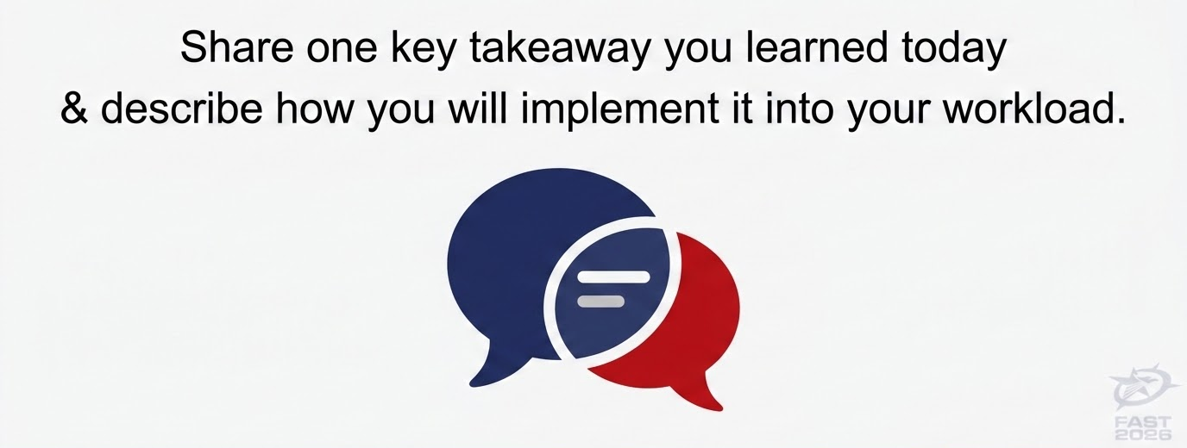
Let’s discuss

Slide 29
Thank you slide

Slide 30
Closing Slide

