Slide 1
Federal Acquisition Service Overview
U.S. General Services Administration
Small Business Works 2023: Navigating Equity in Procurement

Slide 2
Topics
GSA Mission
GSA Schedule Contracts
Multiple Award Contracts (MACs)
Governmentwide Acquisition Contracts (GWACs)
GSA eTools

Slide 3
GSA Mission
“To deliver the best customer experience and value in real estate, acquisition, and technology services to the government and the American people.”
Vision: Effective and efficient government for the American people.
Values: Service, Accountability, and Innovation Federal Acquisition Service
Possesses unrivaled capability to deliver comprehensive products and services across government at the best value possible.

Slide 4
GSA Schedule Contracts
Federal Supply Schedule (FSS) - governmentwide contract vehicle for commercial products, services, and solutions
Also known as “Multiple Award Schedule (MAS)”
GSA receives Schedule contract offers through standing solicitations
GSA conducts negotiations; awards; and administers Schedule Contracts IAW FAR Part 12

Slide 5
GSA Schedule Facts
Over 25 million commodities and services
Over 18,500 Schedule contracts
80% are small businesses
$48 Billion total annual spend
Orders are governed by FAR 8.4

Slide 6
GSA Schedule Value Proposition
Realize cost savings
Experience Flexibility and Choice
Save Time
Control the Procurement

Slide 7
Products Available on Schedule
Office Supplies and Equipment
Tools and Hardware
Building and Industrial Materials
Furniture
Scientific Equipment
Information Technology Products
Vehicles and support equipment
Appliances and Food Services
Law enforcement, Fire, and Security Products
Note: For a comprehensive list of products please visit GSA eLibrary. www.gsaelibrary.gsa.gov
www.gsa.gov/schedules

Slide 8
Services Available on Schedule
Environmental Services
Professional Engineering Services
Logistics Services
Language Services
Management and Consulting Services (including Training)
Temporary Administrative and Professional Services
Information Technology Services
Advertising and Marketing Services
Financial and Business Solutions
Security Solutions
Facilities Maintenance
Disaster Relief
Note: For a comprehensive list of services please visit GSA eLibrary. www.gsaelibrary.gsa.gov

Slide 9
Multi-AGENCY Contracts (MACs)
Governmentwide contracts available to authorized ordering activities for a wide variety of products and services
GSA MACs include:
OASIS and OASIS SB (One Acquisition Solution for Integrated Services)
HCaTS (Human Capital and Training Services)
BMO (Building Maintenance and Operations)
Ordering procedures prescribed by FAR 16.505
Limited task order protest ability (Increase in scope, period of performance, or dollar value up to $10M)

Slide 10
Governmentwide Acquisition Contracts (GWACs)
A Governmentwide Acquisition Contract (GWAC) is defined as a task or delivery order contract for information technology (IT)
Hardware, software and ancillary services may be acquired to support a services task
GSA manages the following GWACs:
Alliant 2
8(a) STARS III – an 8(a) set-aside contract
VETS 2 – a Service-Disabled Veteran-Owned Small Business set-aside

Slide 11
GSA ETOOLS
Notes:
Slide is self-explanatory and does not have notes.

Slide 12
_{www.gsaadvantage.gov}
Search
Review
Place Order
View history
GSA Advantage!® - an online shopping service through which ordering activities may place orders against the Schedules using the Governmentwide Purchase Card.

Slide 13
_{www.gsaelibrary.gsa.gov}
Schedules listings
Descriptions
Clauses
Contractor details
EPLS status
_{eLibrary}
eLibrary - The official online source for complete GSA and VA Schedules information – a great market research too!
Notes:
GSA eLibrary provides access to information on millions of supplies and services. It is the official online source for complete GSA and VA Schedules contract award information.
GSA eLibrary is a centralized source for researching Schedules that include:
Basic ordering guidelines
Complete Schedule listings
Powerful search engine
Vendor socioeconomic status
GSA eLibrary enables you to search which suppliers have a contract and what is currently available. Searches can be conducted using various search options, e.g. Schedule contractor’s name, contract number, SIN / NAICS, Schedule number or keyword.
GSA eLibrary provides links to GSA Advantage!® and GSA eBuy for ordering agencies and provides direct access to contractor websites and email addresses.

Slide 14
_{www.ebuy.gsa.gov}
Post Requirements
Issue RFI/RFQ
Notification of Award
eBuy - An online RFQ system that allows ordering activities to post requirements, obtain quotes, and issue orders.
Notes:
Issuing an RFQ via eBuy allows ordering activities to post requirements, obtain quotes, and award orders electronically.
eBuy, GSA’s electronic Request for Quotation (RFQ) system, streamlines the buying process with point and click functionality by allowing RFQs and RFIs to be exchanged between Federal buyers and Schedule contractors. Use of eBuy increases competition in Federal contracting through its transparency feature; it allows maximum exposure to all vendors within a specific SIN. eBuy greatly supports civilian and DoD goals of increased competition in contracting.
Market research may be facilitated using eBuy to distribute an RFI to Schedule contractors. Using an RFI via eBuy may produce valuable feedback from potential Schedule contractors on how to best tailor the acquisition and how to best utilize Schedule sources. RFIs should be clearly identified as such and include a statement such as: “This is a request for information only. No award will be made as a result of this request.”

Slide 15
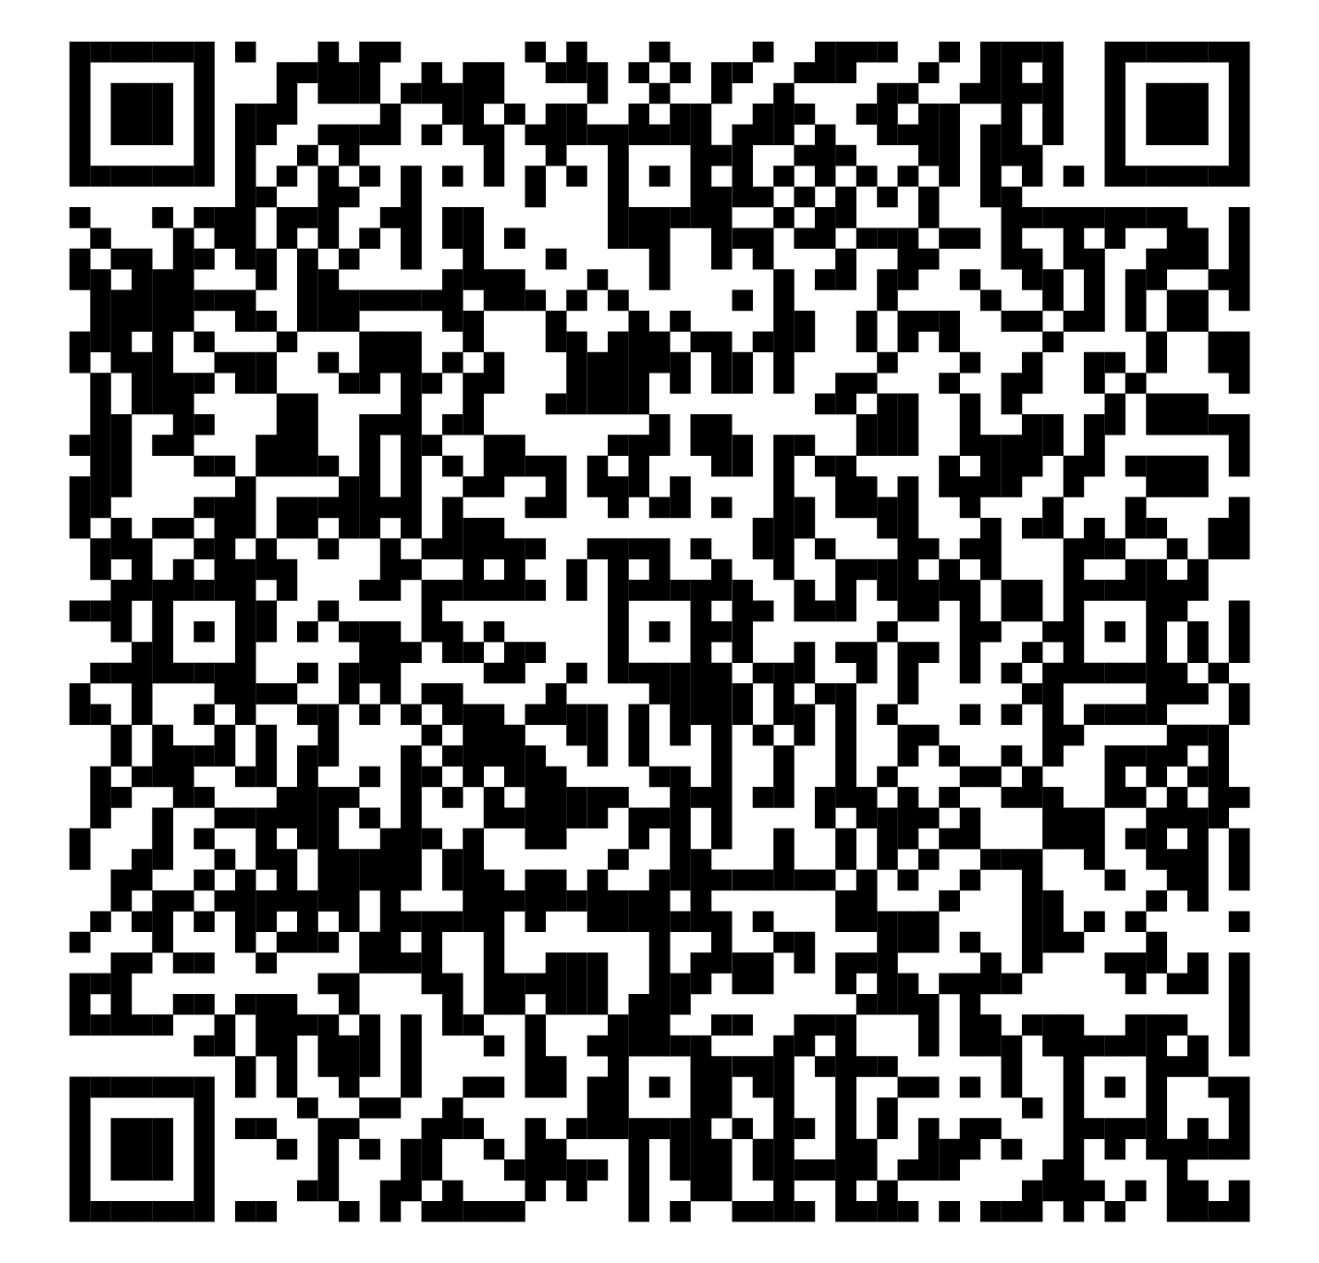
Joey Phelps Business Development Speciaist joey.phelps@GSA.GOV
Notes:
Issuing an RFQ via eBuy allows ordering activities to post requirements, obtain quotes, and award orders electronically.
eBuy, GSA’s electronic Request for Quotation (RFQ) system, streamlines the buying process with point and click functionality by allowing RFQs and RFIs to be exchanged between Federal buyers and Schedule contractors. Use of eBuy increases competition in Federal contracting through its transparency feature; it allows maximum exposure to all vendors within a specific SIN. eBuy greatly supports civilian and DoD goals of increased competition in contracting.
Market research may be facilitated using eBuy to distribute an RFI to Schedule contractors. Using an RFI via eBuy may produce valuable feedback from potential Schedule contractors on how to best tailor the acquisition and how to best utilize Schedule sources. RFIs should be clearly identified as such and include a statement such as: “This is a request for information only. No award will be made as a result of this request.”

Slide 16
GSA

