Slide 1
MAS Value-Added Reseller (VAR) Pricing RFI: Strengthening GSA’s Pricing Practices
FAS Office of Business Optimization | June 16, 2025
Notes:
Good afternoon, everyone. I'm Adam Jones, Director of Procedures & Process Management Service Center, and I am here today to share background information and insights gained on the request for information (RFI) published earlier this year.
Interact

Slide 2

Presenter
Adam Jones
Director, Procedures & Process Management Service Center
Adam.Jones@gsa.gov

Slide 3
Value Added Reseller Request for Information (RFI)

Slide 4
RFI on IT Hardware Procured Through VARs
On January 22, 2026, GSA issued a Request for Information (RFI) to enhance the Government’s understanding of the Value Added Reseller (VAR) marketplace under SIN 33411. The RFI closed on February 9, 2026.
Primary Objectives
Primary Objectives
Market Intelligence
Enhance the Government's understanding of the reseller marketplace.
Operational Alignment
Align contracting operations with commercial practices for efficiency and effectiveness.
Industry Empowerment
Enable Industry to clearly propose and communicate value of offerings.
Contracting Officer Support
Provide Contracting Officers with necessary information and tools to ensure fair pricing.
Notes:
Earlier this year GSA issued a Request for Information, or RFI, that closed on February 9, 2026.
Our primary objectives for issuing this RFI:
Enhance the Government's understanding of the reseller marketplace for IT Hardware, specifically under Multiple Award Schedule Special Item Number (SIN) 33411,
Align contracting operations with commercial practices and standards to boost efficiency and effectiveness while minimizing burden on industry and the acquisition workforce
Enable Industry to clearly propose and communicate the value of their offerings.
Ensure we’re providing our Contracting Officers with the necessary information and tools to accurately and efficiently evaluate proposed pricing.

Slide 5




RFI Demographics
136 RFI Respondents Participated
77% Small Business
22% Other than Small Businesses
87% Are VARs
Value Added Resellers
87% GSA MAS
Currently have a GSA MAS contract
67% SIN 33411
MAS contract includes SIN 33411
Notes:
There were 136 RFI respondents; however, not all entities responded to every single question.
77% of respondents (106) are Small Businesses and 22% are Other than Small Businesses
87% report they are considered a VAR
87% of respondents (119) currently have a GSA MAS contract
67% of respondents (88) reported that their MAS contract includes SIN 33411

Slide 6
Key Insights

Slide 7

Widely Accepted Commercial Definitions for Resellers and VARs
Majority of respondents indicated there are widely accepted commercial definitions for:
Resellers
Value Added Resellers (VARs)
Notes:
The majority of respondents indicated there are widely accepted commercial definitions for resellers and value added resellers.

Slide 8

Suggested Definition for Reseller
A suggested definition of Reseller is a company that is authorized by an original equipment manufacturer (OEM) to act as an intermediary, primarily focusing on the transaction and delivery of products to end customers.
Notes:
A suggested definition of Reseller is a company that is authorized by an original equipment manufacturer (OEM) to act as an intermediary, primarily focusing on the transaction and delivery of products to end customers.

Slide 9
Suggested Definition for VAR
A suggested definition of Value Added Reseller is a type of reseller that, in addition to selling the Original Equipment Manufacturer (OEM)'s product, also provides services from which the end customer directly benefits, such as configuration, licensing, integration, or professional support.
Notes:
A suggested definition of Value Added Reseller is a type of reseller that, in addition to selling the Original Equipment Manufacturer (OEM)'s product, also provides services from which the end customer directly benefits, such as configuration, licensing, integration, or professional support.
A VAR is a reseller that provides additional, customer-specific services beyond basic fulfillment that directly benefit the customer, driving higher markups and reducing the buyer's implementation burden
The ultimate goal of a VAR is to assume responsibility for delivering a fully operational solution and supporting outcomes (e.g., risk reduction, accelerated time-to-deploy) in addition to simply providing the hardware.

Slide 10

Government Work is More Costly
Operational Cost Drivers
Serving government customers involves higher operational costs than the commercial sector. Key factors include:
Mandatory Security Compliance: Requirements like CMMC and FIPS demand rigorous standards.
Extensive Audit Documentation: High administrative burden for record-keeping and transparency.
Specialized Contract Management: Need for expertise in complex government procurement rules.
Notes:
There was a consensus that serving government customers involves higher operational costs than the commercial sector. Key factors include:
Mandatory Security Compliance: Requirements like CMMC and FIPS demand rigorous standards.
Extensive Audit Documentation: High administrative burden for record-keeping and transparency.
Specialized Contract Management: Need for expertise in complex government procurement rules.

Slide 11

Value in the Service, Not Product Markup
Core Value-Add
The justification for a VAR's margin lies in labor, technical expertise, and risk mitigation, rather than just product markup.
Essential to supply chain, provides:
Multi-vendor integration
Security hardening
Supply chain assurance
Compliance management
Notes:
The Value is in the Service, Not the Product Markup: Respondents across the board affirm that the "value-add" that justifies their margin is the labor, expertise, and risk mitigation they provide (e.g., complex multi-vendor integration, security hardening, supply chain assurance, and compliance management). Many submissions argue that VARs are essential, not mere "pass-through" entities, and provide critical services that OEMs do not necessarily provide to offer a total solution, such as:
Reducing administrative burden on the government.
Providing technical expertise and integrated, multi-OEM solutions.
Making significant, non-recoverable upfront investments (e.g., qualifying technologies, demonstrations).
Handling complex regulatory compliance (FAR, DFARS, cybersecurity). -a major reason some OEMs don't want to be prime contractors

Slide 12



Recommended Pricing and Evaluation Framework
Total Value Focus
Focus on value (e.g., total cost of ownership, mission success) rather than percentage-based markups.
Explicitly differentiate VARs from resellers.
Line-Item Pricing
Encourage line-item pricing for VARs to clearly separate pure product resale from value-added services (VAS).
Allow for flexibility to align with various commercial practices.
Markup Disclosure
Oppose mandatory disclosure of simple markup percentages, as they may violate OEM agreements and fail to capture full value.
Backend incentives and rebates may obscure visibility into true costs.
Notes:
FAS’s interest is how to do we translate that into an effective pricing and evaluation framework
Total Value Focus:
Pricing and evaluation frameworks should focus on value (e.g., total cost of ownership, mission success) rather than percentage-based markups.
Recognizes and clearly differentiates pure resale from value-added services.
Line-Item Pricing
Allows for flexibility in pricing structures (e.g., embedded vs. line-item services)
A majority of respondents advocated for evaluation frameworks that encourage line-item pricing for complex procurements to clearly separate product resale from value-added services (VAS) and increase transparency.
For example: Proposals could include a clear, itemized breakdown, often showing a separate line item for the hardware, a separate line item for software licenses, and a separate section for professional services. This provides transparency on the service costs.
This would allow for flexibility to align with various commercial practices.
Markup Disclosure
Oppose mandatory disclosure of simple markup percentages for a variety of reasons; notably, this may violate OEM agreements and fail to capture full value provided by the reseller. Rigid controls like markup caps or complex cost disclosures presents will:
Hurt small businesses.
Drive business out of the market.
Increase administrative burden for both contractors and the government.
Not fully account for the value, risk, and compliance obligations assumed by resellers.
Backend incentives and rebates may obscure visibility into true costs.
Markup is Deceptive
Profit is Hidden: The impact of Original Equipment Manufacturer (OEM) backend incentives and rebates varies. Several respondents acknowledge backend incentives translate into savings and discounts to federal end-user customers; others noted that rebates lower costs, but don’t necessarily lead to more competitive prices on individual offers. Bottom line: Backend rebates obscure the visibility into the VARs true cost and profit.

Slide 13
Strengthening GSA’s VAR Pricing Practices

Slide 14




Potential MAS Solicitation Enhancements
Definitions
Add clear definitions to distinguish between VARs and resellers.
Description of Services
Require VARs to provide a detailed description of value-added services.
Line-Item Pricing
Encourage offerors to propose separate line-item pricing for value-added services.
Workforce Training & Customer Guidance
FAS will develop workforce training/resources and customer-facing content to support these enhancements.
Notes:
What is FAS doing with this information? This is still preliminary, but we’ve identified a few areas for potential improvement.
FAS is considering solicitation changes that will allow VARs to clearly communicate the value of their offerings while aligning with commercial practices and minimizing administrative burden.
Definitions: Add clear definitions to distinguish between VARs and resellers.
Description of Services: Require VARs to provide a detailed description of value-added services.
Line-Item Pricing: Encourage offerors to propose separate line-item pricing for value-added services. - feedback was that many VARs do this commercially, and this would go a long way to increasing transparency.
Workforce Training & Customer Guidance - FAS will develop workforce training/resources and customer-facing content to support these enhancements.
Key Focus Areas:
Encourage performance-based acquisition strategies (e.g outcome based deliverables)
Importance of obtaining demonstrable value (e.g., mission success, total cost of ownership, secure lifecycle support)
Potential for innovative contracting strategies (e.g., share-in-savings models)
Benefits of line item pricing (e.g., allows for “like-for-like” comparisons, increase in structured pricing data, increased transparency and negotiation leverage, etc.)

Slide 15






Key Takeaways
Key Takeaways
Marketplace Insight
Your feedback has helped FAS better understand the VAR marketplace, with insights to be shared across the acquisition workforce.
Improvement Opportunity
FAS has identified opportunities to enhance solicitation, training, and resources to strengthen pricing practices for agency buyers.
Increased Transparency
Actions will allow VARs to communicate value clearly while aligning with commercial practices and reducing administrative burden.
Enhanced Evaluation
Planned enhancements provide COs with tools to effectively negotiate pricing for VARs and basic resellers.
Strategic Focus
Focus remains on mission success and total cost of ownership rather than simple markup disclosures.
• RFI summary of results now available on GSA Interact. Follow GSA MAS Program community for updates.
Notes:
Marketplace Insight: Your feedback has helped FAS better understand the VAR marketplace, with insights to be shared across the acquisition workforce.
Improvement Opportunity: FAS has identified opportunities to enhance solicitation, training, and resources to strengthen pricing practices for agency buyers.
Increased Transparency: Actions will allow VARs to communicate value clearly while aligning with commercial practices and reducing administrative burden.
Enhanced Evaluation: Planned enhancements provide COs with tools to effectively negotiate pricing for VARs and basic resellers.
Encourage COs to use readily available pricing data such as transactional data (TDR data), commercial pricing, contract level pricing, etc. for establishing negotiation objectives.
The RFI summary of results is now available on GSA Interact.
Continue to follow MAS Program community on GSA Interact for additional updates, including any planned changes to the MAS solicitation
We appreciate your valuable feedback and thank you for your continued partnership.

Slide 16
Made in America on MAS contracts and GSAAdvantage!®
Office of Optimization | June 16, 2025
Notes:
Please ** MAKE COPY TO EDIT**

Slide 17

Presenter_2
Brennan Conaway
Procedures & Process Management Service Center
brennan.conaway@gsa.gov

Slide 18
Background on “Made in America” Laws
Two statutes primarily apply to federal contracts:
  The Buy American Act (BAA)
  The Trade Agreements Act (TAA)
The statutes apply based on the dollar value of the contract. GSA and Contracting Officers (CO) do not get to “choose” which applies.
Statute | When it applies
Buy American Act | $10,000 (micro-purchase) to ~$172,000 (TAA thresholds)
Trade Agreements Act | ~$172,000 (TAA thresholds) and above
Notes:
Other MIA laws:
Berry Amendment (DoD) - Requires certain items (textiles, clothing, food, tools, flags, etc.) to be wholly domestic.
Specialty Metals Restriction (DoD) - Requires specialty metals in covered defense systems to be melted or produced in the U.S.
Kissell Amendment (DHS) - Domestic sourcing requirements for certain textiles and clothing tied to national security missions.

Slide 19
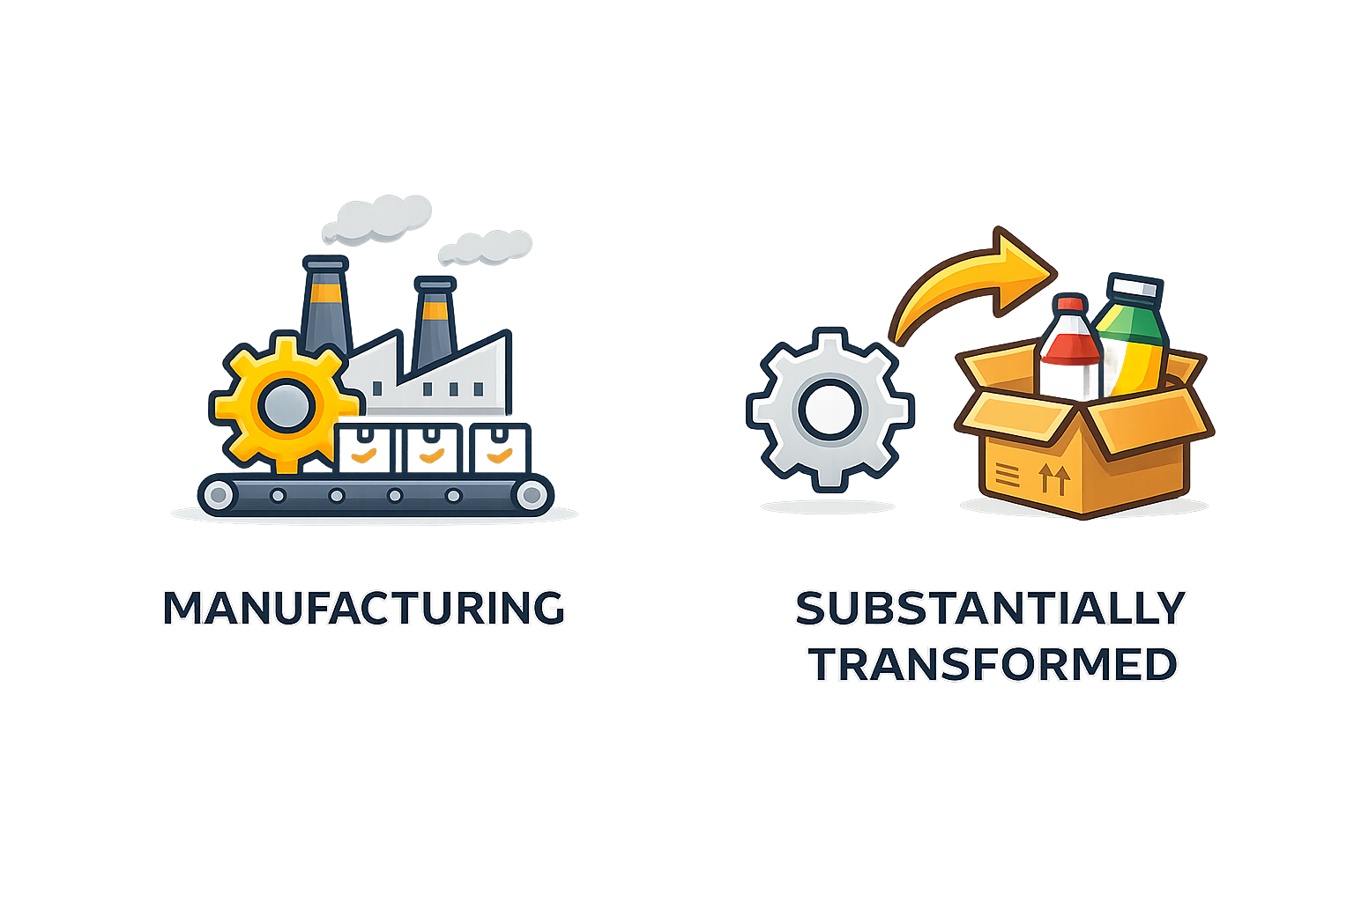


TAA Applies to MAS Contracts because the total dollar value exceeds TAA thresholds
This means MAS awards U.S.-made and “designated country end products” (i.e., products from countries we have a trade agreement with).
Under TAA, products are “from” a country if they are manufactured or substantially transformed (i.e., changed into a new and distinct product) there.

Slide 20
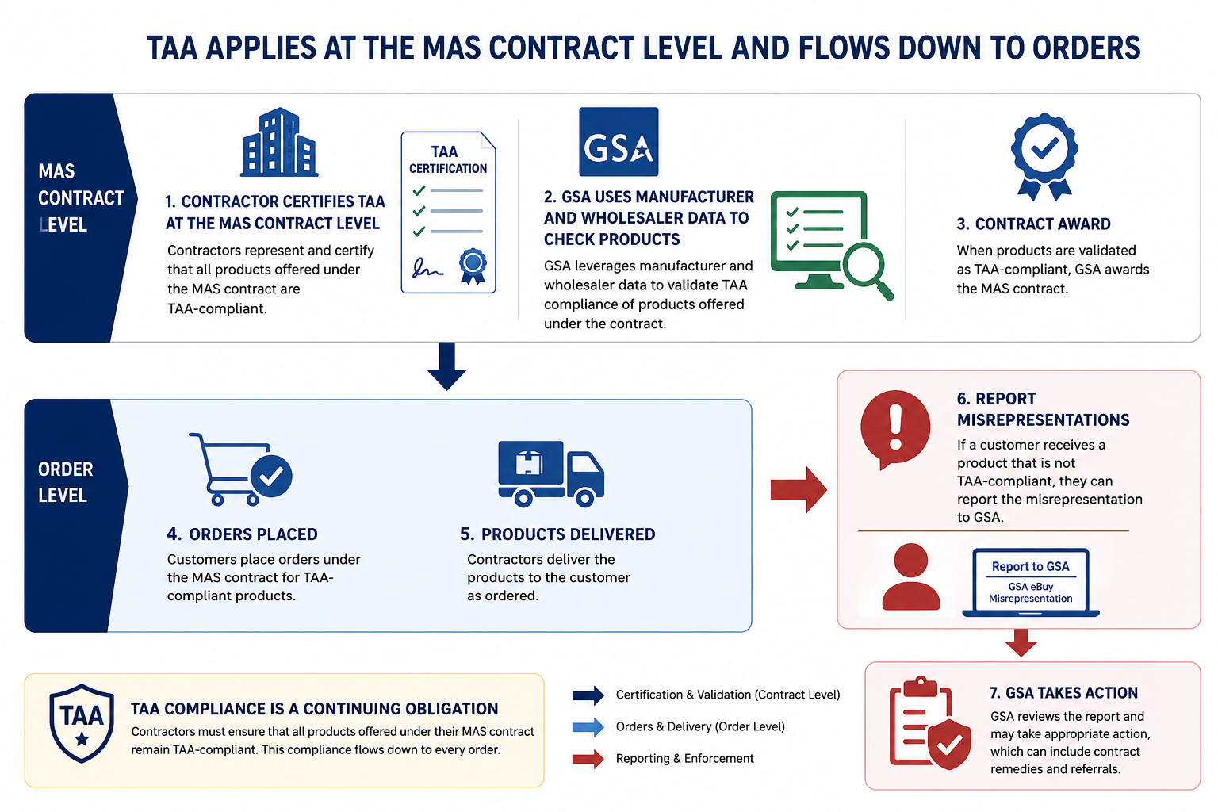
TAA Compliance

Slide 21
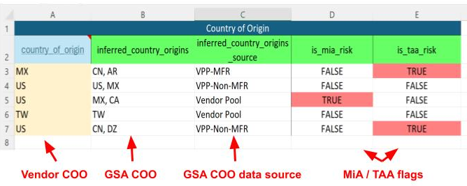
Compliance & Pricing (C&P) Report - Country of Origin Flags

Slide 22
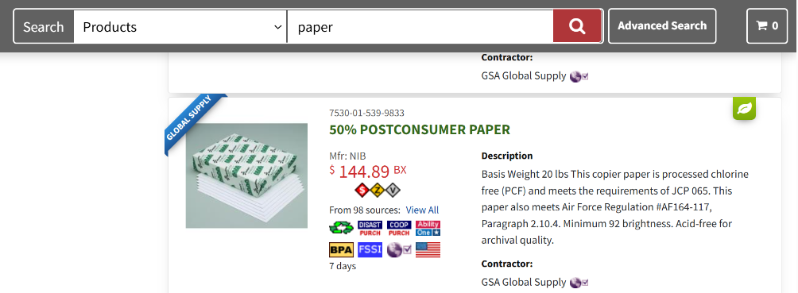
GSAAdvantage! Icon Highlights Products Contractors have Certified as “U.S.” under TAA

Slide 23
Potential Changes to the MAS program
Through forthcoming RFI, GSA will explore ways to make it easier for federal agencies to buy products that meet the BAA component test while maintaining our obligations under the Trade Agreements Act.
The objectives are to:
  On-shore and/or create American jobs
  Promote American manufacturing
  Strengthen an important part of the U.S. economy
  Reduce reliance on foreign manufacturing

Slide 24
What is the BAA Component Test*?
For most products, 65% of the product components must be from the U.S. This increases to 75% in calendar year 2029.
For products that consist mostly or wholly of steel, 95% of the product must be from the U.S.
65%
75%
95%
Now
2029
Now
*See FAR 25.101(a)(2) for the precise text regarding the component test

Slide 25
Two Possible Approaches
Approach 1:
Representation
Icon
Search Results
Survey (if needed)
Allow companies to voluntarily represent that their products meet the component test and qualify as made in America
Add an icon on GSA Advantage to identify the products that meet that criteria.
Filter those items to the top when they meet the search criteria
If the buyer does not select these products, GSA will ask them to complete a survey to understand why they did not select the products that meet the BAA component test. GSA will use this data to better understand the buyers' decision making processes.

Slide 26
Two Possible Approaches
Approach 2:
GSA is exploring the possibility of creating a new Special Item Number (SIN) for products that meet the BAA component test.
The SIN would be limited to one or more selected product categories and would be exclusive to original equipment manufacturers (OEMs).
BAA📦 + OEM🏭 = ✔ BAA SIN Product

Slide 27
Proposed FAR Rule: Prohibition on Certain Semiconductor Products and Services
Supplier Compliance & Supply Chain Risk Management Service Center (SC3) | June 16, 2026
Notes:
Please ** MAKE COPY TO EDIT**

Slide 28
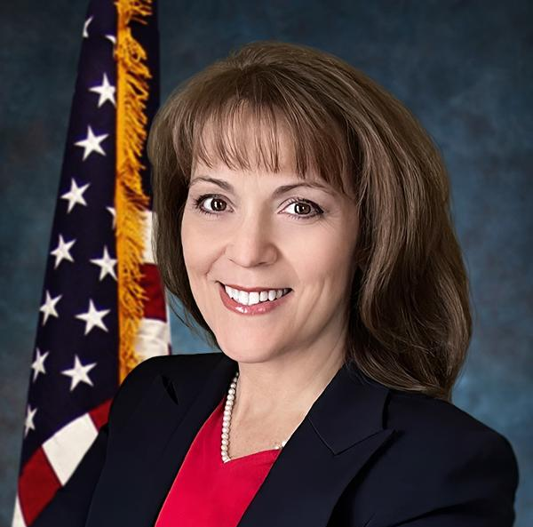
Presenter_3
Kelley Artz
Supply Chain Risk Management Technical Lead - FAS OPTIMIZE SC3
kelley.artz@gsa.gov

Slide 29
Proposed Rule
Section 5949 of the FY 2023 National Defense Authorization Act (NDAA)
This presentation is informational only and does not provide legal advice. Please consult with appropriate legal counsel for specific application.

Slide 30

Purpose of the Proposed Semiconductor Rule
NDAA Implementation
Implements Section 5949 of the FY 2023 National Defense Authorization Act (NDAA).
Procurement Restrictions
Restricts federal procurement of certain semiconductor products/services linked to security vulnerabilities.
Supply Chain Integrity
Aims to strengthen hardware and cyber supply chain integrity across the board.
Visibility & Control
Drives greater visibility and control over semiconductor components in acquisitions.

Slide 31
Scope of the Rule
Procured Products & Services
Applies to electronic products and electronic services procured by federal agencies.
Affected Systems
Covers IT, telecommunications, and other systems that contain semiconductors.
non-commercial services, and commercial IT & telecommunication services
Acquisition Types
Includes both non-commercial services and commercial IT & telecommunication services.
Contractual Relationships
Applies to prime contracts and downstream supplier relationships across the supply chain.

Slide 32
Prohibited Actions After Dec 23, 2027
Procurement Prohibition
Agencies may not procure electronic products or services that include “covered semiconductor products or services”
Comprehensive Application
Applies across contract solicitations, awards, and delivery of affected products/services
Compliance Certification
New FAR provision will require compliance certification during acquisition

Slide 33
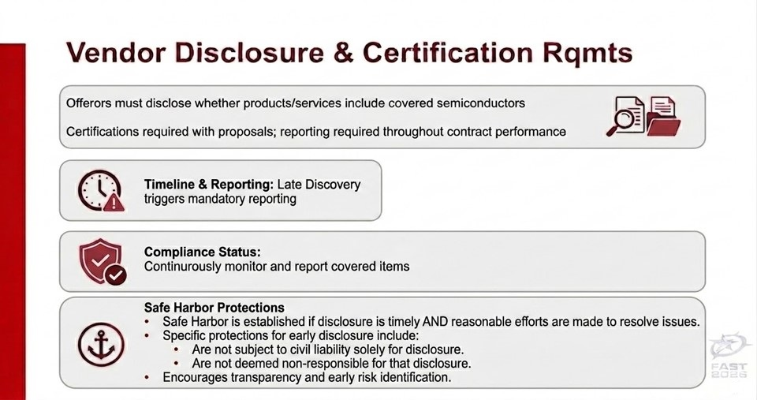
Vendor Disclosure

Slide 34
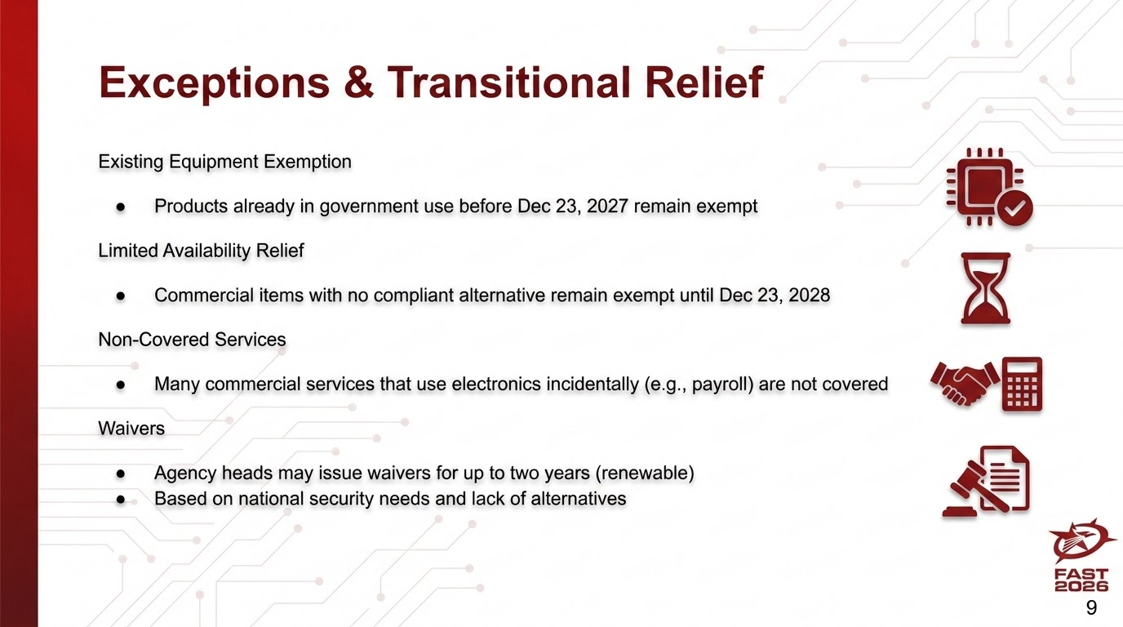
Exceptions & Transitional Relief

Slide 35
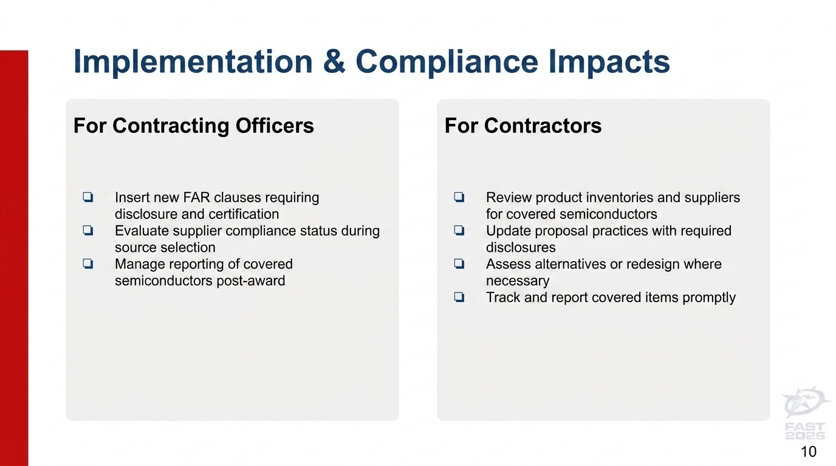
Implementation Impacts

Slide 36
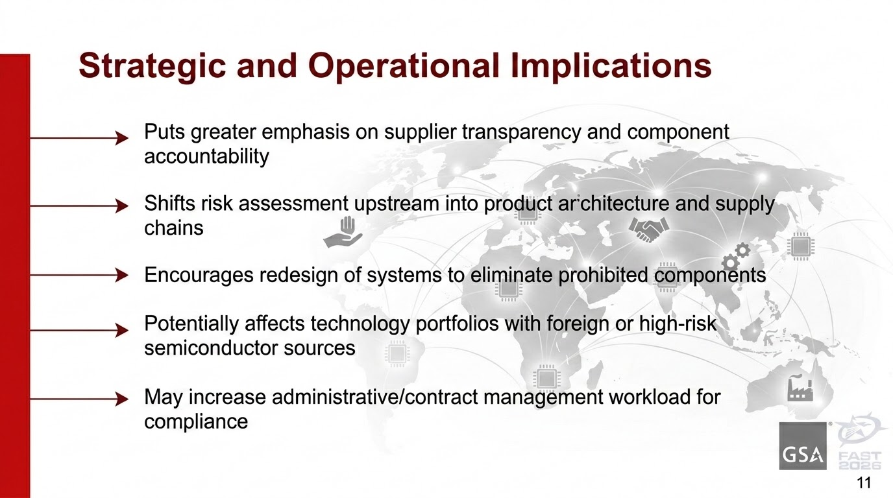
Strategic Implications

Slide 37

Timeline & Next Steps
Proposed rule issued: Feb 17, 2026
Public comments due: Apr 20, 2026
Prohibition effective: Dec 23, 2027
Transitional exceptions apply through Dec 23, 2028
FAS has begun readiness planning

Slide 38
Anticipated Changes to the Multiple Award Schedule (MAS) Pricing Algorithm
Office of Mission Delivery | June 16, 2026
Notes:
Please ** MAKE COPY TO EDIT**

Slide 39

Presenter_4
Alexandar Brown
Systems Service Center
alexandar.brown@gsa.gov

Slide 40
GSA Enhances MAS Program with Pricing 2.0 Refinements
On June 5th, 2026 GSA implemented Pricing 2.0, a targeted refinement to the previous pricing algorithm that reflects this Administration's commitment to ensuring every taxpayer dollar is spent wisely.
Strengthens the Multiple Award Schedule (MAS) program by addressing persistent outlier pricing while maintaining a healthy, competitive marketplace for our industry partners.
While the MAS program overall provides significant market savings, isolated cases of overpricing erode taxpayer confidence.
GSA is addressing these outliers to reduce cost, reinforce trust in federal procurement, and ensure a more consistent marketplace.

Slide 41
Key Changes from Previous Model
Commercial Price Anchor: The Market Baseline is now capped at the lower of the current model's formula or the minimum observed commercial price, excluding outliers. This ensures government baseline pricing cannot drift above the best commercial rates while preserving the analytical rigor of our existing methodology.
Adjusted Price-Proportional Premium: The price-proportional premium will be reduced by 50% from previous levels. Refining this premium reduces excessive price variability for identical items, and protects taxpayers from outlier pricing while maintaining fair profit opportunities for quality contractors.

Slide 42
How Pricing 2.0 Delivers Taxpayer Value While Supporting Fair Competition
Establishes a Clear Market Baseline: The new model caps the Market Baseline at the minimum observed commercial price (excluding outliers), ensuring it cannot exceed the best commercially available rates. This baseline serves as a starting point—not a ceiling—for government pricing.
Maintains Reasonable Pricing Flexibility: The market baseline is adjusted upward through an inflation adjustment and price-proportional premium to establish the market threshold. This balanced approach protects taxpayer interests while ensuring contractors can maintain sustainable margins.
Preserves Contracting Officer Discretion: Contracting Officers retain full authority to negotiate prices based on specific circumstances, ensuring flexibility for unique government requirements while maintaining accountability to taxpayers.

Slide 43
What’s Next?
Pricing 2.0 went live on June 5th, 2026 and will appear in Compliance and Pricing (C&P) reports automatically going forward.
How will the Market Threshold be calculated?
The "market_threshold" column, generated in the Compliance and Pricing (C&P) report, helps to simplify the price evaluation process by using one main number that takes into account various pricing data and trends. The following sources are used to collect pricing data, which are refreshed every two months on a rolling 12-month basis:
Government contract prices from GSA Advantage, FedMall, and NASA SEWP
Government order prices from MAS Transactional Data Reporting (TDR)
Commercial catalog prices
Please review the following resources for step-by-step details and examples:
The “Pricing 2.0 - Refining the Pricing Algorithm for MAS Contracts with Products” Interact Post
The “Market Threshold FAQ” found on the FCP help page

Slide 44
Thank You.

Slide 45
GSA Trademark Logo

