Slide 1
GSA eBuy essentials: Your path to acquisition excellence!
Office of Strategy & Innovation
April 15th, 2026

Slide 2
Speaker
Peter Bastone
Program Analyst

Slide 3
What are we going to cover today?
Introduce eBuy:
Who uses eBuy and what types of requests get created
How it has been making people’s lives easier for two decades
What programs and vehicles does it support?
Register and request:
How to register for a FAS ID and/or link your PIV/CAC card
How to choose a vehicle, and select sources
Completing the request details, and posting the request
Amend, award, and afterwards
How to amend requests and address questions
How to review quotes and make an award notification
How to archive or reissue requests
Wrap up and questions
Post presentation discussion and/or follow ups in more detail as needed.

Slide 4



What are the key takeaways?
What eBuy is, what are the benefits of using it, and where it fits in FAS’ acquisition toolbox.
How to use eBuy to request quotes, proposals, or information.
Ideas for marketing eBuy to your customers, clients, and contract holders.

Slide 5
Introducing eBuy
How eBuy helps you with your work.

Slide 6

Have you ever found yourself…
…Needing a quote or proposal for a service, but having no idea where to start?
…Wondering whether a large quantity buy would enable you to get a better unit price?
…Wanting feedback on requirements or help identifying sources of supply?
Notes:
“Selling eBuy”
This slide describes common tasks that buyers perform on eBuy and how the tool can help them accomplish their missions.
Extra Notes For Trainers
This slide and the next one is intended to allow you to articulate just how valuable eBuy can be. You are connecting with your audience by asking them if they have ever had to do things (that we all know they probably have had to do) and how much eBuy can help.
Remove these trainer notes if you are presenting with visible notes.
You should absolutely customize these two slides to your audience because it can really help you make an early connection.
This type of slide has proven very effective for piquing the interest of customers who may not be familiar with just how much eBuy can do.

Slide 7



You can do that with eBuy!
Services!
Volume Discounts!
Market Research!
eBuy was designed with services in mind! Post your statement of work and the details around your request and get responses.
eBuy makes it easy for you to compete for volume discounts. Sellers can easily offer discounts beyond their normal contract price.
Post draft requirements or requests for information to help find sources and/or get feedback for a future procurement.

Slide 8
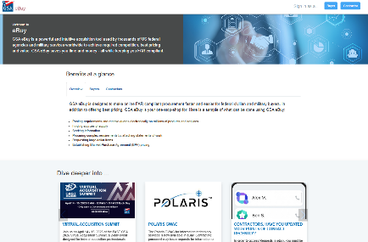
Who can use eBuy?
As a buyer:
Federal agency buyers have full access to request quotes, proposals, or information on all listed acquisition vehicles.
State and Local agency buyers may post requests under Cooperative Purchasing and/or Disaster Recovery solutions.
Native and Tribal users may use the tool in tandem with the authority they have.
As a seller:
Holders of GSA contracts such as Multiple Award Schedules, BPAs, MACs, GWACs, and other IDVs as loaded may respond to requests posted under the categories their contracts cover.

Slide 9

eBuy is Everything
Dental assistant services
Dell computers and laptops
Milk and dairy products
Laptops with and without Docking stations, Monitors
Fire alarm monitoring and inspections
Network Fiber Installation/Replacement
Cleaning Supplies
150 pairs of Reebok boots
BLM-CO CANM HVAC Chiller System Repair
Conference room upgrade
S66 T4 Bobcat Skid Steer Loader with Snowblower Attachment
Interior Painting of Walls and Ceiling
Radiology, Nuclear Medicine, & Healthcare Services
High Resolution Inductively Coupled Plasma Mass Spectrometer (HR-ICP-MS)
eBuy is for EVERYTHING!
40,272 RFQs closed | $28Bn est. awards | 15,773 SB set asides
Notes:
Examples of Requests:
eBuy is used for an incredible variety of requests across a lot of contract vehicles. Anything from shoes, to sleds to services to installations to painting and more.
Extra Notes For Trainers
If you know what your audience is interested in, this is a great opportunity to research similar requests. Some audiences respond very well to being shown that something they want is already being competed.
This is also an opportunity to talk up other tools like buy.gsa.gov libraries where statements of work can be found.

Slide 10
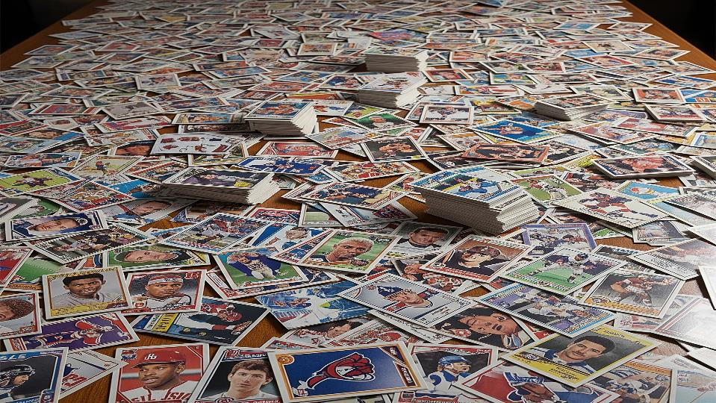
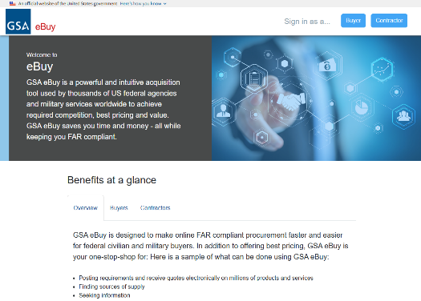

FY2025 Season Stats
Activity:
Req’s: 40,272 | Quotes: 125,848 | 3+: 12,786
Top Users
1: Air Force, 2: GSA, 3: Navy, 4: Army, 5: Off. SecDef
Highlights:
Awards Over $1M: 81 | SB Set asides: 15,773
Breakout:
MAS/VA: 81% | BPAs: 15% | IDVs: 2.5% | Tech: 1.5%
eBuy is the MVP
Notes:
FY2025 Statistics for eBuy Activity
This slide lays out at a high level what kind of activity has run through eBuy in terms of quotes and by vehicle.
Extra Notes For Trainers
This slide is a great opportunity to sell how broad the appeal of buying and/or selling through eBuy is.
Inspiration – make eBuy stats look like a baseball card
RFQs closed (we use “closed” instead of “created” because actions can be taken on them.
Total quotes received
Est. award value
Categories purchased
Top 3 agency buyers

Slide 11
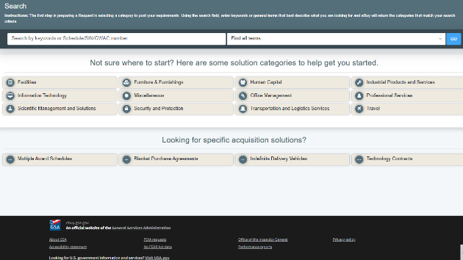
In Summary:
What eBuy is and who can use it:
An online marketplace for government buyers to request quotes, information, or proposals from GSA contract holders.
Who can use it, and when:
Federal, state & local, and native & tribal buyers in accordance with their respective purchasing authority.
Holders of GSA contract vehicles such as MAS or GWACs can respond to quotes
Business Volume:
Steady activity, billions in estimated awards, and still an average of 3 quotes per request.

Slide 12
Accessing eBuy
Your FAS ID, Advantage, and PIV/CAC Cards

Slide 13
Register, register, register…
Register for your FAS ID:
A secure centralized credential for logging into multiple GSA systems (including eBuy and Advantage).
Uses an email address and a password, and then additional information depending on the application.
Enter your email at one of the many entry points such as eBuy or buy.gsa.gov
If you have a FAS ID, you’ll be carried through to collect additional information.
If your email address is not associated with a FAS ID, you’ll complete the registration.
Register through GSA Advantage
eBuy registration goes through GSA Advantage screens.
Identify whether you are a federal or state user and fill out the form as prompted.
Complete the email “handshake” and set up multi factor authentication.
Register your PIV/CAC Card:
You must register the card first (initially or afterwards) before you can use it to log in.
Click the “register PIV/CAC card” link in Advantage member information and select the certificate.
Confirm the certificate and you may now use the “Sign In with PIV/CAC card” in future

Slide 14
An overview of the request process:
Select a request type:
Do you want to receive a quote, a proposal, or information (RFQ, RFP, or RFI)?
Choose a vehicle and find your sources:
Multiple Award Schedules (MAS) and all of its super and subcategories
MACs, GWACs, and other IDVs (OASIS+, Alliant, or 8ASTARS3)
Blanket Purchase Agreements (BPAs) such as 2GIT or GSS IT Products
Enter details, and post:
Give your request a title and details, configure contract and award type, and set a close date
Enter line item data, add attachments, and select a place of performance or delivery
Post, and wait for responses to come in.
Amend, evaluate, and award-notify:
Make amendments or upload answers to questions you’ve received.
Review responses as they come in, and make an award notification after the request closes.
Save the request in your history to reissue later if you need to.

Slide 15
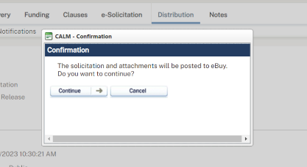
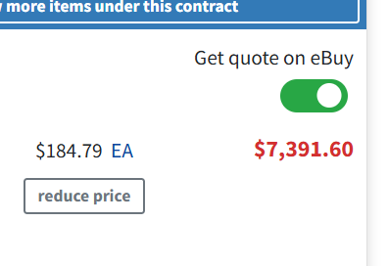
Alternative eBuy entry points:
From CALM via eBuy Connect:
Use CALM to initiate a solicitation and compete it on eBuy. Bring responses back into CALM.
From an Advantage shopping cart:
Toggle “Get a quote on eBuy” from the cart. Selected items are pre-populated in eBuy for you!

Slide 16
Walking Through eBuy
A step by step demonstration.

Slide 17
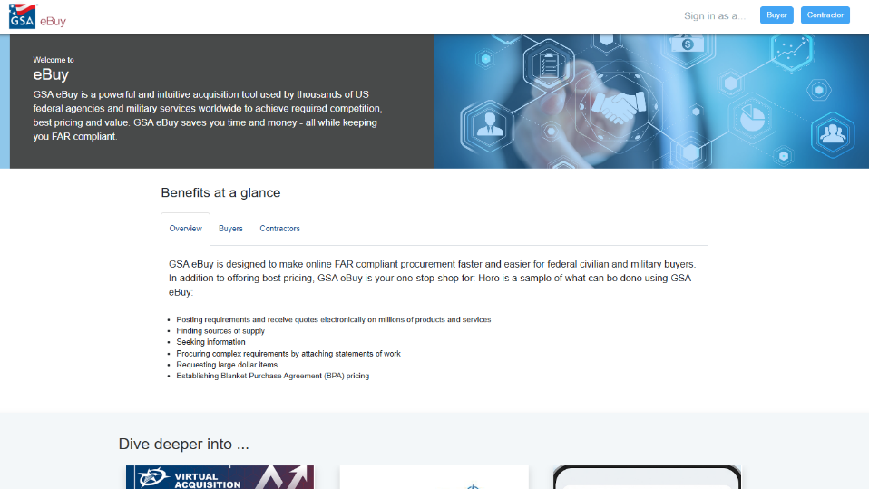
www.ebuy.gsa.gov

Slide 18
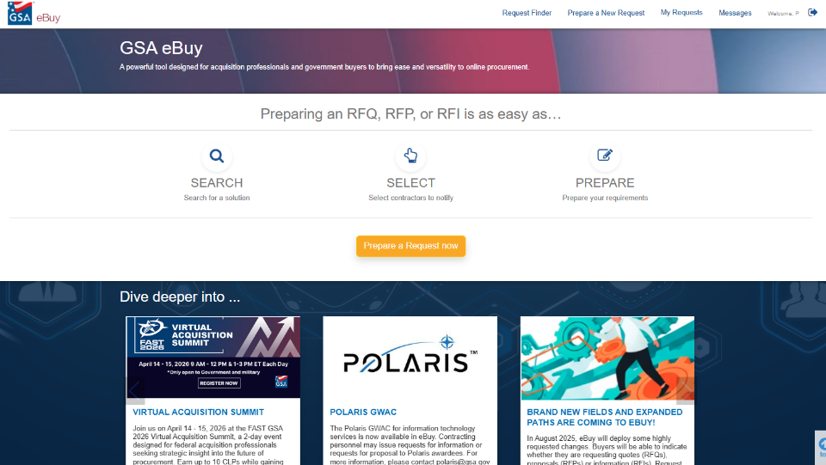
GSA eBuy Continues

Slide 19
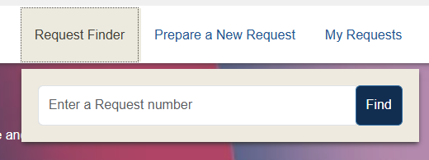
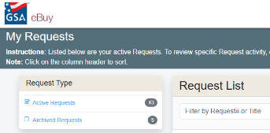
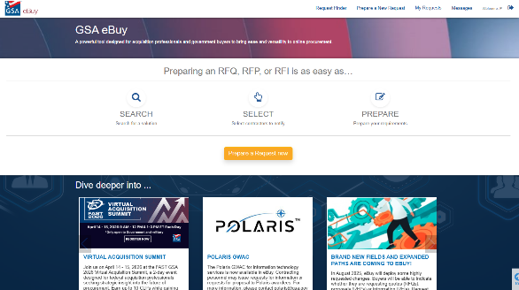
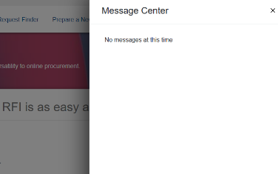
GSA eBuy Requests

Slide 20
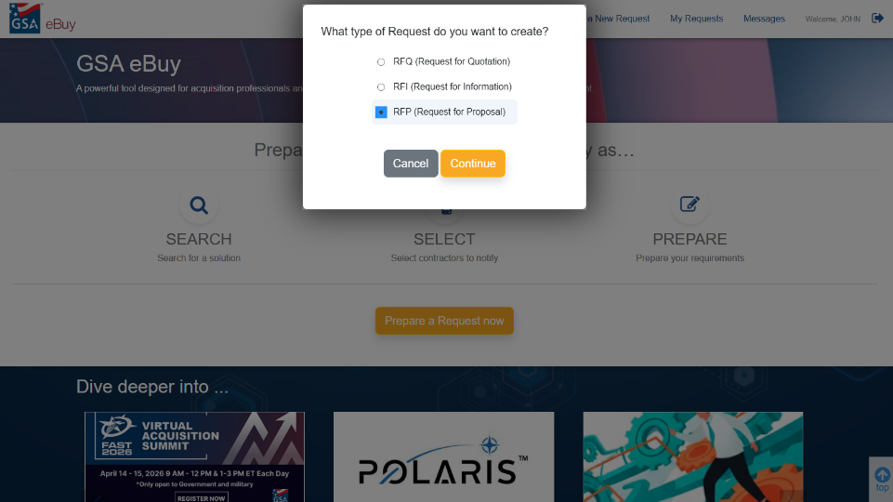
Create a Request

Slide 21
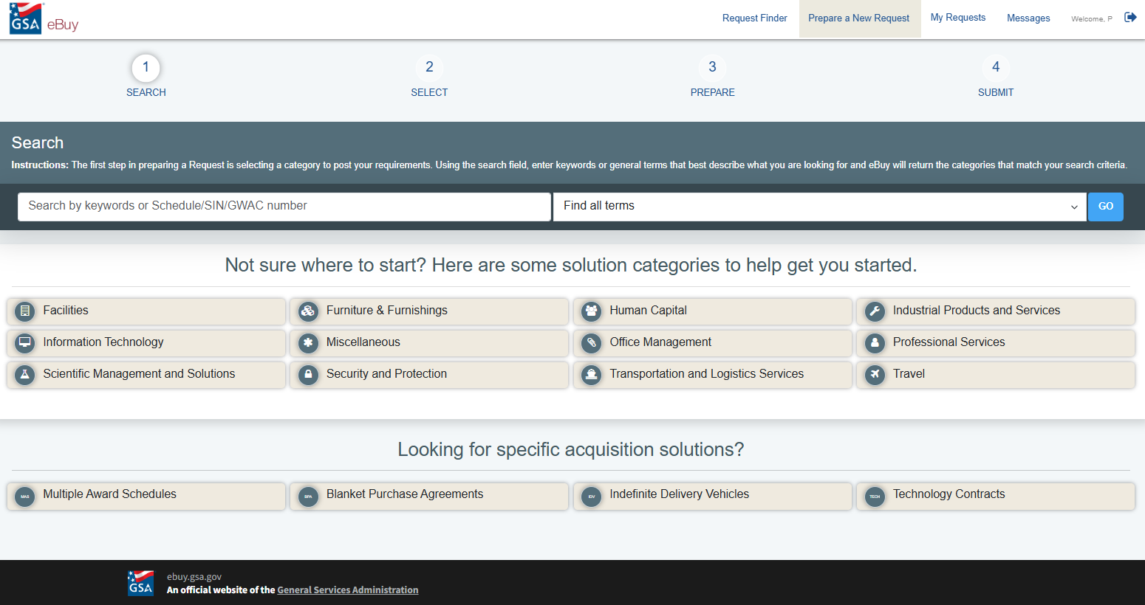
Search by Keywords

Slide 22
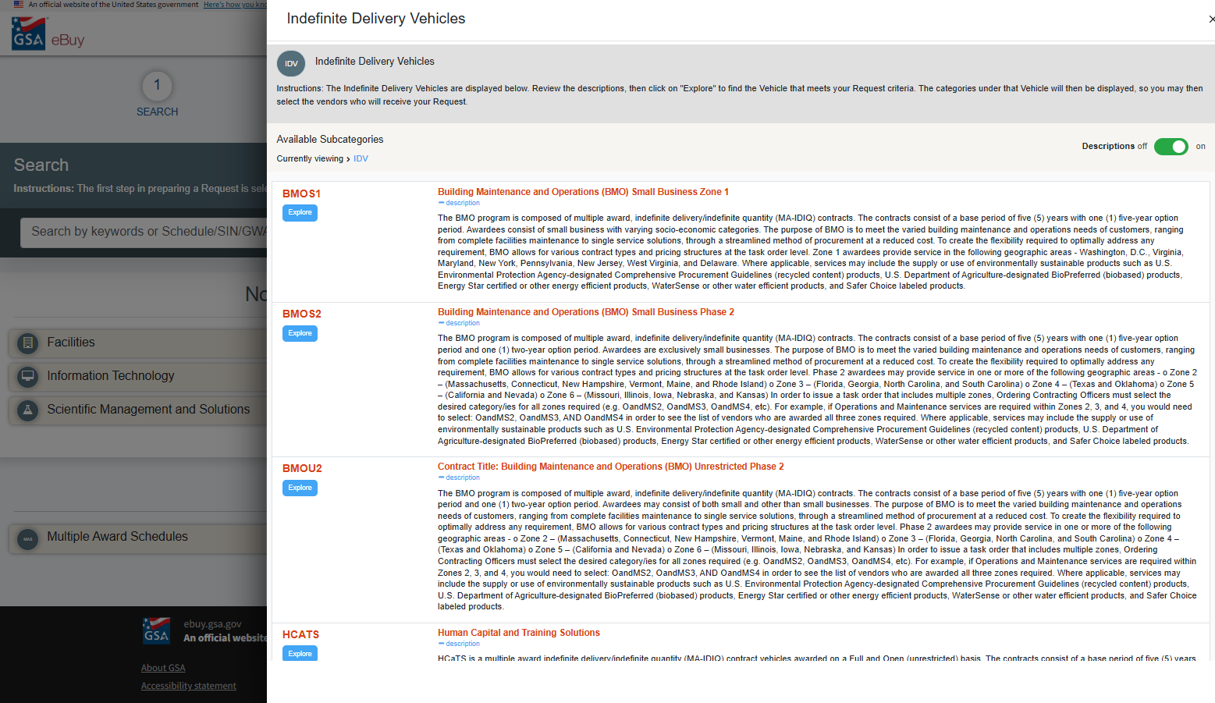
Indefinite Delivery Vehicles

Slide 23
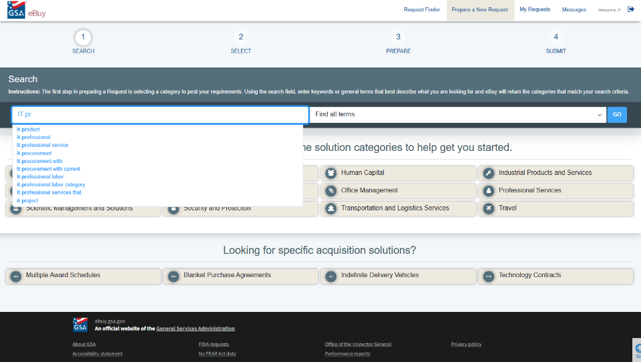
Search

Slide 24
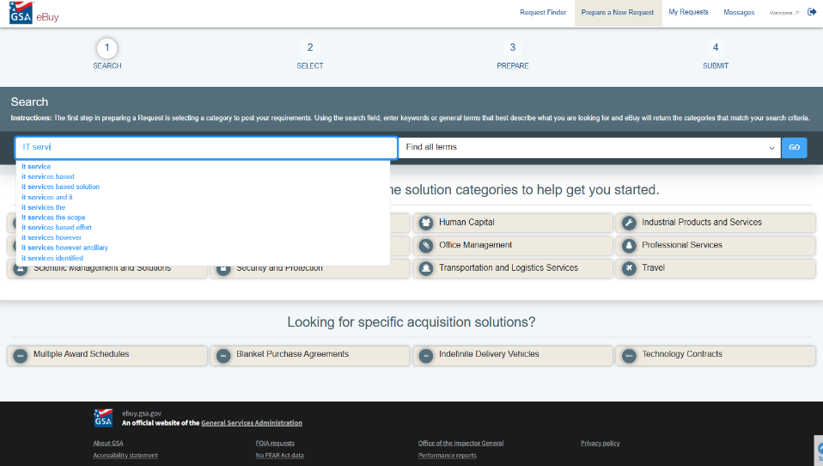
Search for IT Services

Slide 25
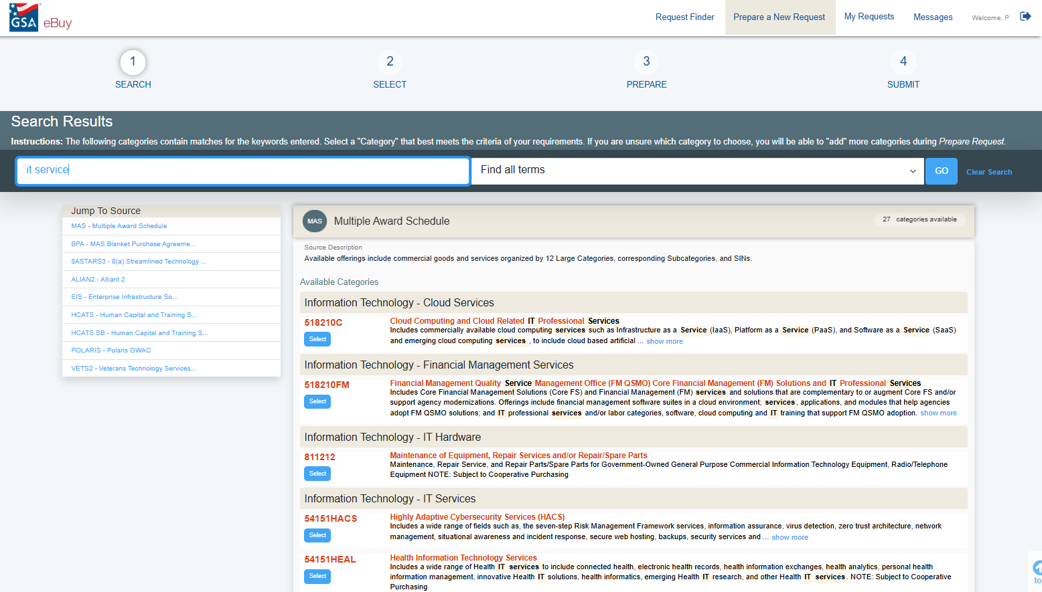
Search Results

Slide 26
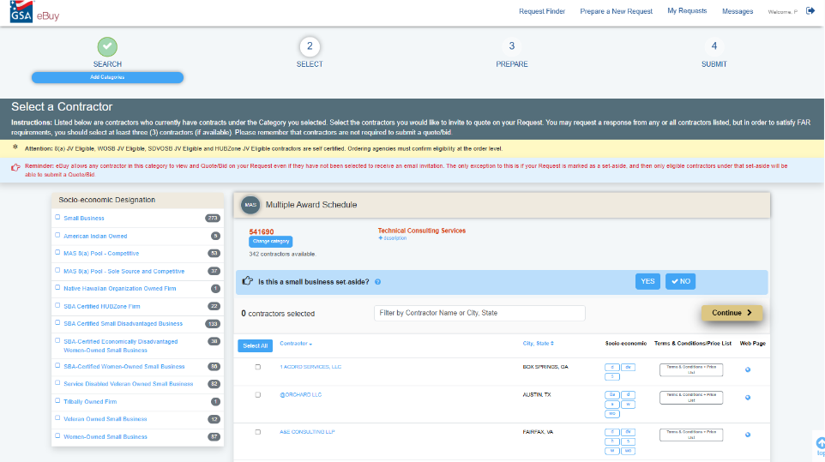
Review Results

Slide 27
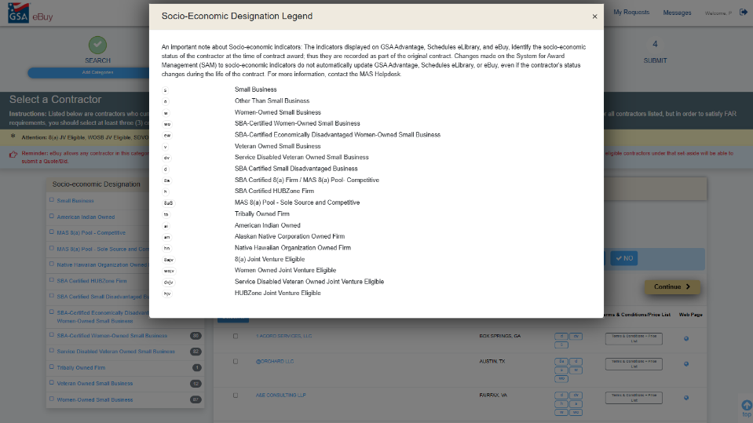
Socio-Economic Legend

Slide 28
Thank You

Slide 29
GSA Starmark Logo – America 250

