Slide 1
Fleet Welcome Slide
GO.gov & Fleet Consolidation
Deliver Portfolio
April 14, 2026

Slide 2
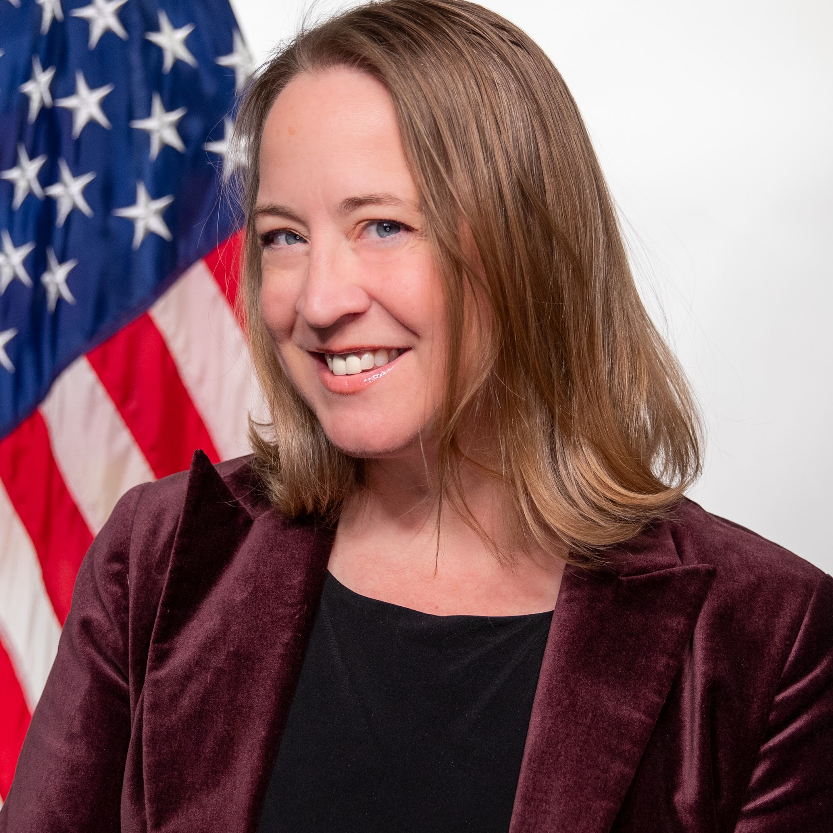

Meet your Speakers
Carolyn Meza
Executive Director, Travel and Transportation (Acting)
carolyn.meza@gsa.gov
Stephanie Gresalfi
Senior Advisor, GSA Fleet
Stephanie.Gresalfi@gsa.gov

Slide 3
What is GO.gov?
Federal Travel, Simplified

Slide 4











There’s a Better Way to Travel
ETS2, GSA’s legacy Travel & Expense system, currently manages:
124
Separate civilian agencies, commissions, and boards
56
Custom, agency-specific financial system interfaces
59
Task orders across two master contracts
30
Separate production instances
Wouldn’t it make more sense…
…to bring them all together?
Notes:
Opening
Today, the government’s travel and expense management system – ETS2 – operates in a highly decentralized way…
Main Points
ETS2 currently supports 124 civilian agencies, commissions, and boards through a patchwork of separate systems and processes.
GSA and its stakeholder agencies manage 30 separate production instances, 56 custom, agency-specific financial system interfaces, and 59 task orders across just two master contracts.
The result is a complex environment — with more than 8,000 government staff serving as system administrators — that’s difficult to maintain and update
The technology behind ETS2 is aging, making it increasingly challenging to provide efficient, accurate travel booking and expense processing.
Closing
Since 2018, GSA has partnered closely with CFO Act agencies through the Common Services Alignment Working Group (CSAW) and the Federal Integrated Business Framework (FIBF) to identify common needs and requirements for a modernized approach.
Transition
From that collaboration, GO.gov was formed. For the first time, all civilian agencies have jointly agreed on a shared set of requirements and will transition to one centralized, standardized system, GO.gov
Optional below:
The shared service element of GO.gov focuses on centralizing common government functions into a standardized platform that multiple agencies can access. Instead of each agency building and maintaining its own systems, GO.gov promotes a unified infrastructure that reduces duplication, improves interoperability, and ensures consistent user experiences across services.
Eliminates inefficient spending that results from duplicative service offerings and systems
Promotes agility and innovation within agencies by improving speed, flexibility and responsiveness to provisioning services through a “Shared-First” approach
Focuses more agency resources on core mission requirements rather than administrative support services
Spurs the adoption of best practices and best-in-class ideas and innovations;
Reduces the support costs of redundant resources
Improves cost efficiencies through shared commodities.
Provides a consolidated distributed model which is agile at the agency level
Supports transparency, data management, strategic sourcing and cost savings
Enhances the customer experience (manager and end user)
Drives valued and efficient behavioral change

Slide 5

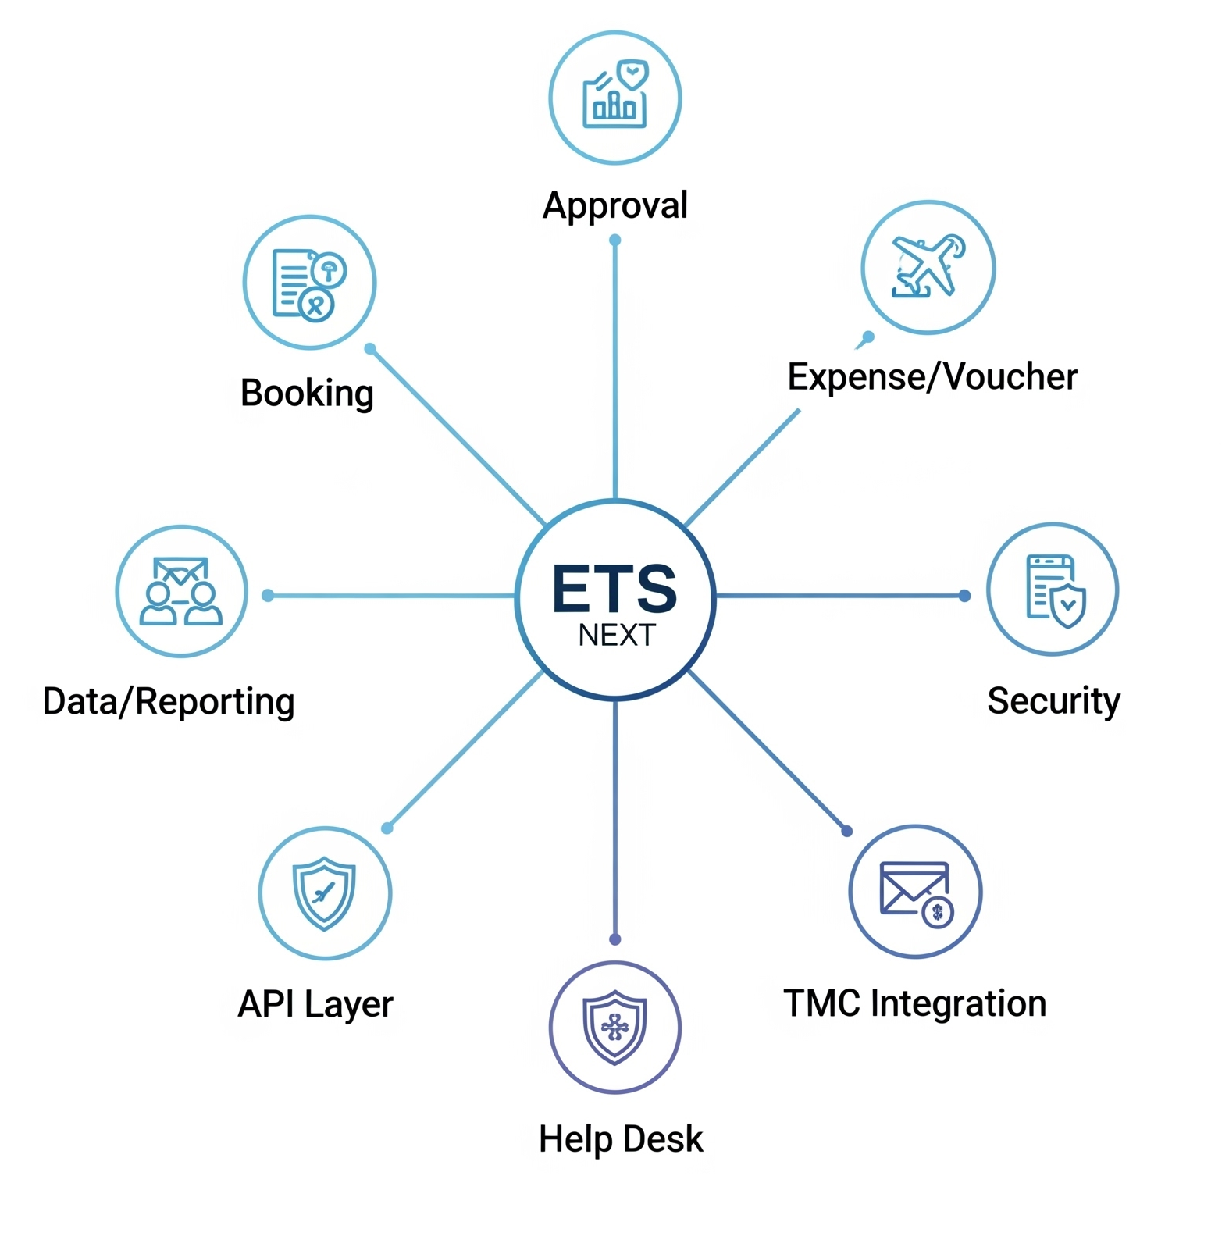

Go.gov definition
What is GO.gov?
GO.gov is a mandatory, centralized, governmentwide system for travel and expense for all civilian agencies.
One of the first mandated shared systems for all of government
A suite of best in class systems
Deploy across 100+ agencies by Summer 2027
GO.gov
A Single, End-to-End System of Systems
Notes:
Opening
GO.gov is the government’s new, mandatory travel and expense management system — a single, end-to-end solution for all civilian agencies.
Main Points
GO.gov replaces today’s fragmented, agency-specific systems with one centralized, modern platform that handles booking, authorization, expense reporting, data, and more.
Use of the E-Travel System (ETS) has always been mandatory for civilian agencies, and with ETS2 expiring in December 2027, GSA is responsible for delivering the next-generation solution
It’s the first shared system to manage an entire business function across civilian government — a major step forward in modernization.
Closing
GO.gov isn’t just a new system — it’s a unified approach to how the government manages travel, ensuring consistency, efficiency, and accountability across every agency.
Transition
So, what does all of that actually mean for your agency?...

Slide 6
Responsibility in ETS2 vs GO.gov
Most costs formerly borne by agencies will shift to GO.gov and will be recovered via the SAF. Centralizing these responsibilities to GSA reduces overall governmentwide costs.
Cost / Responsibility | ETS2 |  | GO.gov
 | Agency | GSA | Agency | GSA
Acquisition Management | ◕ | ◔ |  | ⬤
Vendor Mgmt | ⬤ |  |  | ⬤
Implementation | ⬤ |  |  | ⬤
Program Mgmt | ◑ | ◑ |  | ⬤
Reports Maintenance | ⬤ |  |  | ⬤
Release Testing | ⬤ |  | ◑ | ◑
Configuration Mgmt | ⬤ |  | ◑ | ◑
Duty of Care | ⬤ |  | ◑ | ◑
Training | ⬤ |  | ◑ | ◑
Help Desk | ⬤ |  | ◑ | ◑
Other Ops & Maintenance | ⬤ |  |  | ⬤
Notes:
Opening:
So, what's changing?
Main Points
As a shared services PMO, GO.gov will now bear the upfront cost and responsibility of travel and expense management that currently falls on the shoulders of agencies. This will save the government $2B dollars over the course of the 15-year contract.
We will also centralize acquisition of travel management systems and platforms as well as award Travel Management Company Services on behalf of agencies.
Transition:
Now that we know what GO.gov is, let's look under the hood.

Slide 7
GO.gov Implementation Timeline
System Integration Testing
User Acceptance
Testing
Go-Live
FOC-A
May 2026
June 2026
Aug 3rd, 2026
FOC-B
Aug 2026 (FM Integration)
Nov 2026 (Travel Integration)
Dec 2026 through Jan 2027
Spring 2027
Notes:
Opening: I'm sure you're wondering when GO.gov will be available for your agency.
Main points:
We're taking a phased approach to the GO.gov transition.
Three agencies transitioned to GO.gov in January 2026, in our Initial Operating Capacity phase.
The rest of civilian agencies are broken into two phases.
FOC, or Full Operating Capabity) phase A will go live in August and November 2026
FOC B will go live in the spring of 2027
Closing

Slide 8
GO.gov Platform Features

Slide 9
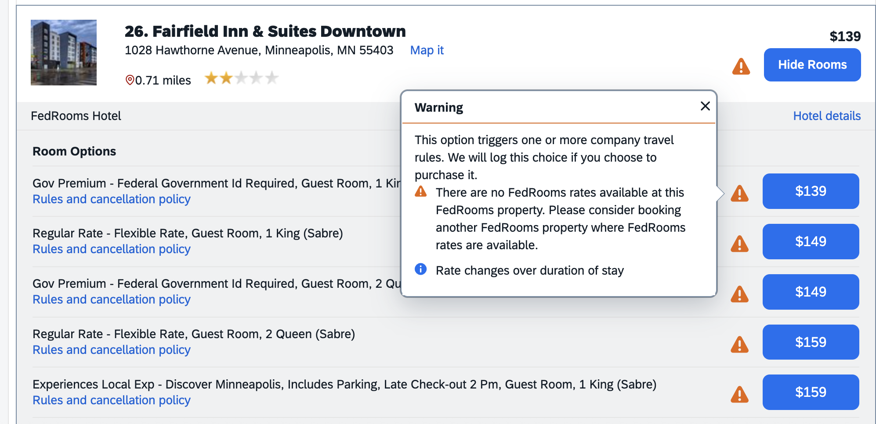



In-Policy Lodging Guidance
Benefits
Policy compliance
Cost savings
What it is: A policy-driven booking configuration that guides travelers toward compliant lodging options — including participation in the U.S. Government’s FedRooms program
Mechanism: The system highlights and prioritizes lodging options that conform to the Federal Travel Regulation (FTR) and agency travel policy. For lodging, this includes visually identifying FedRooms properties, which offer government-specific benefits such as free Wi-Fi, no additional fees, and flexible cancellation terms
Improved traveler decision-making
Notes:
Traveler Workflow Benefits:
Through the User Experience and on their screen they can easily make decisions that are compliant and leads to larger cost savings by choosing the right hotels that are compliant.
Standard configuration drives policy compliance and guidance to select reservation components that conform to travel policy and the Federal Travel Regulations.
E.g. For lodging, guiding travelers to utilize the US Government’s FedRooms program which offers travelers benefits like free wifi, late cancellation, no additional fees, etc.
Supporting FedRooms information from https://www.gsa.gov/travel/plan-a-trip/lodging/fedrooms:
FedRooms provides Federal Travel Regulation (FTR) compliant hotel accommodations at or below per diem with standardized amenities.
The program is available to all U.S. government and military personnel.
In 2026, there are over 14,000 FedRooms properties available in more than 3,000 markets globally.

Slide 10
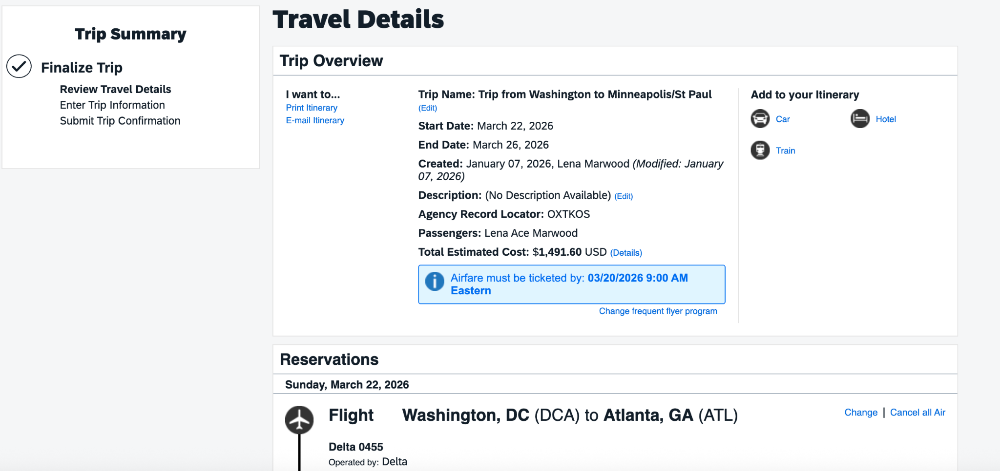


Cleaner Interface
Benefits
Simplified itinerary management
What it is: A centralized, streamlined interface that allows travelers to view their complete itinerary — including all reservations booked through the Online Booking Engine — in one place
Mechanism: All booked travel components (air, hotel, rental car, etc.) are automatically consolidated into a single trip view within the platform. This enables travelers to review their full itinerary at once and confirm that all required reservations have been included
Increased traveler confidence
Notes:
Cleaner interface:
1 place to review their entire trip that was booked in the online booking engine so that the traveler has confidence they have included all reservations they need and have the confidence they have not forgotten anything.
Traveler Workflow Benefits:
Easy to follow itinerary

Slide 11
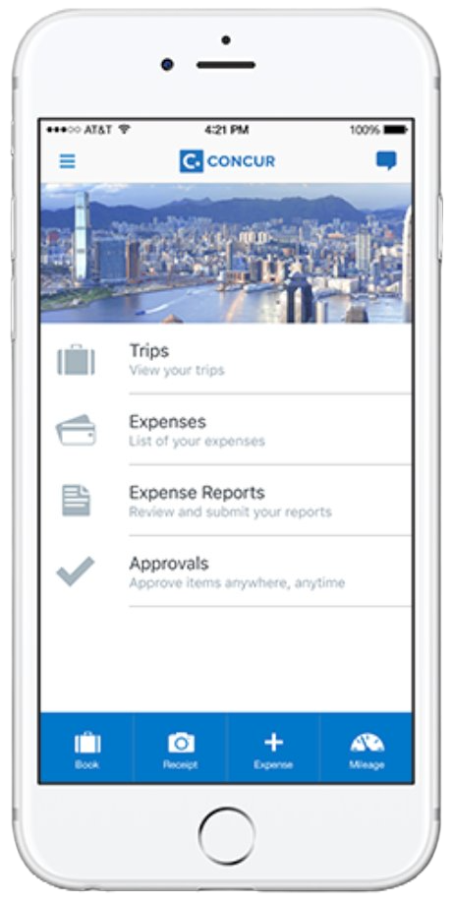
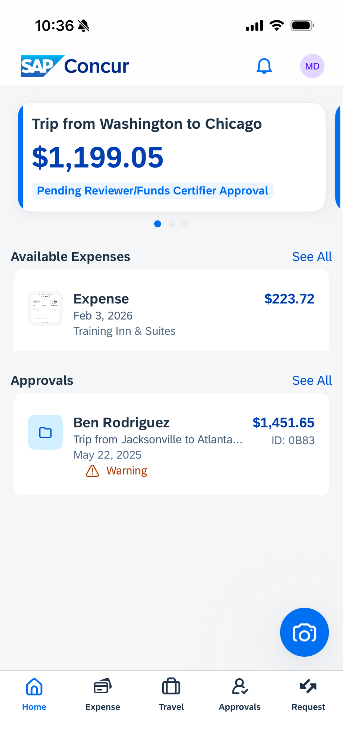


Mobile App
Benefits
What it is: The mobile app offers a range of features to enhance the travel and expense process for both employees and approvers, though the full Travel module is currently unavailable on the app.
Mechanism: Users, however, CAN use the mobile app to submit expense reports, upload receipts, and conduct approvals at this time
User experience and efficiency
Continue business processes, regardless of location
Notes:
High Level Points: best the commercial world offers for T&E, automated credit card feeds, governmentwide data, mobile, AI for audit checks)
GO.gov streamlines the full travel lifecycle, from authorization to booking to reimbursement; all within a single, user-friendly interface.
Built on the best available COTS products, allowing the government to use what fortune 500 companies around the world rely on for their travel and expense process.
Agencies gain access to standardized processes and automated reporting, reducing operational overhead and compliance risk.
Travelers benefit from clearer workflows, mobile-friendly tools, and consistent experiences regardless of agency.
The mobile app offers a range of features to enhance the travel and expense process for both employees and approvers, though the full Travel module is currently unavailable on the app. End users, however, CAN use the mobile app to submit expense reports, upload receipts, and conduct approvals.
Key Features:
Instant Receipt Capture: Travelers can capture receipts instantly with the mobile camera.
Automated Expense Creation: The app uses receipt scanning to automatically parse details like the expense amount and category, significantly reducing data entry. It also enables a three-way match with the credit card expense and e-receipt.
Intelligent Expense Categorization: The app automatically assigns expense types (e.g., rental car fuel) from a receipt image.
Expense Report Submission: Travelers can easily create and submit expense reports on the go, resulting in faster reimbursements.
Approver Functionality: Approvers can conduct all necessary approvals directly within the mobile app, ensuring timely review and keeping business processes moving.
Travel (Coming Soon): Trip booking functionality is currently not available in the mobile app due to an upcoming SAP Concur version update but is expected to be available in FOC3
GO.gov Benefits:
User Experience and Efficiency:
User-friendly experience with an intuitive timeline view of expenses.
Reduced data entry and fewer errors/lost receipts thanks to built-in automation.
Enhanced visibility with instant card data and expense creation.
Workflow and Reimbursement:
Faster reimbursements, leading to happier employees.
Streamlined workflows that keep business moving, regardless of location.
Approver Functionality:
Review and approve requests and expense reports on time, every time, regardless of location

Slide 12
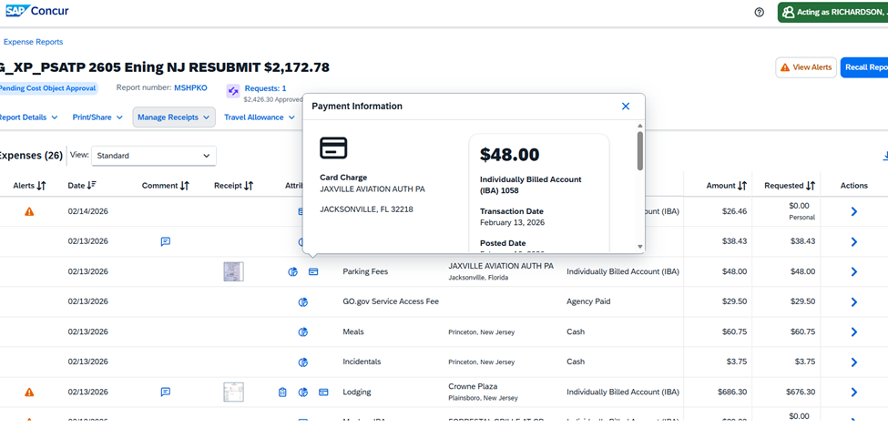
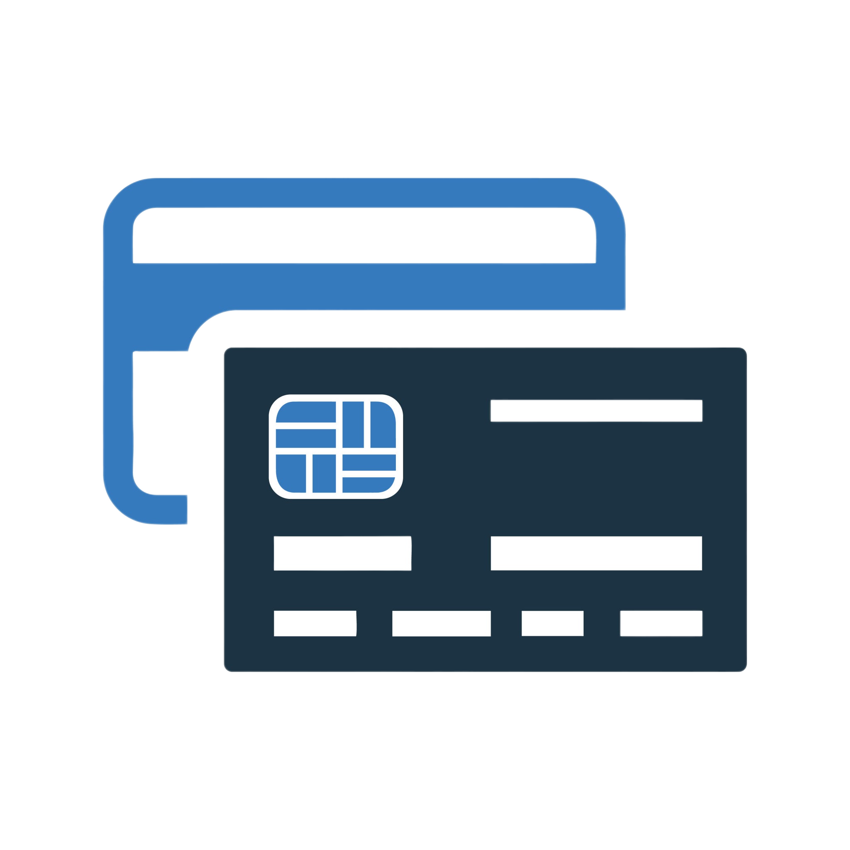


Charge Card Integration
Benefits
Creates a control around the travel card
Minimizes delinquencies, fraud, waste, and abuse
What it is: A built-in expense control that automatically imports posted charge card transactions into a traveler’s available expenses
Mechanism: Transactions are imported automatically from the bank via the charge card feed; they must be claimed on an expense report cannot be deleted
Allows travelers to easily add all miscellaneous IBA charges to their expense report
Notes:
Charge Card Integration
The integrated charge card feed offers a key control for travel expenses, enhancing fraud, waste, and abuse protection.
Key Features and Controls:
Automatic Transaction Pull: The charge card feed automatically pulls posted transactions into the traveler's profile.
Mandatory Claiming: Travelers cannot delete these automatically added transactions; they must be claimed on an expense report.
Timing: Once a charge becomes a posted transaction (typically a day after swiping the travel card), it appears in the traveler's profile.
Key Benefits:
Creates a control around the travel card.
Minimizes delinquencies and fraudulent charges.
Allows travelers to easily add all miscellaneous Individually Billed Account (IBA) charges to their expense report.
This advanced technical feature provides an additional, much-needed layer of protection against fraud, waste, and abuse that has not been available until now, especially for users transitioning from ETS2 to GO.gov.

Slide 13
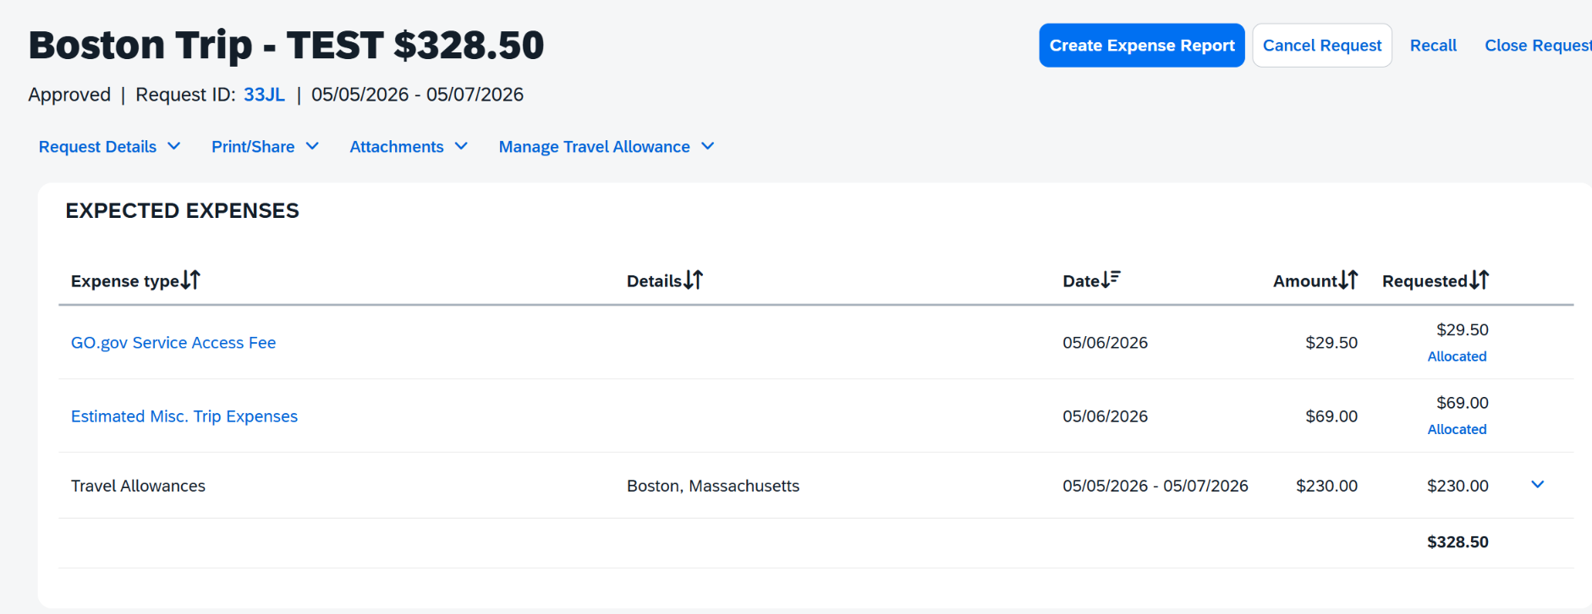
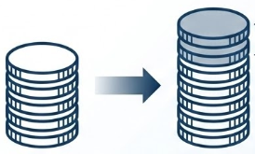


Estimated Miscellaneous Trip Expenses
Miscellaneous Expenses
Travel Expense
+30% Gross Up
Benefits
What it is: A standard configuration and key simplification measure designed to eliminate the need for travelers to manually input miscellaneous expenses (e.g. taxi, Uber, airport parking, etc.)
Mechanism: A 30% estimated miscellaneous trip expense is added to a travel request after it is submitted for approval
Simplified Booking Process
Time Savings
Notes:
Automatic Expense Inclusion and the 30% Gross Up:
Automatic Addition: If the booking module is used, basic expenses (airfare, lodging, and travel allowances based on work location) are automatically accounted for on the travel request.
The 30% Gross Up: This feature is a key simplification measure.
Intent: It is designed to eliminate the need for travelers to manually input estimated miscellaneous expenses (e.g., taxi, Uber, airport parking, or to/from-hotel transportation).
Mechanism: A 30% gross up is added to the request after it is submitted for approval.
Other Fees: The TMC fee and the Service Access Fee (SAF) are also added after the request is submitted. Travelers will see the 30% gross up, TMC fee, and SAF on the submitted request document, not during the initial creation.
Limited Expense Types: The system limits the number of expense types that can be manually added to a request, as most miscellaneous costs are covered by the 30% gross up.

Slide 14
Travel Programs
Notes:
Opening: GO.gov incorporates the government's existing travel programs.
Main: Let's meet GSA's travel programs: Rideshare, FedRooms, City Pair Program, and lodging.

Slide 15
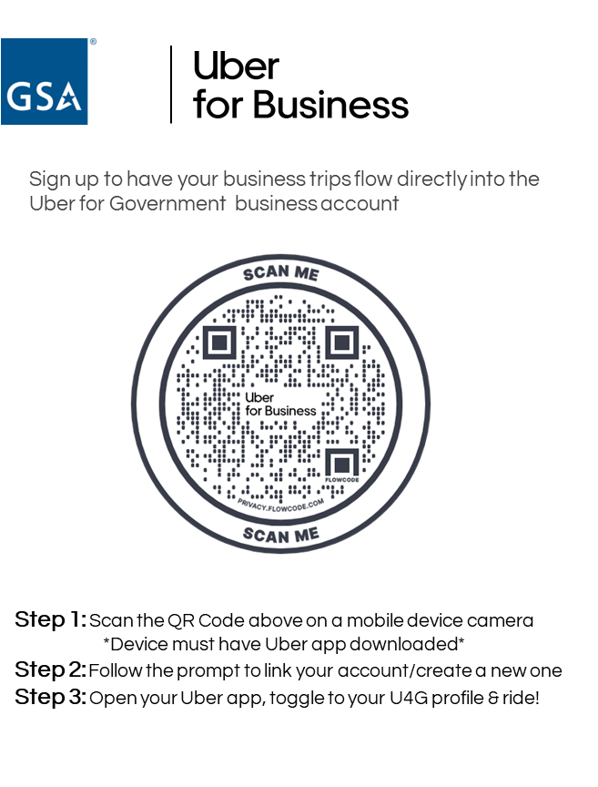

Rideshare
Last mile and local travel solutions
Key Benefits
Negotiated discounts
Easy sign up
24/7 customer support & availability
Data insights
Budget certainty
Full compliance - drivers are vetted
Global coverage
$14M in annual savings potential
Notes:
Opening
GSA’s Rideshare program with Uber delivers measurable savings, convenience, and modernization in line with GSA’s OneGov strategy
GSA's Rideshare program with Uber takes advantage of last mile and local travel solutions at a steep discount
Main Points
GSA's Rideshare program with Uber supports your agency's mission
supports TDY, local travel, health ride needs, and shuttle and Fleet augmentation
currently holds 22% marketshare
There are several key benefits, including data insights, compliance, and global service coverage
GSA's Rideshare program with Uber offers real savings opportunities
$15.9M annually compared to commercial TNCs (Uber, Lyft)
$14.6M annually compared to taxis
GSA's Rideshare program with Uber is built into the GO.gov platform.
Automated backend receipt forwarding provides agencies with visibility into actual rideshare expenditures, enhancing transparency and audit readiness
Popups for rideshare policy compliance ensures travelers utilize the approved rideshare solution with the government discount, maximizing savings and policy adherence
$500K Additional Annual Federal Government Savings Potential
Rideshare's current partner is Uber for Government
Uber is offering complimentary Uber One membership through October 1, 2027, for federal employees if you sign up for Uber for Business
get separate work and personal Uber receipts
24/7 support and white glove business service
Discounts on every business trip
Use the QR code shown here to sign up.
Since October, we’ve had a 26% increase in sign ups
Transition

Slide 16


City Pair Program
Best fares for flexible travel and excellent discounts for governmentwide savings
Key Benefits
Last seat availability
No change fees
Budget certainty & fully refundable
No blackout dates
Aligned with policies, laws, and treaties
24/7 availability
$2.9B annual savings potential
⭐ Best in Class Solution
📍 Mandatory use program
Notes:
Opening
The government purchases airfare through the City Pair Program
first was developed in 1980
now is the world’s largest corporate air program
City Pair provides the best fares for flexible travel and excellent discounts for governmentwide savings.
Main Points
Last Seat Availability
No Change Fees
Budget Certainty & Fully Refundable
No Blackout Dates
Aligned with FTR policy, Fly America Act, & worldwide treaties adherence
24/7 Availability
Best in Class solution
Mandatory Use program
Supports unique government requirements as well as Executive and Legislative Branches, Congress, Department of War, and Tribal Governments
Year over year, CPP provides billions in annual savings and beats commercial and corporate rates
$385M in annual savings v. commercial non-refundable fares
$666M in annual savings v. corporate fares
$2.9B in annual savings v. commercial refundable fairs
GSA's City Pair Program is built into the GO.gov platform.
Prioritize _CA Fares: Select lower-cost _CA fares over YCA when available
Shifting 10% of bookings from YCA to _CA fares
$175 Average Savings Per Trip
Shared Service Configuration: Centralized GO.gov setup across agency booking tools drive users behavior
Promote Early Booking: Use OGP Bulletins to maximize access to lower-cost _CA fares.
$110M Additional Annual Federal Government Savings Potential
Transition
Let's look at our final travel area - lodging.

Slide 17


Lodging
Best rates for flexible travel and excellent discounts for governmentwide savings
EMERGENCY LODGING SERVICES
LONG TERM LODGING
Temporary Duty Travel (TDY)
At or below per diem
12,000+ hotel accommodations
No add-on fees
$88M in savings in FY25
⭐ Best in Class Solution
Lodging support during
Emergencies
Coordinated responses training
Mission needs
$767M in savings in FY25
⭐ Best in Class Solution
For 30+ nights
Temporary or permanent relocation
Extended training assignments
Apartment and condominium style accommodation
$22M average savings annually
Notes:
Opening
GSA's lodging programs offer the best rates for flexible travel and excellent discounts for governmentwide savings.
Main Points
GSA Lodging programs supports your agency's mission through 3 programs:
FedRooms
Emergency Lodging Services
Long Term Lodging
Fedrooms and Emergency Lodging Services are Best in Class Solutions
There are several key benefits to FedRooms, including rates at or below per diem, no add on fees, no early check out penalties, and 4pm cancellation policy in the US, and supports TDY through 12,000 hotels globally
GSA's Lodging Programs offers real savings opportunities
Fedrooms: $88M annually compared to corporate rates
Emergency Lodging: $767M in savings in FY25
Long Term Lodging: $22M annually on average
The lodging programs are built into the GO.gov platform.
$211M Additional Annual Federal Government Savings Potential
Continuing to explore new lodging technology - such as AirBNB and VRBO
All lodging providers must meet FEMA fire safety requirements to participate in lodging programs.
Transition

Slide 18
Thank you Slide

Slide 19
Fleet Consolidation
Fleet as a Shared Service
Notes:
Centralizing Fleet Management under one entity is a strategic move, in line with Administrative priorities, towards governmentwide efficiency, enabling agencies to streamline fleet management, cut costs and better support mission delivery.
Not only does it align with government-wide efficiency goals, but it reduces costs and redundant contracts and functions
Consolidation under one centralized entity with one fleet management information system is results driven, accountable and can lead to greater transparency
Allows agencies to focus more attention on their core mission
Flexibility in fleet composition and size (easy to upsize or downsize)
In line with Executive Order, "Eliminating Waste and Saving Taxpayer Dollars by Consolidating Procurement" (EO 14240), to centralize the acquisition of common goods and services under the General Services Administration (GSA).

Slide 20

Fleet as a Shared Service
Centralizing Fleet Management under one entity is a strategic move, in line with Administrative priorities, towards governmentwide efficiency, enabling agencies to streamline fleet management, cut costs and better support mission delivery.
Moving to a shared services model (under one entity) reduces redundancies
Moving to one fleet management information system is results driven, accountable and leads to greater transparency
Allows for flexibility in fleet composition and size (easy to upsize or downsize)
Agencies can focus more attention on their core mission and more effectively manage their fleets
Notes:
Your mission is extremely important to us
We stand ready to assist!

Slide 21

GSA Cost-Efficient Fleet Offerings
🔑
Non-Tactical Vehicle Purchasing
Non-Tactical Vehicle Leasing
Short Term Vehicle & Equipment Rental
Mandatory source
Drive $1.2B in savings over 5 years by standardization, volume, and streamlined ordering
Comprehensive support with engineering services for compliance and custom solutions
Annual purchases of ~41K vehicles
Non-mandatory service with global operations & commercial sector reliance
Full-service leasing: rates 30% lower than commercial options and 20% lower than agency-owned fleets
Centralized support reduces overhead for agencies
Compliance with the FAR & other regulations & laws
Manage ⅓ of federal fleet (~230K+ vehicles)
Non-mandatory service
Flexible rentals for up to 120 days for seasonal, surge, maintenance, and emergency needs
Streamlined contracting, competitive pricing and 24/7 ordering
Easy access to exactly the right vehicles or equipment for the mission
Rented 51K assets in FY25

Slide 22
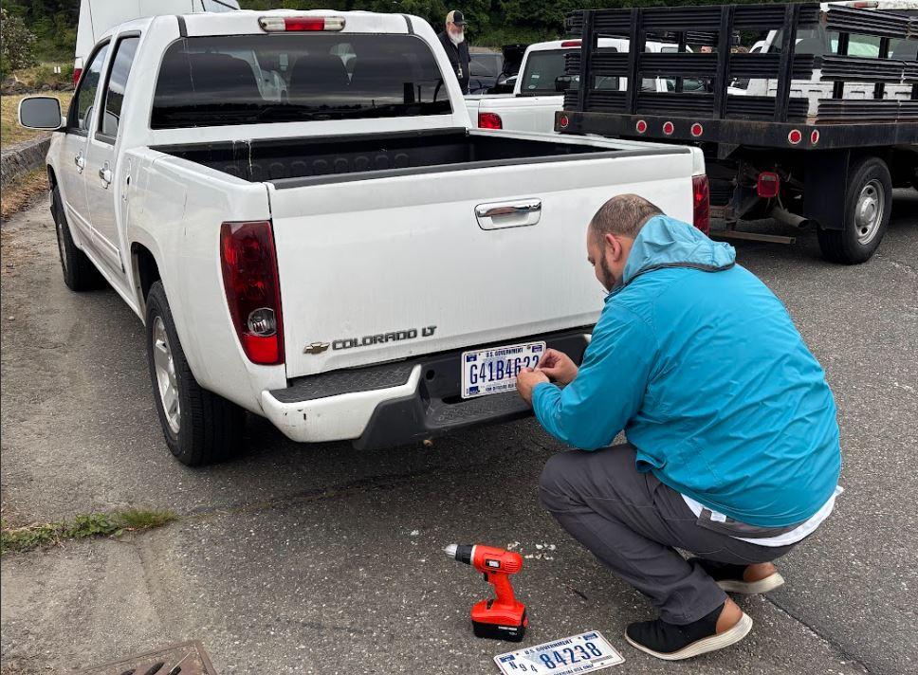
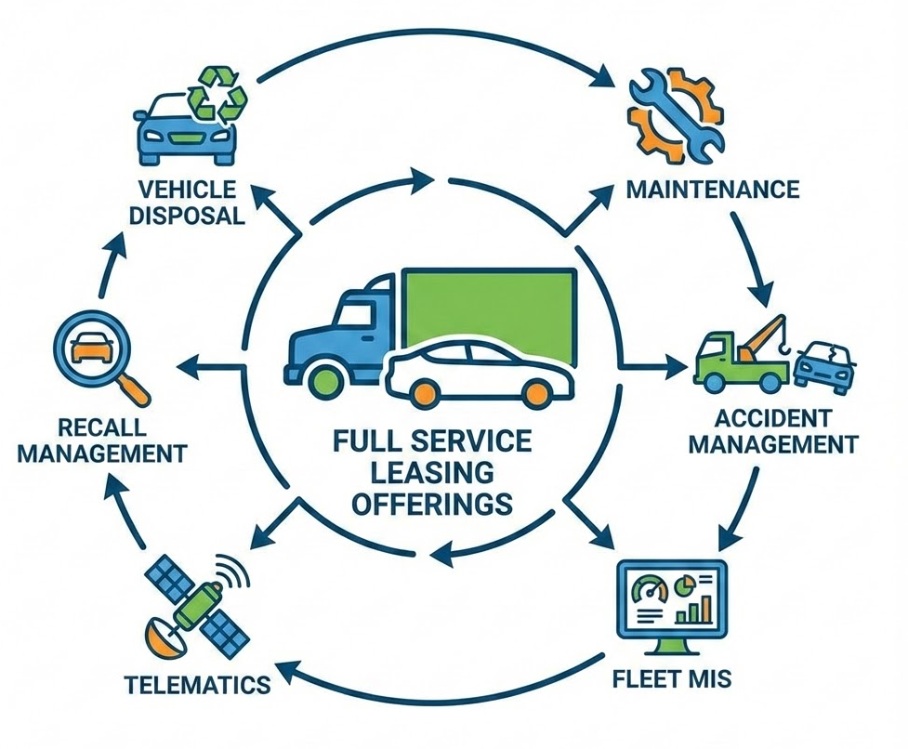
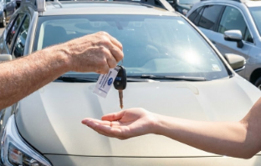
The Process for Centralizing Fleet Management Under GSA: Vehicle Consolidation
Asset Transfer
Comprehensive GSA Fleet Support
GSA Replacement Commitment
Interagency asset transfer of the vehicle to GSA’s ownership
Agencies retain use and custody of vehicles
Access GSA’s full suite of vehicle management services as part of all-inclusive rate
Lease payments begin
GSA & agencies optimize fleets in support of agency missions
GSA funds and manages vehicle replacements going forward
Notes:
Through vehicle consolidations agencies convert their agency-owned vehicles and commercial lease
requirements to GSA Fleet leasing. GSA Fleet is committed to providing agencies with cost-saving
opportunities that assist in reducing the cost of the Federal Fleet by providing efficient and effective
low cost, modern, fuel-efficient vehicle leasing options. GSA Fleet’s consolidation opportunity assists
agencies to readily meet reduction and efficiency targets and goals.

Slide 23
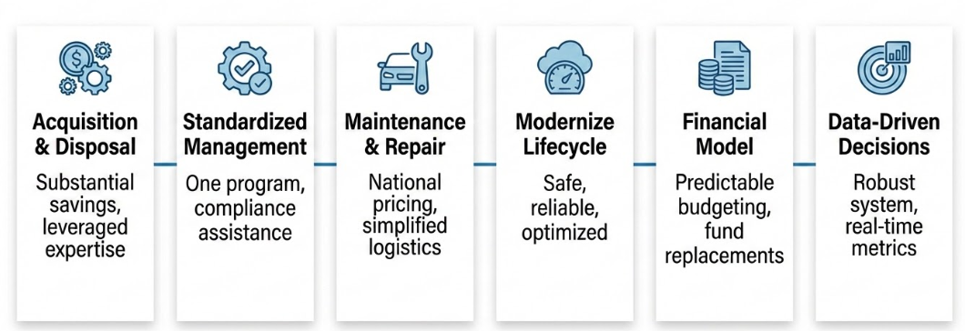
Benefits of Full Service Vehicle Leasing with GSA
All-inclusive monthly rate provides burden-free lease with predictable budget planning and no agency capital outlay:
Notes:
GSA handles acquisition and disposal -- you select your replacement vehicle, then we take care of the rest. once the new vehicle is delivered, you simply drive up to the closest marshaling site and swap the old vehicle with a new one. And if you participate in our LE upfit program, your vehicle will be ready with the additional equipment you need.
Fully burdened cost represented by lease rate.
Economies of scale allow us to provide services that are cost prohibitive by individual agencies. Agencies are assigned a local fleet rep. They can help you:
Determine appropriate vehicles and insure requirements are met to the best of their ability.
Order new vehicles and facilitate the receipt of new vehicles.
Monitor use / make utilization suggestions
Facilitate vehicle maintenance.
GSA Fleet allows for oversight without dictating operating parameters.
Goal is to provide the tools you need to manage your fleet within you Agency’s guidance
GSA Fleet is a full-service leasing provider
● Low-Cost Provider
○ 20% more cost-effective than agency-
owned fleets (Federal Fleet Reports)
○ Rates are 37% lower than reported
commercial lease prices and 34% below
multiple award schedule leases
● Predictable budget planning and no agency capital
outlay
● All-inclusive rates
● Automated information systems
● Guaranteed vehicle replacements
● Safe, fuel-efficient fleet
● Reduced fleet administrative burden
● Less vehicle downtime
● Flexibility in fleet configuration and size
● Streamlined fleet solutions
● Help with reductions and vehicle re-homing

Slide 24

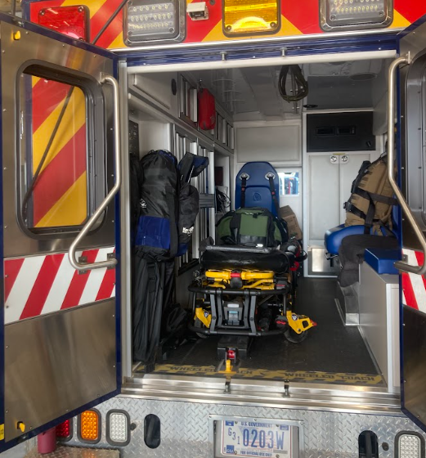
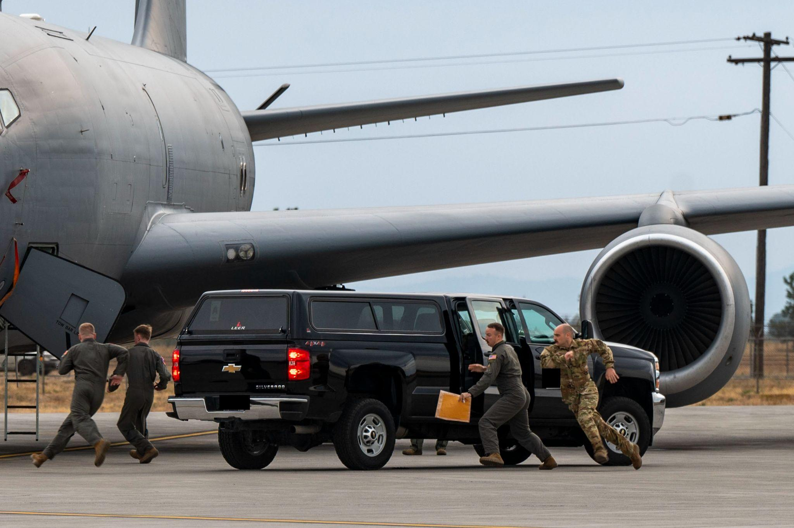
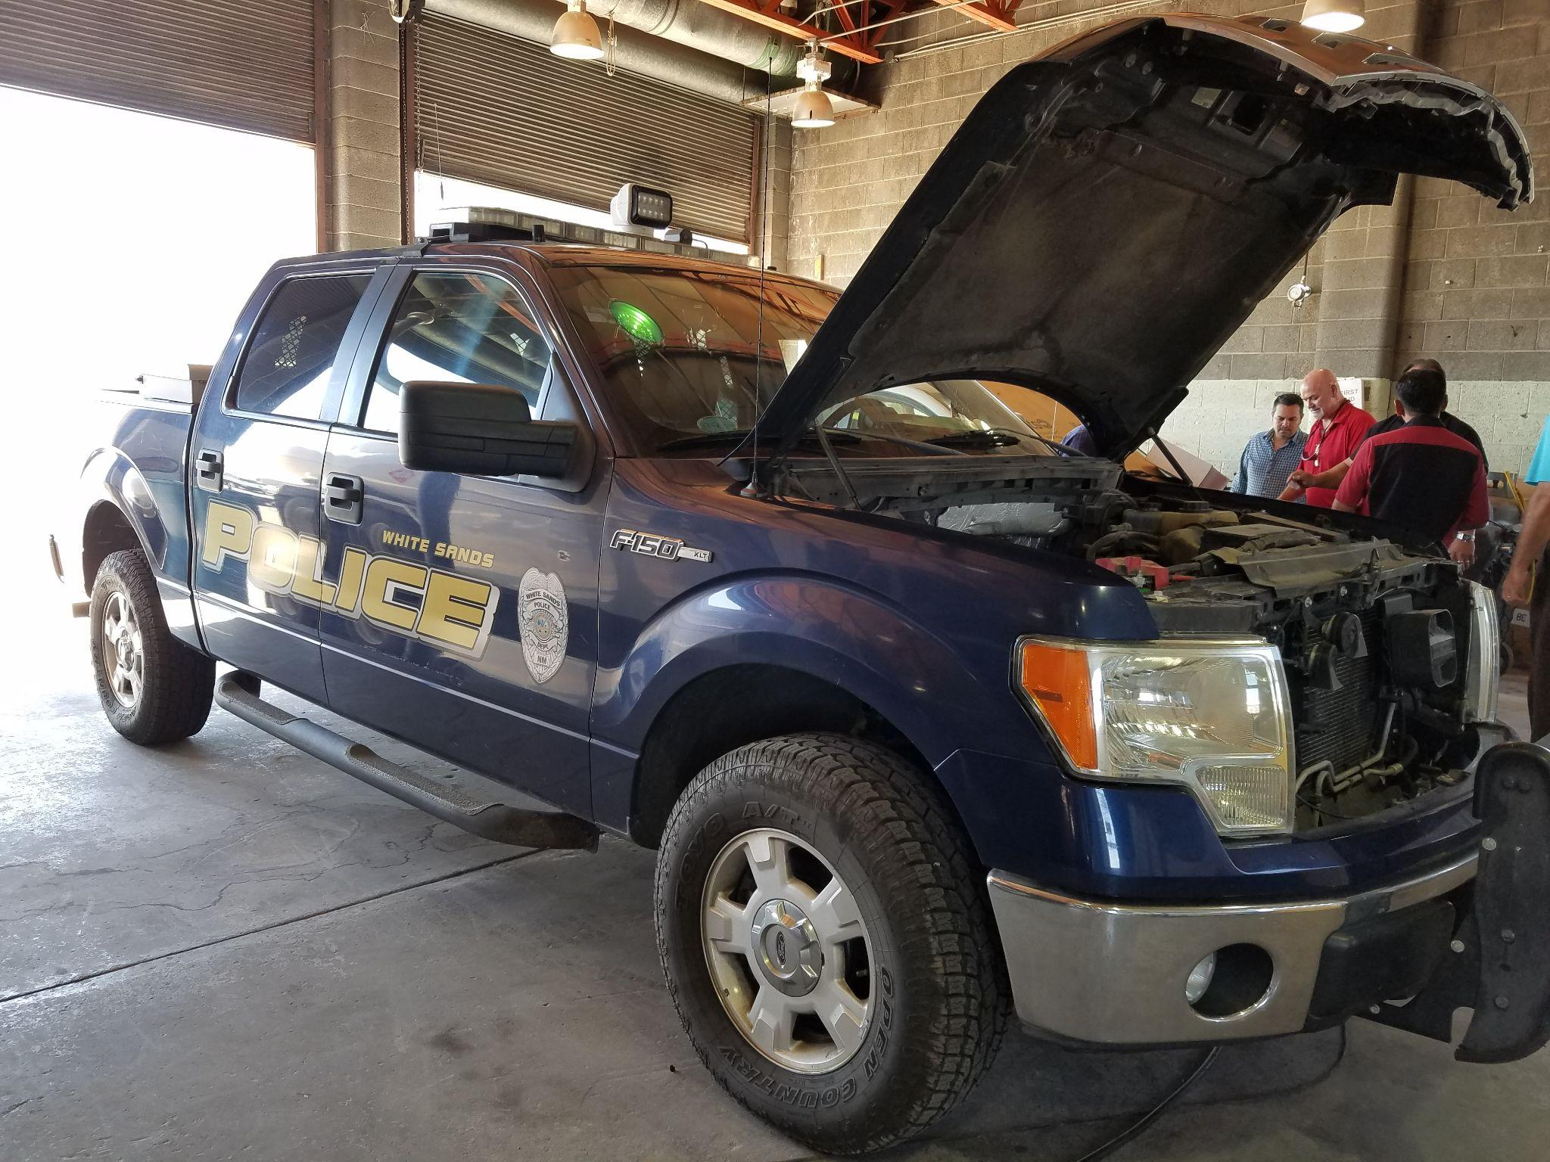
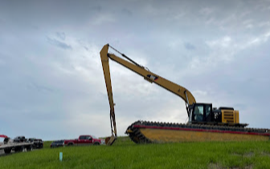

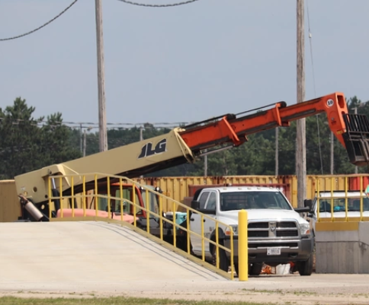
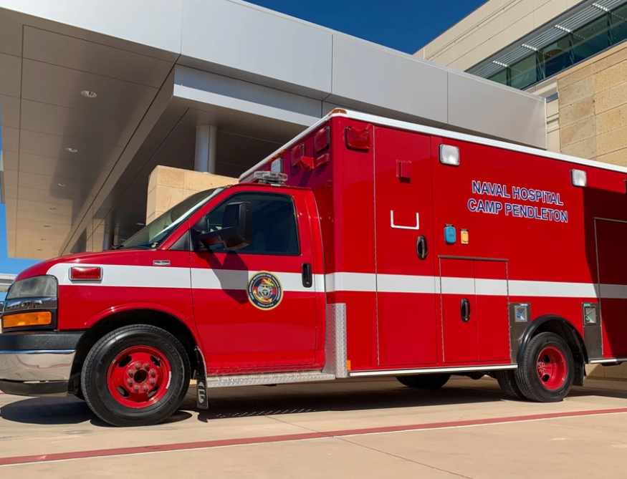
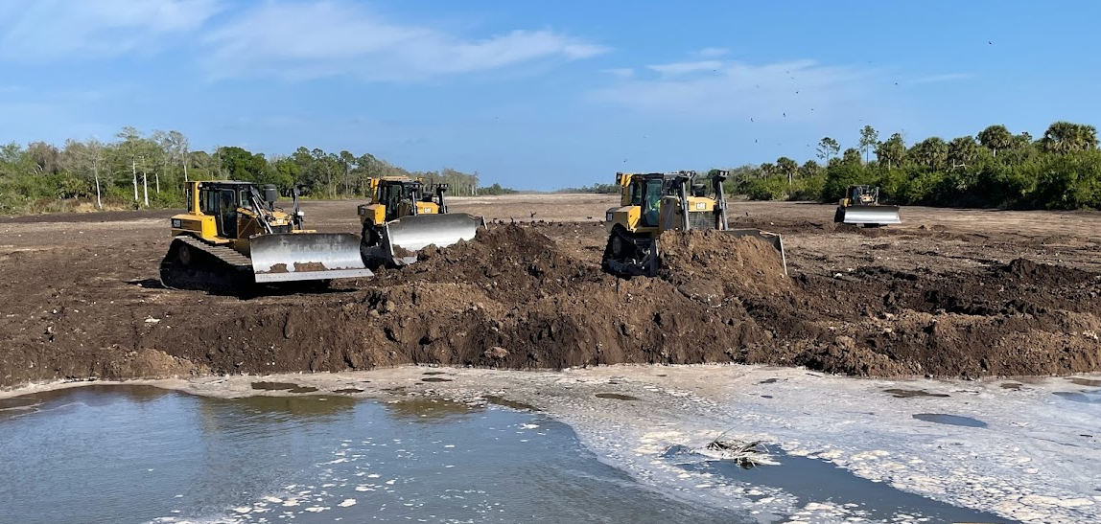
GSA Fleet Vehicle Assets Support Critical Missions
71% leased to DOD, DHS, VA, and DOJ for defense, emergency response law enforcement, and national security
DHS Security Missions and Agency-Wide Support
Weapons of Mass Destruction Response
On the go - GSA supports AF Readiness Mission
Southwest U.S./Off Road Missions
Army Corps of Engineers Infrastructure Support
Investigative and Pursuit Missions
Army Lethality: Ammunition Plant Support
Emergency Response Capabilities
Notes:
GSA leased fleet is a Working fleet used for unique missions, often in rough terrain, remote locations, and unique equipment required
Used for
Wartime readiness
Response to Weapons of Mass Destruction attacks
Border patrol and immigration Enforcement
Prisoner Transport
Military recruiting officers
Military funeral honors & USMC band support
FAA / AF flight line readiness
Support of White Sands Missile Range ain the SW US
Refueling tankers,
National park management and many other mandated services performed by our government.
And likely what you’re most interested in. Law enforcement (pursuit and investigative) missions like CBP
Many small operations add up to the federal fleet. Precision and partnership is required to make meaningful reductions that do not gravely impact critical mission operations
White Sands National Park is a mission we support in the SW US. Their mission is to Test and evaluate missile systems and defense technologies.
Agency Consolidations Happen Regularly

Slide 25
GSA Fleet Vehicle Leasing by the Numbers
20% 37% 4.5 vs 9 years $0.23
Overall Fleet Management Savings
Lower Cost than Commerical Leasing
Average age (in years)
Average cost per mile savings

Slide 26

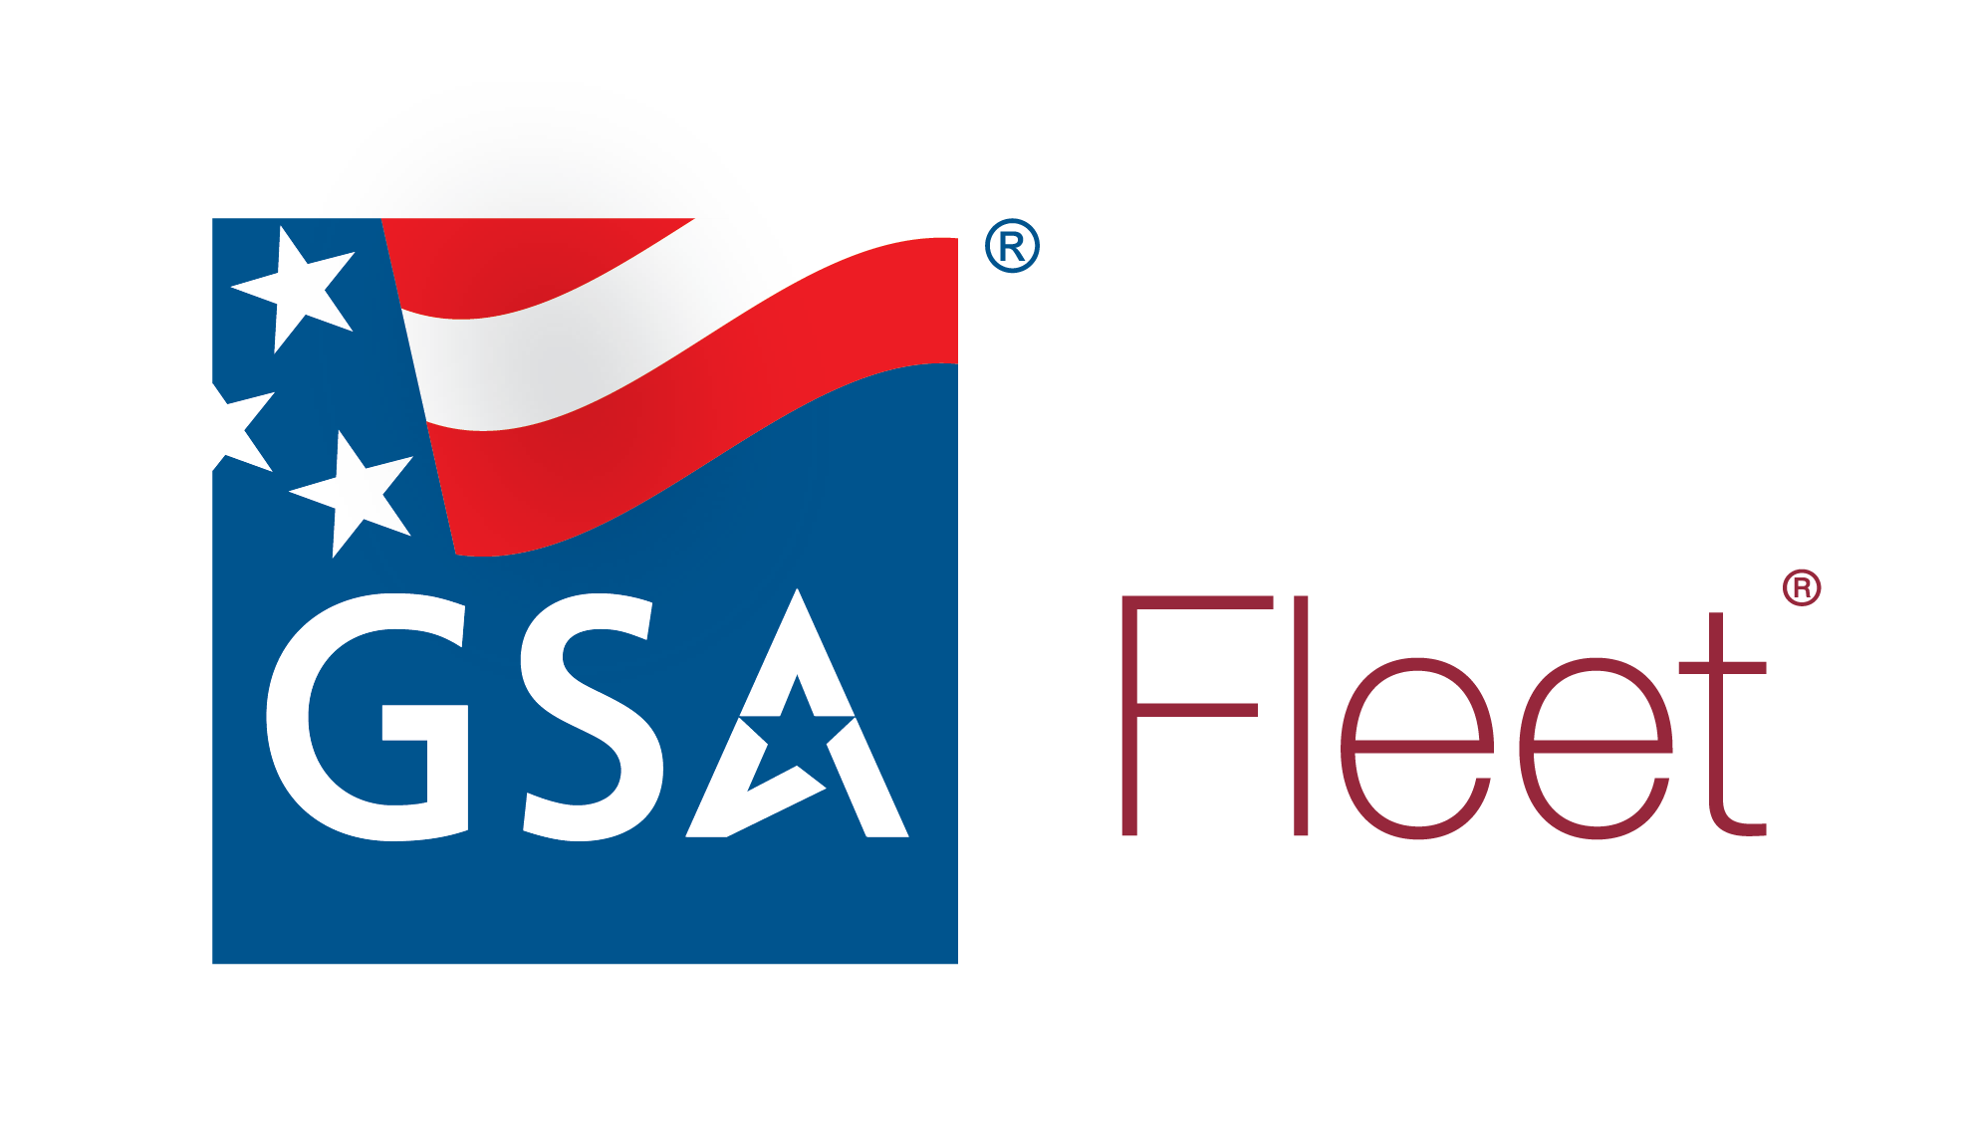
Next Steps
Contact us at GSAFleet-Consolidation@gsa.gov

Slide 27
Thank You…

Slide 28
Closing Slide

