Slide 1
Small Business Works 2022:
Navigating Equity in Procurement
U.S. General Services Administration

Slide 2
GSA Governmentwide Acqusition Contract (GWAC) Program Overview and Opportunities for Small Business
U.S. General Services Administration

Slide 3
GSA GWAC Team
Lori Ginnings
Polaris Program Manager
U.S. General Services Administration
lori.ginnings@gsa.gov

Slide 4
GSA GWAC Team
Herman Lyons
8(a) STARS III Program Manager
U.S. General Services Administration
herman.lyons@gsa.gov

Slide 5
GSA GWAC Team
BeLinda DeVore
VETS 2 Program Manager
U.S. General Services Administration
belinda.devore@gsa.gov

Slide 6
What is a GWAC?
A GSA GWAC is a master contract developed by GSA to provide opportunities for companies who provide IT Services such as:
Data Management
Information and Communications Technology
IT Operations and Maintenance
IT Security
Software Development
Systems Design
New and Emerging Technologies

Slide 7
GWAC Development
When developing a GWAC, GSA:
Conducts market research
Focus groups
Surveys
Interviews
Issues draft solicitation(s) for feedback
Posts the final solicitation on Sam.gov*
Evaluates proposals received
*Industry can set up notifications on Sam.gov for applicable opportunities

Slide 8
GWAC Features and Benefits
Multiple Award, IDIQ contracts for IT Services
Best-in-Class Designations
Socio-Economic Credit for Small Business GWACs/Subcontracting credit for Alliant 2
Limited Ability to Protest
Flexible Ordering
Streamlined procedures IAW 16.505 (shortened lead-time)
Worldwide Geographic Coverage
Highly Qualified Contractors

Slide 9
GWAC Industry Certifications
Audited and approved cost accounting system
Secret or higher facility clearance
CMMI and ISO 9001 credentials
Extensive past performance across the federal government

Slide 10
GSA GWAC Dashboard www.gsa.gov/gwacdashboards
The GSA GWAC Dashboard provides insight to:
Historical sales data for the GSA GWACs
Ability to customize your own data feed and download
Knowledge of agency usage
Top industry awardees

Slide 11
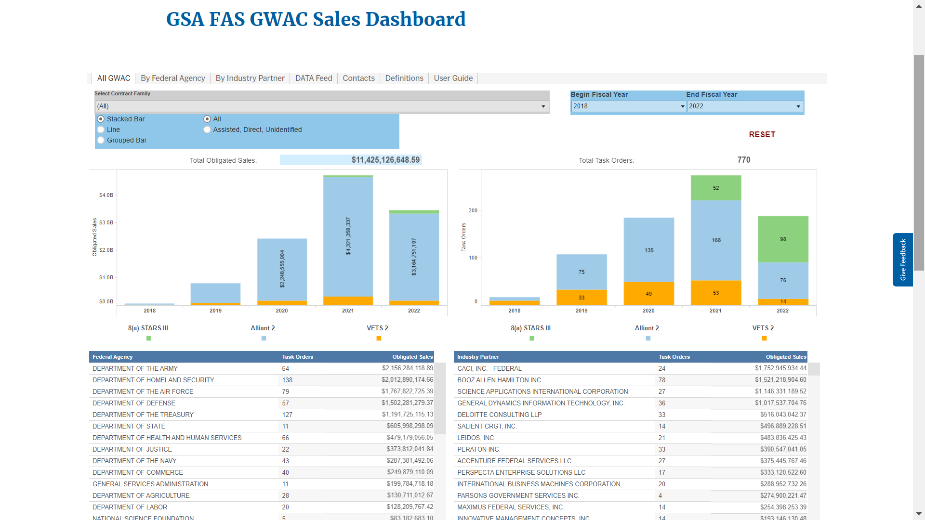
GSA FAS GWAC Sales Dashboard

Slide 12
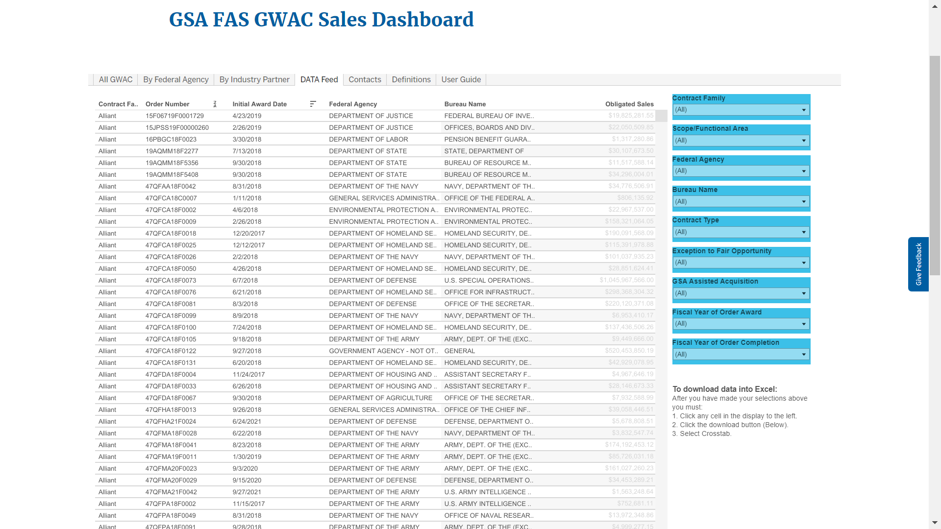
GSA FAS GWAC Sales Dashboard

Slide 13
GSA GWACs
Small Business GWAC Division
VETS 2
8(a) STARS III
Polaris (coming soon)
Enterprise GWAC Division
Alliant 2
Alliant 3 (planned)

Slide 14
VETS 2 GWAC
SDVOSB Set-Aside
63 Industry Partners
Five-year base with a five-year option
541512-Primary NAICS Code
$5 Billion Program Ceiling
*Opportunities for subcontracting to awardees

Slide 15
VETS 2 Contract Information
Order Period of Performance
Base Period: 2/23/2018 – 2/22/2023
Option Period: 2/23/2023 – 2/22/2028
Available Order Types
Fixed Price
Cost Reimbursement
Time & Materials
Labor Hour

Slide 16
8(a) STARS III Contract Information
8(a) Small Disadvantaged Business Set-Aside
1,109 industry partners
$50B program ceiling
Five-year base with a three-year option
Primary NAICS- 541512
Main area- IT services and integrated solutions
Two sub-areas
Emerging Technology
OCONUS
*Opportunities for subcontracting to awardees, future open seasons

Slide 17
8(a) STARS III Contract Information
Order Period of Performance
Base Period: 07/02/2021-07/01/2026
Option Period: 07/02/2026-07/01/2029
Available Order Types
Fixed Price
Time & Materials
Labor Hour

Slide 18
Alliant 2 Contract Information
Enterprise GWAC
46 industry partners
$50B program ceiling
Five-year base with a five-year option
Primary NAICS- 541512
*Opportunities for subcontracting to awardees. Alliant 3 being planned

Slide 19
Alliant 2 Contract Information
Order Period of Performance
Base Period: 07/1/2018 -06/30/2023
Option Period: 07/01/2023-06/30/2028
Available Order Types
Fixed Price
Cost Reimbursement
Time & Materials
Labor Hour
Requirements

Slide 20
Coming Soon
GSA’s Next Generation GWACs
Polaris (Small Business)-www.gsa.gov/polaris
Small Business
Women-Owned Small Business
HUBZone
Service-Disabled Veteran-Owned Small Business
Alliant 3 (Open)- www.gsa.gov/alliant3
Interact- Community of Interest Groups

Slide 21
GWAC Websites
GWAC Main Page www.gsa.gov/gwacs
VETS 2 www.gsa.gov/VETS2
8(a) STARS III www.gsa.gov/S3
Alliant 2 www.gsa.gov/alliant2

Slide 22
GWAC Summary
Our GWACs provide agencies with access to customized IT solutions from a highly qualified pool of industry partners
Small businesses participation:
Participate as subcontractors to existing GWACs
Monitor Sam.gov and GWAC websites for new GWAC opportunities
Provide a proposal in response to open solicitations (when available)

Slide 23
Points of Contact
8(a) STARS III s3@gsa.gov
VETS 2 VETS2@gsa.gov
Alliant 2 alliant2@gsa.gov
Polaris polaris@gsa.gov

Slide 24
Questions?

Slide 25
Thank You!

