Slide 1
Small Business Works 2023
Facilities Management
Michelle Bohm
PBS R3 Acquisition Branch Chief
U.S. General Services Administration

Slide 2
Agenda
Overview of GSA MAS Schedules
PBS Procurement Approach to Facilities Management
Overview of Getting a MAS Schedule

Slide 3
Introduction
Public Buildings Service (PBS) Acquisition Branch Chief with the new Acquisition Center for Facilities Management Services
Procure all recurring Building Service contracts across three (3) PBS Regions
Region 3, Mid-Atlantic Region
Region 4, Southeast Sunbelt Region
Region 11, National Capital Region
3

Slide 4
Schedules Program Overview
Slide title

Slide 5
GSA Schedule - Basics
FAR 8.4 Federal Supply Schedules
Contracts awarded by GSA or the VA for similar or comparable supplies and services, established with more than one supplier, at varying prices
IDIQ Contracts with a 5 year Base and three 5 year Options
Vast amount of commercial supplies and services
Made up of Special Item Numbers (SIN’s)
Categorization method that groups similar supplies and services together to aid in the acquisition process
Worldwide coverage
5

Slide 6
GSA Schedule - Advantages
Save Time
Eliminates need for requiring activity to award own IDIQ
Streamlined acquisition procedures
i.e. Ordering CO determines RFQ timeframe & source selection methodology
Save Money
Time is Money!
Prices for labor and supplies already negotiated and determined fair and reasonable at MAS Contract level
Further discounts available at BPA or Order level
Reduce Risk
Large selection of pre-qualified Contractors
Requirements are tailored at BPA or Order level
6
Notes:
Further Discounts at the Order level = expand upon with competition and TO CO is encouraged to seek discounts.

Slide 7
PBS Procurement Approach

Slide 8
Why MAS?
To implement the Spend Under Management (SUM)/Best in Class (BIC) Strategy adopted in October 2018, to more effectively manage contract spending and reduce contract duplication
This buying strategy includes measures encouraging PBS to use existing contract vehicles, such as GSA Schedules
Use of the MAS schedule helps PBS meet this SUM measure

Slide 9
MAS & Facilities Management
How does PBS use the MAS for Facilities Management Services?
Facilities Maintenance, Management and Repair subcategory provides federal agencies a streamlined procurement device to acquire all of the services necessary to maintain and manage a facility.
Complete Facilities Maintenance and Management - primary Special Item Number (SIN) 561210FAC - covers the breadth of services required to manage and maintain our federal buildings and courthouses

Slide 10
MAS & Facilities Management
Use in GSA PBS
The GSA Public Buildings Service (PBS) has increased their utilization of the MAS (SIN 561210FAC) for O&M and CFM requirements since 2018
FAS recruiting competitive pool of qualified contractors to provide O&M solutions on PBS properties
Contractors that have provided services in the past
Contractors that can illustrate the capability to provide O&M solutions in the future

Slide 11
MAS Outreach
What is being done to promote this approach?
Outreach events for all interested vendors
Request for Information / Sources Sought - Current MAS contract holders
Special Item Number (SIN) Modifications - Current MAS contract holders

Slide 12
PBS Procurement Process
Overview of the Solicitation Procedures
Procedures in FAR 8.405-3 will be followed
Goal is to establish single-award Blanket Purchase Agreements (BPAs) between 5-10 years in length
New procurements for building services will be conducted through a competitive process*
Majority of O&M, CFM, elevator maintenance services
Limited stand-alone custodial services opportunities
Utilization of small business concerns, in particular socioeconomic categories, is a priority
*With the exception of services that are on the Procurement List maintained by the Committee for Purchase From People Who Are Blind or Severely Disabled (See FAR Subpart 8.7)

Slide 13
PBS Procurement Process
Overview of solicitation procedures
Best-value tradeoff procedures will be utilized
Technical > Total Evaluated Price
Technical Factors may include:
Management Plan
Prior Experience
Relevant Past Performance
Small Business Socioeconomic Designation

Slide 14
PBS Procurement Process
Management Plan Factor for O&M/CFM Services
Management Approach
Staffing Plan
Monthly Progress and Communications Plan
Quality Control Plan
Technical Approach
Preventive/Predictive Maintenance Plan
NCMMS Usage and Data Management
Repair Plan
Project Management and Alteration Project Assistance Plan
Energy & Water Conservation Approach

Slide 15
PBS Procurement Process
Prior Experience Factor
Measures the breadth, depth and relevance of contractor’s prior experience in performing similar projects
Measures the number of opportunities the contractor has had to learn by doing
The experience of teaming partners and subcontractors who will have meaningful involvement in performing the work may be considered when evaluating the prime contractor

Slide 16
PBS Procurement Process
Relevant Past Performance Factor
Measures the quality of the contractor’s past performance in performing projects of similar size, scope and complexity to the one described in the solicitation
Evaluation is based upon questionnaires completed and submitted by the contractor’s customers and/or building owners
The Government reserves the right to conduct interviews in connection with additional projects it may be aware of

Slide 17
PBS Procurement Process
Small Business Socioeconomic Factor
Considers whether an offeror is a small business and if so, with any socioeconomic category designations
Small disadvantaged business (SDB)
Women-owned small business (WOSB)
Service disabled veteran-owned small business (SDVOSB)
HUBZone small business (HUBZone)
Additional credit offered to vendors with additional socioeconomic category designations

Slide 18
PBS Procurement Process
Contractor Team Arrangements
Use of Contractor Team Arrangements (CTAs) is encouraged in order for vendors to provide a total solution
More information on GSA Schedule CTAs: https://www.gsa.gov/buying-selling/purchasing-programs/gsa-schedules/schedule-features/contractor-team-arrangements

Slide 19
PBS Procurement Process
Special Item Numbers (SINs)
Vendors will be required to have certain SINs awarded under their MAS contract in order to be considered eligible
If necessary, existing vendors must modify their MAS contracts to satisfy these requirements
Must demonstrate experience under a SIN and provide fair and reasonable pricing

Slide 20
PBS Procurement Process
Special Item Numbers (SIN) - Minimum Requirements
For O&M and CFM Requirements:
561210FAC Complete Facilities Maintenance & Management
ANCILLARY Ancillary Supplies and/or Services
ANCRA Ancillary Repair and Alterations
OLM Order-Level Materials (OLMs)

Slide 21
PBS Procurement Process
Special Item Numbers (SIN) - Minimum Requirements
For Custodial Requirements:
561210FAC Complete Facilities Maintenance & Management
ANCILLARY Ancillary Supplies and/or Services
OLM Order-Level Materials (OLMs)

Slide 22
PBS Procurement Process
Special Item Numbers (SIN) - Minimum Requirements
For Elevator Maintenance Requirements:
561210FAC Complete Facilities Maintenance & Management
OLM Order-Level Materials (OLMs)

Slide 23
PBS Procurement Process
Continuous Contract Requirement
Blanket Purchase Agreements (BPAs) and Orders awarded under MAS cannot extend beyond the expiration date of the underlying GSA Schedule contract unless there are option periods remaining under the GSA Schedule contract that, if exercised, would cover the BPA/order period of performance
If a contractor’s ultimate 20-year contract expiration date is due to occur during the performance of the requirement in question, the contractor must put a new continuous contract in place
Evidence of a continuous contract must be provided as part of the quotation submission

Slide 24
PBS Procurement Process
Self-Certification Requirement
Quotation response must contain a “Self-Certification” that all rates offered correspond to line items on the contractor’s GSA Schedule and that they do not exceed the contractor’s rates of the applicable SIN.

Slide 25
PBS Procurement Process
Points of Emphasis for Quote Submissions
Technical Quote:
Read the submission instructions in the solicitation (RFQ) and follow them carefully
All components of the Management Plan must be addressed
Merely restating the language of the RFQ in the technical quote is of no value in the evaluation
The Government is looking for viable solutions to meet the challenges of the requirement
Be clear about the level of commitment of the staff being proposed for the project
Be proactive in ensuring your references submit completed Past Performance questionnaires by the closing date

Slide 26
PBS Procurement Process
Points of Emphasis for Quote Submissions
Price Quote:
Provide prices for all contract line item numbers (CLINs) listed on the electronic offer sheet
Use the most current version of the electronic offer sheet
Provide the most current MAS modification/catalog pricing
Make sure the GSA eLibrary information is updated with
the most current pricing information
modification refresh acceptance
contact information
small business size status
Acknowledge all RFQ amendments
Make sure the quote is signed by an authorized company representative

Slide 27
Getting on GSA Multiple Award Schedule

Slide 28
Getting on Schedule
Review Multiple Award Schedule Offerings
GSA eLibrary is the source for the latest GSA contract award information
Customer Facing view of the Multiple Award Schedule

Slide 29
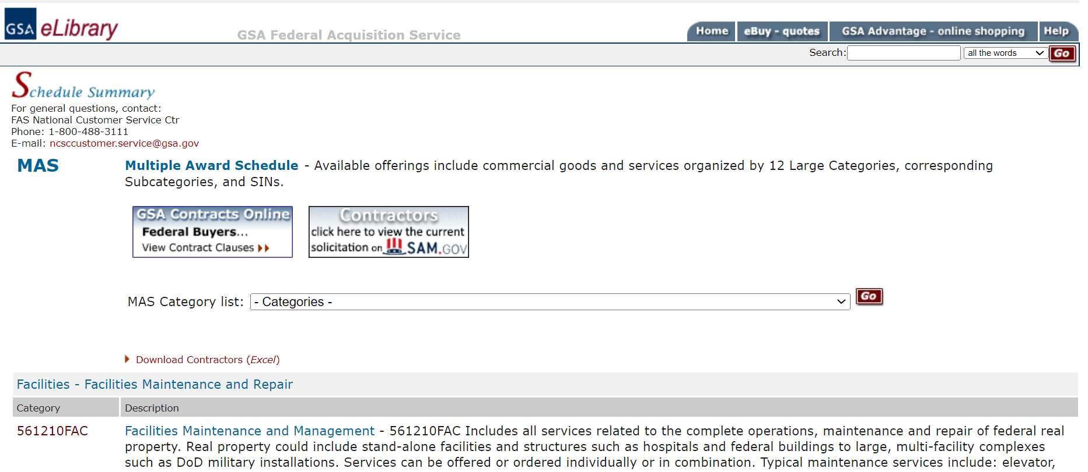
Getting on Schedule
Review Multiple Award Schedule Offerings
GSA eLibrary will bring you to the solicitation found on sam.gov
From the Multiple Award Schedule page, click the button to access the current solicitation

Slide 30
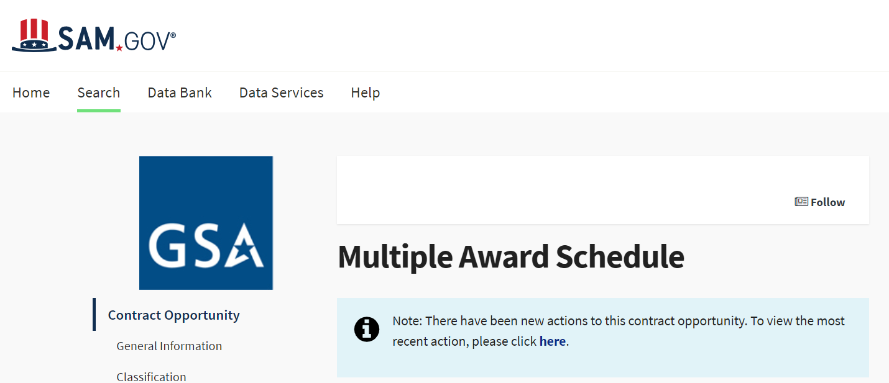
Getting on Schedule
Review Multiple Award Schedule Offerings
After you arrive at sam.gov, click the link in the blue box to find the latest solicitation refresh

Slide 31
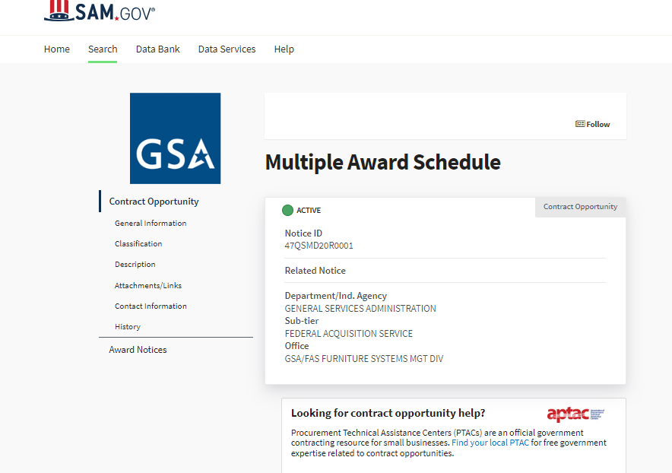
Getting on Schedule
Review Multiple Award Schedule Offerings
Most recent solicitation posting will look similar to the below:

Slide 32
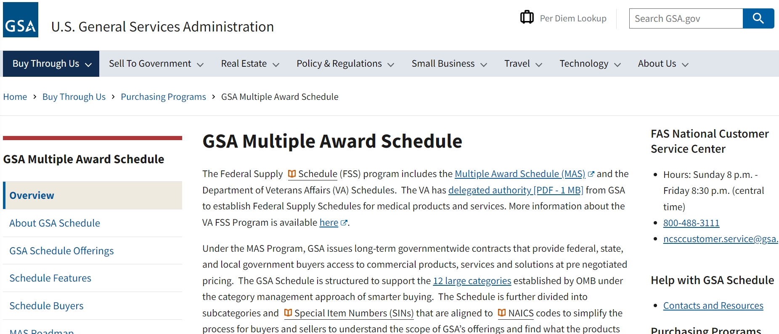
MAS Resources
GSA Multiple Award Schedule Homepage
https://www.gsa.gov/buy-through-us/purchasing-programs/gsa-multiple-award-schedule

Slide 33
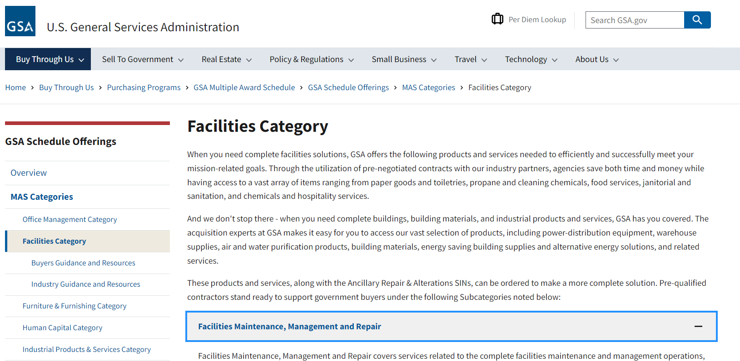
MAS Resources
GSA MAS Scope & Templates Link

Slide 34
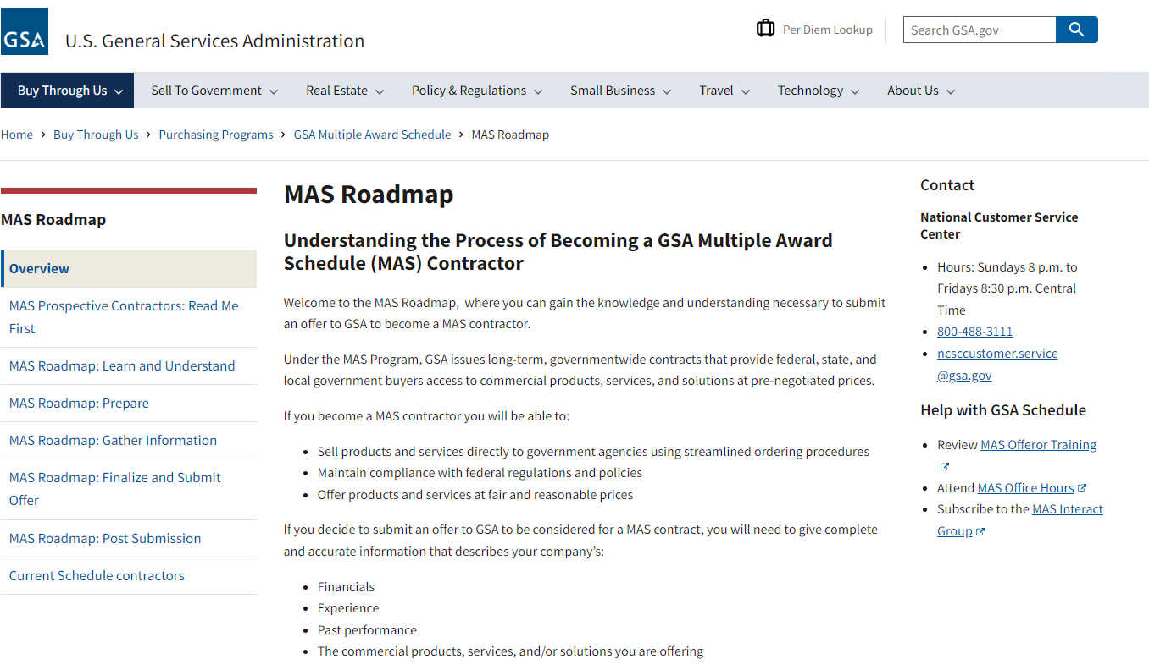
Where to Start?
GSA MAS Roadmap Link

Slide 35
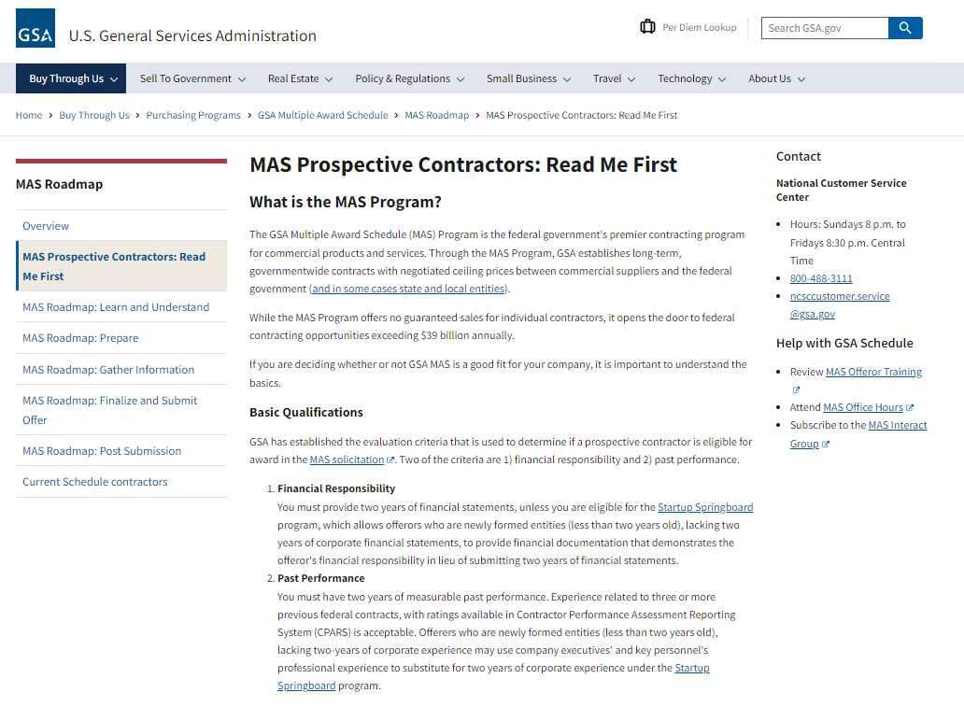
Where to Start?
GSA MAS Prospective Contractors Link

Slide 36
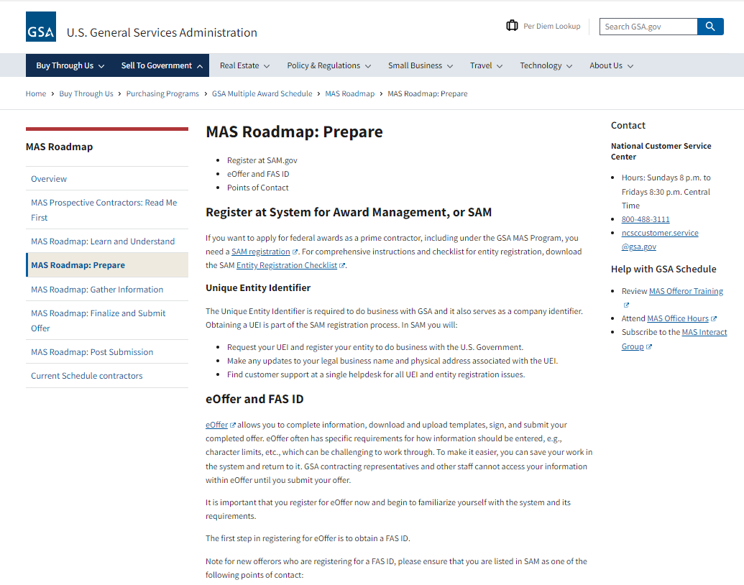
Preparing an Offer
GSA eOffer/eMod

Slide 37
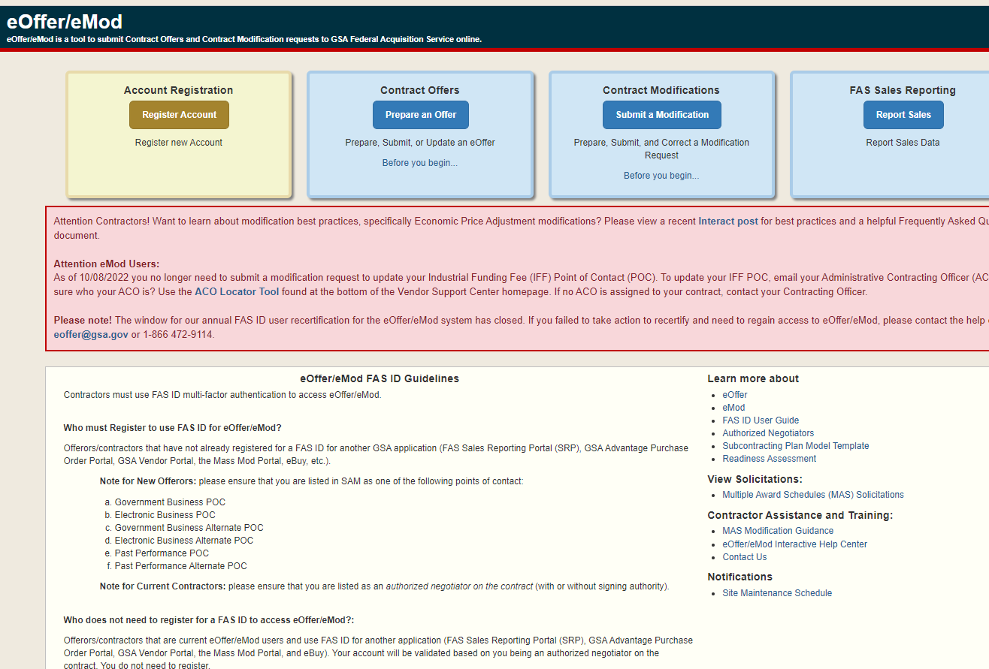
Preparing an Offer
GSA eOffer/eMod

Slide 38
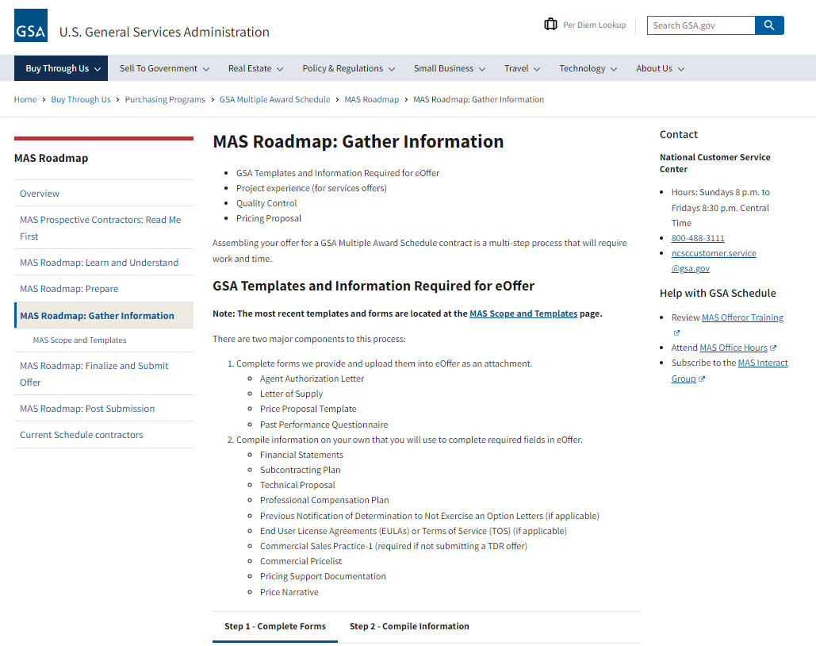
MAS Resources
GSA MAS Gather Information Link

Slide 39
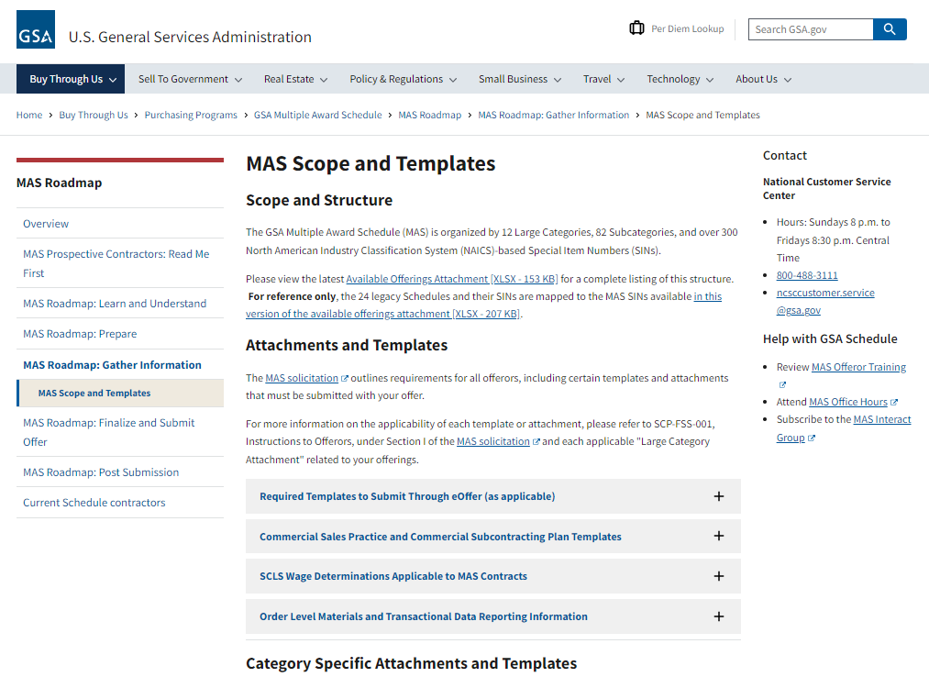
MAS Resources
GSA MAS Scope & Templates Link

Slide 40
Modify Your Existing MAS Contract
Adding Additional Labor Categories & Supplies
Ability to adjust your MAS contract as needed
Consider adding as many supplies and labor categories on your MAS contract that could possible be needed
i.e. adding an entire price list (such as Grainger) is allowable
Strategy to help guard against the OLM cap which cannot exceed 33.33% of your order value
Adding labor categories and supplies to your MAS contract is allowed both before and after award of a BPA or order

Slide 41
Modify Your Existing MAS Contract
Continuity of Contracts - Overlap your MAS Contracts!
Why overlap your MAS Contracts?
MAS Contract Period of Performance (PoP) vs. BPA/Order PoP
When an existing Contractor has one or more active BPAs or Orders under its existing Contract (or has submitted quotes and is awaiting an award decision), the Contractor is eligible for the award of a new overlapping MAS Contract
An existing MAS contractor may submit an offer for a new contract for the same MAS at any time during the existing MAS’s period of performance pursuant to updated Clause A-FSS-11 Consideration of Offers
Holding overlapping MAS contracts allows existing contractor to complete work under existing BPAs and Orders under the existing MAS Contract, and to pursue future opportunities under the new MAS Contract

Slide 42
Questions?

Slide 43
GSA

