Slide 1
Getting on Schedule for Human Capital Category
Jennifer Jackson
Supervisory Business Development Specialist
Jennifer.Jackson@gsa.gov

Slide 2
MAS Overview
Under the MAS Program, GSA enters into contracts with commercial firms to provide commercial products and services to federal agencies and other authorized users. Buying activities place orders directly with MAS contractors to acquire products and services to meet their procurement needs.

Slide 3
MAS Overview
The MAS program, commonly referred to as GSA’s Schedule program, is the premier commercial acquisition program within the federal government.
GSA’s Multiple Award Schedule (MAS) is an indefinite-delivery, indefinite-quantity (IDIQ) contract for commercial products and services that are available for use by federal agencies worldwide and other authorized users

Slide 4
MAS Basics
20 year contract (5 year option periods)
1 Schedule organized by Special Item Numbers (SIN)
SINs are also grouped by Category (IT, Human Capital, etc)
Uses FAR 8.4 streamlined acquisition methods
Fair and Reasonable ceiling prices at contract-level
Firm Fixed Price
Although, Time and Materials and Labor Hours may be requested by customer
Ability for Blanket Purchase Agreements (BPAs)

Slide 5
MAS Basics
It is important to remember that you must market your contract to potential buyers.
The GSA Schedule contract provides no guarantee of sales, but can open doors to the federal market.
Federal agencies and authorized users obligate
~$35 billion annually through MAS contracts

Slide 6
Visibility
Customers may find your GSA contract via:
eLibrary (including your Price List)
eBuy (quote via RFQs)
GSA Advantage
Your website
A MAS Contract is no guarantee of future sales.

Slide 7
Category Management
The MAS program aligns closely with Category Management, an approach the federal government is applying to buy smarter and more like a single enterprise. Category Management enables the government to eliminate redundancies, increase efficiency, and deliver more value and savings from the government’s acquisition programs.

Slide 8
Category Management
Category Management involves: • Identifying core areas of spend
• Collectively developing heightened levels of expertise
• Leveraging shared best practices
• Providing acquisition, supply, and demand management solutions
• The MAS Program is organized around the 12 governmentwide categories prescribed by the Office of Management and Budget (OMB).

Slide 9
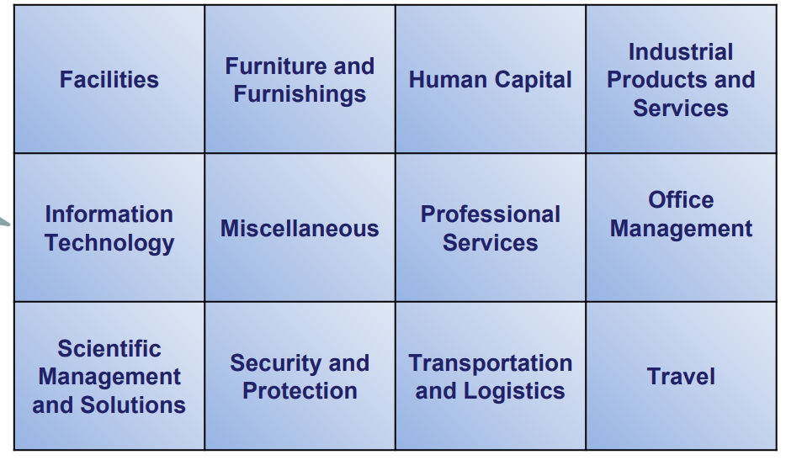
Category Management

Slide 10
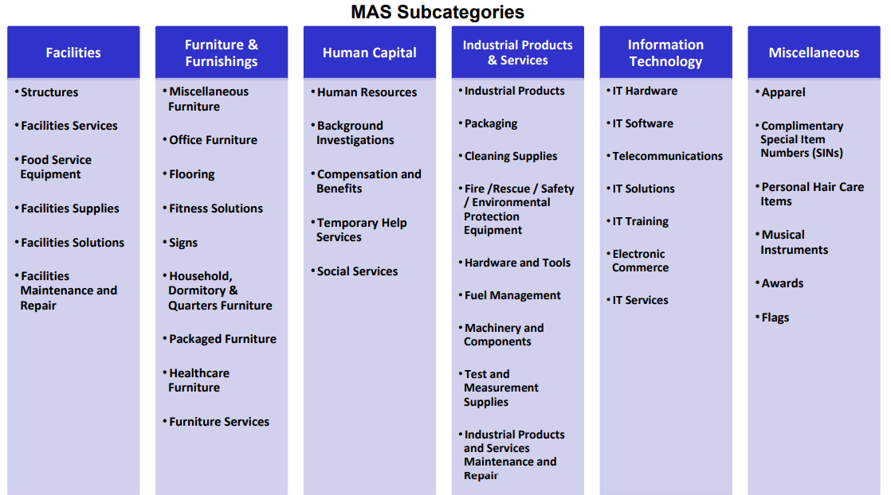
MAS Subcategories

Slide 11
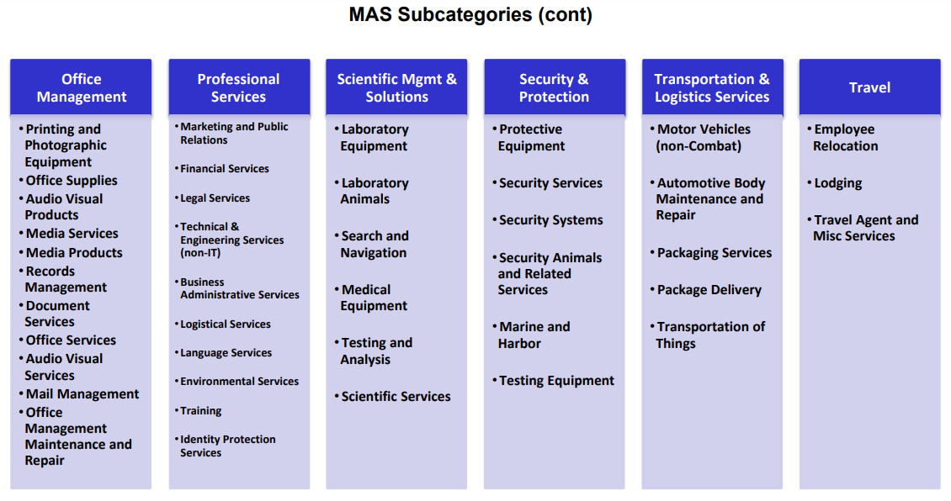
C

Slide 12
MAS Notes
Max Ordering Threshold
NAICS vs. SIN
SINs are NOT NAICS
They’re NAICS-based to help buyers find the vendors that have experience/items in that SIN’s scope
You only have 1 NAICS, at the contract-level
Life of the contract
Sole determinant for SB status
Customer only selects PSC at award, NAICS is automatically populated regardless of SIN

Slide 13
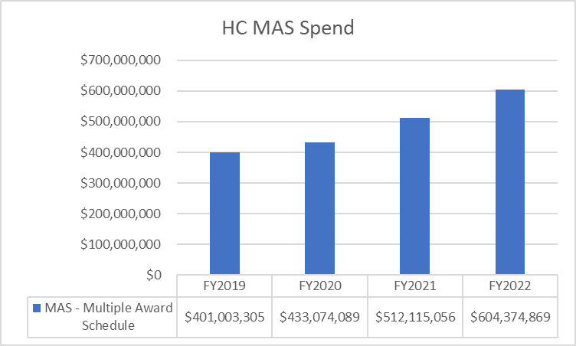
Opportunity
TOP 5 CUSTOMERS
DEPARTMENT OF HOMELAND SECURITY
DEPARTMENT OF VETERANS AFFAIRS
DEPARTMENT OF AGRICULTURE
DEPARTMENT OF AIR FORCE
DEPARTMENT OF ARMY

Slide 14
Readiness
Understand the scope, requirements, and commitment Consider:
• Does market research show that federal, state, and local governments are buying the types of products and services that your company wants to offer? • Have you been in business for at least two years and have two years of financial statements to support this? • Do you have evidence of successful past performance? • Do you have the resources to market your commercial products and services after the award of the contract?

Slide 15
Readiness
If no, consider:
Subcontracting
Open Market Opportunities
Other Agency MACs
Reconsidering at a later time
More than 90% of government procurements are not made through MAS!

Slide 16
Schedule Offers
Understand the MAS Solicitation:
Download,
Read, and
Understand
the entire solicitation and applicable category attachment(s).
Pay close attention to Solicitation Provision SCP-FSS-001, Instructions to Offerors contained within the solicitation.

Slide 17
Schedule Offers
Understand the Scope:
To qualify for a GSA MAS contract, your company must have products or services that fit under a GSA Schedule category, i.e., Special Item Number (SIN). For more information on SINs, visit GSA eLibrary at www.gsaelibrary.gsa.gov.

Slide 18
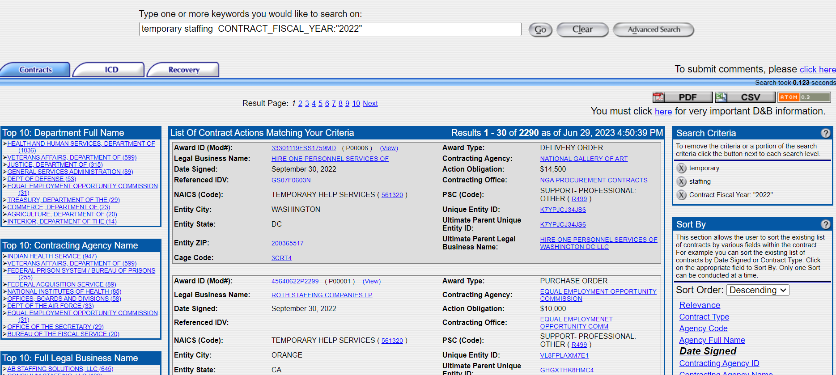
Federal Procurement Data Systems (FPDS)
Click “Advanced Search” to add search terms that will help you refine your search.
Download search results here.
See which Departments have the highest # of contract actions
Easily modify your search terms.
For the most recent contract actions, we’ll sort by “Date Signed”

Slide 19
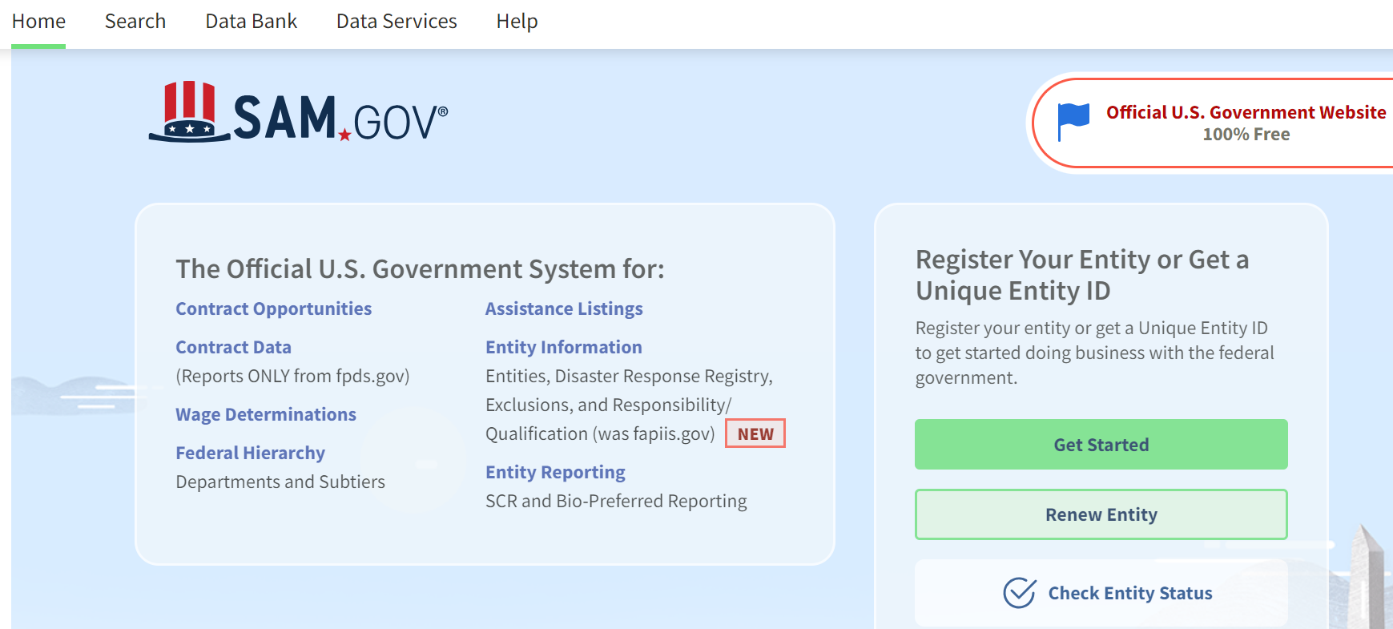
SAM.gov
FREE
See current open opportunities
Set search alerts
Read prior solicitations
Respond to RFIs, RFPs, Sources Sought Notices
Learn more about other partners
Learn how your customers buy

Slide 20
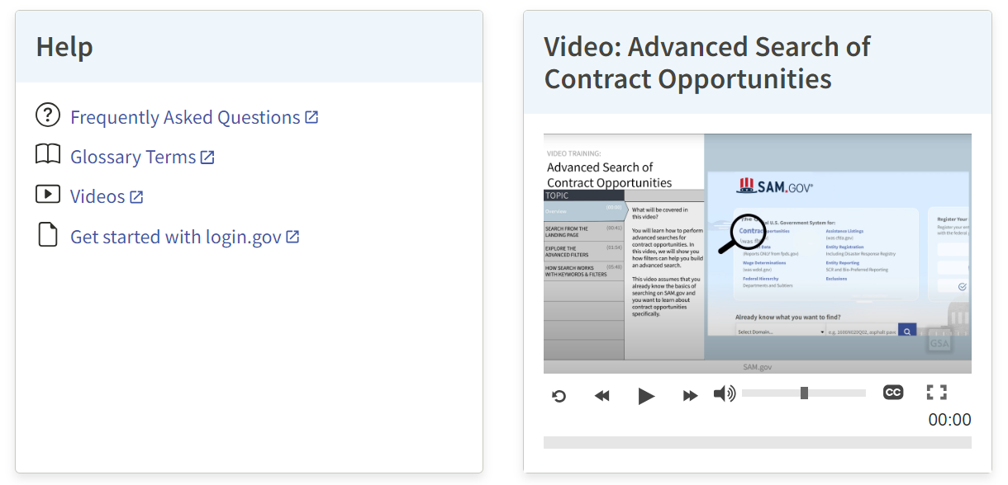
SAM.gov

Slide 21
Forecast of Contracting Opportunities
FREE
Nationwide dashboard of upcoming federal contracting opportunities.
Search Agency, NAICS, Place of Performance, Est. Contract Value, Acquisition Strategy, Estimated Award date
Points of Contact!

Slide 22
Forecast of Contracting Opportunities

Slide 23
Training/Resources
MAS Office Hours: https://gsa.zoomgov.com/webinar/register/WN_EETVm2LNRH2MeM90Kg_D-A
GSA Interact: https://interact.gsa.gov/
Sign up for at least the MAS group (newsletter, refresh info)
YouTube:
Ex: https://www.youtube.com/playlist?list=PLvdwyPgXnxxX3I6FfCXIB5GK0QKfi1EEq
https://www.youtube.com/c/usgsa
Other GSA Training: http://www.gsa.gov/events
Vendor Support Center (VSC): https://vsc.gsa.gov/vsc/
Procurement Technical Assistance Center (PTAC)
https://www.aptac-us.org/

