Slide 1
Doing Business with GSA:
Multiple Award Schedule (MAS) Information Technology (IT)
Pre Award / Offer Preparation
U.S. General Services Administration

Slide 2
Tara Wetli
Senior Contracting Officer
Information Technology Category (ITC)
Federal Acquisition Service (FAS)
Contracts Division 3 Atlanta

Slide 3
Agenda
Information Technology Category (ITC)
GSA MAS Solicitation
eOffer Preparation
Common Mistakes to Avoid
Questions and Answers (Q&A)

Slide 4
Information Technology Category (ITC)
GSA’s Information Technology acquisition market space offers a large selection of innovative products, services, and solutions within the IT Category that are procured by our Federal, State and Local Government agencies.
When our commercial industry partners sell products and services to government agencies, different types of contract vehicles may be utilized. Such as our Governmentwide Acquisition Contracts, known as our GWACs.
In addition to GWACS we have our Multiple Award Schedule (MAS), which features over 7.5 million innovative IT products and services.

Slide 5
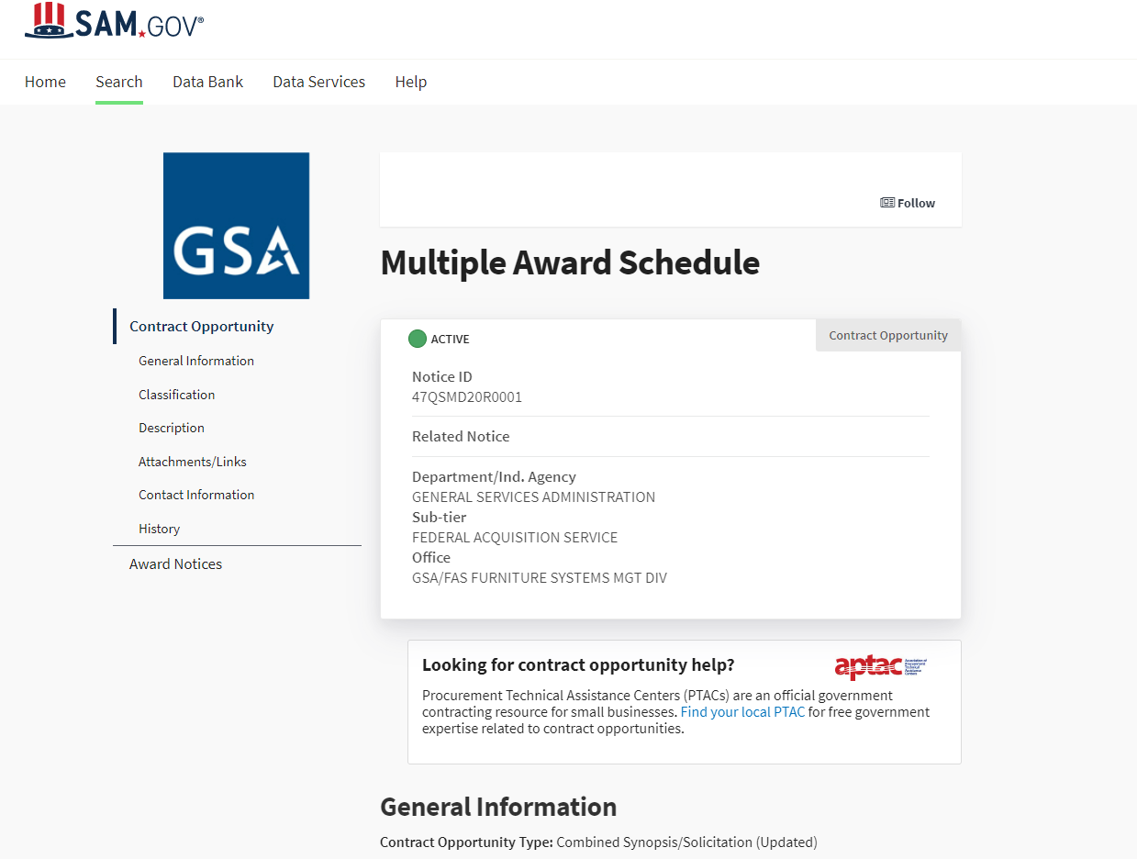
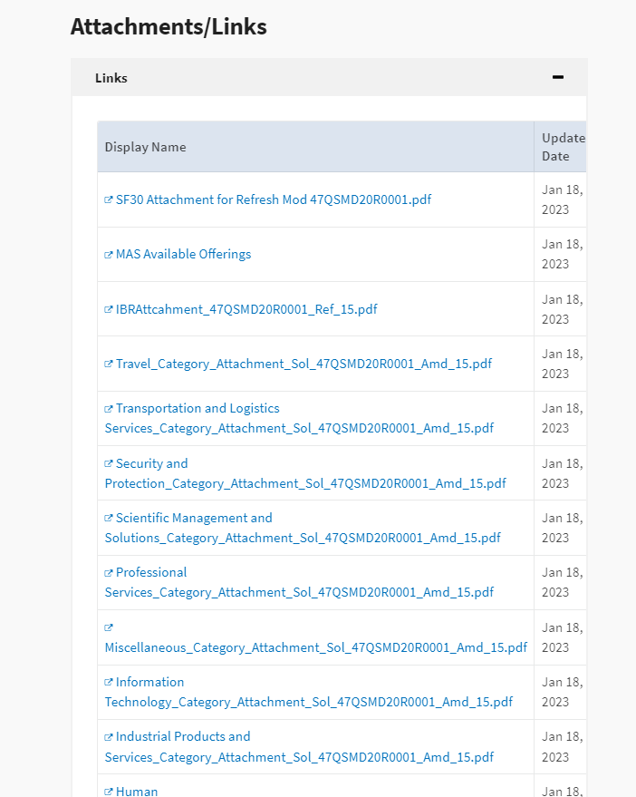
GSA MAS Solicitation
GSA MAS solicitation No: 47QSMD20R0001, Refresh 17

Slide 6
GSA MAS Solicitation
Section I Offer Preparation Instructions and Evaluation Criteria
Section IA Instructions to Offerors
Section IB Offer Preparation Instructions and Evaluation Criteria
Section II Available Offerings - Special Item Numbers (SINs)
Section III Contract Terms and Conditions
Section IIIA Terms and Conditions Related to Schedule Contract Administration
Section IIIB Terms and Conditions Related to Performance of an Order
Section IV List of Attachments

Slide 7
MAS Available Offerings
Large Categories
Office Management
Facilities
Furniture and Furnishings
Human Capital
Industrial Products and Services
Information Technology
Miscellaneous
Professional Services
Scientific Management and Solutions
Security and Protection
Transportation and Logistics Services
Travel

Slide 8
Offer Preparation

Slide 9
Organizing Your Approach
Prepare
Take Assessments/Training
Register for SAM
Get Docusign
Gather Required Documents
Technical Proposal
Select appropriate SIN
Develop responses to the evaluation factors
Gather Required Documents
Pricing Proposal
Research market & competition
Formulate your proposed pricing
Proposal Submission & Award
Review Required Documents
Submit the Offer Responses Document

Slide 10
Prepare - Assessments/Training
and Registration
Pathways To Success Training and Readiness Assessment
System for Award Management (SAM) - See the Entity Registration Checklist for complete details.
Ensure you have included applicable NAICS for your proposed SINs
Respond “YES” to acceptance of Credit Card payments
The Offeror’s SAM, FAR, DFAR Rep and Certs Section 889 must represent that it DOES NOT provide covered telecommunications and DOES NOT use covered telecommunications equipment or services, or any equipment, system, etc.
DocuSign (Registration must remain active throughout the duration of a schedule contract)
eOffer - FAS ID required

Slide 11
Gather Required Documents - Financial Statements
Past 2 fiscal years (indicate if audited)
Balance Sheets
Income Statements
Note - For companies who have been in existence less than 2-years they may qualify for Startup Springboard. For more information visit: Startup Springboard Info Page

Slide 12
Gather Required Documentation (Products)
Dealers & Resellers
Submit a Letter of Supply LOS, End User License Agreement or Terms of Service Agreement from the Manufacturer:
Must be dated and signed on company letterhead
Includes TAA clause
All agreements must be submitted for review by GSA Legal
Terms and conditions must be compliant with the FAR
OR
Use the GSA Verified Product Portal (VPP) System

Slide 13
Gather Required Documentation (Services)
Labor Category Description Page - Offerors shall provide a description of each type of IT Professional Service offered. The following is an example of the manner in which the description of a commercial job title should be presented:
EXAMPLE: Job Title: System Engineer
Minimum/General Experience: Three (3) years of technical experience which applies to systems analysis and design techniques for complex computer systems. Requires competence in all phases of systems analysis techniques, concepts and methods; also requires knowledge of available hardware, system software, and input/output devices.
Functional Responsibility: Guides users in formulating requirements, advises alternative approaches, conducts feasibility studies.
Minimum Education: Bachelor's Degree in Computer Science
Professional Compensation Plan - Offeror shall submit a Professional Compensation Plan setting forth salaries and fringe benefits proposed for the professional employees who will work under the contract in accordance with Clause 52.222.-46
Labor Category Matrix and Descriptions (If applicable)

Slide 14
Pricing Requirements - Applicable to Both Products and Services
Commercial Price List or Internal Market Rate Sheet
If proposed pricing is based on a published or publicly available commercial price list, submit a copy of the company's current, dated, price list, catalog, or standard rate sheet.
This must be an existing, standalone document, and not prepared for purposes of this solicitation.
Economic Price Adjustment (EPA) Mechanism
Future price adjustments for pricing based on a market price list are subject to clause I-FSS-969 Economic Price Adjustment. The offeror must either propose a fixed annual escalation rate in accordance with I-FSS-969 paragraph (b)(1) OR propose a relevant market indicator (e.g., the Bureau of Labor Statistics Employment Cost Index (ECI)(b)(2)
Future price adjustments for pricing based on a commercial price list are subject to clause 552.216-70 Economic Price Adjustment – Multiple Award Schedule Contracts.

Slide 15
Complete the Required Documents
MAS Roadmap: Gather Information
Price Proposal Template (PPT):
Products - Price Proposal Template
Services and Training - Price Proposal Template
The PPT MUST be submitted in the approved Microsoft Office Excel format.
The price proposal is a mandatory offer document.
Ensure all cells are filled in - empty cells are not accepted
Columns that include drop-down options are used and not altered
No formulas have been altered

Slide 16
Agent Authorization Letter
Authorizes third parties authority to:
Discuss the eOffer
Sign contract actions, if approved by Contracting Officer
Negotiate with the Government
Submit modifications
Template

Slide 17
Offer Responses Document
Pathways to Success and Readiness Assessment acknowledgement
Contains Proposed SINs
Preponderance of work (North American Industrial Classification System (NAICS) Code)
Annual Sales Projections per SIN
Previous Schedule contracts
Required clauses e.g. Delivery Info, Marketing POC, etc.
Authorized Negotiators
*Generated in the system based on offeror responses

Slide 18
Evaluation Factors: Factor 1 Corporate Experience
Submit a document of two (2) page maximum detailing:
Years of relevant experience (Min. 2 years) except for Startup Springboard
Organization’s structure, including size, experience and resources
Brief history of the organization’s activities
Ability to acquire resources/manpower proposed
Schedule-specific marketing strategy

Slide 19
Evaluation Factors: Factor 2 Past Performance
Offers must submit a minimum of three (3) Past Performance Evaluations Questionnaires or (3) or more contractor performance assessment reports (CPARS), filed by a federal ordering activity.
Past Performance Questionnaire [PDF - 138 KB] - To be completed by customer references The past performance questionnaires must demonstrate past performance is similar in scope and complexity to the work solicited under the proposed SIN(s).
OR
Contractor Performance Assessment Reporting System (CPARS),(A) Offerors with three (3) or more contractor performance assessment reports available in the federal (CPARS) must represent:
(1) contracts or orders completed within three (3) years of the date of offer submission;
(2) at least three (3) distinct orders and/or contracts; and
(3) work similar in scope to products/services included in this solicitation.

Slide 20
Evaluation Factors: Factor 3 Quality Control
The offeror must provide a single quality control narrative directly through the eOffer prompts addressing
Description of internal review procedures that facilitate high-quality standards
Identification of individuals responsible for ensuring quality control
Use of subcontractor and the quality control measures used to ensure acceptable subcontractor performance
How potential problem areas/solutions are handled
Procedures for ensuring quality performance when meeting urgent requirements
How quality control will be managed when completing simultaneous projects

Slide 21
Evaluation Factors: Factor 4 Relevant Project Experience
For SINs 561422, 51821OC, 54151HACS, 54151S, 517312, 54151HEAL, and 541519ICAM
Demonstrate capability to perform SINs offered by providing information on two (2) projects:
Project/Contract Name
Project Description
Dollar Amount of Contract
Project Duration
Point of Contact and Telephone Number

Slide 22
SIN Specific - Technical Evaluation Guidelines
For Cloud and Cloud Related IT professional services send an email to cloud-sin-rfi@gsa.gov and your Contracting Officer/Contract Specialist with the subject line as “CLOUD Technical Evaluation.” Attach to the email the following documentation:
Technical responses, if applicable for cloud computing services Infrastructure as a service (IaaS), Platform as a service (PaaS), Software as a service (SaaS); and
Price proposal template
For Highly Adaptive Cybersecurity Services (HACS) Oral Evaluation - Identify up to 5 key personnel to field questions by the Technical Evaluation Board. Scheduled on a first-come-first-served basis.
Offerors may request High Value Asset (HVA) Assessments, Risk Vulnerability Assessment (RVA), Penetration Testing, Incident Response, and Cyber Hunt.
Attach to the email the following documentation: Technical responses, Price Proposal Template

Slide 23
Commercial Sales Practices (CSP)
for non-TDR eOffers only
What is the CSP?
Details offeror's commercial discounting practices & policies
Prepared for each SIN offered
Entered into eOffer system
Must provide:
Sales to the general public: 12-month period
Discounting Policies or Standard CSP
Commercial Sales Practices Format (CSP-1) The CSP Format is to be completed within the eOffer system. Submission of a separate CSP Format document will not be accepted

Slide 24
IT FASt Lane - If Applicable
Eligible vendors get shorter processing times for contract actions that directly support federal customer agency requirements, and agencies get fast access to emerging technologies and innovative offerings
New offers may be awarded within 45 days
Offer must meet specific eligibility requirements to participate in FASt Lane:
Only applicable to the IT Category and IT SINs
Offer must be associated with a FASt Lane eligible initiative
Additional information regarding IT FASt Lane and eligibility requirements:
FASt Lane Information

Slide 25
Post Offer Submission
Once submitted, your offer will be assigned to either a Contracting Officer or Contract Specialist for review
Introduce yourself to the Contract Specialist
Respond to all correspondence in a timely manner

Slide 26
Need More Information?
eOffer/eMod Helpdesk
Phone: 866-472-9114
Email: eoffer@gsa.gov
GSA MAS Solicitation Helpline
Phone: 877-446-4870
GSA Vendor Support Center
Phone: 877-495-4849
Visit our MAS Roadmap!
Subscribe to the MAS Interact Group

Slide 27
GSA Office of IT Category

Slide 28
GSA

