Slide 1
How to Get on the GSA Schedule for Office Management and Furniture
Kristine Stein Business Development Director
Integrated Workplace Acquisition Center
Federal Acquisition Services

Slide 2
Agenda
Understanding the GSA Multiple Award Schedule (MAS)
The GSA MAS Solicitation
The Roadmap for a GSA MAS Contract
Submitting your Offer for a GSA MAS Contract
How Your Offer is Evaluated
Resources

Slide 3
Understanding
the GSA Multiple Award Schedule (MAS)

Slide 4
What is a GSA Multiple Award Schedule?
GSA establishes long-term, governmentwide contracts with commercial firms to provide ordering activities with access to a wide variety of commercial supplies or services.
Multiple Award IDIQ (5-year award, three 5-year options)
Fixed Price EPA (Economic Price Adjustment)
Fair and reasonable pricing
Price reductions may be applied at the order level
Performance requirements established at the order level

Slide 5
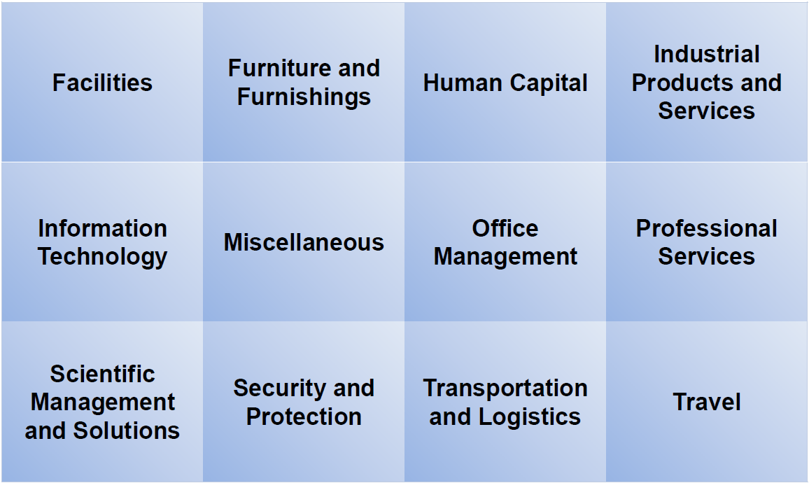
Organized into 12 Large Categories

Slide 6
Categories are Divided into Subcategories
Office Management
Document Services
Office Services
Audio Visual Services
Mail Management
Office Management Maintenance and Repair
Printing and Photographic Equipment
Office Supplies
Audio Visual Products
MediaServices
MediaProducts
Records Services
Furniture and Furnishings
Miscellaneous Furniture
Office Furniture
Flooring
Fitness Solutions
Signs
Household,Dormitory & Quarters Furniture
Packaged Furniture
Healthcare Furniture
Furniture Services

Slide 7
NAICS and SINS
A NAIC Code is a classification within the North American Industry Classification System.
A Special Item Number, referred to as a SIN , is a number that identifies products and services that GSA Schedule contract holders offer to
government buyers through a Schedule contract.
SINs align with NAICS codes.

Slide 8
GSA elibrary
www.gsaelibrary.gsa.gov
THE official online source for complete GSA Schedule information great market research tool.

Slide 9
The GSA MAS
Solicitation

Slide 10
What is the GSA MAS Solicitation?
www.sam.gov/opp/1103ada8f9f94c4dbbe6dfd73b9b5e59/view
GSA’s formal request for contractors to submit offers to obtain a Schedule contract. It provides detailed information and instructions, including:
Required elements of an offer.
Evaluation criteria used to evaluate your offer and determine whether or not to award a Schedule contract to your company.
Specific terms and conditions you will need to comply with as part of your contract.

Slide 11
Your First Two Steps
STEP ONE LEARN & ASSESS
Go to https://go.usa.gov/xS5G7
Complete the “Pathway to Success” and “Readiness Assessment” training
STEP TWO READ
Go to this link
Download and understand the solicitation and applicable Office Management or Furniture attachments
t

Slide 12
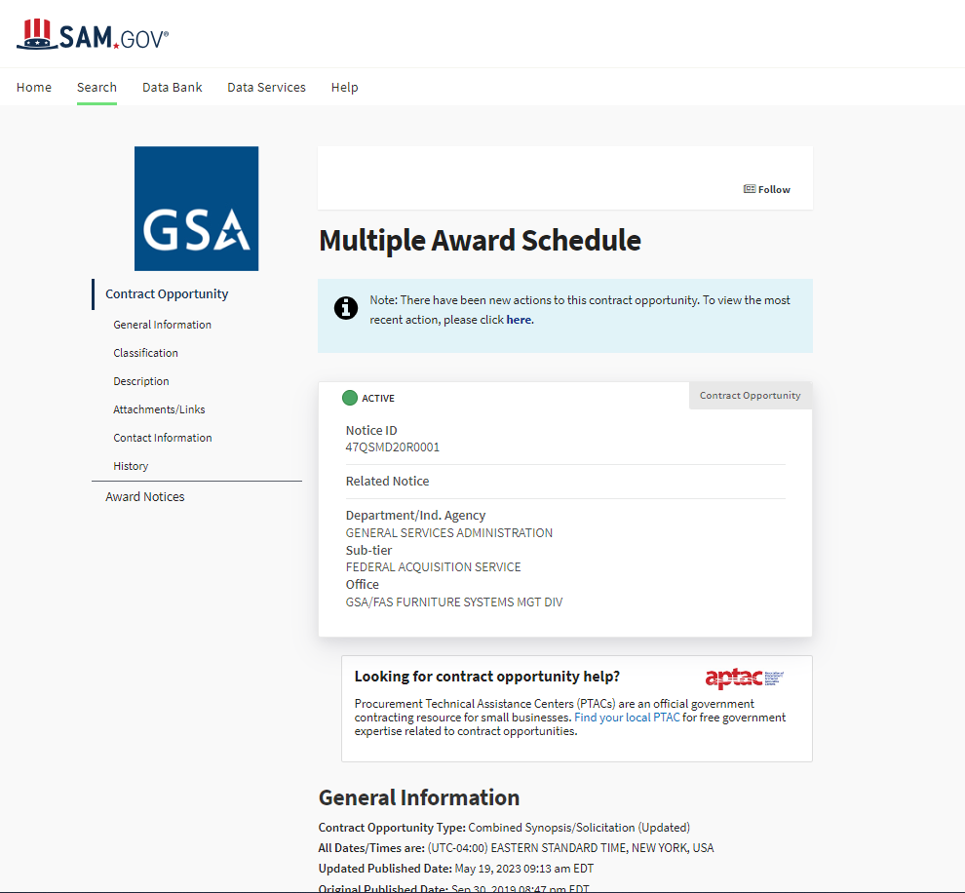
https://sam.gov/opp/c3621cd18404429498c811896a04f3d2/view

Slide 13
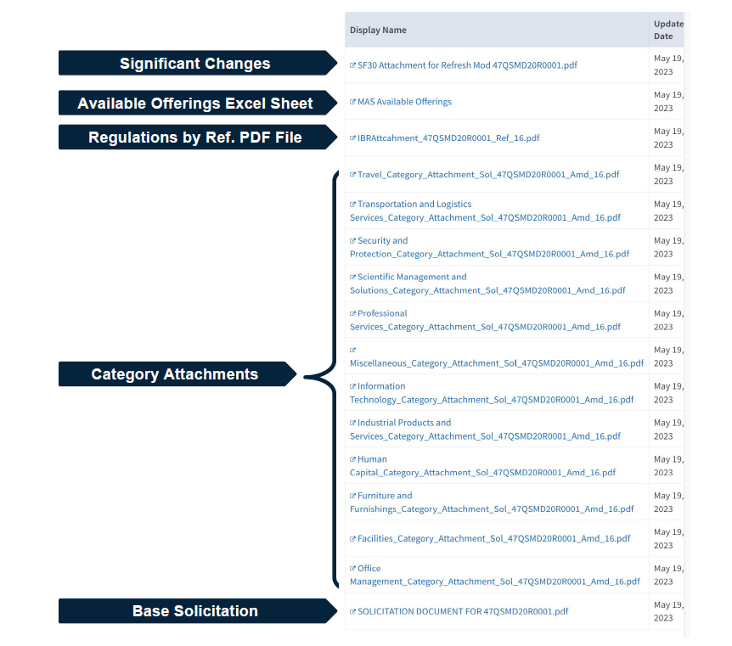
HERE YOU See Important - Unique Requirements for Furniture and Office Management

Slide 14
Visit
MAS Scope & Templates PAGE
Here you will understand GSA requirements
SPECIFIC to
Furniture and Furnishings and Office Management
SPECIFICS
INCLUDE
Packaged Furniture SINs
Perfect for furniture resellers/integrators
How does it work?
You sell NO products under your GSA contract.
Rather, you are required to have Contractor Teaming Arrangements (CTAs) with suppliers that provide furniture on their own separate GSA contract.
For example,
You offer design and installation services on your GSA Packaged Furniture contact.
To bid on complete furniture projects, you obtain CTAs with GSA manufacturers of systems furniture, seating, and executive wood furniture, etc.

Slide 15
Continued
More requirements that are
SPECIFIC to
Furniture and Furnishings and Office Management
Furniture and Flooring Testing Requirements
Do you want to add furniture and flooring products to your GSA contract?
You are required to follow the guidance in the category attachment for product testing
Certify that you have completed all required testing.
Electronic Records Management
Do you want to offer Electronic Records Management (ERM)?
You must certify that you are capable of meeting elements set forth by the National Archives and Records Administration (NARA)

Slide 16
The Roadmap for a GSA MAS Contract

Slide 17
What is the MAS Roadmap?
Provides information on the contract award process to make it easier to do business with the government.
Why is this helpful?
Breaks down the offer submission process into easy to follow step-by-step instructions.
www.gsa.gov/masroadmap

Slide 18
What is required by EVERY GSA Contractor?
Must be in business for two years and you must provide two years of financial statements
Unless you are proposing under the Startup Program GSA Springboard
Ability to demonstrate past performance
Products or services must be commercially available
Products or services must be compliant with the Trade Agreements Act (TAA)

Slide 19
Submitting your Offer for a GSA MAS Contract

Slide 20
Are you READY for your offer submission?
Have you:
Completed the preliminary training
Registered on Sam.gov
Familiarized yourself with the GSA MAS solicitation
Great! It’s time to develop your proposal for submission to GSA.
IMPORTANT
When assembling your offer, you must complete the forms (as applicable), which are located here www.gsa.gov/masscopeandtemplates Forms include:
Agent Authorization Letter
Letter of Supply
Price Proposal Template

Slide 21
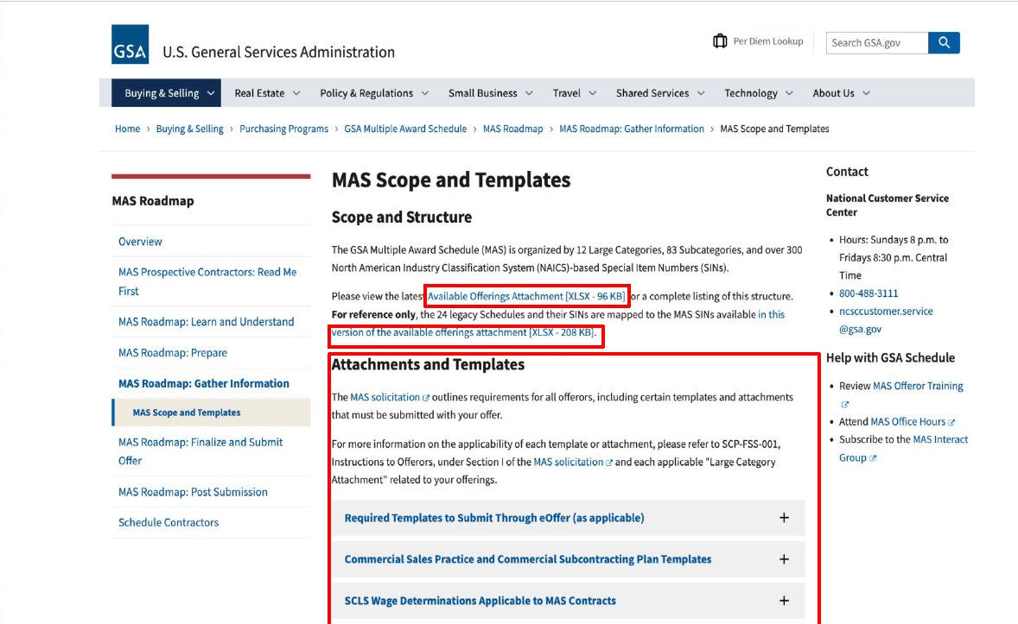
2

Slide 22
HOW TO Submit an OFFER
You will need to compile all the information below (as applicable) and submit it through the GSA eOffer system, www.eoffer.gsa.gov
You can find the forms and their descriptions at https://go.usa.gov/xSUaA.
Financial statements
Subcontracting plan
Technical proposal
Commercial Sales Practice-1 (CSP-1)
Professional compensation plan
Commercial price list
Previous cancellation and rejection letters
Price narrative with supporting documentation

Slide 23
How Your Offer is Evaluated

Slide 24
After You Submit
your completed offer in www.eoffer.gsa.gov:
Your offer will be assigned to one of our contracting professionals for review.
You will work directly with your assigned representative to clarify any questions or issues and negotiate pricing or other elements of your offer, if necessary.
After review and negotiation, you will know whether you will receive a Schedule contract, based on the decision of the GSA Contracting Officer.
Learn more about finalizing your offer at
https://go.usa.gov/xHssV

Slide 25
Success as a GSA MAS Contractor

Slide 26
2
Nearly $800M in federal furniture sales are awarded annually to our MAS furniture suppliers and
Over $700M is awarded to our MAS office management suppliers
Four Tips for Success:
Dedicate a resource to your GSA contract.
Highlight your GSA contract on your own commercial website. This will draw federal buyers to your company.
Become familiar with your GSA Business Development Team (see emails below).
Monitor the GSA site for Requests for Quotes very closely www.ebuy.gsa.gov/ebuy
Resources for Success Marketing Your GSA Contract
Set-up a marketing consultation with the GSA business development team, email furniture@gsa.gov or officemanagement@gsa.gov
Review GSA’s marketing guidance here
Sign up and attend MAS Office Hours, monthly sessions to help YOU
Watch the YouTube Playlist of past MAS Office Hours videos and LEARN!
Enjoy the YouTube Playlist of Office Mgmt training webinars
Here is a great recorded training on Managing your GSA Contract
Furniture suppliers, join the GSA Quality Partnership Council, our Furniture Industry Forum

Slide 27
Resources

Slide 28
2
EMAIL for Help:
GSA Furniture business development support furniture@gsa.gov
GSA Office Management business development support officemanagement@gsa.gov
GSA MAS Program Mgmt Office maspmo@gsa.gov
Sites for Guidance and Tools:
www.gsa.gov/masroadmap
www.gsa.gov/schedule
www.gsa.gov/events
www.gsa.gov/smallbizresources
www.aptac-us.org ( now branded as Apex Accelerators)
Thank You

Slide 29
GSA

