Slide 1
Session 7: How to Get on the GSA Schedule for Professional Services
August 3, 2023
Bounce Quarry GSA/FAS
U.S. General Services Administration

Slide 2
Agenda
Introduction
Multiple Award Schedule Program
Category Management
Professional Services
MAS Program Benefits
Is MAS a Good Opportunity for my Firm
SAM
Offer Submission
Additional Resources

Slide 3
Multiple Award Schedule (MAS)
The MAS program, commonly referred to as GSA’s Schedule program, is the premier commercial acquisition program within the federal government.
GSA’s Multiple Award Schedule (MAS) is an indefinite-delivery, indefinite-quantity (IDIQ) contract for commercial products and services
Under the MAS Program, GSA enters into contracts with commercial firms to provide commercial products and services to federal agencies and other authorized users.
Buying activities place orders directly with MAS contractors to acquire products and services to meet their procurement needs.

Slide 4
Category Management
The MAS program aligns closely with Category Management as a Tier 2 contract, Category Management allows the government to eliminate redundancies, increase efficiency, and deliver more value and savings from the government’s acquisition programs.
Identifies core areas of spend
Collectively develops heightened levels of expertise
Leverages shared best practices
Provides acquisition, supply, and demand management solutions
Eliminates contract redundancies

Slide 5
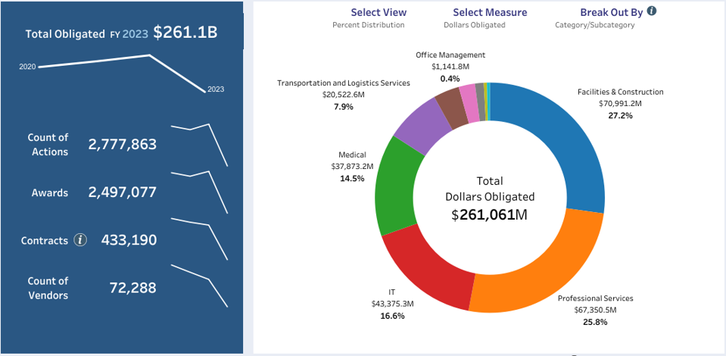
Professional Services
Total Obligated in 2023 $261.1B

Slide 6
Professional Services Sub Categories
Marketing and Public Relations
Financial Services
Legal Services
Technical & Engineering Services (non-IT)
Business Administrative Services
Logistical Services
Language Services
Environmental Services
Training
Identity Protection Services

Slide 7
Benefits of the MAS Program
The MAS program is designed to mirror commercial buying practices in accordance with FAR Part 12 and helps to foster the government’s use of commercial practices and access to commercial markets.
Streamlined Ordering process for federal buyers
Uses procedures that follow FAR 8.4.
Reduction in costs in selling to the government
Opportunities across the government if you become a MAS contractor.

Slide 8
Is MAS a Good Opportunity for my Firm?
It is important to understand the scope, requirements, and commitment needed to become a GSA MAS contractor
Does market research show that federal, state, and local governments are buying the types of products and services that your company wants to offer?
Have you been in business for at least two years and have two years of financial statements to support this?
Do you have evidence of successful past performance?
Do you have the resources to market your commercial products and services after the award of the contract? Companies who can answer “yes” to the above questions – and understand their commitments and obligations – enhance their chance at a successful outcome. The award of a GSA MAS contract does not guarantee future sales, and it is up to you to market your company.

Slide 9
Competing on the MAS Program
Take a look at your competitors
GSA eLibrary www.gsaelibrary.gsa.gov
GSA Advantage!® www.gsaadvantage.gov

Slide 10
Is my Organization Positioned for MAS Contract Success?
Your firm must invest in education for your organization’s staff on how the program works and how to successfully manage your contract
• Prepare a MAS Contract Specific Business Plan
• Devote Resources
• Develop Expertise

Slide 11
System for Award Management (SAM)
This website is the single point of entry for all Government procurements that exceed $25,000.
Refer to the following government marketplace websites:
Contracting Opportunities and Contract Data Reports: https://sam.gov/

Slide 12
Getting Started
Take GSA MAS training courses and read all the available MAS program literature.
Read, and understand the MAS solicitation
GSA offers training resources through these sites:
MAS Roadmap: gsa.gov/masroadmap
Schedule Information: gsa.gov/schedule
GSA Training Events: gsa.gov/events

Slide 13
Assemble Your Offer
GSA eOffer: Download Templates
Agent authorization letter
Letter of supply (products only)
Price proposal template You will also need to compile all the information below and submit it through the eOffer system.
Financial statements
Subcontracting plan (if you are not a small-business concern)
Technical proposal
Commercial Sales Practice-1 (CSP-1)
Professional compensation plan
Commercial price list
Previous cancellation and rejection letters
Price narrative with supporting documentation
Successful past performance documentation

Slide 14
Evaluation Factors
After offers are received, each individual offer is evaluated on its own merit Offerors are provided opportunities to clarify deficiencies and are allowed to submit supplemental information Schedule contract evaluation factors include:
Technical
○ Factor One – Corporate Experience
○ Factor Two – Past Performance
○ Factor Three – Quality Control
○ Factor Four – Relevant Project Experience (services contracts only)
● Pricing

Slide 15
Additional Resources
Category Management dashboards
Recorded Category Management dashboard presentation
BUY.GSA.GOV
GSA Interact
Forecast of Contracting Opportunities Tool
Procurement Technical Assistance Centers
SAM.GOV Data Bank
Schedule Sales Query
Government Contracting Factsheets
GSA Small Business Support Contacts
Category Management Information
GSA FEDSIM/Industry

Slide 16
Contact Information
Contact Information
Bounce Quarry
Supplier Relationship Management Specialist for the Professional Services Category
bounce.quarry@gsa.gov
(253) 229-0534

Slide 17
Questions?

Slide 18
GSA

