Slide 1
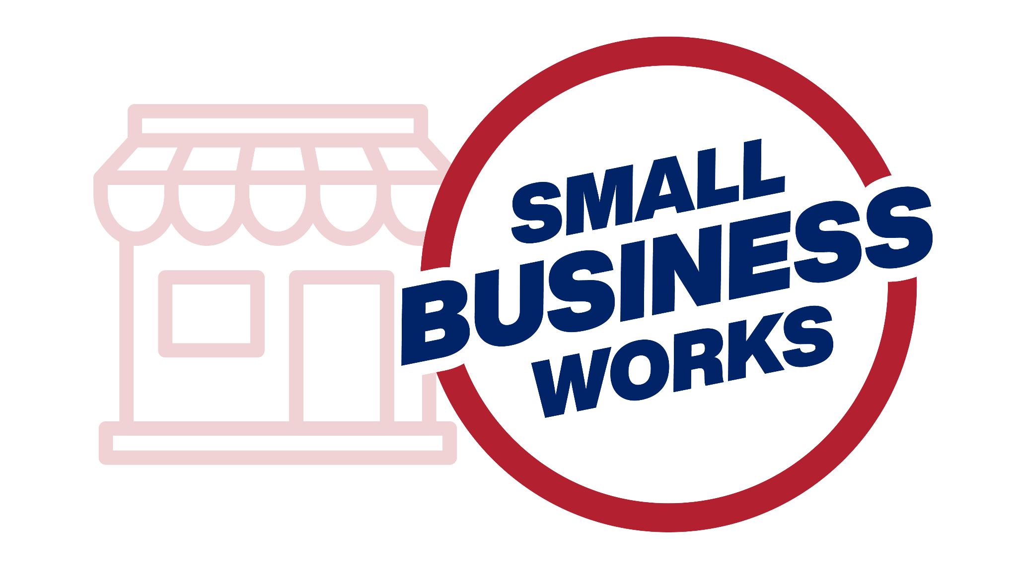
Small Business Works 2022:
Navigating Equity in Procurement
U.S. General Services Administration

Slide 2
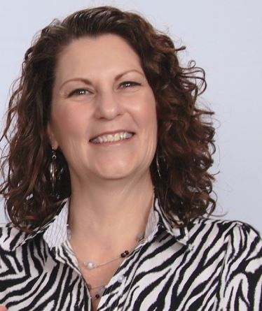
How to Obtain Surety Bonds:
What Every Small Business Should Know
Tamara E. Murray
Underwriting Marketing Specialist
U.S. Small Business Administration

Slide 3
Link to embedded video: SBA Surety Bonds for Small Businesses
Notes:
(Link to embedded video: SBA Surety Bonds for Small Businesses – YouTube)

Slide 4
SBA guarantees contract bonds
1
Bid
2
Performance
3
Payment
4
Maintenance
Contracts and subcontracts up to $6.5 million.
Direct federal contracts up to $10 million.

Slide 5
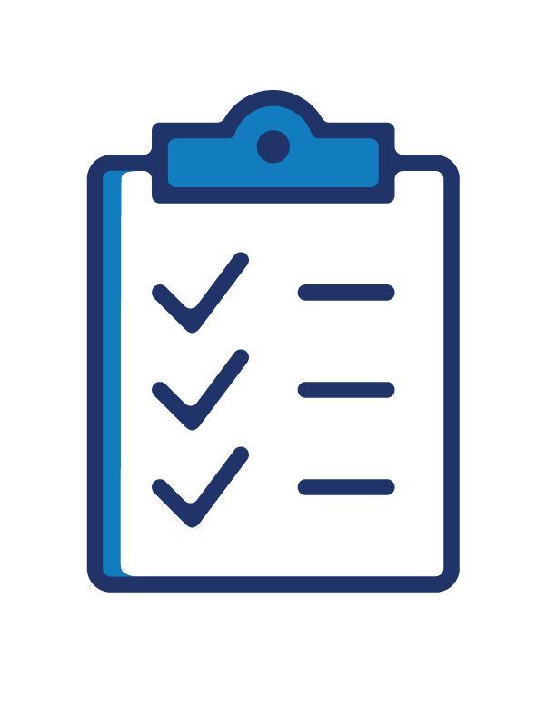
Evaluation based on capacity, capital & character
Capacity (your ability to complete the work) is based on experience in your field, key personnel experience, and day-to-day business management practices.
Capital is based on your company’s cash flow, profitability and the quality of your financial statements.
Character means the small business owner’s personal credit history and business reputation.

Slide 6
We help small businesses facing barriers to success by creating access and opportunity to qualify for contract bonding, increase bonding capacity and grow.

Slide 7
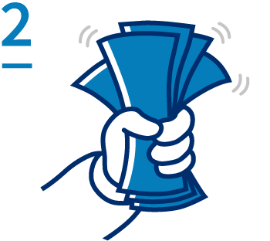
Providing access and creating stability
You gain access to bid, performance, payment, and maintenance bonds.
Our guarantee allows small businesses to qualify for more bonding.

Slide 8
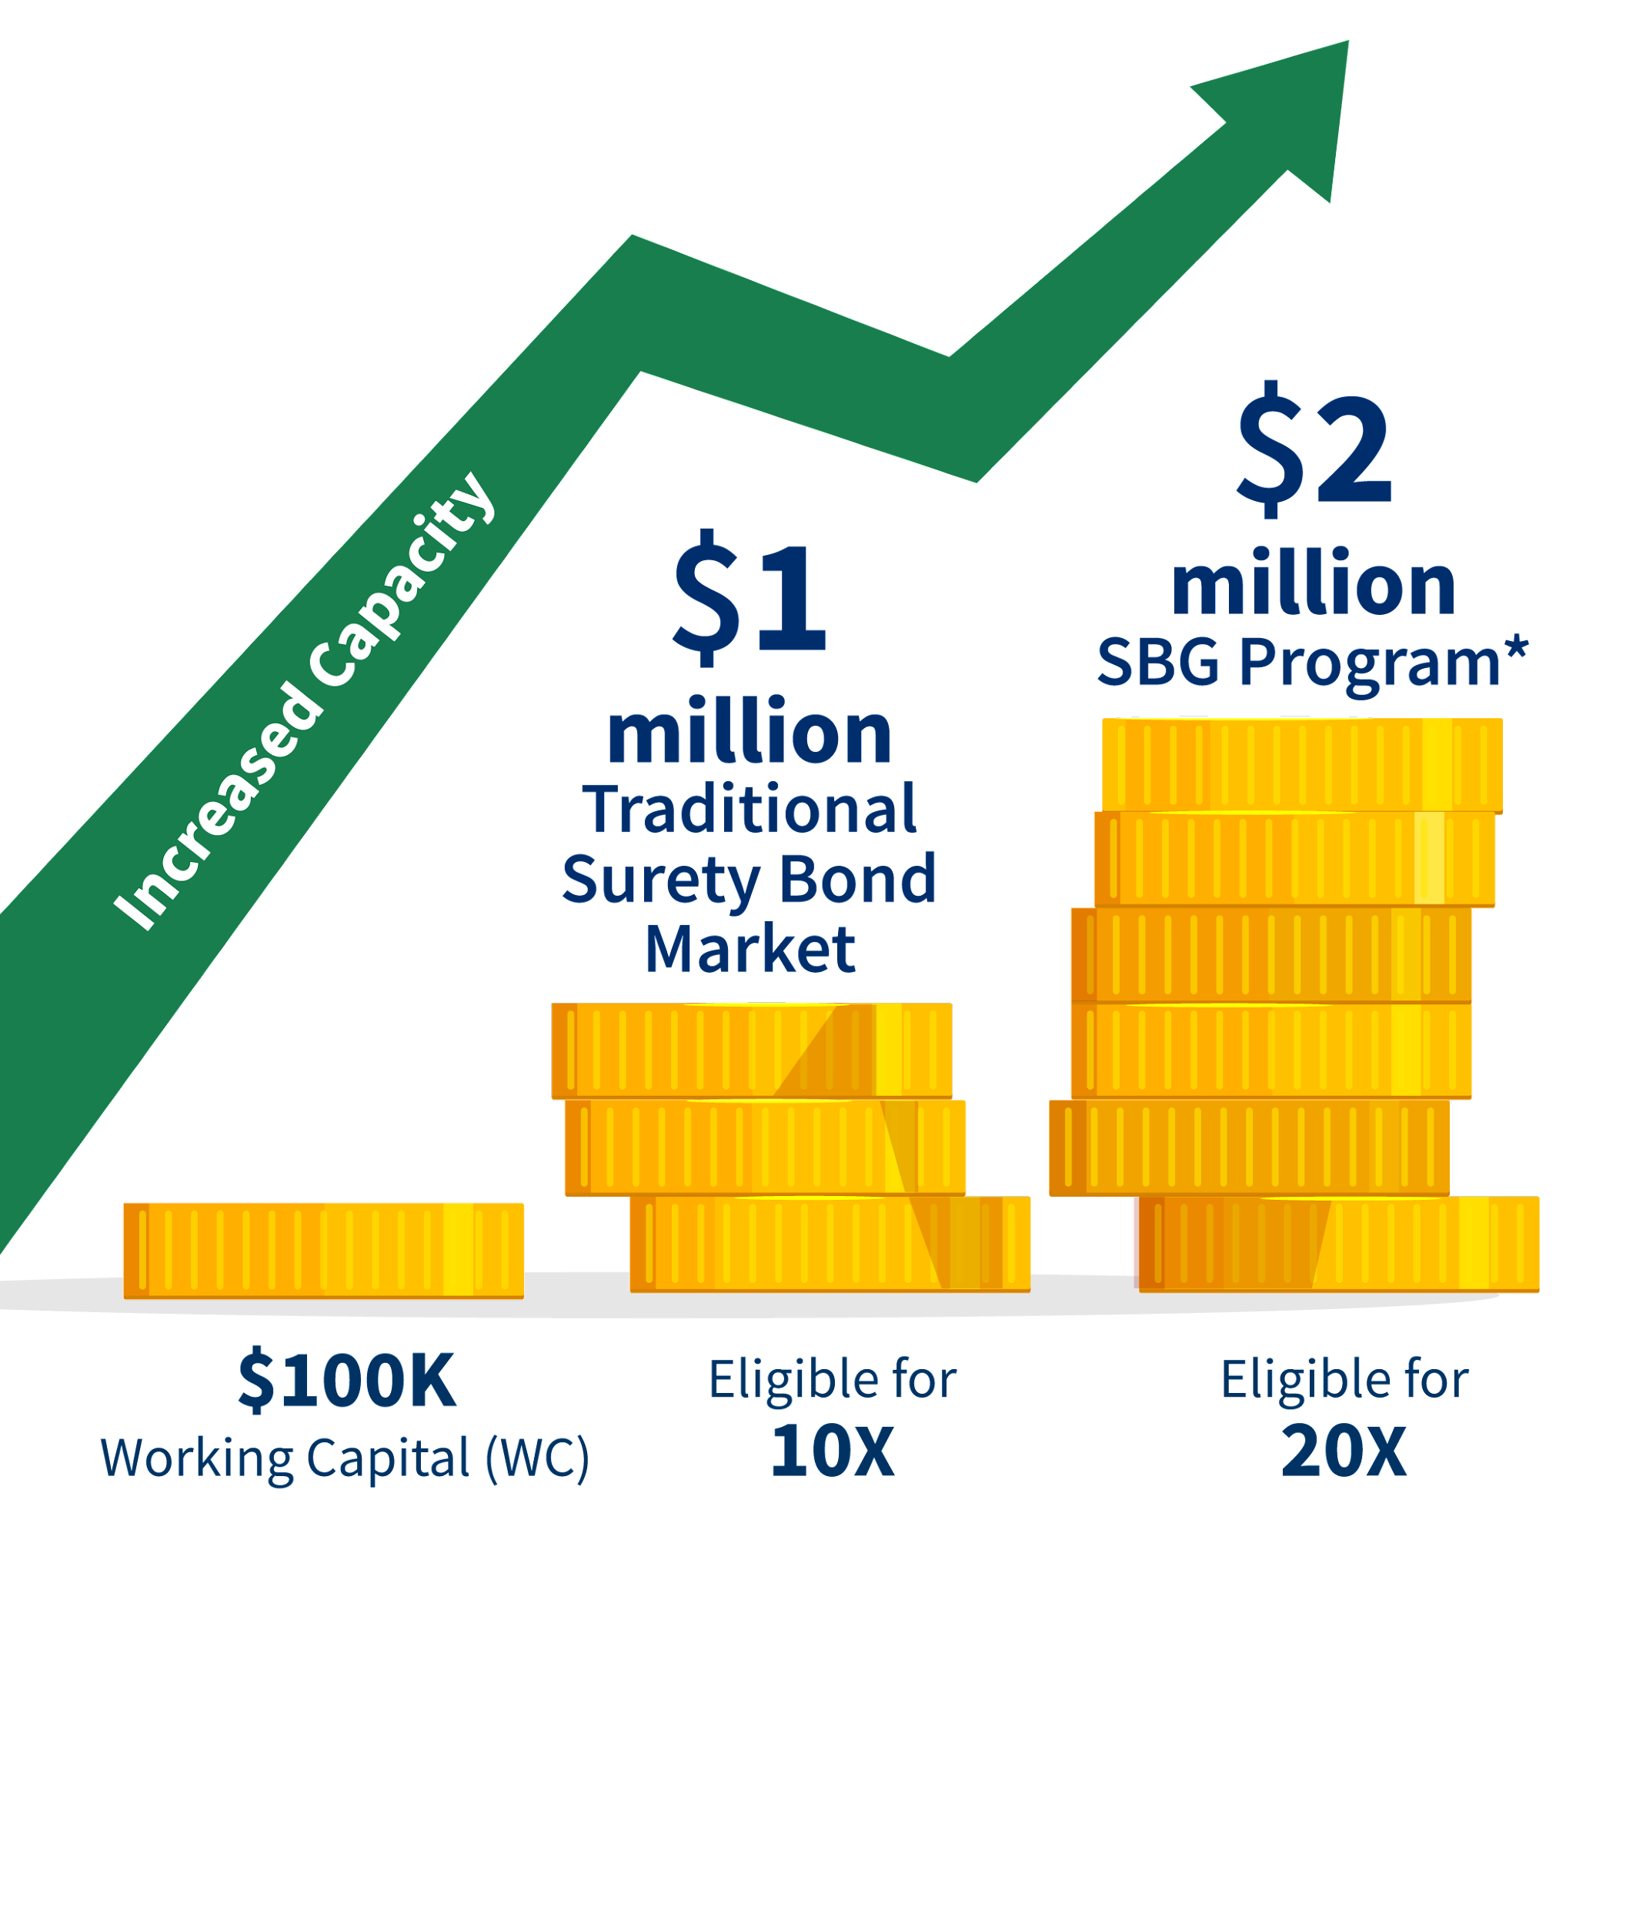
Benefits of SBA guaranteed bonds
Working capital required is about half what is normally needed for contract bonds.
We count the unused portion of working capital bank lines of credit.

Slide 9
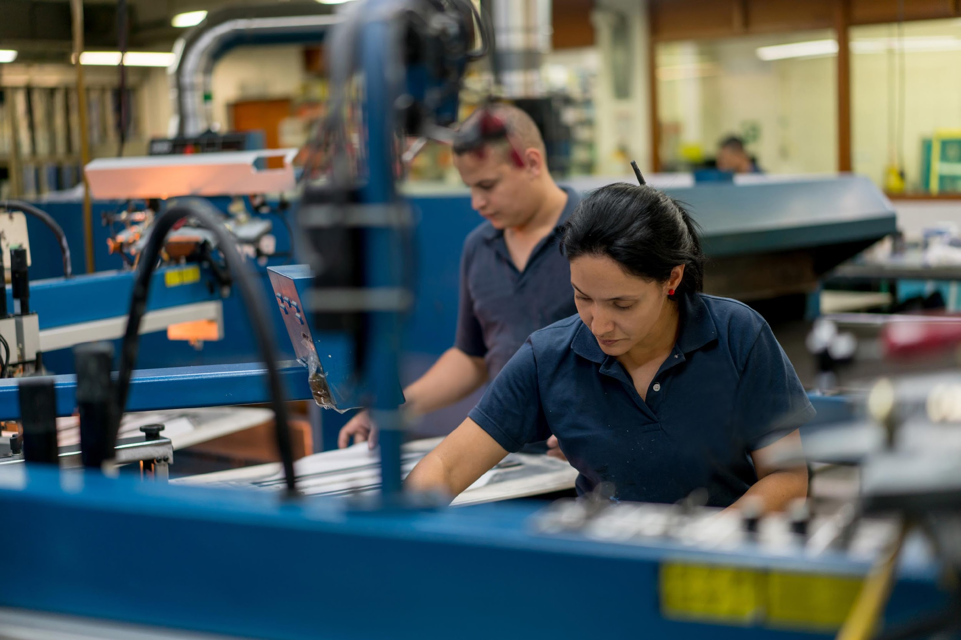
Bond guarantees available on larger projects with internal financial statements.

Slide 10
Making an impact
We guarantee more than $7 billion a year in contract bonds for over 1,600 small businesses annually.

Slide 11
Fast application process
• Up-to-date technology • Experienced and professional staff • Online application process

Slide 12
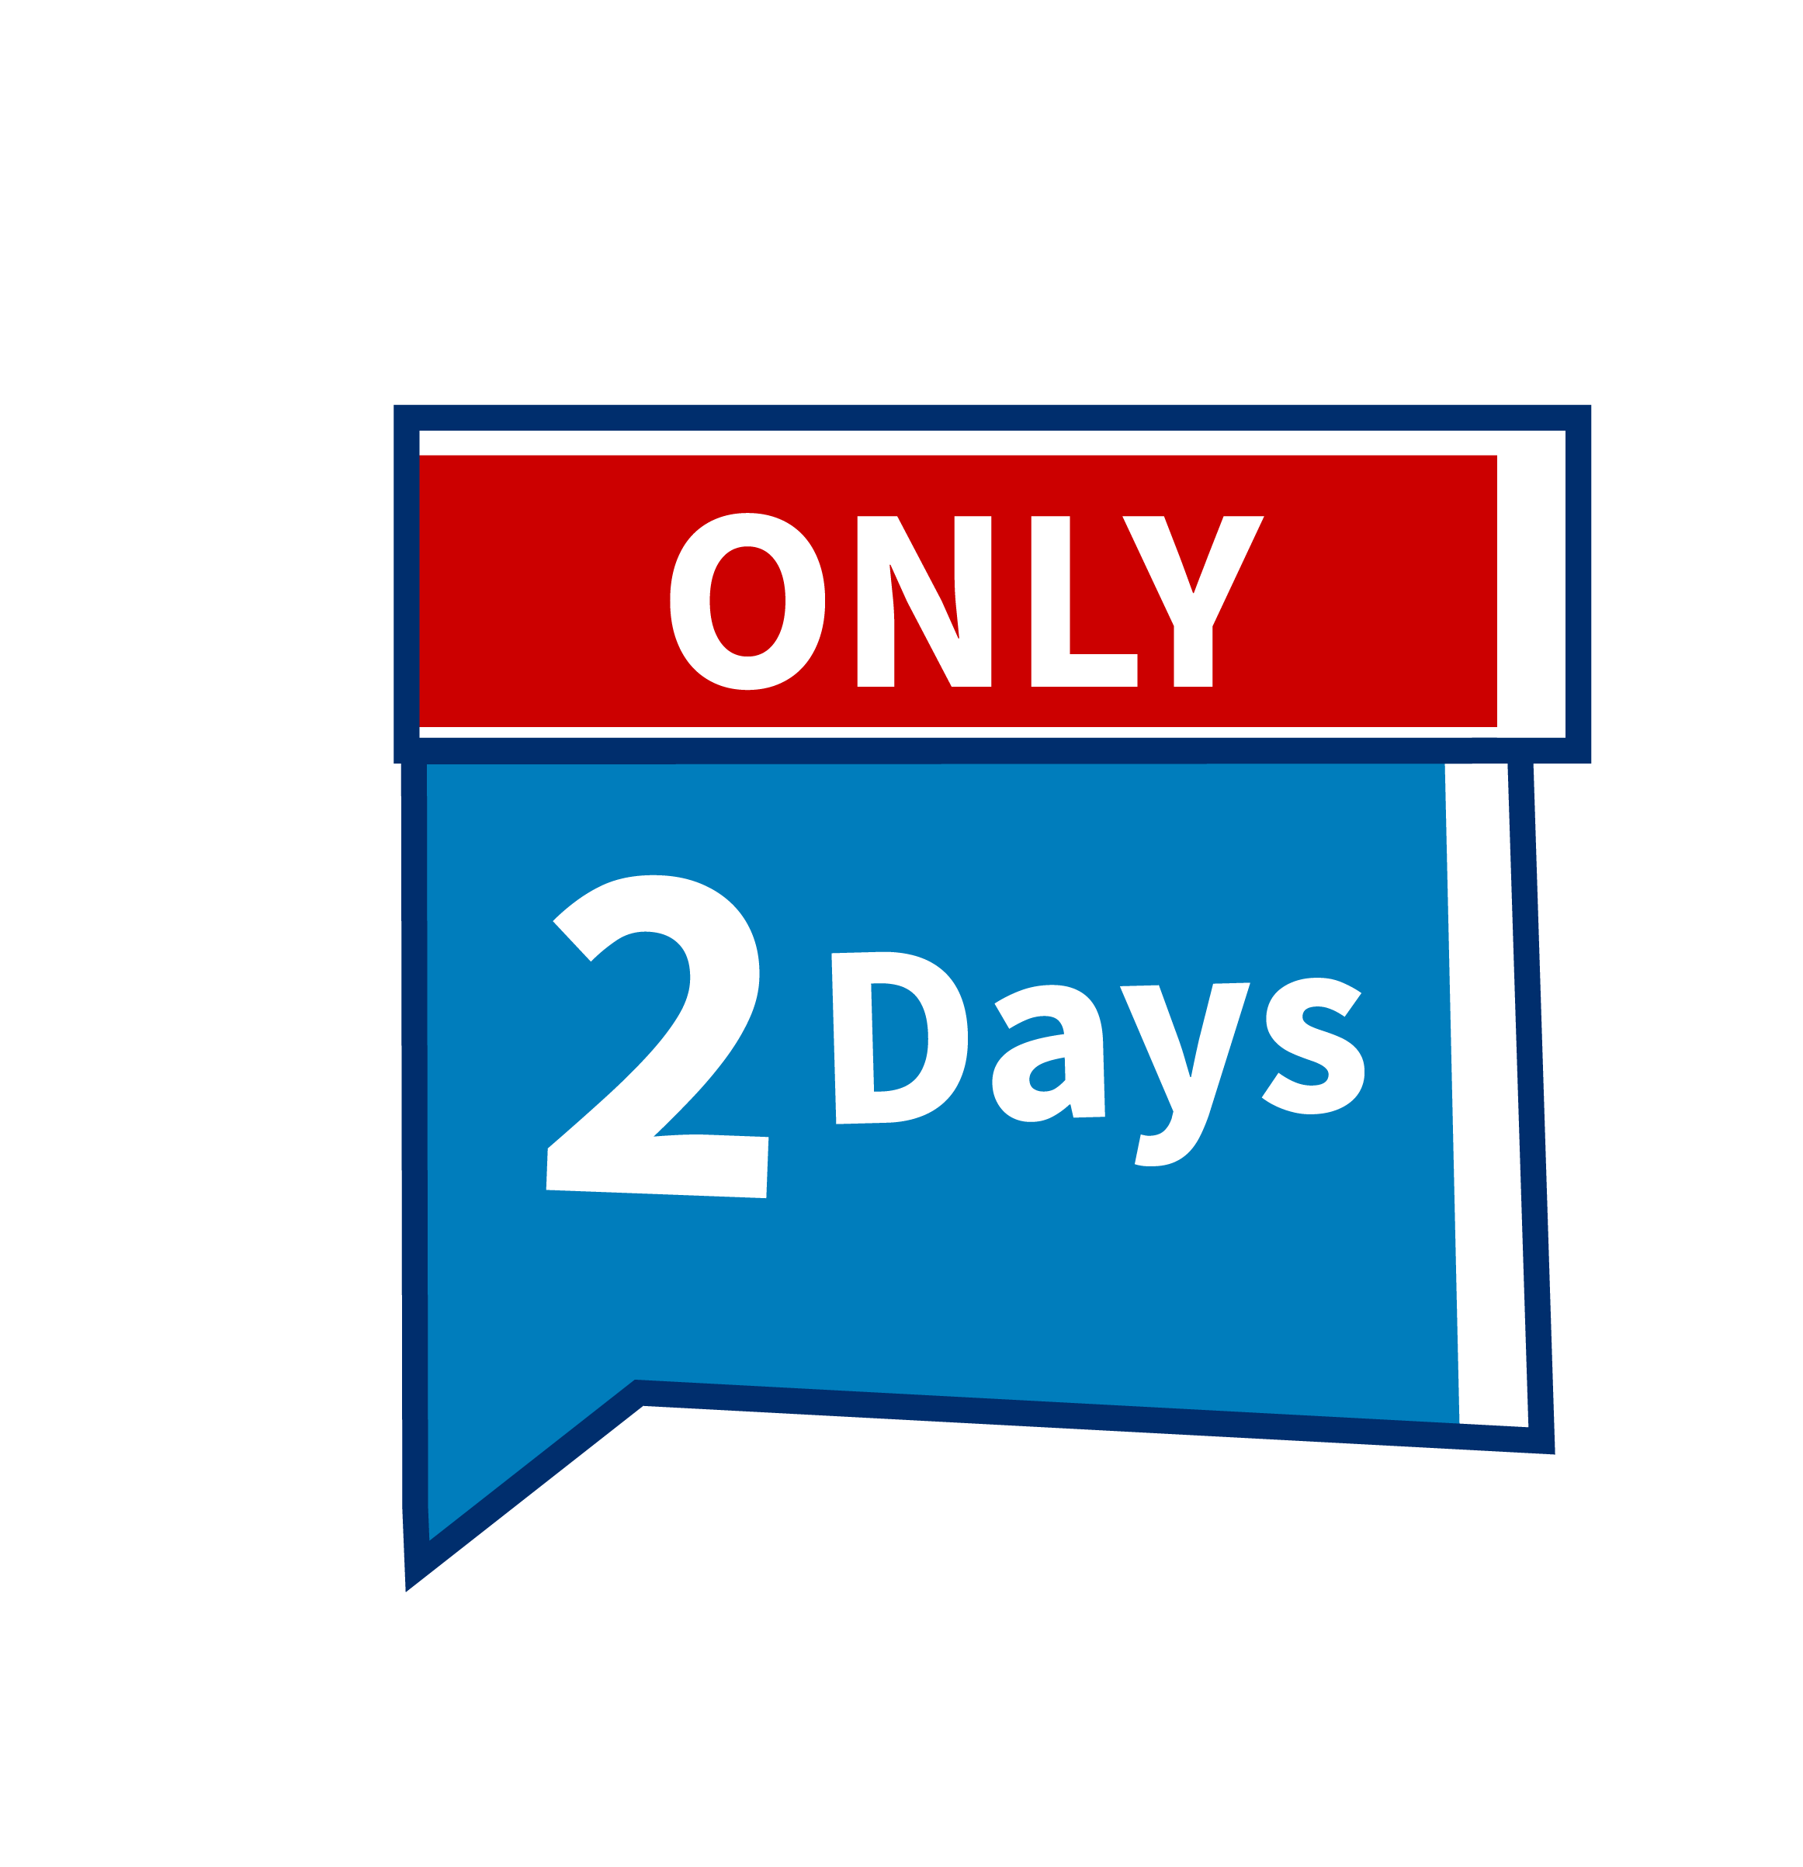
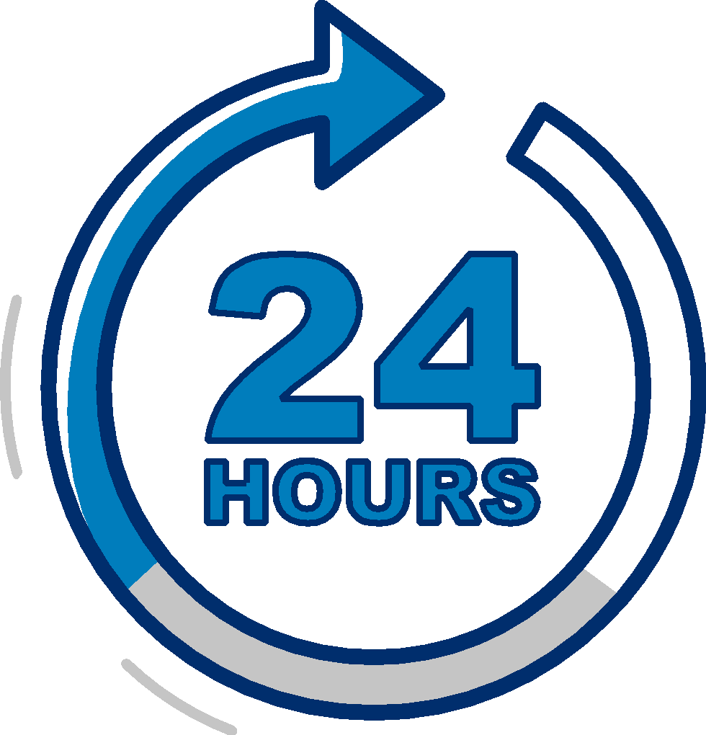
Prior Approval Program + QuickApp =
Fast decisions
Decisions in about 24 hours on QuickApp bonds up to $400,000.
Decisions in about 2 days on larger contracts.

Slide 13
Program eligibility
Be a small business based on:
SBA size standards
U.S. based, for profit firm with legal resident owners
Other requirements
Possess good character
Current on public debts & taxes
Eligible to do business with the federal government
Pass underwriting standards
Not involved in bankruptcy

Slide 14
Contract bond fees
No SBA bid bond fee
SBA contractor’s fee
0.6% of the contract amount paid to SBA for the guarantee
Surety’s premium
paid to the surety company for the bond

Slide 15
Find an SBA authorized agent
Visit
sba.gov/osg

Slide 16
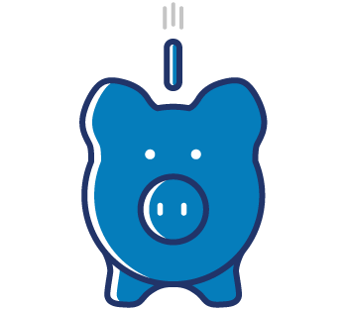
How you benefit
Grow your business
Increase opportunity
Flexible requirements

Slide 17
Vera Hall, Small Business Owner
“The ability to get this type of bonding through the SBA’s Surety Bond Guarantee program allows you as a small business owner to realistically compete with larger corporations for contracts that you want and need to grow your business.”
Let the SBG Program help your business grow.

Slide 18
Questions?

Slide 19
Thank You!

