Slide 1
FAST 2024
Innovative Solutions for the Future of Professional Services
March 27, 2024, 1:00-4:30 PM EST

Slide 2
Welcome and Intro

Slide 3
Poll

Slide 4
Today’s Agenda
Keynote Address
State of the Marketplace
Emerging Trends
10 Min Break
Market Research
User Stories and Case Studies

Slide 5
Keynote Address

Slide 6
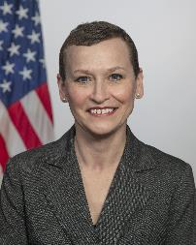
Keynote Address
Tiffany Hixson
Assistant Commissioner
Office of Professional Services
& Human Capital Categories

Slide 7
State of the Marketplace

Slide 8
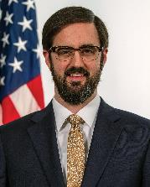
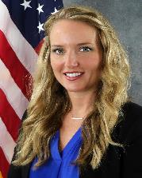
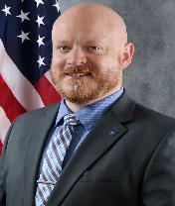
State of the Marketplace: Panel Discussion
Adam Soderholm
Director
Center for Professional Services Solutions
Office of Program Operations
Office of Professional Services and Human Capital Categories
Jill Akridge
Director
Strategic Initiatives and Business Intelligence Division
Office of Professional Services and Human Capital Categories
Jonathan Evans (he/him)
Program Manager & Senior Facilitator
Civilian Services Acquisition Workshop Program
Office of Professional Services and Human Capital

Slide 9
Emerging Technology and Trends

Slide 10
Emerging Technology and Trends
Bill Niess
Supervisory Program Manager
Office of Program Operations Office of Professional Services and Human Capital Categories
Eugene Hwang
Acquisition Project Management Specialist
Civilian Services Acquisition Workshops Program
Office of Professional Services and Human Capital Categories

Slide 11
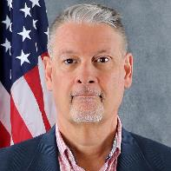
OASIS+: The Next Generation Services MAC
Bill Niess
OASIS+ Program Manager

Slide 12
What is OASIS+
One Acquisition Solution for Integrated Services Plus (OASIS+) is a government wide, multiple award, IDIQ acquisition program that provides best-in-class contracts and vendors who offer customer agencies a full range of integrated professional services to help them meet their mission requirements.
Using a phased approach, OASIS+ will eventually combine the scope:
OASIS (SB, 8(a), and UR);
Building, Maintenance & Operations (BMO);
Human Capital & Training Solutions (HCaTS); and
New areas of previously undefined services.

Slide 13
OASIS+ Contract Program
OASIS+ consists of six (6) separate and distinct IDIQ contracts:
Total Small Business (SB)
SBA-Certified 8(a) Small Business (8(a))
SBA-Certified HUBZone Small Business (HZ)
SBA-Certified Service-Disabled Veteran-Owned Small Business (SDVOSB)
SBA-Certified Women-Owned Small Business Small Business (WOSB)
Unrestricted (UR)

Slide 14
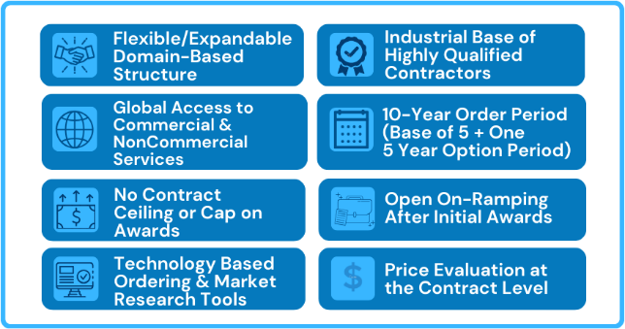
OASIS+ Unique Features
Domains
On-Ramps

Slide 15
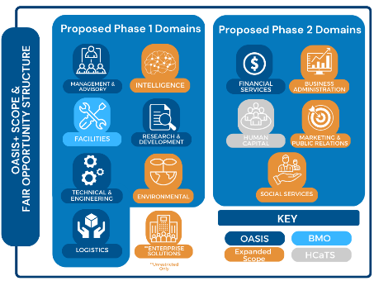
OASIS+ Domains
The scope of each OASIS+ contract is categorized into functional groupings known as Domains.
Eight (8) Domains are in the Phase I OASIS+ contracts (FY24)
“Continuous Open” (FY25-beyond)
Five (5) Domains are planned for the Phase II OASIS+ contracts (FY25/26).
“Continuous Open” (FY27-beyond)
Phase 1 Domains
Proposed Phase 2 Domains
BMO = Building Maintenance and Operations (BMO) contract. Scope: (1) Facility Support Services; (2) Operation & Maintenance; and (3) Architectural and Framework Building Maintenance Services.
HCaTS = Human Capital and Training Solutions (HCaTS) contract. Scope: (1) Customized Training and Development Services; (2) Customized Human Capital Strategic Services; and (3) Organizational Performance Improvement Services.

Slide 16
OASIS+ Domains
The scope of each OASIS+ contract is categorized into “functional groupings” known as Domains. Eight (8) Domains are in the Phase I OASIS+ contracts (FY24):
Enterprise Solutions (UR only)
Environmental
Facilities
Intelligence
Logistics
Management & Advisory
Research & Development
Technical & Engineering
Five (5) Domains are planned for the Phase II OASIS+ contracts (FY25/26). Examples: Business Administration, Financial Services, Human Capital, Marketing & PR, and Social Services.

Slide 17
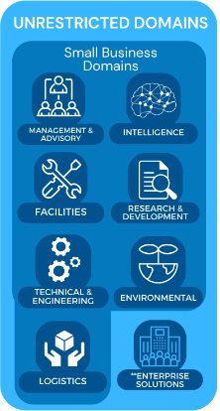
OASIS+ Domains
Domains are based on groupings of North American Industry Classification System (NAICS) codes.
Each Domain contains multiple NAICS codes. OASIS+ Contractors may qualify for award of some or all NAICS included in the specific Domain (provided they meet all qualifications for award).
Ordering Contracting Officers (OCOs) will determine the appropriate OASIS+ contract vehicle, select the appropriate Domain, and then select the appropriate NAICS that best represents the scope of their requirement.
NOTE: Fair Opportunity is provided at the individual NAICS level.

Slide 18
OASIS+ DPA Requirement
OCOs must obtain an OASIS+ Delegation of Procurement Authority (DPA) from GSA prior to issuing orders against the OASIS+ contracts. Ordering Contract Specialists assisting with solicitations must also attend DPA training.
To obtain an OASIS+ DPA, the OCO must:
Complete OASIS+ DPA Training
Be a warranted Federal Contracting Officer (per FAR 2.101)
Formally apply for a DPA by providing GSA with their OCO Warrant Number and OASIS+ DPA Training certificate
OASIS+ DPA Training is in development with an expected release of Spring 2024. The training will include a link to the online OASIS+ Ordering Guide.
OASIS+ Task Order Management Training (using Symphony) is also in development with an expected release of late Spring 2024.

Slide 19
OASIS+ DPA Requirement
OCOs must obtain an OASIS+ Delegation of Procurement Authority (DPA) from GSA prior to issuing orders against the OASIS+ contracts. Ordering Contract Specialists assisting with solicitations must also attend DPA training.
To obtain an OASIS+ DPA, the OCO must:
Complete OASIS+ DPA Training
Be a warranted Federal Contracting Officer (per FAR 2.101)
Formally apply for a DPA by providing GSA with your OCO Warrant Number and OASIS+ DPA Training certificate
OASIS+ DPA Training is in development with an expected release of Spring 2024. The training will include a link to the online OASIS+ Ordering Guide.
OASIS+ Task Order Management Training (using Symphony) is also in development with an expected release of late Spring 2024.
Ordering Process
( 6 Steps)

Slide 20
OASIS+ Ordering Process

Slide 21
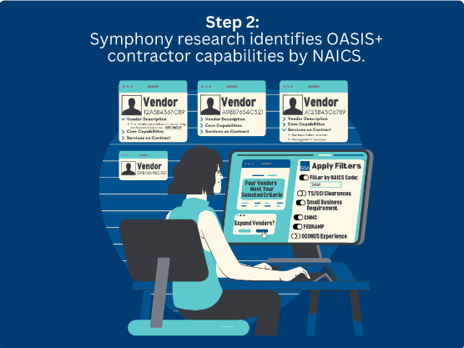
OASIS+ Ordering Process

Slide 22
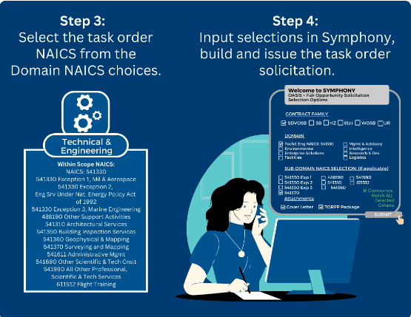
OASIS+ Ordering Process

Slide 23
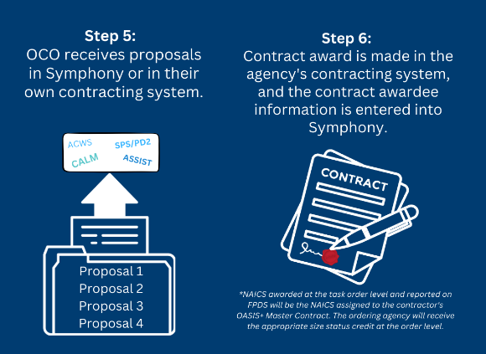
OASIS+ Ordering Process

Slide 24
OASIS+ Scope Reviews
GSA offers task order level Pre-Solicitation Scope Reviews to customer agencies as part of the OASIS+ Program.
Highlights:
Strongly recommended but not required (... and they’re free)
Helps ensure your requirement is being placed under the appropriate contract vehicle
Instructions currently under development with an estimated release date early Spring 2024
Click here for the current Scope Review Request Form

Slide 25
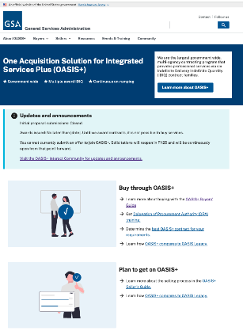
OASIS+ Resources
OASIS+ Website: https://www.gsa.gov/buy-through-us/products-and-services/professional-services/buy-services/new-oasis-multiagency-contract
Note – BOLO for the new OASIS+ website (late March 2024) – insert link here when available
OASIS+ Email:
OASISPlus@gsa.gov
OASIS+ Interact Community:
buy.gsa.gov/interact/community/196/activity-feed

Slide 26
OASIS+ High-Level Milestones (FY21-25)
Market Research
Acquisition Planning
Release Draft RFPs
Release Final RFPs
OSP/Symphony webinars
Stakeholder Communications
DPA Training Continues
Task Order Activity Continues
OASIS+ PMR #1
Initiate OASIS+ Phase 2
FY21
FY23
FY25
FY22
FY24
Prepare Draft RFPs
Proposal Evaluation (Q1-3)
Ordering Guide/DPA Training (Q2/3)
BIC Designation (Q2)
Rolling Contract Awards/NTP (Q3/4)
Task Order Activity Begins (Q3/4)
Expiration Dates – OASIS Contracts
Name | Contract Holders* | Expires | Notes
OASIS SB | 488 | 12/19/2024 | No extension available
OASIS 8(a) | 115 | 12/19/2024 | No extension available
OASIS UR | 147 | 3/01/2025 | No extension available
* Source: OASIS landing page on GSA.gov

Slide 27
OASIS+ High-Level Milestones (FY21-25)
Market Research
Acquisition Planning
Release Draft RFPs
Release Final RFPs
OSP/Symphony webinars
Stakeholder Communications
Task Order Activity Continues
OASIS+ PMR #1
OASIS+ Phase 1 “Open Continuous”
OASIS+ Phase 2
FY21
FY23
FY25
Today
FY22
FY24
Prepare Draft RFPs
Proposal Evaluation (Q1-4)
Ordering Guide/DPA Training (Q2-4)
BIC Designation (Q2-3)
Contract Awards/NTPs (Q3/4)
Task Order Activity Begins (Q3/4)
Expiration Dates – OASIS Contracts
Name | Contract Holders* | Expires | Notes
OASIS SB | 488 | 12/19/2024 | No extension available
OASIS 8(a) | 115 | 12/19/2024 | No extension available
OASIS UR | 147 | 3/01/2025 | No extension available
* Source: OASIS landing page on GSA.gov

Slide 28
Bill Niess
OASIS+ Program Manager
OASISPlus@gsa.gov
william.niess@gsa.gov
For more information, visit: gsa.gov/FAST

Slide 29
Civilian Services Acquisition Workshops
Eugene Hwang
CSAW Facilitator
Acquisition Project Management Specialist

Slide 30
What is a CSAW?

Slide 31
Civilian Services Acquisition Workshop (SAW):
A facilitated workshop built around a specific acquisition and its multi-functional integrated project team (IPT). The workshop walks the complete team through the performance-based acquisition (PBA) process from beginning to end.
Notes:
The Civilian SAW (CSAW) initiative was proposed by a member of the the Professional Services Interagency Team who had experienced the benefits of the approach. As a result, GSA (in partnership with OFPP) began research into CSAWs.

Slide 32
Workshop Purpose:
Develop the mission, measurable objectives, requirements, performance standards, and performance-based strategies for the agency requirement and a roadmap to complete it.

Slide 33
CSAW Objectives:
Understand and Apply the Performance-Based Acquisition (PBA) process and the Steps to PBA
Utilize the tools, resources, techniques, innovations and best practices to successfully execute this requirement
Collaborate as a team through facilitated activities to develop draft documentation for this requirement
Develop a high-level roadmap for successful implementation of this performance-based acquisition
Gain consensus on critical decisions and the path ahead

Slide 34
Benefits
What happens in a CSAW? | Resulting in...
Workshops bring the right team of people together based on pre-workshop engagement with executive sponsor(s) and project manager | Reduced lead times and better team dynamics
The highly structured, facilitated workshop is built around the specific needs of the team while walking them through all the steps in the PBA process | Greater participation and accelerated team performance
Teams collaborate to develop the mission, vision, high-level objectives, and team success factors | Clarity of purpose that is shared among all members
Teams identify market research needs, high-level risks, key stakeholders, and a high-level communications strategy | Better overall project management
Teams will identify and refine performance requirements with associated performance standards, AQLs, and quality assurance approach | Better performance outcomes
Teams work together on each step in the PBA process and document the additional actions that will need to be taken after the workshop to complete each step | A high-level roadmap for working together to accomplish the project
Throughout the workshop, teams will gain consensus on their work products and path ahead | Increased stakeholder buy-in the end product

Slide 35
Good Fit for a CSAW

Slide 36
Good Fit Customer Requirements
Preponderance is a SERVICES requirement for which there is a clear need/plan to procure
Full commitment from Agency Leadership + Contracting Office & Program Office
Total Lifecycle Value >= $50M (or requirement is significantly complex)
Average total lifecycle value of previous requirements is appx. $100-200M
Workshop is most effective for acquisition teams that have sufficient lead time (18 months to 2 years)

Slide 37
Who Should Attend
Program / Project Manager - MUST ATTEND
Contracting Officer and Specialist - MUST ATTEND
Contracting Officer’s Representative - MUST ATTEND
Technical Representatives / SMEs - MUST ATTEND
Customer Representatives (Requirements Owners / Key-Users) - MUST ATTEND
Oversight/Management Personnel Representatives (ex. Quality Assurance Specialist, Inspector) - SHOULD ATTEND
External Support (ex. AAS Program Manager and/or CO, or external SMEs) - SHOULD ATTEND
OPTIONAL: IT Support (ex. Enterprise Architect, ISSM, ISSO, System/Product Owner) - MAY ATTEND
OPTIONAL: Small business representative(s) (if applicable) - MAY ATTEND
OPTIONAL: Legal Counsel (if there are known legal complexities requiring significant input and participation) - MAY ATTEND
OPTIONAL: Budget / Finance Office Representative (when needed – cost type or fixed price incentive contracts) - MAY ATTEND

Slide 38
CSAWs to Date
34 Successful workshops completed
18 Agencies
DOC, DOE, DOI, DOJ, DOL, DOT, Education, EPA, FAS, HHS, HUD, NASA, OPM, PBGC, PBS, SSA, USDA, VA
7 Requirement Categories
Information Technology
Professional Services
Facilities & Construction
Transportation & Logistics
Medical
Industrial Products & Services
Cross Category
More than $33 billion in services spend impacted
Notes:
CSAWs play a crucial role in making strategic investments in quality requirements. By bringing together cross-functional teams early in the acquisition process, we significantly reduce the likelihood of costly revisions and minimize the need for rework.
CSAWs facilitate the gathering of the right experts from program, acquisition, supply chain, IT, and other fields. This collaborative effort ensures a comprehensive understanding of requirements, leading to more effective and precise contract specifications.
The workshops provide a platform for diverse perspectives to be considered, fostering creativity and innovation in the development of performance-based requirements.
To date we have provided over 30 workshops, representing over $33 Billion in services spend.

Slide 39
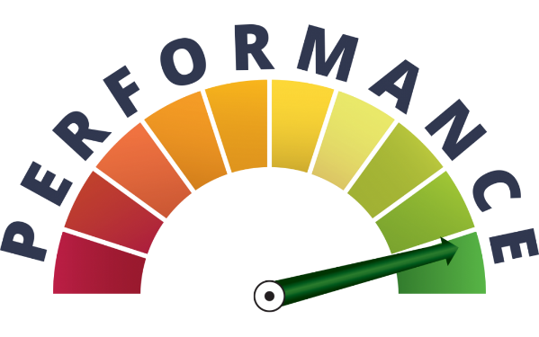
Better Contracting Initiative
Saving Money and Avoiding Waste by Getting Contract Requirements Right the First Time.
“...Over the coming months, GSA will continue to sponsor a series of facilitated requirements development and acquisition planning workshops for services contracts with acquisition teams across the Government. GSA will also partner with the agencies’ acquisition leadership to help train individuals that can facilitate workshops within their own agencies.”

Slide 40
CSAW Webinar Series!
April 17 (1pm ET) - Performance Standards & QASP
June 26 (1pm ET) - Incentive Strategies
Go to gsa.gov/events to register (they are posted about 1 month prior to event)

Slide 41
Performance Based Acquisition

Slide 42
What is PBA?
"Performance-based Acquisition" (PBA) means an acquisition structured around the results to be achieved as opposed to the manner by which the work is to be performed. - FAR 2.101
Notes:
Requirements are set forth in clear, specific, and objective terms with measurable outcomes
Does not state HOW the work is to be performed or have a broad and imprecise statement of work
Use of the word "acquisition" rather than "contracting" reflects the broader scope (from mission planning through contract closeout) and the broader community (including program offices) that are a necessary part of the process.

Slide 43
Performance Based Acquisition is the preferred method for acquiring services
Agencies must use PBA methods to the maximum extent practicable
FAR 37.102(a)(1)

Slide 44
4 KEY ELEMENTS OF PBA
Uses a Performance Work Statement (PWS) or Statement of Objectives (SOO)
Includes measurable performance standards for all performance requirements
Provides appropriate incentives to drive higher performance and/or promote innovation
Utilizes a Quality Assurance Surveillance Plan (QASP) to define how the contract will be monitored (see FAR 46.4)

Slide 45
STEPS TO PERFORMANCE BASED ACQUISITION
STEP 1
Form the Team
STEP 2
Identify Objectives
STEP 3
Market Research
STEP 4
Develop Work Statement
STEP 5
Define Measures
STEP 6
Source Selection
STEP 7
Manage Performance
STEP 8
Complete Closeout
PURPOSE: Establish the team and conduct high-level project planning. POTENTIAL OUTPUTS: - Project Vision, Mission & Team Success Factors - Stakeholder ID & Analysis - High-Level Communications Plan - High-Level Risk ID - Project Charter | PURPOSE: Identify why we’re doing this in the first place and what are the high-level objectives (HLO). POTENTIAL OUTPUTS: - Review/analyze current approach - Tie project into Agency Mission / Strategy - Establish High-Level Objective | PURPOSE: A team approach to market research using available tools and innovative resources. POTENTIAL OUTPUTS: - ID Market Research Topics / Questions - Team market research assignments - Draft MR document - Draft IPT Master Schedule | PURPOSE: Well-written requirements statements and identifying the appropriate work statement type. POTENTIAL OUTPUTS: - Draft Performance Requirements Statements - Draft Work Statement Template Selection - ID Solicitation Requirements | PURPOSE: What constitutes successful performance and how does the team measure this? POTENTIAL OUTPUTS: - Develop performance standards and possible incentives - Review acquisition strategy alternatives | PURPOSE: Review options for evaluation criteria and think through the source selection process. POTENTIAL OUTPUTS: - Explore innovative source selection approaches - ID Tech Eval criteria | PURPOSE: Managing the contract to ensure performance objectives are met. POTENTIAL OUTPUTS: - Draft Risk Management Plan - QASP vs. QAP - Performance tracking approach - Roles & Responsibilities - Change & Transition Management | PURPOSE: Considerations for closing out the contract and concluding the project. POTENTIAL OUTPUTS: - Lessons Learned - Celebrate Success - Document in CPARs
Notes:
https://pba.app.cloud.gov/app/#/pba

Slide 46
Eugene Hwang
CSAW Facilitator
Office of Professional Services & Human Capital Categories
GSA Federal Acquisition Service
Email: csaw@gsa.gov
GSA.gov/csaw
CSAW Interact Community
For more information, visit: gsa.gov/FAST

Slide 47
Break

Slide 48
Market Research

Slide 49
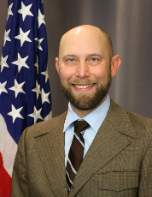
Market Research
Jill Akridge
Director
Strategic Initiatives and Business Intelligence Division
Office of Professional Services and Human Capital Categories
Brian Boothe
Professional Services Advisor
Customer Engagement Branch
Office of Professional Services and Human Capital Categories

Slide 50
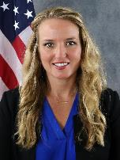
CALC+ Snapshot
Jill Akridge
Director of Strategic Initiatives and Business Intelligence

Slide 51
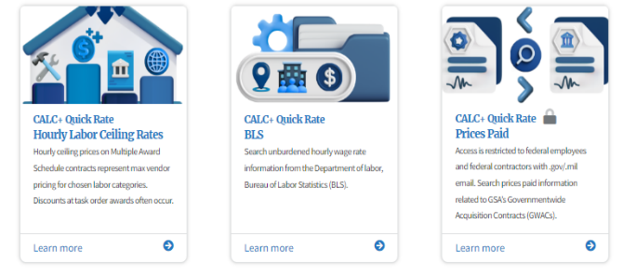
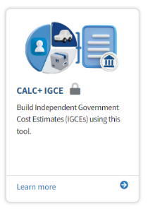
CALC+ Snapshot
Labor Hour Market Research Tools
IGCE Builder
buy.gsa.gov/pricing

Slide 52
CALC+ Labor Hour Data Sources
Hourly Labor Ceiling Prices | Prices Paid | Bureau of Labor Statistics (BLS)
Fully Loaded Rates | Fully Loaded Rates | Wage Rates
Multiple Award Schedules (MAS) FAR Part 8 contracts | GSA GWAC and MAC Prices Paid on actual task orders | BLS wage rate data with the ability to add indirect rates if needed
Professional Services, IT Services, Facilities Services, Security Services | Alliant 2, 8a Stars, VETS II, OASIS, HCaTS data | All BLS labor categories
Over 50,000 line items Over 2000 contracts | Over 50,000 transactions 172 Labor Categories | All BSL Occupations
Filter By: Education Years of Experience Worksite Business Size Security Clearance SIN or Category | Filter By: Country / State Labor Category Labor Category Level Contract Vehicle Worksite Invoice Submission Date Range | Filter By: Metropolitan Statistical Area NAICS State Occupation Level

Slide 53
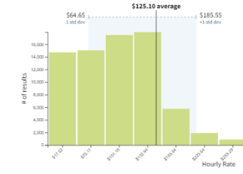
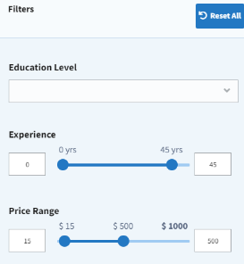
Labor Hour Tools
Multiple Search Options
Labor Category Search is consistent across all three sources
Visual Results
Breakdown of rates
Calculated Averages across related fields
Filters
Dig into your specific requirement
Variety of options in each data tool
Save Your Results

Slide 54
Hourly Labor Ceiling Prices: Search Use Cases
Labor Category
Vendor
Contract
You know the general labor categories you are looking for and want to see rates
You want to see how common certain labor categories are and/or what type of experience and other factors are common to a labor category
You want to see the entire catalog of a vendor on GSA MAS
You know what type of companies do the work for your requirement but aren’t sure what labor categories you should ask for / estimate
You want to confirm that a vendor has the labor categories you need or that they put in their proposal
Get a preview of their prices or compare a vendors proposed task order prices to their ceiling rates
Notes:
CALC+ Hourly Labor Ceiling Prices Use Cases
There are a wide variety of use cases for CALC+
Even industry partners use CALC+ when trying to determine what they should offer in their proposals!

Slide 55
Prices Paid: Search Use Cases
See Historical LC Use
Evaluate Price Trends
Evaluate Pricing
Look at the whole of prices paid to see what labor categories are historically used to plan for your own requirements
Pull data for the last 3 years and do your own analysis to see how prices have changed to calculate growth / inflation for your own estimates
Prices paid is one of multiple data sources for completing pricing estimates and evaluations. Remember to use more than one source for any price reasonableness determinations.
Notes:
Use Cases
These are three examples of how prices paid data may be used - but there are many more - especially for analysts

Slide 56
BLS: Search Use Cases
Cost Estimates
Geographical Data
BLS Occupation Titles
You need to do estimates for a cost type contract and want data on direct wage rates
You want to compare cost proposals from industry partners to a large data set for proposed wage rates
You want to drill down to a specific geographical area to see what wage rates are in that location
You want to determine what the general locality adjustment might be for other cost / price estimates
You cannot find a specific labor category you’re interested in other CALC+ tools and need estimates
You are ordering from a contract that maps to BLS labor occupational titles and want to use matching titles for your requirement
Notes:
CALC+ BLS
There are a wide variety of use cases for CALC+
Even industry partners use BLS Occupation Titles and rates when trying to determine what they should offer in their proposals!

Slide 57
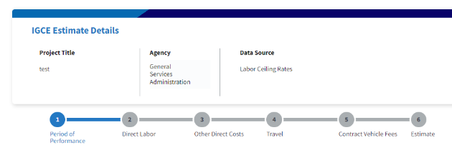
IGCE Builder
The IGCE tool walks users through 6 steps:
You can jump to any of the steps as you go
Add Period of Performance
Add Direct Labor rates / prices
Add Other Direct Costs
Add Travel Costs
Add Contract Vehicle Fees*
View your estimate
*Contract Vehicle Fees step is included but not modifiable at this time as the MVP BETA is designed for Schedules rates which have fees already
Notes:
Create new IGCE

Slide 58
Live Demo

Slide 59
Jill Akridge
Director of Strategic Initiatives and Business Intelligence
GSA Federal Acquisition Service
Email: jill.akridge@gsa.gov
buy.gsa.gov/pricing
For more information, visit: gsa.gov/FAST

Slide 60
Scope Review Tool
Brian Boothe
Professional Services Advisor
Agriculture, Energy, Homeland Security, Interior, EPA, Army, GSA

Slide 61
Scope Review Tool
Category Solutions Currently Available for Review(s)
MAS
Facilities Solutions
Furniture & Furnishings
Human Capital
Industrial Products and Services
Professional Services
Office Management
Scientific Management and Solutions
Security and Protection
One Acquisition Solution for Integrated Services (OASIS)
OASIS+ (coming soon)
Human Capital and Training Solutions (HCaTS)
Scope Review Tool Benefits
Optional Free Service analyzes the scope of your proposed requirement
Documents required
Statement of Work (SOW), Statement of Objectives (SOO), or Performance Work Statement (PWS)
IGCE (required for OASIS and OASIS+, suggested for all other Category reviews)
Add up to 5 supporting documents
Simple fillable form that allows the SME’s to review requirements efficiently and effectively
Review time ~2-5 business days
Addition option to add Market Research as a Service (MRaS)
Notes:
Combined effort between GSA’s Market Research as a Service and Scope Review Tool teams to streamline valuable free market research tools for upcoming requirements/solicitations
Request a FREE analysis of a Statement of Work (SOW), Statement of Objectives (SOO), or Performance Work Statement (PWS) for future services tasks, along with a scope compatibility determination to help you determine whether your requirement is within the scope of the GSA contract being considered *** Additional Categories to be added in the future ***

Slide 62
Demonstration of the Scope Review Tool

Slide 63
Is Your Requirement in Scope?

Slide 64
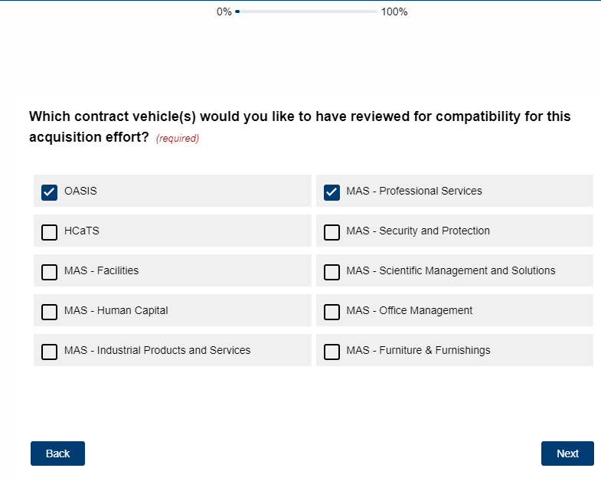
Which Contract Vehicle?
Notes:
You can select multiple contract for review at one time

Slide 65
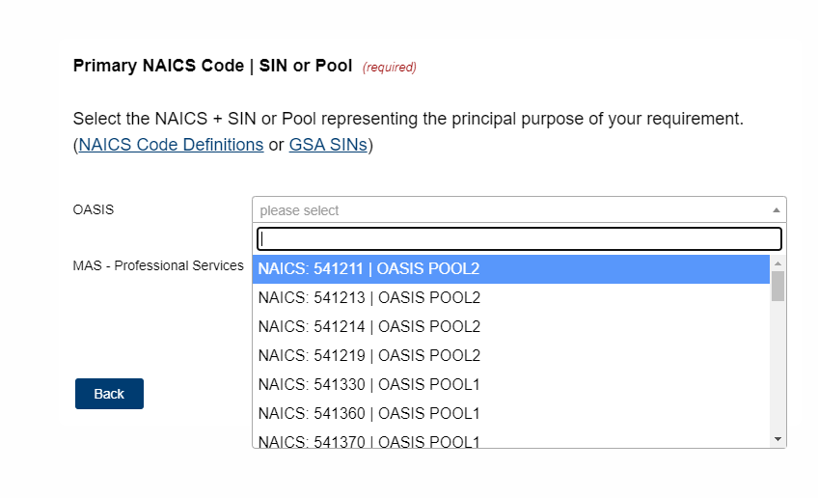
NAICS Codes
Notes:
Only NAICS/SINs available to the selected contracts will be displayed. If unsure which NAICS/SIN to use, please use the linked guides

Slide 66
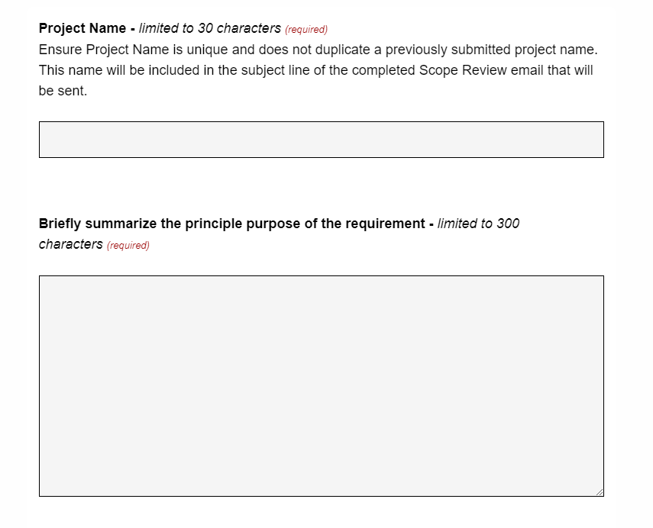
Project Information Details
Notes:
Enter the current PWS/SOW/SOW/Project Name
Briefly summarize the the principle purpose of of the requirement
The rest of the form will walk you through area such as

Slide 67
Required Information Checklist
Project Name and Summary
Previous contract # if applicable
Proposed Order Type (FFP, T&M, etc.)
Estimated Value
Estimated Solicitation & Award Dates
Small Business Set-aside?
Commerciality
Single or Multiple Award/BPA or IDIQ
ODC’s?
Agency and Contact Information
Requirements document (PWS, SOW, or SOO)
IGCE (required for OASIS and OASIS+, suggested for all other Category reviews)
Notes:
Combined effort between GSA’s Market Research as a Service and Scope Review Tool teams to streamline valuable free market research tools for upcoming requirements/solicitations
Request a FREE analysis of a Statement of Work (SOW), Statement of Objectives (SOO), or Performance Work Statement (PWS) for future services tasks, along with a scope compatibility determination to help you determine whether your requirement is within the scope of the GSA contract being considered *** Additional Categories to be added in the future ***

Slide 68
Market Research as a Service
(MRaS)

Slide 69
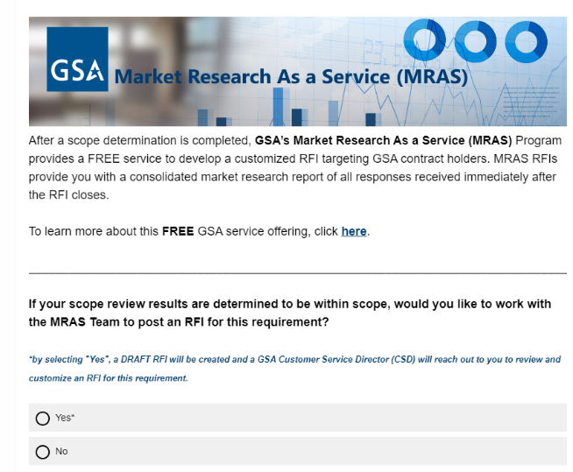
Market Research as a Service
Notes:
After a scope determination is completed, GSA’s Market Research As a Service (MRAS) Program provides a FREE service to develop a customized RFI targeting GSA contract holders. MRAS RFIs provide you with a consolidated market research report of all responses received immediately after the RFI closes. By selecting this option, you will not have to fill out two separate forms. All information will be carried over to the MRaS Tool.
MRAS provides each customer with a unique, comprehensive, and easy-to-understand report. The report analyzes industry partner data related to the customers' needs, which gives an understanding of the results expected under the markets researched. The Market Research Report includes socio-economic, technical, capabilities, and comprehensive business information so Agencies can complete their Acquisition Planning and Small Business strategies and requirements and estimate documents. *** All RFI’s are posted in eBuy as of March 24’

Slide 70
Questions, future enhancements, comments and resources
Jon DeWolfe - jonathan.dewolfe@gsa.gov
Program Manager - Buyer Experience
Strategic Initiatives and Business Intelligence Division
Professional Services and Human Capital Categories
Scope Review Tool
Link
Market Research as a Service (MRaS)
Link
rfi@research.gsa.gov
For more information, visit: gsa.gov/FAST

Slide 71
User Stories and Case Studies

Slide 72
User Stories and Case Studies
Eugene Hwang
Acquisition Project Management Specialist
Civilian Services Acquisition Workshops Program
Office of Professional Services and Human Capital Categories
Chanda Tallman
Procurement Analyst
Office of Professional Services and Human Capital Categories
Rachel Wynne
Customer Branch Chief
Office of Professional Services and Human Capital Categories

Slide 73
CSAW Success Story
Eugene Hwang
CSAW Facilitator

Slide 74
Success Story: EPA’s Office of Air and Radiation (OAR)
OAR's Goals: Comply with requirements for Spend Under Management, Small Business Goals, and develop expertise in their procurement processes for top spend areas.
CSAW Process: Facilitated OAR's EARTH team to develop performance-based requirements, establish a milestone schedule, complete acquisitions planning, and obtain acquisition strategy buy-in.
Key Benefits: The facilitated process enabled EPA to use performance-based acquisition strategies; ensured transparency, clarity, collaboration, and streamlined decision-making.
Outcomes:
EPA’s EARTH Acquisition Design consolidated 30 unique Statements of Work using performance-based acquisition best practices.
The agency established a Multiple-award Blanket Purchase Agreements against GSA Multiple Award Schedule, catering to both small and large business tracks.
The Program’s success led to the team receiving EPA’s highest award - The EPA Gold Medal
Notes:
Let me illustrate the impact of CSAWs with one of our success stories.
Environmental Protection Agency’s Office of Air and Radiation (OAR) wanted to establish a performance-based blanket purchase agreement for their the Environmental, Analytical, Research, Technical, and Hybrid (EARTH) Support Services contracts.
OAR’s goals were to comply with Federal and Agency Requirements for Spend Under Management and Small Business Goals, develop expertise in what and how they buy, and build effective, efficient solutions to streamline support in the top spend area of professional services for environmental consulting.
Through the CSAW, the OAR EARTH team identified workgroups and a milestone schedule to address specific project areas, completing acquisitions planning, and confirmed buy-in on the acquisition strategy. The facilitated process helped EPA use performance-based acquisition strategies to establish transparency and clarity of the OAR EARTH Acquisition requirement and acquisition strategy, fostering collaboration and streamlined decision-making.
The outcomes were significant:
EPA’s EARTH Acquisition Design consolidated 30 unique Statements of Work using performance-based acquisition best practices.
The agency established Multiple-award Blanket Purchase Agreements against GSA Multiple Award Schedule, including small business and large business tracks.
The team’s high-quality pre-award package was accepted without revision by both OGC and OSDBU - avoiding months of potential delays
EARTH’s nearly $10B value was placed against existing GSA schedule contracts and received no protests - again avoiding months of potential delays
The IPT won the EPA Gold Medal award for their work...
This success story is example of how CSAWs drive efficiency and excellence in acquisition practices.

Slide 75
Success Story: NASA
Past Workshops for NASA
Agency Wide Logistics Support Service (AWLSS)
Grounds Services
Agency Communication
NASA Shared Services Center (NSSC)
Administrative Services
NASA Stennis Space Center
Notes:
1/2021 - Agency Wide Logistic Support Service ($31)
BPA for
(a) Equipment Services
(b) Motor Pool and Transportation Services
(c) Flight Hardware Support Operations Services
(d) Shipping and Receiving Services
(e) Mail Services
(f) Moves and Furniture Services
(g) Property Disposal Services
(h) Material, Property, and Warehouse Management Services
7/2021 - Grounds Service ($50)
Mission Architecture Program, NASA is moving from a decentralized approach to acquiring grounds maintenance service to a more enterprise approach.
NASA has established a Requirements Development Team
11/2021 - Agency Communication ($305)
to award an Agency-wide contract to provide communications core function services for: Media Relations & Public Affairs; Digital Media Engagement; Public Engagement & Stakeholder Communications; and Communications Strategy & Policy. As the Office of Communications (OCOMM) transitioned to an Enterprise Office, it was discovered that 43 contracts were identified across the Agency with a mix of cost and fixed type contracts. This acquisition initiative will work to combine those insular contracts into 3 or 4 regional contracts that all of NASA will have access to utilize in the purchase of communications core functions
1/2022 - Shared Services Center ($320)
The services required under this contract support a broad range of functional activities for Financial Management (FM), Human Resources (HR), Procurement (PR), Agency Business Services (ABS)
Service Provider (SP)
4/2022 - Administrative Services ($60)
NASA currently procures administrative support in a decentralized manner, as part of other contract vehicles at each NASA center. Using Product Service Lines or category management, NASA intends to procure administrative services through NASA Langley Office of Procurement to align the method of acquiring services, as well as to develop consistent requirements across the agency.
4/2023 - Stennis Space Center ($1.2 billion)
contract for site wide Operations and Maintenance to include Logistics & Property Management, Environmental, Safety, Industrial Hygiene/Environmental Health, Design & Analysis, Construction, Logistics Manufacturing & Fabrication, and Site Services (custodial, grounds maintenance, pest management, etc.,). The contract will cover John C. Stennis Space Center (SSC), Mississippi and Marshall Space Flight Center’s (MSFC) Michoud Assembly Facility (MAF), Louisiana.
IDIQ

Slide 76
Eugene Hwang
CSAW Facilitator
Office of Professional Services & Human Capital Categories
GSA Federal Acquisition Service
Email: csaw@gsa.gov
GSA.gov/csaw
CSAW Interact Community
For more information, visit: gsa.gov/FAST

Slide 77
Success Stories: Helping Government Agencies meet their Professional Services Requirements
Rachel Wynne
Customer Engagement Branch Chief

Slide 78
Department of Homeland Security, US Coast Guard
CHALLENGE: Agency had a tight acquisition time frame and were looking to set-aside for Service-Disabled Veteran-Owned Small Businesses
STEPS:
Agency requested Scope Review in May 2023
Determined requirement was a fit for OASIS
Solicitation was issued in Aug 2023
Award was made in Jan 2024
RESOLUTION:
The agency was able to quickly do a competitive award under FAR 16 ordering procedures
Set the order aside for their desired small business type
Include the incumbent in the competition
As a bonus, receive Best-in-Class SUM credit for the award.

Slide 79
US Army Medical Research Acquisition Activity
CHALLENGE: Agency had a rigid timeline and were looking to set for Women-Owned Small Businesses
STEPS:
Agency reached out to Customer Service Director in mid Jan 2023
CSD assisted by providing examples from the APP site
PSA from PSHC provided input on technical questions regarding NAICS, SIN, and the Multiple Award Schedules program
CSD posted RFI on Feb 3 and provided responses on Feb 14
Agency issued solicitation on Mar 17
Award was made on May 13
RESOLUTION: Thanks to a super-responsive CSD, a very streamlined market research process (MRAS), and quick category support, the agency was able to quickly determine they could meet their needs using the streamlined procedures of FAR 8.4. Timeline was met and socio-economic goal was satisfied.

Slide 80
Rachel Wynne
Customer Engagement Branch Chief
GSA Office of Professional Services and Human Capital Categories
Rachel.wynne@gsa.gov
professionalservices@gsa.gov
www.gsa.gov/professionalservices
For more information, visit: gsa.gov/FAST

Slide 81
When the Army and GSA Work Together: The EXPRESS Program
Chanda Tallman
Procurement Analyst

Slide 82
1997 BRAC - Base Realignment and Closure
In 1997 the merger of ATCOM (Aviation) and MICOM (Missile) missions on Redstone Arsenal brought together two distinctly different methods of acquisition
Aviation had been utilizing a multiple award task order program that they managed internally for their A&AS requirements
Missiles used numerous stand alone contracts, designed to support only one program or functional organization
ATCOM and MICOM became what we know as AMCOM today
“AMCOM” - United States Army Aviation & Missile Command
Notes:
1997 BRAC - Base Realignment and Closure
MICOM from St. Louis Missouri did a wholesale move to Redstone Arsenal in Huntsville, AL, forever changing the landscape of Huntsville and making it one of the biggest defense centric cities in the United States. We’re often called the Southern DC.

Slide 83
Follow-on Contract Vehicle
In 2000, AMCOM Acquisition Center created the Omnibus 2000, or O2K, program to replace the existing haphazard A&AS contracting infrastructure
O2K consisted of 12 multiple award IDIQ (5-year) contracts for A&AS using logistics, programmatic and technical categories
10 Small Business Primes (including woman-owned and 8(a))
2 Large Business Primes
Over 200 subcontractors
However, not all AMCOM customers agreed to use these contracts, citing exceedingly long PALT by the AMCOM Acquisition Center (now ACC-RSA)
Notes:
This was a five year contract so in reality as soon as the twelve IDIQ contracts were awarded it was time to start thinking about the follow-on contract vehicle. That’s the drawback of five year contracts without options.

Slide 84
Long Term Program
O2K Follow-On Acquisition Planning/Strategies:
Improve the current contract situation (PALT on multiple award IDIQs)
Establish individual stand-alone contracts (“C” type, not IDIQs)
Utilize GSA Schedules to establish Blanket Purchase Agreements
Since PALT time was the issue with O2K for many customers, the following advantages of GSA’s MAS program were considered:
Pre-negotiated labor rates and labor categories at the Schedule contract level
Limits on LCATS could be lifted (this was done on O2K for the sake of PALT)
Flexible pricing arrangements - fixed price, T&M, labor hour
The BPAs would provide guidelines for a streamlined task order award process
Dynamic teaming via Schedule CTAs would allow small business goals to be met
Notes:
GSA Customer Service director in Huntsville in the early 2000s who had an idea …… stop the madness and stop “starting over” every five years and use GSA MAS to create a long term program.

Slide 85
Army-wide
In 2005 “AMCOM” EXPRESS was born
EXPRESS = Expedited Professional and Engineering Support Services
It has grown and matured over the past two decades
Army-wide
Dropped “AMCOM”
Current State: 60 BPAs leveraging GSA’s Multiple Award Schedule (MAS) program categorized within five domains aligned by scope
Technical (541715 R&D)
Technical (541330 Non-R&D)
Programmatic (541611)
Logistics (541614)
Business & Analytical (541611)
$23B in obligations over the last two decades
Unique Features - CTAs, Subcontractors only under Awardee, Direct Awards, SBSA or F&O, Evergreen Acquisition Strategy, Can be Utilized Army-wide
Notes:
Army-wide:
Currently have two small task orders in process for customers who are not tied to Redstone Arsenal. The KOs have taken the DPA training, the requirements offices have participated in our quarterly industry events and the RFIs and in one case the TORFP have gone out. EXPRESS is officially Army wide.

Slide 86
Express Program
Notes:
Hierarchy of the EXPRESS progra. The GSA schedule contracts are the basis for the BPAs and the BPAs are the basis for the task orders under which the work is performed. Without the GSA schedule contracts this program wouldn’t exist as it does today.

Slide 87
Express Program
OPEN TO USE ARMY-WIDE
Just a Few Advantages
Delegation of Procurement Authority (DPA) offered to qualifying Army Contracting Officers
Receive Tier 2 Spend Under Management credit for OMB Category Management metrics
No Acquisition Plan or Acquisition Strategy Required
Class T&M D&F already in place at the BPA level
Streamlined CRP documentation and support available
Full range of professional services available to support Army customers
PALT of 150 days or less per Task Order
No additional fees for use
Additional Info:
https://acc.army.mil/contractingcenters/acc-rsa/Express.html
https://buy.gsa.gov/interact/community/82/activity-feed

Slide 88
Questions?
Chanda Tallman
GSA Procurement Analyst
Embedded Support to ACC-RSA
chanda.tallman@gsa.gov
For more information, visit: gsa.gov/FAST
Notes:
Thank you all for your time today.

Slide 89
Thank you for your participation!
For more information, visit: gsa.gov/FAST

