Slide 1
Small Business Works 2022:
Lunch & Learn Panel: Meet the Buyers
Day 1: July 26, 2022
U.S. General Services Administration

Slide 2
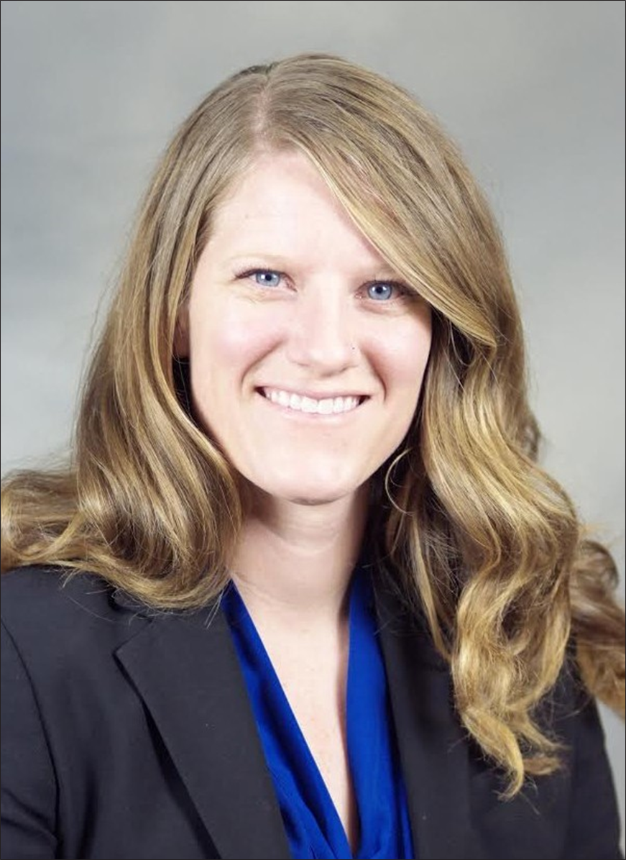
TODAY’S MODERATOR
Michelle Leshe
Procurement Analyst
U.S. General Services Administration

Slide 3
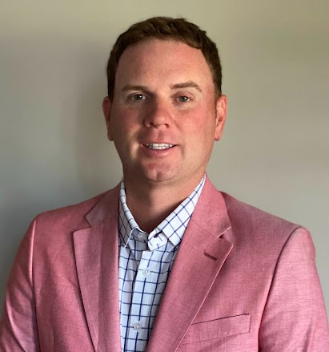
TODAY’S PANELISTS
Terrance Cowley
Supervisory Contract Specialist
Acquisition Management Division Services Acquisition Branch
Public Buildings Service
U.S. General Services Administration

Slide 4
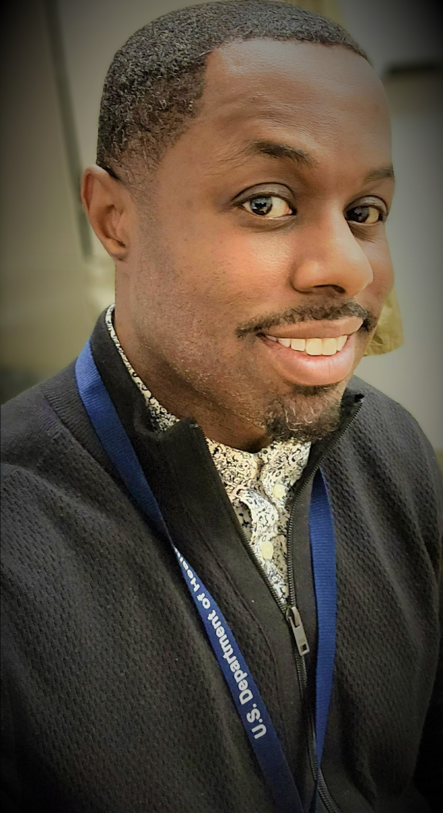
TODAY’S PANELIST
Joshua Blow
Small Business Specialist
Office of Small and Disadvantaged Business Utilization
U.S. Department of Health and Human Services

Slide 5
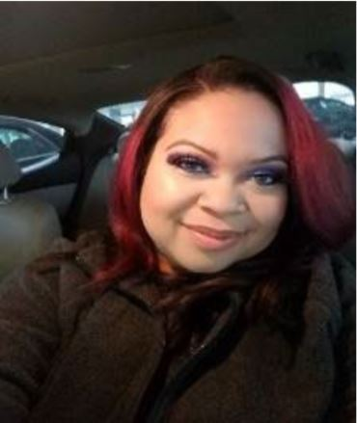
TODAY’S PANELIST
Trenescia Briggman
Supervisory Contract Specialist
U.S. Department of Energy

Slide 6
Question 1:
Can you provide us with an example of a successful small business working with your agency?
(i.e past performance, understands the agency needs, solutions provided)

Slide 7
Question 2
Why do you think some small businesses fail to succeed in obtaining a government contract at your agency?
(i.e. lack past performance, knowledge on the agency & how they procure)

Slide 8
Question 3
Who are the key players small businesses need to know in your agency?
(i.e. Program Managers, Contracting Officers, Small Business Specialist)

Slide 9
Final thoughts

Slide 10
Questions?

Slide 11
Thank You!

