Slide 1
Small Business Works 2022:
Market Research as a Service (MRAS) for Small Business Vendors
U.S. General Services Administration

Slide 2
Making Market Research Easy:
Enhancing Industry Partnerships
Tiffany Shabanian tiffany.shabanian@gsa.gov
Program Manager, Market Research as a Service
U.S. General Services Administration
Kristy Wilbur kristy.wilbur@gsa.gov
Branch Chief, Market Research as a Service
U.S. General Services Administration
Kevan Kivlan kevin.kivlan@gsa.gov
Director, Customer and Stakeholder Engagement
U.S. General Services Administration

Slide 3
Objectives
What is MRAS?
Overview of MRAS Successes
Why Market Research is conducted
When and how we conduct Market Research
Completing GSA’s Market Research Surveys
Ensuring agencies get accurate information about your business
What GSA does with the results
Reminders and Resources

Slide 4
What is Market Research as a Service (MRAS)?
MRAS uses the latest research techniques to help agencies visualize the competition and socioeconomic responses that they can expect if they use GSA’s acquisition vehicles.
We conduct market research for both products and services
Federal and State/Local agencies can choose to utilize MRAS for market research analysis but it is not a requirement.

Slide 5
GSA’s Market Research as a Service (MRAS) Successes
350 + clients and 20+ Agencies supported
$23 billion worth of projects awarded to GSA schedule holders
50% or more of the requirements we research go to a GSA contract holder.

Slide 6
MRAS Success Story - Department of Commerce
Requirement: The Department of Commerce is seeking program and project management efforts to maintain business objectives, organizational performance, as well as to coordinate and manage various projects and strategic initiatives. utilizing a GSA solution.
Possible GSA Solutions: Multiple Award Schedule (MAS), OASIS Small Business, OASIS 8A, OASIS Unrestricted or BPA.
Outcome: 86 vendors responded, of those 74 were small businesses.

Slide 7
Why Customers Research
To gain knowledge
Start the conversation
Understand and begin to act
To make informed decisions
See the solutions and understand the impact
To drive mission capabilities
To remain relevant, gain efficiency, and innovate.
Gathering feedback
Listening to Stakeholders
To ensure regulatory compliance, understand market constraints, and recognize opportunities.

Slide 8
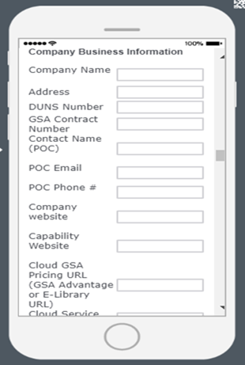
How we Research
We use commercially available software to streamline the process.
We keep it simple
We ask questions with a purpose but consider how we want to visualize the data.
We use video, websites, demos, manuals, and more.

Slide 9
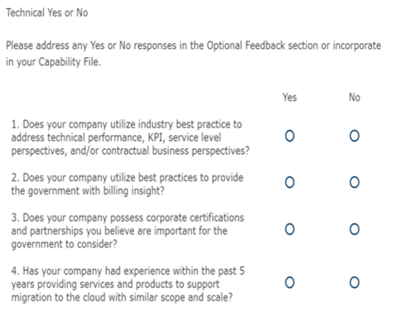
How we Research (Cont.)
We ask yes or no questions.
We ask for ranges, pre-set percentages, and more.
We ask questions with visualization and creating data sets in mind.

Slide 10
We Produce Visuals to Make Decisions Easier

Slide 11
How to find MRAS Surveys/RFIs
All MRAS RFIs are posted via GSA’s eBuy site as a Request for Quote (RFQ) as a Sources Selection under the applicable SINs and contracts.
If you’re under the SIN and contract for that RFI you will get notified via email.
Make sure the email associated with your company in eLibrary is current and up to date, as RFI requests will be sent to that email.

Slide 12
Be sure to meet the due date for responses
Review the Scope description in the summary
Be sure to download any requirements attachments like the PWS or SOW

Slide 13
Be sure to include a URL only

Slide 14
Choose the SIN or NAICS most appropriate for the requirement
By selecting yes, your responses will be included in the report
Multiple answers can be selected here. Non GSA Contract Holder information will be filtered out of our reports as we only research markets within GSA Contracts.

Slide 15
Select “other” if you are not a small business
Be sure to select any and all designations, or “NA” if none apply

Slide 16
Examples of technical questions, answers can be explained in capabilities statement
Provide honest feedback about the survey, include questions or concerns you may have about the requirement

Slide 17
POC Information will be sent to you should you have additional questions.
Include more information about relevant experience in your capabilities statement
By submitting your response to the survey, you agree to have your information shared with other Government entities

Slide 18
Tips for your Capability Statement
You have two instances to include a capability statement:
You can provide a general capability statement in the “Company Information” section in the field “Capability Statement URL”.
At the end of the survey you can upload a more specific Capability Statement.
Only one attachment can be uploaded, so combine your files into one document.
Provide more information on any technical questions that you answered as “No”.
Be sure to elaborate on any additional open ended questions that may be asked in the survey.
Please note this is an optional document.

Slide 19
What Happens Next?
A Market Research Report summarizing your responses is sent to Agency Acquisition Professionals.
Feedback you provide regarding the requirement is summarized in a report to Agency Acquisition Professionals.
An Agency Point of Contact is provided to you if you have further questions regarding the RFI or requirement.

Slide 20
The Results - Industry
Visibility as potential source in front of customers.
Access to GSA and Agency Points of Contacts.
Responses to RFI lead to additional business; 50% or more of the requirements we research go to a GSA contract holder.
The Results - Agency Acquisition Professionals
Provides agencies with visuals and data they can include in reports to Small Business.
Provides agencies with narratives they can leverage for Acquisition Planning.
Gives agencies an outlook on whether competition and socio-economic participation is likely.

Slide 21
Reminders - Attachments
You must respond to our RFIs to have your information included. If you send us attachments or capabilities statements via email, they will not be included in the report seen by buyers.
We will not forward your attachment unless it has been uploaded via the RFI form.
Please do not email attachments.
We recommend forwarding any attachments not included in your RFI response to the customer directly once we provide a POC.

Slide 22
Reminders - Points of Contact and Questions
We send Agency POC information to the email included in your original response, 5-10 days after RFIs closes. If you still need the Agency POC information, email us that you lost the email. Only vendors that respond to the RFI can be given the Agency POC information
Questions may be asked in your RFI response via the Optional Feedback Question; it is up to the Agency to answer your questions once the RFI closes. If you do not receive a response from the agency, you can reach out to the GSA POC.
We are unable to provide information regarding the expected acquisition strategy, or expected RFP date. Please contact the Agency POC for this information.

Slide 23
Reminders - Extensions and Updates
No extensions will be granted. This is only market research and the RFIs are meant to be streamlined, therefore, please respond with whatever information you have available by the due date.
In order to Re-open your RFI we will need your Business Name, Email, and the Subject description of the RFI from Ebuy, the RFQ number is not mandatory.
After you respond to a survey, you will receive an email with a confirmation of your responses. Email rfi@research.gsa.gov if you need to update your response.

Slide 24
MRAS Industry Training Schedule
Making Market Research Easy - Enhancing Industry Partnerships
Want to learn more about Requests for Information (RFIs) and how they can be a useful tool for your business? Participants in this session will walk away with a better understanding of why GSA collects industry responses and and how the data collected shapes future purchasing decisions.
August 23, 2022 - 12pm - 1pm ET
September 27, 2022 - 12pm - 1pm ET
Click HERE to register or visit www.GSA.gov/Events for more information.

Slide 25
Resources
Please email: rfi@research.gsa.gov for any additional questions
To submit an Industry Help Request: Industry Help Request Form
Sign up for future MRAS Industry Training

Slide 26
Questions?

Slide 27
Thank You!

