Slide 1
Small Business Works 2022:
OSDBU Tools and Resources: Foundational Small Business Data Sources
Day 2: July 27, 2022
U.S. General Services Administration

Slide 2
TODAY’S MODERATOR
Amy Lara
OSDBU Director, Small Business Compliance & Goaling
U.S. General Services Administration

Slide 3
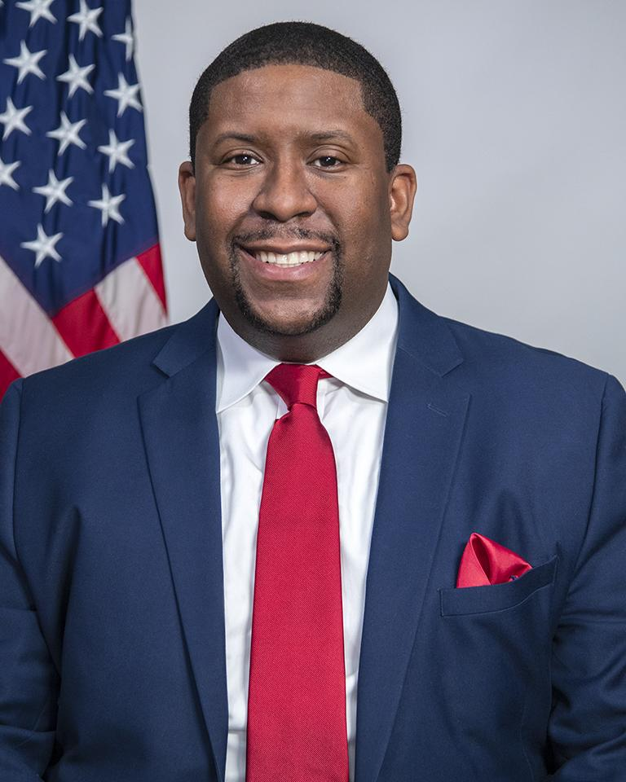
TODAY’S PANELISTS
Exodie C. Roe, III
OSDBU Associate Administrator
U.S. General Services Administration

Slide 4
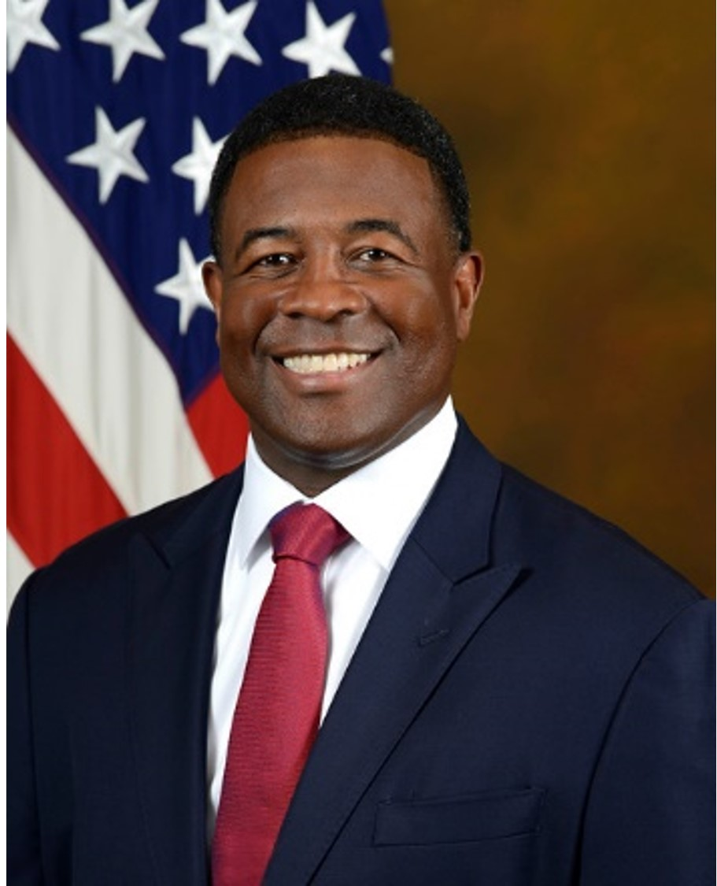
TODAY’S PANELISTS
Shannon Jackson
OSDBU Director
U.S. Department of Health and Human Services

Slide 5
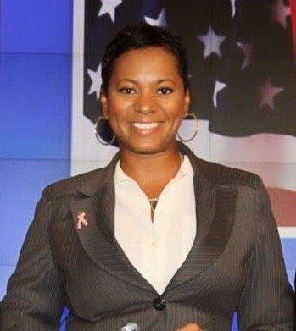
TODAY’S PANELISTS
Darlene Bullock
OSDBU Director
U.S. Department of Homeland Security

Slide 6
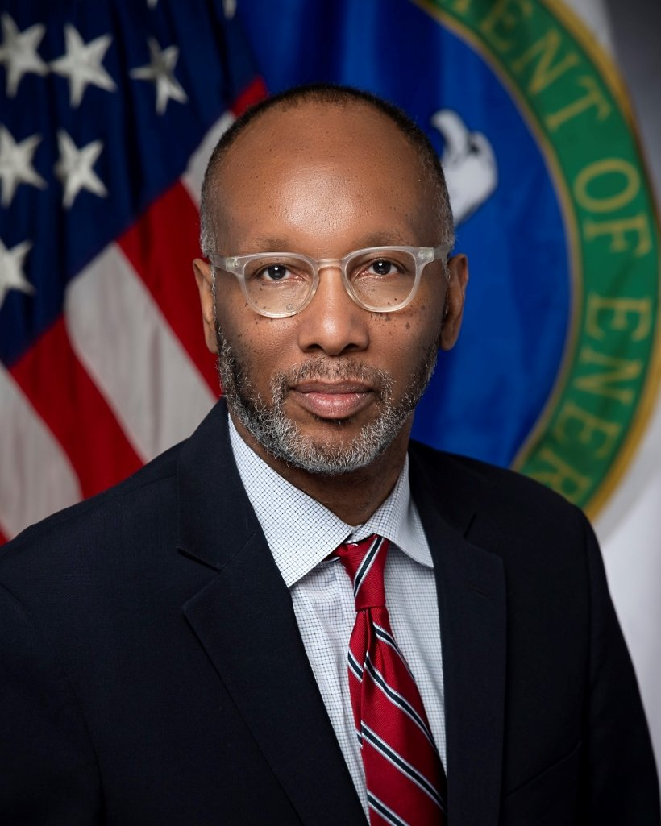
TODAY’S PANELISTS
Ron Pierce
OSDBU Director
U.S. Department of Energy

Slide 7
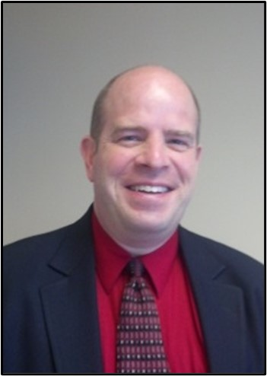
TODAY’S PANELISTS
Cordell Smith
Director for Acquisition Policy
U.S. Department of Veterans Affairs

Slide 8
Question 1
Since the Biden-Harris’ Administration issued an executive order to increase the share of contracts going to disadvantage business by 50% by 2025, what steps has your agency taken to achieve that goal?

Slide 9
Question 2
What resources within your agency's OSDBU Office do you provide to the Acquisition Workforce?

Slide 10
Question 3
What are some best practices/lessons learned the Acquisition Workforce can utilize to partner with their Small Business Specialist/OSDBU Office?

Slide 11
Final Thoughts

Slide 12
Questions?

Slide 13
Thank You!

