Slide 1
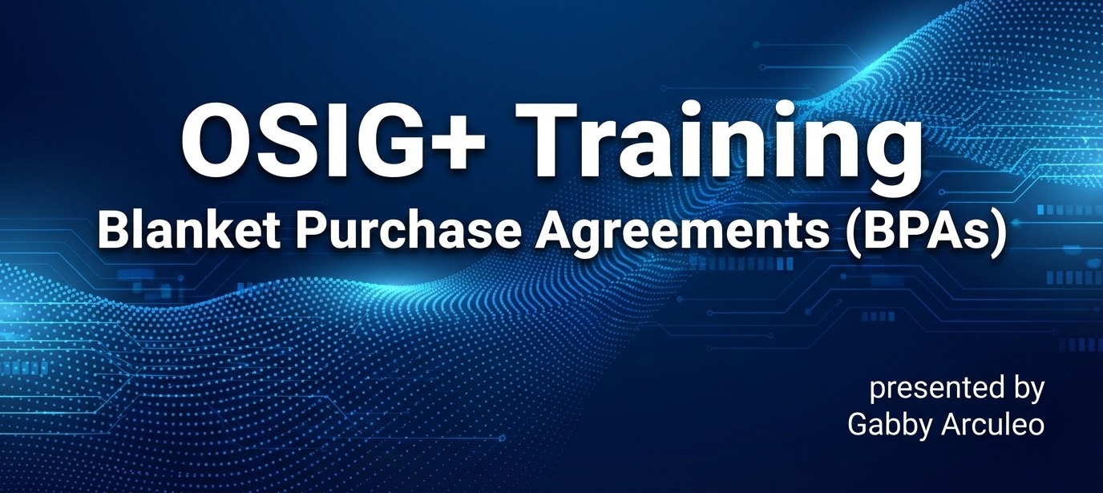
Opening slide

Slide 2
Agenda
Disclaimers
What is a BPA and why agencies use them
Single vs Multiple Award BPAs
Understand OASIS+ BPA fundamentals
Learn how to pitch BPAs to government customers
Understand fair opportunity and thresholds
Compare OASIS+ BPAs vs Schedule BPAs
FAQs
Contractor Supply Sources

Slide 3
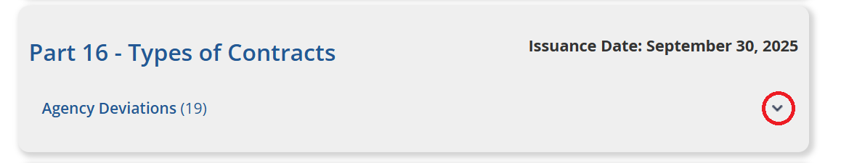
Disclaimers
An agency must have an approved class deviation in place adopting the Revolutionary FAR Overhaul (RFO) Part 16 procedures.
See if the Federal agency has officially signed the Deviation noted at FAR Parts and Agency Deviations. Scroll down to FAR Part 16 and select the arrow on the bottom right to view all agencies with an active Deviation.

Slide 4
Disclaimers Continued
This guidance is based on RFO-16-2025 and RGO-538-2026
and subject to change when the final FAR and GSAR case are issued. You should rely solely on the final FAR and GSAR rules once issued.
The cross-references in the RFO FAR (e.g., to Part 12 or Part 13) for BPAs are informational and do not inherently restrict the applicability of a section to commercial or non-commercial acquisitions unless explicitly stated.

Slide 5
What is a BPA and why do agencies use them?
According to FAR 12.201-1(e)(3) A blanket purchase agreement (BPA) is a simplified method of filling anticipated repetitive needs for supplies or services.
Used when an agency expects recurring or ongoing needs
  Orders (calls) are where work and money are actually awarded
Used if the agency values lower administrative effort in the long-run

Slide 6
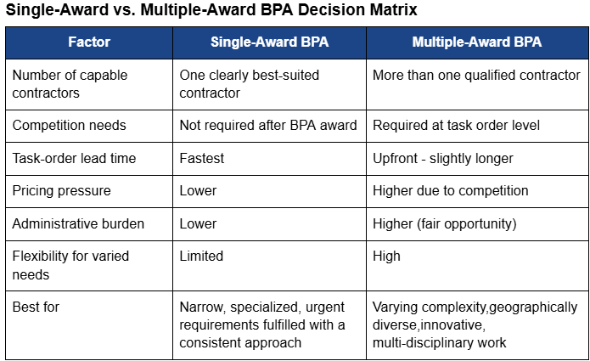
Single vs Multiple Award BPAs

Slide 7
OASIS+ BPA Fundamentals
BPAs can be established under indefinite delivery indefinite quantity (IDIQ) contracts for both commercial and non-commercial acquisitions. The IDIQ must allow for the placement of BPAs, and OASIS+ does!
Supports FFP, T&M, Labor Hour, and Cost-Reimbursable orders
Supplies or services outside the scope of the parent OASIS+ contract are not authorized under any OASIS+ BPA.
Ordering Contracting Officers establishing a BPA must have a Delegation of Procurement Authority (DPA).
BPAs cannot cross OASIS+ Domains/CLINs.*
  Serve as fair opportunity pools.
  System limitation of eBuy.

Slide 8
OASIS+ BPA Fundamentals Continued
OASIS+ BPAs must align with the timeline of the underlying contract, inclusive of options (see Diltex, Inc., B-433434). Ensure your BPA meets these requirements:
  Duration Limit: a BPA ordering period cannot extend beyond the remaining term of the OASIS+ contract, including option periods.
  Performance Coverage: Your specific contract must have sufficient active and/or option periods to cover the entire BPA ordering period.
    for example, a five-year BPA may only be awarded if you have at least five years of total contract eligibility remaining, combining the current term and available options.
  Existing BPA Task Orders: Task orders awarded before the OASIS+ contract expires may continue for the full period of performance stated in the order, in accordance with FAR 52.216-22, Indefinite Quantity (Apr 2023) (Deviation), and may extend up to five years and six months beyond the OASIS+ contract expiration.

Slide 9
BPA Value Proposition
BPAs are a lead-time reduction strategy
Flexible for evolving requirements
Risk reduction and administrative efficiency
  Example: “If you expect recurring or evolving needs, an OASIS+ BPA can reduce lead time, streamline ordering, and stay fully compliant with Revolutionary FAR Overhaul subpart 16.5. You compete once, then order quickly - either through a single award for speed or multiple awards for flexibility and competition.”

Slide 10
Fair Opportunity
FAR 16.507-2(a)(1): “The contracting officer must provide each awardee a fair opportunity to be considered for each order or BPA valued above the micro-purchase threshold”... “unless a sole source order or BPA is justified and approved according to 16.507-6.”
To place task orders against BPAs established under an IDIQ, the ordering procedures must comply with FAR 16.507-2(c)(3), which includes providing fair opportunity to BPA recipients based on the total estimated value of the order.
When a BPA with a single source is established under a multiple-award IDIQ, FAR 16.507-2(c)(3) requires COs to follow the same procedures as placing a task or delivery order, including any required Exception to Fair Opportunity (FAR 16.505(b)(2)). Once the single-award BPA is properly justified and approved, BPA orders issued within the scope, value, and period of performance do not require a separate fair opportunity justification approval—because the competition decision occurred at the BPA level.

Slide 11
Fair Opportunity under OASIS+
A contractor’s awarded CLINs (NAICs Codes) are the Fair Opportunity pools they are eligible to compete in.
When an Ordering Contracting Officer wishes to establish a BPA under OASIS+, they would post their requirement to the Domain NAICs they deem most appropriate in eBuy.
An OASIS+ contractor may only propose to the BPA solicitation posted to their respective Fair Opportunity pools.
The Ordering Contracting Officer (OCO) will make their award decision and administer the BPA according to the terms and conditions they set.

Slide 12
Fair Opportunity & Thresholds
FAR 16.507-3 Orders valued above the micro purchase threshold but not above the SAT.
  Fairly consider all contract holders
  May order without new solicitation if existing info allows fair consideration
  Document rationale showing all were fairly considered

Slide 13
Fair Opportunity & Thresholds 2
FAR 16.507-4 Orders valued above the SAT but not above
$7.5 million.
  Provide fair notice to all contractors via:
    Solicitation or
    Notice of intent (contractor must respond to compete)
  Document that all responses were fairly evaluated

Slide 14

OASIS+ vs MAS BPAs

Slide 15
RFO FAR Part 16 BPAs vs. GSAR 538.71 FSS BPAs
OASIS+ vs MAS BPAs
Topic | RFO FAR Part 16 BPAs | GSAR 538.71 FSS (MAS) BPAs
Underlying Contract | IDIQ / Multiple Award Contract (MAC) / Governmentwide Acquisition Contract (GWAC) | Multiple Award Schedule (MAS/FSS)
Governing Authority | FAR Subpart 16.5 (Class Deviation RFO-16-2025) | GSAR 538.71
Primary Purpose | Support complex, non-commercial, or evolving requirements | Streamline buying of commercial products and services
Typical Use Cases | Professional services, IT services, engineering, advisory, R&D | Software, products, standardized commercial services
Competition Model | Fair Opportunity at the BPA/order level | MAS ordering procedures (GSAR 538.71)
Pricing Flexibility | Fixed price, T&M/LH, cost-type orders allowed | Fixed price and T&M/LH orders only

Slide 16
OASIS+ vs MAS BPAs 2
Topic | RFO FAR Part 16 BPAs | GSAR 538.71 FSS (MAS) BPAs
Labor Flexibility | Highly flexible labor categories | Limited to MAS labor categories and OLMs
Order Complexity | Well-suited for custom, mission-specific solutions | Best for repeatable, predictable acquisitions
BPA Establishment | BPA terms based on the IDIQ and tailored to agency mission needs | BPA terms based on MAS contract and tailored to agency mission needs
Term Limits | BPA ordering period cannot extend beyond the remaining term of the OASIS+ contract, including option periods | BPA term tied to remaining MAS contract term, including option periods
Domain/SIN | Limited to one Domain due to the fair opportunity pools and current limitations of the eBuy system | BPAs can cross multiple SINs

Slide 17
OASIS+ vs MAS BPAs 3
Topic | RFO FAR Part 16 BPAs | GSAR 538.71 FSS (MAS) BPAs
BPA On-Ramping | Encouraged, requires determination for not using in BPAs over 5 years | Allowed, but not prescribed
Best For | Long-term mission support and evolving requirements for all contract types | Quick access to commercial solutions
Protests | Follows overhauled FAR 16.508 Protests of orders, protests only on the basis of: The order increases the scope, period, or maximum value of the contract 10 U.S.C. § 2304c; or Order valued in excess of $10 million (41 U.S.C. 4106(f)) (for all GSA IDIQs) | Subject to the jurisdictional thresholds established by the awarding agency, Government Accountability Office (GAO) and the Court of Federal Claims (COFC). For GAO protests, the jurisdictional threshold is typically $35 million for DoW procurements (RFO 16.508) and $10 million for civilian agency procurements (4 C.F.R. § 21.2). For COFC protests, there is no specific dollar threshold, but the court generally exercises jurisdiction over protests related to procurements that exceed the simplified acquisition threshold (SAT).

Slide 18
FAQs
How can we best make the business case for OASIS+, given that—unlike GSA MAS, which allows a single BPA with both unrestricted and set-aside orders—it requires at least two separate BPAs (Unrestricted and Small Business), increasing administrative burden?

Slide 19
FAQs 2
Should the OASIS+ PMO allow OCOs the same flexibility as MAS—where BPAs are solicited through eBuy, but Call Orders can be solicited and managed through alternate methods?

Slide 20
FAQs 3
I'm trying to enter my OASIS+ BPA into SAM.gov/FPDS, but the system won't accept it. What's wrong?

Slide 21
A note on 8(a) BPAs
SBA approval at the OASIS+ master level does not automatically cover a BPA or orders issued under it. Ordering activities must offer, and SBA must accept, each order under a BPA, in addition to offering and accepting the BPA itself (FAR 19.108-6 (GSA Class Deviation RFO-2025-16)).

Slide 22

Contract modification to incorporate this clause TBD.
When possible, contractors should prioritize OneGov discounted items whenever possible.
The ordering Contracting Officer can restrict or prohibit the use of other Government contracts for a specific order as long as this is clearly stated at the order level. Otherwise, contractors may use other federal contracts as needed.
FAR 52.208-90
Government Supply Sources

Slide 23
FAR 52.208-90
Government Supply Sources
As prescribed in 8.105-2(c), insert the following clause:
Government Supply Sources (Deviation Date)
The Contracting Officer may issue the Contractor an authorization to use Government supply sources in the performance of this contract. Title to all property acquired by the Contractor under such an authorization shall vest in the Government unless otherwise specified in the contract. The provisions of the clause at FAR 52.245-1, Government Property, apply to all property acquired under such authorization.
(End of clause)

Slide 24

Any Questions

Slide 25
Blanket Purchase Agreements Toolkit (on the OASIS+ website!)
(RFO-2025-16 FAR Subpart 16.5)
FAR Companion 2.0
OneGov
Resources

