Slide 1
OS4 Purchasing Channel
Maria Viscione
R2 MAS Branch Chief
Program Manager, OS4 FSSI, BIC
U.S. General Services Administration

Slide 2
Agenda
Overview of OS4
Sales and Cost Avoidance
How to submit an offer for OS4
GSA eLibrary/GSA eBuy/GSA Advantage!
New Vendor Engagement
Resources/Points of Contact

Slide 3
FSSI OS4 Overview
Federal Strategic Sourcing Initiative (FSSI) for Office Supplies Fourth Generation (OS4) - A Best In Class (BIC) Program!
Program consists of 63 OS4 contracts to date (as of July 1st 2023)
Enhanced Special Item Numbers (SINs)
SIN 339940OS4: Enhanced SIN For Office Products & Services / Office Supplies 4th Generation (OS4)
SIN 339940OVER: Enhanced SIN For Overseas Office Products & Service / Office Supplies 4th Generation (OS4)
All contracts are Multiple Award Schedule (MAS) contracts. They are awarded for a base period of five years and have three five year options. Total contract period, if all options are exercised, is twenty years.

Slide 4
FSSI OS4 Overview SIN 339940OS4 (On Consolidated MAS 99)
Offerors may offer their entire commercial catalog, or may offer a select, limited line of office products.
This SIN also includes all commercially available services related to support office products.
Optional services include, but are not limited to:
Desktop Delivery
Secure Desktop Delivery
On-Site Stores
Walk-in Stores

Slide 5
FSSI OS4 Overview SIN 339940OVER (On consolidated MAS 99)
This SIN covers items for use only in overseas destinations
This SIN also includes all commercially available services related to the support office products.
Optional services include, but are not limited to:
Desktop Delivery
Secure Desktop Delivery
On-Site Stores
Walk-in Stores

Slide 6
OS4 Solution OS4, the Office Supplies solution, has awarded 63 contracts! (as of July 1st 2023)
This list is updated frequently. For the updated list of vendors on SIN 339940OS4 and SIN 339940OVER, please see:
https://www.gsaelibrary.gsa.gov/ElibMain/sinDetails.do?scheduleNumber=MAS&specialItemNumber=339940OS4&executeQuery=YES
Major features:
Real time order status! – Find out where your order is in real time.
Convenience fees – No longer be limited by minimum orders – vendors will ship orders below minimum order amount for a nominal shipping fee.

Slide 7
OS4 Features
Improved pricing and savings
Enhanced vendor requirements
Capture data (data spending tracking capabilities)
Vendor accountability
Provide 4-day direct delivery (CONUS) and 7-day direct delivery (OCONUS)
Enable achievement of socio-economic goals
Support nation’s Small Businesses
Drive compliance with mandates, acts, orders (e.g., TAA, AbilityOne/ETS)
Conform with Agency business practices
Easy to use
Makes it easy to purchase green items
Offers enhanced delivery options including next-day delivery, desktop delivery, and secure desktop delivery

Slide 8
Value to the Customer
Continue to provide Government Savings under OS4
Enable Agency Socio-economic Goals
Meet all Procurement Regulations
Government Savings

Slide 9
Value to the Customer
OS4 Figures since inception:
OS4 FY19:
$23.6M sales
$5.2M cost avoidance
OS4 FY20:
$92.7M sales
$26.3M cost avoidance
OS4 FY21:
$155.2M sales
$60.9M cost avoidance
OS4 FY22:
$157.3M sales
$96.2M cost avoidance

Slide 10
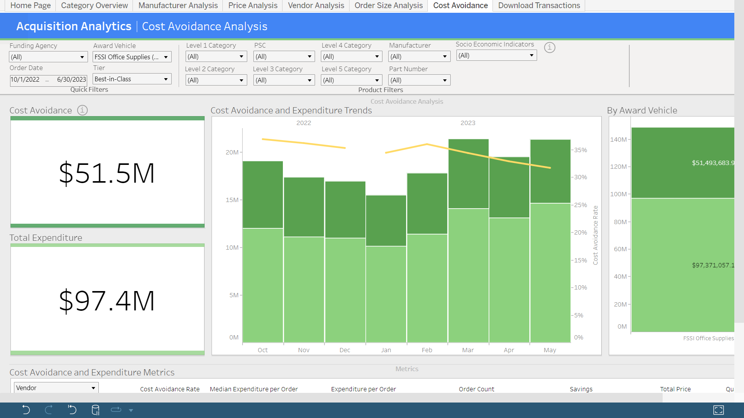
OS4 Sales FY23 through 5/31/23

Slide 11
How to Submit an Offer for OS4
You will need to access the new consolidated MAS schedule. Link is below:
https://sam.gov/opp/b9cd986b393b4e99b12f55568468f459/view
From there you would go to the Office Management category:
https://sws.gsa.gov/sws-search/viewSolDocument.do?method=view&solNum=NDdRU01EMjBSMDAwMQ==&solRefresh=MDAxNw==&solDoc=MDkwMDI5YjQ4YWE5YzJlZQ==
Page 22 of the PDF doc there starts the OS4 SINs.

Slide 12
How to Submit an Offer for OS4
Then go to the link for the mandatory OS4 requirements: http://www.gsa.gov/mascategoryrequirements
All vendors must complete the Letter of Compliance for SIN 339940OS4 (located at www.gsa.gov/mascategoryrequirements) in order to certify their understanding of the requirements under this SIN.

Slide 13
How to Submit an Offer for OS4
Access the category specific requirements for Office Management. Under the Office Supplies SubcategoryOS4 information is highlighted below.
Office Supplies Subcategory
SIN 339940 --- Office Products
Review, complete, and submit the Letter of Compliance for SIN 339940 [PDF - 411 KB].
OS4 SINs 339940OS4 Office Products and Supplies and 339940OVER Overseas Office Products and Supplies
Letter of Compliance [PDF - 216 KB] - Offers proposing products under OS4 must ensure they have met all of the requirements outlined in this document.
OS4 Business Rules [PDF - 120 KB]
OS4 Rules for Offer and Modification Submittal [PDF - 86 KB]

Slide 14
GSA eLibrary

Slide 15
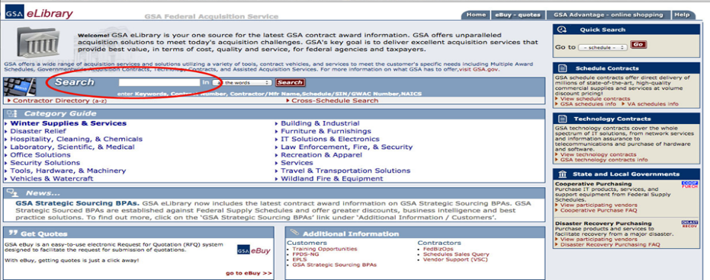
Within GSA eLibrary
www.gsaelibrary.gsa.gov on your internet browser.
Type “OS4” into the search bar.

Slide 16
SINs Under Category

Slide 17
GSA eBuy
Customers can use GSA eBuy to post RFQs (Request for Quotes) for FSSI OS4.
GSA eBuy is an online Request for Quote (RFQ) tool. Buyers may prepare and post RFQs for specific supplies.
When searching GSA eBuy, search “OS4” instead of
“Office Supplies.”
For orders over the micro-purchase threshold

Slide 18
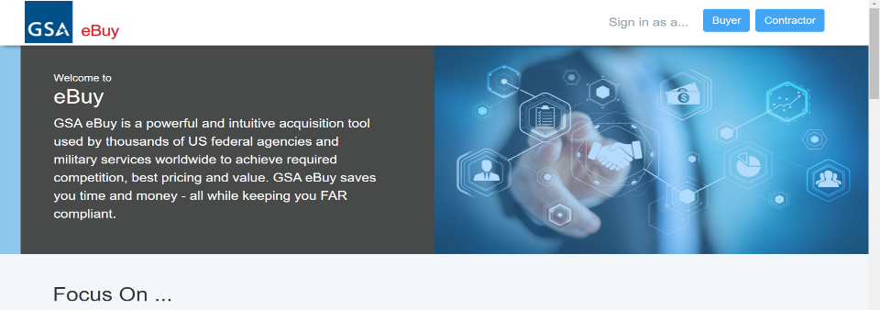
eBuy Login
Select “Buyer” at the top right

Slide 19
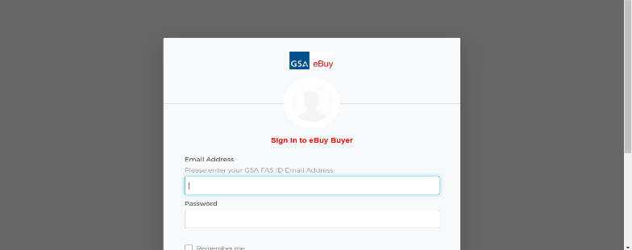
eBuy Login
Customers enter their GSA Advantage!® ID and Password to log in

Slide 20
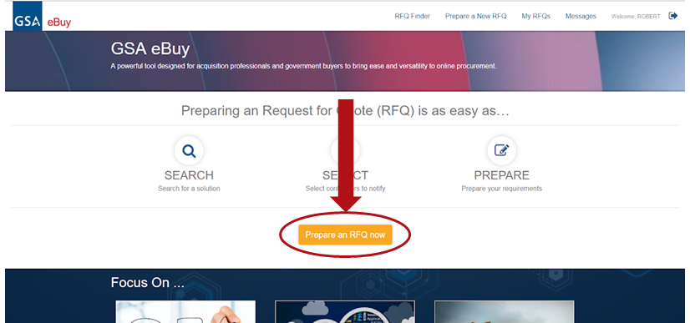
eBuy Search
Click “Prepare RFQ now”
Click “Prepare an RFQ now”

Slide 21
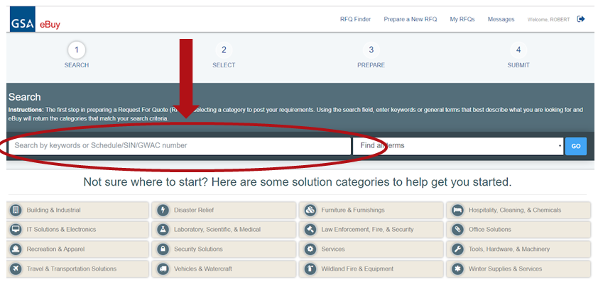
eBuy Search
Type “OS4” into the eBuy Search Bar

Slide 22
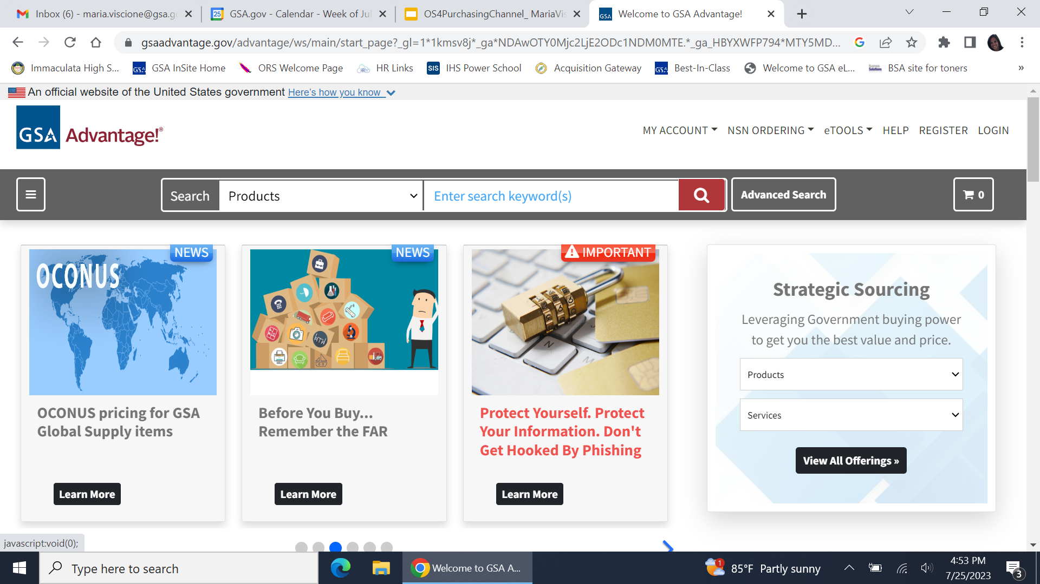
GSA Advantage!® Online
https://www.gsaadvantage.gov

Slide 23
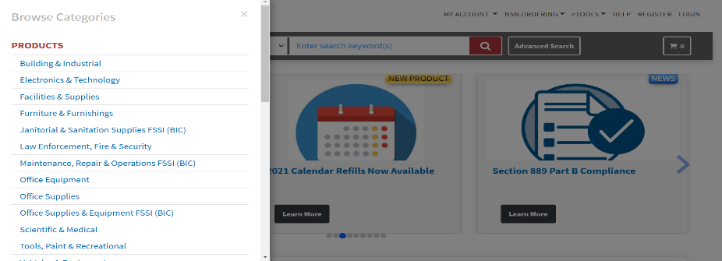
Customers Can Access the FSSI Office Supply Items
Hover your mouse over Products; click on “Office Supplies & Equipment FSSI (BIC)”

Slide 24
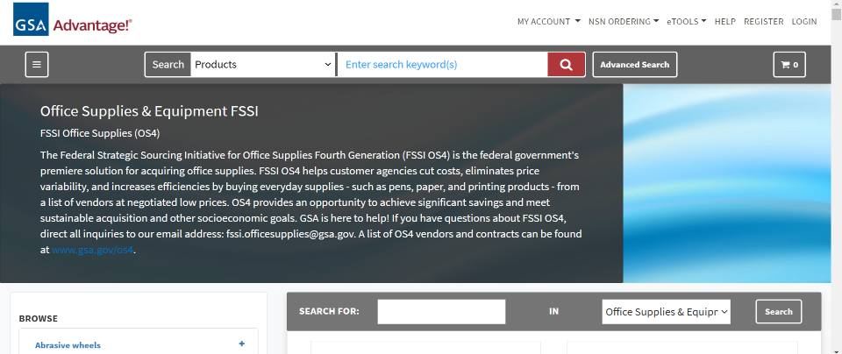
FSSI Office Supplies (OS4)

Slide 25
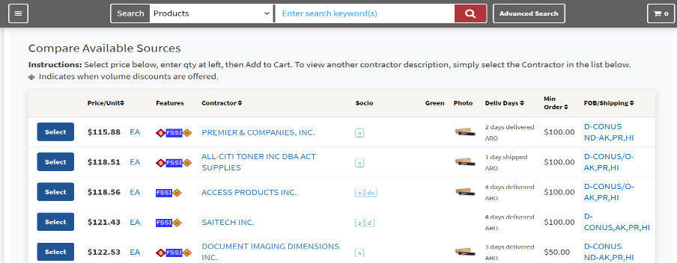
BLUE “FSSI” Icon!!

Slide 26
New Vendor Orientation
Once you have been awarded an MAS contract, the R2 Office of Customer and Stakeholder Engagement (CASE) Group conducts New Vendor Orientation webinars.
Topics will include:
Meet your Business Development (BD) Team
MAS Contract aspects/requirements (101 level)
Making the best use of your contract
Tools/Resources
Discussion
The R2 BD team will be provide vendor support and vendor training.

Slide 27
New Vendor Orientation
Other Topics Covered:
Contract Sales Reporting
Sales Criteria
Compliance - such as Trade Agreements Act (TAA)
MAS Buying Procedures
Visibility to Customers
Types of Contract Modifications
Market Research
GSA Customer Service Directors (CSDs)
Contractor Teaming Arrangements
Additional Training and Resources/Points of Contact

Slide 28
Information Sources
https://www.gsa.gov/buying-selling/purchasing-programs/gsa-schedules
Overview of GSA Schedules Program
https://www.gsa.gov/buying-selling/purchasing-programs/gsa-schedules/gsa-schedule-offerings/mas-categories/office-management-category
Office Management Category under Schedules Program
http://www.gsa.gov/os4
Links to information on OS4 Program
http://www.gsa.gov/csd
Find your local GSA Customer Service Director

Slide 29
Thank You!
From the GSA OS4 Program Team
Feel free to contact us!
FSSI.OfficeSupplies@GSA.GOV
Maria Viscione
maria.viscione@gsa.gov

Slide 30
GSA

