Slide 1
DOING BUSINESS WITH GSA
The Office of Small Business (OSB) | June 16, 2026
Notes:
Please ** MAKE COPY TO EDIT**

Slide 2
TOPICS
OSB Overview
Accessing Federal Contract Opportunities
Forecasting of Contracting Opportunities
Small Business Resources

Slide 3

Agency Overview
Office of Small Business (OSB)
https://www.gsa.gov/small-business
According to the Small Business Act as amended by Public Law 95-507, the Office of Small & Disadvantaged Business was established to:
  Advocate, within each Federal Executive Agency, for the maximum practicable use of all designated small business categories within the Federal Acquisition process.
  Ensure inclusion of small businesses as sources for goods and services in federal acquisitions as prime contractors and subcontractors.
  Manage the small business utilization programs for each respective organization.
Notes:
The Office of Small Business (OSB), was established by the Small Business Act.
OSB is responsible for administering, implementing, and coordinating our small business programs. OSB provides guidance and advice, as appropriate, to contracting activities and serves as a liaison between the small business community and contracting activities.

Slide 4

Agency Overview (Cont.)
Office of Small Business (OSB)
For GSA Small Business Support, please reach out to your local small business advocate. https://www.gsa.gov/about-us/contact-us/small-business-support

Slide 5
Agency Overview (Cont..)
Public Buildings Service (PBS)
As the landlord for the civilian federal government, PBS acquires space on behalf of the federal government through new construction and leasing, and acts as a caretaker for federal properties across the country.
PBS owns or leases 8,800 assets, maintains an inventory of more than 370 million square feet of workspace, and preserves more than 500 historic properties.
What does PBS Procure?
Construction A&E Services Janitorial Landscape Interior Design Painting HVAC Lighting Security Window Washing Electrical Lease
Where are the PBS Opportunities?
GSA Forecast
GSA Subcontracting
Sam.gov
GSA Multiple Award Schedules (MAS)
Indefinite Delivery Indefinite Quantities (IDIQ)
www.gsa.gov/pbs

Slide 6
Agency Overview (Cont...)
Federal Acquisition Services (FAS)
GSA is America's only source solely dedicated to procuring goods and services for government.
As an integral part of GSA, FAS possesses unrivaled capability to deliver comprehensive products and services across government at the best value possible
What does FAS Procure?
Environmental Moving Services Information Technology Transportation
Furniture Law Enforcement Equipment Professional Training
Telecom & Network Services Travel Services Staffing Services
Emergency Preparedness & Response Equipment…
Where are the FAS Opportunities?
GSA Forecast
GSA Subcontracting
SAM.gov
GSA Multiple Award Schedules (MAS)
Indefinite Delivery Indefinite Quantities (IDIQ)
Governmentwide Acquisition Contracts (GWAC)
https://www.gsa.gov/fas
www.gsaauctions.gov

Slide 7

Agency Overview (Cont….)
Office of Small Business (OSB)
Who are GSA’s Customers?

Slide 8

Federal Obligations by Awarding Agency
Rank | Awarding Agency | Obligations | Share of Top 25 Total
1 | Department of Health and Human Services | $3.390T | 40.3%
2 | Social Security Administration | $2.612T | 31.0%
3 | Department of Defense | $642.8B | 7.6%
4 | Department of Veterans Affairs | $464.8B | 5.5%
5 | Department of Agriculture | $297.7B | 3.5%
6 | Department of Transportation | $194.3B | 2.3%
7 | Department of Education | $150.2B | 1.8%
8 | Department of Housing and Urban Development | $137.3B | 1.6%
9 | Department of Homeland Security | $136.2B | 1.6%
10 | Department of Energy | $122.4B | 1.5%
11 | General Services Administration | $38.0B | 0.5%
Notes:
FY 25 & FY26
The top 10 agencies account for approximately 96.9% of obligations among the top 25 agencies.
GSA ranks 11th, with approximately $38.0 billion in obligations, representing about 0.5% of the top 25 total.

Slide 9
Federal Obligations by Awarding Agency (Cont)
Federal Obligations by Awarding Agency
Agency Group | Obligations | Share of Top 25 Total
HHS and SSA | $6.002T | 71.3%
Agencies ranked 3–5 | $1.405T | 16.7%
Agencies ranked 6–10 | $740.4B | 8.8%
GSA, ranked 11th | $38.0B | 0.5%
Other agencies ranked 12–25 | $227.0B | 2.7%
Notes:
The top 25 agencies account for approximately $8.413 trillion in obligations. The largest obligations are concentrated in HHS and SSA, which together account for more than 70% of the total. GSA appears just outside the top 10, ranking 11th with $38.0 billion in obligations.
The top 10 agencies account for approximately 96.9% of obligations among the top 25 agencies.
GSA ranks 11th, with approximately $38.0 billion in obligations, representing about 0.5% of the top 25 total.

Slide 10
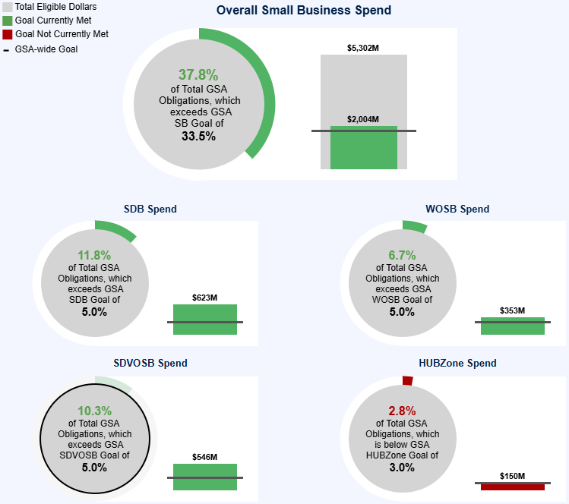
GSA Small Business Achievement

Slide 11



Encouraging the Use of Small Businesses
RFO and Small Business
For Contracts: Rule of Two
For Orders: Discretionary
Applies when 2+ small businesses can provide supplies/services above the MPT.
Required by statute between the micro-purchase threshold (MPT) and the Simplified Acquisition Threshold (SAT).
The FAR Council retained the rule above the SAT as essential to sound procurement.
FAR Part 19 reaffirms that the rule of two does not apply to orders under multiple-award contracts.
Contracting officers may, at their discretion, set aside orders.
The decision to set-aside (or not) is an exercise of discretion and not a basis for a protest.
Notes:
The RFO reinforces that it is the Government’s policy to provide maximum practicable opportunities in its acquisitions to small business, 8(a) participants, and other small business socioeconomic categories (i.e. veteran-owned small business, service-disabled veteran-owned small business, HUBZone small business, small disadvantaged business, and women-owned small business concerns).

Slide 12
Encouraging the Use of Small Businesses (Cont)
Encouraging the Use of Small Businesses
RFO and Small Business
Small Business Set-Aside & Program Authorities
General Mandate
Set aside contracts valued above MPT for small businesses in certain circumstances. (Ref: 19.104)
Program Access
HUBZone Program (19.105)
SDVOSB Program (19.106)
WOSB Program (19.107)
8(a) Program (19.108)
Order Strategy
Set aside task/delivery orders (19.111-2) or use reserves on multiple-award contracts.
Preferences
HUBZone price evaluation preference in full and open competitions (19.110).
CORE MANDATE
SOCIO-ECONOMIC
ORDER FLEXIBILITY
PREFERENCES
Notes:
Contracting officers must set aside contracts valued at more than the micro-purchase threshold for small businesses
in certain circumstances which are:
there is a reasonable expectation of obtaining offers from two or more responsible small business concerns; and
2. That are competitive in terms of fair market prices, quality, and delivery.
The contracting officer must document the reason when a contract is not set aside for small business as required

Slide 13


Encouraging the Use of Small Businesses (Cont.)
Encouraging the Use of Small Businesses
RFO and Small Business
Competing 8(a) Orders
Automatic Release from 8(a)
Applicable Order Types:
Delivery Orders, Task Orders, Purchase Orders, and BPA Calls
Requirement:
When an acquisition is below the competitive threshold, COs must first attempt a competitive 8(a) order.
Process:
Use SBA-approved gov-wide contracts
Must try competitive before sole source
The Condition:
A requirement is automatically released if the follow-on acquisition is set aside for other programs.
Qualifying Programs:
HUBZone Programs
SDVOSB Programs
WOSB Programs
Notes:
Socio economic set-asides are retained in the RFO.
Contracting officers may set aside or sole source contracts under the HUBZone Program. See 19.105.
Contracting officers may set aside or sole source contracts under the SDVOSB Program. See 19.106.
Contracting officers may set aside or sole source contracts under the WOSB Program. See 19.107.
Contracting officers may set aside or sole source contracts under the 8(a) Program. See 19.108.
Contracting officers may set aside task orders or delivery orders. See 19.111-2.
Contracting officers must require a small business subcontracting plan in certain acquisitions. See 19.109 and
19.302-1.
Contracting officers must use a HUBZone price evaluation preference in full and open competitions. See 19.110.
Contracting officers may use reserves on multiple-award contracts for any of the small business concerns identified

Slide 14

Encouraging the Use of Small Businesses (Cont..)
Encouraging the Use of Small Businesses
Per FAR 19.202-1, the Contracting Officer shall:
divide acquisitions of supplies and services
plan acquisitions so more than one small business concern may perform
ensure delivery schedules are realistic
encourage prime contractors to subcontract with small businesses
provide a copy of the acquisition package to the Small Business Administration (SBA) Procurement Center Representative (PCR)
……what else can COs use to encourage the use of small businesses?
Notes:
Revolutionary FAR Overhaul (RFO)
Small business concerns shall be afforded an equitable opportunity to compete for all contracts that they can perform to the extent consistent with the Government’s interest.

Slide 15
Encouraging the Use of Small Businesses
(Cont…)
Encouraging the Use of Small Businesses
Per FAR 19.202-1, the Contracting Officer shall:
divide acquisitions of supplies and services
plan acquisitions so more than one small business concern may perform
ensure delivery schedules are realistic
encourage prime contractors to subcontract with small businesses
provide a copy of the acquisition package to the Small Business Administration (SBA) Procurement Center Representative (PCR)
……what else can COs use to encourage the use of small businesses?
Notes:
Revolutionary FAR Overhaul (RFO)
Small business concerns shall be afforded an equitable opportunity to compete for all contracts that they can perform to the extent consistent with the Government’s interest.

Slide 16
Encouraging the Use of Small Businesses
(Cont….)
Encouraging the Use of Small Businesses
SB Participation Plan Evaluation Factor
Used to ensure firms receiving a Government contract will utilize small businesses in performance of the contract
Emphasis is on prime contractor including small businesses in proposal development and ultimately subcontracting
Used when acquisition not set-aside for small business
Shall be used if bundling & consolidation applies
Notes:
Revolutionary FAR Overhaul (RFO)
Small business concerns shall be afforded an equitable opportunity to compete for all contracts that they can perform to the extent consistent with the Government’s interest.

Slide 17
ACCESSING FEDERAL CONTRACT OPPORTUNITIES
System for Award Management (SAM)
Register Here. It’s Free
www.sam.gov
Unique Entity Identifier (UEI)
Assigned through SAM.GOV registration
www.gsa.gov/entityid
Small Business Administration (SBA)
Business Categories
www.sba.gov/.../contracting-assistance-programs
NAICS Industry Codes
Identify your NAICS
www.census.gov/naics
Size Standards
Determine your size of business
www.sba.gov/.../size-standards

Slide 18
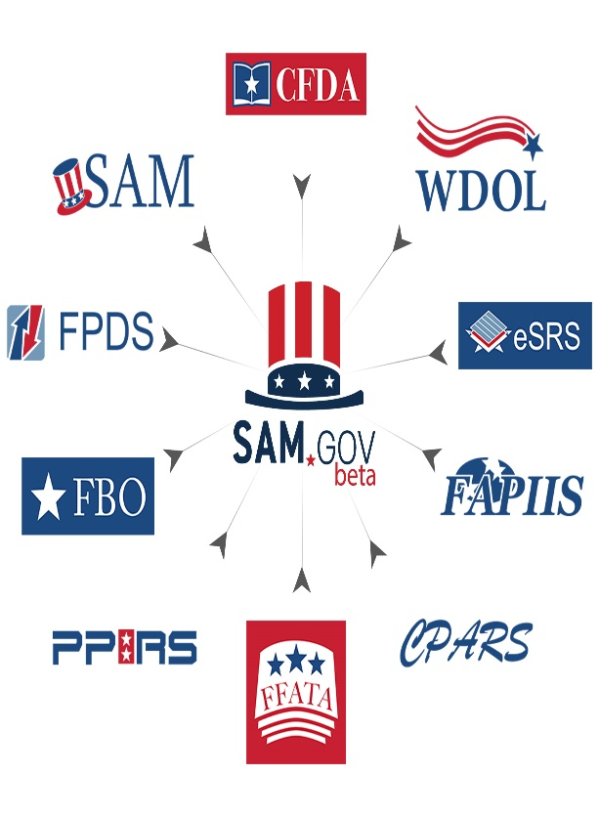
ACCESSING FEDERAL CONTRACT OPPORTUNITIES (CONT.)
SAM.Gov includes the following:
Contract Opportunities: (Formerly fbo.gov)
Contract Data: (Reports only: from fpds.gov)
Wage Determinations: (Formerly wdol.gov)
Entity Registration: (Combined with the former beta.sam.gov)
Entity Reporting
Assistance Listings: (Formerly cfda.gov)

Slide 19

ACCESSING FEDERAL CONTRACT OPPORTUNITIES (CONT..)
ACCESSING FEDERAL CONTRACT
OPPORTUNITIES (CONT.)
Learn about potential contracting opportunities early in the acquisition process.
Plan your marketing strategies before opportunities post in the System for Award Management (SAM) and eBuy.
Be more effective in business development & planning.
Use the lead time to prepare for the nature and scope of potential procurement opportunities.
Notes:
Today we want to get your feedback on the Forecast of Contracting Opportunities Tool.
The tool provides early visibility into upcoming federal contracting opportunities before they are posted for solicitation. The goal is to help small businesses plan ahead and target the right work.
The tool brings forecast information from multiple agencies into one place and is available at acquisitiongateway.gov/forecast.
We want to hear whether you use the tool, how you use it, and how it can be improved.

Slide 20
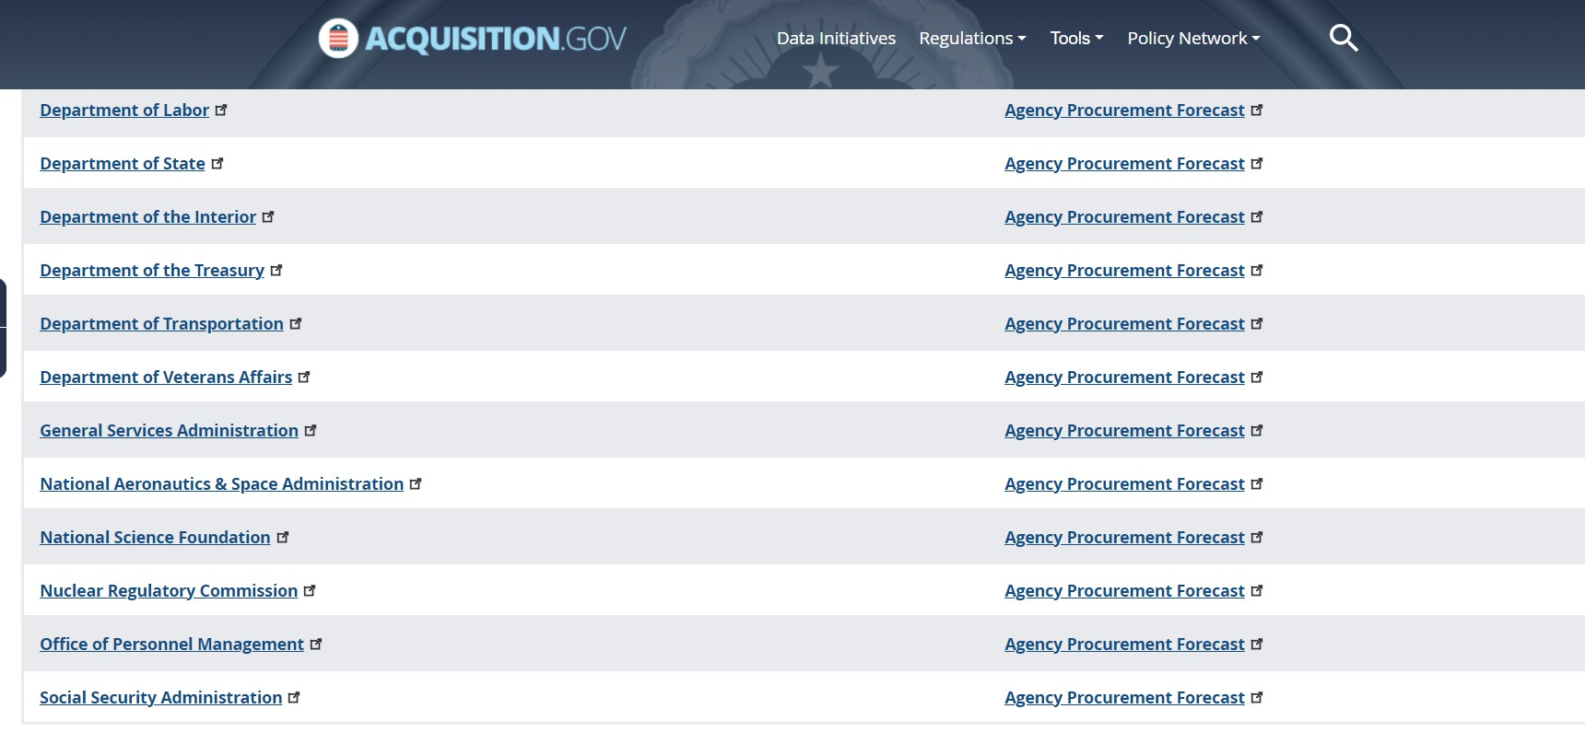
Accessing Federal Contract Opportunities (Cont…)
ACCESSING FEDERAL CONTRACT OPPORTUNITIES (CONT.)
How to Access the Forecast Tool:
Background:
Focuses on acquisition planning and increases awareness of potential prime and subcontracting opportunities.
The goal is to help both GSA buyers and vendors easily communicate around potential contracting opportunities.
The tool includes information for 12 Federal Agencies, including (GSA, DOI, DOL, SBA, OPM, VA, DOC, SSA, HHS, NRC, FCC, DOT)
Forecast Website Access:
  https://acquisitiongateway.gov/forecast
  https://www.fbf.gov
  https://www.acquisition.gov/procurement-forecasts

Slide 21

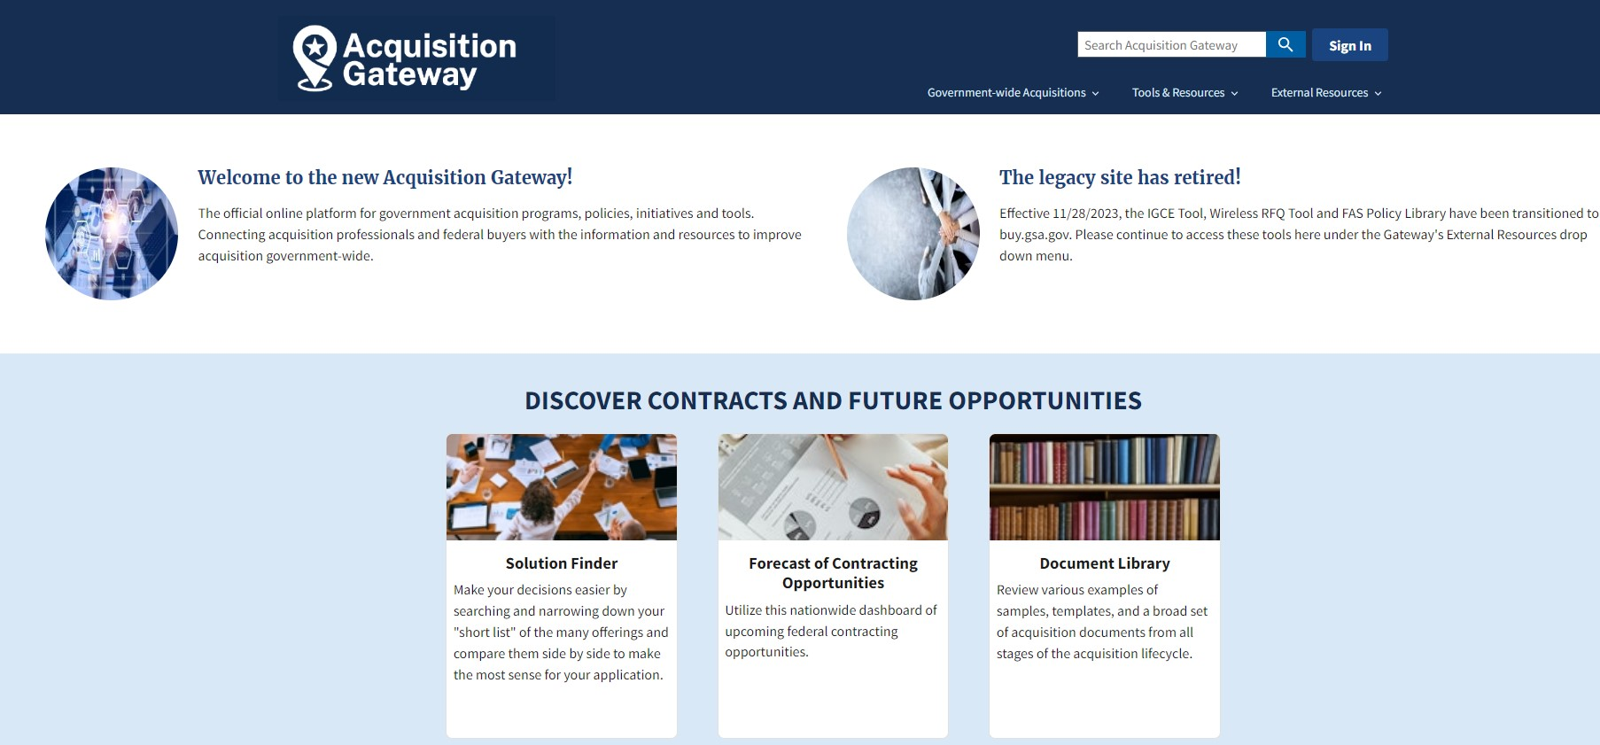

Accessing Federal Contract Opportunities (Cont….)
ACCESSING FEDERAL CONTRACT OPPORTUNITIES (CONT.)
  https://acquisitiongateway.gov/

Slide 22




Accessing Federal Contract Opportunities (Cont…..)
ACCESSING FEDERAL CONTRACT OPPORTUNITIES (CONT.)
GSA GOVERNMENTWIDE ACQUISITION CONTRACTS (GWAC): www.gsa.gov/gwac
Alliant 2: GWAC represents the next generation GWAC vehicle for comprehensive information technology (IT) solutions through customizable hardware, software, and services solutions purchased as a total package. Small business governmentwide acquisition contract for acquiring customized information technology services and IT services-based solutions. | Alliant 3: GSA’s next-generation Governmentwide Acquisition Contract for information technology services
Largest governmentwide, multi-agency contract program that provides professional services via six indefinite delivery, indefinite quantity, or IDIQ, contracts
gsa.gov/oasis-plus
Notes:
Alliant 2 - offers worldwide coverage and a full range of comprehensive IT services-based solutions in standard and non-standard IT labor categories including artificial intelligence, distributed ledger technology, robotic process automation, and other emerging technologies.
Alliant 3 - GSA’s next-generation governmentwide acquisition contract (GWAC) for IT services. Learn how Alliant 3 expands flexibility for agencies and supports emerging technologies such as Artificial Intelligence, Blockchain, and Robotic Process Automation.
Polaris is a small business governmentwide acquisition contract for acquiring customized information technology services and IT services-based solutions. Polaris has four unique set aside pools:
Small Business
Women-Owned Small Business (task orders may be issued)
HUBZone Business (task orders may be issued)
Service-Disabled Veteran-Owned Small Business (task orders may be issued)
OASIS+ GSA launched OASIS+ Phase II, a major expansion of our next-generation government-wide contract program. This new phase ensures the program's compliance with Executive Order 14240, "Eliminating Waste and Saving Taxpayer Dollars by Consolidating Procurement," dated March 20, 2025. Phase II will introduce five new service domains across all six OASIS+ solicitations for a total of 13 domains combined.

Slide 23
SMALL BUSINESS
RESOURCES
OSB Training and Counseling | Training and counseling on Doing Business with GSA gsa.gov events page
SMALL BUSINESS FIRST FRIDAYS Monthly OSB National Training (MONT) 1:1 Counseling | Join us for OSB’s Small Business First Fridays training - This webinar covers basic aspects of navigating the federal sector. Targeted training to industry on specific topics to deepen understanding of federal acquisition strategies. Ccounseling from Small Business Technical Advisors contact an OSB small business specialist.

Slide 24
Small Business Resources (Cont..)
SMALL BUSINESS
RESOURCES
APEX Accelerators (Formerly known as Procurement Technical Assistance Center- PTAC) | Training and counseling on Marketing, Financial, and Contracting https://www.apexaccelerators.us/
Small Business Administration (SBA) | Procurement Center Representatives (PCRs) - https://www.sba.gov/contracting/resources-small-businesses/pcr-directory SBA Business Development Centers – https://www.sba.gov/tools/local-assistance/sbdc Get free and confidential mentoring by former CEOs through SCORE - https://www.score.org

Slide 25
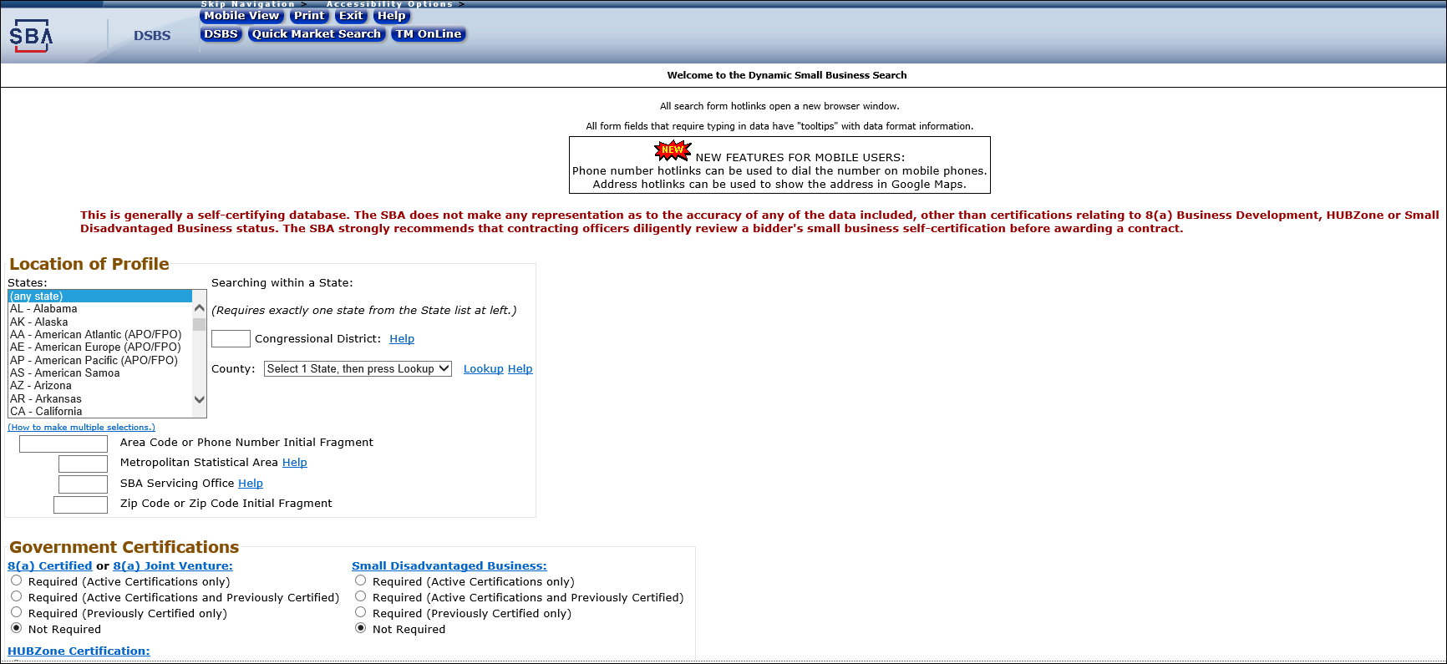

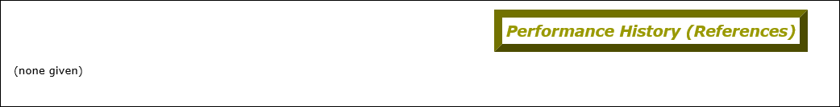
Small Business Resources (Cont…)
SMALL BUSINESS
RESOURCES (Cont.)

Slide 26
Small Business Resources (Cont….)
SMALL BUSINESS
RESOURCES (Cont.)
GSA Small Business Support
Name | Phone | Email | Region
Anthony Caruso Small Business Specialist | 213-200-0946 | Anthony.caruso@gsa.gov | CA, NV, AZ, HI
Jemeek Morris Small Business Specialist | 917-969-7963 | Jemeek.Morris@gsa.gov | Northern NJ, NY, PR, USVI
Alex Stutzman Small Business Specialist | 253-753-6745 | Alexander.Stutzman@gsa.gov | AK, ID, OR, WA
Kimberly Hutchinson Small Business Specialist | 312-353-1889 | Kimberly.hutchinson@gsa.gov | IL, IN, MI, MN, OH, WI
Carolina Vargas Small Business Specialist | 913-415-8309 | Carolina.Vargas@gsa.gov | KS, MO, NE, IA
Sean Murphy Small Business Specialist | 202-336-2482 | Sean.Murphy@gsa.gov | Washinton DC area including parts of MD and VA.
Albert Garza Small Business Specialist | 817-978-2828 | Albert.Garza@gsa.gov | AR, LA, NM, OK, TX
Major George, Jr. Small Business Specialist | 404-215-6740 | Major.george@gsa.gov | AL, FL, GA, KY, MS, NC, SC, TN
https://www.gsa.gov/small-business/small-business-resources/contact-information-for-small-business-support

Slide 27
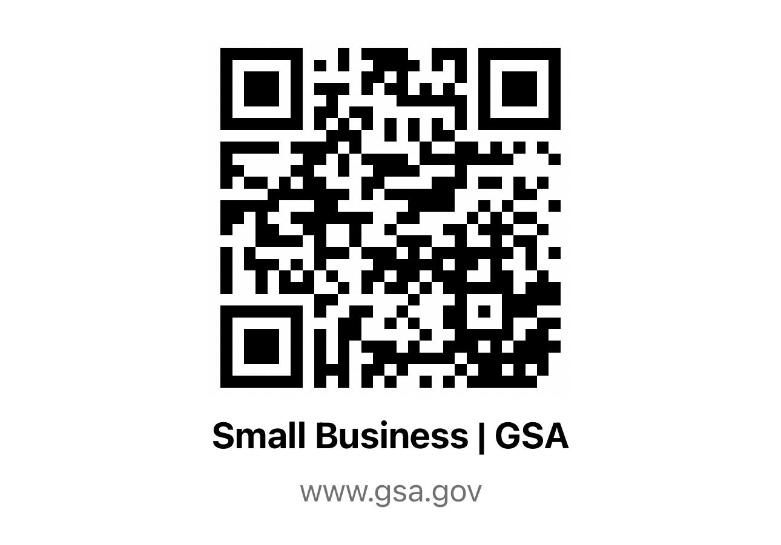
VISIT OUR
GSA SMALL BUSINESS WEBSITE
Paula Mensah
Supervisory Small Business Advisor
Office of Small Business (OSB)
PaulaL.Mensah@gsa.gov
Chasity Ash
Supervisory Small Business Advisor
Office of Small Business (OSB)
chasity.ash@gsa.gov

Slide 28
Thank You.

