Slide 1
OneGov Welcome Slide
OneGov Strategy
One government.
One strategy.
Smarter buying.
Federal Acquisition Service
Office of IT Category
April 14, 2026

Slide 2


Meet your Speakers
Jeremy Wustner-Brown
Jaime Martinez
Branch Chief,
Stakeholder Engagement
Office of Information
Technology Category
Division Director,
Acquisition
Office of Information
Technology Category
Notes:
I’m joined today by the real expert. Jaime Martinez, Division Director for Acquisition.

Slide 3
Agenda
Overview of OneGov - What it is and why it matters
What We’re Seeing in Practice - Agency examples and early outcomes
How It Works - OEM engagement, prioritization, and MAS delivery
Results and Current Portfolio - Savings, active agreements, and solution areas
What’s Next - Scaling the model and how to engage
Notes:
I’ll start with a quick overview of the OneGov Strategy—what it is and why we’re taking this approach.
Then I’ll walk through what we’re seeing in practice, including examples of how agencies are already using this model.
From there, I’ll cover how it works—how we engage with OEMs, how we prioritize, and how the Multiple Award Schedule supports delivery.
I’ll also touch on what this means in terms of results, the types of solutions available today, and what we’re learning as we scale.
And finally, I’ll close with where we’re headed next and how you can engage.

Slide 4
OneGov Overview
Strategic Goals
Unify IT buying across agencies to reduce duplication and increase value.
Modernize acquisition models to reflect how commercial IT is delivered today.
Strengthen strategic partnerships with industry to foster innovation and accountability.
Standardize terms and performance expectations to improve security, transparency, and mission outcomes.
OneGov is GSA’s enterprise acquisition strategy focused on delivering greater value, security, and accountability for agencies.
Launched publicly on April 29, 2025, the initial focus areas include major software vendors. It aims to buy as one government, consolidating purchasing power to secure better pricing, stronger terms, and improved vendor performance.
Why OneGov Matters
Software licensing is fragmented and inefficient across government, OneGov addresses that with a coordinated, strategic approach.
Better terms mean cost savings, but also improved cybersecurity, stronger SLAs, and more direct lines of accountability with vendors.
Supports the PMA and President’s Executive Order (EO) 14240: Eliminating Waste and Saving Taxpayer Dollars by Consolidating Federal Contracting, to ensure Commercial, Cost-Effective Solutions in Federal Contracts.
Benefits
Billions in savings in FY26.
Visibility and accountability via direct OEM contracts.
Improved security, data protection, support, and response.
Improved efficiency and reduced administrative burden for agencies.
Notes:
At its core, the OneGov Strategy is GSA’s enterprise approach to how the federal government buys and manages common IT.
Today, many agencies are still buying the same products and services separately—with different pricing, different terms, and different levels of performance. That fragmentation limits visibility, creates inconsistency, and makes it harder to manage risk across the enterprise.
OneGov is designed to address that by bringing those efforts together—so we can approach the market more consistently, using shared data and coordinated demand.
This directly supports Executive Order 14240, which calls for reducing duplication, improving efficiency, and ensuring the government is getting cost-effective commercial solutions.
We started with enterprise software, where fragmentation was most visible, and we’re continuing to expand into areas like cloud, cybersecurity, and infrastructure.
This isn’t a new contract vehicle. It builds on the Multiple Award Schedule and focuses on how we engage—working more directly with OEMs to establish consistent pricing, terms, and expectations across government.
At a high level, that approach leads to more consistent outcomes—more predictable pricing, clearer accountability, stronger security expectations, and a simpler acquisition experience for agencies.

Slide 5
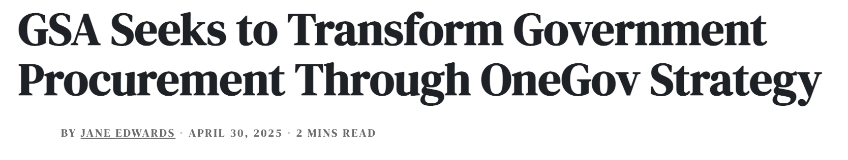
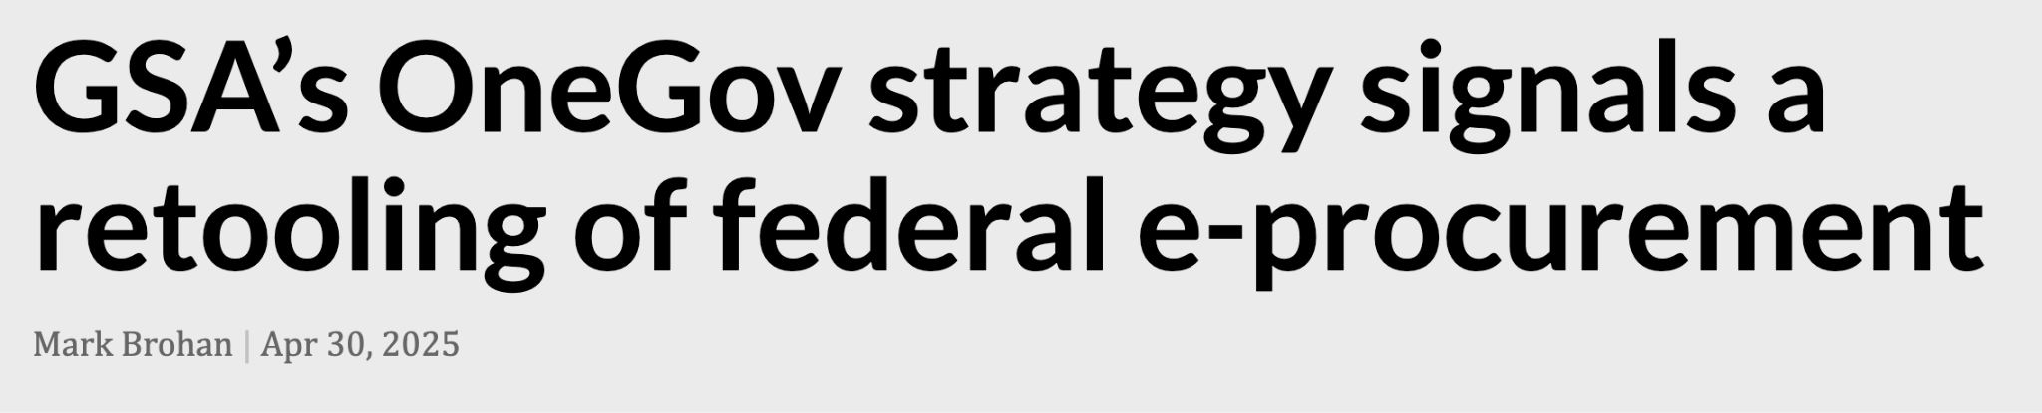
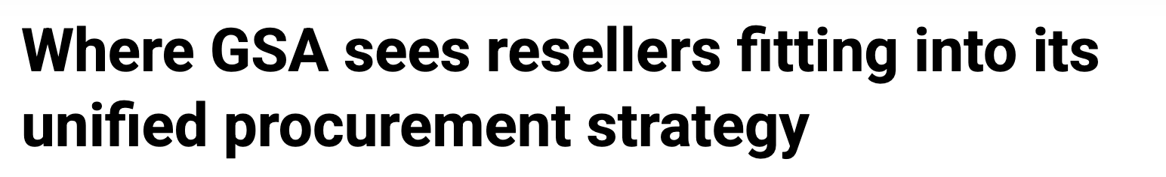
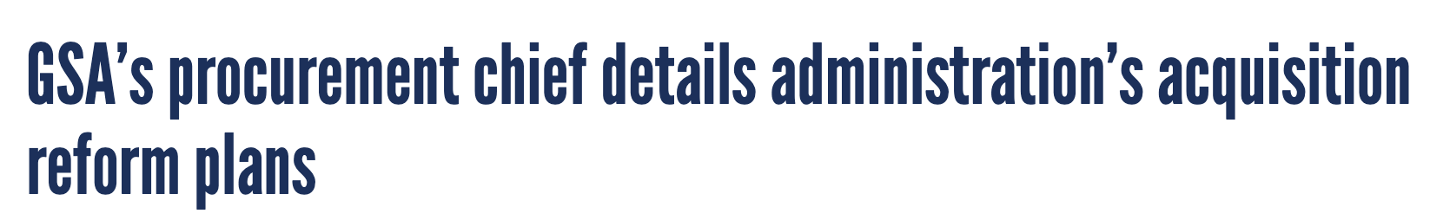
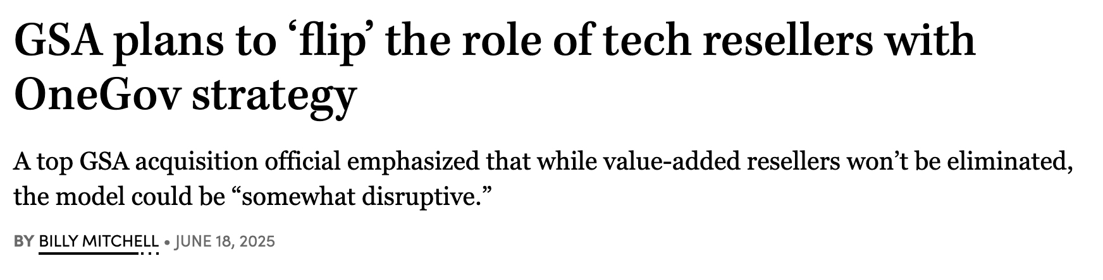
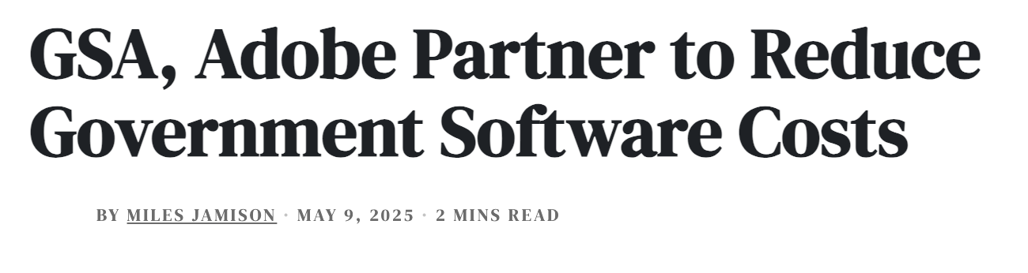
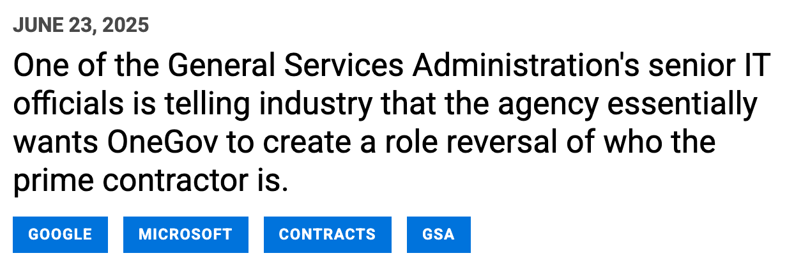
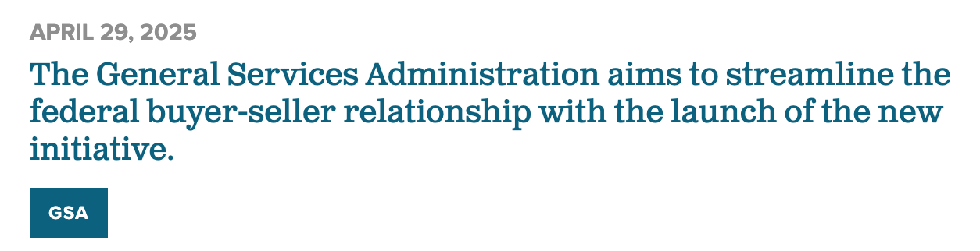
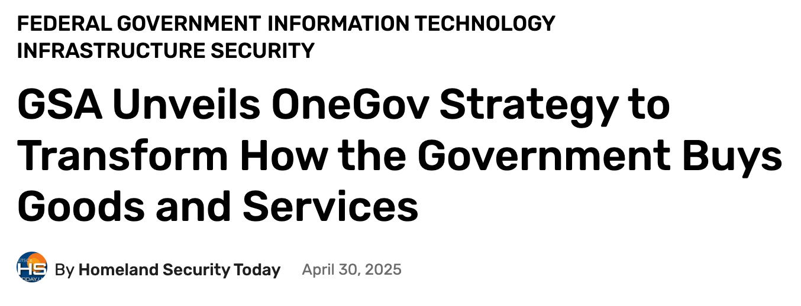
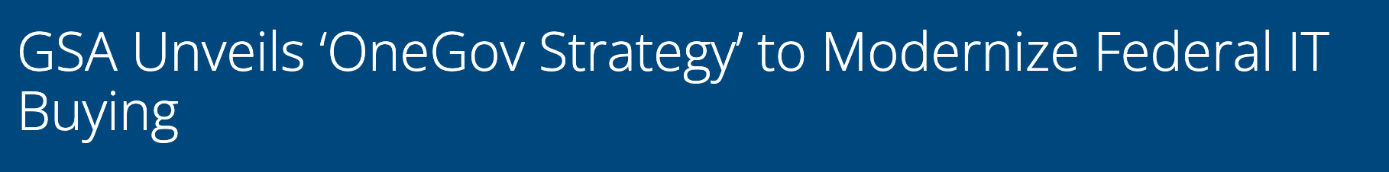
OneGov Strategy - In the news
Notes:
You’ve likely seen some of the recent coverage around OneGov.
We’re starting to see consistent attention across federal IT and acquisition communities—from trade press to agency forums.
What that tells us is that this approach is resonating. Agencies are looking for more coordinated ways to buy, and industry is engaging in that shift.
But more importantly, the attention is being driven by results.
So with that, let me show you what this looks like in practice.

Slide 6

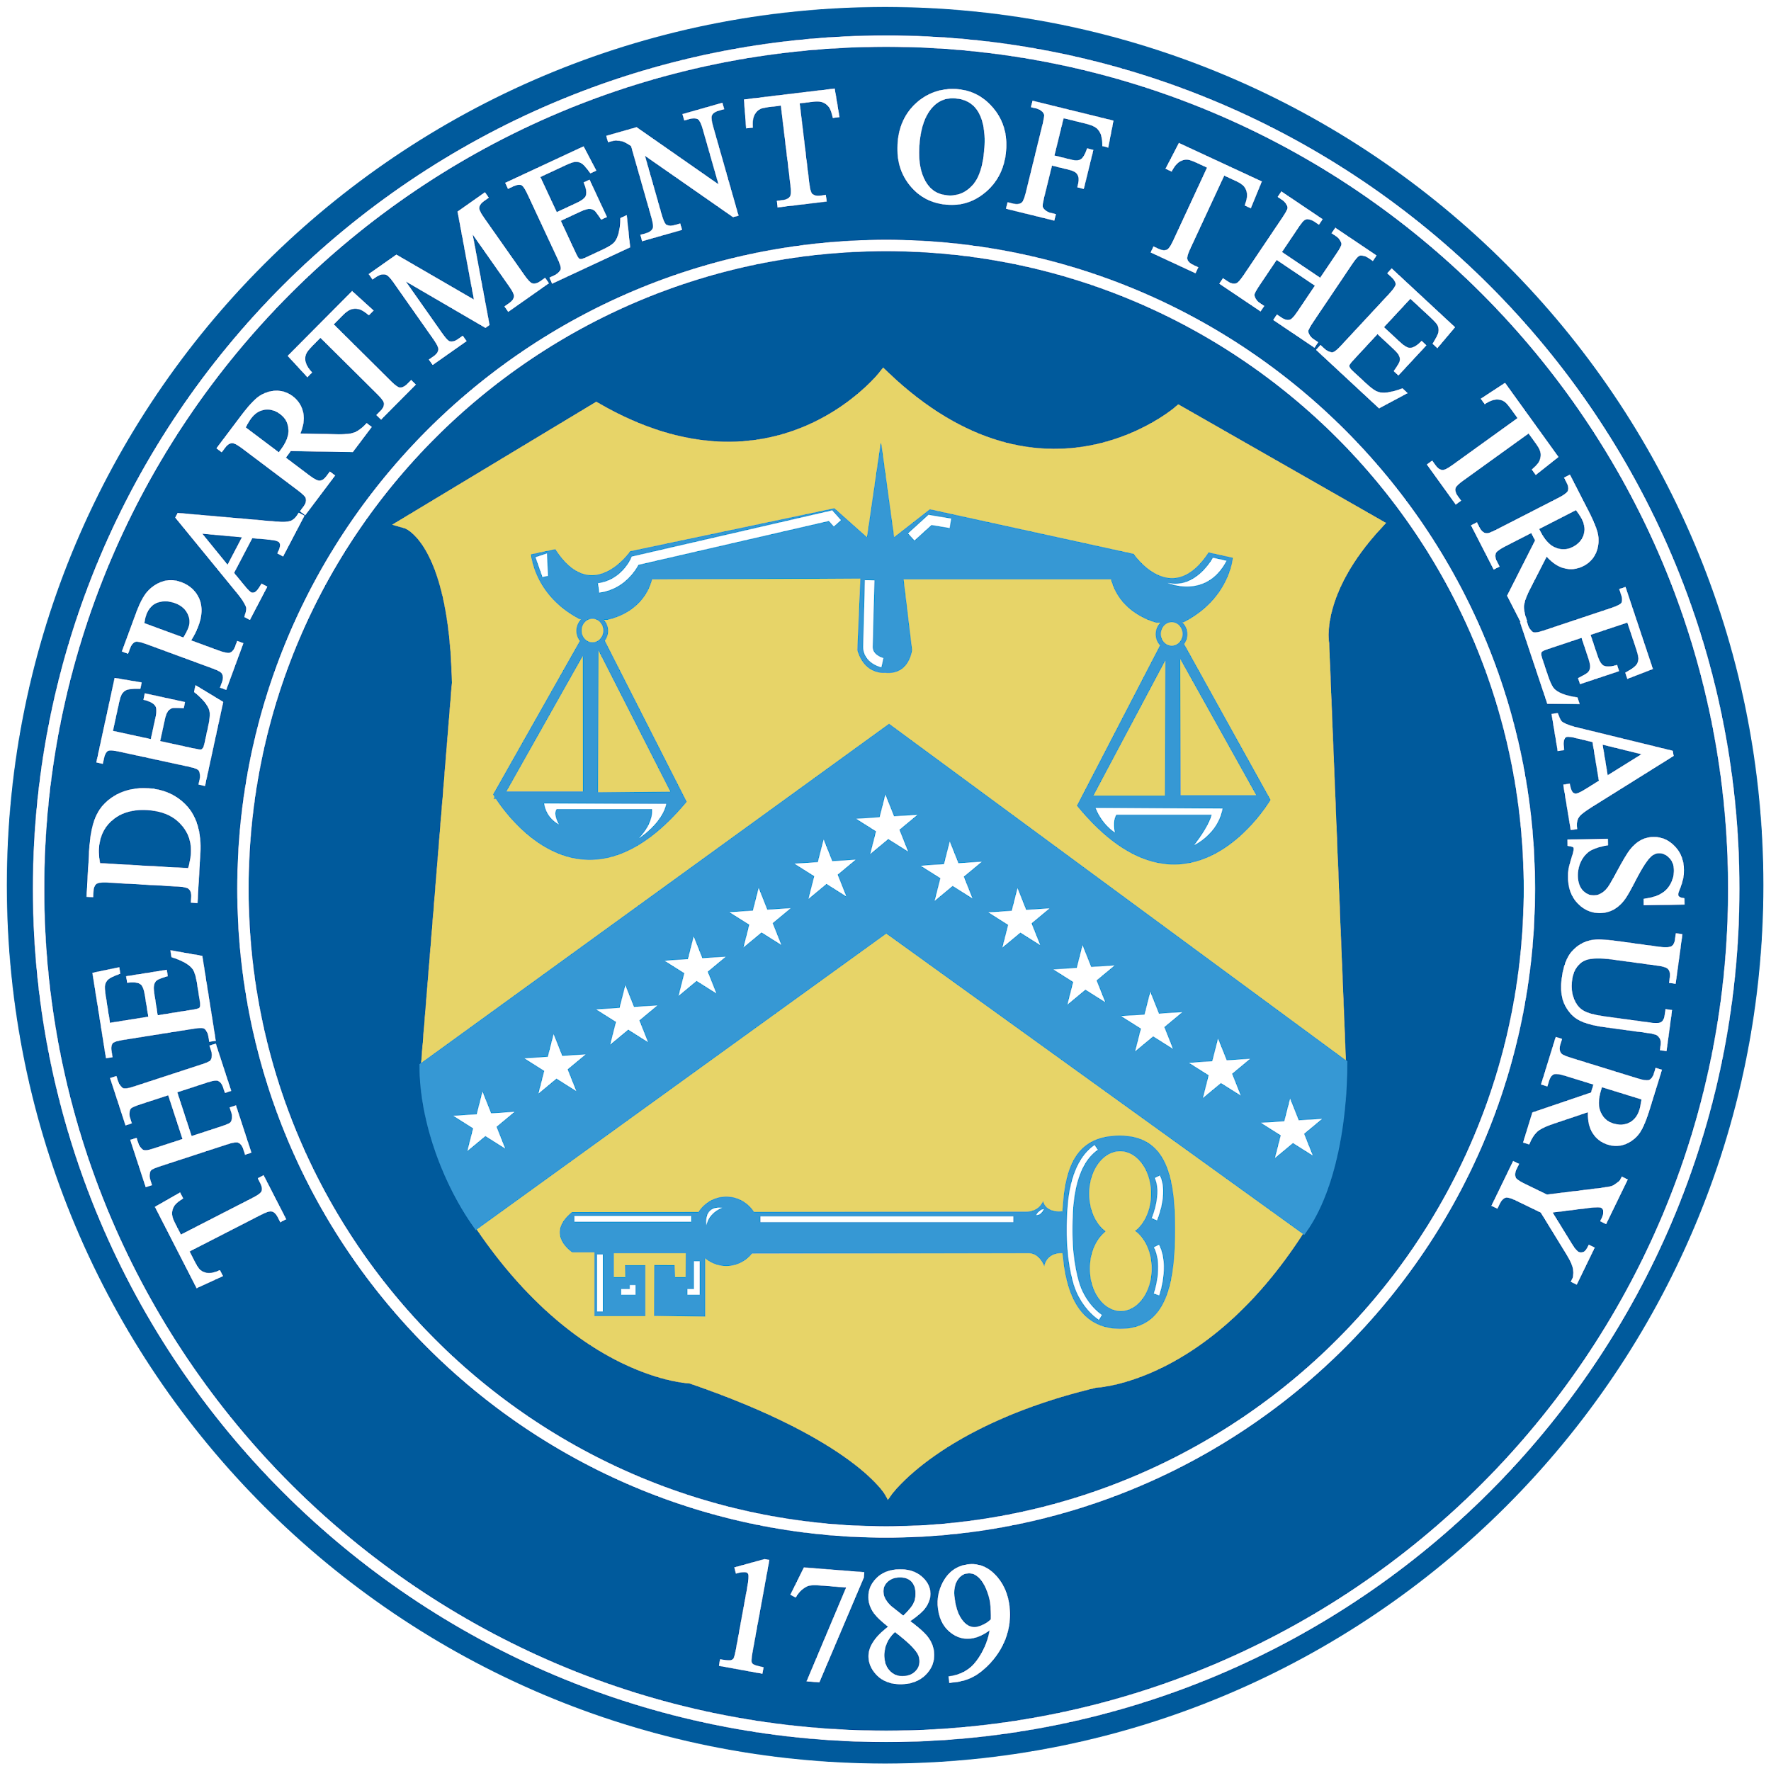

OneGov success stories
Centers for Medicare and Medicaid Services and Amazon Web Services (via GDIT)
With support from GDIT, CMS transitioned to the OneGov cloud acquisition model using Amazon Web Services.
New applications moved to the cloud in under 60 days, generating millions in taxpayer savings.
Savings are now reinvested into digital modernization for seniors and vulnerable populations.
Department of the Treasury + ID.me
Treasury partnered with GSA to establish a $1B+ BPA with ID.me for digital identity services.
The MAS IT team added ID.me to Schedule and awarded the task order in under 45 days.
This is a direct, permanent-pricing agreement—improving security, reducing duplication, and standardizing access across government.
Department of Transportation + Google Workspace
DOT used OneGov to award an $89M enterprise license for Google Workspace tools.
Initial users onboarded in just 22 days, with rollout expanding across its 50,000+ workforce.
The agreement simplified procurement terms and supports collaboration and IT modernization.
Notes:
The following examples show how OneGov is changing the way federal agencies buy and deliver.
These stories demonstrate faster buying, stronger pricing, and measurable mission impact.
Centers for Medicare & Medicaid Services + Amazon Web Services (via GDIT)
CMS needed to move fast. In under 60 days, they transitioned a number of applications to the cloud using the OneGov model.
GDIT supported the agreement with AWS, delivering significant taxpayer savings.
Those savings are now being reinvested in digital services for our senior citizens and vulnerable populations.
This shows how OneGov supports cloud adoption at speed and scale.
Department of the Treasury + ID.me
Treasury identified the need for scalable digital identity services.
Working with the MAS IT team and ID.me, they awarded a $1 billion BPA.
The MAS team added ID.me to Schedule directly and awarded the task order in under 45 days.
The deal established permanent pricing and eliminated repetitive negotiations.
It created a reusable, secure digital identity solution for broader government use.
Department of Transportation + Google Workspace
DOT used OneGov to secure an $89 million enterprise license for Google Workspace.
Initial onboarding happened in 22 days, with rollout expanding across more than 50,000 employees.
By leveraging government-wide demand, DOT received better pricing and simplified procurement terms.
These examples highlights collaboration and IT modernization at scale.

Slide 7
Four Pillars of the OneGov Strategy
01
02
03
04
Direct Contracting via MAS
Best Pricing
Full Catalog of Offerings
Verifiable Data
Notes:
As I begin, I want to provide some insight on what OneGov is and what we consider the pillars of our OneGov engagements with OEMs.
First, direct contracts with OEMs via the Multiple Award Schedule. Contracting directly with the OEM establishes a single catalog for the OEM products, rather than multiple versions being spread across numerous reseller versions. This improves accuracy, agility, and C-SCRM safety of the catalog. It ensures end-of-life products are removed timely from the supply chain and only genuine products are represented.
Second, pricing based on the buying power of the Government, not a discount of one but Government wide enterprise discount.
Third, a full catalog of offerings, if agencies need it we want to make sure it’s available on contract.
And finally, verifiable data to calculate cost savings.
These 4 pillars are what make a contractor part of OneGov and what we are looking to achieve with our OneGov industry engagements.

Slide 8
Direct Contract Vision
Privity of Contract - Single direct contract between GSA and OEM on the Multiple Award Schedule (MAS)
Reseller & Small Business Integration - Reseller, Integrator and Small Business support services built into the OEM catalog as subcontractors
Mandatory Use - Seeking OMB guidance for mandatory use for all federal agencies; single source for OEM's products and services
Price Reductions - Deep discounts from commercial pricing expected
Mature State - GSA will consolidate agency requirements and place orders on behalf of the government
Notes:
At a high level, where this model is heading is toward more direct relationships with OEMs.
Historically, agencies have often purchased through multiple layers—resellers, integrators, and other intermediaries—which can create variation in pricing, terms, and visibility.
Under OneGov, we’re working to establish more direct agreements with the OEMs who develop and support these products, using the Multiple Award Schedule as the foundation.
That allows us to set more consistent pricing and terms at the enterprise level, while also creating a clearer line of accountability for performance, security, and support.
At the same time, partners continue to play a critical role.
Resellers, integrators, and small businesses remain essential for implementation, integration, and mission support. The difference is that those roles are more clearly aligned within an OEM-led structure.
Over time, the goal is a more streamlined model—where agencies can access a full catalog of OEM offerings through a single, consistent framework, with pricing and terms established upfront.

Slide 9
Tiers and IT Focus
The OneGov initiative has adopted a tiered model to prioritize OEM engagement based on governmentwide impact, spend, and agency footprint. Starting with software and cloud providers with FedRAMP-authorized cloud solutions (excluding on-premise offerings), this structures engagement into four tiers that reflective of relative scale and reach across the federal enterprise
Tier 1
$500M in annual federal spend, a presence across all 24 CFO Act agencies
Tier 2
$200M–$500M in spend, 18+ CFO Act agencies
Tier 3
Tier 3: $50M–$200M in spend, 10+ CFO Act agencies
Tier 4
Tier 4: $10M–$50M in spend, 5+ CFO Act agencies
Notes:
The next piece of the OneGov framework is how we focus our efforts — what we call our tiered engagement model.
The federal IT marketplace is vast, and not every software provider has the same governmentwide footprint or strategic importance. The tiered model helps us prioritize where to engage first, ensuring our resources are concentrated where they can deliver the greatest enterprise value.
Here’s how it works.
We’ve structured OneGov engagement into four tiers, based on overall government spend, agency reach, and impact on federal operations.
Tier 1 includes the largest OEMs with governmentwide contracts and mission-critical platforms — companies like Microsoft, Adobe, and Google. These providers touch nearly every agency and represent the greatest opportunity for standardization and savings.
Tier 2 covers OEMs with significant multi-agency use — often focused on specialized capabilities like cybersecurity, workflow, or analytics.
Tier 3 includes emerging or niche providers with growing federal adoption. These are innovators who may start with one or two agencies but can scale quickly under the OneGov model.
Tier 4 represents OEMs with smaller government footprints — typically those with between $10 million and $50 million in total spend across five or more CFO Act agencies.
The tiered model supports data-driven decision-making. As we collect more information on usage, cost, and performance, we can move OEMs up or down tiers based on measurable outcomes — keeping the strategy dynamic and accountable.
In short, this model gives us focus without rigidity. It lets us prioritize enterprise-scale contracts first, while still enabling innovation and competition from smaller players.
This is how we scale the strategy responsibly — starting where it matters most, then expanding outward as success compounds.

Slide 10
Benefits of MAS
For Government
Stronger buying power through coordinated, governmentwide negotiations that go beyond MAS’s $500K ceiling.
Consistent, fair, and reasonable pricing across agencies, reducing disparities for identical products.
Improved compliance and risk management through standardized terms & conditions.
Faster acquisition cycles with already approved and negotiated contracts with OEMs evaluated for experience, past performance, and quality control.
Greater transparency into pricing, terms, and vendor performance across government.
Reduced duplication of efforts—agencies no longer need to individually vet, negotiate, or reconcile terms.
For Industry
Streamlined engagement with a single, coordinated governmentwide process instead of navigating multiple separate agency negotiations.
Clear and consistent requirements through standardized T&Cs, pricing structures, and compliance expectations.
Faster time to award due to pre-vetting and reduced administrative burden for each offeror.
Larger, more predictable demand signals driven by aggregated government needs and consolidated buying.
Less price variance pressure as unified purchasing reduces agency-by-agency renegotiation and one-off discount demands.
Improved relationship building with a centralized team that understands their portfolio and long-term roadmap.
Notes:
The Multiple Award Schedule — or MAS — remains central to how OneGov works. It’s the foundation that makes this strategy possible.
By using MAS, we’re able to streamline and scale our agreements with OEMs while keeping the acquisition process familiar and accessible to agencies.
Under the OneGov model, MAS offers clear advantages for both government and industry.
For agencies, it means:
Stronger buying power through coordinated, governmentwide negotiations that go beyond individual agency thresholds.
Fair, consistent pricing across agencies — no more paying different rates for the same product.
Improved compliance and risk management through standardized terms and conditions.
Faster acquisition cycles because the work of negotiating and vetting has already been done.
Greater transparency into pricing, vendor performance, and usage across government.
And for industry, the MAS framework simplifies engagement.
Fewer duplicative negotiations — one unified set of terms instead of dozens of separate agreements.
Predictable demand signals based on the government’s consolidated buying power.
A single, coordinated process that reduces administrative burden and allows companies to focus on delivery and innovation.
MAS is what allows OneGov to deliver scale with structure. It’s not reinventing federal procurement — it’s optimizing what already works, and using that platform to modernize how agencies and industry partner to achieve shared outcomes.

Slide 11
Impact
$1.1B
Cumulative savings achieved to date
20
# of active offers
Expanding Agency Awareness: Conducting targeted outreach to CIO, CAO, and procurement communities; integrating updates into IT Buyers CoP sessions, OEM briefings, and quarterly IT Category touchpoints.
Leveraging GSA’s AI platform to analyse FPDS data to understand spend type and product categories and contract expirations of the 24 CFO Act agencies across OneGov discount OEMs to appropriately target agences that could make use of the discounts
Notes:
Here’s what we’re seeing so far.
To date, OneGov has delivered more than $1 billion in cumulative savings across participating agreements.
We currently have 20 active offers spanning software, cloud, cybersecurity, and related technologies—each with established pricing and terms that agencies can access today.
At the same time, we’re continuing to expand awareness and adoption.
We’re working closely with CIOs, CAOs, and acquisition leaders across the CFO Act agencies, and using data to identify where existing contracts are expiring and where there are opportunities to transition into these agreements.
So while these numbers are important, the bigger takeaway is that this is scaling—both in terms of adoption and in how we’re targeting opportunities across the enterprise.

Slide 12

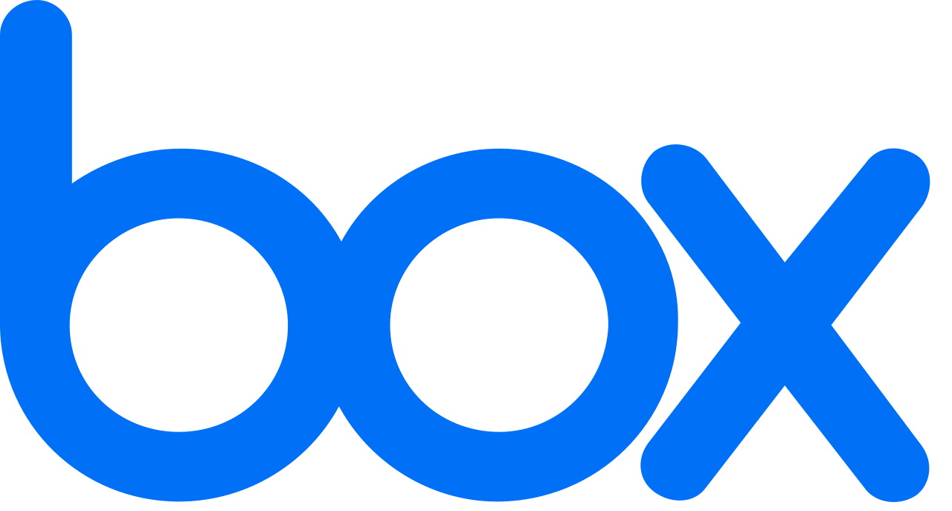
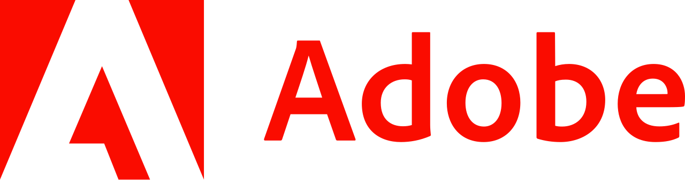


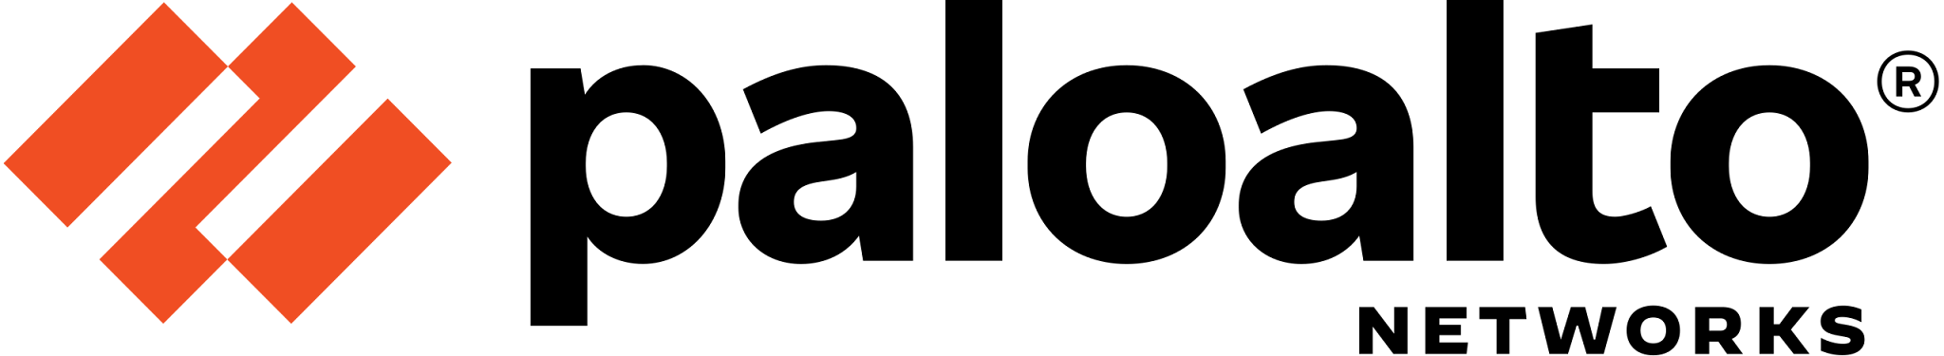






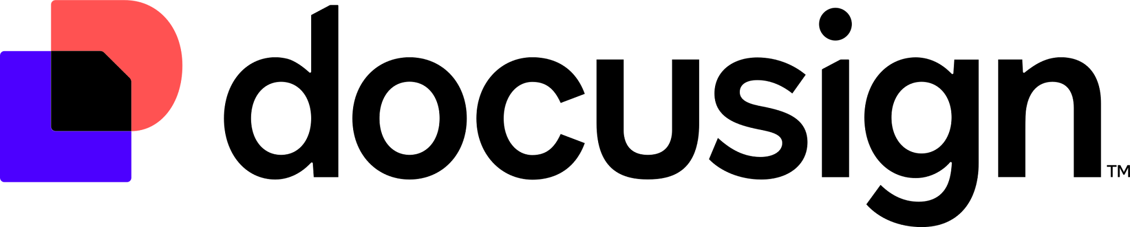
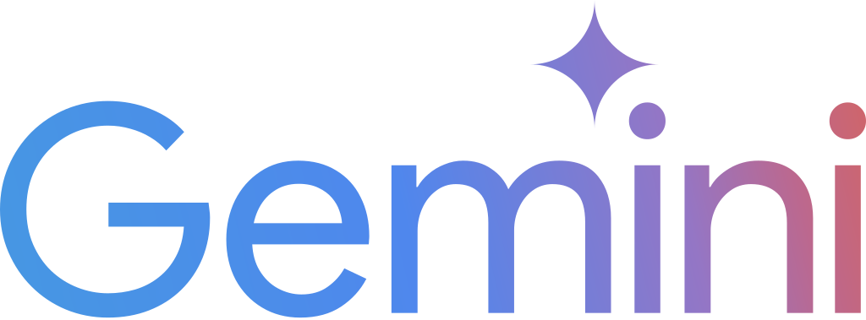


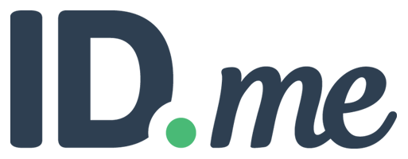


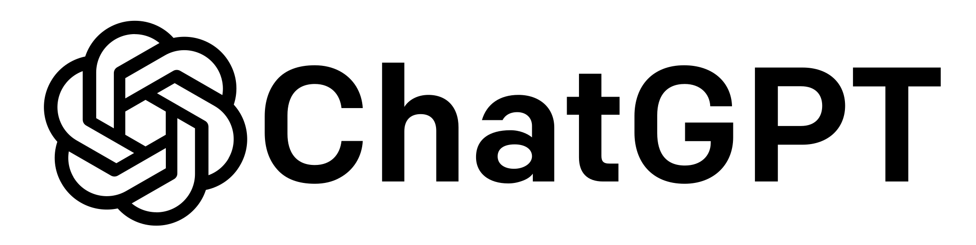

Deal Categories
Enterprise software and collaboration tools, including Microsoft, Google, Box, and Adobe—covering email, file storage, productivity suites, CRM, and workflow automation.
Cloud platforms and infrastructure, including Amazon Web Services and Google Cloud, which are foundational to agencies’ modernization efforts and digital transformation goals.
AI and large language models, from providers like OpenAI (ChatGPT), Google (Gemini), xAI (Grok), and Perplexity—ensuring secure, standards-based access to commercial generative AI while maintaining control over procurement, pricing, and usage.
Cybersecurity and risk management tools, including Palo Alto Networks, Tenable, Broadcom, Elastic, and Cohesity—delivering critical capabilities for zero trust, endpoint protection, vulnerability scanning, and secure data management.
Digital identity, authentication, and signing services, such as ID.me and DocuSign— streamlining how agencies verify user access and deliver secure, paperless workflows.
Emerging tech and developer platforms, including Oracle, ServiceNow, and Copilot—providing tools for software development, digital services, and future-ready infrastructure.
Notes:
As you can see here, OneGov is already delivering access to a robust and diverse portfolio of software and services from many of the world’s leading technology providers. These aren’t just brand names—they represent the breadth of IT needs across government, and the types of solutions we’re simplifying under OneGov.
Through these governmentwide agreements, agencies now have access to:
Enterprise software and collaboration tools, including Microsoft, Google, Box, and Adobe—covering email, file storage, productivity suites, CRM, and workflow automation. Cloud platforms and infrastructure, including Amazon Web Services and Google Cloud, which are foundational to agencies’ modernization efforts and digital transformation goals.
AI and large language models, from providers like OpenAI’s ChatGPT, Google’s Gemini, xAI Grok, and Perplexity—ensuring secure, standards-based access to commercial generative AI while maintaining control over procurement, pricing, and usage.
Cybersecurity and risk management tools, including Palo Alto Networks, Tenable, Broadcom, Elastic, and Cohesity—delivering critical capabilities for zero trust, endpoint protection, vulnerability scanning, and secure data management.
Digital identity, authentication, and signing services, such as ID.me and DocuSign—streamlining how agencies verify user access and deliver secure, paperless workflows.
Emerging tech and developer platforms, including Meta, Oracle, ServiceNow, and Copilot—providing tools for software development, digital services, and future-ready infrastructure.
Each of these deals represents real savings, real simplification, and real speed to mission. They’re negotiated with governmentwide usage in mind, meaning we’ve done the work upfront—so agencies can move faster with less friction.
And we’re not done. This portfolio will continue to grow as we identify high-value opportunities across government IT demand.

Slide 13
Maturity
Strong Start
Maturity Strategy
Looking Ahead
Year One Momentum
Quality over Quantity
Scaled Durable Outcomes
20+ agreements executed in <12 months
Time-limited discounts drove fast adoption
Proved speed, savings, and scale are possible
Agencies saw early, tangible results
Shift from number of deals to long-term value
Prioritizing OEMs with broad, enterprise impact
Identifying targets through usage + spend data
Direct contracts increase accountability and standardization
Moving away from limited-time discounts as a primary driver
Savings to come from structural efficiency and consolidated demand
Working with OMB on mandatory-use policies to scale adoption
Long-term value, simplified acquisition, stronger buying posture
Notes:
As we’ve implemented these agreements, we’ve learned a lot about what works—and where we need to refine the model.
In the early stages, limited-time offers helped drive awareness and adoption. They showed that we could move quickly, generate savings, and operate at scale.
What we’re seeing now is a shift.
We’re focusing less on the number of deals, and more on long-term value—prioritizing OEMs with broad, enterprise impact and using data to guide where we engage.
We’re also moving toward more direct agreements, where pricing, terms, and accountability are established up front and applied consistently across agencies.
And over time, the expectation is that savings come less from one-time discounts and more from structural efficiency—coordinated demand, standardized terms, and reduced duplication.
So this is an evolving model.
We’re taking what we’ve learned, refining the approach, and building toward something that is more durable, more scalable, and easier for both agencies and industry to operate within.

Slide 14
What’s Next?
UPCOMING INFORMATION SESSIONS
RESOURCES
For updates and more information visit: https://itvmo.gsa.gov/onegov/
Current Agreements
General Inquiries: itvmo@gsa.gov
Deal Specific Questions: cloudinfo@gsa.gov
Educational Webinars
gsa.gov/events
Agency Office Hours
Sign Up
OEM LTO Webinars
Register
ITVMO Annual Summit
Wednesday May 6, 2026
Register
Notes:
I’ll close with just a few brief points.
First, we covered a lot today, but the core idea is straightforward.
We are taking a more coordinated approach to common IT buying—bringing demand together, working more directly with OEMs, and establishing more consistent pricing and terms across government.
Second, this is still evolving.
We have additional agreements in development, and we’re continuing to refine how this model operates based on feedback from both agencies and industry.
If you’re interested in learning more or getting involved, we’ve included resources here.
That includes the OneGov site, points of contact, and information on upcoming webinars and engagement opportunities.
For industry, continued engagement is important.
Your feedback helps shape how these agreements are structured and how this model develops over time.
With that, I’ll pause and turn it back for questions.
And thank you again for the opportunity to be here today.

Slide 15
Thank you Slide

Slide 16
Closing Slide

