Slide 1
Play it Again… SAM.gov - Updates You Need to Know
January 30th, 2024
Office of Integrated Marketing

Slide 2
Presenter
Salomeh Ghorbani
Director, Outreach and Stakeholder Engagement Division
Integrated Award Environment (IAE) Office
Technology Transformation Services (TTS)
Federal Acquisition Service (FAS)

Slide 3
Agenda
SAM.gov Updates
Complying with Regulations
SBA Women-owned Small Business Certification
Downloading FASCSA Orders
More SAM.gov Updates
Entity Registration and Validation Walkthrough
Deep Dive into Getting Help with SAM.gov

Slide 4
SAM.gov Updates

Slide 5
Complying with Regulations
1
SBA Women-owned Small Business Certification
2
Downloading FASCSA Orders

Slide 6
SBA Women-owned Small Business Certification
1
What Changed?
Two SBA certifications now automatically display on entity registrations
SBA-Certified Women-Owned Small Business
SBA-Certified Economically Disadvantaged Women-Owned Small Business
You can filter and view Contract Opportunities by these two set asides and you can filter Entity Information by these certifications in using the socio-economic status filter
Data Bank reports are updated to show them, where applicable.
Notes:
Before this updates, these two new SBA certifications were unable to be displayed in SAM.gov. There were workarounds with SBA and the agencies to verify. Now, you have a better experience viewing this important entity information alongside other entity information you’re already looking at.

Slide 7
Downloading FASCSA Orders
2
FASCSA orders are a type of supply chain security order governed by the Federal Acquisition Supply Chain Security Act of 2018 and the Federal Acquisition Security Council final rule for complying with exclusion or removal orders and sharing certain supply chain risk information.
SAM.gov provides an easy way to download and view active FASCSA orders.

Slide 8
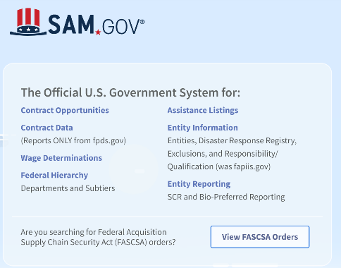
Downloading FASCSA Orders
2
Select the View FASCSA Orders button on the SAM.gov home page.
You do not need to sign in to download them.

Slide 9
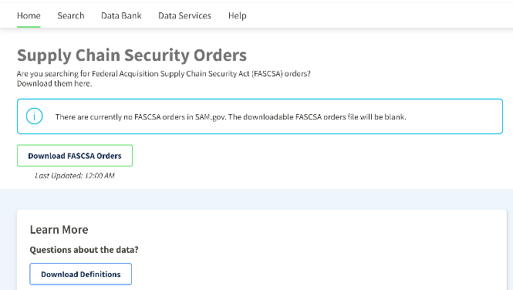
Downloading FASCSA Orders
2
Then select the Download FASCSA Orders button. You’ll get a CSV file of all orders.
Notes:
While there are no active FASCSA orders, an alert will display about the download button informing you that there are no orders and the CSV file, if you download it, will be blank. When orders are added to SAM.gov, the alert will go away and you’ll see information about the orders in the download.

Slide 10
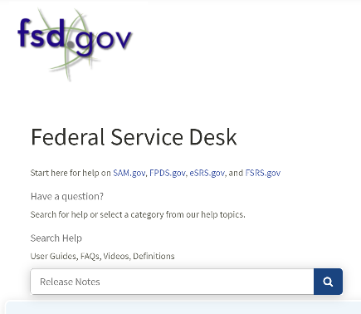
More SAM.gov Updates
View more detail about all the updates to SAM.gov in our Release Notes, published approximately every four weeks to the Federal Service Desk at FSD.gov
Notes:
We routinely make updates to SAM.gov. You can read a comprehensive list of all our updates at the end of each of our program increments by viewing our release notes. They are published at our help desk, FSD.gov. Find them by simply searching “release notes” in the search bar on the FSD.gov home page.

Slide 11
Poll
Vendors I work with would like to learn more about:
How to get on the interested vendors list
How to update their entity registration
How to use SAM.gov for market research
How to report on their award
Something else

Slide 12
Entity Registration and Validation Walkthrough

Slide 13
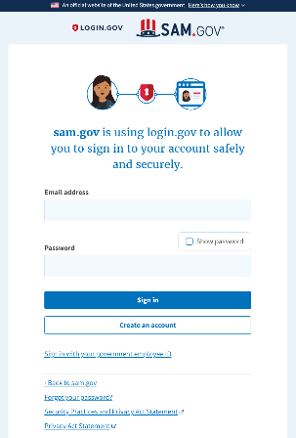
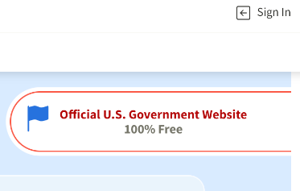
Sign In
Notes:
Select sign in from the top of the SAM.gov home page. If you already have a Login.gov account, you can sign in with that email address and password. Otherwise, select create an account.

Slide 14
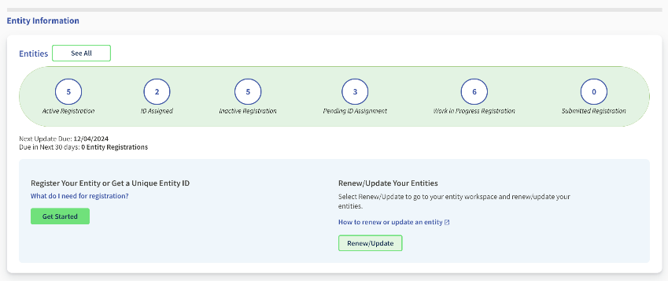
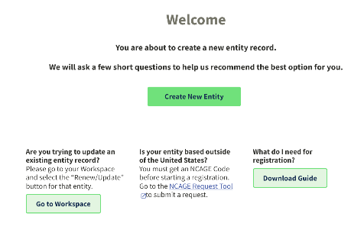
Workspace: Create New Entity
Notes:
Once you are signed in, you land in your Workspace. Non-federal users see an Entities widget at the top of the Workspace. If starting a new registration, they can select the Get Started button.

Slide 15
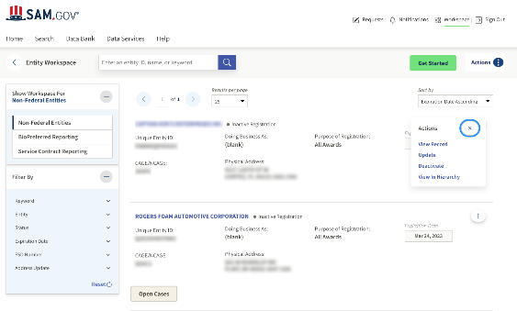
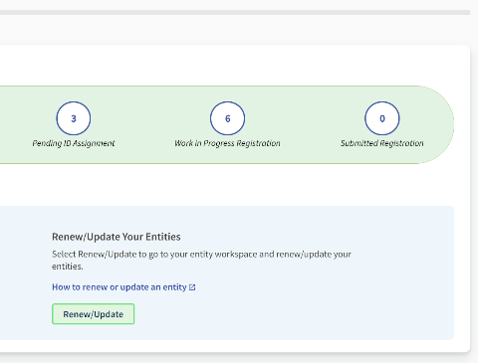
Workspace: Renew or Update Entity
Notes:
If you select the title of the Entities widget, or one of the numbered bubbles, or the renew button, you see a list of entity records. From there, select the button with the three vertical dots and select Update.

Slide 16
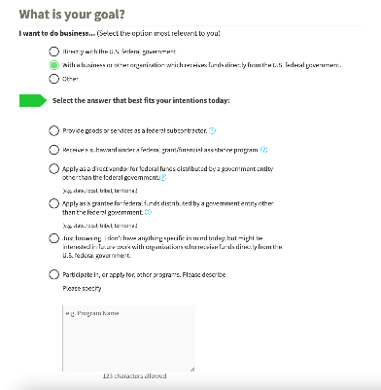
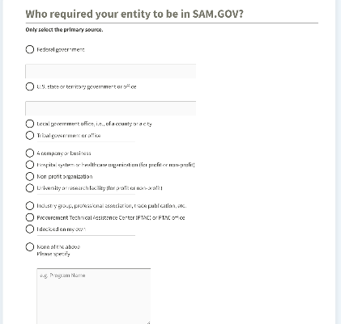
Entity Questionnaire
Notes:
New entities see a two-question survey. The questions help us understand the driving forces behind who is coming to SAM for registration. We analyze these sources to inform on how we improve our services and training. Answers to both questions are anonymous and they are used in the system to help make a purpose of registration recommendation to the user. You’ll only have to answer them once.

Slide 17
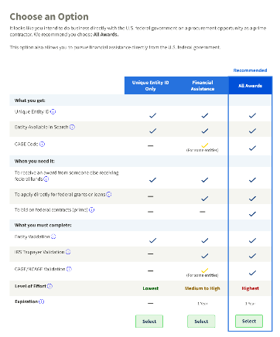
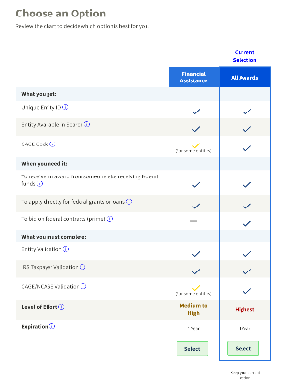
Purpose of Registration Table
For New Entities
For Updating Entities
Notes:
After answering the questions, you see a chart.New entities see a recommendation based on the questions they just answered. Updating entities see your current purpose of registration highlighted. We provide a side-by-side comparison of the different options
We provide additional information for each row
Your recommendation is highlighted in the chart
You can select any option
Renewing entities see the same table, but their existing choice is highlighted and the Unique Entity ID Only option doesn’t appear.

Slide 18
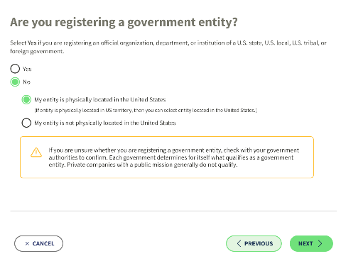
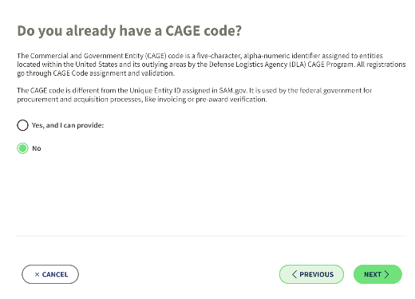
Purpose of Registration (Continued)
Notes:
Vendors must answer whether they represent a non-federal government organization. If they already have a CAGE code, they can provide it or, answer “No,” and one will be assigned later as a part of registration.

Slide 19
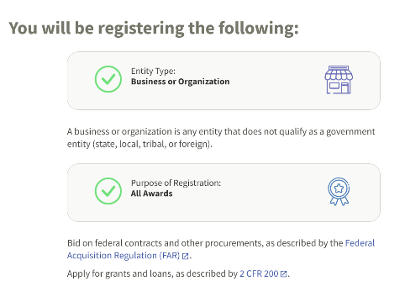
Validation
After answering the questions about what type of registration you want, if you’re a government entity, and if you have a CAGE code, you then start entity validation.

Slide 20
Validation
Validation is a process within registration and a prerequisite for completing it.
1
2
3
4
5
Sign in to SAM.gov
Select Get Started or Update/Renew
Choose a Registration Option
Identify if a government entity
CAGE Code
6
7
8
9
10
Enter entity information to begin validation
Submit validation documents if required
Receive Unique Entity ID
and/or Continue Registration
Complete Core Data, Reps & Certs, & POC Sections
Submit Registration
11
12
13
14
IRS Verification
CAGE Verification
Registration Active
Renew Registration (365 days after submission)
Notes:
Validation is required for all entities starting a new registration, doing an annual renewal, or getting a Unique Entity ID. It verifies your entity is what you say it is. It helps deter fraud and ensure federal awards are going to the proper awardee.
An independent EVS conducts the verification. They use a variety of public and commercial sources to verify your entity’s name, physical address, place of establishment, and start year. As you are validating your entity, if you are required to submit documents in SAM.gov, it means your entity information isn’t available or isn’t completely up to date in the data sources available to the EVS. Submitting your documentation proves your information, and the EVS then adds it to their database, so you shouldn’t have to submit it again in the future, when you renew, for example.

Slide 21
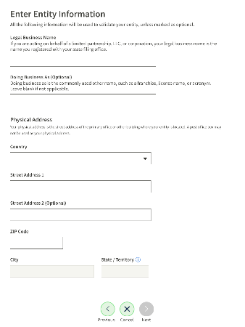
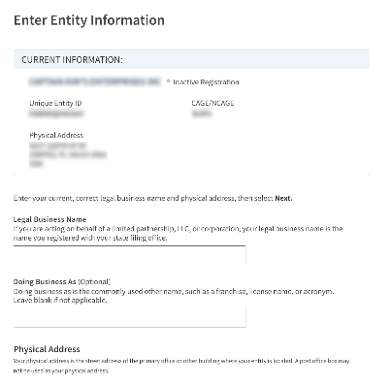
Validation
New entities see this screen.
Updating entities see their current information above the data entry fields.
Notes:
The first step of validation is entering your entity’s legal business name and physical address. Enter information exactly as it appears on official documentation. If there are discrepancies between what you enter and what is on your official documents, for example, a Secretary of State registry, IRS documents, or articles of incorporation, then there could be delays in completing entity validation, or CAGE or IRS verification; all of which will delay getting an active registration, which is required to receive a federal award.

Slide 22
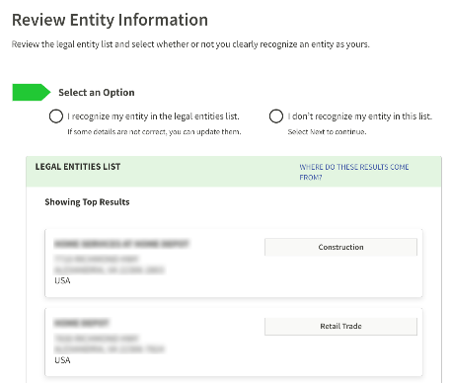
Validation
If your entity is shown in the list, select it.
Some entities may be shown, but with outdated information, like an old address.
Select your entity even if some of the information isn’t up to date. You will be able to update it!
Notes:
When you enter your entity name and physical address, if the EVS database has a match or a close match, you’ll see the “Legal Entities List.” Some of you will find your information, some won’t, and this is normal. Review the list carefully. You should only select an entity if you know it is yours. If you aren’t sure, select “I don’t recognize my entity in the list.”

Slide 23
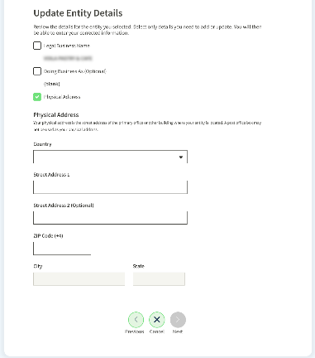
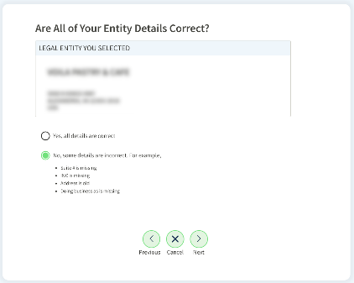
Validation
If everything is correct, you can validate right away.
If something isn’t right, select “No.” Then, on the next page, you can correct it.
Notes:
If you do see your entity, select it to move on. If something is not quite right, these pages are where you should enter what your name and address are. Be sure what you enter matches official documentation you have, because it must match to get through the validation process quickly. What is entered here will determine what documentation you need to provide.

Slide 24
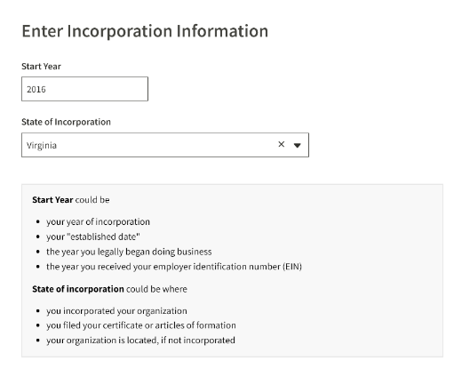
Validation
Start year could be
your date of incorporation
your “established date”
the date you formally began doing business
the date you received your EIN
State of incorporation could be where
you incorporated your organization
you filed your certificate or articles of formation
your organization is located, if not incorporated
Notes:
Provide your entity’s start year and place of incorporation. Some entities have specific challenges with this information. You do not need to be an incorporated entity here. You can use the entity location or where you have filed other official documents. For start year, it can be when the entity was established.

Slide 25
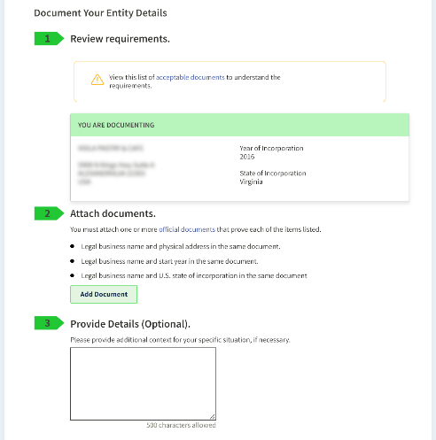
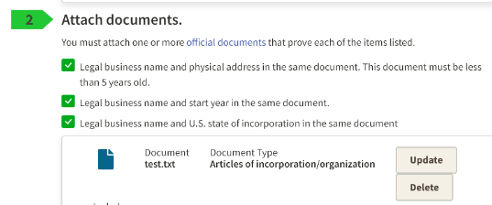
Validation
View a list of common accepted validation documents
Notes:
If you get to this screen, it means your entity information is not available or needs to be updated in the EVS database. Again, this is normal, it means your information is not available in the sources used by the EVS. This is where you will provide your official documents to prove your correct entity information.
Information you must document is provided in a bulleted list.
When you add a document, you pick which requirement it satisfies. A check mark appears in place of the bullet to acknowledge you’ve confirmed the requirement.
You can’t submit your documents until you check off all of the bullet points under “Attach Documents.”

Slide 26
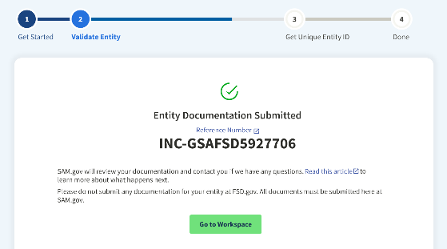
Validation
When you submit your information, you’ll be given a Federal Service Desk reference number.
You’ll receive communication about the progress of your case by email from FSDsupport@gsa.gov. You’ll get instructions on how to confirm your information and continue registration.
Allow approximately 5 business days for processing of documents.
Notes:
This screen confirms your documents have been submitted. Currently, it takes about 5 business days on average to process validation documents.

Slide 27
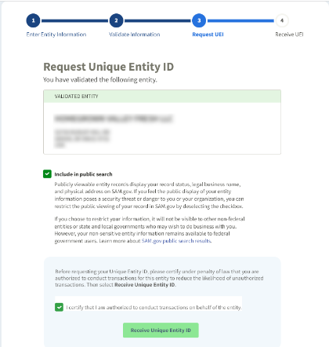
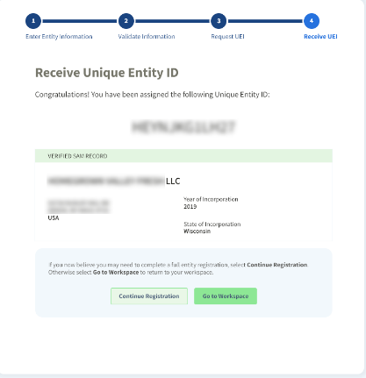
Validation
Once validated, new entities will see these two pages.

Slide 28
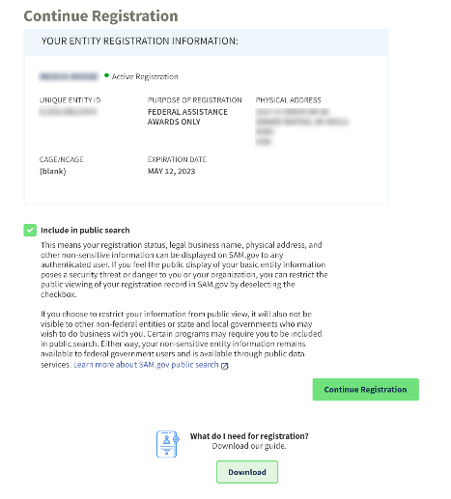
Validation
Updating or Renewing entities will see this page after validation is complete.

Slide 29
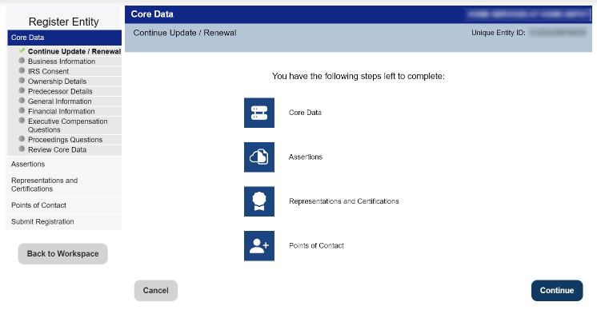
Registration
Go to FSD.gov and select the Get Started with Your Registration button for a checklist and more.
Notes:
When you finish validation and continue on to registration or renewing a registration, the first page outlines the additional sections you need to complete.

Slide 30
Registration - Core Data
Business Information
Organization start date
Date on which your company’s fiscal year ends
Organization’s division name and number
Organization’s website URL
Physical address (auto-filled from validation)
Mailing address
Taxpayer Identification Number (TIN) (U.S. entities only)
IRS Consent
Entity taxpayer name and address (U.S. entities only)

Slide 31
Registration - Core Data
CAGE or NCAGE Code
CAGE Code
NCAGE Code (Non-U.S. entities)
Ownership Details
Predecessor Details
Executive Compensation Questions
Proceedings Questions

Slide 32
Registration - Core Data
General Information
Country of Incorporation
State of Incorporation (U.S. entities only)
Company Security Clearance
Highest Employee Security Clearance Level
Institution Type
Disadvantaged Business Enterprise
Native American Entity Type
Organization Factors
Entity Structure
Profit Structure
Socioeconomic Categories
Financial Information
Accept credit cards as a method of payment (yes or no)
Electronic Funds Transfer
Account type
Routing number
Account number
Automated Clearing House
U.S. phone number
Remittance Address
Name and address

Slide 33
Registration - Assertions
Goods and Services
NAICS codes
Product and Service Codes
Size Metrics
Worldwide and location
Annual receipts
Number of employees
Electronic Data Interchange (EDI)
Disaster Response Information

Slide 34
Registration - Reps & Certs
FAR Response 1
Four questions
FAR Response 2
12 questions
FAR Response 3
Nine questions
FAR Response 4
Ten questions
Architect-Engineer Response
Defense Response
Financial Assistance Response

Slide 35
Registration - Points of Contact
Mandatory Points of Contact (POC)
Accounts Receivable POC
Electronic Business POC
Government Business POC
Optional POCs
Past Performance POC
Past Performance Alternate POC
Electronic Business Alternate POC
Government Business Alternate POC
Additional Optional POCs as Needed

Slide 36
Deep Dive into Getting Help for SAM.gov

Slide 37
Help in Entity Registration
Select data entry field and a box with help pops up on the right side of the page.
Notes:
On entity registration pages, right where you are entering answers to questions, on-page help pops up for each question.There are also links to Acquisition.gov, where applicable, and you can read parts of the FAR that apply to a specific question.

Slide 38
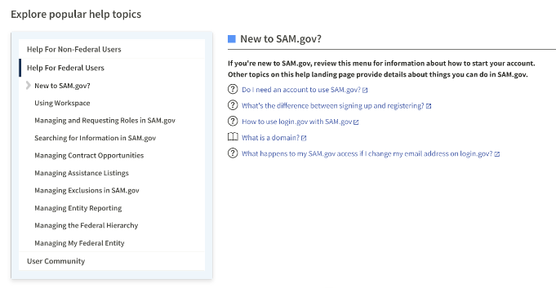
Help on SAM.gov
Notes:
The Help page on SAM.gov outlines our most-used help. You can view it by what type of user your are, a federal user of SAM.gov or a non-federal user. As you select topics on the left, subtopics appear and links to articles appear on the right. You can drill down into hundreds of curated pieces of help on the most popular SAM.gov topics.

Slide 39
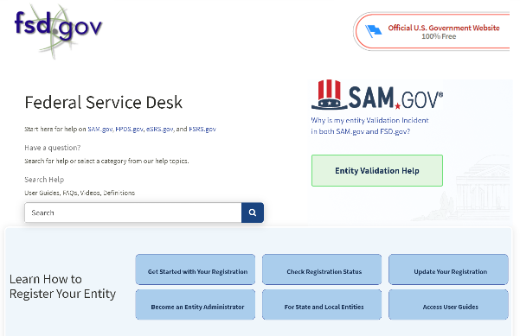
Help at the Federal Service Desk
The Federal Service Desk at FSD.gov is the help desk for SAM.gov.

Slide 40
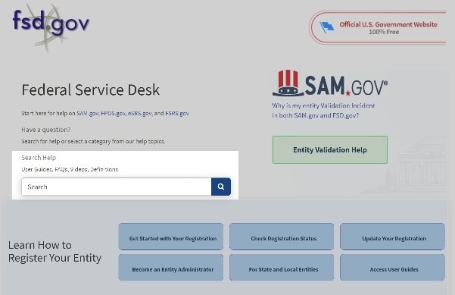
Help at the Federal Service Desk
Our entire knowledge base for SAM.gov, and other IAE systems, is searchable here.
Enter keywords to explore help articles, videos, glossary terms, guides, and more.

Slide 41
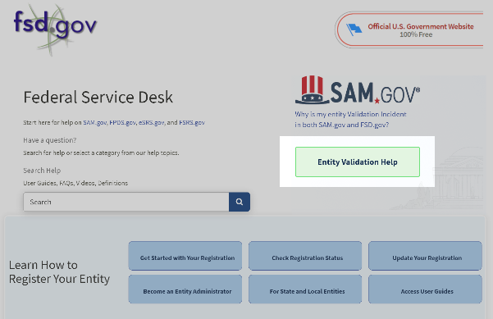
Help at the Federal Service Desk
Use the Entity Validation Help button to view a comprehensive list of help topics related to validation.

Slide 42
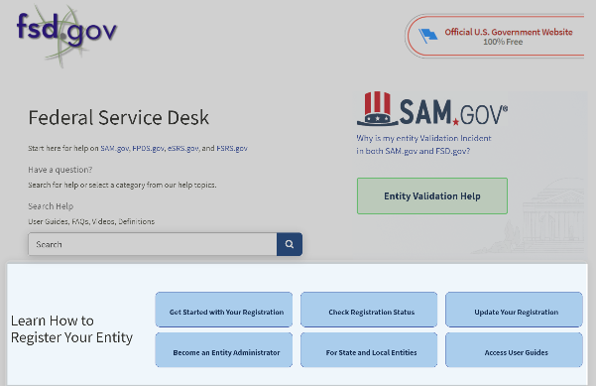
Help at the Federal Service Desk
Use the buttons in the Learn How to Register Your Entity section to view registration help specific to you.

Slide 43
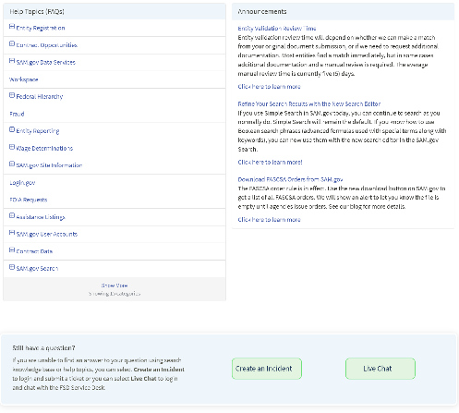
Help at the Federal Service Desk
Scroll down the FSD.gov home page to view more ways to get help.

Slide 44
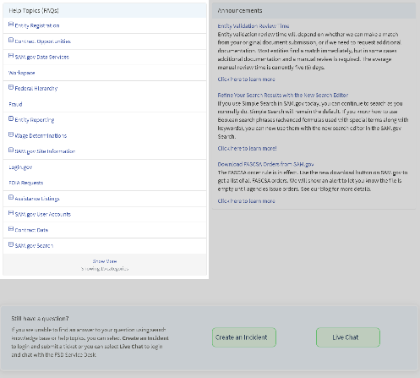
Help at the Federal Service Desk
Select Help Topics to view the most viewed and highest rated help topics in each category.

Slide 45
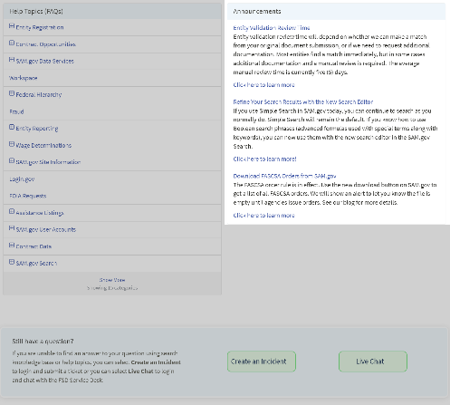
Help at the Federal Service Desk
You can view the latest news about SAM.gov and the latest update on entity validation review times in the Announcements section.

Slide 46
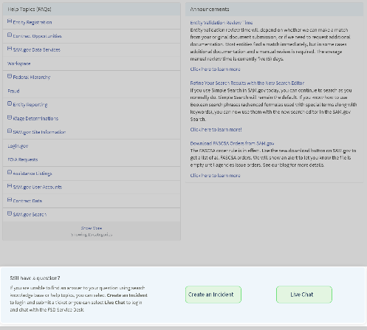
Help at the Federal Service Desk
If you still need help, sign in to FSD.gov (using your login.gov email and password) to chat live with a help desk agent or to submit your issue via a web form.

Slide 47
Poll
At a future session, I'd most like to learn more about:
How to search and view a vendor's registration
Managing the interested vendors list on a contract opportunity
Downloading large sets of data
Viewing and editing published contract opportunities
Helping vendors with completing their registration
Something else

Slide 48
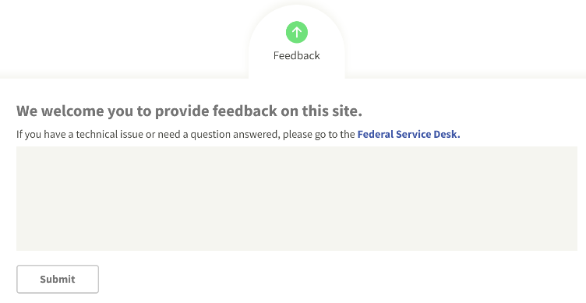
Give Us Your Feedback!
Notes:
We always welcome your feedback on SAM.gov! Tell us how the site is working (or not working) for you; what features do you want or do you like? What would make it better for you? The feedback tool is at the bottom of every page in SAM.gov.

Slide 49
Questions?

Slide 50
Resources
SAM.gov Help Page
Go to the Federal Service Desk (FSD.gov) to search for User Guides, FAQs, Videos, Definitions.
Subscribe to our blog for the latest updates

Slide 51
Thank You!
Office of Integrated Marketing

